Slide 1
CS:526 DIVA
Global Terrorism Analysis
Group 4:
Keya Desai (kd706)
Shang-Hao Huang (sh1384)
Prakruti Joshi (phj15)
Guide:
Professor James Abello
Fangda Han
Nishant Kumar

Slide 2
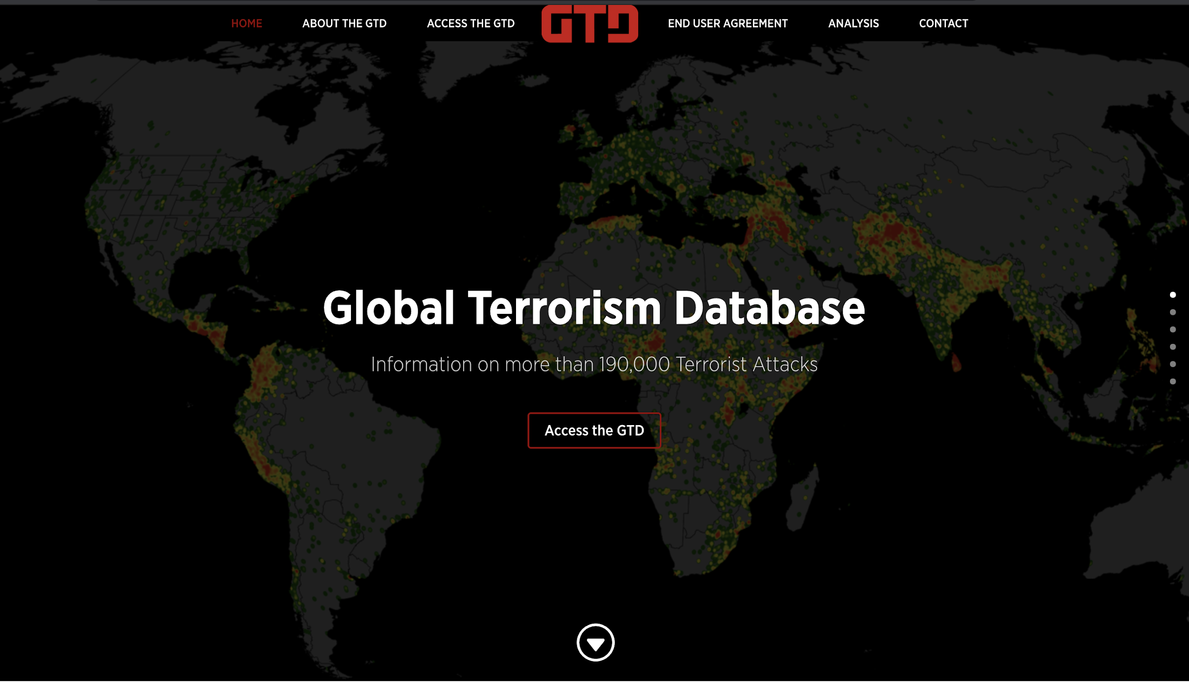
Global Terrorism Database (GTD)
GTD is the most comprehensive unclassified database of terrorist attacks in the world.
Maintained by National Consortium for the Study of Terrorism and Responses to Terrorism (START) at the University of Maryland.
Link to data:
https://start.umd.edu/gtd/
Notes:
Sparse
Data at rest
Time Variant data

Slide 3
Defining Terrorism
The GTD defines terrorism as:
“The threatened or actual use of illegal force and violence by a non-state actor to attain a political, economic, religious, or social goal through fear, coercion, or intimidation.”
Notes:
Explain: Events involved are Kidnapping, Assassination,

Slide 4
Data Description

Slide 5
Data
This dataset recorded information on more than 180K terrorist attacks around the world from 1970 to 2017
Current data format: CSV file
Size : 181,693 rows, 135 columns, 160 MB
Data is at Rest
Data is Time Variant

Slide 6
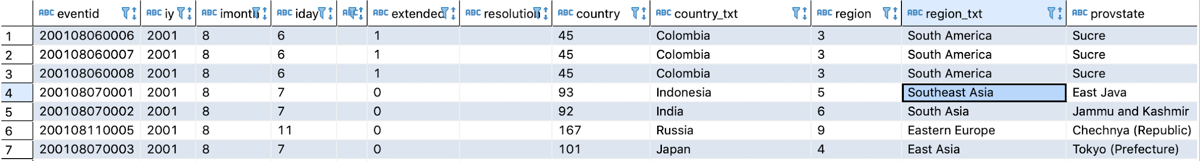
Data Snippet

Slide 7
Important Attributes of Entity in GTD:
Incident/Event
Attack Type - Assassination, Armed Assault, Kidnapping, Hijack, etc.
Weapon Type - Explosives, Firearms
Location and Time
region, country, city, latitude, longitude
year, month, day, number of days
Target/Victim
Target Type - Business, Government (Diplomatic), Military, etc.
Perpetrator
Terrorist group, motive
Number of Kills, Wounds
Casualties and Consequences
Notes:
Relationships:
• Incident occurred at Location.
• Perpetrator carried out the incident.
• Target/Victim casualties or injuries by perpetrator. • Incident caused casualties.
• Nationality (Location) of the Target/Victim

Slide 8
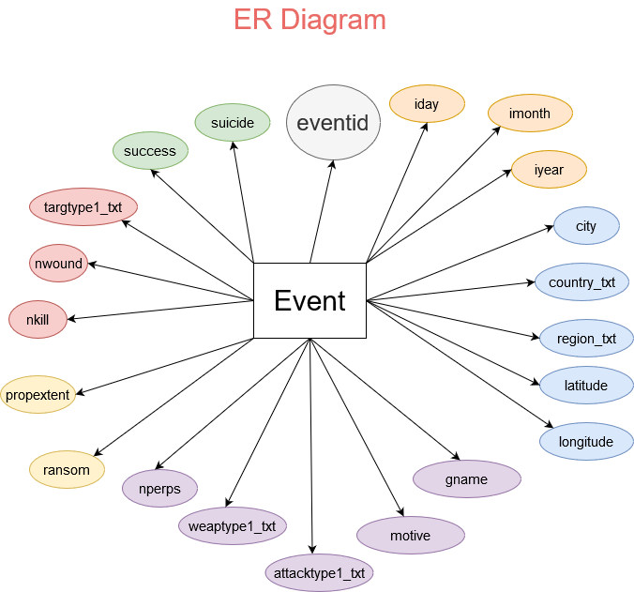
Notes:
Each event is an entity, only one entity
each has 135 attributes, but only important ones are listed here

Slide 9
Questions Addressed
Global distribution of terrorism
Identify highly-conflicted countries
Region wise analysis
Trends over time
Number of casualties in each terrorist act, each year, and each country
Country wise analysis
Most affected cities, damage, terrorist groups active, Attack type, Target Type
Terrorist group activity
Motive, most impact events, damage
Aggregate Analysis
Attack type, Weapon type, Target type distribution
Worst events of all time
Worst affected countries of all time
Notes:
(a)-(i) complete
(a)-(ii) complete
(a)-(iii)
(b)-(i)
(b)-(ii)
(b)-(iii)

Slide 10
Types of Users
General Public
To have a big-picture about global terrorism and country specific information without going through the csv data.
Policy-maker
To better analyze the global terror situation and make suitable policies
Anti-crime Agency/ Police department
To better identify/predict the terrorist events and mitigate it
Researchers
To facilitate exploration of the data for researchers and academics
Notes:
User Types

Slide 11
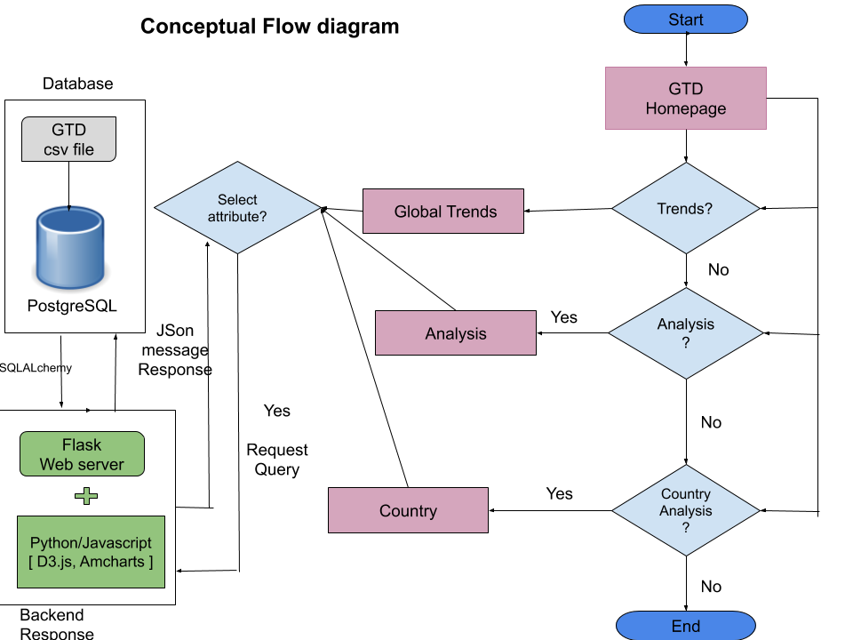

Slide 12
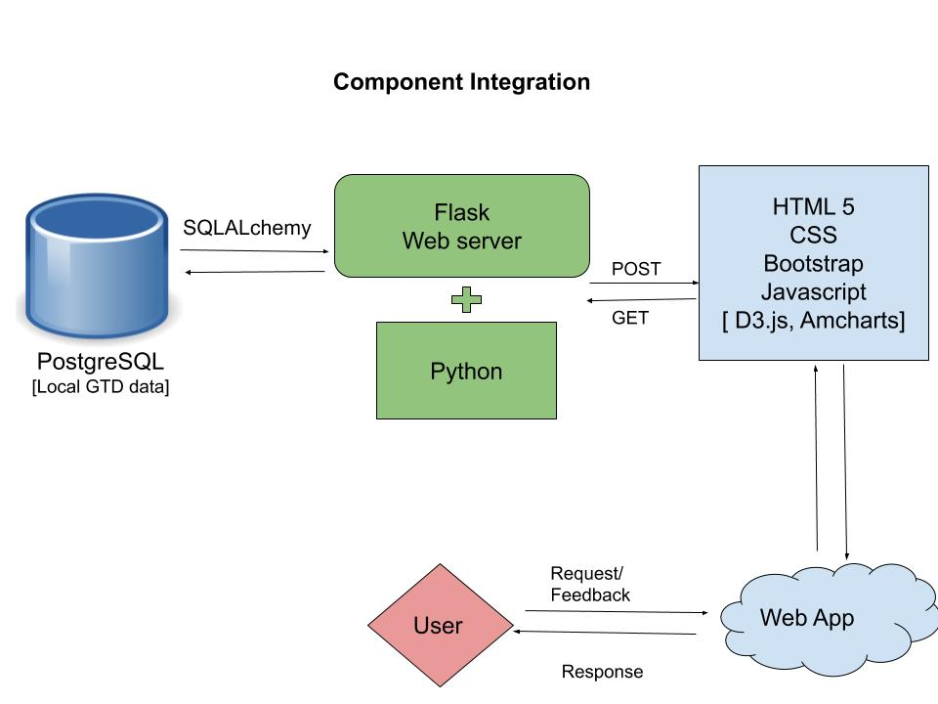
Notes:
Mode of Processing

Slide 13
Visual Representation & Interactivity

Slide 14
Interactivity
Zooming and Panning- In world map for terrorism statistics in smaller regions (cities)
Mouse Hover - To display values
Menu Driven Buttons and tabs -
Drop down buttons for users to select countries and relevant statistics will be displayed (Querying).
Textual- Pop up facts and analysis of the corresponding plot.
Sliders - Time series analysis
Notes:
Statistical analysis for comparing two or more events - death toll, damage etc.
Parameters for Prediction - User inputs

Slide 15
Demo

Slide 16
Findings

Slide 17
Trends in Terrorist Events
In the 80s, Central and South America are at the center of global terrorism
There’s a down period around 1995-2002 (< 2.5k events per year)
Started to Increase after 2003 and rapidly after 2009
Reached its peak around 2013 (> 15k recorded events)
Peak in 2014 coincides with the sharp increase in terrorist violence carried out by the (ISIL), particularly in Iraq, and by the Taliban in Afghanistan.
Highest number ever recorded is 6939 in Middle East, 2013.
Notes:
Along with the line plots

Slide 18
General Findings
Amongst the top 15 worst events of all time, 50% of the attacks are of type Hijacking or Hostage situation and the rest 50% are Bombing and Armed Assault.
Percent of successful attacks : 88.96%
Number of related events: 25k
Iraq, Afghanistan, Pakistan are the worst affected countries.
ISIL (Islamic state of Iraq and Levant) has carried out terror events in 50 countries resulting in mass casualties over the years, becoming one of the largest and deadliest terror groups.

Slide 19
Things Left to Do
Terrorist group analysis
Represent statistics
Zooming of maps
User query page
Notes:
Complex visualizations
Bar chart Race
More options in plots, drop down
Increase interactivity of system
Zooming of world map
User selection of plot
Improve front end layout

Slide 20
Region wise analysis
Three major types of Attacks across all regions:
Bombing/Explosion,
Armed/Unarmed Assault
Facility/Infrastructure Attack
Weapons:
Explosives
Firearms
Incendiary
Targets:
North America, Western Europe - Business, Private Citizen & Property
South Asia - Private Citizen & Property, Police
East Asia - Government, Business
Middle East - Private Citizen & Property, Military

Slide 21
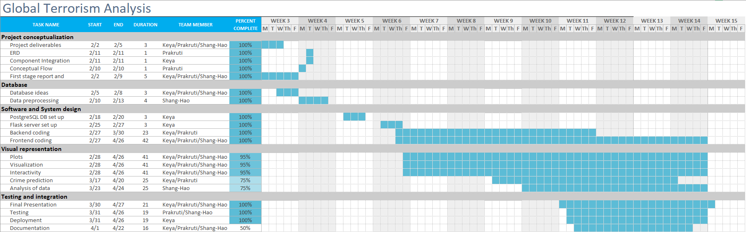
Gantt Chart:

Slide 22
References
GTD Dataset: https://start.umd.edu/gtd/
Framework (Flask): https://flask.palletsprojects.com/en/1.1.x/
Database (Postgres): https://www.postgresql.org/
Visualization
https://d3js.org/
https://www.amcharts.com/demos/
Frontend
HTML & CSS: https://www.w3schools.com/html/
Javascript: https://www.w3schools.com/js/

Slide 23
Thank you!
Questions?

Slide 24
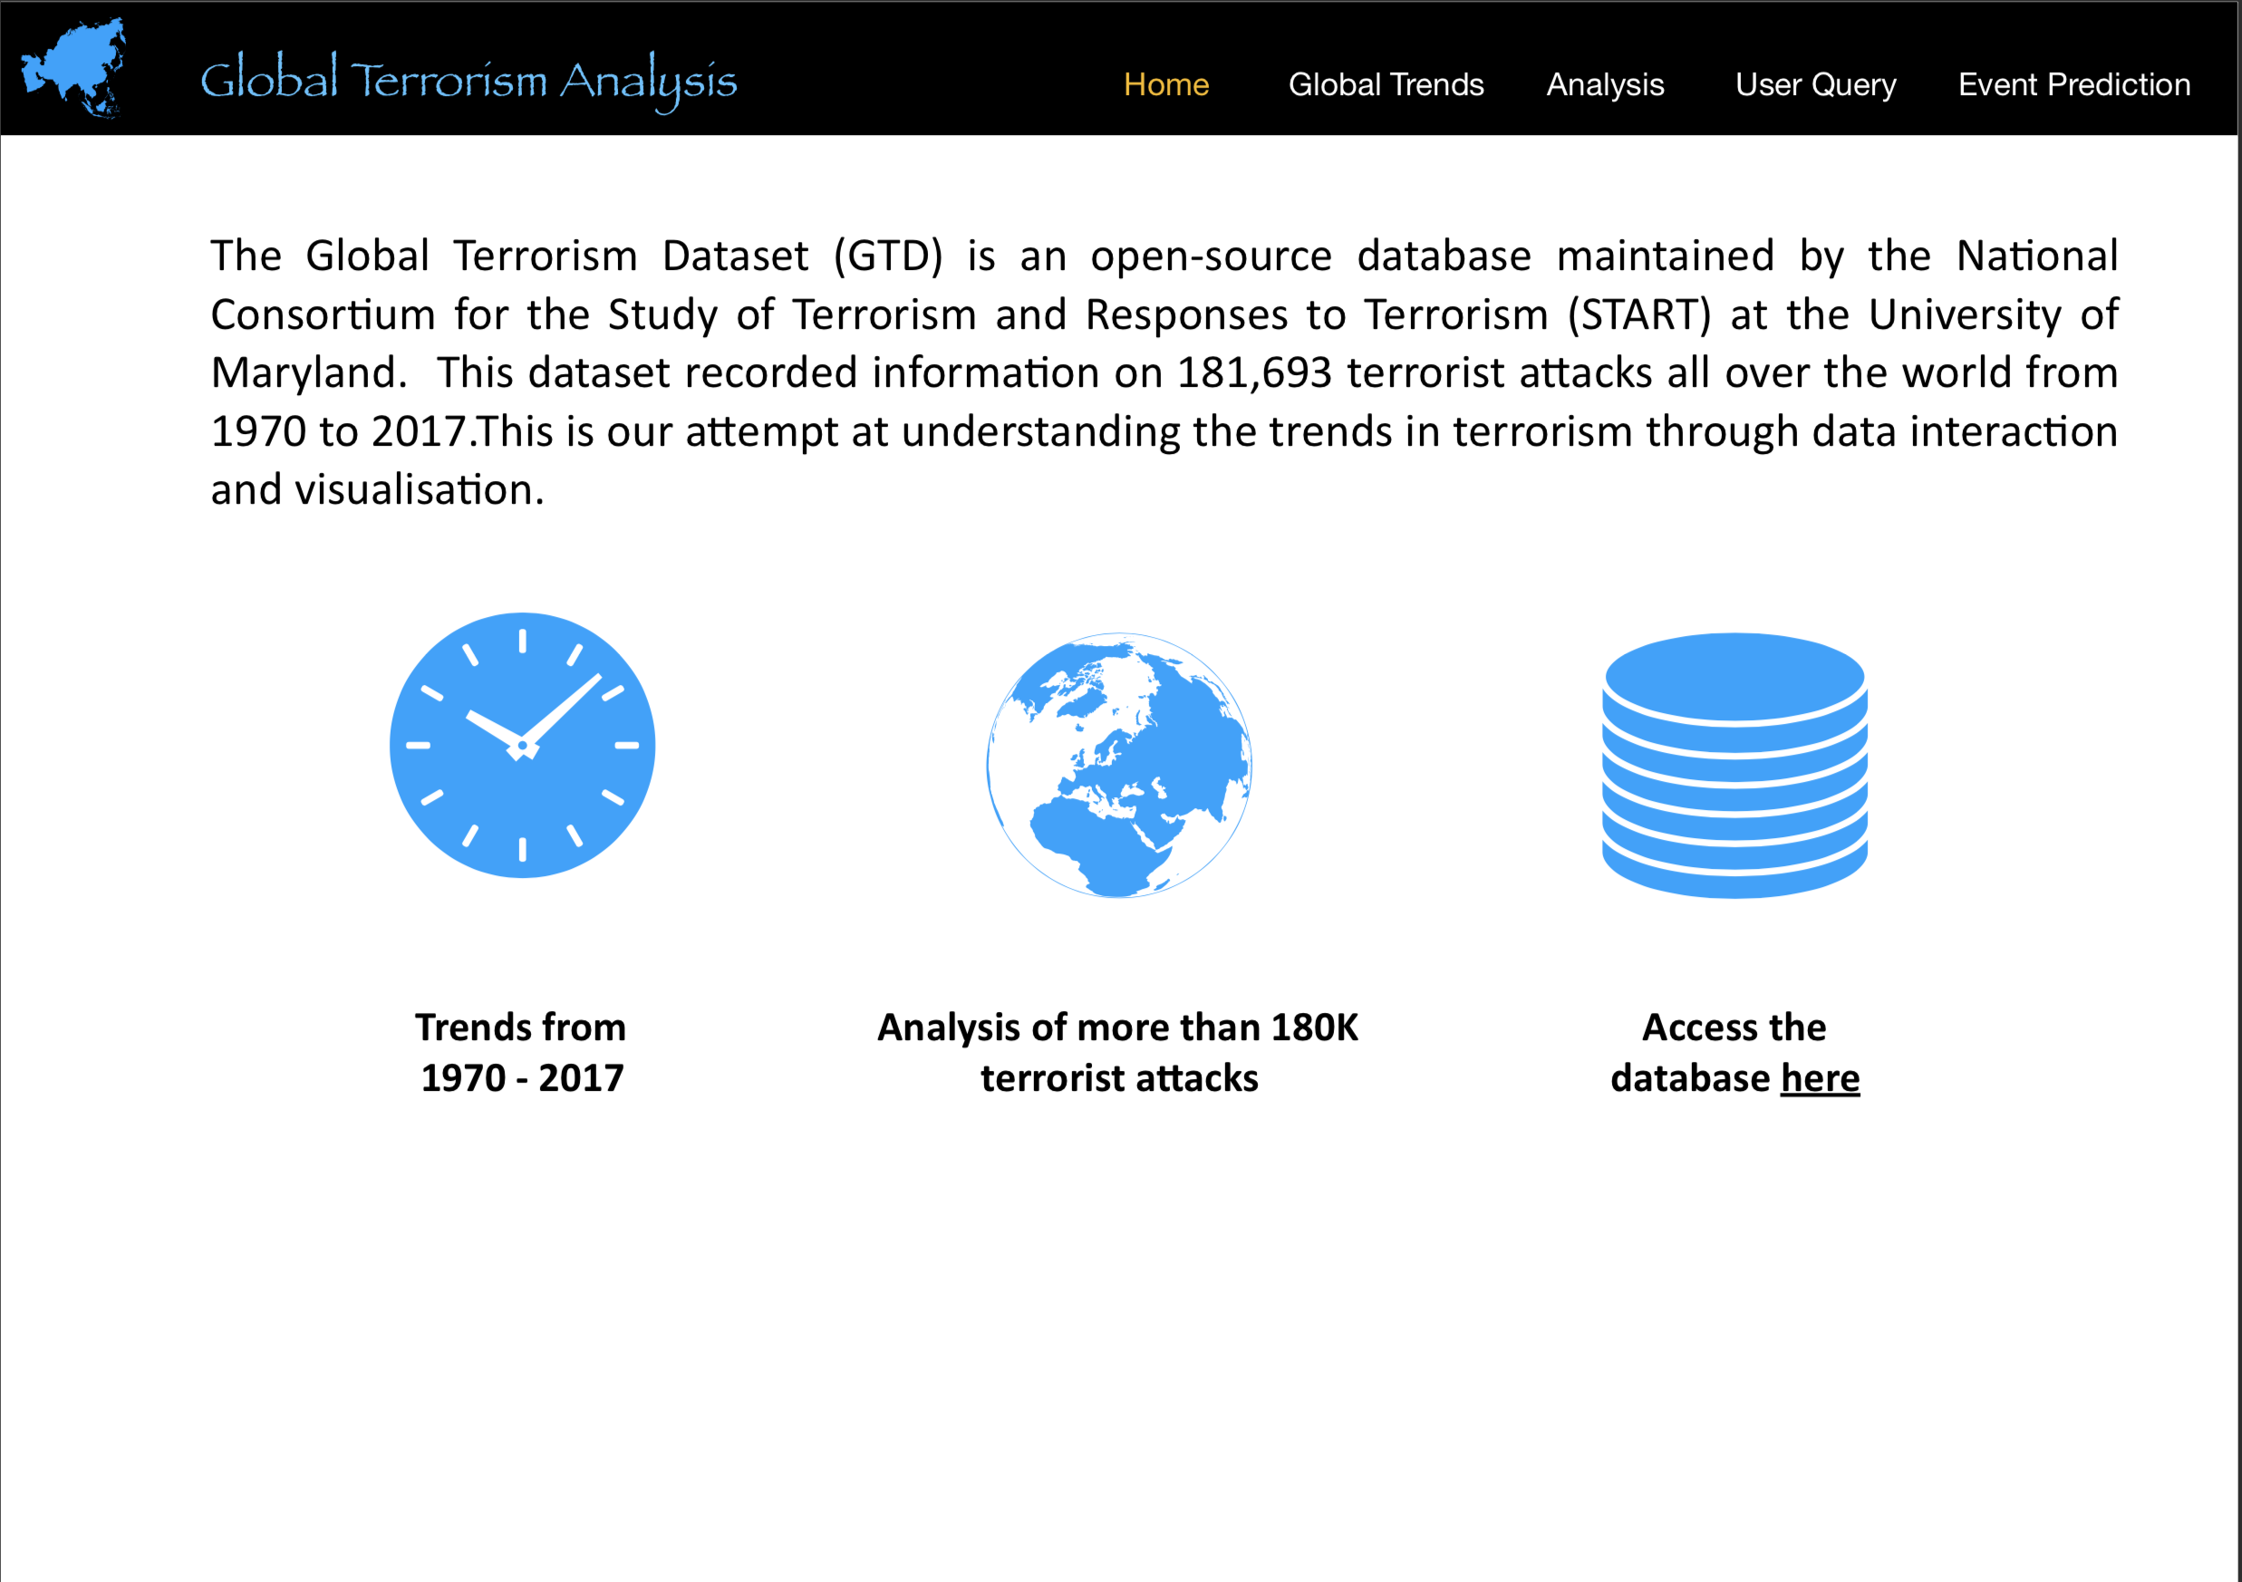
View-1

Slide 25
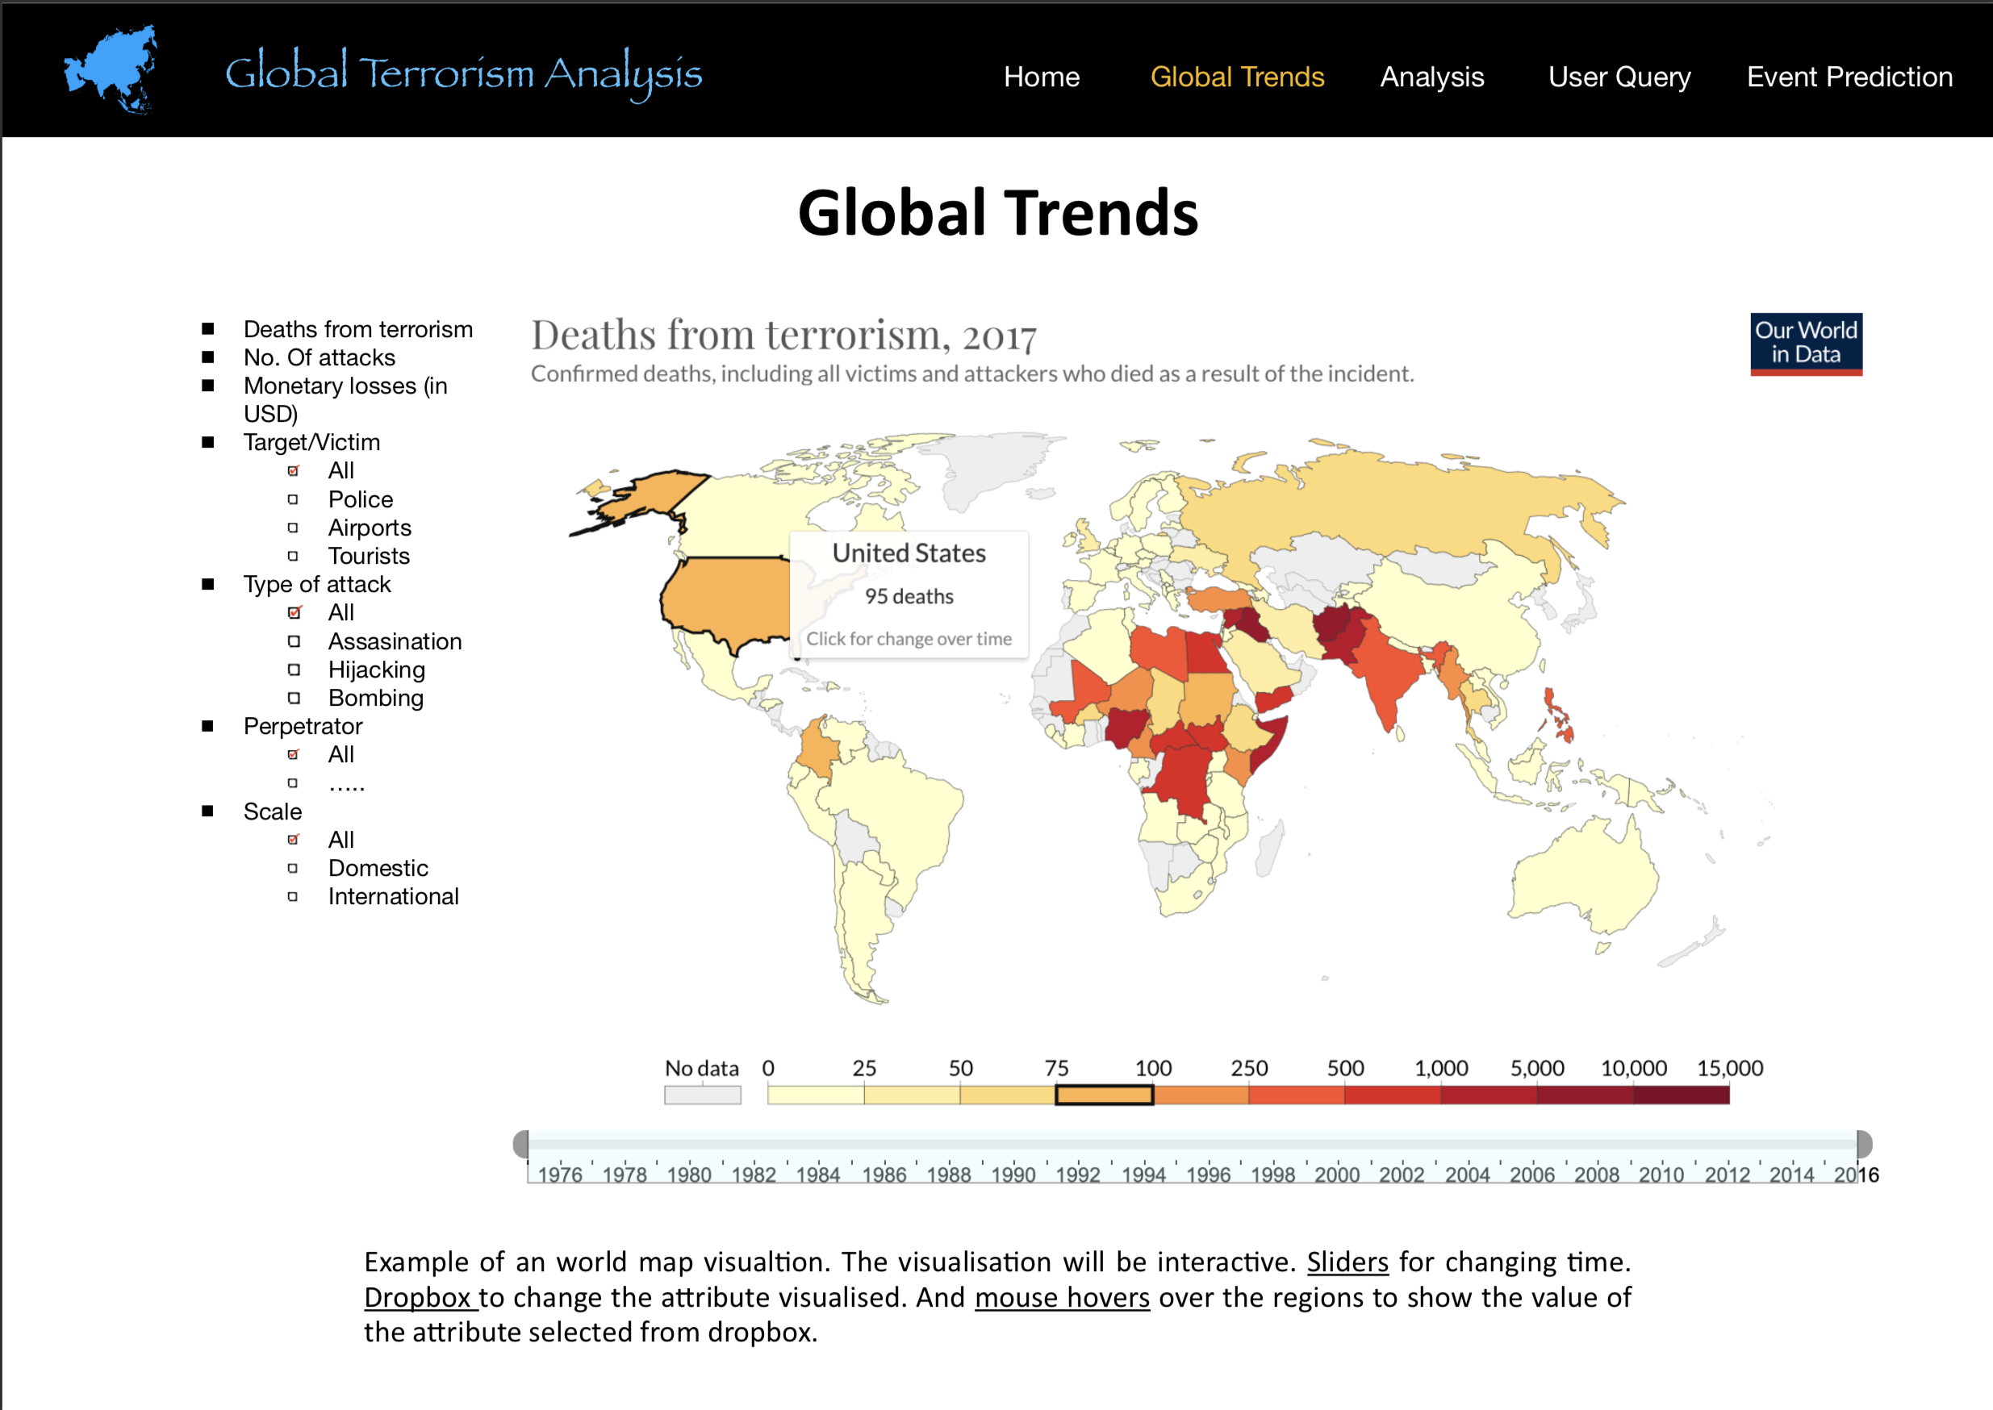
View-2
The sample plots are
taken from :
1) Terrorism by
Hannah Ritchie,
Joe Hasell,
Cameron Appel
and Max Roser
2) Google data
Explorer for
World
development Index

Slide 26
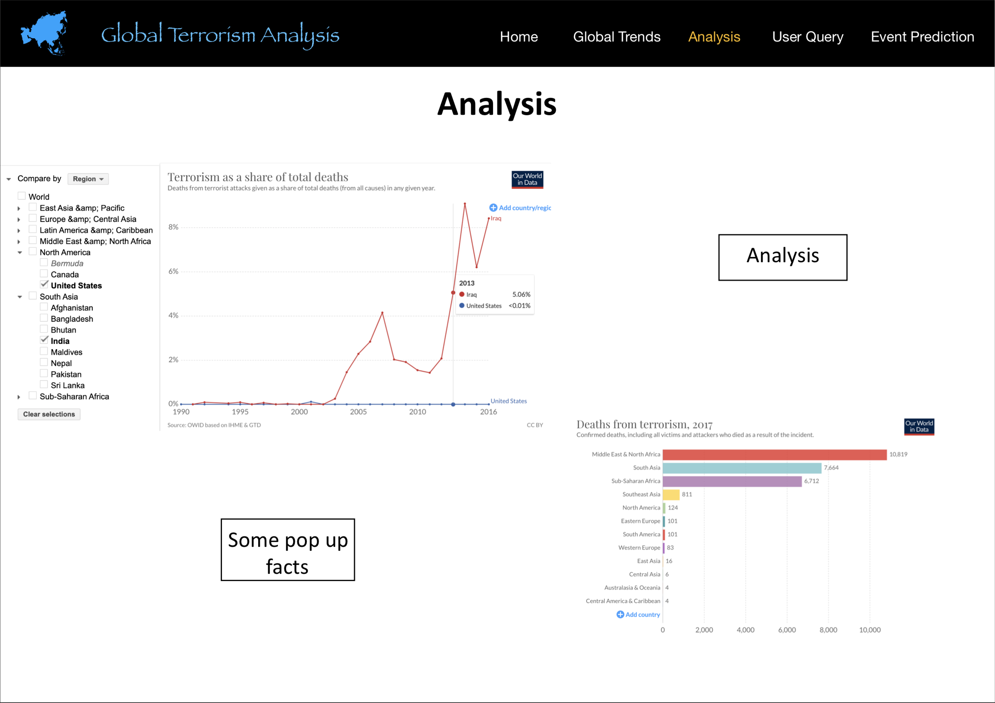
View-3
The sample plots are
taken from :
1) Terrorism by
Hannah Ritchie,
Joe Hasell,
Cameron Appel
and Max Roser
2) Google data
Explorer for
World
development Index

Slide 27
Types of Users
As the terrorism news are becoming more frequent and affecting people’s view toward foreign countries, we want to build a visually informative web interface providing an interactive and vivid way of displaying the data. The main goal is to:
Make the public aware of the issue and help them understand the context easier
Help researchers facilitate exploration of the data
Help the policy makers better analyse the global terror situation.
Notes:
User Types

Slide 28
Mode of Processing
Data representation
PostgreSQL - Data will be stored and processed as SQL tables using Relational Database
Frontend
Javascript
HTML/CSS
Backend
Python
Psycopg2 - Connecting python to the database.
Plotly and D3.js - Producing dynamic, interactive data visualisations
Flask - Building web application
Notes:
Using CSV file will not be efficient given the size of the data
Better to incorporate into our user query interface

Slide 29
Visual Representation - Plots
Map visualisation - attacks through the years, crime hotspots, death tolls
Histogram -
damage over the years in terms of casualties, property damage,
Comparison of casualties, damages between countries (in particular year or throughout the years)
Pie Chart - Prediction for crime in a particular country (Crime percent)
Line plot - Trends in terrorism over the years
Node-link based representation - Connected incidents
Notes:
Plots are important part of the different statistical analysis that we want to show.

Slide 30
Visual Representation - Major views
Major Views:
Home
Global Trends
Analysis
User Query
Predict Event
Linking different views:
Menu-bar at top for navigation.

Slide 31
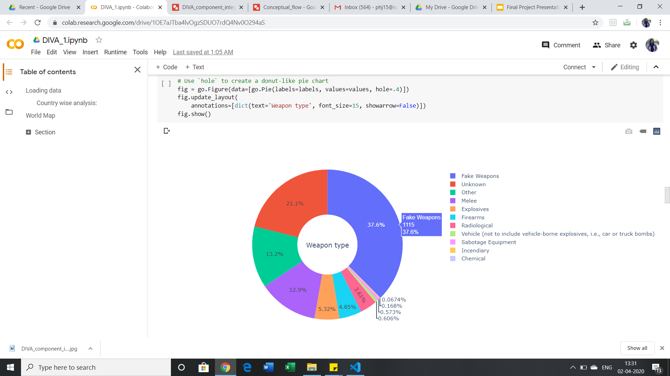
Fun Fact:
In overall analysis, the weapon which is used the most in a terrorist attack is a
Fake weapon!!

