Slide 1
ENGLISH
PRESENTATION BY
GALANG PUTRA
ARBI RIZKY ARIFIANTO
INTAN NUR SABILA

Slide 2
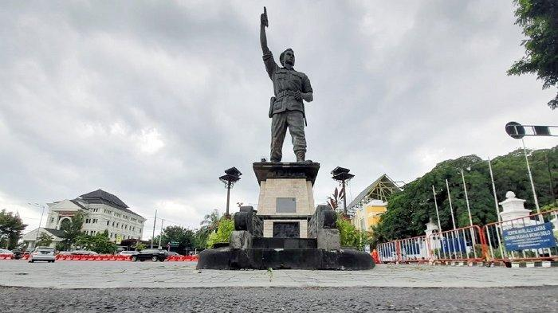

SOLO CITY
ENGLISH
LET’S TAKE A 5-MINUTE BREAK

Slide 3
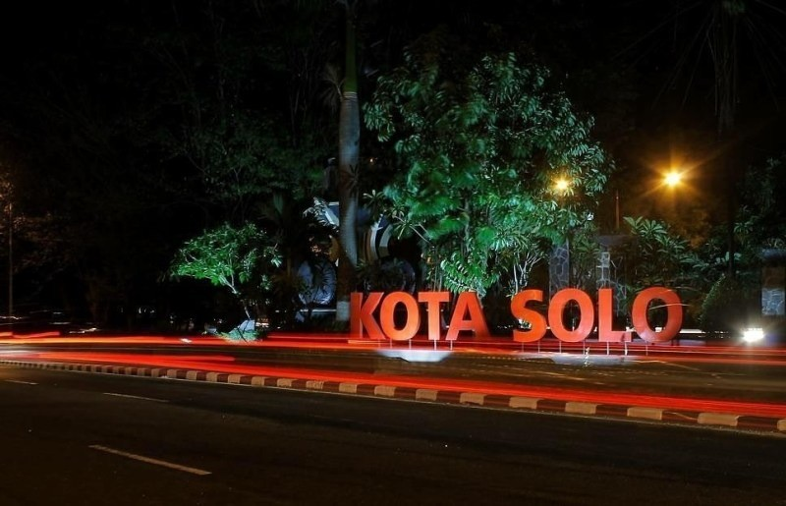

Slide 4
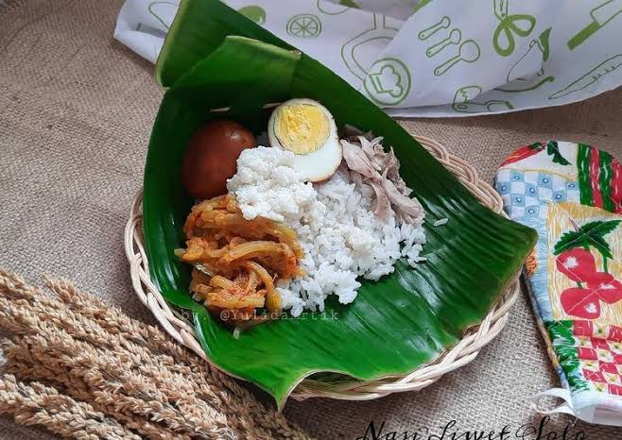
N
A
S
I
N
A
S
I
L
I
W
E
T
L
I
W
E
T

Slide 5
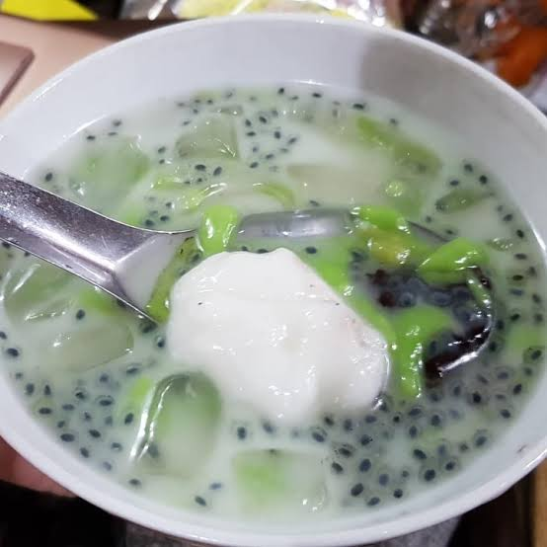
ES
ES
DAWET
DAWET
TELASIH
TELASIH

Slide 6
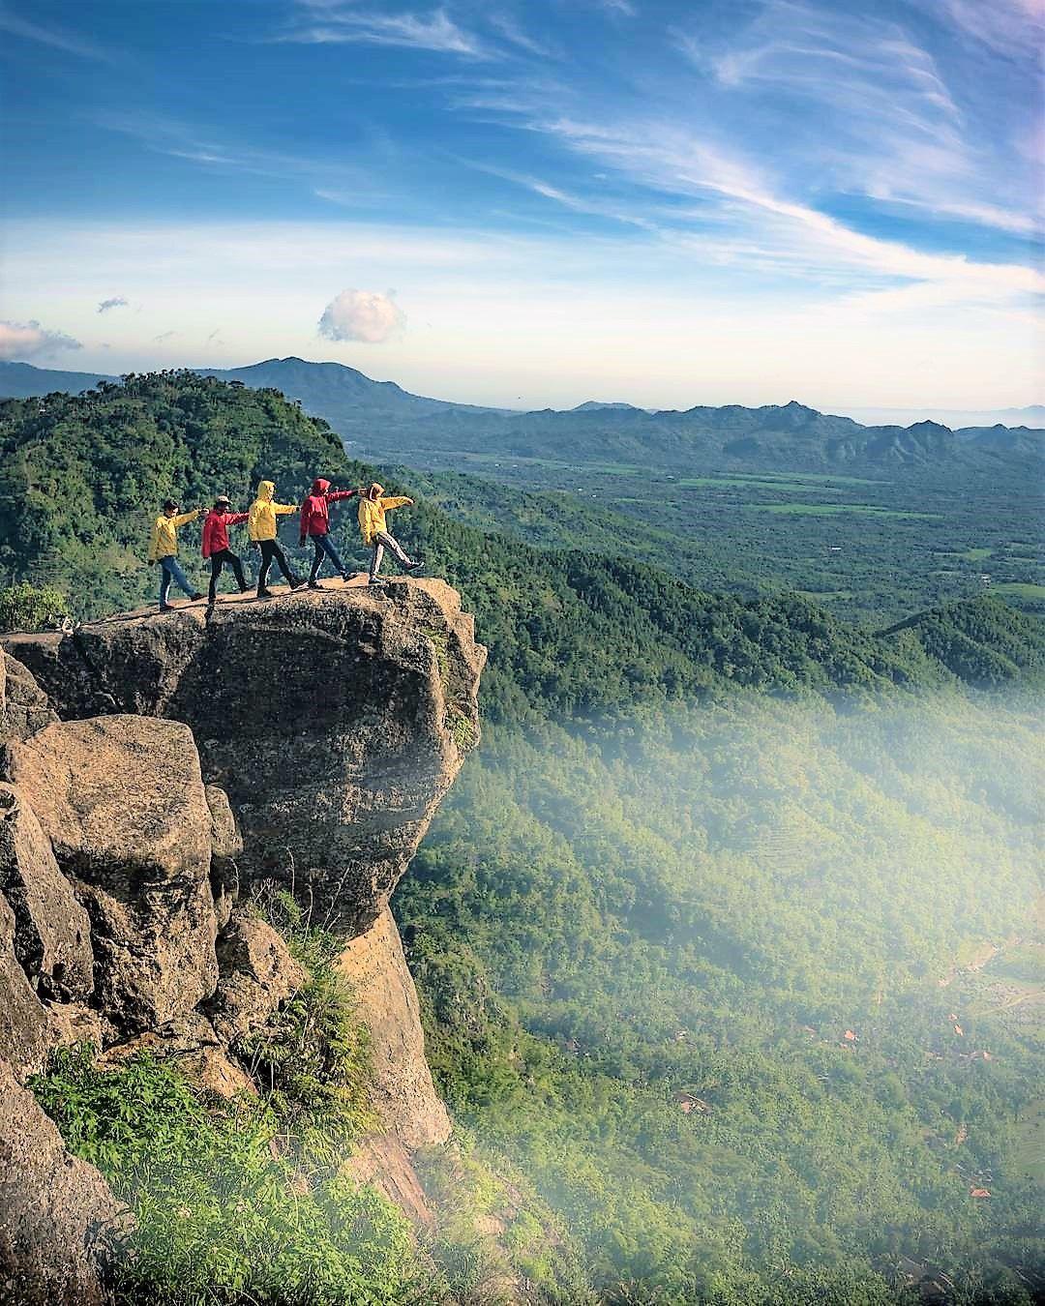
Gunung
wisata
wisata
Besek
Kismantoro

Slide 7

THANKS FOR YOUR ATTENTION

