Slide 1
HOME CREDIT DEFAULT RISK
Predicting the likely defaulters on loans
TEAM: Aakash Ahuja, Ashok Kuppuraj, Prashita Pratapan

Slide 2
AGENDA:
Getting the Data & Data Overview
Exploratory Data Analysis
Feature Engineering
Building a Baseline Model
Building a Challenger Model
Discussion/Analysis of results

Slide 3
Getting The Data & data Overview
Getting the Data: We’ve set up a kaggle API to host our data on the drive while working in Google Colab.
Data Overview:
Size of Data: ~ 1GB
307,511 observations with 122 features in main dataframe(Application_train.csv)
Numerical Features: 106 ; Categorical Features: 16
Highly Imbalanced Target variable with 90% non-defaulters and hardly 10% defaulters.

Slide 4
Exploratory Data analysis
Missing Values:
We decided to remove a feature from our model completely if it had >40% missing values.
As a result, we were left with 73 features out of 122(61 numerical & 12 categorical)
Some of the most correlated features with target variable:
Rating of the region where the client lives
Duration(in days) since client changed his phone(+ correlation)
Duration(in days) since the client has been employed

Slide 5
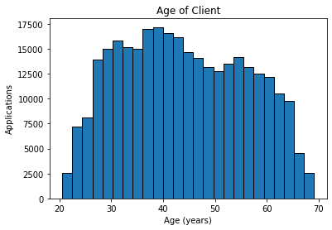
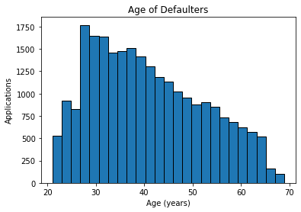
3. Relationship between Age & Chances of defaulting
The ages of our clients looks uniformly distributed except at the very ends.
We can see a clear trend in terms of age of clients who default on their loans. Younger people tend to default more frequently on their loans as compared to older people. So perhaps banks need to be more careful while providing loans to young people.

Slide 6
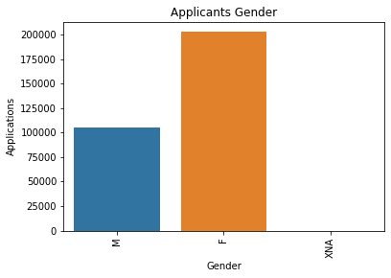
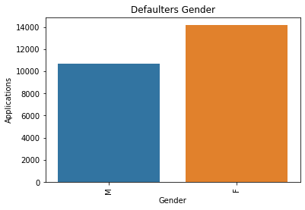
3. Gender & Chances of defaulting
We see that there are far more female loan applicants as compared to men.
But when we see the defaulters numbers, about 7% of the women default on their loans, while 12% of the men default on their loans. So women can be seen to be more trustworthy by the banks to lend money

Slide 7
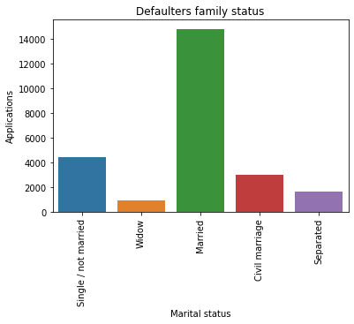
3. Marital Status & Chances of defaulting
We see that married people make the most of the defaulters. This is evident from the fact that with marriage comes great responsibility and increased expenditure. Hence a greater need to borrow

Slide 8
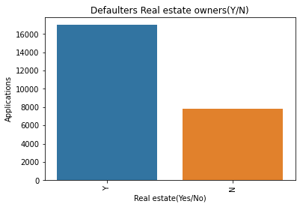
3. Occupation(Real Estate Owners) & Chances of Defaulting
This is a very interesting graph. We see that most defaulters belong to the real estate owners clan. Due to the risky nature of the real estate business, these clients might borrow money & then fail to pay back the loans.

Slide 9
Feature engineering
Feature Engineering is all about removing redundant features, combining multiple levels of a feature or just combining them to derive intelligent KPIs that’ll help us in the prediction process. The major steps being :
Removing Redundant Features: Region_rating_client & Region_Rating_Client_W_City were 2 variables where the region where the client lived was given a rating of 1-3. But the latter variable was adjusted for city. So instead of using both variables in the model, we just used the variable that was adjusted for cities i.e the latter one.
Combining Multiple Levels of a single feature: NAME_INCOME_TYPE has 8 values, we have clustered them to Working, Business and Unemployed
Name_Family_Status has 6 values- Married, Single, Civil Marriage, Separated, Widow, Unknown. So we binned Civil Marriage and Married into one.

Slide 10
OCCUPATION_TYPE has 23 categorical values, we have grouped them based on the general occupation types as BLue, white, Grey collared jobs.
Deriving Intelligent KPIs: We divided the Loan amount by the income of the client to derive a variable called CRED_INCOME which is basically the Repayment Capacity of a client. Then we removed these 2 variables and just used CRED_INCOME in the final model. Lower the value of this variable, better the chances of repayment of loan.

Slide 11
Feature SELECTION
Initially, we drop the columns with more than 35% missing values. The number of features left after this process is 73 out of 122 features.
This reduced set of 73 columns is further reduced using feature selection techniques which are different for each Categorical(12) and Numerical features(61).
We used Random forest classifier for selecting the best numerical features among the 61 numerical features and reduce it to 18 significant features.
For categorical features, we simply calculated the correlation of these 12 features with the target variable and reduced the total categorical features to 8.
Now the total set of 18+8 which is 26 features, after correlating with the target variable, we reduce it down to 18 features, which is then used to build the final model.

Slide 12
Pipeline
Numerical: For Numerical features, the preprocessing comprises of imputer and Scalar transformation. For the imputer the strategy selected is “mean”.
Categorical: For Categorical features, the preprocessing consists of Imputer and One-hot encoding. The strategy used for imputer is “Most Frequent”.

Slide 13
Baseline model
The selected baseline model is logistic regression with 19 correlated and derived features
The measured test accuracy is ~ 91%
The measured AUC is ~0.733 for both test and training datasets
Challenger model
The selected challenger model is logistic regression with 120 raw features
The measured test accuracy is ~ 91%
The measured AUC is ~0.738 for both test and training datasets

Slide 14
RESULTS & CONCLUSION
18 features used in the final model
Baseline model accuracy - 0.733
Challenger Model accuracy - 0.738
Even with the limited set of features, we were able to achieve model accuracy comparable with 120 features.

Slide 15
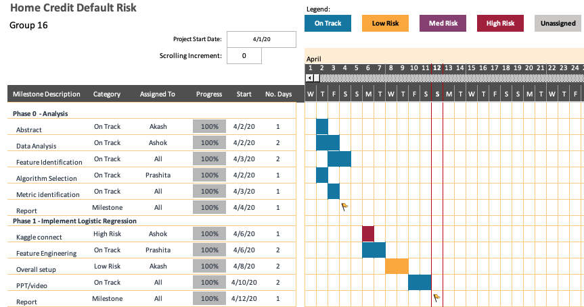
Submission Progress

