Slide 1
Machine Learning (25SC2107E)
Diabetes Risk Prediction Using Logistic Regression and Random Forest with Cross-Validation
Team Members (Team 13, Section 5)
Prakshitha Malla (2520030342); Datla Sri Sai Purna Mahija (2520030261)
Under the Esteemed Guidance of
Rani Mam, Assistant Professor, CSE

Slide 2
Contents
Abstract
Introduction
Literature survey
Problem Statement and Objectives
Hardware and Software requirements
Results
Conclusion
Future Scope

Slide 3
Abstract
Predicting diabetes risk is a vital healthcare objective; this project implements a scalable, end-to-end ML pipeline on the Pima Indians Diabetes dataset (768 patient records, 8 clinical features).
Feature engineering: disguised missing values (zeros in Glucose, BMI, etc.) are imputed, attributes standardized, and PCA + K-means clustering discover latent patient risk groups as engineered features.
Our project focuses on predicting the risk of diabetes using machine learning.
We used the Pima Indians Diabetes dataset, which contains 768 patient records and 8 clinical features.
First, we cleaned the data and handled missing values. Then we used PCA and K-means for feature engineering.
We trained two models, Logistic Regression and Random Forest. We used cross-validation and grid search to properly tune and evaluate the models.
Finally, Random Forest performed better than Logistic Regression, so we selected it as our final model and deployed it using FastAPI.
Logistic Regression (cross-entropy loss, L2-regularized) establishes a linear baseline, compared against a Random Forest classifier using bagging and feature subsampling for non-linear interactions.
Both models are tuned by grid search under stratified 5-fold cross-validation to prevent data leakage.
On the held-out test set, Random Forest reached ROC-AUC 0.815 and 74.7% accuracy, outperforming the Logistic Regression baseline (ROC-AUC 0.805, 69.5% accuracy).
The selected model is packaged with the fitted preprocessing pipeline and served via a FastAPI REST endpoint with a basic drift-monitoring hook.

Slide 4
Introduction
Diabetes is a widespread chronic condition; early risk identification enables preventive, timely care.
This project uses the Pima Indians Diabetes dataset — 768 patients, 8 routine clinical measurements, and a binary diabetic/non-diabetic label — to build and validate a real predictive pipeline.
Diabetes is a common chronic disease, so identifying the risk early can help with timely care and prevention.
In our project, we used the Pima Indians Diabetes dataset. It contains 768 patients and 8 clinical measurements.
Our machine learning system takes these medical measurements as input and predicts whether the patient is diabetic or non-diabetic.
We compare two approaches: Logistic Regression, which is a linear model, and Random Forest, which can capture more complex relationships
The pipeline covers every lifecycle stage: data ingestion, feature engineering, model training, evaluation, packaging, and REST-based deployment with monitoring.
Two complementary modelling paradigms are implemented and compared: a linear baseline (Logistic Regression) and a non-linear ensemble (Random Forest).
The system was built and executed end-to-end (not just designed) — all metrics reported later in this deck come from an actual training run.

Slide 5
Problem Statement and Objectives
Problem Statement
Healthcare providers need a reliable, scalable way to assess a patient's diabetes risk from routine medical records — without relying on overly simplistic linear assumptions or uncontrolled model complexity.
The main problem is that healthcare providers need a reliable way to estimate diabetes risk using routine patient information.
A very simple model may not capture complex relationships, while an overly complex model can also cause problems.
Objectives
Load and clean the Pima Indians Diabetes dataset (handle disguised missing values).
Engineer features using PCA and K-means clustering to capture latent risk groups.
Train a Logistic Regression baseline using cross-entropy loss.
Train a Random Forest classifier leveraging bagging and feature subsampling.
Validate models with stratified k-fold cross-validation and grid-search tuning.
Evaluate using accuracy, precision, recall, F1, ROC-AUC, PR-AUC, and calibration.
Package and serve the selected model via a FastAPI REST endpoint with monitoring.

Slide 6
Flow Chart
Data Ingestion — Pima Indians Diabetes dataset (768 records)
Preprocessing — Missing-value imputation, Scaling, PCA & K-Means Feature Engineering
Model Training — Logistic Regression & Random Forest
Stratified 5-Fold Cross-Validation & Grid-Search Tuning
Evaluation — Accuracy, Precision, Recall, ROC-AUC, PR-AUC, Calibration
Model Packaging (joblib) → FastAPI Deployment & Drift Monitoring

Slide 7
Hardware and Software requirements
Hardware Requirements
Standard workstation/laptop — Intel i5 (or equivalent), 8 GB+ RAM
GPU (optional) — not required for this dataset size; useful only for larger-scale extensions
Minimum 10 GB free disk space for datasets and model artifacts
Software Requirements
Python 3.x, Google Colab / Jupyter Notebook
pandas, NumPy, scikit-learn (StandardScaler, PCA, KMeans, LogisticRegression, RandomForestClassifier, GridSearchCV)
matplotlib for ROC/PR, calibration, and feature-importance plots
joblib for model + preprocessing pipeline packaging
FastAPI and Uvicorn for REST-based model serving

Slide 8
Conclusion
Built and executed an end-to-end diabetes risk prediction pipeline on the Pima Indians Diabetes dataset, from raw data to a served REST API.
Random Forest outperformed the Logistic Regression baseline on the held-out test set — ROC-AUC 0.815 vs 0.805, and accuracy 74.7% vs 69.5% — confirming the value of modelling non-linear feature interactions.
PCA and K-means-engineered features (pca_1, risk_cluster) ranked among the Random Forest's most important predictors, alongside Glucose and BMI.
Stratified 5-fold cross-validation with grid search ensured robust, leakage-free model selection.
The packaged model is served through a FastAPI REST endpoint with a rolling drift-monitoring check, demonstrating a production-style ML workflow.

Slide 9
Future Scope
Extend model comparisons to gradient-boosted trees (XGBoost, LightGBM) for potentially stronger performance.
Apply Bayesian hyperparameter search in place of grid search for faster, more thorough tuning.
Add automated drift detection and performance-degradation alerts to the monitoring endpoint.
Incorporate additional clinical/lifestyle features and larger, more diverse patient datasets.
Build a simple dashboard/UI for clinicians to interact with real-time risk predictions.

Slide 10
Thank you

Slide 11
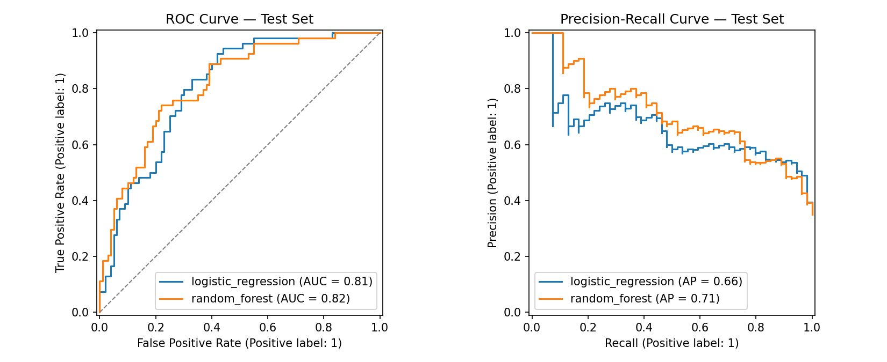
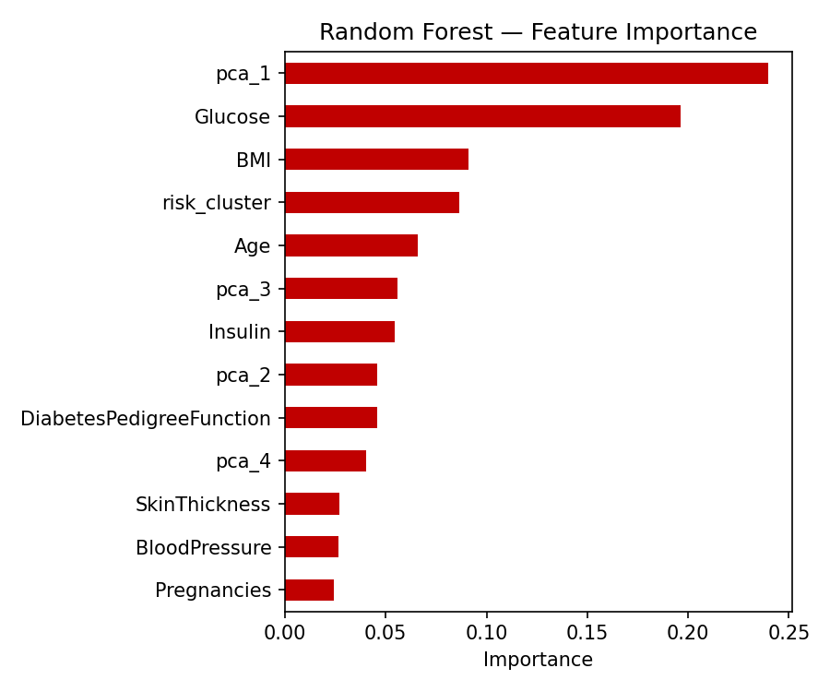
Results
Random Forest — Accuracy 0.747 | Precision 0.615 | Recall 0.741 | F1 0.672 | ROC-AUC 0.815 | PR-AUC 0.708
Logistic Regression — Accuracy 0.695 | Precision 0.575 | Recall 0.500 | F1 0.535 | ROC-AUC 0.805 | PR-AUC 0.658
Metrics computed on a held-out 20% test set never seen during tuning.
ROC / Precision-Recall curves (left) and Random Forest feature importance (right) — pca_1 and the K-means risk_cluster feature both rank among the top predictors.

