Slide 1
zekeLabs
Learning made Simpler ! www.zekeLabs.com

Slide 2
Docker FOR/ON Windows

Slide 3
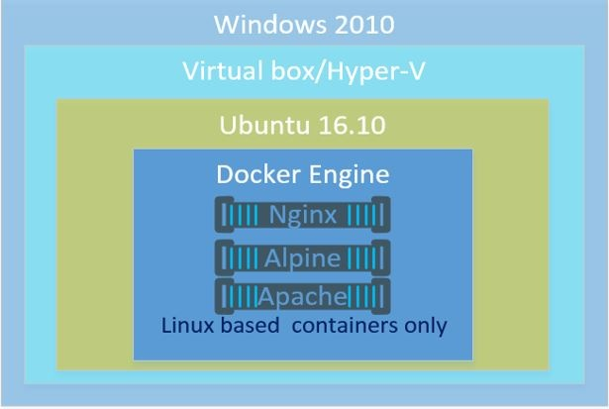
Docker FOR Windows

Slide 4
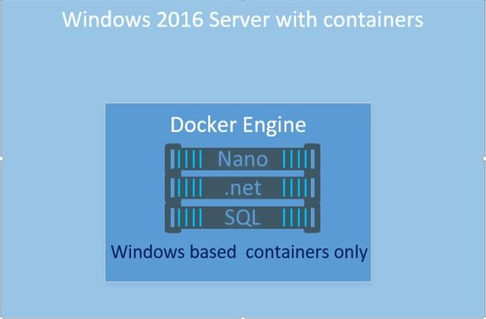
Docker ON Windows

Slide 5
Difference between FOR and ON
Features | Docker For Windows | Docker ON Windows server 2016 | Comments
Swarm Supported? | Yes | Yes | Currently, Docker supports a mixed Windows/Linux Swarm with limitations
Supported container types | Linux based | Windows based | Much larger numbers of Linux based images
Typical image size | Smaller (MBs) | Larger (GBs) | Windows images are generally much larger
Images available on Docker hub? | Yes, many thousands | Yes
Docker engine | Linux Kernel | Windows Kernel and HAL
Can be a Swarm manager In mixed Swarm? | Yes | Not at this time
Container isolation | Cgroups and namespaces | Compute Service Layer

Slide 6
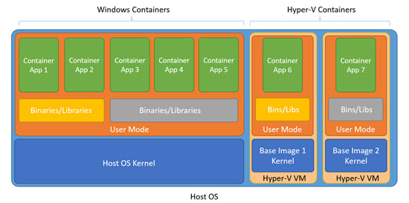
Windows containers vs Hyper-V containers

Slide 7
Challenges with Windows containers:
Not enough isolation since the isolation is at user-mode meaning a shared kernel.
In a multi-tenant environment a bad tenant may try to use the shared kernel to attack other containers.
There is a dependency on the host OS version and even patch level which may cause problems.

Slide 8
Hyper-V containers: (In Windows server 2016)
They use the base image defined for the application and automatically creates a Hyper-V VM using that base image.
So different OS versions are possible
Inside that VM are the various binaries, libraries and the application inside a Windows container.
The application is containerized using Windows containers and then at deployment time you pick the level of isolation required by choosing a Windows or Hyper-V container.

Slide 9
Linux Containers on Windows (LCOW)
Achieved using Hyper-V.
Supported on Windows 10, Windows server 1709 and higher versions.

Slide 10
THANK YOU
Let us know how can we help your organization to Upskill the employees to stay updated in the ever-evolving IT Industry.
Get in touch:
www.zekeLabs.com | +91-8095465880 | info@zekeLabs.com
Visit : www.zekeLabs.com for more details

