Slide 1
zekeLabs
Learning made Simpler ! www.zekeLabs.com

Slide 2
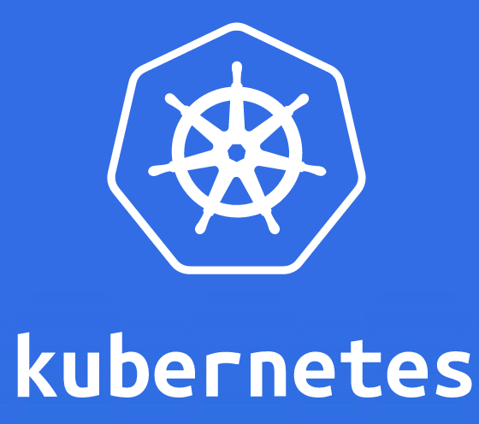

Slide 3
Kubernetes is a container orchestration tool/platform.
Used for automating deployment, scaling, and operations of containerized applications.
Kubernetes is the linux kernel of distributed systems
Kubernetes supports Containerd (docker), Rkt, Cri-o and other containers
What is Kubernetes
info@zekeLabs.com | www.zekeLabs.com | +91 8095465880

Slide 4
Kubernetes - Overview
Kubernetes is an open-source system for automating deployment, scaling, and management of containerized applications.
It groups containers that make up an application into logical units for easy management and discovery.
Kubernetes automates the distribution and scheduling of application containers across a cluster in a more efficient way.

Slide 5
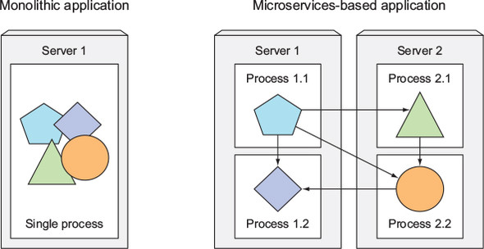
Evolution on application side
info@zekeLabs.com | www.zekeLabs.com | +91 8095465880

Slide 6
Applications Require:
Replication of components
Auto-scaling
Load balancing
Rolling updates
Logging across components
Monitoring and health checking
Service discovery
Authentication

Slide 7
Free and Open source
First Graduated project of CNCF
Community driven
Running in production
Modular and extensible
Hosted and supported by various cloud service providers
Why Kubernetes ?
info@zekeLabs.com | www.zekeLabs.com | +91 8095465880

Slide 8
Functions of Kubernetes
Kubernetes is used to ensure:
scheduling the deployment of a certain number of containers to a specific node,
managing networking between the containers,
following the resource allocation,
moving them around as they grow and many more.

Slide 9
Kubernetes Architecture

Slide 10
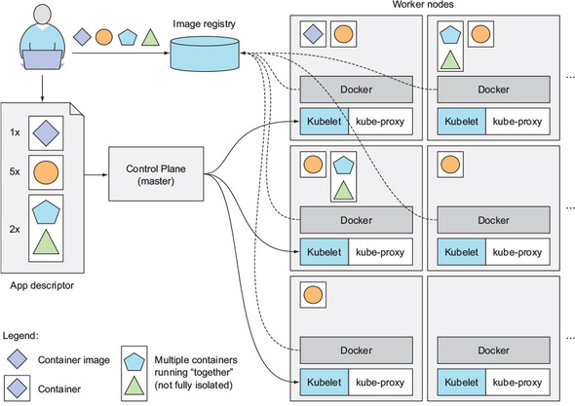
How Kubernetes works ?
info@zekeLabs.com | www.zekeLabs.com | +91 8095465880

Slide 11
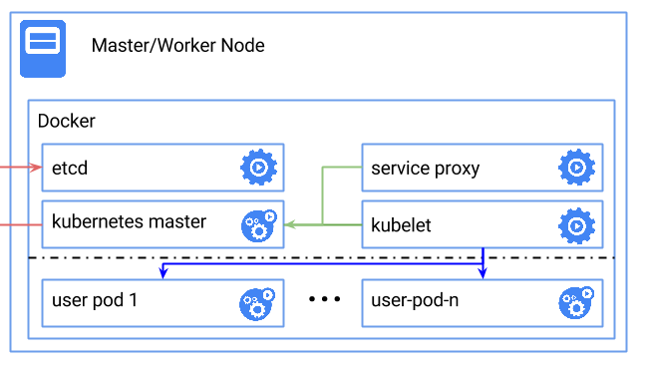
Kubernetes Single instance setup

Slide 12
Master Node
Master node is responsible for the management of Kubernetes cluster.
This is the entry point of all administrative tasks.
Master node is the one taking care of orchestrating the worker nodes.
Following are the components of the master node.
API server
etcd storage
Scheduler
controller-manager

Slide 13
Worker Node
The pods run on worker node.
worker node contains all the necessary services to manage the networking between the containers, communicate with the master node.
nodes assign resources to the containers scheduled.
Following are the components of the Worker node.
Docker Runtime
Kubelet
Kube-proxy
Kubectl

Slide 14
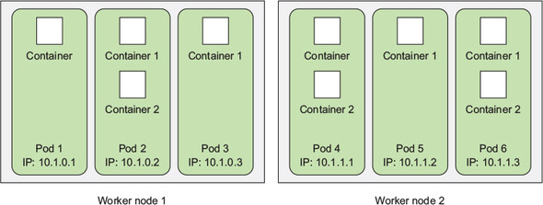
Nodes-pods-containers

Slide 15
Kubectl tool
Kubectl the command line tool for accessing the Kubernetes cluster.
Written in Go language, this nifty tool offers powerful functionality.
Kind of a swiss army knife for performing a variety of functions.
info@zekeLabs.com | www.zekeLabs.com | +91 8095465880

Slide 16
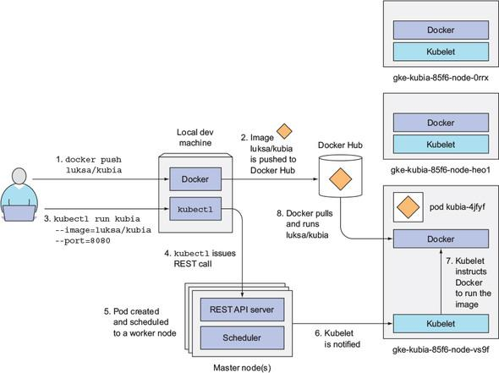
Workflow to run a container on Kubernetes

Slide 17
Lab: Creating a cluster
info@zekeLabs.com | www.zekeLabs.com | +91 8095465880

Slide 18
Kubernetes Objects
Containers
Pods
Nodes
Deployments
Controllers
Services
Volumes
Jobs
Labels
Environment variables
Namespaces
Health checks
Secrets
Logging
info@zekeLabs.com | www.zekeLabs.com | +91 8095465880

Slide 19
Pods
Pod is a group of containers.
It is the smallest unit that can be scheduled to be deployed through K8s.
Normally a microservices is provided by this tightly coupled group of containers.
This groups of containers would share storage, Linux namespaces, cgroups, IP addresses.
These are co-located, hence share resources and are always scheduled together.
Created, destroyed and re-created on demand, based on the state of the server and the service itself.

Slide 20
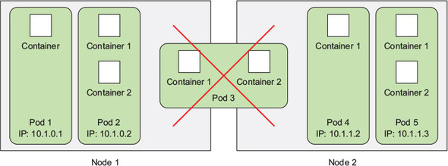
Pods: collocation

Slide 21
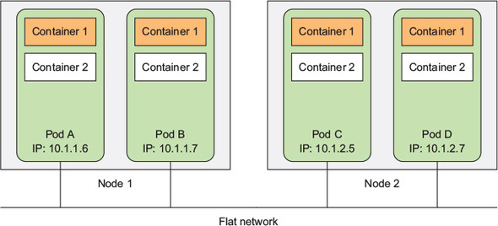
Pods : networking

Slide 22
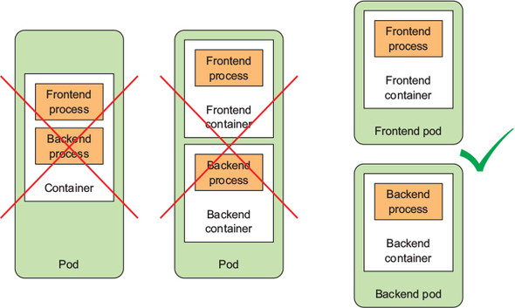
Pods: Design

Slide 23
Service
service, is an abstraction on top of number of pods.
Typically requiring to run a proxy on top, for other services to communicate with it via a Virtual IP address.
This is where you can configure load balancing for your numerous pods and expose them via a service.

Slide 24
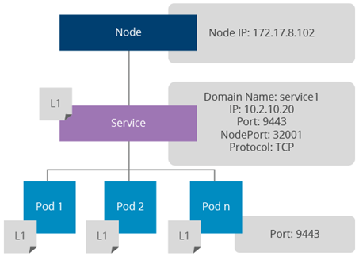
Service

Slide 25
Ingress Controller and load balancing
Kubernetes provides a mechanism for adding a proxy server for Kubernetes services, known as Ingress.
It exposes Kubernetes services via well-known ports, such as 80, 443.
An ingress controller listens to Kubernetes API, generates a proxy configuration in runtime whenever a service is changed, and reloads the Nginx configuration.
It can expose any given port via a Docker host port.
Clients can send requests to one of the Kubernetes node IPs, Nginx port and those will get redirected to the relevant service.
The service will do round robin load balancing in the network layer.
The service can be identified using an URL context or hostname;
https://node-ip/foo/, https://foo.bar.com/

Slide 26
THANK YOU
Let us know how can we help your organization to Upskill the employees to stay updated in the ever-evolving IT Industry.
Get in touch:
www.zekeLabs.com | +91-8095465880 | info@zekeLabs.com
Visit : www.zekeLabs.com for more details

