Slide 1
zekeLabs
Learning made Simpler ! www.zekeLabs.com

Slide 2
Kubernetes
An Introduction
Kubernetes is an open-source system for automating deployment, scaling, and management of containerized applications.
It groups containers that make up an application into logical units for easy management and discovery.
Kubernetes automates the distribution and scheduling of application containers across a cluster in a more efficient way.

Slide 3
Kubernetes Architecture

Slide 4
Kubernetes is used to ensure:
Scheduling the deployment of a certain number of containers to a specific node,
Managing networking between the containers,
Following the resource allocation,
Moving them around
Scale as they grow
To provide security
… and many more.

Slide 5
Applications need to have:
Replication of components
Auto-scaling
Load balancing
Rolling updates
Logging across components
Monitoring and health checking
Service discovery
Authentication

Slide 6
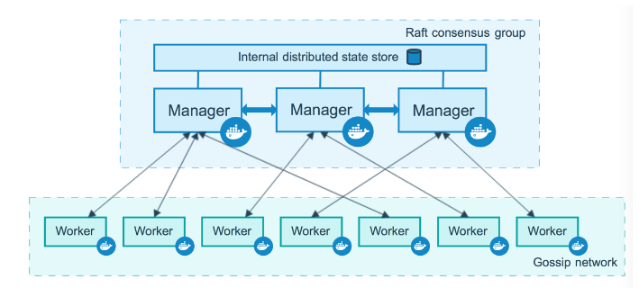
Docker Swarm setup

Slide 7
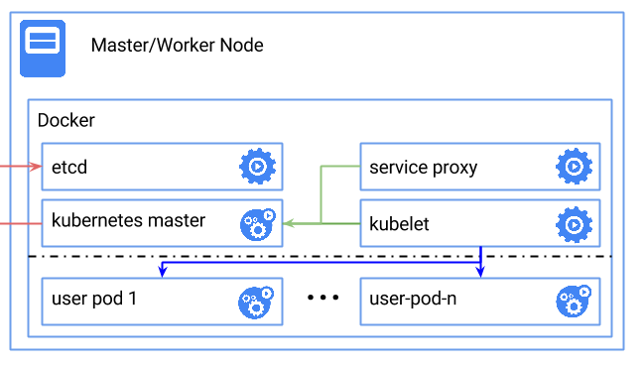
Kubernetes single node setup

Slide 8
Master Node
Master node is responsible for the management of Kubernetes cluster.
This is the entry point of all administrative tasks.
Master node is the one taking care of orchestrating the worker nodes,
Actual services are running on Worker nodes.
Following are the components of the master node.
API server
etcd storage
Scheduler
controller-manager

Slide 9
Worker Node
The pods are run here, so the worker node contains all the necessary services to manage the networking between the containers, communicate with the master node, and assign resources to the containers scheduled.
Following are the components of the Worker node.
Containers
Pod
Kubelet
Kube-proxy
Kubectl

Slide 10
Kubernetes components : Pod

Slide 11
Pods
Pod is a group of containers, the smallest unit that can be scheduled to be deployed through K8s.
Normally a microservices is provided by this tightly coupled group of containers.
This groups of containers would share storage, Linux namespaces, cgroups, IP addresses.
These are co-located, hence share resources and are always scheduled together.
created, destroyed and re-created on demand, based on the state of the server and the service itself.

Slide 12
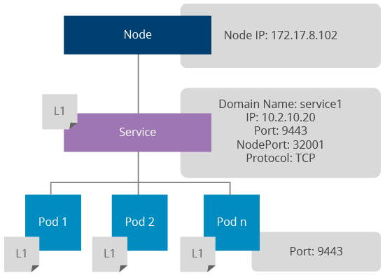
Kubernetes components: Service
service, is an abstraction on top of number of pods,
typically requiring to run a proxy on top, to communicate with it via a Virtual IP address.
This is where you can configure load balancing for your numerous pods and expose them via a service.

Slide 13
Service
ClusterIP
This type will make the service only visible to the internal network for routing internal traffic.
NodeIP
This type will expose the service via node ports to the external network.
Each port in a service will be mapped to a node port and those will be accessible via<node-ip>:<node-port>.
Load Balancer
Services need to be exposed via a dynamic load balancer the service type can be set to Load Balancer.
This feature is enabled by the underlying cloud provider (example: Azure).

Slide 14
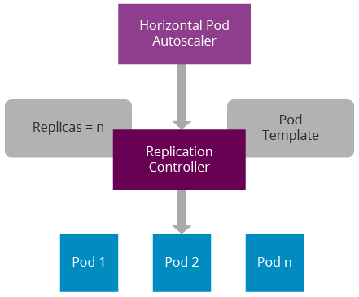
Replication Controller and scaling out

Slide 15
Ingress Controller and load balancing
Ingress controller is a proxy server on kubernetes
It exposes Kubernetes services via well-known ports, such as 80, 443.
An ingress controller listens to Kubernetes API, generates a proxy configuration in runtime whenever a service is changed, and reloads the Nginx configuration.
It can expose any given port via a Docker host port.

Slide 16
Ingress Controller and load balancing
Clients can send requests to one of the Kubernetes node IPs, Nginx port and those will get redirected to the relevant service.
The service will do round robin load balancing in the network layer.
The service can be identified using an URL context or hostname; https://node-ip/foo/, https://foo.bar.com/

Slide 17
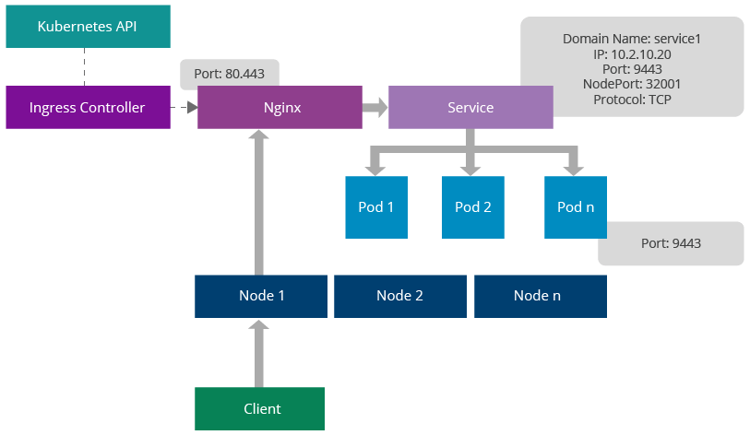
Ingress Controller and load balancing

Slide 18
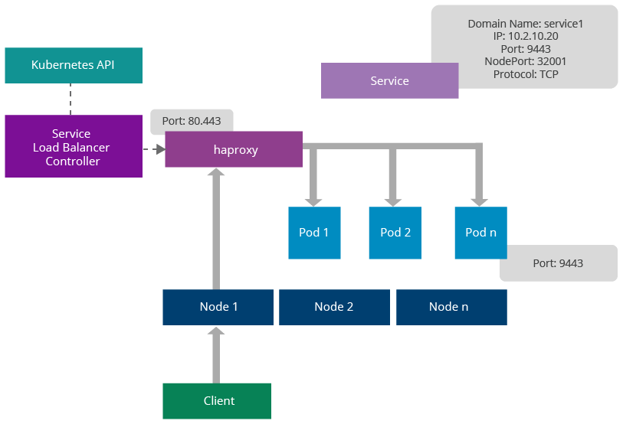
Service Load balancer: Sticky session management

Slide 19
Service Load balancer: Sticky session management
Kubernetes provides another mechanism for load balancing pods using third-party load balancers.
These are known as service load balancers.
Unlike ingress, service load balancers don’t route requests to services, rather they are dispatched directly to the pods.
The main advantage of this feature is the ability to provide sticky session management at the load balancer.

Slide 20
References:
https://kubernetes.io/
https://labs.play-with-k8s.com/
https://wso2.com/
http://collabnix.com/
https://labs.play-with-docker.com/

Slide 21
THANK YOU
Let us know how can we help your organization to Upskill the employees to stay updated in the ever-evolving IT Industry.
Get in touch:
www.zekeLabs.com | +91-8095465880 | info@zekeLabs.com
Visit : www.zekeLabs.com for more details

