Slide 1
zekeLabs
Learning made Simpler ! www.zekeLabs.com

Slide 2
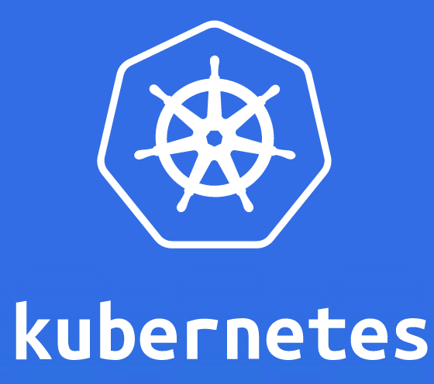

Slide 3
Kubernetes : Controllers
info@zekeLabs.com | www.zekeLabs.com | +91 8095465880

Slide 4
What are controllers ?
Controllers watch the API server for changes to resources (Deployments, Services, and so on) and perform operations for each change, which includes:
creation of a new object
update
deletion of an existing object.
In general, Controllers reconcile the actual state with the desired state.

Slide 5
What are controllers ?
Controllers keep watching the resources through watch on API server.
In case of any mismatch in desired and current state controller updates a resource in the API server
After that the Kubelets and Kubernetes Service Proxies, oblivious of the controllers’ existence, perform their work, such as spinning up a pod’s containers and attaching network storage to them, or in the case of services, setting up the actual load balancing across pods.

Slide 6
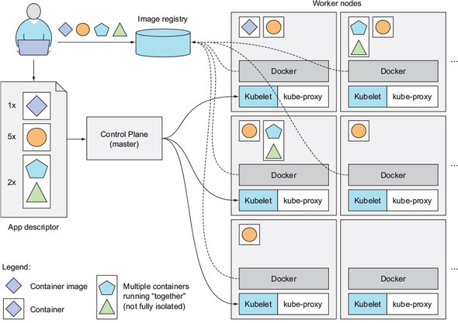
How Kubernetes works ?
info@zekeLabs.com | www.zekeLabs.com | +91 8095465880

Slide 7
Type of controllers
Replication Controller
ReplicaSet, DaemonSet, and Job controllers
Deployment controller
StatefulSet controller
Node controller
Service controller
Endpoints controller
Namespace controller
PersistentVolume controller
Others

Slide 8
Replication Controller
info@zekeLabs.com | www.zekeLabs.com | +91 8095465880

Slide 9
Replication Manager
Replication Manager is the controller of Replication Controller resource.
A ReplicationController is a Kubernetes resource that ensures its pods are always kept running.
If the pod disappears for any reason, such as in the event of a node disappearing from the cluster or because the pod was evicted from the node, the ReplicationController notices the missing pod and creates a replacement pod.
A ReplicationController constantly monitors the list of running pods and makes sure the actual number of pods of a “type” always matches the desired number

Slide 10
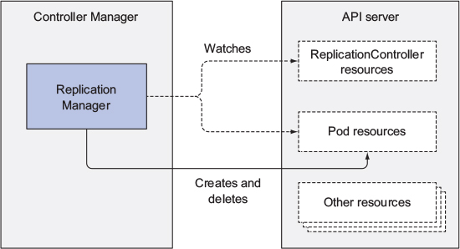
Replication Manager [Similar to other controllers]

Slide 11
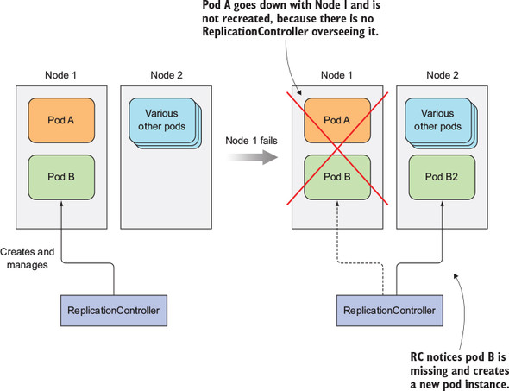
Replication controller

Slide 12
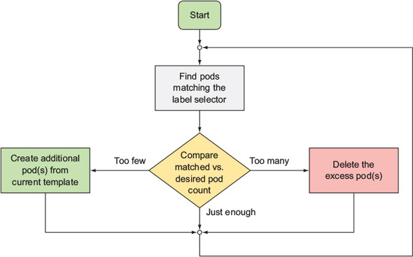
Replication controller

Slide 13
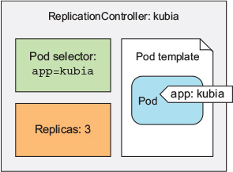
Replication controller
A ReplicationController has three essential parts:
A label selector, which determines what pods are in the ReplicationController’s scope
A replica count, which specifies the desired number of pods that should be running
A pod template, which is used when creating new pod replicas
Refer to the file kubia-rc.yaml

Slide 14
Replication controller : more about it
Follow the exercise in Controllers.bash at github repo
Changes to the label selector and the pod template have no effect on existing pods.
Changing the label selector makes the existing pods fall out of the scope of the Replication-Controller, so the controller stops caring about them.
A Replication Controller’s pod template can be modified at any time.
Changing the pod template will only affect the pods created afterwards.
When you delete a ReplicationController through kubectl delete, the pods are also deleted.
We can keep its pods running by passing the --cascade=false option to the command.

Slide 15
Replica Set
info@zekeLabs.com | www.zekeLabs.com | +91 8095465880

Slide 16
Replica set
It’s a new generation of ReplicationController and replaces it completely.
You usually won’t create them directly, but instead have them created automatically when you create Deployment resource.
A ReplicaSet behaves exactly like a ReplicationController, but it has more expressive pod selectors.
Whereas a ReplicationController’s label selector only allows matching pods that include a certain label, a ReplicaSet’s selector also allows matching pods that lack a certain label or pods that include a certain label key, regardless of its value.

Slide 17
Replica set
Look at the file kubia-replicaset.yaml
The only difference is in the selector.
Instead of listing labels the pods need to have directly under the selector property, you’re specifying them under selector.matchLabels.
This is the simpler (and less expressive) way of defining label selectors in a ReplicaSet.
The main improvements of ReplicaSets over ReplicationControllers are their more expressive label selectors. Look at kubia-replicaset-matchexpressions.yaml

Slide 18
Replica set
You can add additional expressions to the selector.
Each expression must contain a key, an operator, and possibly (depending on the operator) a list of values.
You’ll see four valid operators:
In—Label’s value must match one of the specified values.
NotIn—Label’s value must not match any of the specified values.
Exists—Pod must include a label with the specified key (the value isn’t important). When using this operator, you shouldn’t specify the values field.
DoesNotExist—Pod must not include a label with the specified key. The values property must not be specified.

Slide 19
Daemon Set
info@zekeLabs.com | www.zekeLabs.com | +91 8095465880

Slide 20
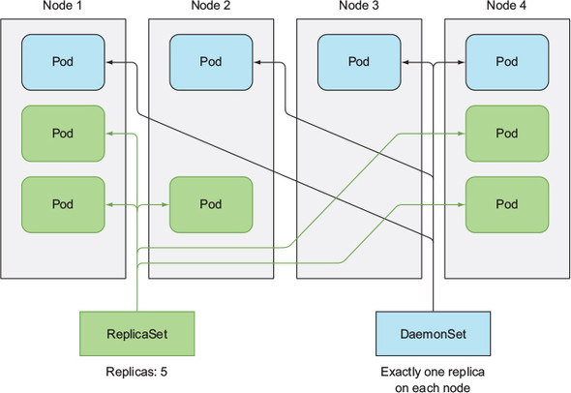
Daemon set

Slide 21
Daemon set
A DaemonSet makes sure it creates one pod on each existing node.
Certain cases exist when you want a pod to run on each and every node in the cluster and each node needs to run exactly one instance of the pod.
Those cases include infrastructure-related pods that perform system-level operations.
For example:
log collector and a resource monitor on every node.
kube-proxy process, which needs to run on all nodes to make services work.

Slide 22
Daemon set
A DaemonSet deploys pods to all nodes in the cluster, unless you specify that the pods should only run on a subset of all the nodes.
This is done by specifying the node-Selector property in the pod template, which is part of the DaemonSet definition.
Look at the ssd-monitor-daemonset.yaml and exercise in controllers.bash

Slide 23
Batch jobs
info@zekeLabs.com | www.zekeLabs.com | +91 8095465880

Slide 24
Job
We talked about pods than need to run continuously.
ReplicationControllers, ReplicaSets, and DaemonSets run continuous tasks that are never considered completed.
Processes in such pods are restarted when they exit.
Jobs allow you to run a pod whose container isn’t restarted when the process running inside finishes successfully.
Once it does, the pod is considered complete.
Pods managed by Jobs are rescheduled until they finish successfully.
Look at the exporter.yaml

Slide 25
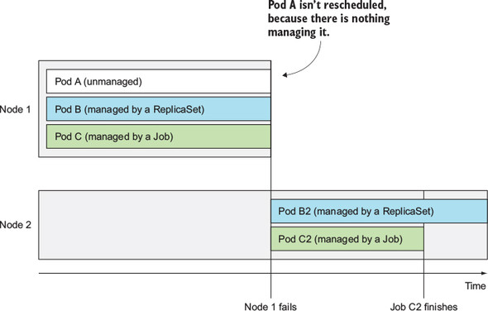
Job

Slide 26
Running multiple pod instances in a Job
Running job pods sequentially
Look at multi-completion-batch-job.yaml
This Job will run five pods one after the other.
It initially creates one pod, and when the pod’s container finishes, it creates the second pod, and so on, until five pods complete successfully.
If one of the pods fails, the Job creates a new pod, so the Job may create more than five pods overall.

Slide 27
Running multiple pod instances in a Job - Parallely
Instead of running single Job pods one after the other, you can also make the Job run multiple pods in parallel.
You specify how many pods are allowed to run in parallel with the parallelism Job spec property.
Look into the multi-completion-parallel-batch-job.yaml

Slide 28
Cron jobs
info@zekeLabs.com | www.zekeLabs.com | +91 8095465880

Slide 29
cron jobs
A cron job in Kubernetes is configured by creating a CronJob resource.
The schedule for running the job is specified in the well-known cron format,
At the configured time, Kubernetes will create a Job resource according to the Job template configured in the CronJob object.
When the Job resource is created, one or more pod replicas will be created and started according to the Job’s pod template.
look into the cronjob.yaml for more details

Slide 30
THANK YOU
Let us know how can we help your organization to Upskill the employees to stay updated in the ever-evolving IT Industry.
Get in touch:
www.zekeLabs.com | +91-8095465880 | info@zekeLabs.com
Visit : www.zekeLabs.com for more details

