Slide 1
zekeLabs
Learning made Simpler ! www.zekeLabs.com

Slide 2
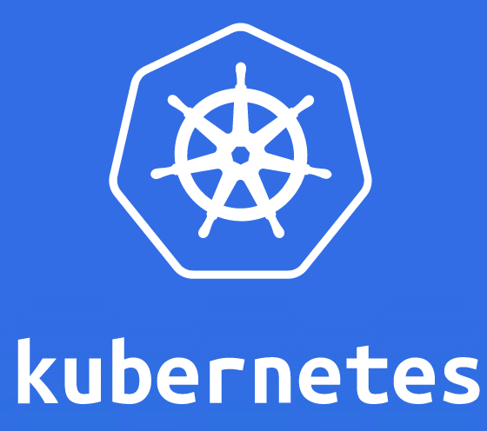

Slide 3
Kubernetes : Networking
info@zekeLabs.com | www.zekeLabs.com | +91 8095465880

Slide 4
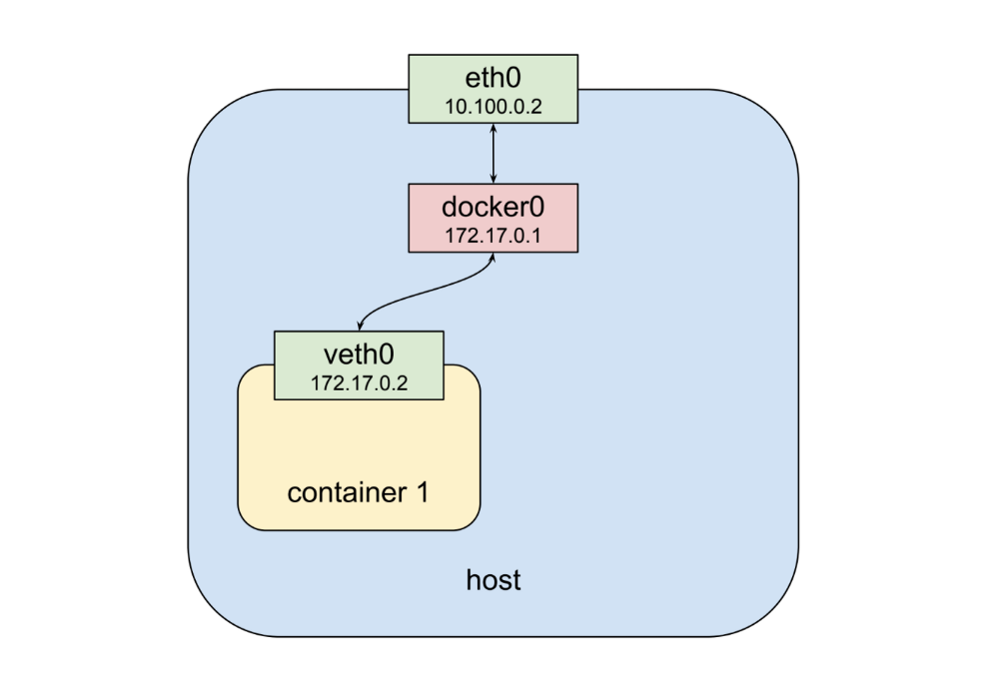
networking (Single Container)
Physical network interface eth0
Bridge (default gateway for veth) docker0
virtual network interface veth0

Slide 5
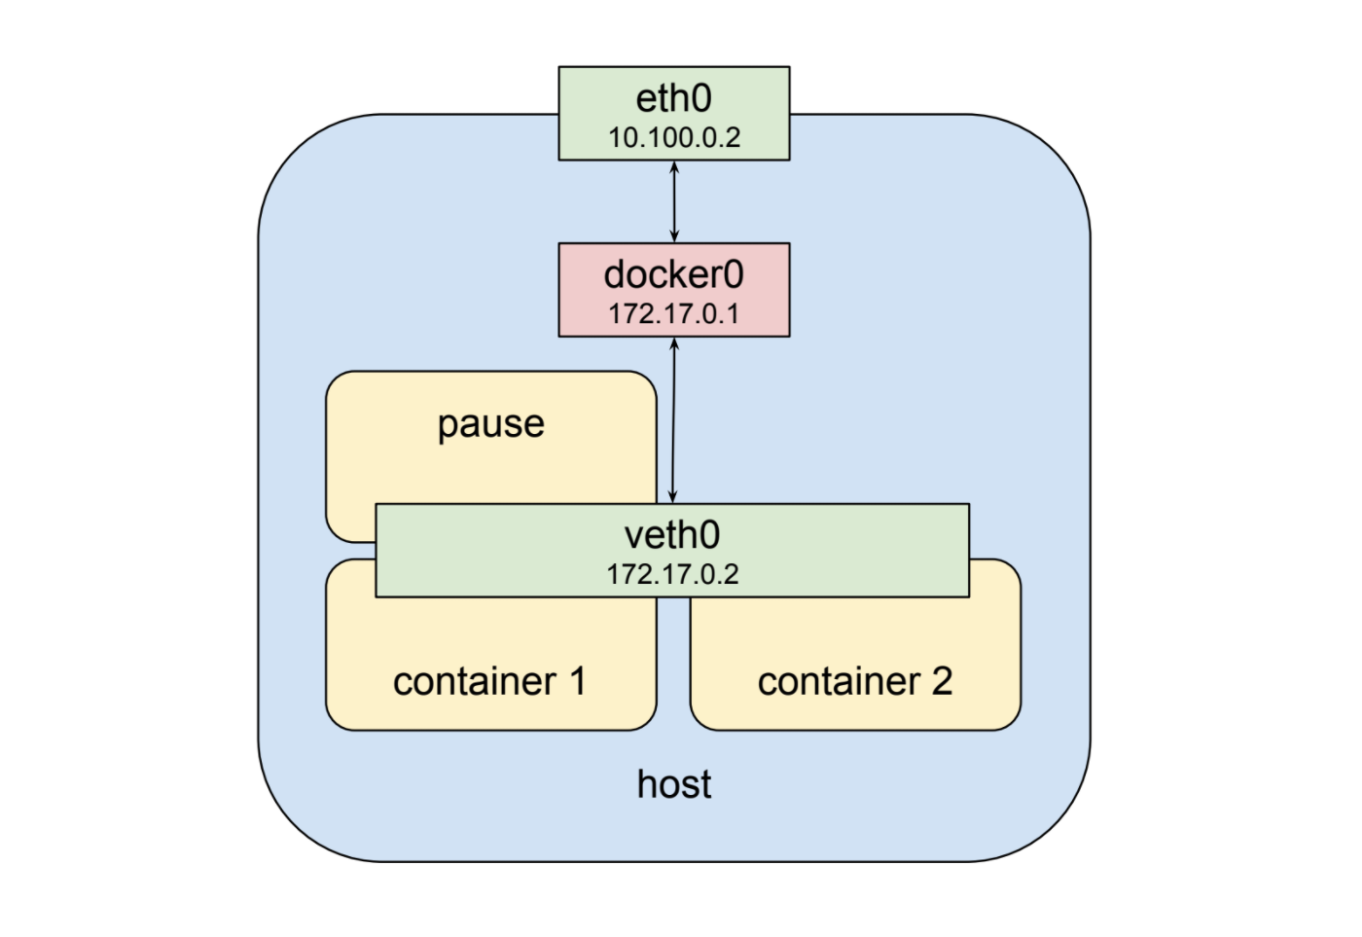
Networking ( Two Containers in a Pod)

Slide 6
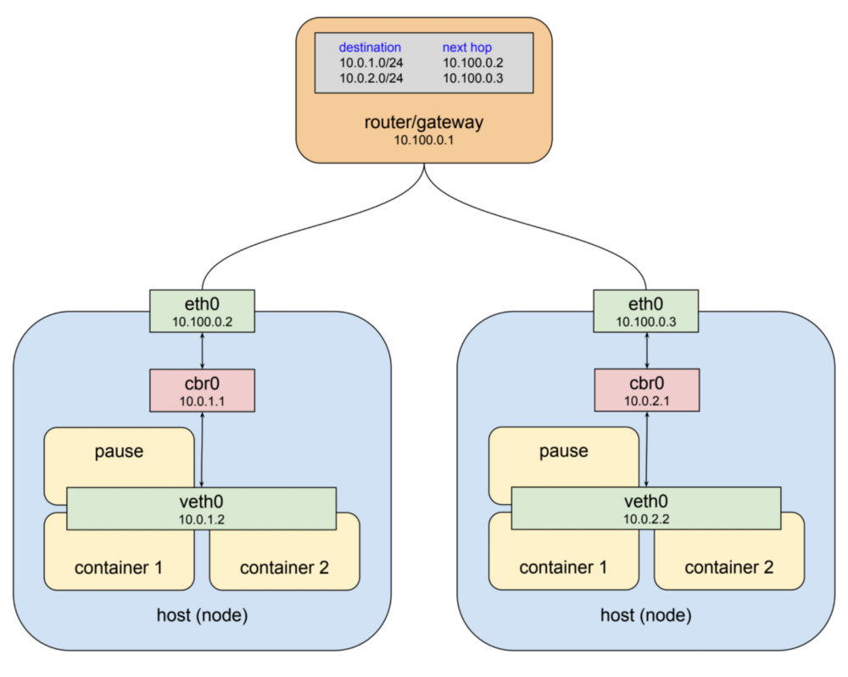
Networking (1 pod each on each host)

Slide 7
Pod B (pod-with-host-network.yaml)
Our cluster (nodes and pods) is one big flat IP network.
Some Rules:
all nodes must be able to reach each other, without NAT
all pods must be able to reach each other, without NAT
pods and nodes must be able to reach each other, without NAT
each pod is aware of its IP address (no NAT)

Slide 8
Kubernetes Network Model :
Everything can reach everything (No control)
No address translation
No port translation
No new protocol
Pods cannot move from a node to another and keep their IP address
IP addresses don’t have to be “portable” from a node to another (We can use e.g. a subnet per node and use a simple routed topology)

Slide 9
CNI:
Networking within Kubernetes is plumbed via the Container Network Interface (CNI).
an interface between a container runtime and a network implementation plugin.
Notes:
https://github.com/containernetworking/cni/blob/master/SPEC.md#network-configuration

Slide 10
Kubenet
Kubernetes default networking provider, kubenet, is a simple network plugin that works with various cloud providers.
Kubenet is a very basic network provider, and basic is good, but does not have very many features.
Moreover, kubenet has many limitations.
Moreover, a cluster cannot be set up in a Private VPC, since that network topology uses multiple route tables. Other more advanced features, such as BGP, egress control, and mesh networking, are only available with different CNI providers.

Slide 11
CNI Plugins:
The CNI plugin is selected by passing Kubelet the --network-plugin=cni command-line option.
Default config directory for CI that kubelet reads :
/etc/cni/net.d
Notes:
https://github.com/containernetworking/cni/blob/master/SPEC.md#network-configuration

Slide 12
Some CNI Plugins:
The Container Network Interface (CNI) is a library definition, and a set of tools under the umbrella of the Cloud Native Computing Foundation project.
Kubernetes uses CNI as an interface between network providers and Kubernetes networking.
Examples
Calico
Canal (Flannel for network + Calico for firewalling)
Cilium
Flannel
Kube-router
Romana
WeaveNet

Slide 13
Features Provided by CNI plugins
Route Distribution
Network Layer
Implementation of Network Policies
Mesh networking
Encryption
Commercial Support

Slide 14
Network Policies
Network polices are used to control traffic in and across the cluster across multiple entities.
Network policies in kubernetes are implemented by CNI plugins that can support it.

Slide 15
Calico
info@zekeLabs.com | www.zekeLabs.com | +91 8095465880

Slide 16
Calico Provides:
secure network connectivity for containers and virtual machine workloads.
creates and manages a flat layer 3 network, assigning each workload a fully routable IP address.
communicate amongst workloads without IP encapsulation or network address translation for bare metal performance.
easier troubleshooting, and better interoperability.
an IP-in-IP tunneling and can work with other overlay networking such as flannel.
dynamic enforcement of network security rules.
fine-grained control over communications between containers, virtual machine workloads, and bare metal host endpoints.

Slide 17
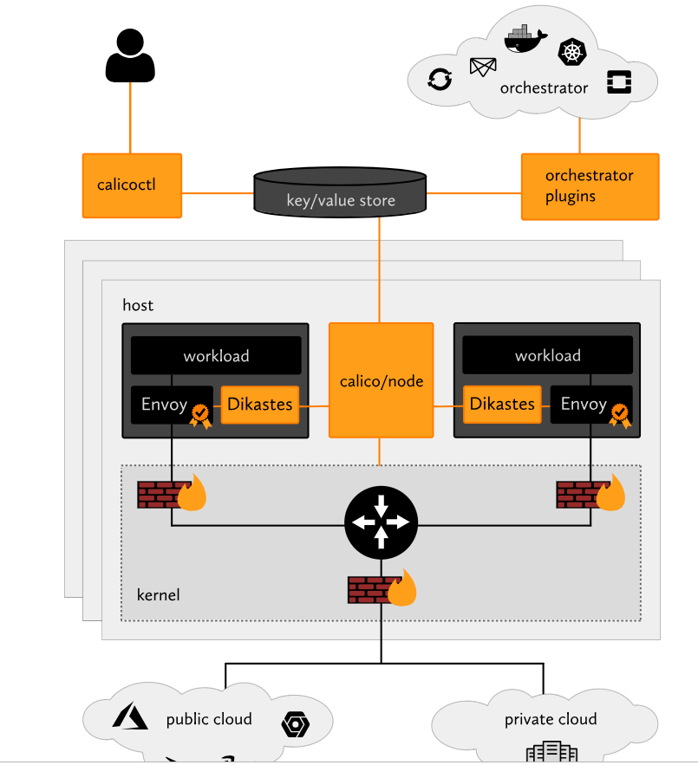
How Calico Works:

Slide 18
Components of Calico:
calicoctl: Allows you to achieve advanced policies and networking from a simple, command-line interface.
orchestrator plugins: provide close integration and synchronization with a variety of popular orchestrators.
key/value store: holds Calico’s policy and network configuration state.
calico/node: runs on each host, reads relevant policy and network configuration information from the key/value store, and implements it in the Linux kernel.
Dikastes/Envoy: optional Kubernetes sidecars that secure workload-to-workload communications with mutual TLS authentication and enforce application layer policy.

Slide 19
Cilium
info@zekeLabs.com | www.zekeLabs.com | +91 8095465880

Slide 20
Cilium
Cilium operates at Layer 3/4 and layer 7
Provides traditional networking and security services with L2 and L3
Uses Layer 7 to protect and secure use of modern application protocols such as HTTP, gRPC and Kafka.
Uses Berkley packet filter (BPF)
BPF is a highly flexible and efficient construct in the Linux kernel allowing to execute bytecode at various hook points in a safe manner.

Slide 21
Cilium: Features
CNI plugin support to provide pod_connectivity with Multi Host Networking.
Identity based implementation of the NetworkPolicy resource to isolate pod to pod connectivity on Layer 3 and 4.
An extension to NetworkPolicy in the form of a CustomResourceDefinition which extends policy control to add - Layer 7 policy enforcement on ingress and egress for the HTTP, Kafka application protocols, Egress support for CIDRs.
ClusterIP implementation to provide distributed load-balancing for pod to pod traffic.
Fully compatible with existing kube-proxy model
Notes:
Reference: http://docs.cilium.io/en/stable/kubernetes/intro

Slide 22
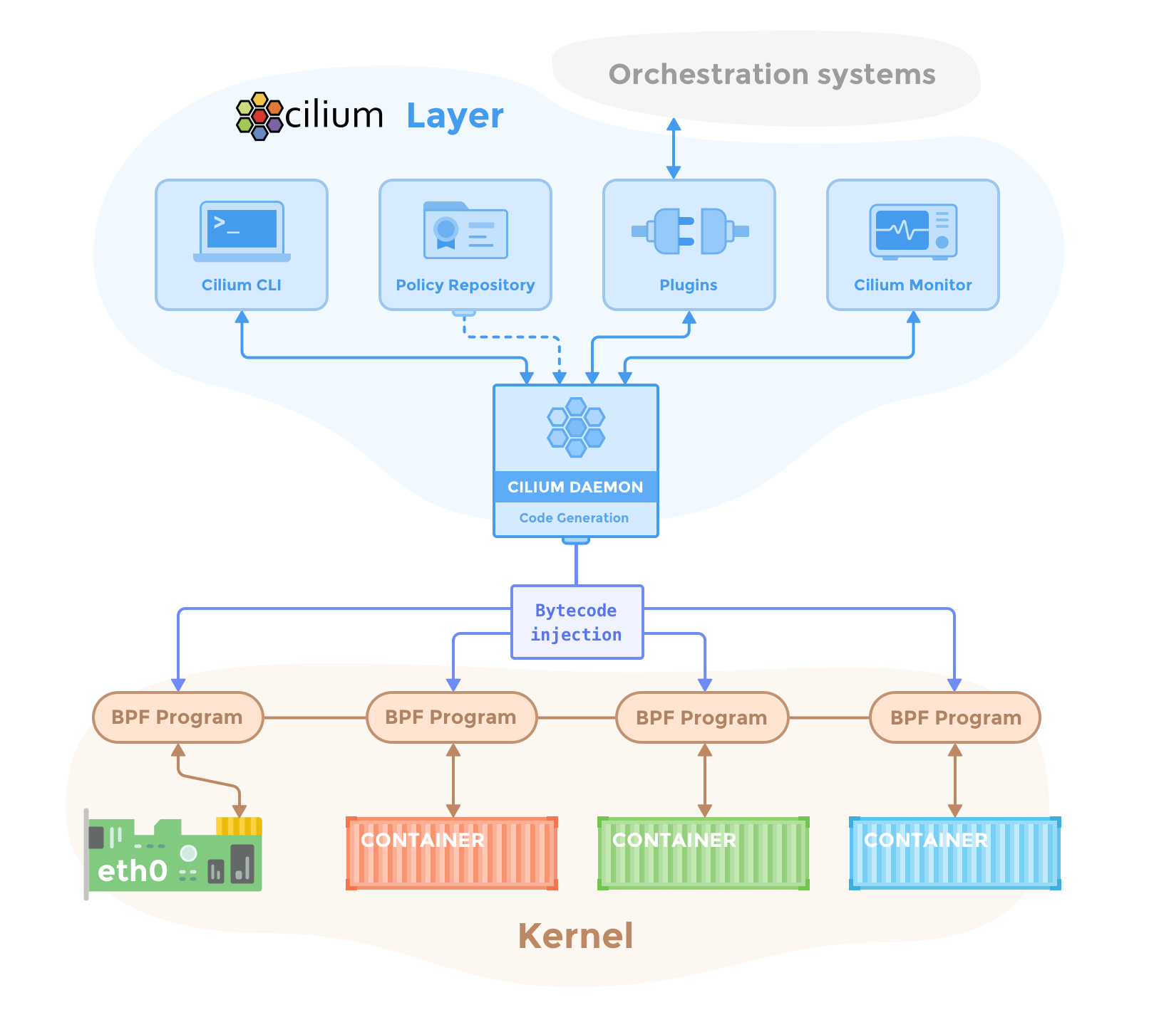
Cilium: Features
Notes:
Reference: http://docs.cilium.io/en/stable/kubernetes/intro

Slide 23
How Cilium works
When implementing ClusterIP, Cilium acts on the same principles as kube-proxy, it watches for services addition or removal, but instead of doing the enforcement on the iptables, it updates BPF map entries on each node.
BPF continues to evolve and gain additional capabilities with each new Linux release. Cilium leverages BPF to perform core datapath filtering, mangling, monitoring and redirection, and requires BPF capabilities that are in any Linux kernel version 4.8.0 or newer.

Slide 24
How Cilium works
The layer 3 policy establishes the base connectivity rules regarding which endpoints can talk to each other. Layer 3 policies can be specified using the following methods:
Labels-based: This is used to describe the relationship if both endpoints are managed by Cilium and are thus assigned labels.
Services-based: This is an intermediate form between Labels and CIDR and makes use of the services concept in the orchestration system.
Entities-based: Entities are used to describe remote peers which can be categorized without knowing their IP addresses. Eg. anything outside the cluster.
IP/CIDR-based: This is used to describe the relationship to or from external services if the remote peer is not an endpoint. This requires to hardcode either IP addresses or subnets into the policies.

Slide 25
How Cilium works
Refer to github.com/ashishrpandey/kubernetes-training/networking/

Slide 26
Weave-net
info@zekeLabs.com | www.zekeLabs.com | +91 8095465880

Slide 27
How Cilium works
Weave Net routers establish TCP connections with each other, over which they perform a protocol handshake and subsequently exchange topology information
Weave Net creates a network bridge on the host.
Each container is connected to that bridge via a veth pair, the container side of which is given an IP address and netmask supplied either by the user or by Weave Net’s IP address allocator.
Weave Net routes packets between containers on different hosts via two methods: a fast data path method, which operates entirely in kernel space, and a fallback sleeve method,

Slide 28
CNI Plugin Comparison
https://kubernetes.io/docs/concepts/cluster-administration/networking/
https://itnext.io/benchmark-results-of-kubernetes-network-plugins-cni-over-10gbit-s-network-36475925a560
https://chrislovecnm.com/kubernetes/cni/choosing-a-cni-provider/
http://machinezone.github.io/research/networking-solutions-for-kubernetes/
Kuberenetes Networking
https://github.com/nleiva/kubernetes-networking-links
https://kubedex.com/kubernetes-network-plugins/
https://www.youtube.com/watch?v=6v_BDHIgOY8
https://www.projectcalico.org/calico-networking-for-kubernetes/

Slide 29
THANK YOU
Let us know how can we help your organization to Upskill the employees to stay updated in the ever-evolving IT Industry.
Get in touch:
www.zekeLabs.com | +91-8095465880 | info@zekeLabs.com
Visit : www.zekeLabs.com for more details

