Slide 1
zekeLabs
Learning made Simpler ! www.zekeLabs.com

Slide 2
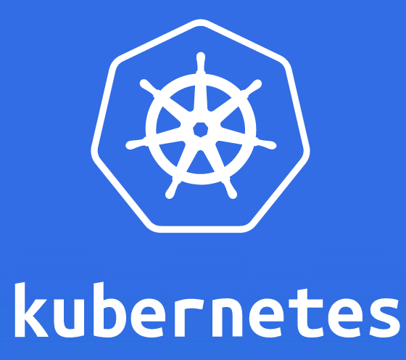

Slide 3
Kubernetes : Pods
info@zekeLabs.com | www.zekeLabs.com | +91 8095465880

Slide 4
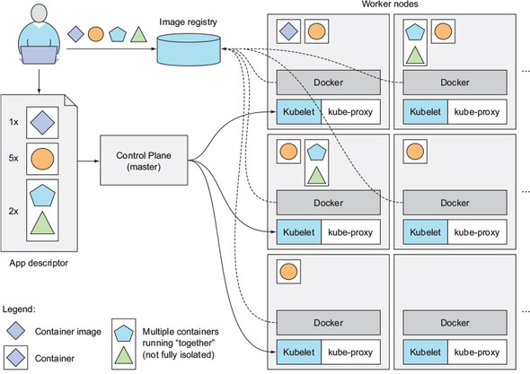
How Kubernetes works ?
info@zekeLabs.com | www.zekeLabs.com | +91 8095465880

Slide 5
Lab: Getting started
info@zekeLabs.com | www.zekeLabs.com | +91 8095465880

Slide 6
Getting started
Follow the getting started with kubernetes.txt on github repo
Deploy an app on the cluster
Creates an replicationcontroller
Expose the service
Access the service (from both master and node)
Scale the service

Slide 7
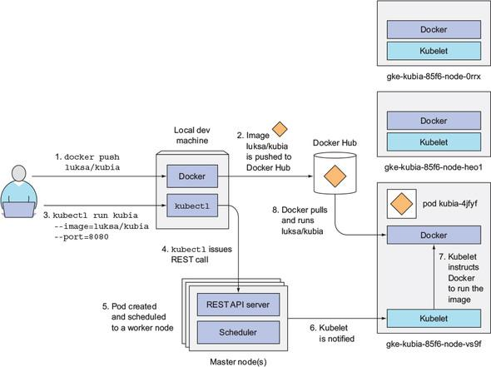
Workflow to run a container on Kubernetes

Slide 8
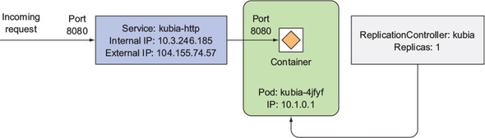
What we achieved with service?

Slide 9
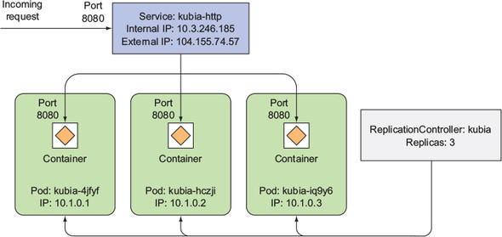
Scaled service

Slide 10
Pods
Pod is a group of containers.
It is the smallest unit that can be scheduled to be deployed through K8s.
Normally a microservices is provided by this tightly coupled group of containers.
This groups of containers would share storage, Linux namespaces, cgroups, IP addresses.
These are co-located, hence share resources and are always scheduled together.
Created, destroyed and re-created on demand, based on the state of the server and the service itself.

Slide 11
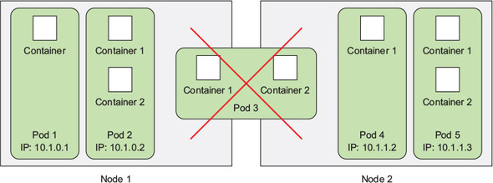
Pods: collocation
Notes:
The key thing about pods is that when a pod does contain multiple containers, all of them are always run on a single worker node—it never spans multiple worker nodes.

Slide 12
Pods
Containers in a pod run in the same Network namespace, they share the same IP address and port space.
Containers of the same pod need to take care not to bind to the same port numbers or they’ll run into port conflicts
Containers of different pods can never run into port conflicts, because each pod has a separate port space

Slide 13
Why one container per pod?
Containers are designed to run only a single process per container (unless the process itself spawns child processes).
...and pods are designed to run single container unless very necessary.
If you run multiple unrelated processes in a single container/pod:
Your responsibility to keep all those processes running, manage their logs, and so on.
You’d have to include a mechanism for automatically restarting processes if they crash.
All those processes would log to the same standard output, so you’d have a hard time figuring out what process logged what.
Kubernetes can not scale containers can scale only pods

Slide 14
Why multiple container per pod?
Main reason to put multiple containers into a single pod is when the application consists of one main process and one or more complementary processes.
For example:
the main container in a pod could be a web server that serves files from a certain directory, while an additional container (a sidecar container) periodically downloads content from an external source and stores it in the web server’s directory.
Sidecar Containers for log rotators and collectors, data processors, communication adapters, and others.

Slide 15
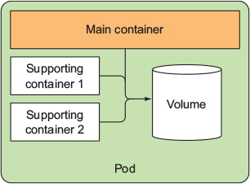
Pods : multiple container per pod

Slide 16
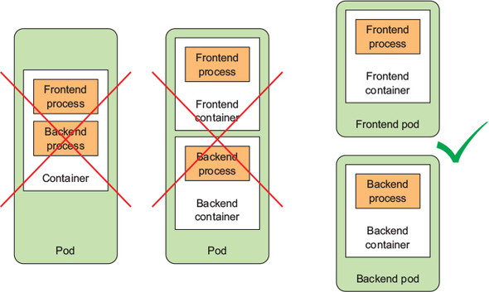
Pods: Design

Slide 17
Pod : Networking
All pods in a Kubernetes cluster reside in a single flat, shared, network-address space
Every pod can access every other pod at the other pod’s IP address
No NAT (Network Address Translation) gateways exist between them.
Each pod gets its own IP address and is accessible from all other pods through this network established specifically for pods. (Done by Calico, Flannel, NSX-T etc)

Slide 18
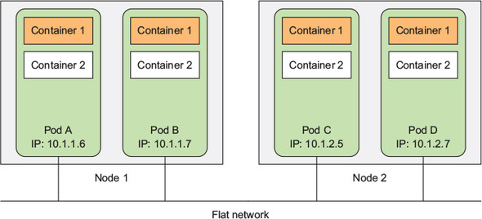
Pods : networking

Slide 19
Lab: Explore pods
info@zekeLabs.com | www.zekeLabs.com | +91 8095465880

Slide 20
Pod Details:
Run: kubectl apply –f pod_name.yml
Get info from pod kubectl get po kubia-zxzij -o yaml
Metadata includes the name, namespace, labels, and other information about the pod.
Spec contains the actual description of the pod’s contents, such as the pod’s containers, volumes, and other data.
Status contains the current information about the running pod, such as what condition the pod is in, the description and status of each container, and the pod’s internal IP and other basic info.

Slide 21
About pod yaml file
Go to kubia-manual.yaml
Kubernetes reference documentation at http://kubernetes.io/docs/api
Refer to the github repo -- pods.txt

Slide 22
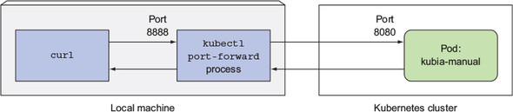
Pod : port forwarding
When you want to talk to a specific pod without going through a service (for debugging or other reasons), Kubernetes allows you to configure port forwarding to the pod.
This is done through the kubectl port-forward command.
kubectl port-forward kubia-manual 8888:8080
curl localhost:8888

Slide 23
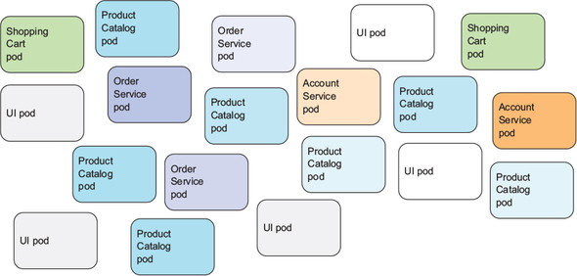
Pods and Labels:

Slide 24
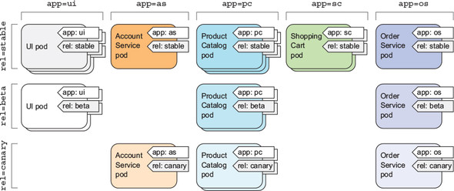
Pods and Labels:

Slide 25
Pods and Labels:
Playing with labels:
Refer to kubia-manual-with-labels.yaml and pods.txt at gihub repo
Scheduling pods to specific nodes using nodeselector:
Refer to kubia-gpu.yml
Also See the result using:
$ kubectl describe pod kubia-manual

Slide 26
Pods and Labels:
You could also schedule a pod to an exact node.
Each node also has a unique label with the key kubernetes.io/hostname and value set to the actual hostname of the node.
But setting the nodeSelector to a specific node by the hostname label may lead to the pod being unschedulable if the node is offline
You shouldn’t think in terms of individual nodes.
Always think about logical groups of nodes that satisfy certain criteria specified through label selectors.

Slide 27
Annotations
Annotations are also key-value pairs, so in essence, they’re similar to labels.
But they aren’t meant to hold identifying information.
They can’t be used to group objects the way labels can.
While objects can be selected through label selectors, there’s no such thing as an annotation selector.
On the other hand, annotations can hold much larger pieces of information and are primarily meant to be used by tools.
For example, an annotation used to specify the name of the person who created the object can make collaboration between everyone working on the cluster much easier.

Slide 28
Namespaces
Kubernetes namespaces provide a scope for objects names.
Instead of having all your resources in one single namespace, you can split them into multiple name-spaces, which also allows you to use the same resource names multiple times (across different namespaces).
But, while most types of resources are namespaced, a few aren’t. One of them is the Node resource, which is global and not tied to a single namespace.
Refer to exercise in pods.txt at github repo.

Slide 29
Lab
info@zekeLabs.com | www.zekeLabs.com | +91 8095465880

Slide 30
THANK YOU
Let us know how can we help your organization to Upskill the employees to stay updated in the ever-evolving IT Industry.
Get in touch:
www.zekeLabs.com | +91-8095465880 | info@zekeLabs.com
Visit : www.zekeLabs.com for more details

