Slide 1
zekeLabs
Learning made Simpler ! www.zekeLabs.com

Slide 2
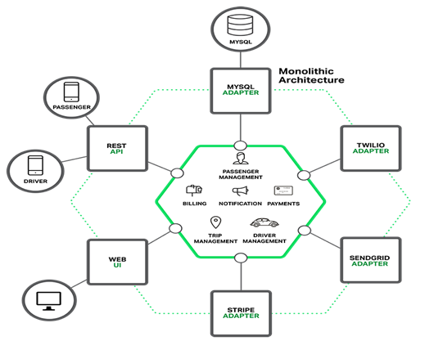
Monolithic Architecture

Slide 3
Monolithic Architecture Challenges
Agility
Scalability
Fault Tolerance
Tightly Coupled
Redeploy entire application on each update
Continuous deployment is difficult

Slide 4
Service and Microservice
A service typically implements a set of distinct features or functionality, such as order management, customer management, etc.
Each microservice is a mini-application that has its own hexagonal architecture consisting of business logic along with various adapters.

Slide 5
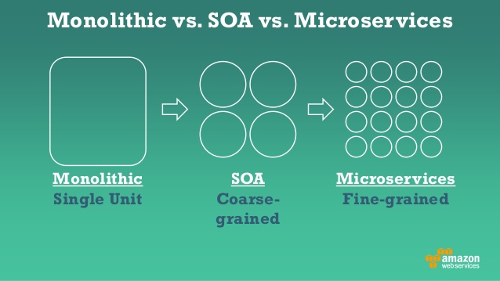
Monolithic vs. Service Oriented Architecture vs. Microservices

Slide 6
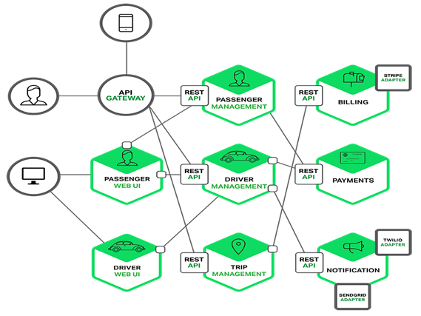
Microservice Architecture

Slide 7
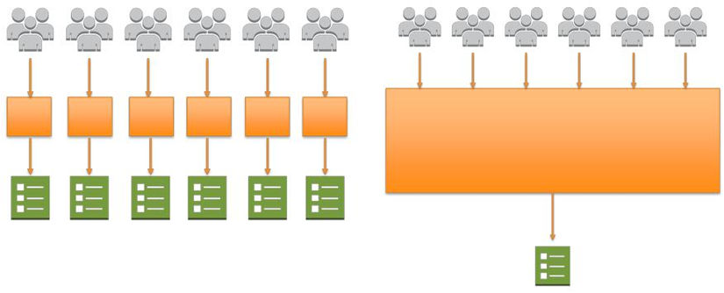
Deploying Microservices
Microservices vs Monolithic Applications
Small independent teams take ownership of their services and deployment
While large team works on monolithic deployment.

Slide 8
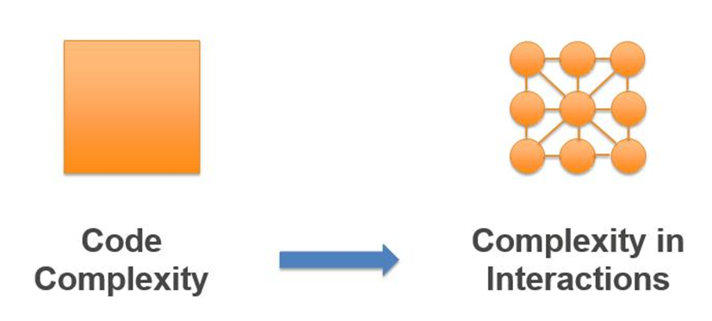
Complexity
Monolithic Applications vs Microservices
In monolithic architectures the complexity and the number of dependencies reside inside the code base, in microservices architectures complexity moves to the interactions of the individual services

Slide 9
Microservice Architecture
Service Oriented Architecture composed of loosely coupled elements that have bounded contexts
Service Oriented Architecture - Services communicate with each other over the network
Loosely Coupled Elements - You can update the services independently; updating one service doesn’t require changing any other services.
Bounded Contexts - Self-contained; you can update the code without knowing anything about the internals of other microservices

Slide 10
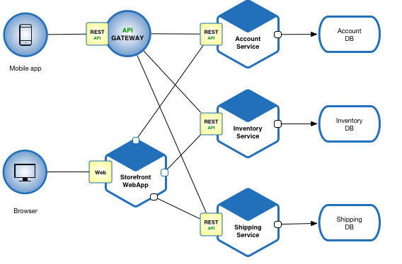
Microservice Architecture - e-commerce application

Slide 11
Benefits of Microservice Architecture
Enables the continuous delivery and deployment of large, complex applications.
Better testability – Smaller and faster services
Better deployability – Independent services
It enables you to organize the development effort around multiple, auto teams.
Each microservice is relatively small
Easier for a developer to understand
The IDE is faster making developers more productive
The application starts faster, which makes developers more productive.
Improved fault isolation. If there is a memory leak in one service then only that service will be affected.
Eliminates any long-term commitment to a technology stack.

Slide 12
Drawbacks of Microservice Architecture
Development Complexity:
Additional complexity of creating a distributed system.
Developer tools/IDEs are oriented on building monolithic applications
Testing is more difficult
Mandatory inter-service communication mechanism.
Distributed transaction
Careful coordination between the teams
Deployment complexity.
Complexity of deploying and
Managing a system comprised of many different service types.
Infrastructure complexity:
Increased memory consumption.
Dynamic changes in product

Slide 13
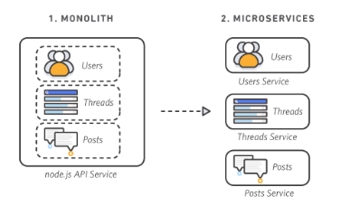
Breaking a monolithic application to microservices

Slide 14
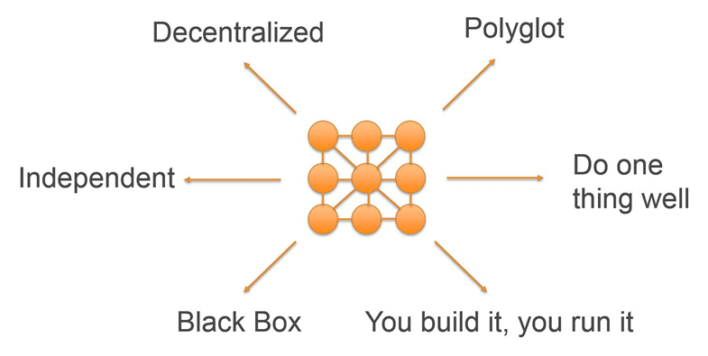
Characteristics of Microservices

Slide 15
THANK YOU !
Let us know how can we help your organization to Upskill the employees to stay updated in the ever-evolving IT Industry.
Get in touch:
www.zekeLabs.com | +91-8095465880 | info@zekeLabs.com
Visit : www.zekeLabs.com for more details

