Slide 1





|| Jai Sri Gurudev ||
Sri Adichunchanagiri Shikshana Trust ®
ADICHUNCHANAGIRI INSTITUTE OF TECHNOLOGY
(An ISO 9001 : 2008 Certified)
Affiliated to Visvesvaraya Technological University (VTU), Belagavi ,
Approved by AICTE, New Delhi , Jyothi Nagar, Chikkamagaluru – 577 102
A Data-Driven LinkedIn
Analysis
Presented By,
Prakul H N
5th semester student
Department of Artificial Intelligence and Machine Learning
Adichunchanagiri Institute of Technology, Chikkamagaluru
Under the Guidance of,
Dr. Sunitha M R
Head of the Department
Department of Artificial Intelligence and Machine Learning
Adichunchanagiri Institute of Technology, Chikkamagaluru

Slide 2
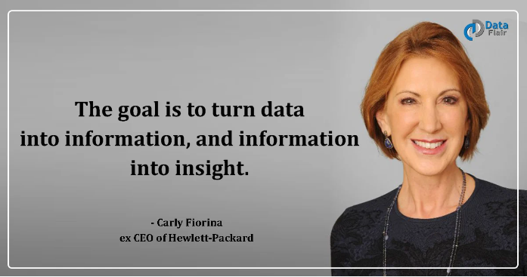

Slide 3
ABSTRACT
Purpose: To analyze the impact of LinkedIn on professional development and personal branding.
Methodology:
Data collection from LinkedIn profile
Data cleaning and preparation
Data analysis using Power BI
Results:
Insights into network growth, content performance, and demographic trends
Identification of strengths and weaknesses in LinkedIn usage
Conclusion:
Data-driven approach can enhance professional growth
Actionable insights for optimizing future networking strategies

Slide 4
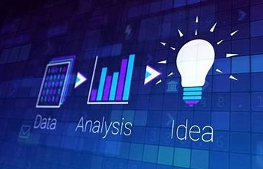
INTRODUCTION
With over 900 million users worldwide, LinkedIn offers a rich dataset to analyze professional trends and individual career trajectories. This mini-project aims to leverage Power BI to explore and visualize personal LinkedIn data, comparing it against industry benchmarks. By identifying strengths, weaknesses, and opportunities, the goal is to provide actionable insights for optimizing LinkedIn usage and career advancement.

Slide 5
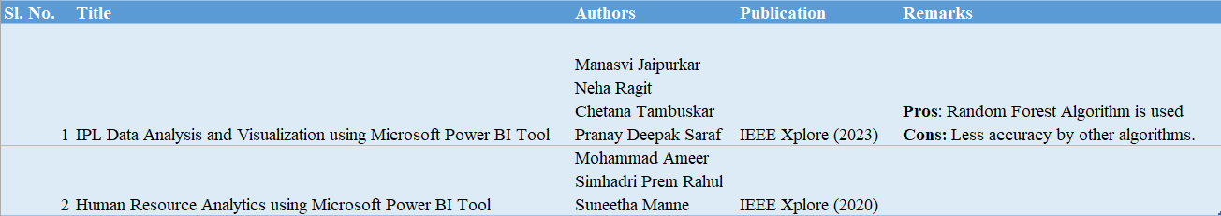
LITERATURE SURVEY

Slide 6
PROBLEM STATEMENT
INPUT: Collect LinkedIn profile data which typically includes information about connections, companies, invitations, reactions, and job role.
PREPROCESSING: It involves preparing the raw LinkedIn data for analysis. This typically includes the following steps:
• Data Extraction: Extracting the LinkedIn profile data, which will be performed through manually exporting the data.
• Data Cleaning: Removing any inconsistencies, errors, or missing values in the data.
• Data Transformation: Transforming the data into a format suitable for analysis.
OUTPUT: Develop a dynamic dashboard using Power BI which provides a visual representation of LinkedIn data, allowing to easily understand and analyze key metrics and trends.

Slide 7
OBJECTIVES
• Gain a comprehensive understanding of your LinkedIn network and professional activity.
• Identify key trends and patterns in your LinkedIn data.
• Gain insights into your professional brand and online presence.
• Identify potential networking opportunities.
• Make data-driven decisions to enhance your professional network

Slide 8
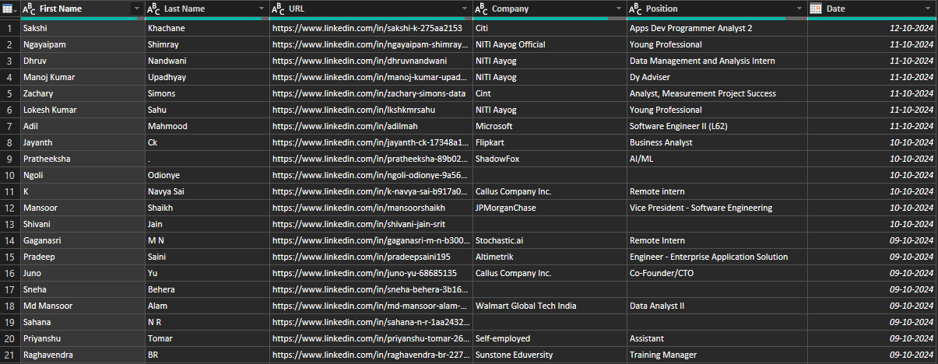
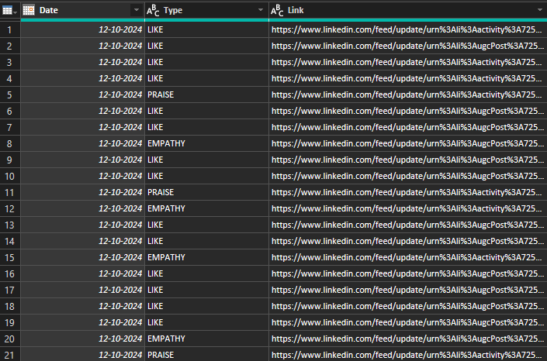
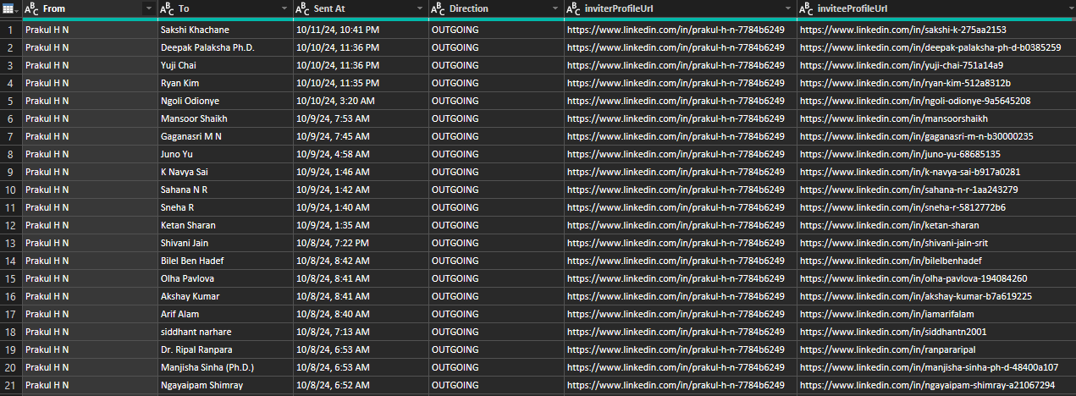
METHODOLOGY
Data Collection and Preparation:
• Data Extraction
• Data Cleaning and Formatting
• Data Transformation

Slide 9
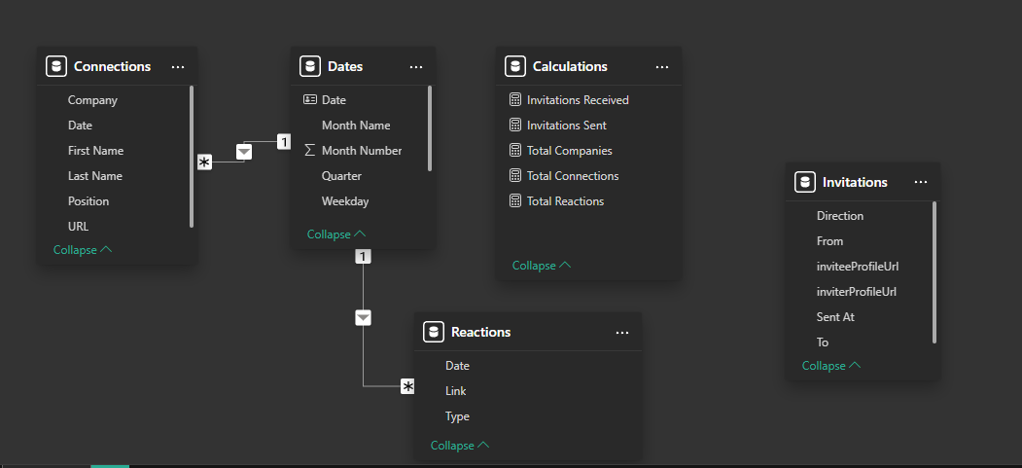
METHODOLOGY

Slide 10
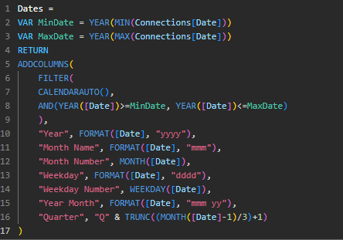

METHODOLOGY
Data Analysis and Visualization:
• Exploratory Data Analysis
• Key Performance Indicator (KPI) Definition
• Data Analysis Techniques
• Dashboard Creation
• Data Interpretation and Insights

Slide 11
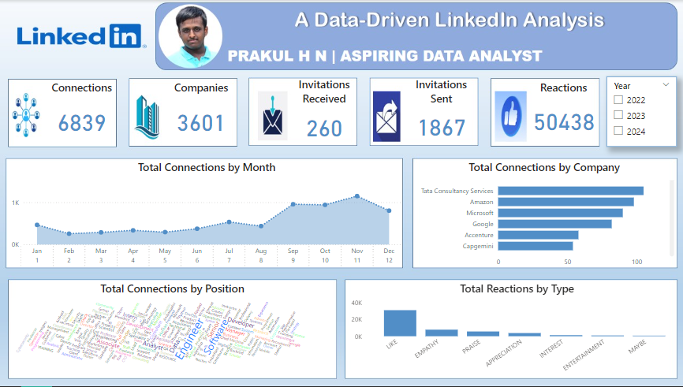
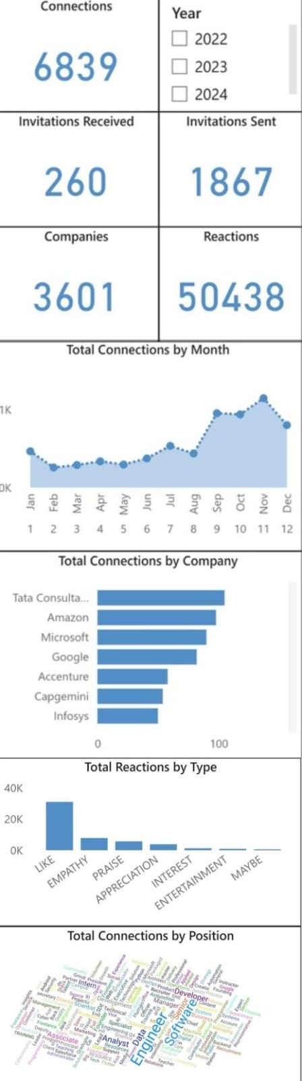
METHODOLOGY

Slide 12
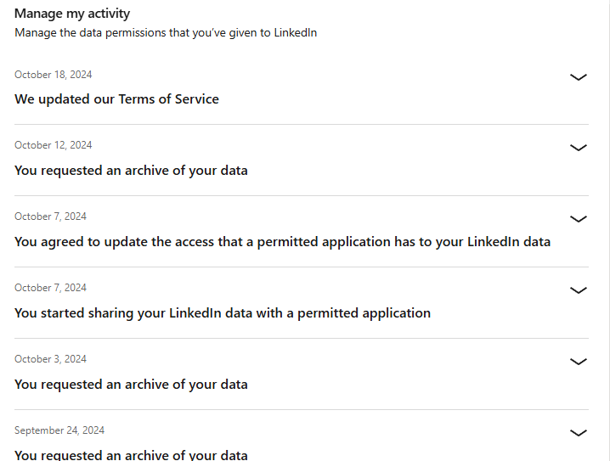
METHODOLOGY
Ethical Considerations:
• Data Privacy
• Consent
• Data Security

Slide 13
RESULTS AND DISCUSSIONS
Objective of Analysis:
This section provides a summary of what the analysis aimed to achieve using LinkedIn data. Investigate different parameters on LinkedIn.
Use Power BI to analyze, visualize, and generate insights from the data
Embed Code:
<iframe title="LinkedIn Analytics" width="600" height="373.5" src="https://app.powerbi.com/view?r=eyJrIjoiNGYzOTc3YTYtZDgyMi00NzFkLTk2NzAtNTM5OGVjM2MyODNhIiwidCI6ImI3MzM3ODVhLTZhNmYtNGY3My04MWJiLTBjMzRiOWE1MmVkOSJ9" frameborder="0" allowFullScreen="true"></iframe>

Slide 14
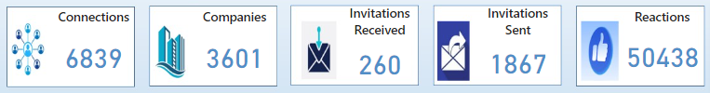

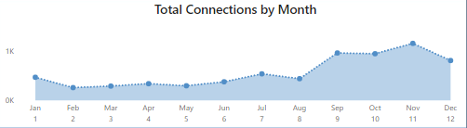
RESULTS AND DISCUSSIONS
Card Visuals
Slicer
Area Chart

Slide 15
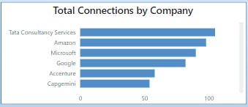
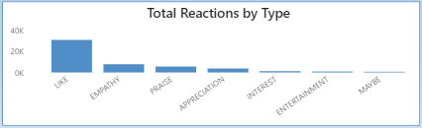
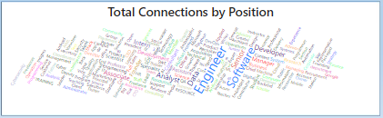
RESULTS AND DISCUSSIONS
Stacked Bar Chart
Stacked Column Chart
WordCloud 2.3.4.0

Slide 16
RESULTS AND DISCUSSIONS
Desktop View
Mobile View

Slide 17
CONCLUSION
The LinkedIn data analysis using Power BI provided valuable insights into various performance metrics, such as total connections, companies followed, and invitations sent and received. The dashboard offers a comprehensive view, including Year as a slicer for dynamic analysis, Month-over-Month (MoM) growth to track performance trends, and breakdowns like total connections by company and connections by position. Additionally, the total reactions given by type helped identify user engagement across different content types. The mobile-friendly view of the dashboard ensures that insights are easily accessible on the go, enabling quick decision-making.
With these features, the dashboard empowers users to track their LinkedIn activity in a detailed and insightful manner, facilitating targeted strategies for network growth and engagement. Ethical considerations, including data privacy and security, were carefully maintained throughout the analysis, ensuring compliance with LinkedIn's terms and safeguarding user data. This comprehensive analysis not only provides actionable insights but also offers a user-friendly, mobile-optimized tool for continuous performance tracking and improvement.

Slide 18
REFERENCES
[1] Manasvi Jaipurkar, Neha Ragit, Chetana Tambuskar, Pranay Deepak Saraf - IPL Data Analysis and Visualization using Microsoft Power BI Tool – IEEE Conference, New Delhi, India [2023]
[2] Mohammad Ameer, Simhadri Prem Rahul, Suneetha Manne - Human Resource Analytics using Microsoft Power BI Tool – IEEE Conference, Madurai, India [2020]
[3] Kamil M S, BI Consultant – LinkedIn Analytics in Power BI [2020]

Slide 19


