Slide 1





AI-Based Wood Quality Assessment
DAYANANDA SAGAR COLLEGE OF ENGINEERING
An Autonomous Institute Affiliated to VTU, Approved by AICTE & UGC
Accredited by National Assessment and Accreditation Council (NAAC) with ‘A’ Grade
Department of Computer Science and Business Systems
2
0
2
6
7th Semester Major Project: Final (100%) Presentation
Date: 23 October 2026
Time: 9Am Onwards
Under the Guidance of
Mrs. Aparna H D
Assistant Professor,
Department of CSBS,
Dayananda Sagar College Of Engineering, Bengaluru
GURUGUBELLI GAYATRI - 1DS23CB014
PRAKYAT PRAMOD SHETTY - 1DS23CB033
SAIPRASAD RAO - 1DS23CB041
YASTI ANIL KOTAK - 1DS23CB063

Slide 2
ORGANIZATION OF THE PRESENTATION
2
0
2
6
Abstract
Introduction
Literature Survey
Problem Statement
Objectives and Final Status
Methodology
Recap: Results at the 50% Review
System Design
Feedback Received and Actions Taken
Data Engineering and Expansion
Mathematical Model: Class Balancing, Box Fusion, Recoverability Index
How We Arrived at the Final Model
Results: 50% Review vs Final
Statistical and Grading Validation
Image Enhancement Study
Demonstration Application
Plan of Action
Conclusion and Future Work
References

Slide 3
ABSTRACT
Surface defects such as knots, cracks and resin pockets reduce the usable part of a wood board; manual grading is slow, subjective and inconsistent. The target application is high-value wood such as sandalwood.
We built an AI system that detects, classifies and localises surface defects on board images and turns them into a quality grade, a recoverable-area estimate and a value estimate.
At the 50% review, YOLO11m and YOLO11s reached 63.0 and 64.6 mAP50 over 8 classes on unseen boards, limited by scarce and imbalanced data.
Revised based on the feedback received: we expanded and engineered the data (20,276 images from 407 boards, synthetic class balancing) and built a mathematical model of class balancing and weighted box fusion with board-level statistical validation.
Result: 76.9 mAP50 on the same unseen test boards and 81.3 on 51 further unseen boards (from 64.6 at mid-term); the fusion gain is significant (95% CI +2.7 to +7.1).
Quality assessment: the Board Recoverability Index proposed by our guide, adapted to our images, matches annotation-based grades with weighted kappa 0.87; a web application shows defects, grade, recoverable area and value.
2
0
2
6

Slide 4
2
0
2
6
INTRODUCTION
Manual inspection of wood depends on human graders; fatigue and inter-inspector variation make results inconsistent, and throughput limits line speed.
Defects differ in severity: a live knot is cosmetic, a dead or missing knot weakens the board, a crack may make a section unusable. Grading needs the defect type and its location, not a yes/no answer.
One-stage detectors of the YOLO family find and classify small objects in real time, which suits a conveyor-mounted line-scan camera.
Our system returns every visible defect with class, position, size and confidence, grades each board with the Board Recoverability Index (A / B / C / Reject), and estimates its recoverable area and value.

Slide 5
  LITERATURE SURVEY
2
0
2
6
Author(s) | Year | Title of the Paper | Algorithm/ Technology used | Result | Drawbacks/Issues
Y. Fang, Y. Ma, S. Gao & J. Chen | 2026 | Recent Advances in Wood Surface Defect Inspection using Deep Learning | Recent Advances in Wood Surface Defect Inspection using Deep Learning | Comprehensive review; supports automated wood-defect inspection | Small datasets, poor generalisation & real-time deployment challenges
J. Zheng | 2026 | IEL-YOLO: A Low-Light Robust Wood Defect Detection Method Based on YOLOv11 | Image Enhancement + YOLOv11 | Improves defect visibility in low-light conditions; handles complex wood textures | Generalisation challenges; no multimodal integration
J. Qu, Y. Pang & Z. Wang | 2026 | WD-SEG: A Deep Learning Framework for Delicate and Accurate Wood Defect Segmentation | AFN + TFN + ICO + Deep Learning | Accurate defect segmentation; handles low contrast and reduces background interference | Noise sensitivity, feature ambiguity & real-time deployment challenges
J. Wang & S. Tang | 2026 | A Novel IWPT-VMD Denoising Method for Enhancing Air-Coupled Ultrasonic Detection of Wood Defects | IWPT + VMD + Ultrasonic Signal Processing | Reduces noise and improves signal quality and defect detection | Requires ultrasonic signals; limited AI integration and no multimodal fusion

Slide 6
  LITERATURE SURVEY
2
0
2
6
Author(s) | Year | Title of the Paper | Algorithm/ Technology used | Result | Drawbacks/ Issues
C. S. Erasmus, D. Drew & M. J. Booysen | 2026 | A Low-Cost Wireless Dendrometer and Digital Twin for Precision Forestry Applications | IoT + LoRaWAN + Digital Twin | Low-cost, scalable system enabling continuous monitoring | No wood-quality assessment; no harvest optimisation; limited data fusion
N. Perry et al. | 2026 | Towards Precision Forestry: A Systematic Review of Optimisation Methods for Individual-Tree Decisions in Forest Management | Heuristics, Mathematical Programming & Machine Learning | Supports optimal forest-management decisions across different objectives | Limited real-world implementation; disturbance risks not fully integrated; limited multi-scale planning
E. Z. Başkent, A. Bončina & J. G. Borges | 2026 | A Review and Conceptual Framework for a New Era of Forest Management Planning | Digital Twin, Monitoring, Simulation & Forecasting | Supports adaptive forest planning and integrates monitoring with forecasting | Limited ML implementation; no harvesting optimisation; no wood-quality assessment
J. Tan, H. Zhang, J. Yang, Y. Liu, D. Zheng & X. Liu | 2025 | ForestryBERT: Continual Learning Adapted to Forestry Text | BERT + NLP + Continual Learning | Provides domain-specific forestry knowledge management and adapts to continuously growing forestry text data | Catastrophic forgetting; limited application to wood-quality assessment; no defect-detection component

Slide 7
2
0
2
6
  PROBLEM STATEMENT
Manual wood quality inspection is time-consuming and subjective, and existing AI approaches mostly stop at detecting defects without a leakage-free evaluation or a path to usable-area estimation; this project therefore aims to develop an AI-based computer-vision system that detects, classifies and localises visible surface defects on wooden boards, evaluates the detector on boards it has never seen, and uses the detections to estimate the recoverable portion of each board.

Slide 8
2
0
2
6
  OBJECTIVES AND FINAL STATUS
Objective 1 (achieved): Annotated dataset of 4,000 line-scan images, 8 classes, 9,053 boxes, split by physical board with zero overlap, expanded to 20,276 images from 407 boards. Higher-resolution input (1280 px), CLAHE / denoising and copy-paste balancing of rare classes were all implemented and evaluated.
Objective 2 (achieved): Deep-learning framework for detection and localisation: reproducible preparation, balancing, training and evaluation scripts; 8-class YOLO11m / YOLO11s and 4-class YOLO11s models, each tested once on held-out boards.
Objective 3 (achieved): Recoverable-area estimation: the guide's Board Recoverability Index gives a damage score, recoverable area and grade per board; validated against annotation-based grades (weighted kappa 0.87); market value estimated from grade.
Objective 4 (achieved): Comparison with P, R, F1, mAP50, mAP50-95 and inference time at identical settings, plus our mathematical model: class-balancing rule, weighted box fusion, Wise-IoU loss, per-class thresholds and statistical validation.

Slide 9
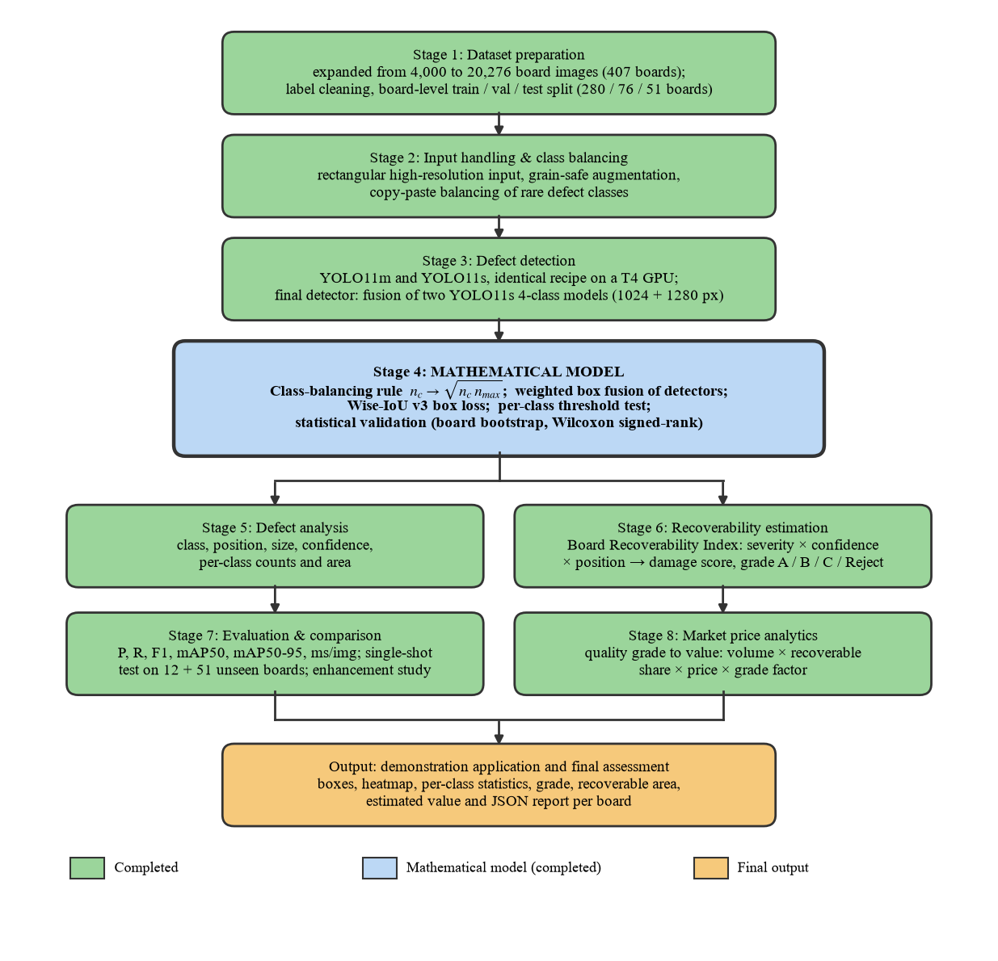
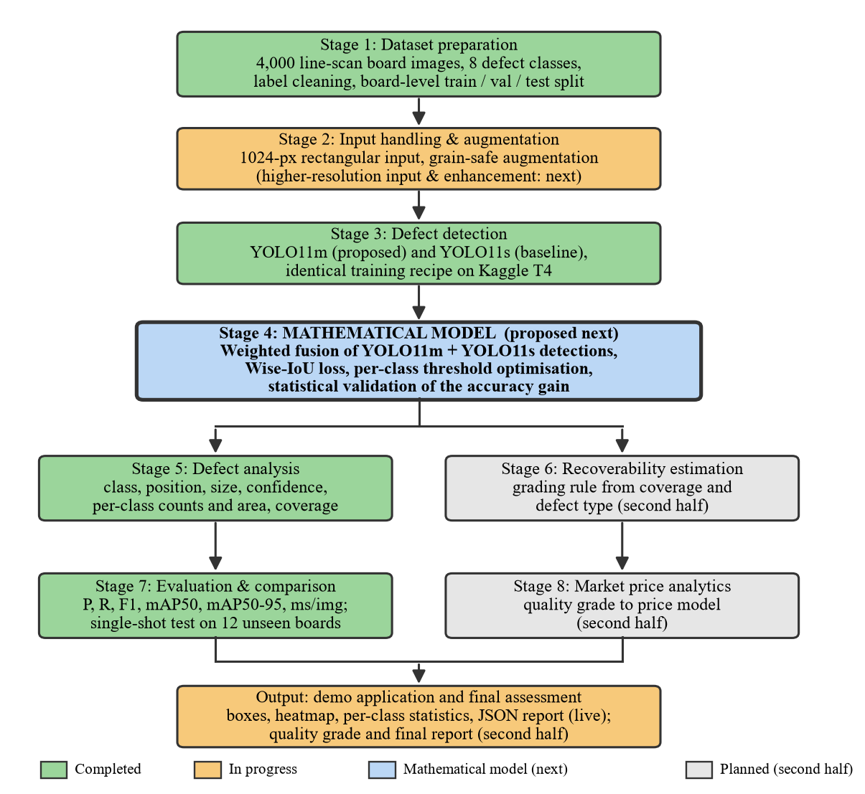
METHODOLOGY
2
0
2
6
Fig. Methodology as completed for the final review

Slide 10
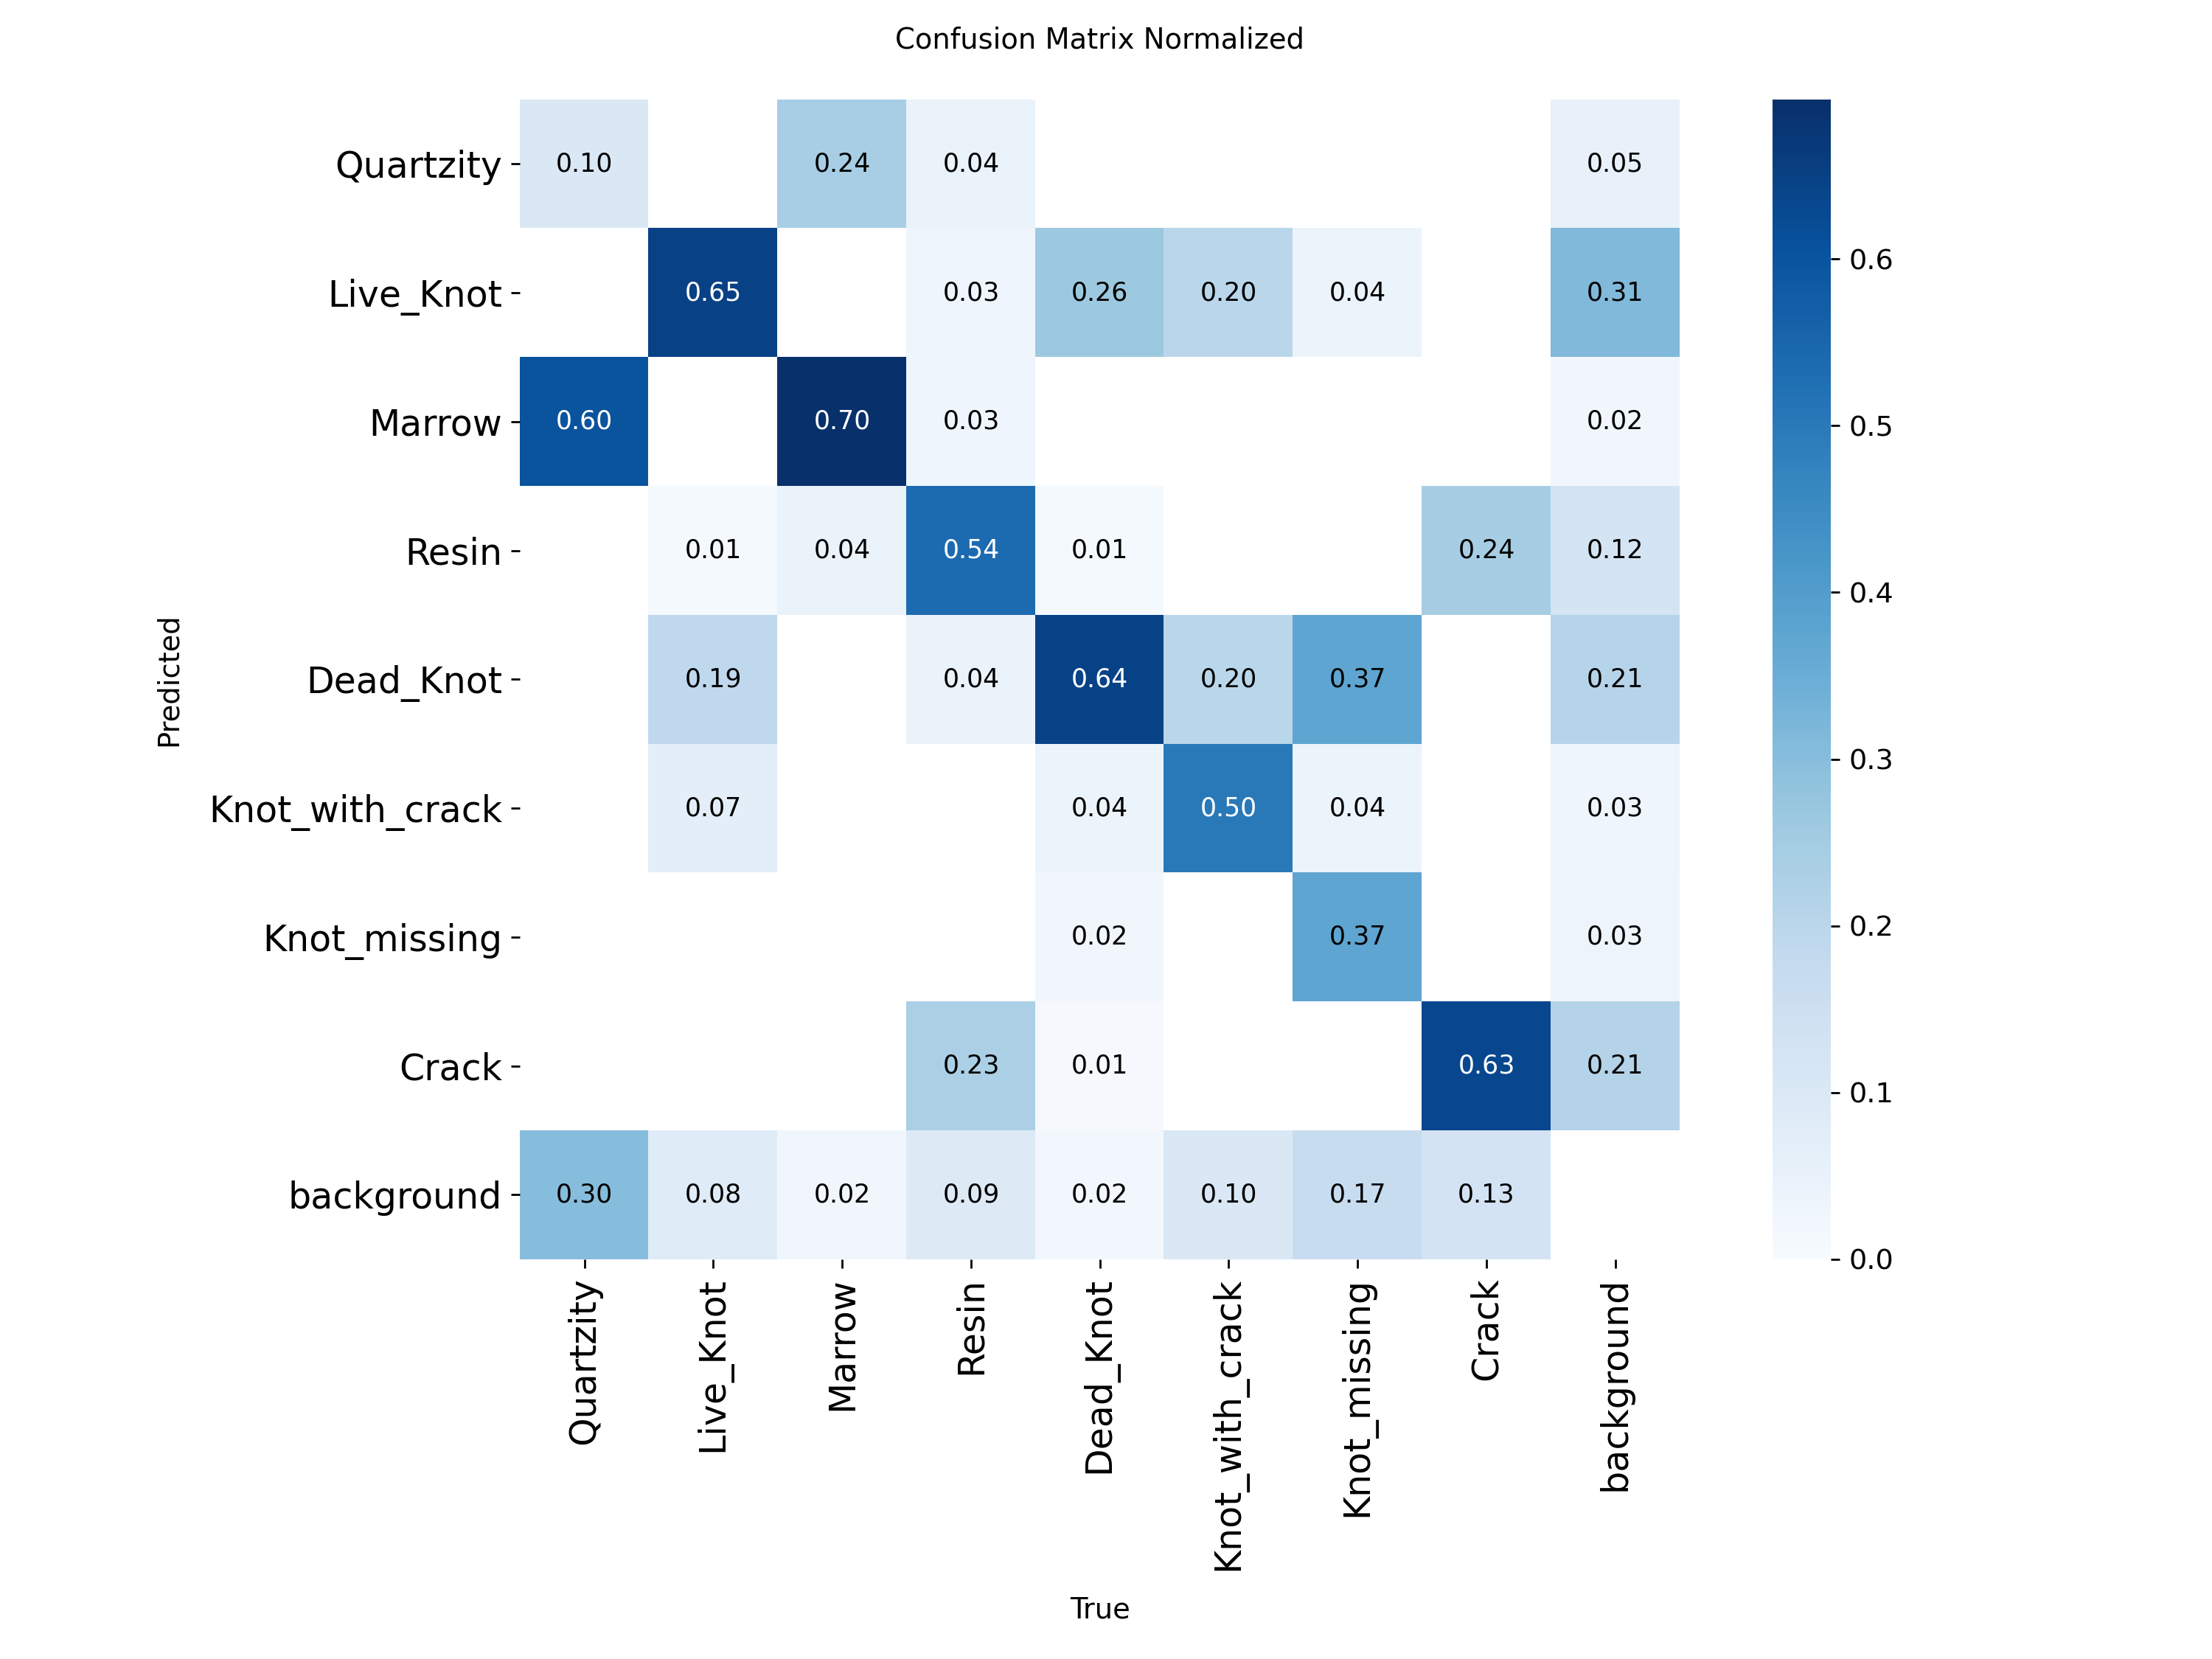
2
0
2
6
RECAP: RESULTS AT THE 50% REVIEW
Aspect | YOLO11m | YOLO11s | m - s
mAP50 | 63.0 | 64.6 | -1.6
mAP50-95 | 34.0 | 33.4 | +0.6
Precision | 63.4 | 71.0 | -7.6
Recall | 66.2 | 64.1 | +2.1
F1 | 64.7 | 67.4 | -2.7
Crack mAP50 / recall | 57.7 / 72.6 | 53.0 / 63.2 | +4.7 / +9.4
Inference, T4 | 33.2 ms (30 FPS) | 11.7 ms (86 FPS) | 2.8x slower
Training cost | 2.64 h | 1.43 h | 1.8x
Parameters | 20.0 M | 9.4 M | 2.1x
Test confusion matrix, YOLO11m
Clean evaluation: split by physical board (52 / 17 / 12 boards, zero overlap); the earlier 62.2 was inflated by boards shared between training and test.
Input: rectangular 1024-px input instead of 640 x 640 squares (63 % padding removed), grain-safe augmentation.
Result: YOLO11m and YOLO11s tied at 63-65 mAP50 over 8 classes; YOLO11s is 2.8x faster.
Conclusion at 50 %: model size is not the bottleneck; scarce and imbalanced data is. This set the plan for the second half.

Slide 11
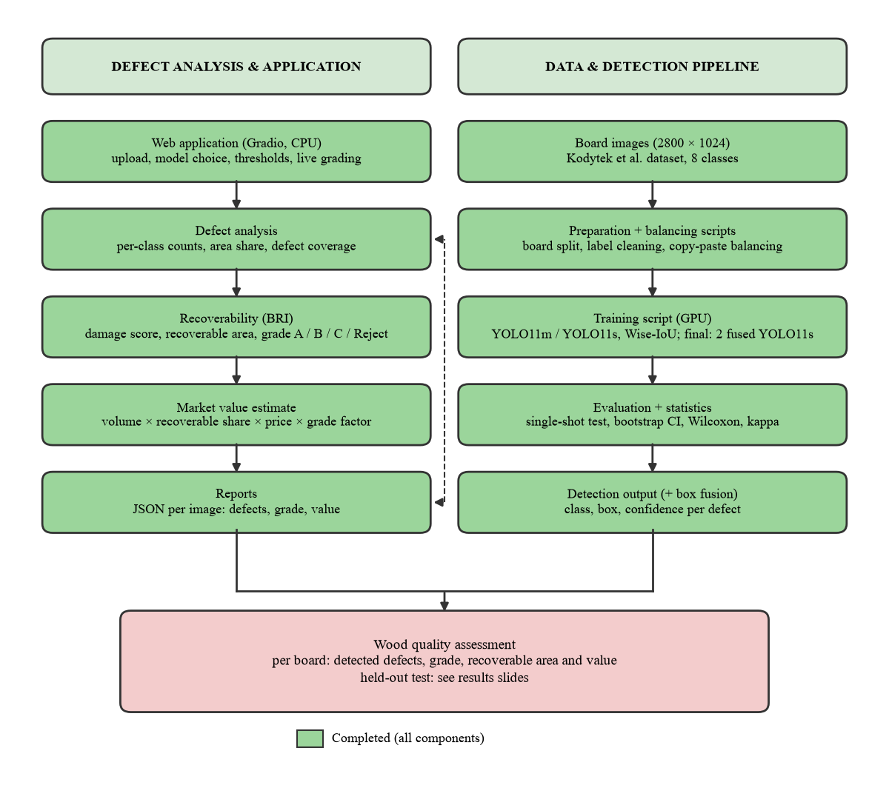
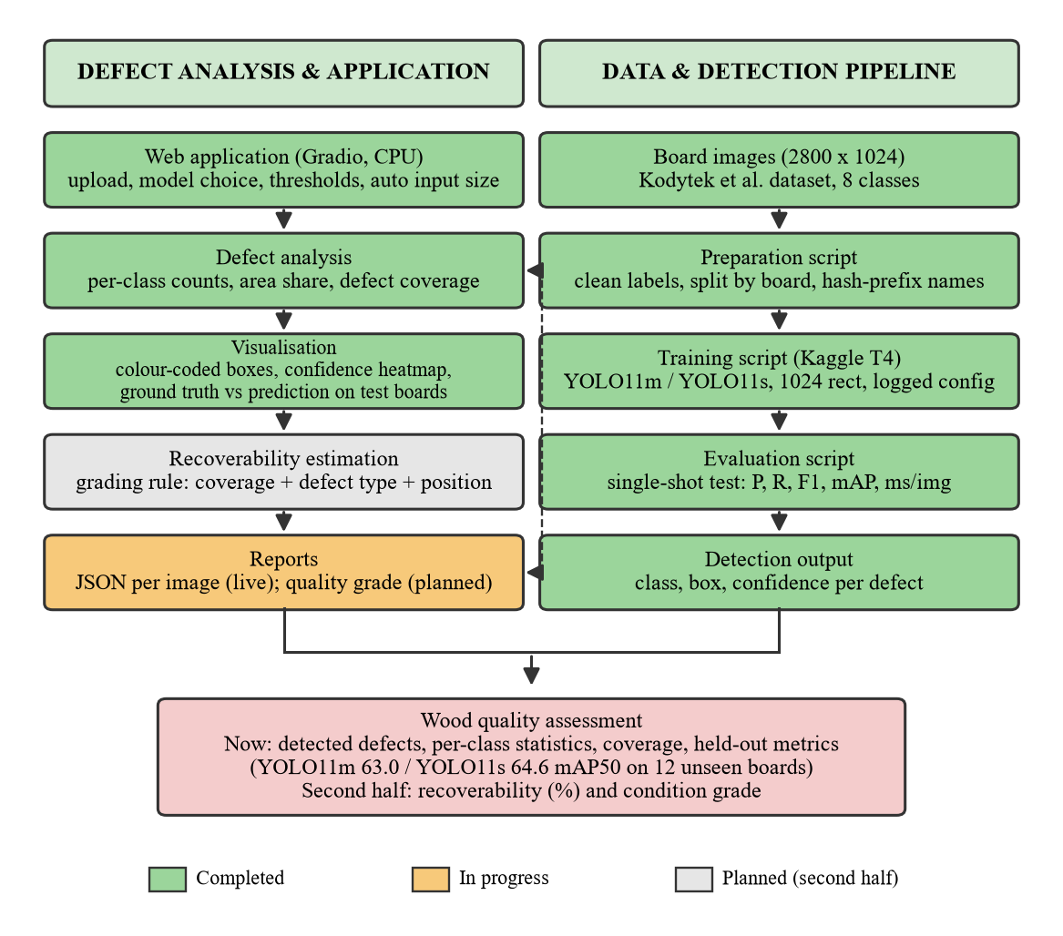
2
0
2
6
Fig. System design as implemented for the final review

Slide 12
FEEDBACK RECEIVED AND ACTIONS TAKEN
2
0
2
6
Feedback at the 50% review | What we did | Outcome
Improve accuracy with a mathematical model | Class-balancing rule, weighted box fusion, Wise-IoU, per-class thresholds, statistical tests | Fusion adopted: +2.7 to +7.1 mAP50 (95% CI)
Rare defect classes have too little data | Expanded to 20,276 images from 407 boards; synthetic copy-paste balancing | Crack training boxes 306 -> 4,612
Quality grade, not just detection | Implemented the guide's Board Recoverability Index, adapted and validated | Weighted kappa 0.87
Higher resolution, enhancement, CWB-style loss | 1280-px models, CLAHE / denoise / sharpen study, Wise-IoU v3 | Tested with intervals; kept only what helped
Show that results are reliable | Board-level bootstrap and Wilcoxon tests; multi-seed runs; single-shot tests | Every claim has a confidence interval
Usable end product | Web application with grade, recoverable area, value estimate and report | Runs on a laptop CPU, ~0.5 s per image
Feedback came from the guide and the review panel; every item was implemented and measured on boards never used for training or for any choice of settings.

Slide 13
DATA ENGINEERING AND EXPANSION
2
0
2
6
 | 50% review | Final
Images / physical boards | 4,000 / 81 | 20,276 / 407 (complete industrial release [12])
Boards train / val / test | 52 / 17 / 12 | 280 / 76 / 51 (original test boards kept fixed)
4-class training boxes incl. our synthetic copy-paste data | 7,502 | 36,165
Crack training boxes (rarest, most severe) | 942 | 4,612
mAP50 / mAP50-95 | Val, 714 original images | Test, 469 original images | Test, 51 further boards (2,488)
Four-model fusion (before expansion) | 78.1 / 39.2 | 74.7 / 36.7 | -
YOLO11s expanded data, 1024 px | 79.1 / 39.9 | 75.7 / 37.9 | 80.5 / 42.8
YOLO11s expanded data, 1280 px | 79.9 / 40.5 | 76.1 / 38.8 | 80.1 / 43.0
Fusion of the two (final detector) | 80.2 / 41.7 | 76.9 / 39.3 | 81.3 / 44.1
Our data work: verified the copy we trained on against the original archive (43,974 boxes identical), fixed label-format errors, removed zero-size boxes, generated grain-aware synthetic defects inside the board mask, and photographed wood surfaces on campus for real-world testing.
Why: rare classes limited accuracy at mid-term; sandalwood, the target, has no public labelled dataset, so the method is built to be species-independent.
Effect: +2.2 mAP50 on the same test boards (95% CI +0.5 to +4.3) with 2 models instead of 4; rule fixed before training (80.2 > 78.1 on validation).

Slide 14
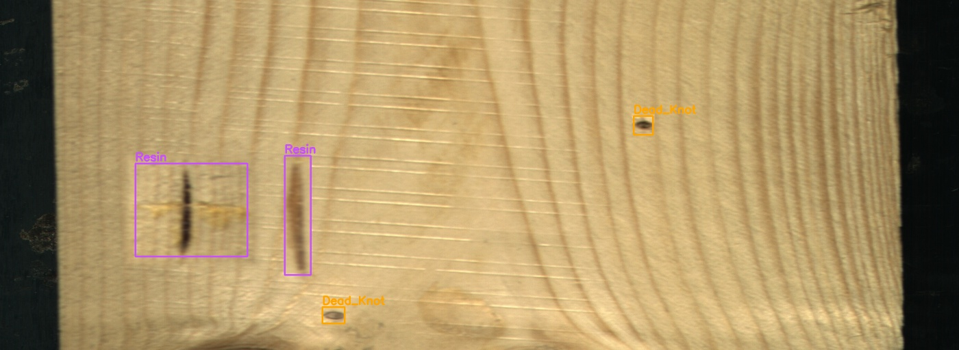
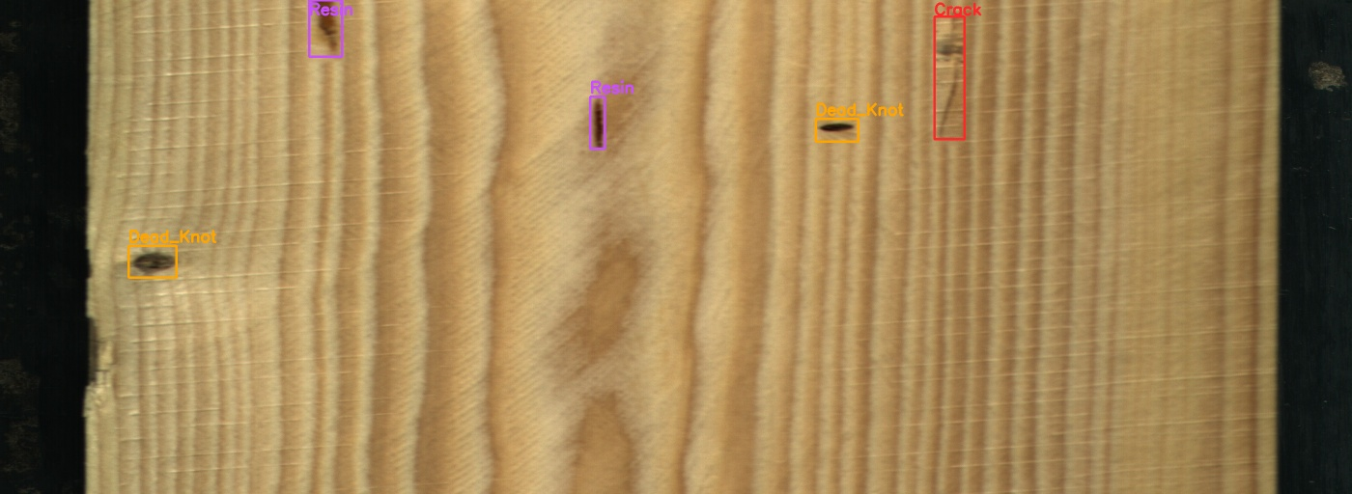
MATH MODEL I: CLASS BALANCING
2
0
2
6
Class | Training boxes | Full balance (1:1) | Partial balance sqrt(n_c n_max)
Live_Knot | 2899 | 2899 | 2899
Dead_Knot | 2071 | 3071 | 2470
Resin | 489 | 2899 | 1191
Crack | 306 | 2899 | 942
Imbalance max : min | 9.5 : 1 | 1.06 : 1 | 3.1 : 1
Rule: target boxes per class n_c* = n_max (full) or n_c* = sqrt(n_c x n_max) (partial, the repeat-factor rule of LVIS [15], same idea as the effective number of samples [14]).
Synthesis: real defect crops cut from training boards and pasted onto defect-free training boards (2-5 per image), only inside the board mask, no rotation, Poisson or feathered blending [16]; training split only.
Result: partial balance raised validation mAP50 from 73.1 to 75.3 but scored 69.2 on test vs 71.7 without balancing; difference not significant (95% CI -4.6 to +0.3).
Why full balance lost: only 160 cracks could be cut out cleanly, so each was pasted up to 17 times.

Slide 15
MATH MODEL II: FUSION AND LOSS
2
0
2
6
Component | Formula | Test result (chosen on validation)
Weighted box fusion [17] | b_f = sum(w c b) / sum(w c); c_f = (sum w c / sum w) x min(sum w, W) / W | YOLO11m + YOLO11s: mAP50 65.7, mAP50-95 36.1 (best single 64.6 / 33.7); mAP50-95 +1.6 to +3.2 (95% CI)
Wise-IoU v3 [18] | L = r x exp(d^2 / (W_g^2 + H_g^2)) x (1 - IoU); r = beta / (delta alpha^(beta - delta)) | val mAP50 74.6 vs 75.3 (CIoU); seed spread 0.8; adopted: no
Per-class thresholds | t_c = argmax_t F1_c(t) on validation | macro-F1 66.2 vs 66.9 with one global threshold: not adopted
Fusion of 4-class models | IoU 0.55, weights [2, 1, 1, 1] | val 78.1 vs best single 75.6; adopted, test 74.7 / 36.7
Fusion of the expanded-data models | IoU 0.65, weights [1, 1] | val 81.3 (full val); adopted, test 76.9 / 39.3 (12 boards), 81.3 / 44.1 (51 boards)
Fusion averages the boxes of several detectors weighted by confidence and lowers the confidence of boxes only one model finds. Fusing four 4-class YOLO11s models (1024 and 1280 px, with and without balancing) raised test mAP50 from 69.2 to 74.7.
Thresholds tuned per class over-fit the few validation boxes of Resin and Crack, so one global threshold is kept.
Every setting was chosen on the 17 validation boards; the 12 test boards were scored once.

Slide 16
HOW WE ARRIVED AT THE FINAL MODEL
2
0
2
6
Step (YOLO11s unless stated) | Val mAP50 | Test mAP50 | Decision and reason
8 classes, YOLO11m vs YOLO11s (50% review) | 65.7 / 65.3 | 63.0 / 64.6 | Tied: capacity is not the bottleneck
Fusion of YOLO11m + YOLO11s, 8 classes | - | 65.7 | mAP50-95 +2.4 (significant), still limited by rare classes
4 main classes, no balancing | 73.1 | 71.7 | Fair baseline for 4 classes: 69.6 (8-class model)
+ full balance 1:1 | 71.9 | not tested | Worse on validation: cracks pasted up to 17 times
+ partial balance sqrt(n_c n_max) | 75.3 | 69.2 | Best single on validation; kept as fusion member
+ 1280 px input | 74.6 | 71.6 | Not better alone; adds diversity for fusion
+ Wise-IoU v3 loss / 3 seeds | 74.6 | not tested | Within seed spread 0.8: not adopted
Fusion of four 4-class models | 78.1 | 74.7 | Significant gain: adopted
Same recipe on the expanded data, fused (final) | 80.2 | 76.9 | Rule 78.1 on val beaten: final, 2 models
Every decision was taken on validation boards by a rule written down before training; test boards were scored once per candidate.
What made the final model: balancing and higher resolution give diverse members, fusion combines them, and more data lifts every member.

Slide 17
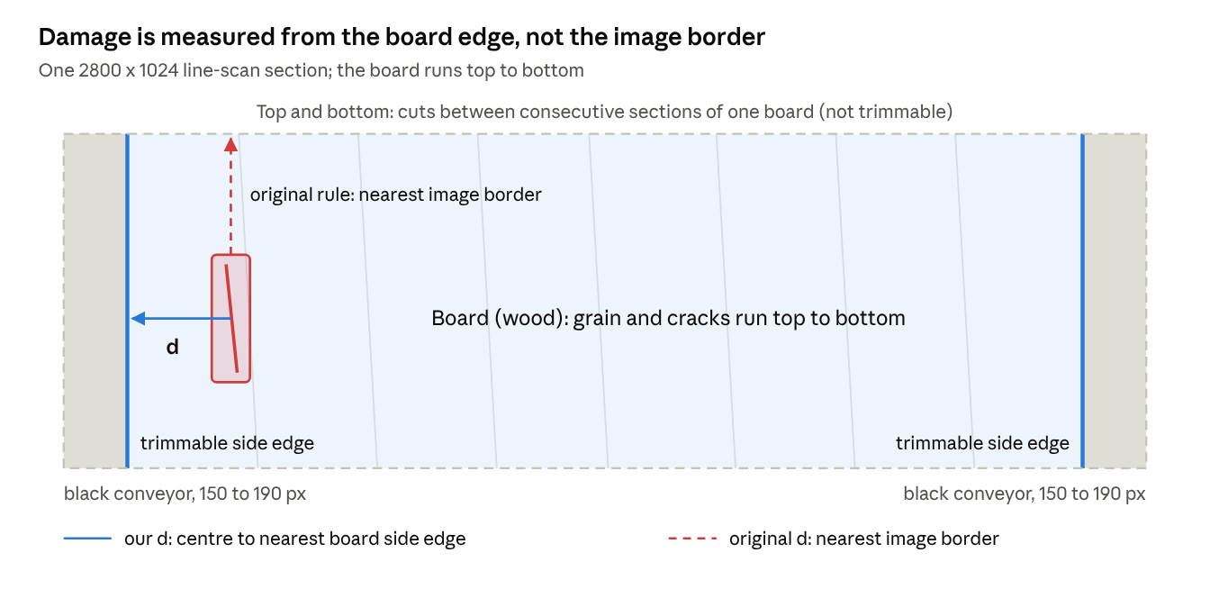
MATH MODEL III: RECOVERABILITY
2
0
2
6
1. Union of defects: A_def = |R_1 U ... U R_n| (overlaps counted once).
2. Severity: w_c: Crack 1.00, Dead_Knot 0.60, Live_Knot 0.40, Resin 0.30 (guide's placeholders).
3. Position: p_i = 1 - exp(-d_i / 250 px), d_i = distance to the board's side edge (our change).
4. Influence: s_i = w_c x conf_i x p_i.
5. Damage: I(x, y) = max_i s_i; DIS = sum I / A_board (board pixels, our change); A_rec = A_board (1 - DIS).
6. Grade: A / B / C / Reject from thresholds fitted on validation boards with the guide's weighted-kappa calibration.
Check: the guide's worked example is reproduced exactly (DIS 0.020860, grade B).

Slide 18
RESULTS: 50% REVIEW vs FINAL
2
0
2
6
Model | Classes | P | R | F1 | mAP50 | mAP50-95 | ms / img (T4) | Params
50% review: YOLO11m | 8 | 63.4 | 66.2 | 64.7 | 63.0 | 34.0 | 33.2 | 20.0 M
50% review: YOLO11s | 8 | 71.0 | 64.1 | 67.4 | 64.6 | 33.4 | 11.7 | 9.4 M
50% review YOLO11s, scored on the 4 classes | 4 | - | - | - | 69.6 | 32.9 | 11.7 | 9.4 M
YOLO11s 4 classes, partial balance | 4 | 74.8 | 69.4 | 72.0 | 69.2 | 33.1 | 11.7 | 9.4 M
Mathematical model: fusion of four 4-class models | 4 | - | - | - | 74.7 | 36.7 | ~60 | 37.7 M
Final: fusion of two models, expanded data | 4 | - | - | - | 76.9 | 39.3 | ~30 | 18.8 M
Final, on 51 further unseen boards | 4 | - | - | - | 81.3 | 44.1 | ~30 | 18.8 M
Class (test mAP50) | Test boxes | 50% review (YOLO11s) | Best single 4-class (P / R) | Single mAP50 | Final detector mAP50
Dead_Knot | 343 | 89.1 | 83.7 / 82.5 | 87.5 | 89.6
Live_Knot | 406 | 75.8 | 74.2 / 77.3 | 76.4 | 79.3
Resin | 69 | 60.4 | 84.7 / 58.0 | 64.2 | 76.6
Crack | 95 | 53.0 | 56.5 / 60.0 | 48.7 | 62.2
ALL (4 classes) | 913 | 69.6 | 74.8 / 69.4 | 69.2 | 76.9
Same 12 unseen test boards throughout: mAP50 64.6 at the 50% review (69.6 on the 4 main classes) -> 76.9 now; Crack 53.0 -> 62.2, Resin 60.4 -> 76.6.
Before the data expansion, only fusion beat the best single model (+2.7 to +7.1 mAP50, 95% CI). The final detector, trained on the expanded data, adds +2.2 on the same boards (CI +0.5 to +4.3) and scores 81.3 on 51 unseen boards.

Slide 19
STATISTICAL VALIDATION
2
0
2
6
Comparison (test, 12 boards) | mAP50 diff | 95% CI (board bootstrap) | Boards better / worse | Wilcoxon p
Final detector (expanded data) - four-model fusion | +2.2 | [+0.5, +4.3] | 8 / 4 | 0.30
Four-model fusion (4 cls) - best single 4-class model | +5.5 | [+2.7, +7.1] | 10 / 2 | 0.042
Fusion (YOLO11m + YOLO11s) - YOLO11s, mAP50 | +1.1 | [-0.5, +2.7] | 7 / 5 | 0.52
Fusion - YOLO11s, mAP50-95 | +2.4 | [+1.6, +3.2] | - | -
Partial balance - no balancing (4 cls) | -2.6 | [-4.6, +0.3] | 4 / 8 | 0.57
Partial balance - 8-class model (4 cls) | -0.4 | [-2.8, +1.9] | 5 / 7 | 0.73
No balancing - 8-class model (4 cls) | +2.2 | [-1.4, +4.4] | 6 / 6 | 0.62
Run-to-run spread (final setup, validation) | Value
Val mAP50, seeds 42 / 1 / 2 | 75.3 / 74.8 / 75.6
Spread (max - min) | 0.8
Board-level bootstrap: the 12 test boards are resampled 1,000 times with replacement, so the interval reflects board-to-board variation [20]; exact Wilcoxon signed-rank test on per-board AP50 differences [21].
Only the fusion and data-expansion gains have intervals that exclude zero; the four-model fusion is also significant by the Wilcoxon test. Differences of 2-3 mAP50 points between single models are within the noise of a 12-board test set.

Slide 20
GRADING VALIDATION (BRI)
2
0
2
6
Agreement with annotation-based grade | Per image (469) | Per board (12)
Exact grade | 78.3 % | 83.3 %
Within one grade | 97.4 % | 100.0 %
Quadratic weighted kappa [19] | 0.87 | 0.73
Spearman correlation of damage scores | 0.90 | 0.80
Mean abs. error, recoverable area | 0.40 pts | 0.36 pts
Reference \ Model | A | B | C | Reject
A (175) | 155 | 17 | 2 | 1
B (113) | 17 | 74 | 20 | 2
C (109) | 4 | 7 | 76 | 22
Reject (72) | 3 | 0 | 7 | 62
Reference grade = BRI on the annotators' boxes, thresholds at the 40th / 70th / 90th percentiles of validation damage scores (0.0020, 0.0062, 0.0179).
Model grade = BRI on the detector's boxes, thresholds fitted on validation with the guide's calibration (0.0012, 0.0032, 0.0099); test boards never used for fitting.
Next step agreed with the guide: blind expert grading of 30-50 boards to calibrate severity weights and thresholds.

Slide 21
IMAGE ENHANCEMENT STUDY (H1)
2
0
2
6
Condition (validation, mAP50) | Raw | CLAHE [22] | Denoise | Sharpen
Normal | 74.8 | 65.8 | 75.3 | 73.8
Low light | 50.0 | 27.7 | 48.0 | 49.3
Over-exposed | 58.2 | 47.9 | 58.2 | 57.7
Blur | 73.3 | 62.2 | 72.9 | 75.1
Noise | 67.8 | 56.5 | 73.0 | 57.0
Low contrast | 61.3 | 62.6 | 61.6 | 62.6
H1 rejected for raw images: CLAHE lowers mAP50 significantly in 5 of 6 conditions (Wilcoxon p <= 0.006); sharpening gives no significant gain.
Denoising helps only on noisy images: +3.2 to +7.2 mAP50 (95% CI), p = 0.006; recommended only for a noisy camera.
Imaging conditions matter more than enhancement: low light costs about 25 points, so controlled lighting is the main requirement for deployment.

Slide 22
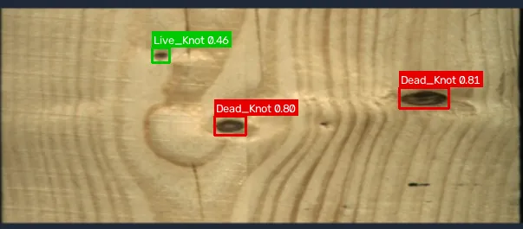
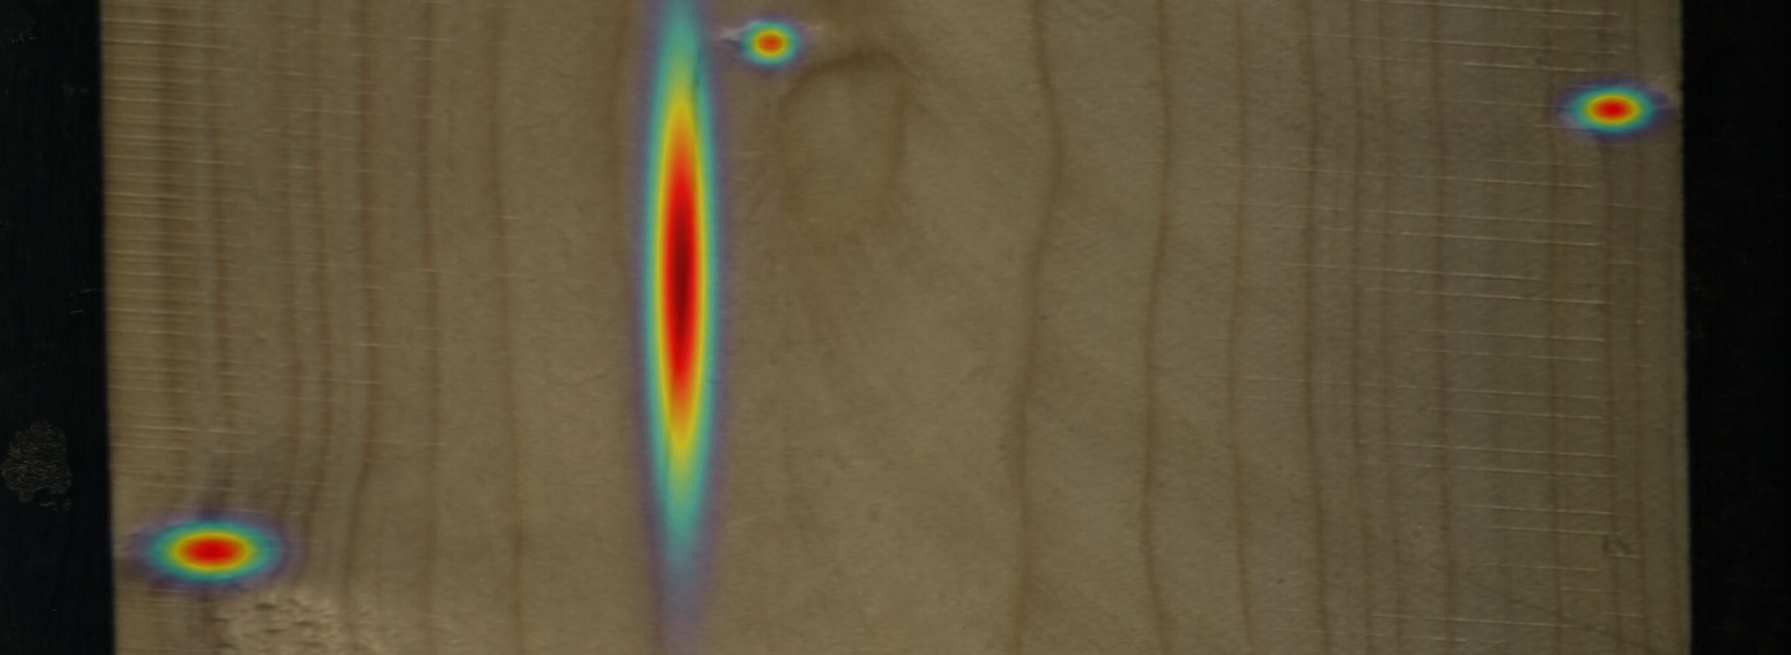
DEMONSTRATION APPLICATION
2
0
2
6
Detect: upload a board image; the final detector (fusion of two models) draws colour-coded boxes with class and confidence; defect heatmap; per-class counts and area.
Grade: Board Recoverability Index grade A / B / C / Reject with the damage score and the cut-offs it is compared to; recoverable area.
Compare: on the unseen test boards, the annotators' boxes and grade are shown next to the model's.
Value (add-on): illustrative estimate = volume x recoverable share x grade-A price x grade factor; all inputs editable.
Report and deployment: downloadable JSON report per image; runs on a laptop CPU, about 0.5 s per image; earlier models selectable for comparison.
Validated components: detection (single-shot test), grading (weighted kappa), enhancement (study on validation).
Limitations: 12-board original test set (plus 51 boards on the expanded data); severity weights and grade thresholds await expert calibration; trained on controlled line-scan imagery.

Slide 23
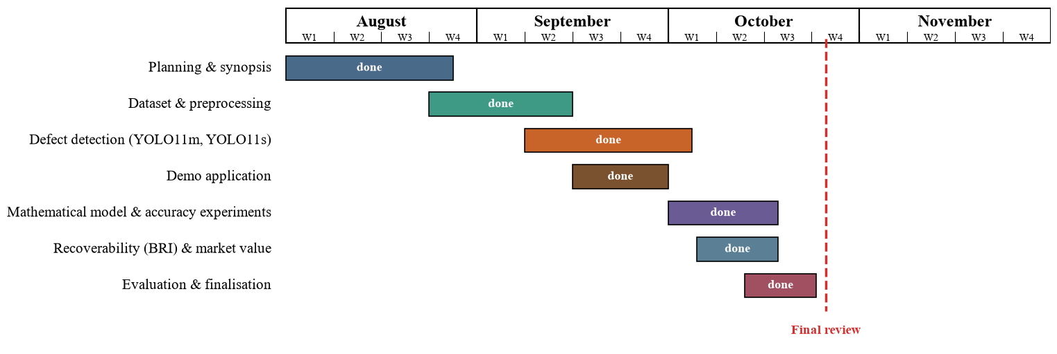
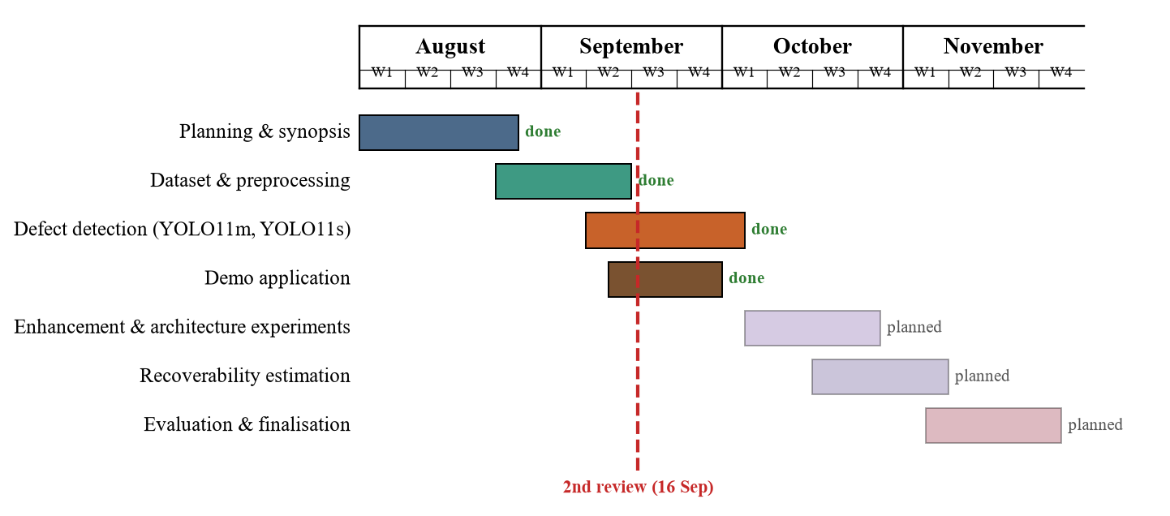
PLAN OF ACTION: COMPLETED
2
0
2
6
All planned work is complete: dataset and preprocessing, defect detection, the mathematical model and accuracy experiments, recoverability estimation and market value, evaluation, application and report.

Slide 24
CONCLUSION AND FUTURE WORK
2
0
2
6
Clean evaluation: a board-level split and rectangular high-resolution input give a reproducible baseline of 63-65 mAP50 over 8 classes on 12 unseen boards; YOLO11s matches YOLO11m at 2.8x the speed.
Mathematical model: weighted box fusion of four balanced / high-resolution YOLO11s models raises test mAP50 from 69.2 to 74.7 (significant, 10 of 12 boards better); balancing or 1280 px alone, Wise-IoU and per-class thresholds gave no significant gain.
Data engineering: the same recipe on the expanded 20,276-image data lifts the final detector to 76.9 mAP50 on the original test boards (+2.2, CI excludes zero) and 81.3 / 44.1 on 51 unseen boards; Crack reaches 67.4.
Quality assessment: the guide's Board Recoverability Index, adapted to line-scan geometry, reproduces annotation-based grades (weighted kappa 0.87 per image with the deployed detector) and drives a market-value estimate.
Deliverable: a CPU web application that shows defects, grade, recoverable area and value for an uploaded board image.
Future work: sandalwood: collect and label sandalwood board images and retrain (the pipeline is species-independent); blind expert grading to calibrate severity weights and thresholds; k-fold validation over boards; more rare-class data; segmentation masks for tighter defect area; CondConv / BiFormer (full CWB) architecture; plywood images and field cameras.

Slide 25
REFERENCES
[1] Y. Fang, Y. Ma, S. Gao, and J. Chen, “Recent advances in wood surface defect inspection using deep learning (2021–2025),” BioResources, vol. 21, no. 3, 2026. https://bioresources.cnr.ncsu.edu/resources/recent-advances-in-wood-surface-defect-inspection-using-deep-learning-2021-2025/ (BioResources)
[2] J. Zheng, “IEL-YOLO: A low-light robust wood defect detection method based on YOLOv11,” in Proc. 2026 3rd Int. Conf. Electrical Technology and Automation Engineering (ETAE), 2026, pp. 818–821, doi: 10.1109/ETAE69474.2026.11496073. https://doi.org/10.1109/ETAE69474.2026.11496073 (ResearchGate)
[3] J. Qu, Y. Pang, and Z. Wang, “WD-SEG: A deep learning framework for delicate and accurate wood defect segmentation,” BioResources, vol. 21, no. 2, pp. 2925–2947, 2026. https://bioresources.cnr.ncsu.edu/resources/wd-seg-a-deep-learning-framework-for-delicate-and-accurate-wood-defect-segmentation/ (BioResources)
[4] J. Wang and S. Tang, “A novel IWPT-VMD denoising method for enhancing air-coupled ultrasonic detection of wood defects,” AIP Advances, vol. 16, no. 2, Art. no. 025217, 2026, doi: 10.1063/5.0313821. https://doi.org/10.1063/5.0313821 (ResearchGate)
[5] C. S. Erasmus, D. M. Drew, and M. J. Booysen, “A low-cost wireless dendrometer and digital twin for precision forestry applications,” Measurement, vol. 276, Art. no. 121442, 2026, doi: 10.1016/j.measurement.2026.121442. https://doi.org/10.1016/j.measurement.2026.121442 (ScienceDirect)
[6] N. Perry, J. Schweier, L. G. Bont, S. K. Kushwaha, H. Peltola, K. Eyvindson, R. Astrup, M. Chapman, and C. Blattert, “Towards precision forestry: A systematic review of optimisation methods for individual-tree decisions in forest management,” Trees, Forests and People, vol. 24, Art. no. 101226, 2026, doi: 10.1016/j.tfp.2026.101226. https://doi.org/10.1016/j.tfp.2026.101226 (ScienceDirect)
2
0
2
6

Slide 26
REFERENCES
[7] E. Z. Başkent, A. Bončina, and J. G. Borges, “A review and conceptual framework for a new era of forest management planning: Integrating hybrid digital twin systems toward sustainable forest ecosystems,” Ecosystem Services, vol. 79, Art. no. 101851, 2026, doi: 10.1016/j.ecoser.2026.101851. https://doi.org/10.1016/j.ecoser.2026.101851 (ScienceDirect)
[8] J. Tan, H. Zhang, J. Yang, Y. Liu, D. Zheng, and X. Liu, “ForestryBERT: A pre-trained language model with continual learning adapted to changing forestry text,” Knowledge-Based Systems, vol. 320, Art. no. 113706, 2025, doi: 10.1016/j.knosys.2025.113706. https://doi.org/10.1016/j.knosys.2025.113706 (ScienceDirect)
[9] T. I. Zohdi, “A machine-learning enabled digital-twin framework for next generation precision agriculture and forestry,” Computer Methods in Applied Mechanics and Engineering, vol. 431, Art. no. 117250, 2024, doi: 10.1016/j.cma.2024.117250. https://doi.org/10.1016/j.cma.2024.117250 (ScienceDirect)
[10] H. An, Z. Liang, M. Qin, Y. Huang, F. Xiong, and G. Zeng, “Wood defect detection based on the CWB-YOLOv8 algorithm,” Journal of Wood Science, vol. 70, Art. no. 26, 2024, doi: 10.1186/s10086-024-02139-z. https://doi.org/10.1186/s10086-024-02139-z (Springer)
[11] L. P. Yi, M. F. Akbar, M. N. A. Wahab, B. A. Rosdi, M. A. Fauthan, and N. H. M. M. Shrifan, “The prospect of artificial intelligence-based wood surface inspection: A review,” IEEE Access, vol. 12, pp. 84706–84725, 2024, doi: 10.1109/ACCESS.2024.3412928. https://doi.org/10.1109/ACCESS.2024.3412928 (Ouci)
2
0
2
6

Slide 27
REFERENCES (contd.)
[12] P. Kodytek, A. Bodzas, and P. Bilik, “A large-scale image dataset of wood surface defects for automated vision-based quality control processes,” F1000Research, vol. 10, p. 581, 2022, doi: 10.12688/f1000research.52903.2.
[13] G. Jocher and J. Qiu, “Ultralytics YOLO11,” version 11.0.0, 2024. [Online]. Available: https://github.com/ultralytics/ultralytics
[14] Y. Cui, M. Jia, T.-Y. Lin, Y. Song, and S. Belongie, “Class-balanced loss based on effective number of samples,” in Proc. IEEE/CVF CVPR, 2019, pp. 9268–9277.
[15] A. Gupta, P. Dollár, and R. Girshick, “LVIS: A dataset for large vocabulary instance segmentation,” in Proc. IEEE/CVF CVPR, 2019, pp. 5356–5364.
[16] D. Dwibedi, I. Misra, and M. Hebert, “Cut, paste and learn: Surprisingly easy synthesis for instance detection,” in Proc. IEEE ICCV, 2017, pp. 1301–1310.
[17] R. Solovyev, W. Wang, and T. Gabruseva, “Weighted boxes fusion: Ensembling boxes from different object detection models,” Image and Vision Computing, vol. 107, Art. no. 104117, 2021.
[18] Z. Tong, Y. Chen, Z. Xu, and R. Yu, “Wise-IoU: Bounding box regression loss with dynamic focusing mechanism,” arXiv:2301.10051, 2023.
[19] J. Cohen, “Weighted kappa: Nominal scale agreement provision for scaled disagreement or partial credit,” Psychological Bulletin, vol. 70, no. 4, pp. 213–220, 1968.
[20] B. Efron and R. J. Tibshirani, An Introduction to the Bootstrap. New York, NY, USA: Chapman & Hall, 1993.
[21] F. Wilcoxon, “Individual comparisons by ranking methods,” Biometrics Bulletin, vol. 1, no. 6, pp. 80–83, 1945.
[22] K. Zuiderveld, “Contrast limited adaptive histogram equalization,” in Graphics Gems IV, P. S. Heckbert, Ed. San Diego, CA, USA: Academic Press, 1994, pp. 474–485.
2
0
2
6

Slide 28
2
0
2
6
Thank You

