Slide 1





AI-Based Wood Quality Assessment
DAYANANDA SAGAR COLLEGE OF ENGINEERING
An Autonomous Institute Affiliated to VTU, Approved by AICTE & UGC
Accredited by National Assessment and Accreditation Council (NAAC) with ‘A’ Grade
Department of Computer Science and Business Systems
2
0
2
6
7th Semester Major Project: 50% Completion Presentation
Date: 16th September 2026
Under the Guidance of
Mrs. Aparna H D
Assistant Professor,
Department of CSBS,
Dayananda Sagar College Of Engineering, Bengaluru
GURUGUBELLI GAYATRI - 1DS23CB014
PRAKYAT PRAMOD SHETTY - 1DS23CB033
SAIPRASAD RAO - 1DS23CB041
YASTI ANIL KOTAK - 1DS23CB063

Slide 2
ORGANIZATION OF THE PRESENTATION
2
0
2
6
Abstract
Introduction
Literature Survey
Problem Statement
Objectives and Status at 50%
Methodology (as implemented)
Dataset and Board-level Split
System Design and Implementation
Results: Training Runs
Plan of Action: Progress
Results: Held-out Test
Model Comparison
Demonstration Application and Remaining Work
References

Slide 3
ABSTRACT
Surface defects such as knots, cracks, resin pockets and pith lines reduce the usable portion of sawn timber; manual grading is slow, subjective and inconsistent at scale.
The project builds an AI-based computer-vision system that detects, classifies and localises visible defects on board images as the basis for automated quality assessment and usable-area estimation.
In the first half we prepared a leakage-free dataset of 4,000 industrial line-scan images (8 defect classes) split by physical board, and trained YOLO11m and YOLO11s under identical, logged settings on Kaggle GPUs.
On 12 boards never seen in training, both models reach 63 to 65 mAP50 and 33 to 34 mAP50-95, above 85 mAP50 on the main knot classes, at 30 to 86 frames per second on a Tesla T4.
A demonstration web application with bounding boxes, defect heatmaps, per-class statistics and JSON reports is ready; recoverability estimation, image enhancement and architectural experiments form the second half.
2
0
2
6

Slide 4
2
0
2
6
INTRODUCTION
Manual inspection of timber depends on human graders; fatigue and inter-inspector variation make results inconsistent, and throughput limits line speed.
Defects differ in severity: a live knot is cosmetic, a dead or missing knot weakens the board, a crack may make a section unusable. Grading needs the defect type and its location, not a yes/no answer.
One-stage detectors of the YOLO family find and classify small objects in real time, which suits a conveyor-mounted line-scan camera.
Our system returns every visible defect with class, position, size and confidence, summarises defect coverage per board, and is designed to feed a recoverability estimate in the second half.

Slide 5
  LITERATURE SURVEY
2
0
2
6
Author(s) | Year | Title of the Paper | Algorithm/ Technology used | Result | Drawbacks/Issues
Y. Fang, Y. Ma, S. Gao & J. Chen | 2026 | Recent Advances in Wood Surface Defect Inspection using Deep Learning | Recent Advances in Wood Surface Defect Inspection using Deep Learning | Comprehensive review; supports automated wood-defect inspection | Small datasets, poor generalisation & real-time deployment challenges
J. Zheng | 2026 | IEL-YOLO: A Low-Light Robust Wood Defect Detection Method Based on YOLOv11 | Image Enhancement + YOLOv11 | Improves defect visibility in low-light conditions; handles complex wood textures | Generalisation challenges; no multimodal integration
J. Qu, Y. Pang & Z. Wang | 2026 | WD-SEG: A Deep Learning Framework for Delicate and Accurate Wood Defect Segmentation | AFN + TFN + ICO + Deep Learning | Accurate defect segmentation; handles low contrast and reduces background interference | Noise sensitivity, feature ambiguity & real-time deployment challenges
J. Wang & S. Tang | 2026 | A Novel IWPT-VMD Denoising Method for Enhancing Air-Coupled Ultrasonic Detection of Wood Defects | IWPT + VMD + Ultrasonic Signal Processing | Reduces noise and improves signal quality and defect detection | Requires ultrasonic signals; limited AI integration and no multimodal fusion

Slide 6
  LITERATURE SURVEY
2
0
2
6
Author(s) | Year | Title of the Paper | Algorithm/ Technology used | Result | Drawbacks/ Issues
C. S. Erasmus, D. Drew & M. J. Booysen | 2026 | A Low-Cost Wireless Dendrometer and Digital Twin for Precision Forestry Applications | IoT + LoRaWAN + Digital Twin | Low-cost, scalable system enabling continuous monitoring | No wood-quality assessment; no harvest optimisation; limited data fusion
N. Perry et al. | 2026 | Towards Precision Forestry: A Systematic Review of Optimisation Methods for Individual-Tree Decisions in Forest Management | Heuristics, Mathematical Programming & Machine Learning | Supports optimal forest-management decisions across different objectives | Limited real-world implementation; disturbance risks not fully integrated; limited multi-scale planning
E. Z. Başkent, A. Bončina & J. G. Borges | 2026 | A Review and Conceptual Framework for a New Era of Forest Management Planning | Digital Twin, Monitoring, Simulation & Forecasting | Supports adaptive forest planning and integrates monitoring with forecasting | Limited ML implementation; no harvesting optimisation; no timber-quality assessment
J. Tan, H. Zhang, J. Yang, Y. Liu, D. Zheng & X. Liu | 2025 | ForestryBERT: Continual Learning Adapted to Forestry Text | BERT + NLP + Continual Learning | Provides domain-specific forestry knowledge management and adapts to continuously growing forestry text data | Catastrophic forgetting; limited application to wood-quality assessment; no defect-detection component

Slide 7
2
0
2
6
  PROBLEM STATEMENT
Manual wood quality inspection is time-consuming and subjective, and existing AI approaches mostly stop at detecting defects without a leakage-free evaluation or a path to usable-area estimation.
The project aims to develop an AI-based computer-vision system that detects, classifies and localises visible surface defects on timber boards, evaluates the detector on boards it has never seen, and uses the detections to estimate the recoverable portion of each board.

Slide 8
2
0
2
6
  OBJECTIVES AND STATUS AT 50%
Objective 1 (done, enhancement pending): a well-annotated dataset: 4,000 line-scan board images, 8 classes, 9,053 boxes after cleaning, split by physical board with zero overlap.
Objective 2 (done): a deep-learning framework for detecting and localising defects: reproducible preparation, training and evaluation scripts; YOLO11m and YOLO11s trained and evaluated on held-out boards.
Objective 3 (started): recoverable-area estimation: per-defect area and per-board defect coverage are computed in the application; the grading rule is second-half work.
Objective 4 (done for two models): comparison with precision, recall, F1, mAP50, mAP50-95 and inference time at identical data and settings.

Slide 9
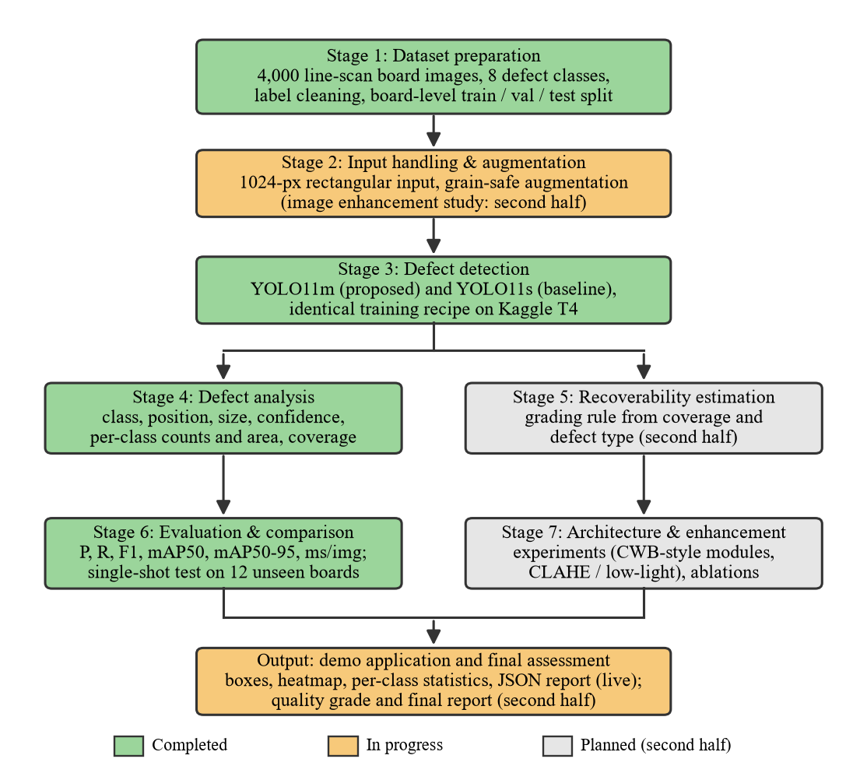
METHODOLOGY
2
0
2
6
Fig. Methodology with completion status at the 50% review

Slide 10
METHODOLOGY
2
0
2
6
Dataset preparation. Public industrial line-scan dataset; label cleaning; class mapping verified; group-stratified split by board id (52 / 17 / 12 boards).
Input handling. Boards are 2800 x 1024 (2.73:1); training and inference at 1024 px with rectangular batches (1024 x 384 effective) keep thin defects resolvable.
Detection. Ultralytics YOLO11 fine-tuned from COCO: YOLO11m as proposed model, YOLO11s trained with the identical recipe as baseline.
Grain-aware augmentation. Horizontal flip, mild translation, scale and colour jitter; no rotation or vertical flip; no random erasing of small regions.
Evaluation protocol. Model selection on validation boards only; test boards evaluated exactly once per model: P, R, F1, mAP50, mAP50-95, ms per image.
Defect analysis and application. Per-defect class, box, size and confidence; per-class counts and area; defect coverage; heatmap; JSON report; web application.

Slide 11
DATASET AND BOARD-LEVEL SPLIT
2
0
2
6
Source: Kodytek, Bodzas and Bilik (2022), F1000Research 10:581; 4,000-image Kaggle subset, 2800 x 1024 line-scan strips, YOLO boxes, CC BY 4.0.
Content: 9,053 boxes after removing 158 zero-size labels; 388 background images (9.7%); 81 physical boards; 8 classes: Quartzity, Live_Knot, Marrow, Resin, Dead_Knot, Knot_with_crack, Knot_missing, Crack.
Why split by board: consecutive images come from the same board and share grain and lighting; a per-image split would leak boards into the test set. Zero overlap is asserted by the preparation script.
Split | Boards | Images | Backgr. | Quartzity | Live_Knot | Marrow | Resin | Dead_Knot | Knot_w_crack | Knot_missing | Crack
train | 52 | 2817 | 272 | 125 | 2899 | 94 | 489 | 2071 | 377 | 78 | 306
val | 17 | 714 | 71 | 20 | 713 | 64 | 88 | 482 | 98 | 15 | 111
test | 12 | 469 | 45 | 10 | 406 | 46 | 69 | 343 | 30 | 24 | 95
Class imbalance: Live_Knot 44% and Dead_Knot 32% of boxes; Knot_missing 1.3%, Quartzity 1.9%, Marrow 2.2%. Test has only 10 Quartzity and 24 Knot_missing boxes, so those per-class figures are indicative only.
Every class is present in all three splits; file names carry a seeded hash prefix so that rectangular batches still mix boards.

Slide 12
2
0
2
6
SYSTEM DESIGN
1. Data / input layer (done): board images, cleaned labels, board-level train / val / test sets on Kaggle.
2. Input processing (partly): 1024-px rectangular input and grain-aware augmentation in place; CLAHE / denoising / brightness experiments planned.
3. Detection model (done): YOLO11m (20.0 M parameters) and YOLO11s (9.4 M) fine-tuned from COCO with one logged recipe; architectural additions (CWB-style modules) planned.
4. Defect analysis (done): class, position, size, confidence per defect; per-class counts and area; defect coverage per board.
5. Recoverability estimation (planned): grading rule from coverage, defect type and position; validation against expert-graded boards.
6. Training and evaluation (done): P, R, F1, mAP50, mAP50-95, ms per image; single-shot test on 12 unseen boards; YOLO11m vs YOLO11s.
7. Application (done): web interface with boxes, heatmap, per-class table, JSON report; deployable on Hugging Face Spaces.

Slide 13
2
0
2
6
TRAINING CONFIGURATION
Setting | Value (identical for YOLO11m and YOLO11s)
Pretrained weights | COCO yolo11m.pt (20.0 M params, 68 GFLOPs) / yolo11s.pt (9.4 M, 21 GFLOPs)
Input | imgsz 1024, rectangular batches (effective 1024 x 384)
Optimiser / schedule | AdamW, lr0 0.001, lrf 0.01, cosine, 3 warm-up epochs, weight decay 5e-4
Batch / epochs / patience | 32 / 100 / 40 (early stopping on validation)
Loss gains | cls 1.0, box 7.5, dfl 1.5
Augmentation | hsv 0.01 / 0.3 / 0.2, translate 0.08, scale 0.3, fliplr 0.5, degrees 0, flipud 0, mosaic 0, erasing 0.05
Reproducibility | seed 42, deterministic; configuration and results logged per run
Model selection / test | best.pt by validation fitness; test split evaluated once per model (conf 0.001, NMS IoU 0.6)
Compute: Kaggle, one NVIDIA Tesla T4 (15 GB). Multi-GPU was rejected because the framework disables rectangular batching under DDP. YOLO11m: about 2.6 GPU-hours per 100 epochs; YOLO11s: 1.4. Total used: 6.8 of 30 weekly hours.
Software: Python 3.12, PyTorch 2.10, Ultralytics 8.4.142, OpenCV, Gradio. Scripts: prepare_dataset.py, train_yolo11m.py, evaluate.py, app.py; decision log in NOTES.md; all results version-controlled.

Slide 14
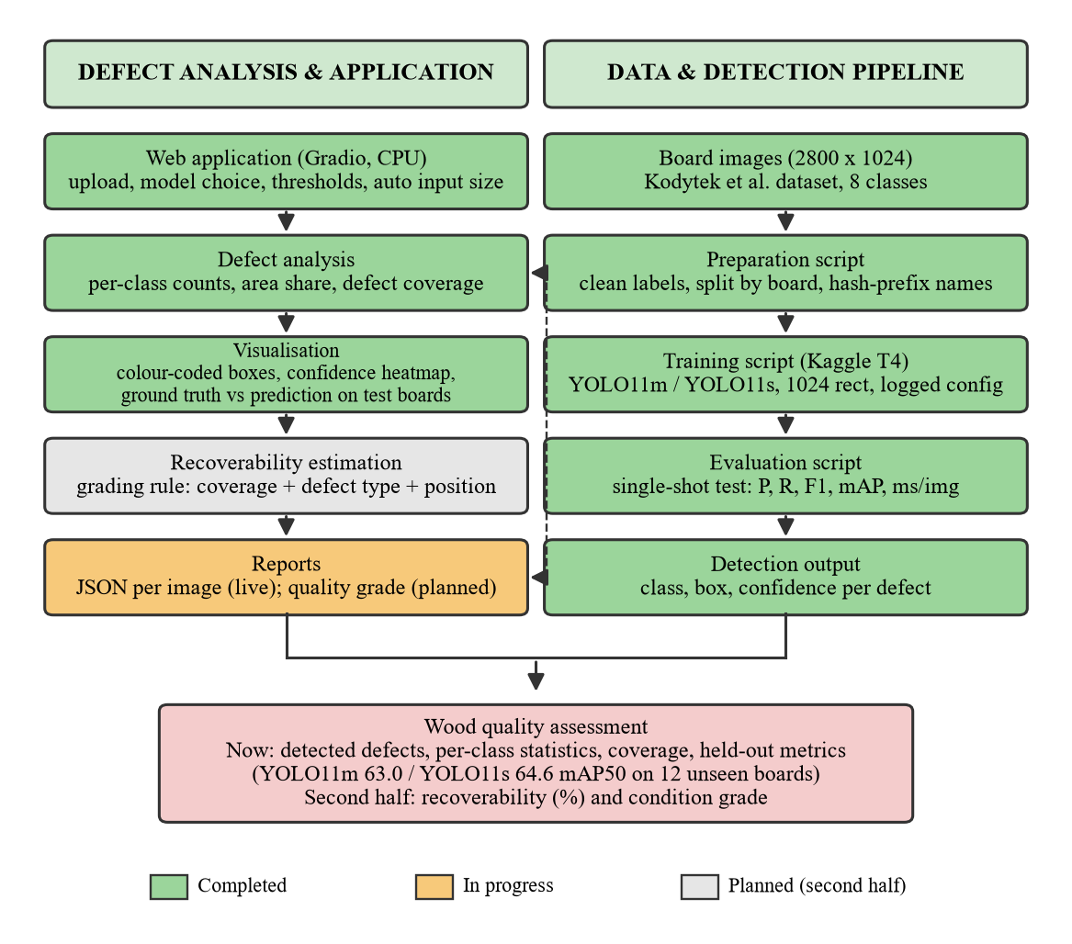
2
0
2
6
Fig. System design as implemented at the 50% review

Slide 15
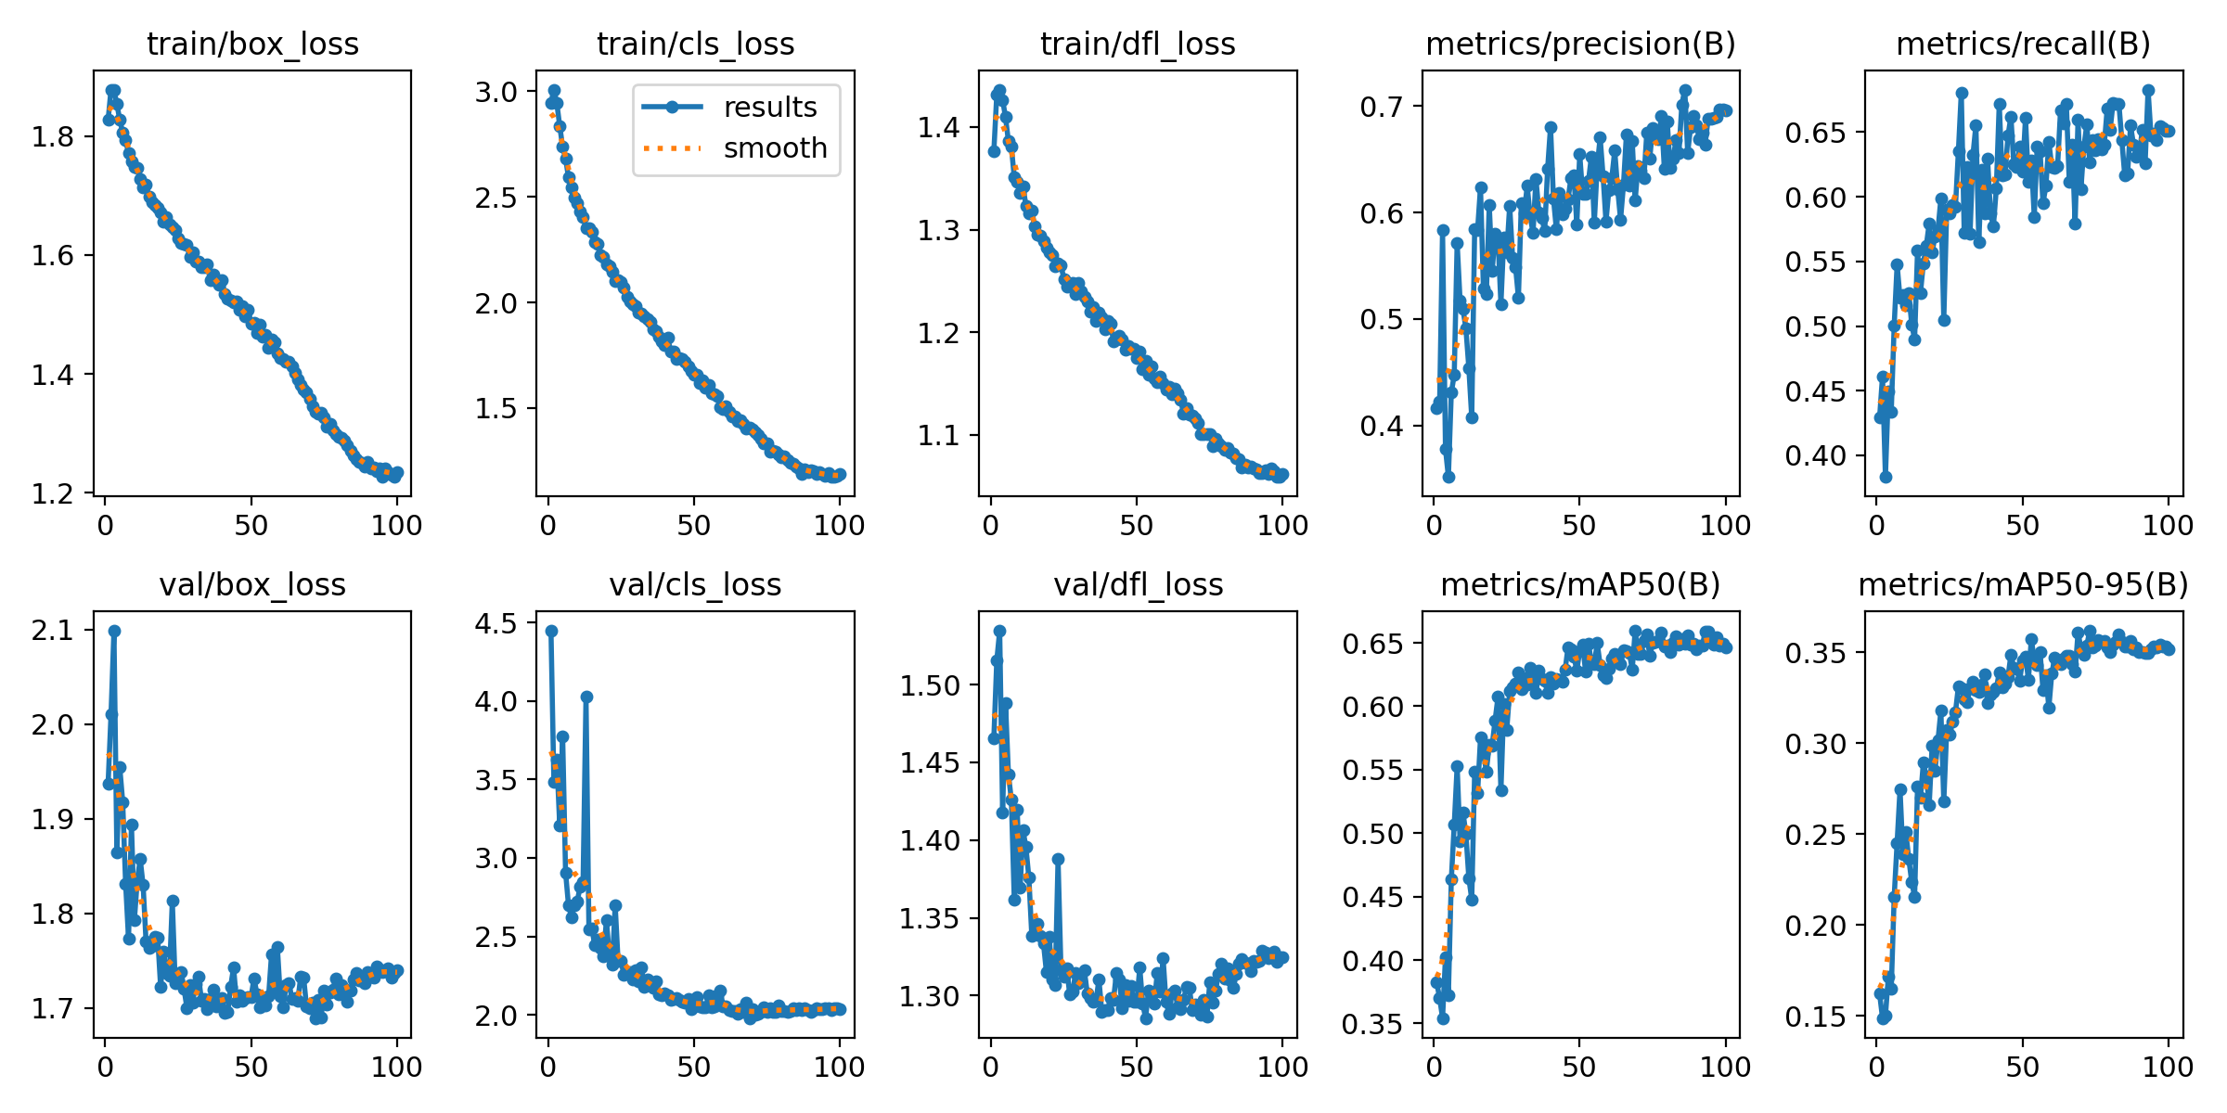
RESULTS: TRAINING RUNS
2
0
2
6
Run | Model | Settings | Epochs / GPU time | Best epoch | Val mAP50 | Val mAP50-95
1 | YOLO11m | batch 16, lr0 0.002, patience 25 | 89 (early stop) / 2.54 h | 64 | 62.6 | 33.7
2 | YOLO11m | batch 32, lr0 0.001, patience 40 (adopted) | 100 / 2.64 h | 73 | 65.7 | 36.2
3 | YOLO11s | as run 2 | 90 (early stop) / 1.43 h | 50 | 65.3 | 36.0
Run 1 showed an unstable validation curve (10-15 point drops in mAP50).
Batch 32 with lr0 0.001 and longer patience removed the instability and improved every class on validation; adopted for both models.
Decision made on validation only; the test split was not touched.
About 100 s per epoch on one T4.
Fig. Training and validation curves, YOLO11m (adopted run 2)

Slide 16
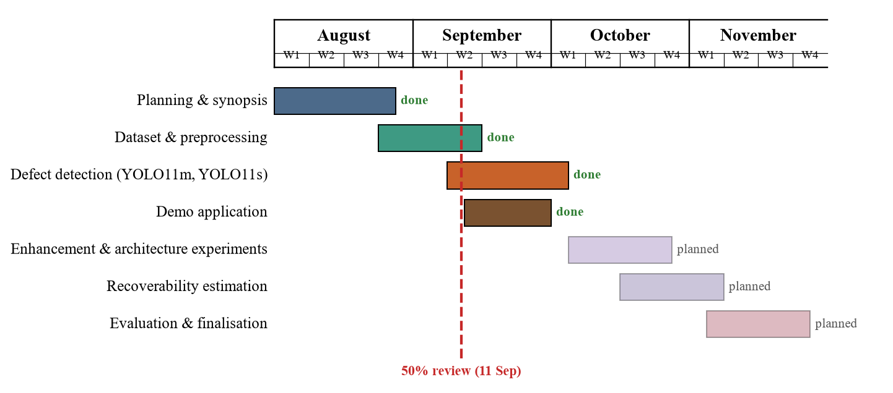
PLAN OF ACTION: PROGRESS
2
0
2
6
Completed: planning, dataset and preprocessing, defect detection (both models, held-out evaluation), demo application. Planned: enhancement and architecture experiments, recoverability estimation, final evaluation and report.

Slide 17
RESULTS: HELD-OUT TEST
2
0
2
6
Model | Precision | Recall | F1 | mAP50 | mAP50-95 | ms / image (T4) | FPS | Params
YOLO11m (proposed) | 63.4 | 66.2 | 64.7 | 63.0 | 34.0 | 33.2 | 30 | 20.0 M
YOLO11s (baseline) | 71.0 | 64.1 | 67.4 | 64.6 | 33.4 | 11.7 | 86 | 9.4 M
Class | Test boxes | 11m P | 11m R | 11m mAP50 | 11m mAP50-95 | 11s P | 11s R | 11s mAP50 | 11s mAP50-95
Dead_Knot | 343 | 77.2 | 88.0 | 86.8 | 41.8 | 83.0 | 84.3 | 89.1 | 43.3
Marrow | 46 | 79.6 | 84.9 | 85.8 | 57.4 | 89.3 | 72.7 | 87.7 | 55.2
Live_Knot | 406 | 73.5 | 79.2 | 74.8 | 32.0 | 75.2 | 75.1 | 75.8 | 32.6
Knot_missing * | 24 | 57.9 | 62.5 | 62.7 | 35.7 | 80.8 | 70.8 | 69.6 | 34.1
Knot_with_crack | 30 | 63.2 | 63.3 | 61.7 | 38.4 | 80.9 | 63.3 | 67.5 | 42.8
Resin | 69 | 68.0 | 56.5 | 59.5 | 29.9 | 81.9 | 53.6 | 60.4 | 29.5
Crack | 95 | 56.8 | 72.6 | 57.7 | 31.0 | 60.5 | 63.2 | 53.0 | 26.3
Quartzity * | 10 | 30.7 | 22.3 | 15.4 | 5.7 | 16.7 | 30.0 | 13.4 | 3.0
ALL | 1023 | 63.4 | 66.2 | 63.0 | 34.0 | 71.0 | 64.1 | 64.6 | 33.4
Each model evaluated exactly once on boards never used for training, validation or threshold choice. * fewer than 25 test boxes: indicative only.
Knot classes above 85 mAP50; Crack 53-58; Quartzity (125 training boxes) not yet learned; remaining errors are between visually similar knot sub-types.

Slide 18
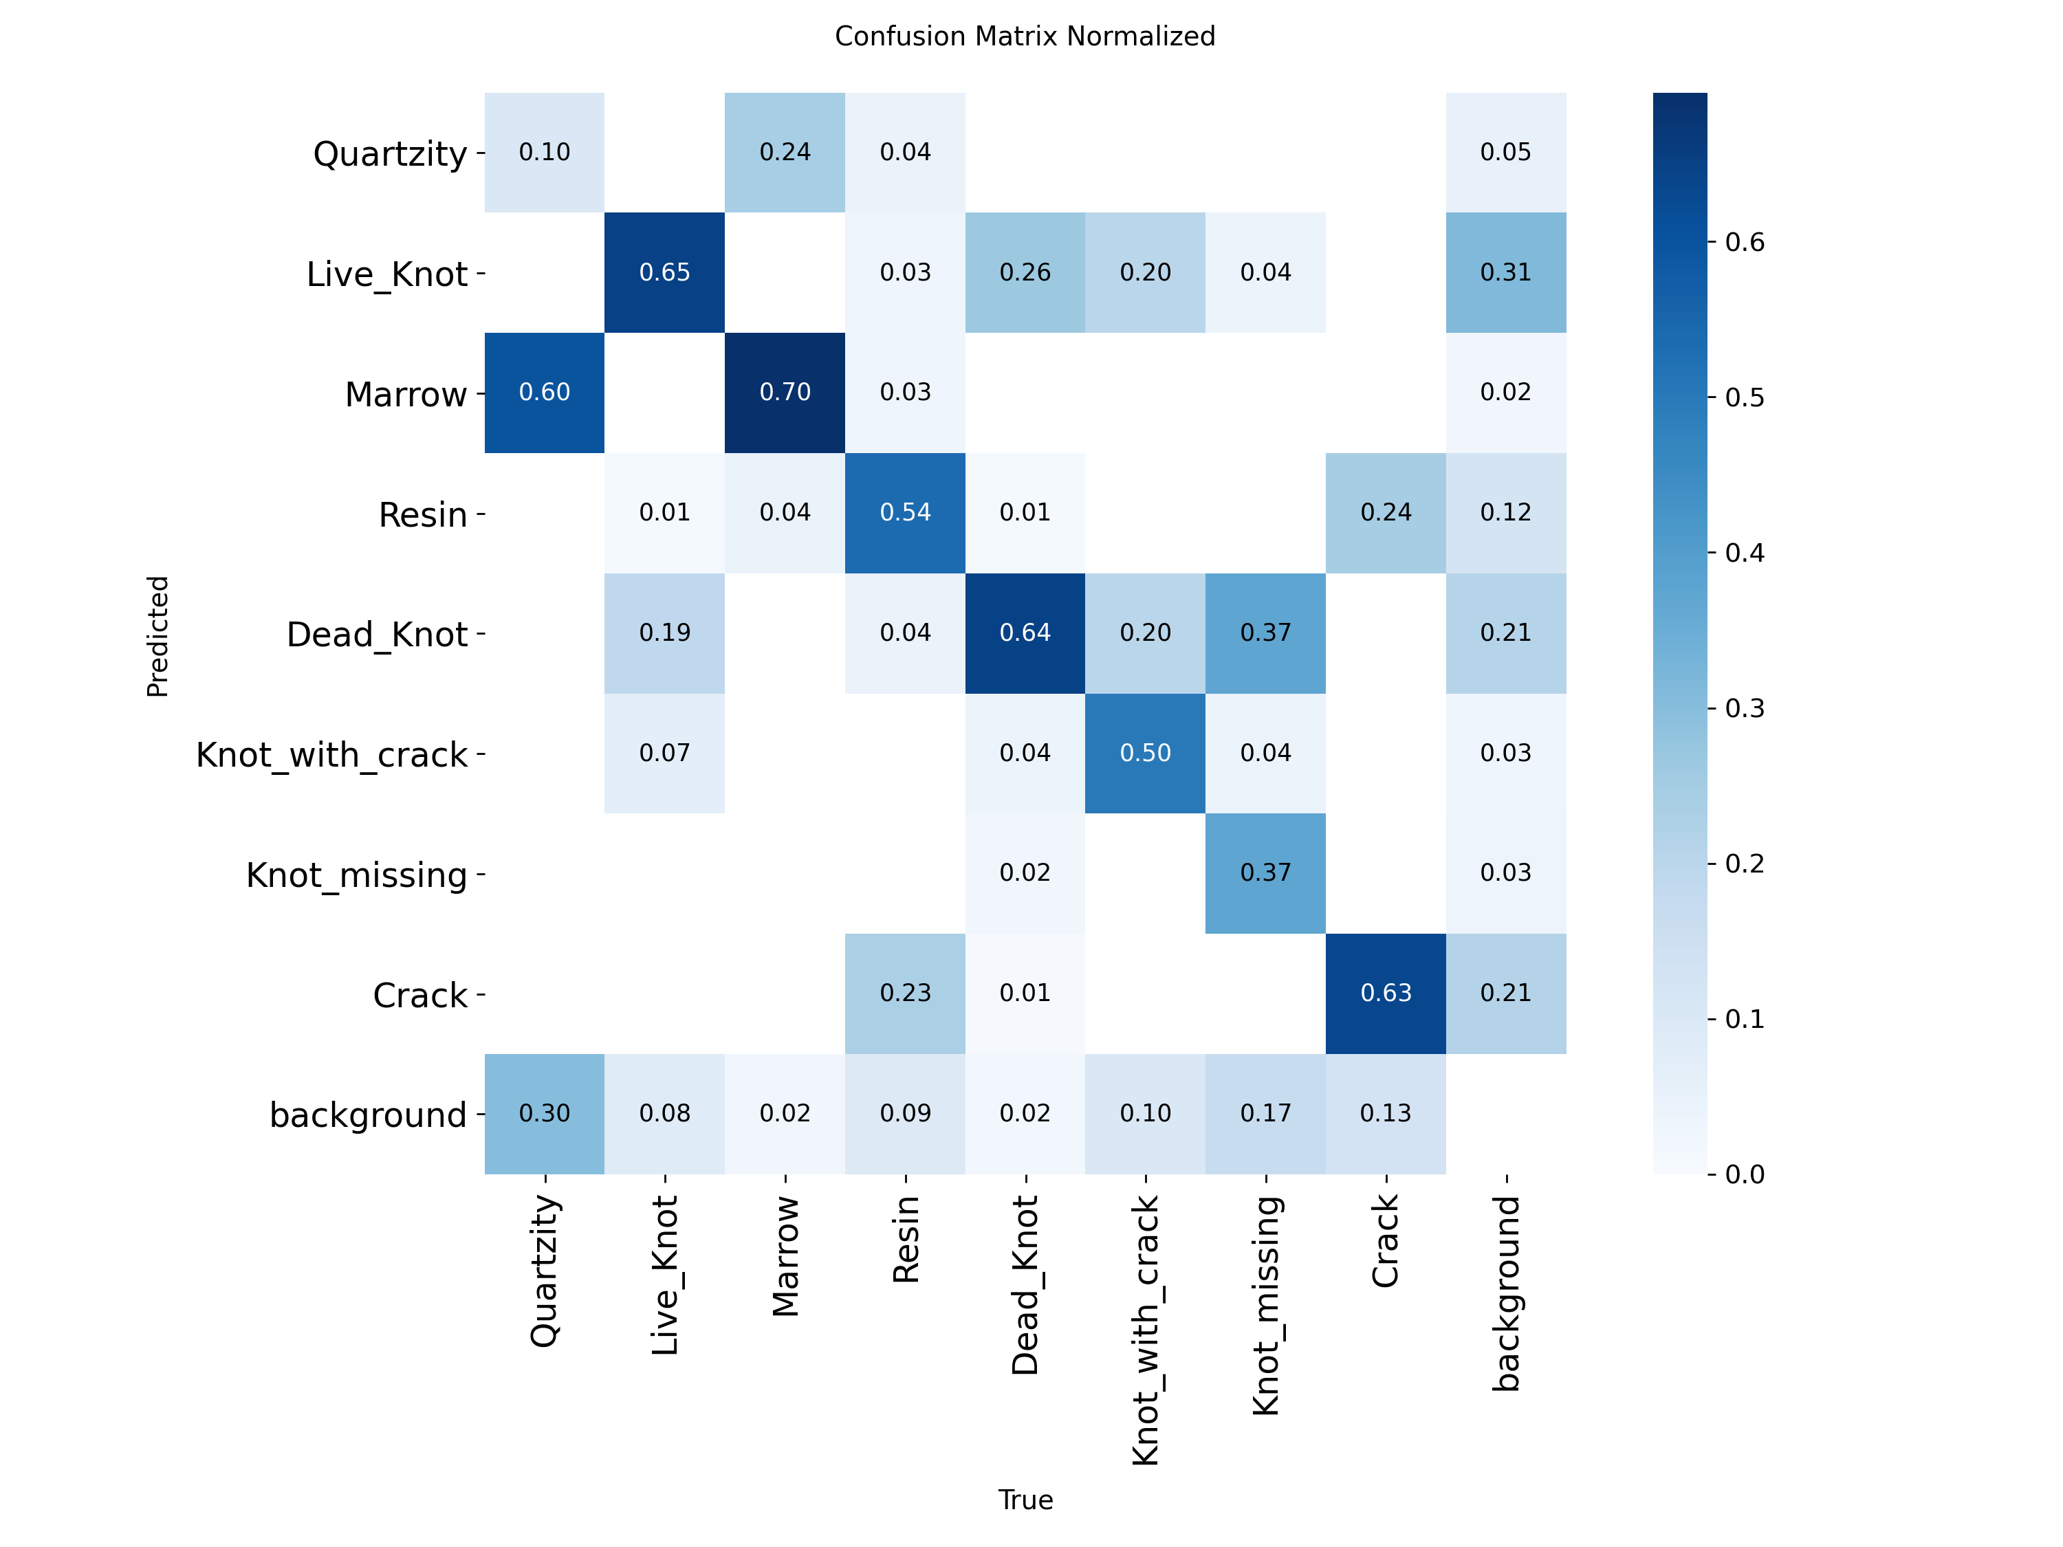
2
0
2
6
MODEL COMPARISON: YOLO11m vs YOLO11s
Aspect | YOLO11m | YOLO11s | m - s
mAP50 | 63.0 | 64.6 | -1.6
mAP50-95 | 34.0 | 33.4 | +0.6
Precision | 63.4 | 71.0 | -7.6
Recall | 66.2 | 64.1 | +2.1
F1 | 64.7 | 67.4 | -2.7
Crack mAP50 / recall | 57.7 / 72.6 | 53.0 / 63.2 | +4.7 / +9.4
Inference, T4 | 33.2 ms (30 FPS) | 11.7 ms (86 FPS) | 2.8x slower
Training cost | 2.64 h | 1.43 h | 1.8x
Parameters | 20.0 M | 9.4 M | 2.1x
Test confusion matrix, YOLO11m
Same data, split, seed and recipe: differences are due to model size alone. Overall accuracy is tied within the noise of a 12-board test set.
YOLO11m trades precision for recall and is stronger on the thin Crack class; YOLO11s is more precise and 2.8x faster.
Model capacity is not the bottleneck: rare classes and similar knot sub-types are. Second half focuses on data, input enhancement and targeted architecture changes.

Slide 19
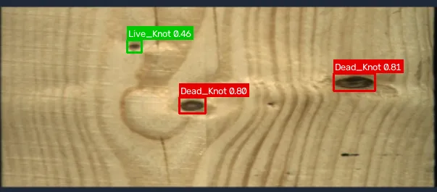
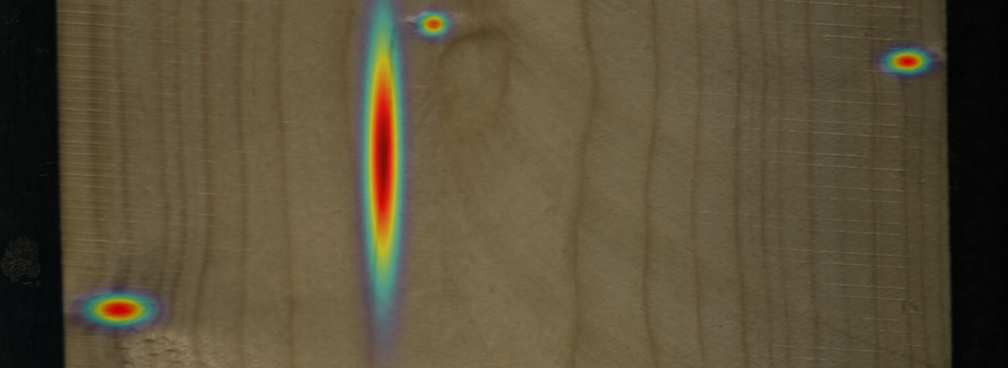
DEMO APP AND REMAINING WORK
2
0
2
6
Application (done): upload a board, choose YOLO11m / YOLO11s or both, thresholds, automatic input size; colour-coded boxes, heatmap, per-class count and area, defect coverage, JSON report.
Test-board view: annotator's boxes next to the model's prediction on the 12 unseen boards.
Deployment: runs on a CPU laptop (0.2-0.6 s per image); packaged for Hugging Face Spaces.
Remaining work:
image enhancement study (CLAHE, denoising, low-light) on validation
rare-class and thin-defect improvements; multi-seed runs
CWB-style architectural experiment on the YOLO11 baseline, with ablations
recoverability grading rule (coverage, defect type, position) validated on expert-graded boards
final single-shot evaluation, synopsis update and report
App output: detections on a board and confidence heatmap
Limitations: 12-board test set; single seed per configuration; trained on controlled line-scan imagery; recoverability not yet estimated.

Slide 20
REFERENCES
[1] P. Kodytek, A. Bodzas and P. Bilik, "A large-scale image dataset of wood surface defects for automated vision-based quality control processes," F1000Research, vol. 10, 581, 2022, doi:10.12688/f1000research.52903.2.
[2] Kaggle dataset nomihsa965/large-scale-image-dataset-of-wood-surface-defects, 4,000-image subset at 2800 x 1024 with YOLO labels, CC BY 4.0.
[3] Ultralytics, YOLO11, software version 8.4.142, https://docs.ultralytics.com.
[4] H. An, Z. Liang, M. Qin, Y. Huang, F. Xiong and G. Zeng, "Wood defect detection based on the CWB-YOLOv8 algorithm," Journal of Wood Science, vol. 70, art. 26, 2024, doi:10.1186/s10086-024-02139-z.
[5] J. Zheng, "IEL-YOLO: A low-light robust wood defect detection method based on YOLOv11," Proc. ETAE 2026, pp. 818-821, doi:10.1109/ETAE69474.2026.11496073.
[6] Y. Fang, Y. Ma, S. Gao and J. Chen, "Recent advances in wood surface defect inspection using deep learning (2021-2025)," BioResources, vol. 21, no. 3, 2026.
[7] J. Qu, Y. Pang and Z. Wang, "WD-SEG: A deep learning framework for delicate and accurate wood defect segmentation," BioResources, vol. 21, no. 2, pp. 2925-2947, 2026.
[8] L. P. Yi et al., "The prospect of artificial intelligence-based wood surface inspection: A review," IEEE Access, vol. 12, pp. 84706-84725, 2024, doi:10.1109/ACCESS.2024.3412928.
2
0
2
6

Slide 21
2
0
2
6
Thank You

