Slide 1





AI-Based Wood Quality Assessment
DAYANANDA SAGAR COLLEGE OF ENGINEERING
An Autonomous Institute Affiliated to VTU, Approved by AICTE & UGC
Accredited by National Assessment and Accreditation Council (NAAC) with ‘A’ Grade
Department of Computer Science and Business Systems
2
0
2
6
7th Semester Major Project: Final (100%) Presentation
Date: 24 October 2026
Time: 9Am Onwards
Under the Guidance of
Mrs. Aparna H D
Assistant Professor,
Department of CSBS,
Dayananda Sagar College Of Engineering, Bengaluru
GURUGUBELLI GAYATRI - 1DS23CB014
PRAKYAT PRAMOD SHETTY - 1DS23CB033
SAIPRASAD RAO - 1DS23CB041
YASTI ANIL KOTAK - 1DS23CB063

Slide 2
ORGANIZATION OF THE PRESENTATION
2
0
2
6
Abstract
Introduction
Literature Survey
Problem Statement
Objectives and Final Status
Methodology
Dataset and Board-level Split
System Design and Implementation
Training Configuration and Runs
Mathematical Model: Class Balancing, Box Fusion and Wise-IoU, Recoverability Index
Results on Held-out Boards
Statistical and Grading Validation
Image Enhancement Study
Model Comparison
Demonstration Application
Plan of Action
Conclusion and Future Work
References

Slide 3
ABSTRACT
Surface defects such as knots, cracks and resin pockets reduce the usable part of sawn timber; manual grading is slow, subjective and inconsistent.
We built an AI system that detects, classifies and localises surface defects on board images and turns them into a quality grade, a recoverable-area estimate and a value estimate.
Data: 4,000 industrial line-scan images, 8 defect classes, split by physical board (52 / 17 / 12 boards), so every test board is unseen.
Detection: YOLO11m and YOLO11s reach 63.0 and 64.6 mAP50 over 8 classes on 12 unseen boards; YOLO11s is 2.8x faster, so the final system is built on YOLO11s.
Mathematical model: class balancing, higher resolution and weighted box fusion of four 4-class YOLO11s models raise test mAP50 from 69.2 (best single model) to 74.7 and mAP50-95 from 33.1 to 36.7; 95% CI of the mAP50 gain +2.7 to +7.1, Wilcoxon p = 0.042.
Quality assessment: the guide's Board Recoverability Index, adapted to line-scan geometry, matches annotation-based grades with weighted kappa 0.83 on unseen boards; a web application shows defects, grade, recoverable area and value.
2
0
2
6

Slide 4
2
0
2
6
INTRODUCTION
Manual inspection of timber depends on human graders; fatigue and inter-inspector variation make results inconsistent, and throughput limits line speed.
Defects differ in severity: a live knot is cosmetic, a dead or missing knot weakens the board, a crack may make a section unusable. Grading needs the defect type and its location, not a yes/no answer.
One-stage detectors of the YOLO family find and classify small objects in real time, which suits a conveyor-mounted line-scan camera.
Our system returns every visible defect with class, position, size and confidence, grades each board with the Board Recoverability Index (A / B / C / Reject), and estimates its recoverable area and value.

Slide 5
  LITERATURE SURVEY
2
0
2
6
Author(s) | Year | Title of the Paper | Algorithm/ Technology used | Result | Drawbacks/Issues
Y. Fang, Y. Ma, S. Gao & J. Chen | 2026 | Recent Advances in Wood Surface Defect Inspection using Deep Learning | Recent Advances in Wood Surface Defect Inspection using Deep Learning | Comprehensive review; supports automated wood-defect inspection | Small datasets, poor generalisation & real-time deployment challenges
J. Zheng | 2026 | IEL-YOLO: A Low-Light Robust Wood Defect Detection Method Based on YOLOv11 | Image Enhancement + YOLOv11 | Improves defect visibility in low-light conditions; handles complex wood textures | Generalisation challenges; no multimodal integration
J. Qu, Y. Pang & Z. Wang | 2026 | WD-SEG: A Deep Learning Framework for Delicate and Accurate Wood Defect Segmentation | AFN + TFN + ICO + Deep Learning | Accurate defect segmentation; handles low contrast and reduces background interference | Noise sensitivity, feature ambiguity & real-time deployment challenges
J. Wang & S. Tang | 2026 | A Novel IWPT-VMD Denoising Method for Enhancing Air-Coupled Ultrasonic Detection of Wood Defects | IWPT + VMD + Ultrasonic Signal Processing | Reduces noise and improves signal quality and defect detection | Requires ultrasonic signals; limited AI integration and no multimodal fusion

Slide 6
  LITERATURE SURVEY
2
0
2
6
Author(s) | Year | Title of the Paper | Algorithm/ Technology used | Result | Drawbacks/ Issues
C. S. Erasmus, D. Drew & M. J. Booysen | 2026 | A Low-Cost Wireless Dendrometer and Digital Twin for Precision Forestry Applications | IoT + LoRaWAN + Digital Twin | Low-cost, scalable system enabling continuous monitoring | No wood-quality assessment; no harvest optimisation; limited data fusion
N. Perry et al. | 2026 | Towards Precision Forestry: A Systematic Review of Optimisation Methods for Individual-Tree Decisions in Forest Management | Heuristics, Mathematical Programming & Machine Learning | Supports optimal forest-management decisions across different objectives | Limited real-world implementation; disturbance risks not fully integrated; limited multi-scale planning
E. Z. Başkent, A. Bončina & J. G. Borges | 2026 | A Review and Conceptual Framework for a New Era of Forest Management Planning | Digital Twin, Monitoring, Simulation & Forecasting | Supports adaptive forest planning and integrates monitoring with forecasting | Limited ML implementation; no harvesting optimisation; no timber-quality assessment
J. Tan, H. Zhang, J. Yang, Y. Liu, D. Zheng & X. Liu | 2025 | ForestryBERT: Continual Learning Adapted to Forestry Text | BERT + NLP + Continual Learning | Provides domain-specific forestry knowledge management and adapts to continuously growing forestry text data | Catastrophic forgetting; limited application to wood-quality assessment; no defect-detection component

Slide 7
2
0
2
6
  PROBLEM STATEMENT
Manual wood quality inspection is time-consuming and subjective, and existing AI approaches mostly stop at detecting defects without a leakage-free evaluation or a path to usable-area estimation; this project therefore aims to develop an AI-based computer-vision system that detects, classifies and localises visible surface defects on wooden boards, evaluates the detector on boards it has never seen, and uses the detections to estimate the recoverable portion of each board.

Slide 8
2
0
2
6
  OBJECTIVES AND FINAL STATUS
Objective 1 (achieved): Annotated dataset of 4,000 line-scan images, 8 classes, 9,053 boxes, split by physical board with zero overlap. Higher-resolution input (1280 px), CLAHE / denoising and copy-paste balancing of rare classes were all implemented and evaluated.
Objective 2 (achieved): Deep-learning framework for detection and localisation: reproducible preparation, balancing, training and evaluation scripts; 8-class YOLO11m / YOLO11s and 4-class YOLO11s models, each tested once on held-out boards.
Objective 3 (achieved): Recoverable-area estimation: the guide's Board Recoverability Index gives a damage score, recoverable area and grade per board; validated against annotation-based grades (weighted kappa 0.83); market value estimated from grade.
Objective 4 (achieved): Comparison with P, R, F1, mAP50, mAP50-95 and inference time at identical settings, plus our mathematical model: class-balancing rule, weighted box fusion, Wise-IoU loss, per-class thresholds and statistical validation.

Slide 9
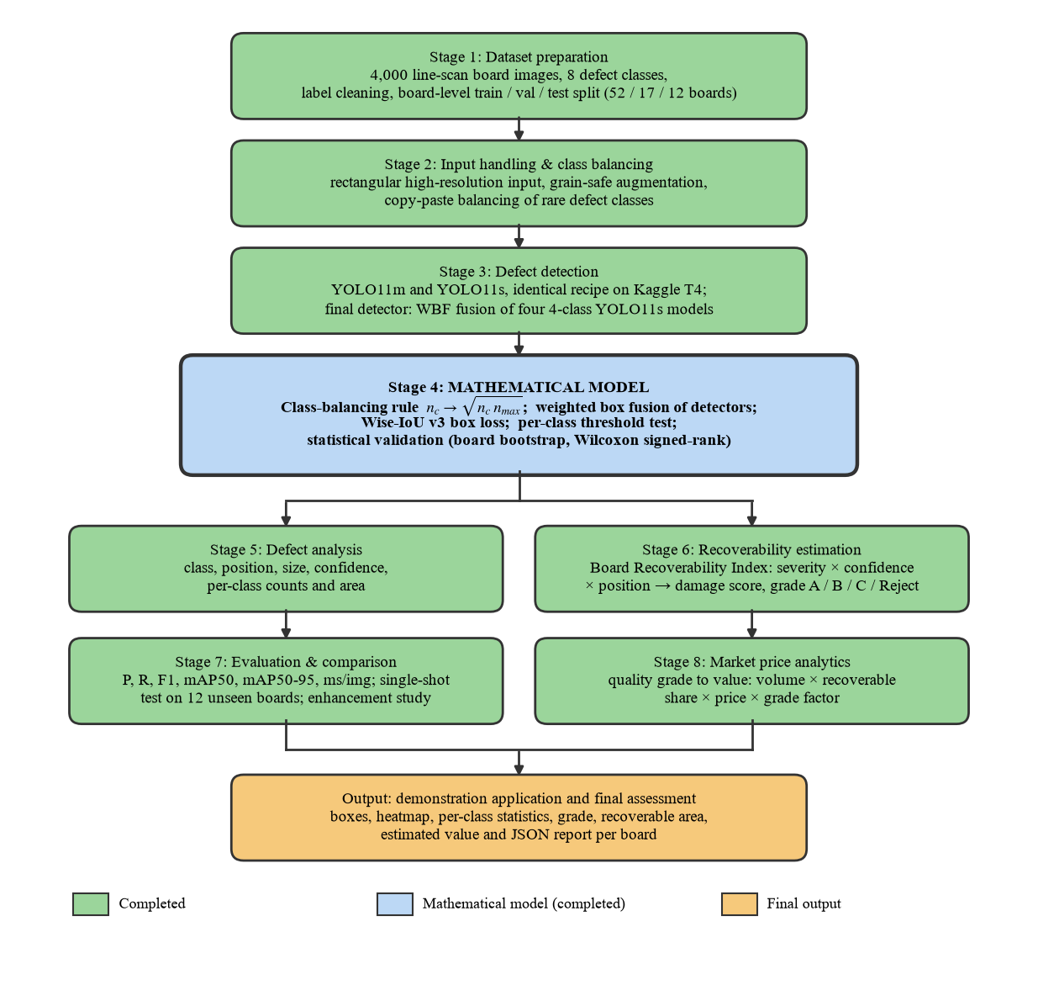
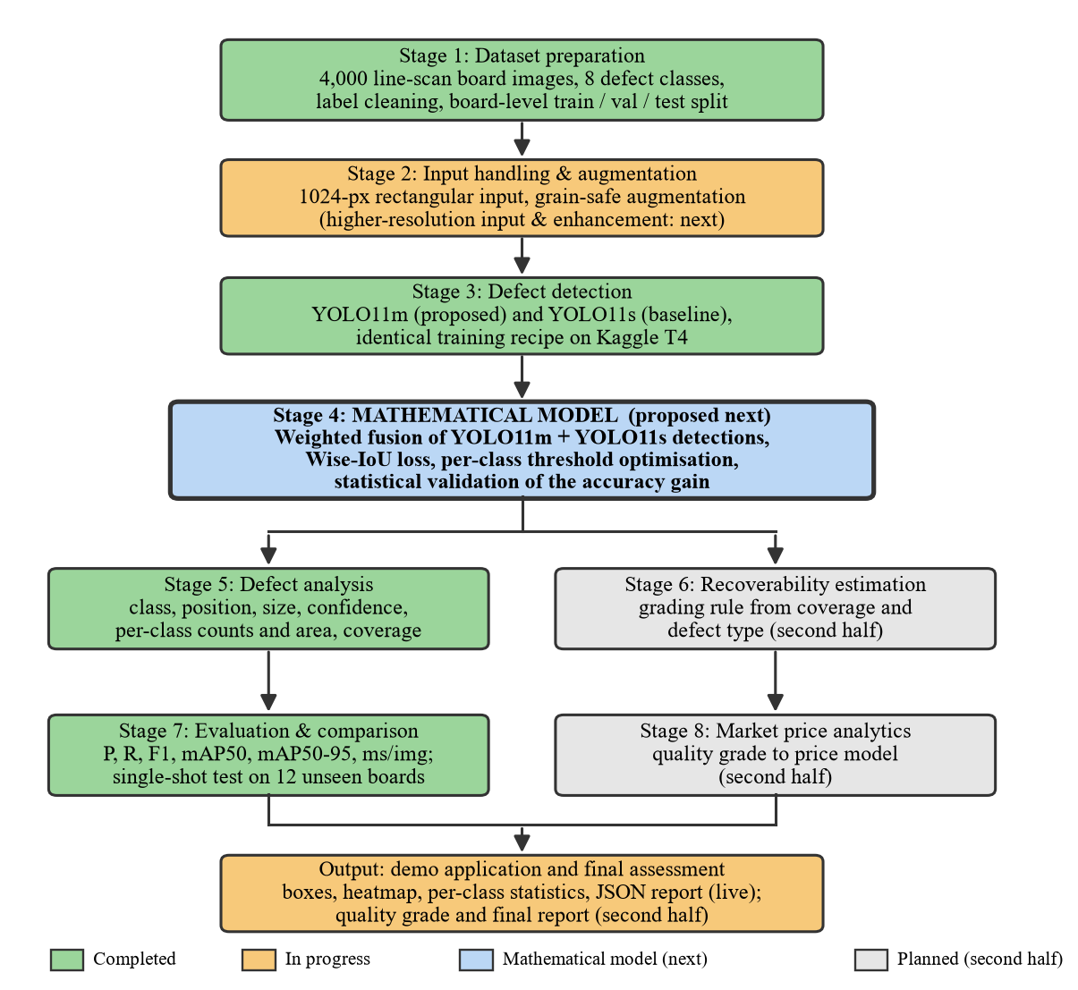
METHODOLOGY
2
0
2
6
Fig. Methodology as completed for the final review

Slide 10
METHODOLOGY
2
0
2
6
Dataset preparation. Public industrial line-scan dataset; label cleaning; class mapping verified; group-stratified split by board id (52 / 17 / 12 boards).
Input handling. 2800 x 1024 strips trained with rectangular batches at 1024 px (1024 x 384) and, as an experiment, 1280 px (1280 x 480).
Class balancing. Four most frequent classes kept; real defect crops pasted onto defect-free training boards along the grain until n_c reaches n_max or sqrt(n_c x n_max).
Detection. Ultralytics YOLO11 fine-tuned from COCO: YOLO11m and YOLO11s with one recipe; Wise-IoU v3 tested as the box loss.
Mathematical model. Weighted box fusion of detectors, per-class confidence thresholds, and statistical validation (board-level bootstrap, exact Wilcoxon test).
Recoverability and value. Board Recoverability Index: severity x confidence x position penalty -> damage score, recoverable area, grade A / B / C / Reject; value = volume x recoverable share x price x grade factor.
Evaluation protocol. Every choice made on validation boards; each test model evaluated exactly once; enhancement study (CLAHE, denoise, sharpen) on validation.

Slide 11
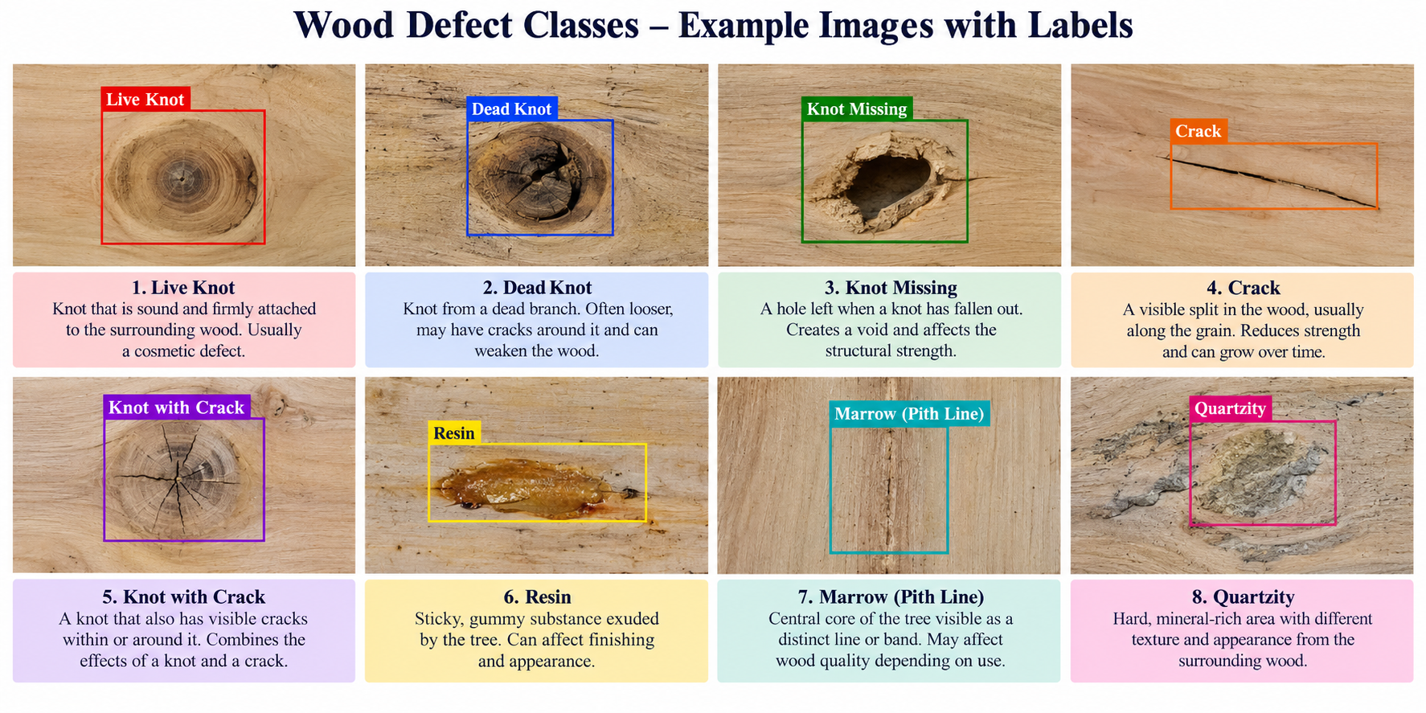
DATASET AND BOARD-LEVEL SPLIT
2
0
2
6
Content: 9,053 boxes after removing 158 zero-size labels; 388 background images (9.7%); 81 physical boards; 8 classes: Quartzity, Live_Knot, Marrow, Resin, Dead_Knot, Knot_with_crack, Knot_missing, Crack.
Why split by board: consecutive images come from the same board and share grain and lighting; a per-image split would leak boards into the test set. Zero overlap is asserted by the preparation script.
Split | Boards | Images | Backgr. | Quartzity | Live_Knot | Marrow | Resin | Dead_Knot | Knot_w_crack | Knot_missing | Crack
train | 52 | 2817 | 272 | 125 | 2899 | 94 | 489 | 2071 | 377 | 78 | 306
val | 17 | 714 | 71 | 20 | 713 | 64 | 88 | 482 | 98 | 15 | 111
test | 12 | 469 | 45 | 10 | 406 | 46 | 69 | 343 | 30 | 24 | 95
Imbalance: Live_Knot 44%, Dead_Knot 32% of boxes; Knot_missing 1.3%. Final detector: the 4 most frequent classes (Live_Knot, Dead_Knot, Resin, Crack).

Slide 12
2
0
2
6
SYSTEM DESIGN
1. Data / input layer : board images, cleaned labels, board-level train / val / test sets; balanced 4-class training sets.
2. Input processing : rectangular 1024 / 1280-px input, grain-aware augmentation, copy-paste balancing; CLAHE, denoising and sharpening evaluated.
3. Detection model : YOLO11m (20.0 M) and YOLO11s (9.4 M); Wise-IoU variant; weighted box fusion of detectors.
4. Defect analysis : class, position, size, confidence per defect; per-class counts and area.
5. Recoverability estimation : Board Recoverability Index with a board mask; grade thresholds fitted on validation boards; weighted-kappa validation.
6. Training and evaluation : P, R, F1, mAP50, mAP50-95, ms per image; single-shot test on 12 unseen boards; bootstrap and Wilcoxon tests.
7. Application : web interface with boxes, heatmap, grade, recoverable area, value estimate and JSON report.

Slide 13
2
0
2
6
TRAINING CONFIGURATION
Setting | Value (identical across models unless stated)
Pretrained weights | COCO yolo11m.pt (20.0 M params, 68 GFLOPs) / yolo11s.pt (9.4 M, 21 GFLOPs)
Input | imgsz 1024 rectangular (1024 x 384); high-resolution runs imgsz 1280 (1280 x 480)
Optimiser / schedule | AdamW, lr0 0.001, lrf 0.01, cosine, 3 warm-up epochs, weight decay 5e-4
Batch / epochs / patience | 32 / 100 / 40 (early stopping on validation)
Loss | cls 1.0, box 7.5, dfl 1.5; box loss CIoU, or Wise-IoU v3 (alpha 1.9, delta 3)
Augmentation | hsv 0.01 / 0.3 / 0.2, translate 0.08, scale 0.3, fliplr 0.5, degrees 0, flipud 0, mosaic 0, erasing 0.05
Class balancing (4-class) | copy-paste of real crops; plain, full (1:1) or partial sqrt(n_c x n_max) (3:1)
Reproducibility | seed 42, deterministic; seeds 1 and 2 repeat the final setup
Model selection / test | best.pt by validation; each test model evaluated once (conf 0.001, NMS IoU 0.6)
Compute: Kaggle, one NVIDIA Tesla T4 (15 GB); about 1.4-2.4 GPU-hours per YOLO11s run, 2.6 per YOLO11m run.
Software: Python 3.12, PyTorch 2.10, Ultralytics 8.4.142, OpenCV, Gradio. Scripts: prepare_dataset, build_balanced, train_yolo11m, train_wiou, evaluate, eval_capture, math_model, bri, bri_validate, enhance_study, app; decision log in NOTES.md.

Slide 14
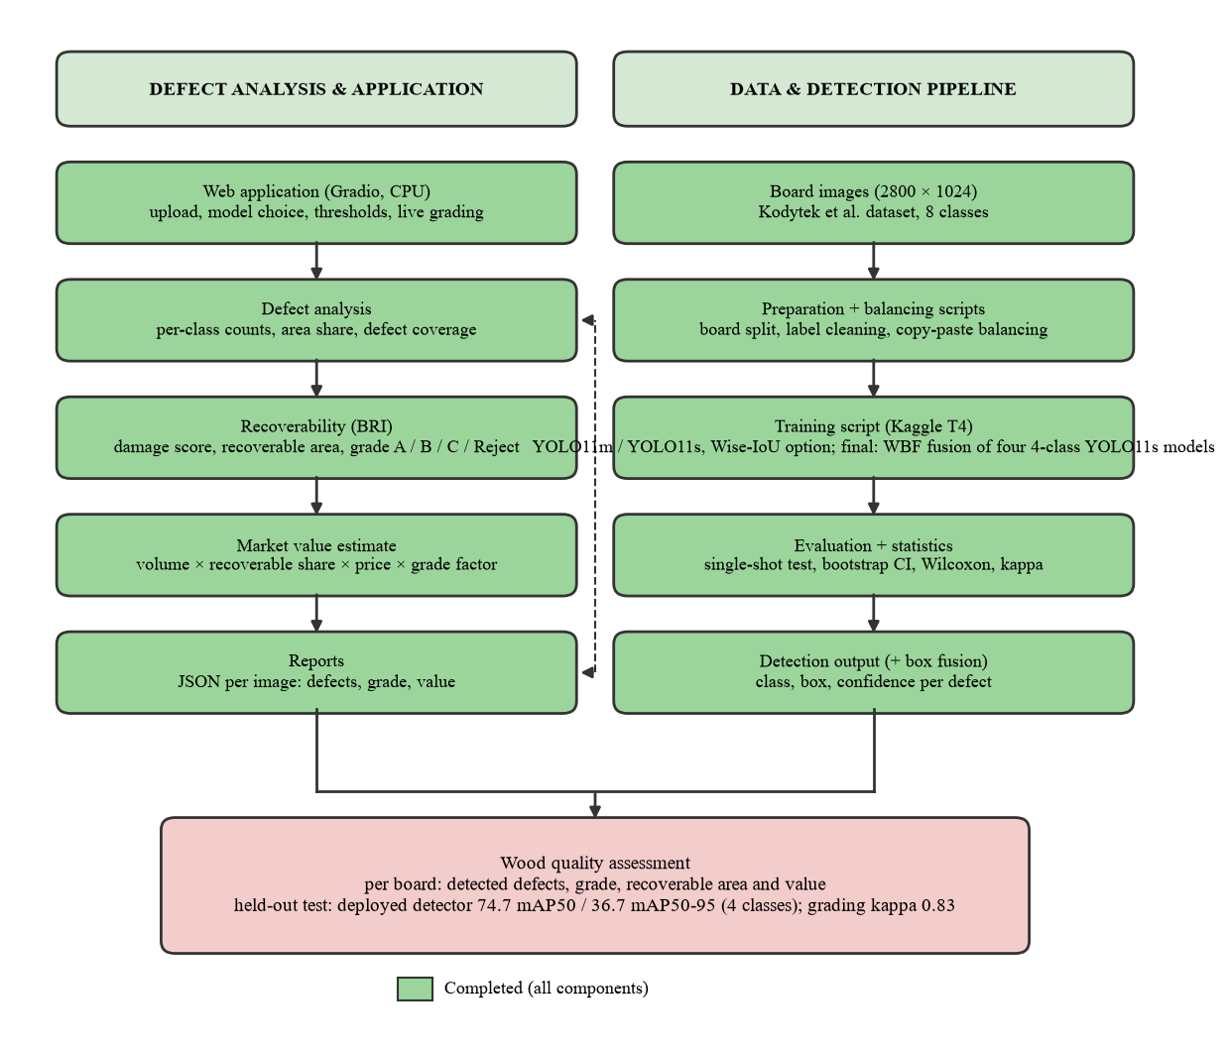
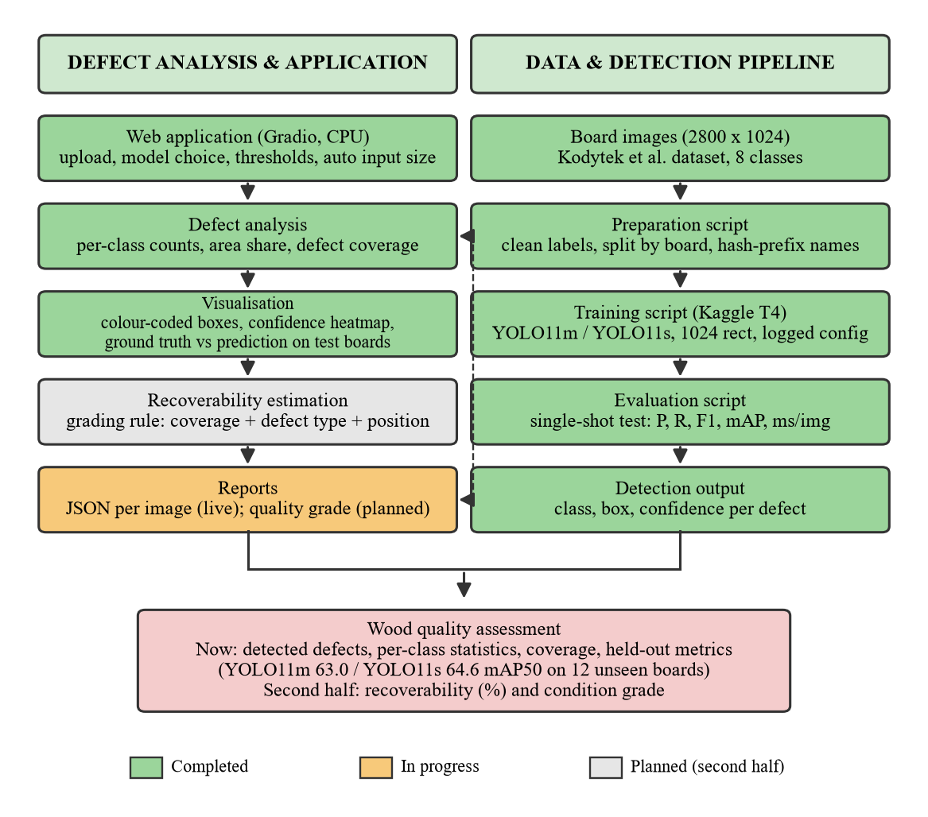
2
0
2
6
Fig. System design as implemented for the final review

Slide 15
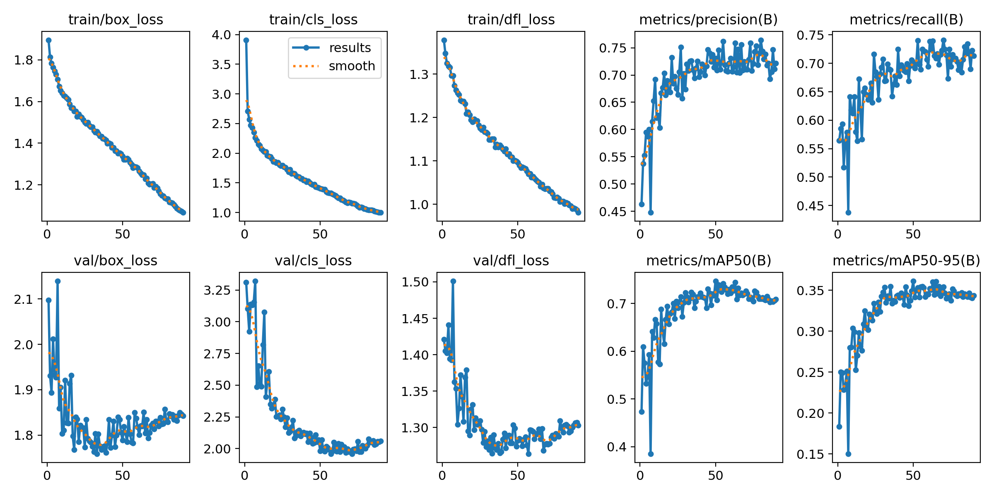
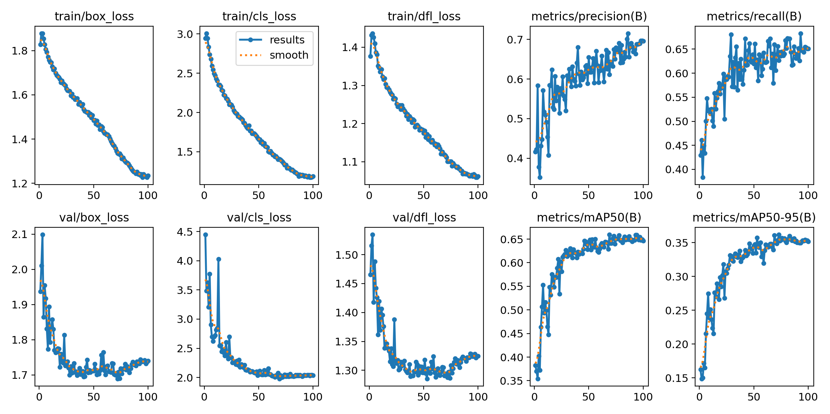
RESULTS: TRAINING RUNS
2
0
2
6
Run | Model / data | Settings | Epochs / GPU h | Best ep. | Val mAP50 | Val mAP50-95
1 | YOLO11m, 8 cls | batch 16, lr0 0.002 | 89 / 2.54 | 64 | 62.6 | 33.7
2 | YOLO11m, 8 cls | batch 32, lr0 0.001 (adopted) | 100 / 2.64 | 73 | 65.7 | 36.2
3 | YOLO11s, 8 cls | as run 2 | 90 / 1.43 | 50 | 65.3 | 36.0
4a | YOLO11s | 4 cls, no balancing, 1024 | 91 / 1.43 | 51 | 73.1 | 35.4
4b | YOLO11s | 4 cls, full balance 1:1, 1024 | 97 / 2.39 | 46 | 71.9 | 36.0
4c | YOLO11s | 4 cls, partial balance 3:1, 1024 (final) | 90 / 1.58 | 50 | 75.3 | 36.0
5a | YOLO11s | 4 cls, partial balance, 1280 | 93 / 2.1 | 53 | 74.6 | 35.5
5b | YOLO11s | 4 cls, no balancing, 1280 | 100 / 2.17 | 68 | 71.5 | 33.9
6 | YOLO11s | Wise-IoU v3, final setup | - | - | 74.6 | -
6 | YOLO11s | seed 1, final setup | - | - | 74.8 | -
6 | YOLO11s | seed 2, final setup | - | - | 75.6 | -
Runs 1-3: 8-class models (validation pass during training).
Runs 4-6: 4-class models, validation by evaluate.py.
Partial balance at 1024 px had the best validation mAP50 and is the final single model (rule fixed before training).
1280 px and Wise-IoU did not improve validation mAP50; seeds 42 / 1 / 2 spread 0.8.
Fig. Training and validation curves, final model (run 4c)

Slide 16
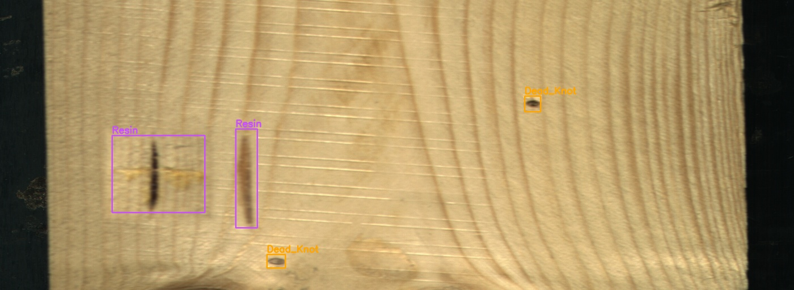
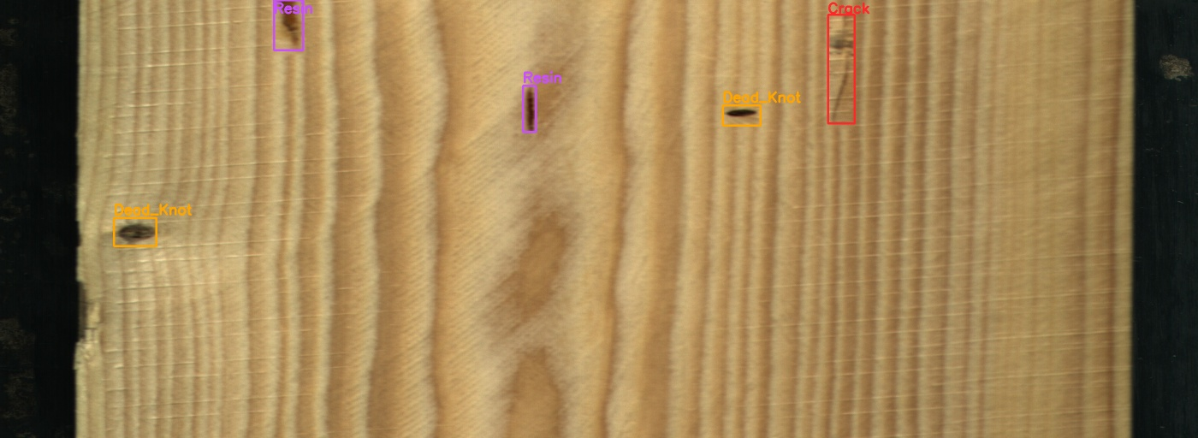
MATH MODEL I: CLASS BALANCING
2
0
2
6
Class | Training boxes | Full balance (1:1) | Partial balance sqrt(n_c n_max)
Live_Knot | 2899 | 2899 | 2899
Dead_Knot | 2071 | 3071 | 2470
Resin | 489 | 2899 | 1191
Crack | 306 | 2899 | 942
Imbalance max : min | 9.5 : 1 | 1.06 : 1 | 3.1 : 1
Rule: target boxes per class n_c* = n_max (full) or n_c* = sqrt(n_c x n_max) (partial, the repeat-factor rule of LVIS [15], same idea as the effective number of samples [14]).
Synthesis: real defect crops cut from training boards and pasted onto defect-free training boards (2-5 per image), only inside the board mask, no rotation, Poisson or feathered blending [16]; training split only.
Result: partial balance raised validation mAP50 from 73.1 to 75.3 but scored 69.2 on test vs 71.7 without balancing; difference not significant (95% CI -4.6 to +0.3).
Why full balance lost: only 160 cracks could be cut out cleanly, so each was pasted up to 17 times.

Slide 17
MATH MODEL II: FUSION AND LOSS
2
0
2
6
Component | Formula | Test result (chosen on validation)
Weighted box fusion [17] | b_f = sum(w c b) / sum(w c); c_f = (sum w c / sum w) x min(sum w, W) / W | YOLO11m + YOLO11s: mAP50 65.7, mAP50-95 36.1 (best single 64.6 / 33.7); mAP50-95 +1.6 to +3.2 (95% CI)
Wise-IoU v3 [18] | L = r x exp(d^2 / (W_g^2 + H_g^2)) x (1 - IoU); r = beta / (delta alpha^(beta - delta)) | val mAP50 74.6 vs 75.3 (CIoU); seed spread 0.8; adopted: no
Per-class thresholds | t_c = argmax_t F1_c(t) on validation | macro-F1 66.2 vs 66.9 with one global threshold: not adopted
Fusion of 4-class models | IoU 0.55, weights [2, 1, 1, 1] | val 78.1 vs best single 75.6; adopted, test 74.7 / 36.7
Fusion averages the boxes of several detectors weighted by confidence and lowers the confidence of boxes only one model finds. Fusing four 4-class YOLO11s models (1024 and 1280 px, with and without balancing) raised test mAP50 from 69.2 to 74.7.
Thresholds tuned per class over-fit the few validation boxes of Resin and Crack, so one global threshold is kept.
Every setting was chosen on the 17 validation boards; the 12 test boards were scored once.

Slide 18
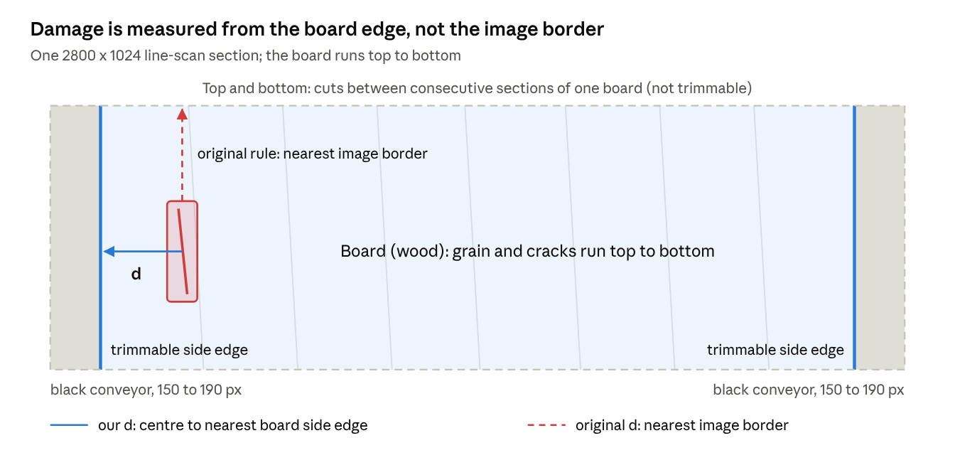
MATH MODEL III: RECOVERABILITY
2
0
2
6
1. Union of defects: A_def = |R_1 U ... U R_n| (overlaps counted once).
2. Severity: w_c: Crack 1.00, Dead_Knot 0.60, Live_Knot 0.40, Resin 0.30 (guide's placeholders).
3. Position: p_i = 1 - exp(-d_i / 250 px), d_i = distance to the board's side edge (our change).
4. Influence: s_i = w_c x conf_i x p_i.
5. Damage: I(x, y) = max_i s_i; DIS = sum I / A_board (board pixels, our change); A_rec = A_board (1 - DIS).
6. Grade: A / B / C / Reject from thresholds fitted on validation boards with the guide's weighted-kappa calibration.
Check: the guide's worked example is reproduced exactly (DIS 0.020860, grade B).

Slide 19
RESULTS: HELD-OUT TEST
2
0
2
6
Model | Classes | P | R | F1 | mAP50 | mAP50-95 | ms / img (T4) | Params
YOLO11m | 8 | 63.4 | 66.2 | 64.7 | 63.0 | 34.0 | 33.2 | 20.0 M
YOLO11s | 8 | 71.0 | 64.1 | 67.4 | 64.6 | 33.4 | 11.7 | 9.4 M
Fusion (WBF) YOLO11m + YOLO11s | 8 | - | - | - | 65.7 | 36.1 | 44.9 | 29.4 M
YOLO11s, no balancing | 4 | 76.7 | 70.0 | 73.2 | 71.7 | 33.4 | 11.7 | 9.4 M
YOLO11s, partial balance (final) | 4 | 74.8 | 69.4 | 72.0 | 69.2 | 33.1 | 11.7 | 9.4 M
YOLO11s, partial balance, 1280 px | 4 | 78.0 | 67.9 | 72.6 | 71.6 | 34.3 | 11.7 | 9.4 M
Fusion (WBF) of four 4-class models (deployed) | 4 | - | - | - | 74.7 | 36.7 | ~60 | 37.7 M
Class (test mAP50) | Test boxes | 8-class YOLO11s | Best single 4-class (P / R) | Single mAP50 | Deployed fusion mAP50
Dead_Knot | 343 | 89.1 | 83.7 / 82.5 | 87.5 | 90.3
Live_Knot | 406 | 75.8 | 74.2 / 77.3 | 76.4 | 78.6
Resin | 69 | 60.4 | 84.7 / 58.0 | 64.2 | 69.7
Crack | 95 | 53.0 | 56.5 / 60.0 | 48.7 | 60.2
ALL (4 classes) | 913 | 69.6 | 74.8 / 69.4 | 69.2 | 74.7
Each model evaluated exactly once on boards never used for training, validation or any choice. 8-class and 4-class rows are not directly comparable: on the same four classes the 8-class YOLO11s scores 69.6 mAP50.
The deployed fusion is the only model with a significant gain over the best single model: mAP50 +2.7 to +7.1 (95% CI), better on 10 of 12 boards. Crack remains the hardest class.

Slide 20
STATISTICAL VALIDATION
2
0
2
6
Comparison (test, 12 boards) | mAP50 diff | 95% CI (board bootstrap) | Boards better / worse | Wilcoxon p
Deployed fusion (4 cls) - best single 4-class model | +5.5 | [+2.7, +7.1] | 10 / 2 | 0.042
Fusion (YOLO11m + YOLO11s) - YOLO11s, mAP50 | +1.1 | [-0.5, +2.7] | 7 / 5 | 0.52
Fusion - YOLO11s, mAP50-95 | +2.4 | [+1.6, +3.2] | - | -
Partial balance - no balancing (4 cls) | -2.6 | [-4.6, +0.3] | 4 / 8 | 0.57
Partial balance - 8-class model (4 cls) | -0.4 | [-2.8, +1.9] | 5 / 7 | 0.73
No balancing - 8-class model (4 cls) | +2.2 | [-1.4, +4.4] | 6 / 6 | 0.62
Run-to-run spread (final setup, validation) | Value
Val mAP50, seeds 42 / 1 / 2 | 75.3 / 74.8 / 75.6
Spread (max - min) | 0.8
Board-level bootstrap: the 12 test boards are resampled 1,000 times with replacement, so the interval reflects board-to-board variation [20]; exact Wilcoxon signed-rank test on per-board AP50 differences [21].
Only the fusion gains have intervals that exclude zero; the 4-class fusion is also significant by the Wilcoxon test. Differences of 2-3 mAP50 points between single models are within the noise of a 12-board test set.

Slide 21
GRADING VALIDATION (BRI)
2
0
2
6
Agreement with annotation-based grade | Per image (469) | Per board (12)
Exact grade | 78.3 % | 83.3 %
Within one grade | 96.2 % | 100.0 %
Quadratic weighted kappa [19] | 0.83 | 0.73
Spearman correlation of damage scores | 0.86 | 0.79
Mean abs. error, recoverable area | 0.47 pts | 0.50 pts
Reference \ Model | A | B | C | Reject
A (175) | 153 | 19 | 3 | 0
B (113) | 13 | 77 | 22 | 1
C (109) | 6 | 5 | 85 | 13
Reject (72) | 6 | 2 | 12 | 52
Reference grade = BRI on the annotators' boxes, thresholds at the 40th / 70th / 90th percentiles of validation damage scores (0.0020, 0.0062, 0.0179).
Model grade = BRI on the detector's boxes, thresholds fitted on validation with the guide's calibration (0.0010, 0.0027, 0.0104); test boards never used for fitting.
Next step agreed with the guide: blind expert grading of 30-50 boards to calibrate severity weights and thresholds.

Slide 22
IMAGE ENHANCEMENT STUDY (H1)
2
0
2
6
Condition (validation, mAP50) | Raw | CLAHE [22] | Denoise | Sharpen
Normal | 74.8 | 65.8 | 75.3 | 73.8
Low light | 50.0 | 27.7 | 48.0 | 49.3
Over-exposed | 58.2 | 47.9 | 58.2 | 57.7
Blur | 73.3 | 62.2 | 72.9 | 75.1
Noise | 67.8 | 56.5 | 73.0 | 57.0
Low contrast | 61.3 | 62.6 | 61.6 | 62.6
H1 rejected for raw images: CLAHE lowers mAP50 significantly in 5 of 6 conditions (Wilcoxon p <= 0.006); sharpening gives no significant gain.
Denoising helps only on noisy images: +3.2 to +7.2 mAP50 (95% CI), p = 0.006; recommended only for a noisy camera.
Imaging conditions matter more than enhancement: low light costs about 25 points, so controlled lighting is the main requirement for deployment.

Slide 23
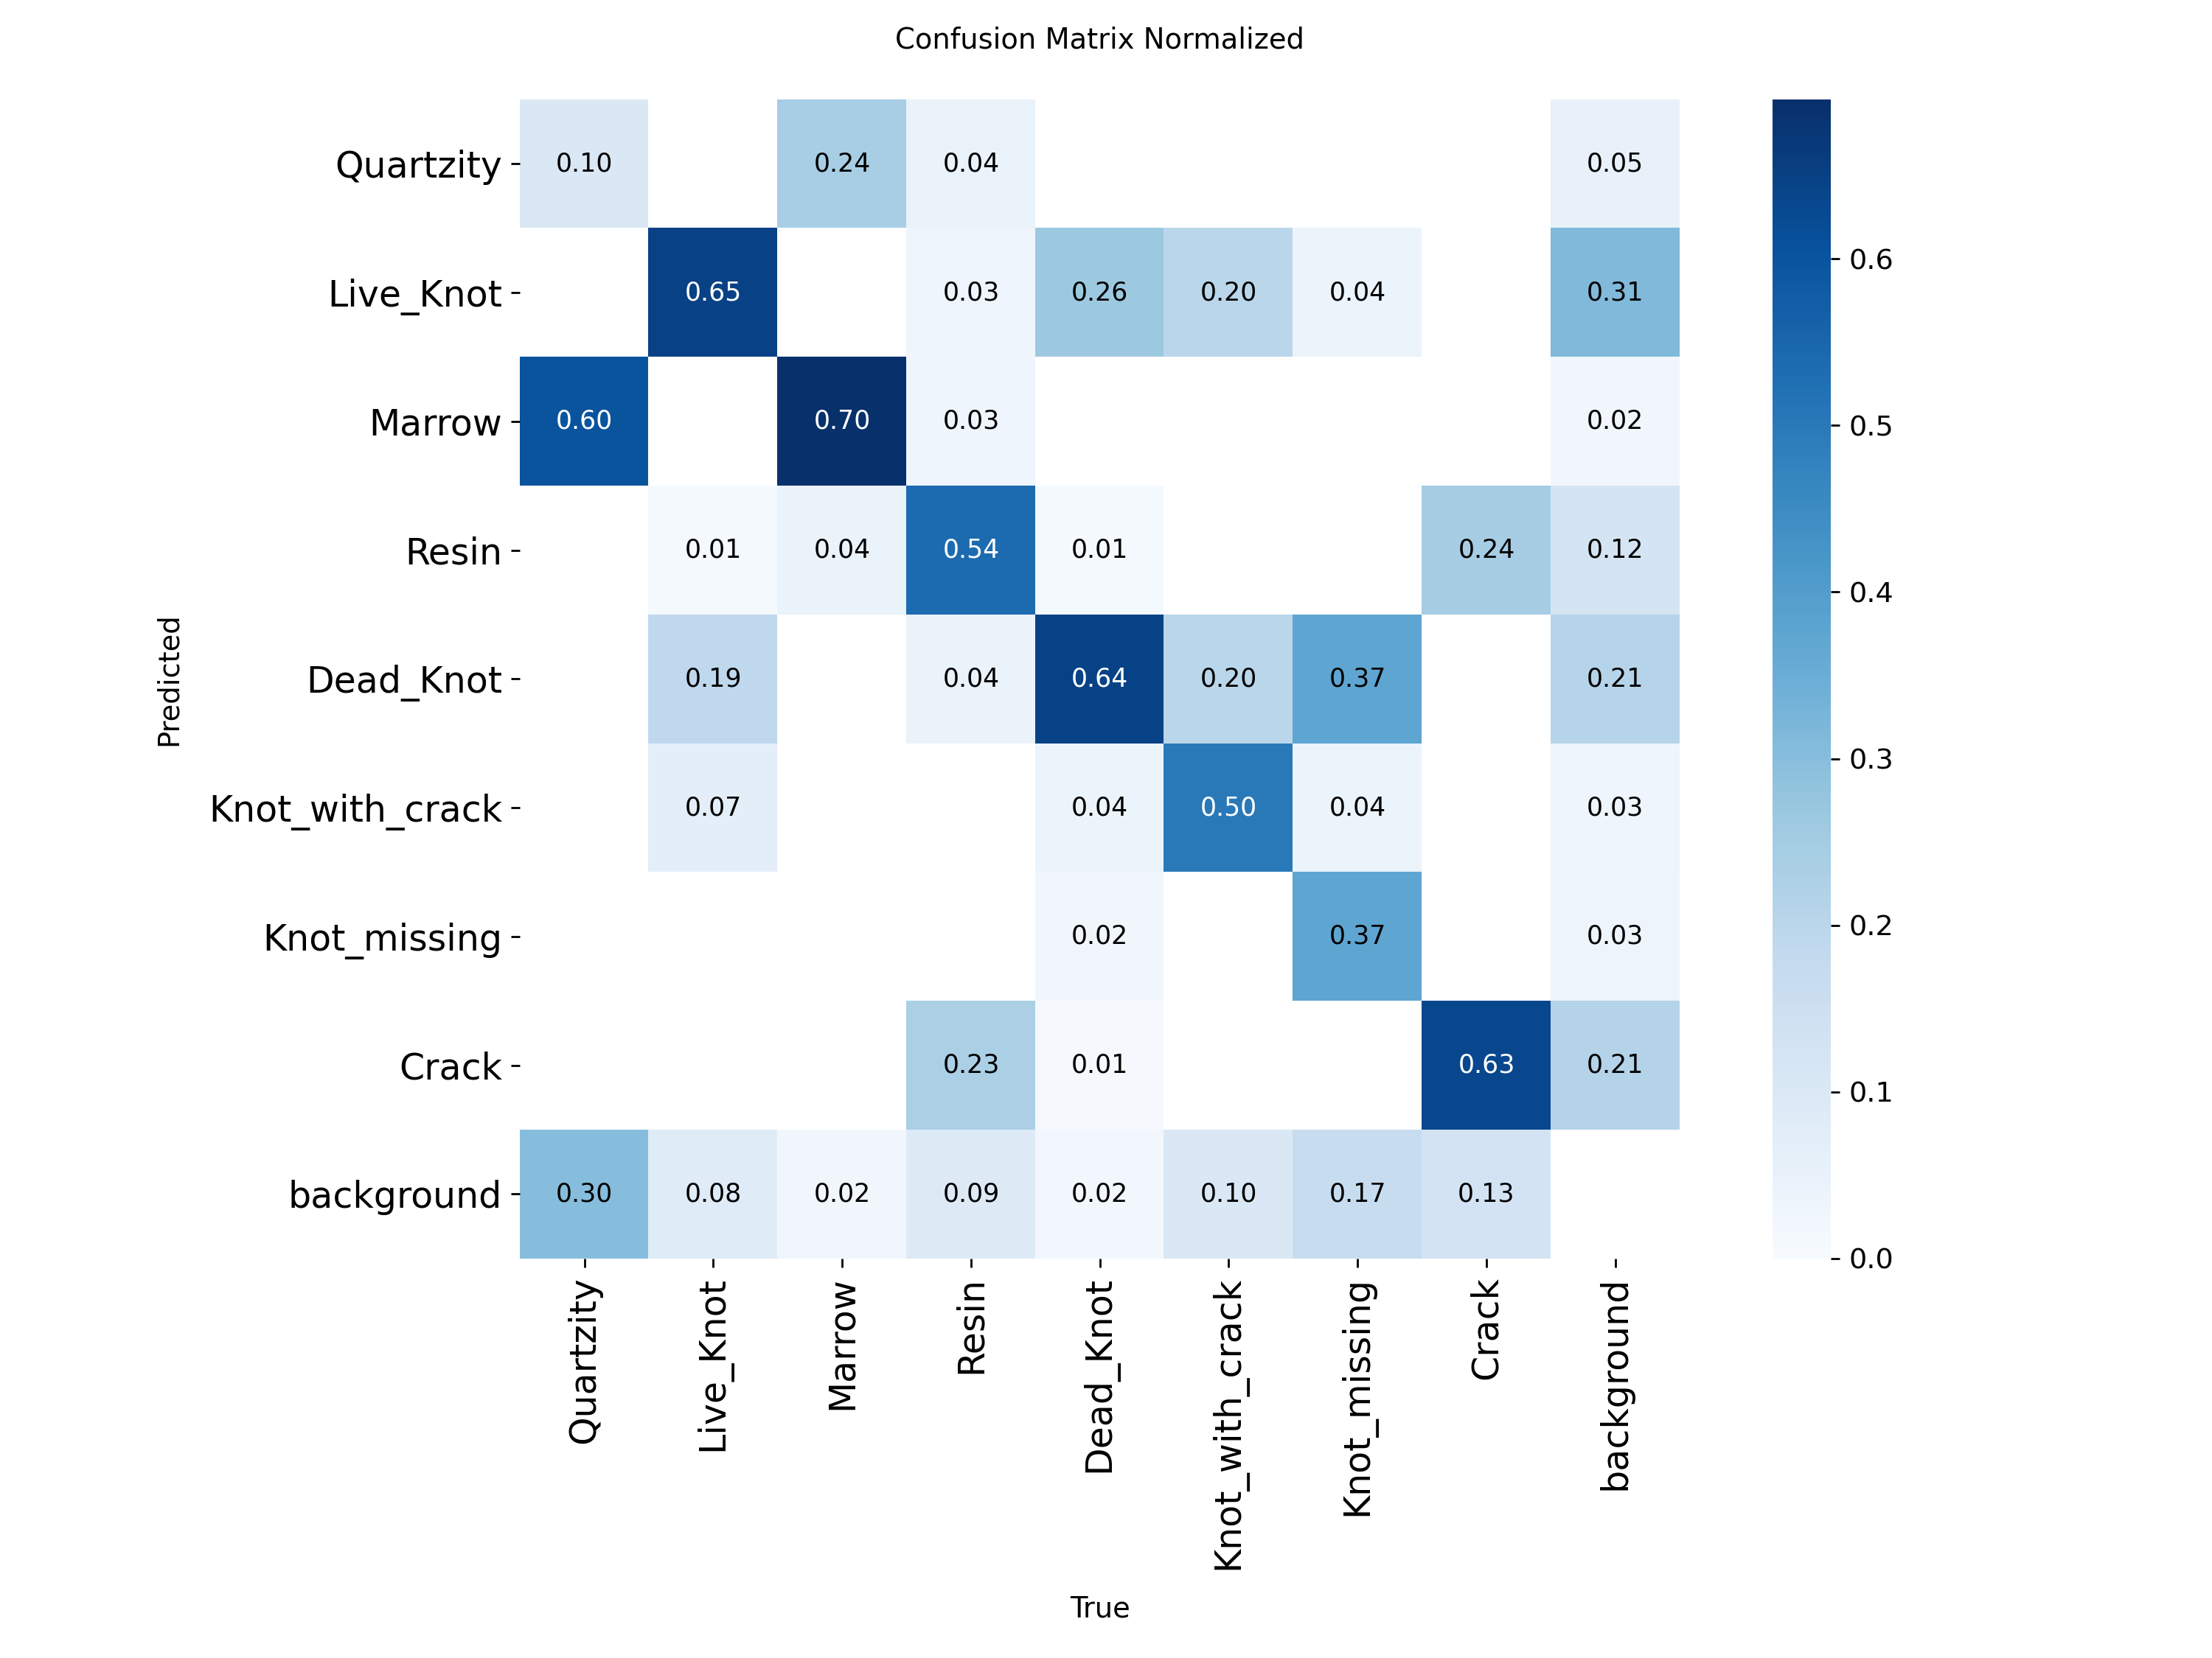
2
0
2
6
MODEL COMPARISON: YOLO11m vs YOLO11s
Aspect | YOLO11m | YOLO11s | m - s
mAP50 | 63.0 | 64.6 | -1.6
mAP50-95 | 34.0 | 33.4 | +0.6
Precision | 63.4 | 71.0 | -7.6
Recall | 66.2 | 64.1 | +2.1
F1 | 64.7 | 67.4 | -2.7
Crack mAP50 / recall | 57.7 / 72.6 | 53.0 / 63.2 | +4.7 / +9.4
Inference, T4 | 33.2 ms (30 FPS) | 11.7 ms (86 FPS) | 2.8x slower
Training cost | 2.64 h | 1.43 h | 1.8x
Parameters | 20.0 M | 9.4 M | 2.1x
Test confusion matrix, YOLO11m
Same data, split, seed and recipe: differences are due to model size alone. Overall accuracy is tied within the noise of a 12-board test set.
YOLO11m trades precision for recall and is stronger on the thin Crack class; YOLO11s is more precise and 2.8x faster.
Model capacity is not the bottleneck: rare classes and similar knot sub-types are. Second half focuses on data, input enhancement and targeted architecture changes.

Slide 24
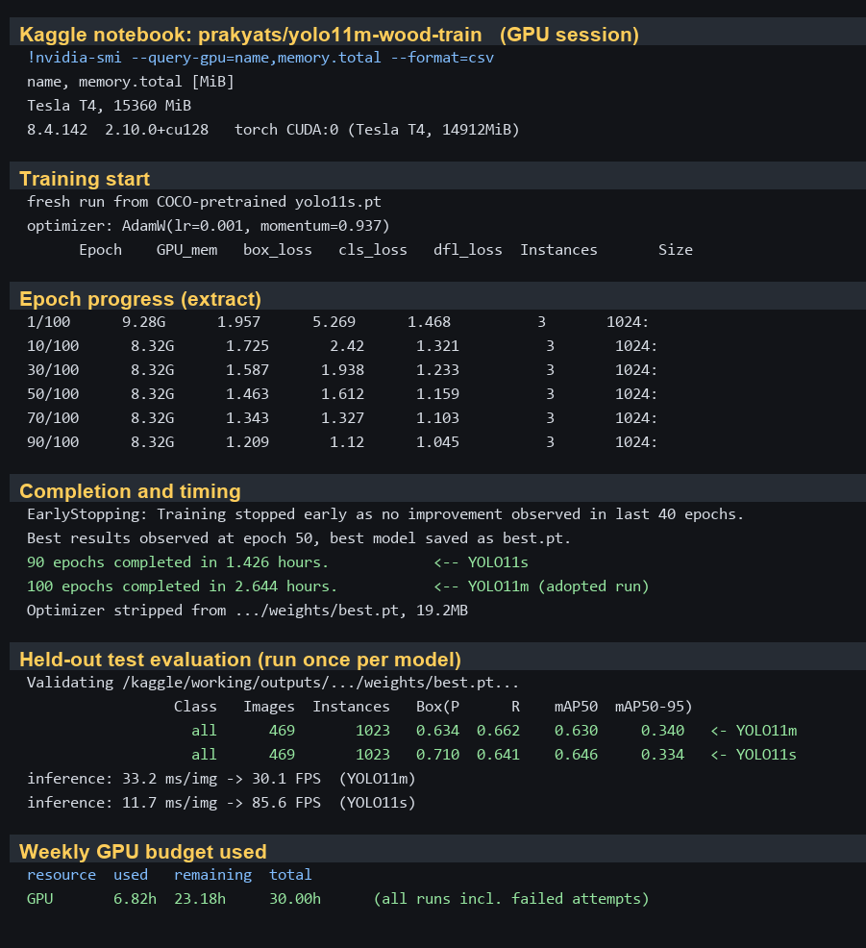
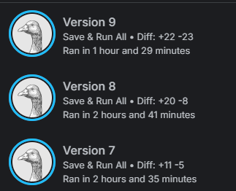
TRAINING : KAGGLE GPU RUNS
2
0
2
6
Fig. Extracts from the Kaggle session logs: GPU, epoch progress, wall-clock training time and the single held-out test evaluation of each model.

Slide 25
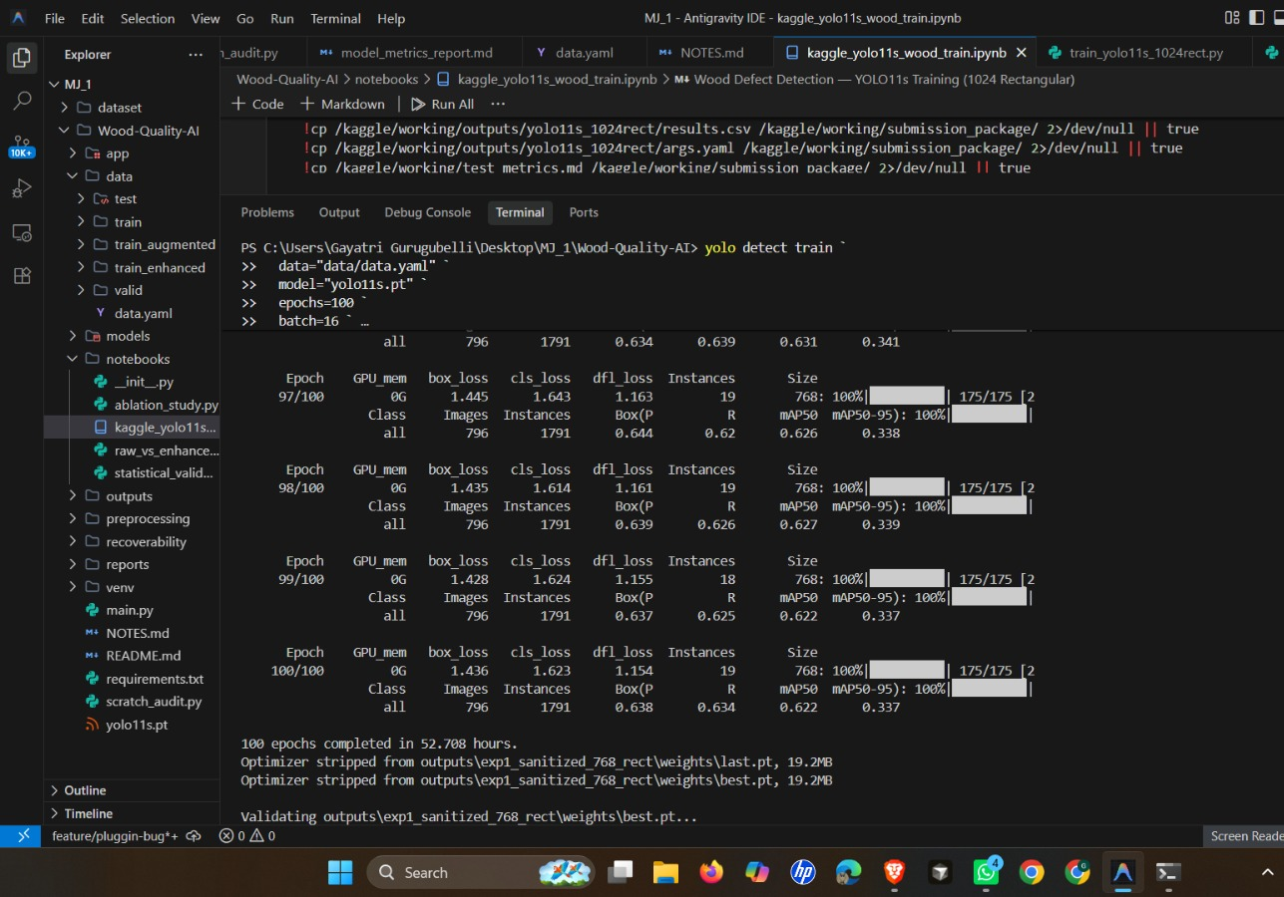
TRAINING : LOCAL SYSTEM RUNS
2
0
2
6
Fig. Local System Runs

Slide 26
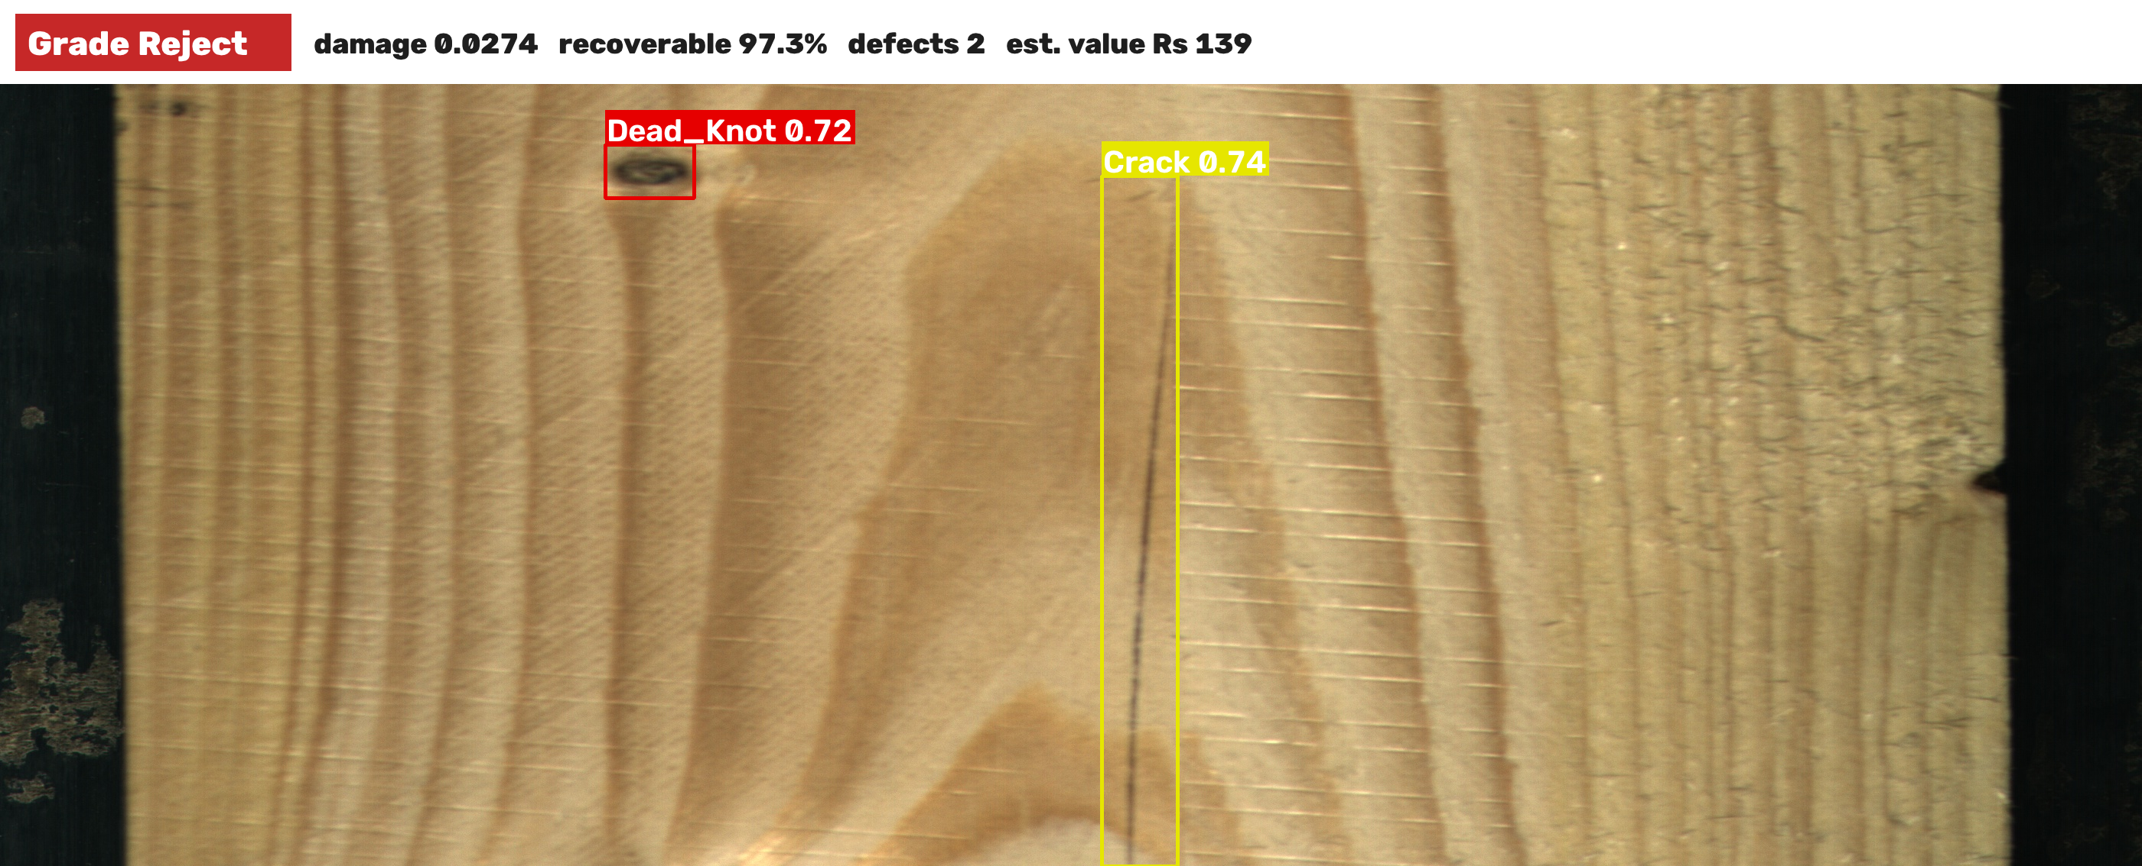
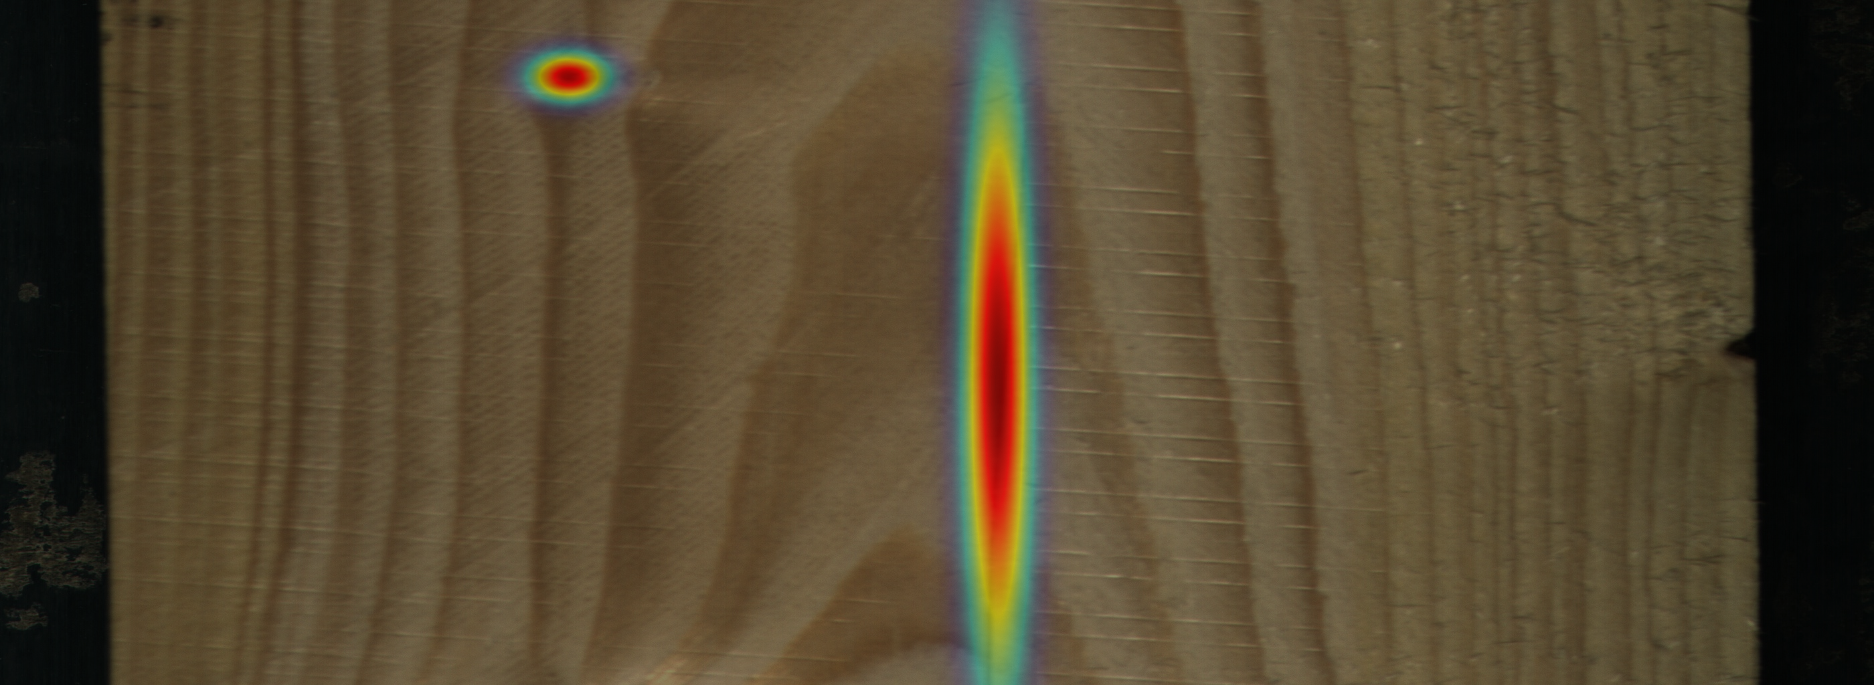
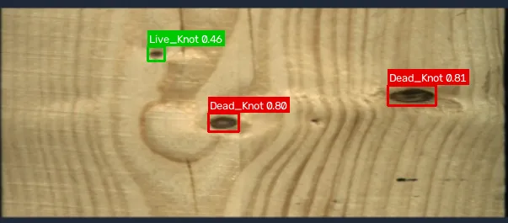
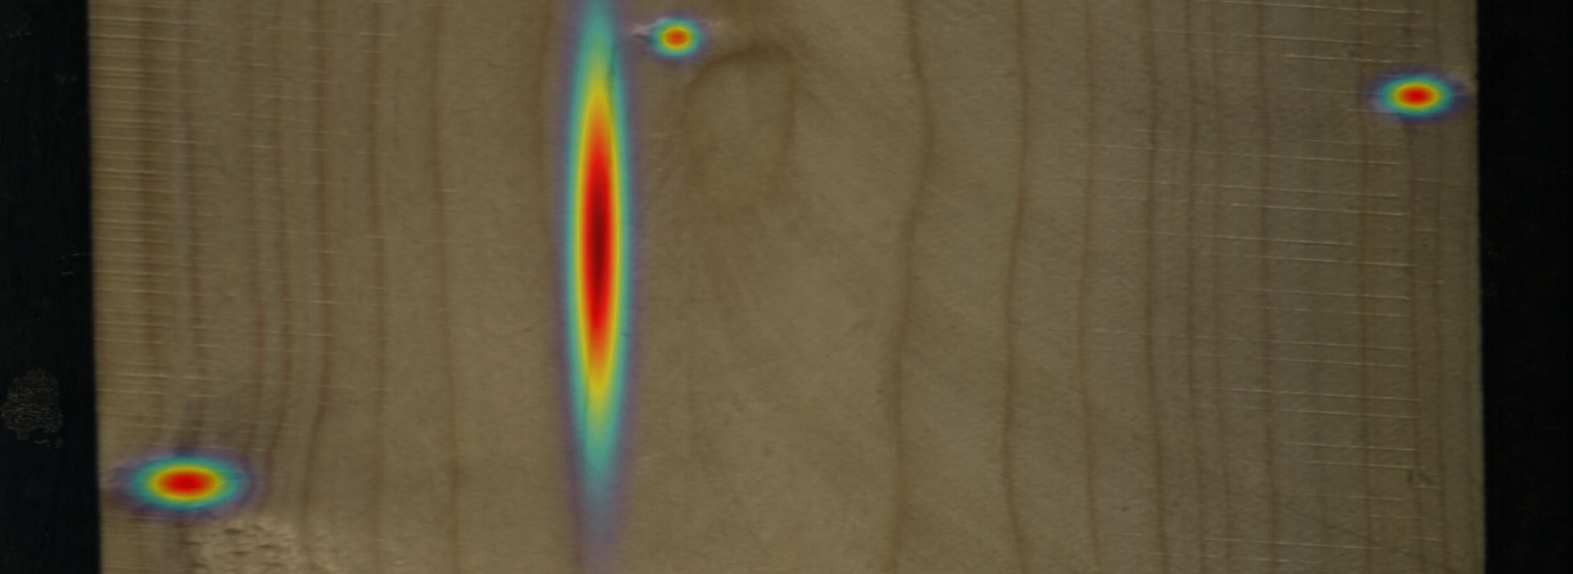
DEMONSTRATION APPLICATION
2
0
2
6
Detect: upload a board image, choose a model or run all; colour-coded boxes, heatmap, per-class counts and area.
Grade: Board Recoverability Index grade A / B / C / Reject, damage score, recoverable area; editable market-value estimate.
Test boards: annotators' boxes and grade next to the model's on the 12 unseen boards.
Deployment: runs on a CPU laptop (0.2-0.6 s per image); JSON report per image.
Validated components: detection (single-shot test), grading (weighted kappa), enhancement (study on validation).
App output: detections on a board and confidence heatmap
Limitations: 12-board test set; severity weights and grade thresholds await expert calibration; trained on controlled line-scan imagery.

Slide 27
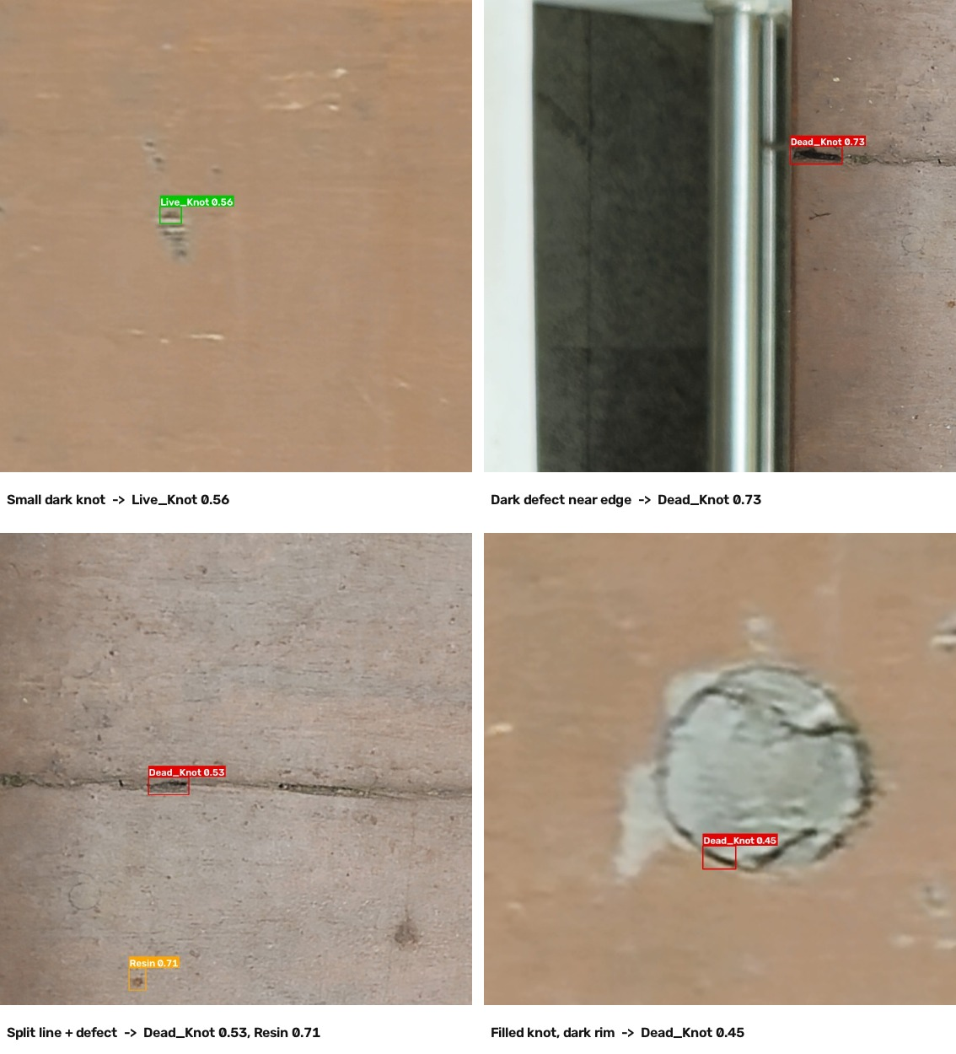
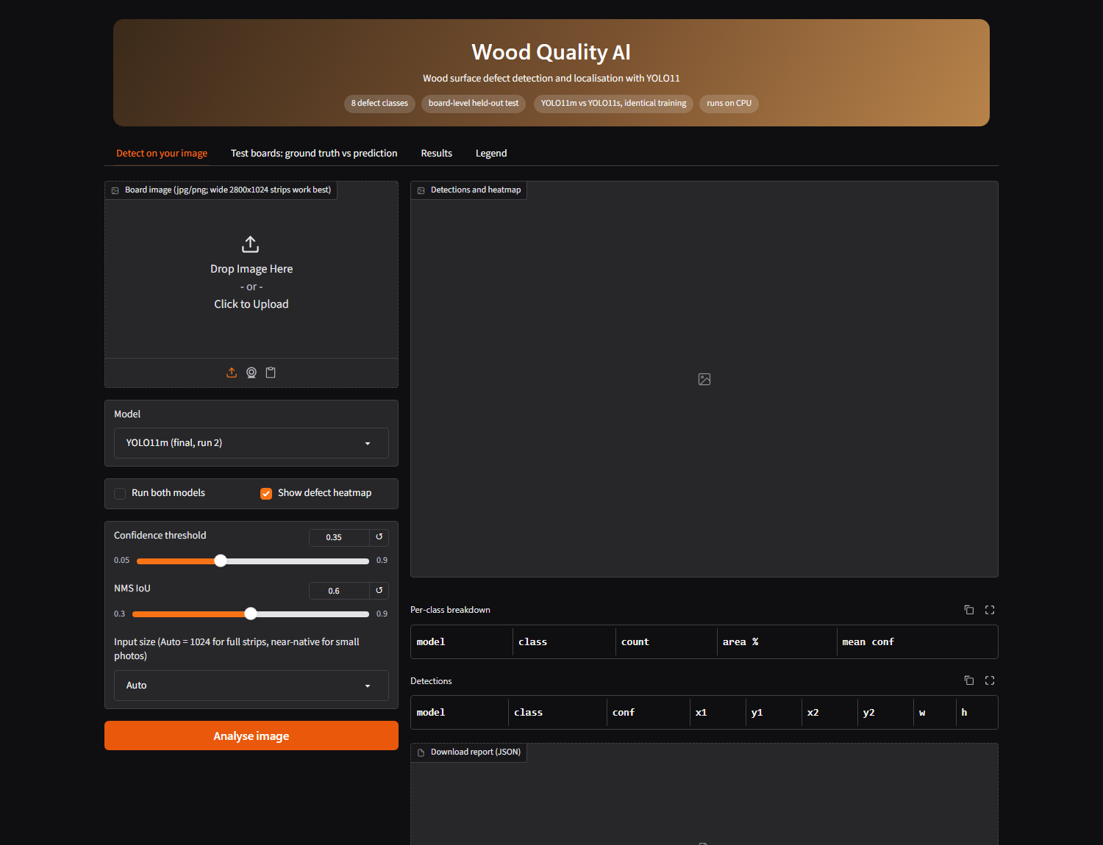
TESTED ON COLLEGE WOOD SAMPLES
2
0
2
6
The application running locally
Classes found: Live_Knot, Dead_Knot, Resin.
Confidence: 0.45 to 0.73 on unseen wood types.
Note: the model is trained on close-range board scans, so the view must be framed at a comparable scale.
Detections on wood photographed in college (YOLO11m)

Slide 28
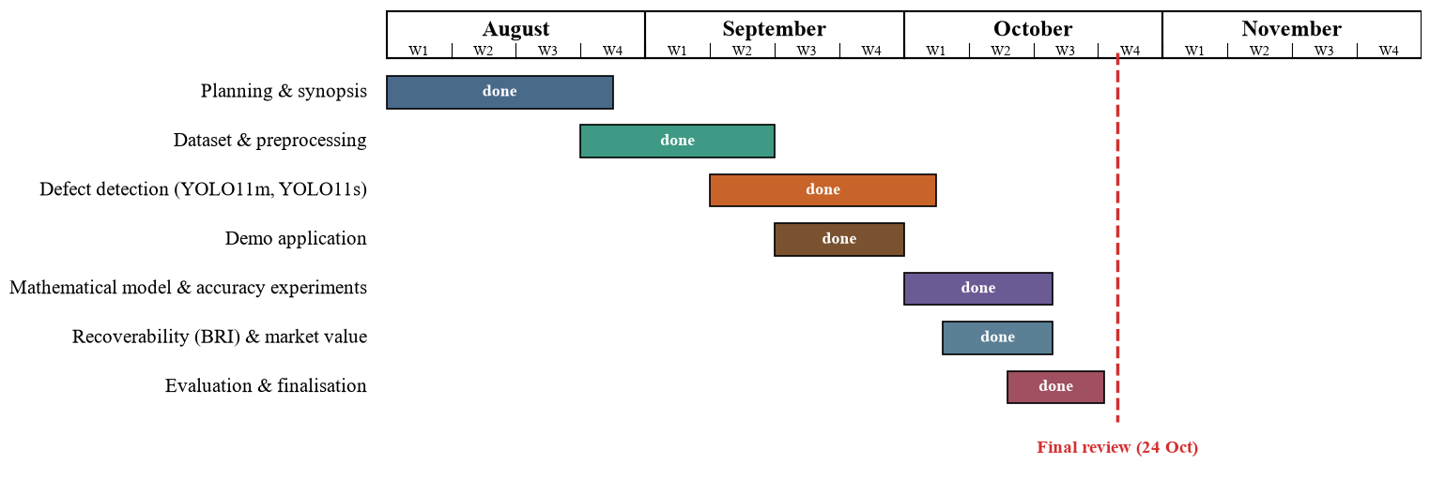
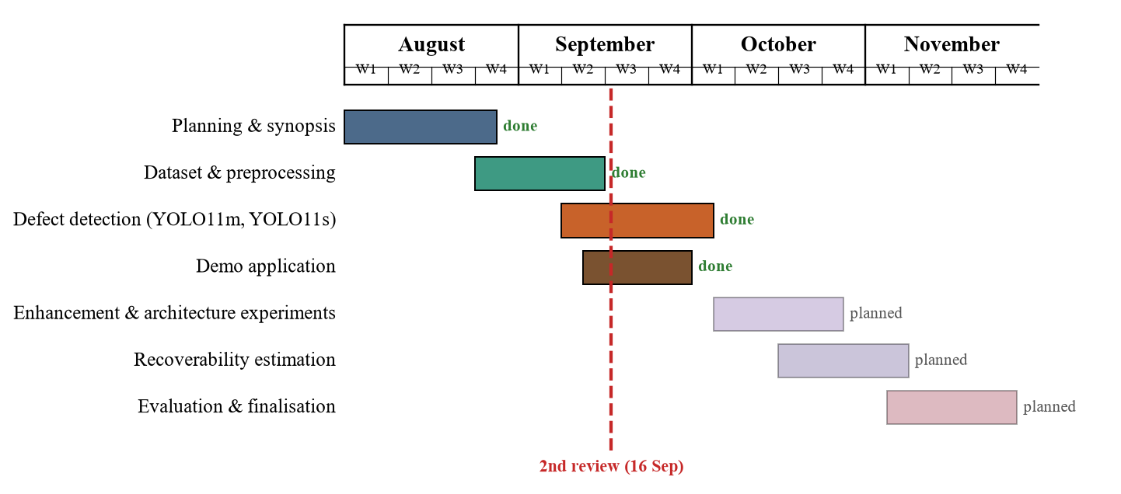
PLAN OF ACTION: COMPLETED
2
0
2
6
All planned work is complete: dataset and preprocessing, defect detection, the mathematical model and accuracy experiments, recoverability estimation and market value, evaluation, application and report.

Slide 29
CONCLUSION AND FUTURE WORK
2
0
2
6
Clean evaluation: a board-level split and rectangular high-resolution input give a reproducible baseline of 63-65 mAP50 over 8 classes on 12 unseen boards; YOLO11s matches YOLO11m at 2.8x the speed.
Mathematical model: weighted box fusion of four balanced / high-resolution YOLO11s models raises test mAP50 from 69.2 to 74.7 (significant, 10 of 12 boards better); balancing or 1280 px alone, Wise-IoU and per-class thresholds gave no significant gain.
Quality assessment: the guide's Board Recoverability Index, adapted to line-scan geometry, reproduces annotation-based grades (weighted kappa 0.83 per image with the deployed detector) and drives a market-value estimate.
Deliverable: a CPU web application that shows defects, grade, recoverable area and value for an uploaded board image.
Future work: blind expert grading to calibrate severity weights and thresholds; more boards and k-fold validation; more rare-class data; segmentation masks for tighter defect area; CondConv / BiFormer (full CWB) architecture; plywood images and field cameras.

Slide 30
REFERENCES
[1] Y. Fang, Y. Ma, S. Gao, and J. Chen, “Recent advances in wood surface defect inspection using deep learning (2021–2025),” BioResources, vol. 21, no. 3, 2026. https://bioresources.cnr.ncsu.edu/resources/recent-advances-in-wood-surface-defect-inspection-using-deep-learning-2021-2025/ (BioResources)
[2] J. Zheng, “IEL-YOLO: A low-light robust wood defect detection method based on YOLOv11,” in Proc. 2026 3rd Int. Conf. Electrical Technology and Automation Engineering (ETAE), 2026, pp. 818–821, doi: 10.1109/ETAE69474.2026.11496073. https://doi.org/10.1109/ETAE69474.2026.11496073 (ResearchGate)
[3] J. Qu, Y. Pang, and Z. Wang, “WD-SEG: A deep learning framework for delicate and accurate wood defect segmentation,” BioResources, vol. 21, no. 2, pp. 2925–2947, 2026. https://bioresources.cnr.ncsu.edu/resources/wd-seg-a-deep-learning-framework-for-delicate-and-accurate-wood-defect-segmentation/ (BioResources)
[4] J. Wang and S. Tang, “A novel IWPT-VMD denoising method for enhancing air-coupled ultrasonic detection of wood defects,” AIP Advances, vol. 16, no. 2, Art. no. 025217, 2026, doi: 10.1063/5.0313821. https://doi.org/10.1063/5.0313821 (ResearchGate)
[5] C. S. Erasmus, D. M. Drew, and M. J. Booysen, “A low-cost wireless dendrometer and digital twin for precision forestry applications,” Measurement, vol. 276, Art. no. 121442, 2026, doi: 10.1016/j.measurement.2026.121442. https://doi.org/10.1016/j.measurement.2026.121442 (ScienceDirect)
[6] N. Perry, J. Schweier, L. G. Bont, S. K. Kushwaha, H. Peltola, K. Eyvindson, R. Astrup, M. Chapman, and C. Blattert, “Towards precision forestry: A systematic review of optimisation methods for individual-tree decisions in forest management,” Trees, Forests and People, vol. 24, Art. no. 101226, 2026, doi: 10.1016/j.tfp.2026.101226. https://doi.org/10.1016/j.tfp.2026.101226 (ScienceDirect)
2
0
2
6

Slide 31
REFERENCES
[7] E. Z. Başkent, A. Bončina, and J. G. Borges, “A review and conceptual framework for a new era of forest management planning: Integrating hybrid digital twin systems toward sustainable forest ecosystems,” Ecosystem Services, vol. 79, Art. no. 101851, 2026, doi: 10.1016/j.ecoser.2026.101851. https://doi.org/10.1016/j.ecoser.2026.101851 (ScienceDirect)
[8] J. Tan, H. Zhang, J. Yang, Y. Liu, D. Zheng, and X. Liu, “ForestryBERT: A pre-trained language model with continual learning adapted to changing forestry text,” Knowledge-Based Systems, vol. 320, Art. no. 113706, 2025, doi: 10.1016/j.knosys.2025.113706. https://doi.org/10.1016/j.knosys.2025.113706 (ScienceDirect)
[9] T. I. Zohdi, “A machine-learning enabled digital-twin framework for next generation precision agriculture and forestry,” Computer Methods in Applied Mechanics and Engineering, vol. 431, Art. no. 117250, 2024, doi: 10.1016/j.cma.2024.117250. https://doi.org/10.1016/j.cma.2024.117250 (ScienceDirect)
[10] H. An, Z. Liang, M. Qin, Y. Huang, F. Xiong, and G. Zeng, “Wood defect detection based on the CWB-YOLOv8 algorithm,” Journal of Wood Science, vol. 70, Art. no. 26, 2024, doi: 10.1186/s10086-024-02139-z. https://doi.org/10.1186/s10086-024-02139-z (Springer)
[11] L. P. Yi, M. F. Akbar, M. N. A. Wahab, B. A. Rosdi, M. A. Fauthan, and N. H. M. M. Shrifan, “The prospect of artificial intelligence-based wood surface inspection: A review,” IEEE Access, vol. 12, pp. 84706–84725, 2024, doi: 10.1109/ACCESS.2024.3412928. https://doi.org/10.1109/ACCESS.2024.3412928 (Ouci)
2
0
2
6

Slide 32
REFERENCES (contd.)
[12] P. Kodytek, A. Bodzas, and P. Bilik, “A large-scale image dataset of wood surface defects for automated vision-based quality control processes,” F1000Research, vol. 10, p. 581, 2022, doi: 10.12688/f1000research.52903.2.
[13] G. Jocher and J. Qiu, “Ultralytics YOLO11,” version 11.0.0, 2024. [Online]. Available: https://github.com/ultralytics/ultralytics
[14] Y. Cui, M. Jia, T.-Y. Lin, Y. Song, and S. Belongie, “Class-balanced loss based on effective number of samples,” in Proc. IEEE/CVF CVPR, 2019, pp. 9268–9277.
[15] A. Gupta, P. Dollár, and R. Girshick, “LVIS: A dataset for large vocabulary instance segmentation,” in Proc. IEEE/CVF CVPR, 2019, pp. 5356–5364.
[16] D. Dwibedi, I. Misra, and M. Hebert, “Cut, paste and learn: Surprisingly easy synthesis for instance detection,” in Proc. IEEE ICCV, 2017, pp. 1301–1310.
[17] R. Solovyev, W. Wang, and T. Gabruseva, “Weighted boxes fusion: Ensembling boxes from different object detection models,” Image and Vision Computing, vol. 107, Art. no. 104117, 2021.
[18] Z. Tong, Y. Chen, Z. Xu, and R. Yu, “Wise-IoU: Bounding box regression loss with dynamic focusing mechanism,” arXiv:2301.10051, 2023.
[19] J. Cohen, “Weighted kappa: Nominal scale agreement provision for scaled disagreement or partial credit,” Psychological Bulletin, vol. 70, no. 4, pp. 213–220, 1968.
[20] B. Efron and R. J. Tibshirani, An Introduction to the Bootstrap. New York, NY, USA: Chapman & Hall, 1993.
[21] F. Wilcoxon, “Individual comparisons by ranking methods,” Biometrics Bulletin, vol. 1, no. 6, pp. 80–83, 1945.
[22] K. Zuiderveld, “Contrast limited adaptive histogram equalization,” in Graphics Gems IV, P. S. Heckbert, Ed. San Diego, CA, USA: Academic Press, 1994, pp. 474–485.
2
0
2
6

Slide 33
2
0
2
6
Thank You

