Slide 1


Geetha Shishu Shikshana Sangha (R) GSSS INSTITUTE OF ENGINEERING & TECHNOLOGY FOR WOMEN DEPARTMENT OF COMPUTER SCIENCE & ENGINEERING
SEMINAR
ON
UNDERSTANDING CHAT MESSAGES FOR STICKER RECOMMENDATION IN HIKE MESSENGER
Presented by
Prakruthi S 4GW16CS415
Under the Guidance of
Smt. ASHARANI M
Assistant Professor
Dept. of CSE GSSSIETW

Slide 2

Introduction
Hike Messaging app is the cross platform instant messaging app for communication on the internet. It was launched in December 2012.
It is one of the first instant messaging app made in India.
Users can send each other Graphical stickers,emocations,audio,video,files etc

Slide 3
ABSTRACT
Stickers are popularly used in messaging app such as hike .
Visually express nuanced range of thoughts and convey exaggerated emotions
Discovering right sticker at the right time in a chat from a large and ever expanding pool of stickers.
In this paper we describe a system for recommending stickers based on what user is typing.
Emoji’s are used before to express emotions, stickers would be an graphical alternative for text message

Slide 4
Literature survey
Hike was Launched on Dec 2012
Attained 15 Billion users in 2014
Over next few months it launched free text messaging across india
Made its first acquisition in 2015, buying free voice calling company Zip Phones which allowed it to launch free app based calling services
Integrated TinyMogul and Hopper under its own brand name
In 2015 it launched “Great Indian Sticker Challenge” to invite designers to design new stickers
In October 2015 it reached 20 Million users with 20 billion messages shared each month

Slide 5
In January 2016 it crossed 100 Million users
In November 2016 it launched the feature of stories
In June 2017, Hike launched Hike 5.0 along with Hike Wallet, first indian messaging app to launch this feature
Later in 2017, Hike announced its acquisition hardware startup creo
In January 2018, launched Total, Built by hike.it allowed users to access services on their mobile even in the offline mode.

Slide 6
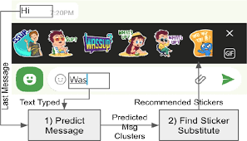
Methodology
2 Major Steps involved
1. Predict the message based on chat context & user typed input
2. Recommend stickers by mapping the predicted message to stickers that can substitute it
Novel application of type ahead sticker recommendation
Cluster chat messages with same meaning
Novel hybrid message prediction model, runs on low latency on low end phones

Slide 7

CHAT MESSAGE CLUSTERING
Input to encoder is a message Mi consisting of a sequence of n words
Output is a continuous Vector ei $∈$ Rdxi
Bag of Words(BOW) is used to compare words
Encoder
Effectively captures its semantics & represents it as a fixed length vector

Slide 8
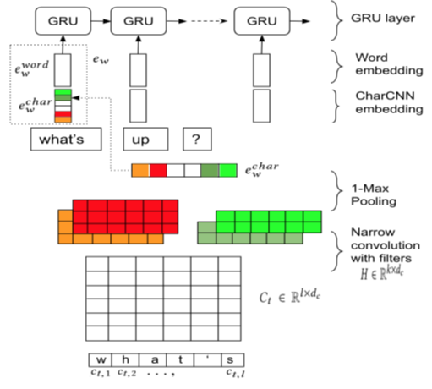
MODEL ARCITECTURE
Skip Through Chat(STC)
Input Response Chat(IRC)
Skip Through Chat
Message can be guessed using a triplet
(Mi-1(Previous Message),Mi(Current Message), Mi+1(Next Message))

Slide 9
INPUT RESPONSE CHAT
Model ( Mi, Mi+1) extracted from a conversation between two users.
Both ei and ei+1 represents the encoding of message in same space.
Since we use ei and ei+1 in the same space memory space can be saved.
Memory saving is a key factor to run hike in lower end mobile.

Slide 10
CLUSTERING AND PREDICTION
Clustering refers to same type of message with different spells will be clustered in a group( eg. Gm, Good Morng etc)
Message Clustering Prediction
can be done in two ways
1. Quantized Message Prediction Model
2. Hybrid Message Prediction Model

Slide 11
Quantized Message Prediction Model
Converts both weight & activation from 32 bit float number to 8 bit integer and few 32 bit bias integer

Slide 12
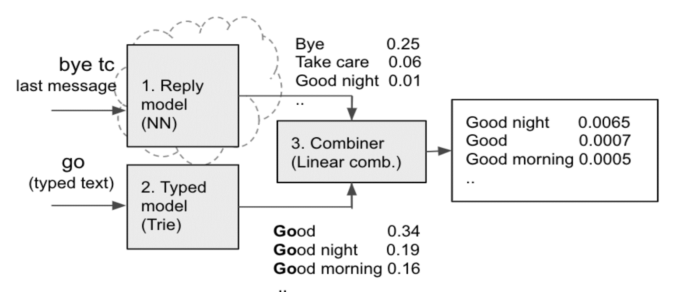
Hybrid message Prediction Model

Slide 13
Reply Model
P reply( G=g|prev )
Typed Model
Keep < Phrase, Message Cluster> pairs as < Key, Value>
Combiner Model
Reply & Tric Model
Final message Phybrid (G=g|typed, prev)→Preply (G= g|prev) +Ptric(G=g/typed)

Slide 14
RESULTS
Hike stands different compared to other texting apps.
Methodology used to suggest the stickers for the user will be more appropriate compared to others.

Slide 15
conclusion
Hike is more Expressive in terms of stickers when compared with competitive chat rooms.
Hike supports lower and higher end mobiles which makes it user friendly.
Abundant stickers are available which makes hike more expressive than others.
Wallet is an unique option which is not available in most of the other messaging Apps.

Slide 16
REFERENCES
2018. Multimodal emoji prediction. arXiv preprint arXiv:1803.02392 (2018).
arXiv preprint arXiv:1810.04805 (2018).
use: Study on a twitter based corpus. In Proceedings of the 8th Workshop
Computational Approaches to Subjectivity, Sentiment and Social Media Analysis.
www.google.com
www.hike.in
www.Wikipedia.com

