Slide 1

eTourismbd
Team Name: HyperCube
Team No: 012

Slide 2
The Concept
Its an application to help tourists and visitors getting all information about famous and historical beautiful places and accommodation in every district, Upazilla and Union of Bangladesh. Our aim is to develop tourism sector of this country. When information of tourism will be in the hand of people they will be interested to visit the places. It will also increase tourism business. Now a days there is a lack of knowledge and limited access to information about attractive places of this country. But with this mobile application people will have the easy access to get the information.

Slide 3
The Features
District/Zilla/Upazila Based location searching(general , specific and categorized).
Information about the desired places
Photos, Maps, user rating
Accommodation : Hotels and fooding.
Transportation System : Bus, train and other available transportation system’s contact number, address etc.
User feedback and location adding in database of this application.
Sharing in social networks.

Slide 4
What we developed in GDG
(Detail out the solution and features you developed in GDG. Explain them with screen shots)

Slide 5
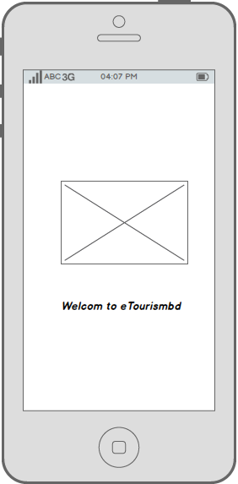
What we developed in GDG:

Slide 6
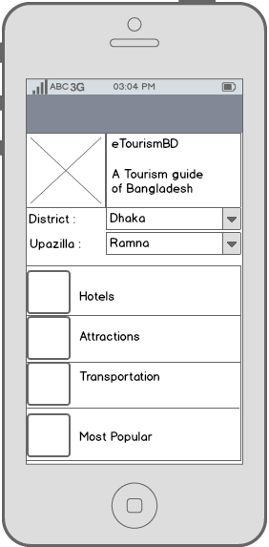
What we developed in GDG:
icon

Slide 7
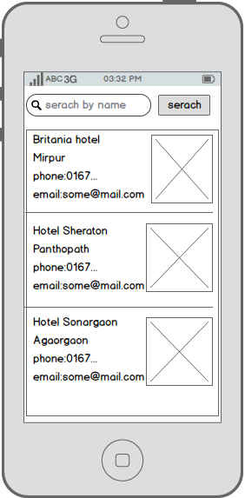
What we developed in GDG:

Slide 8
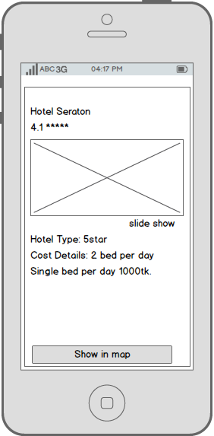
What we developed in GDG:

Slide 9
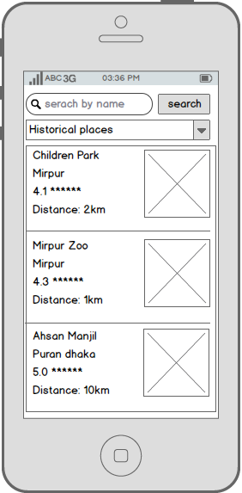
What we developed in GDG:

Slide 10
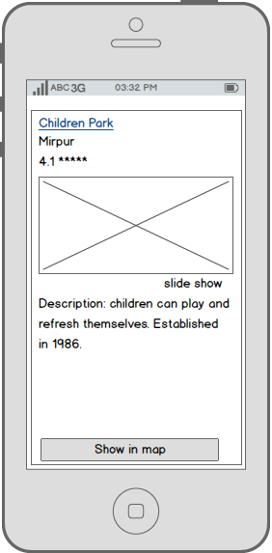
What we developed in GDG:

Slide 11
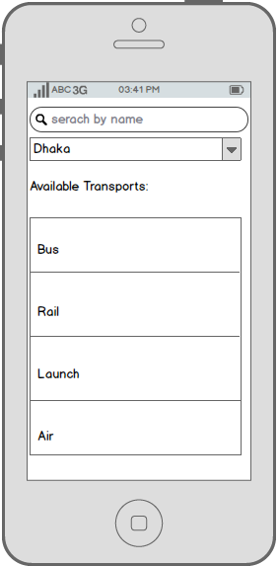
What we developed in GDG:

Slide 12
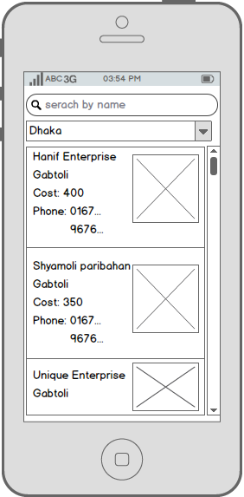
What we developed in GDG:

Slide 13
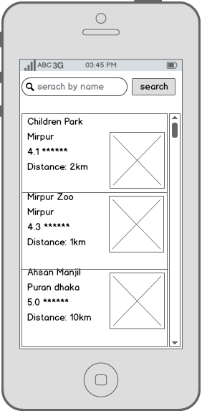
What we developed in GDG:

Slide 14
Final Vision
A Complete tourism guide of Bangladesh
Required 4 working days

Slide 15
Supports We Need
1.Full access to national web portal, it’s web services and databases.

Slide 16
Team Details
Domain expert: Kazi Saemuzzaman
Email: saem_saimum@yahoo.com
Team Leader: Md. Jumman Hussain
Email: pralgomathic@gamil.com
Git link: Github.com/pralgomathic
Team member 2:Md. Asfaq Sufian
Email: asfaqleeon@gamil.com

