Slide 1
Artificial Intelligence
History

Slide 2
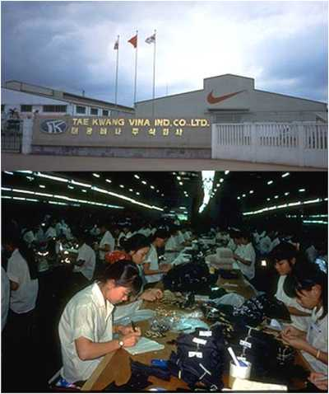
Could AI Stop This?

Slide 3
What is Artificial Intelligence?
A.I. is the study of how to make computers do things at which, at the moment, people are better.

Slide 4
Or, Stepping Back Even Farther, Can We Build Artificial People?
Historical attempts
The modern quest for robots and intelligent agents
Us vs. Them

Slide 5
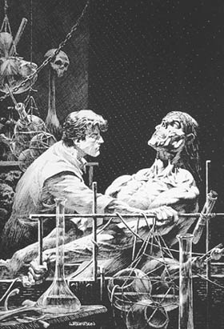
Historical Attempts - Frankenstein
The original story, published by Mary Shelley, in 1818, describes the attempt of a true scientist, Victor Frankenstein, to create life.
http://members.aon.at/frankenstein/frankenstein-novel.htm
Frankenstein creates the fiend - illustration by
Bernie Wrightson (© 1977)

Slide 6
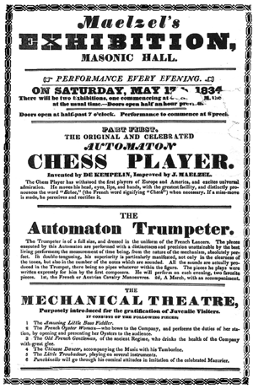
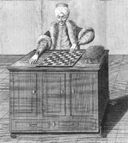
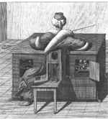
Historical Attempts – The Turk
http://www.theturkbook.com

Slide 7
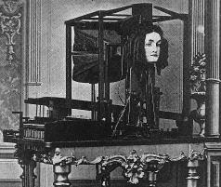
Historical Attempts - Euphonia
Joseph Faber's Amazing Talking Machine (1830-40's). The Euphonia and other early talking devices are described in detail in a paper by David Lindsay called "Talking Head", Invention & Technology, Summer 1997, 57-63.
About this device, Lindsay writes:
It is "... a speech synthesizer variously known as the Euphonia and the Amazing Talking Machine. By pumping air with the bellows ... and manipulating a series of plates, chambers, and other apparatus (including an artificial tongue ... ), the operator could make it speak any European language. A German immigrant named Joseph Faber spent seventeen years perfecting the Euphonia, only to find when he was finished that few people cared."
From http://www.haskins.yale.edu/haskins/HEADS/SIMULACRA/euphonia.html

Slide 8
Historical Attempts - RUR
In 1921, the Czech author Karel Capek produced the play R.U.R. (Rossum's Universal Robots).
"CHEAP LABOR. ROSSUM'S ROBOTS."
"ROBOTS FOR THE TROPICS. 150 DOLLARS EACH."
"EVERYONE SHOULD BUY HIS OWN ROBOT."
"DO YOU WANT TO CHEAPEN YOUR OUTPUT?
ORDER ROSSUM'S ROBOTS"
Some references state that term "robot" was derived from the Czech word robota, meaning "work", while others propose that robota actually means "forced workers" or "slaves." This latter view would certainly fit the point that Capek was trying to make, because his robots eventually rebelled against their creators, ran amok, and tried to wipe out the human race. However, as is usually the case with words, the truth of the matter is a little more convoluted. In the days when Czechoslovakia was a feudal society, "robota" referred to the two or three days of the week that peasants were obliged to leave their own fields to work without remuneration on the lands of noblemen. For a long time after the feudal system had passed away, robota continued to be used to describe work that one wasn't exactly doing voluntarily or for fun, while today's younger Czechs and Slovaks tend to use robota to refer to work that’s boring or uninteresting.
http://www.maxmon.com/1921ad.htm

Slide 9
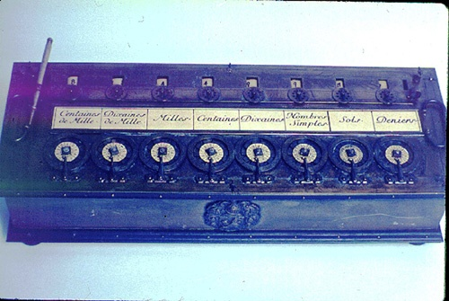

The Roots of Modern Technology
5thc B.C. Aristotelian logic invented
1642 Pascal built an adding machine
1694 Leibnitz reckoning machine

Slide 10
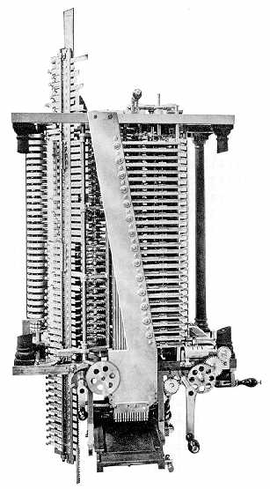
The Roots, continued
1834 Charles Babbage’s
Analytical Engine
Ada writes of the engine, “The Analytical Engine has no pretensions whatever to originate anything. It can do whatever we know how to order it to perform.”
The picture is of a model built in the late 1800s by Babbage’s son from Babbage’s drawings.
Notes:
Picture from http://www.fourmilab.ch/babbage/hpb1910.html

Slide 11
The Roots: Logic
1848 George Boole The Calculus of Logic
chocolate and ¬ nuts and mint
chocolate
nuts
mint

Slide 12
Mathematics in the Early 20th Century –
(Looking Ahead: Will Logic be the Key to Thinking?)
1900 Hilbert’s program and the effort to formalize mathematics
1931 Kurt Gödel’s paper, On Formally Undecidable Propositions
1936 Alan Turing’s paper, On Computable Numbers with an application to the Entscheidungs problem

Slide 13
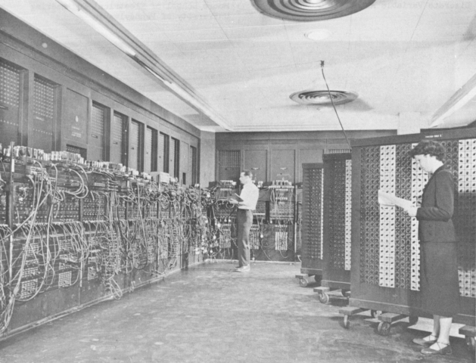
The Advent of the Computer
1945 ENIAC The first electronic digital computer

Slide 14
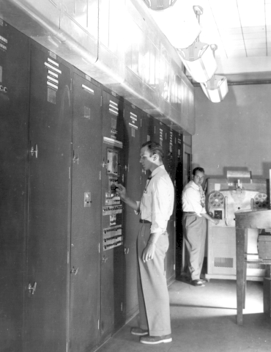
1949 EDVAC
The first stored program computer

Slide 15
The Dartmouth Conference and the Name Artificial Intelligence
J. McCarthy, M. L. Minsky, N. Rochester, and C.E. Shannon. August 31, 1955. "We propose that a 2 month, 10 man study of artificial intelligence be carried out during the summer of 1956 at Dartmouth College in Hanover, New Hampshire. The study is to proceed on the basis of the conjecture that every aspect of learning or any other feature of intelligence can in principle be so precisely described that a machine can be made to simulate it."

Slide 16
Time Line – The Big Picture
academic $ academic and routine
50 60 70 80 90 00 10
1956 Dartmouth conference.
1981 Japanese Fifth Generation project launched as the
Expert Systems age blossoms in the US.
1988 AI revenues peak at $1 billion. AI Winter begins.

Slide 17
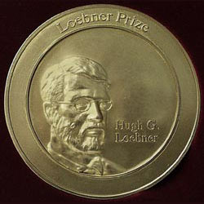
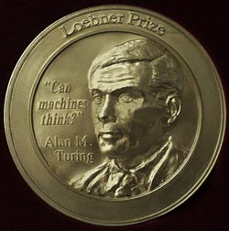
How Will We Recognize AI?
1950 Alan Turing’s paper, Computing Machinery and Intelligence, described what is now called “The Turing Test”. http://www.abelard.org/turpap/turpap.htm
1990 Loebner Prize established. Grand Prize of $100,000 and a Gold Medal for the first computer whose responses are indistinguishable from a human.
Notes:
http://cogsci.ucsd.edu/~asaygin/tt/ttest.html
http://www.loebner.net/Prizef/loebner-prize.html

Slide 18
The Origins of AI Hype
1950 Turing predicted that in about fifty years "an average interrogator will not have more than a 70 percent chance of making the right identification after five minutes of questioning".
1957 Newell and Simon predicted that "Within ten years a computer will be the world's chess champion, unless the rules bar it from competition."
Notes:
Herbert A. Simon and Allen Newell, "Heuristic Problem Solving: The Next Advance in Operations Research," Operations Research, January-February 1958, 1-10.

Slide 19
Was Turing Right?
A conversation with Jabberwacky, 2003
Jabberwacky: Have you been to the Moon?
User: No. Few have. Have you?
Jabberwacky: Many a time my dear chap!
User: What was the most interesting thing you saw?
Jabberwacky: Fred.
User: Why did you find him interesting?
Jabberwacky: It just came into my head.
User: What sorts of things do you generally find interesting?
Jabberwacky: Nothing but smelly socks.
Notes:
http://www.jabberwacky.com
2003 Loebner bot winner, beaten by two people

Slide 20
Another One
A Conversation with Alice, 2004
>What's the best place to eat Chinese food?
ALICE: My favorite places are California and Maine. Holland is cool too.
>What do you like about Maine?
ALICE: The special effects are the best.
http://www.alicebot.org/
Notes:
http://www.alicebot.org/

Slide 21
Alice, Again
>Who invented paper towels?
ALICE: The Chinese, long before Europeans.
>Who invented pet rocks?
ALICE: The Wright Brothers.
>Who invented Barbie dolls?
ALICE: Thomas Edison.
Notes:
Note here that the language processing seems fine. It’s a lack of specific knowledge that is killing Alice.

Slide 22
Were Newell and Simon Right?
1950 Claude Shannon published a paper describing how
a computer could play chess.
1957 Newell and Simon predicted that a computer will
beat a human at chess within 10 years.
1967 MacHack was good enough to achieve a class-C
rating in tournament chess.

Slide 23
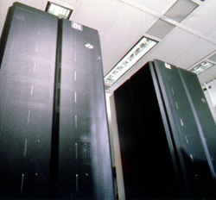
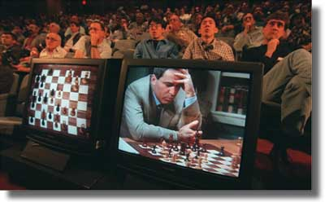
Chess Today
In 1997, Deep Blue beat Gary Kasparov.
Notes:
Is this AI? Is it just search? Is chess a representative “intelligent problem”?
What about role playing games? Need a lot more knowledge.

Slide 24
Why Did They Get it Wrong?
They failed to understand at least three key things:
  The need for knowledge (lots of it)
  Scalability and the problem of complexity and exponential growth
  The need to perceive the world
Notes:
Knowledge – more later
Perception – more later

Slide 25
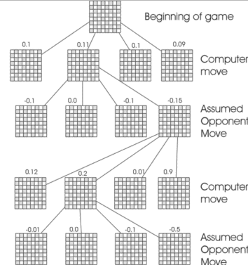
Scalability
Solving hard problems requires search in a large space.
To play master-level chess requires searching about 8 ply deep. So about 35⁸ or 2⋅10¹² nodes must be examined.
Notes:
http://sern.ucalgary.ca/courses/CPSC/533/W99/presentations/L1_5A_Szuch_Boyd/game.html

Slide 26
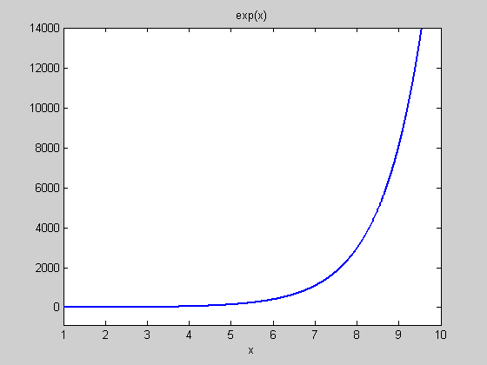
Exponential Growth

Slide 27
But Chess is Easy
The rules are simple enough to fit on one page
The branching factor is only 35.

Slide 28
A Harder One
John saw a boy and a girl with a red wagon with one blue and one white wheel dragging on the ground under a tree with huge branches.
Notes:
Parses: read bottom up. It gets worse at the end. 8064 total.
With huge branches: tree, ground, dragging, wheel, wagon, girl, boy and girl, saw (8)
under a tree can attach to ground, dragging, wheel, wagon, girl, boy and girl, saw. (7)
On the ground (6)
Dragging: wheel, wagon, girl, boy and girl (4)
And: (one blue and one white) wheel, one blue and (one white wheel) (2)
With a red wagon: girl, boy and girl, saw (3)
How hard to check each?
Current approaches: use statistics to guess right a lot of the time. But note that this one is ambiguous even for people.

Slide 29
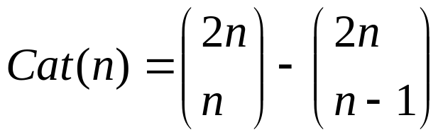
How Bad is the Ambiguity?
Kim (1)
Kim and Sue (1)
Kim and Sue or Lee (2)
Kim and Sue or Lee and Ann (5)
Kim and Sue or Lee and Ann or Jon (14)
Kim and Sue or Lee and Ann or Jon and Joe (42)
Kim and Sue or Lee and Ann or Jon and Joe or Zak (132)
Kim and Sue or Lee and Ann or Jon and Joe or Zak and Mel (469)
Kim and Sue or Lee and Ann or Jon and Joe or Zak and Mel or Guy (1430)
Kim and Sue or Lee and Ann or Jon and Joe or Zak and Mel or Guy and Jan (4862)
The number of parses for an expression with n terms is the n’th Catalan number:
Notes:
From Church and Patil, 1982, via http://www.cogs.susx.ac.uk/lab/nlp/gazdar/teach/nlp/nlpnode11.html
Binomial coefficients: (a b) = a!/(b!(a-b)!)
Cat(n) is the number of ways to parenthesize an expresssion of length n with two conditions:
1) Equal number of open and closes. That’s the first term.
2) They must be properly nested. That’s the second term, so it subtracts out the improper ones.

Slide 30
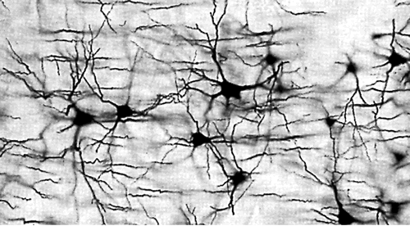
Can We Get Around the Search Problem ?
Notes:
Maybe the problem is representation. Can we punt search if we have trained a neural net to simply do the right thing? Maybe but now we have to search in a different space, the space of all neural nets.

Slide 31
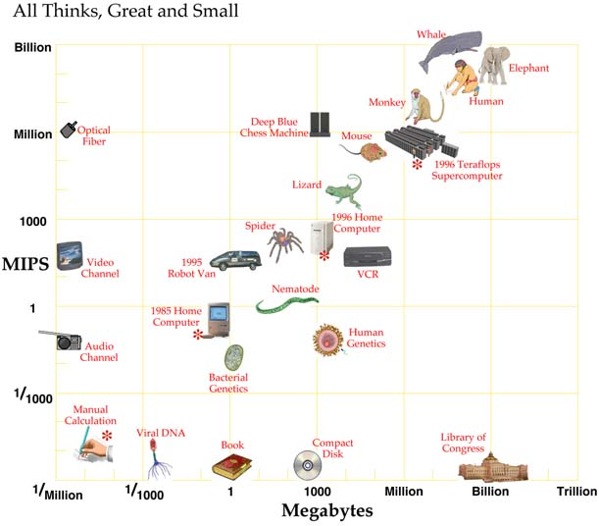
How Much Compute Power Does it Take?
From Hans Moravec, Robot Mere Machine to Transcendent Mind 1998.

Slide 32
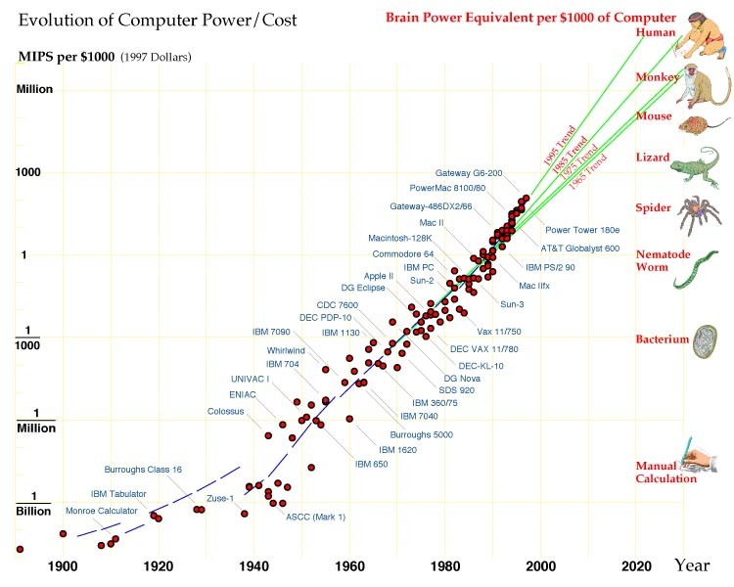
How Much Compute Power is There?
From Hans Moravec, Robot Mere Machine to Transcendent Mind 1998.

Slide 33

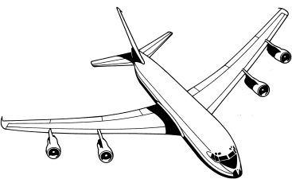
Evolution of the Main Ideas
Wings or not?
Games, mathematics, and other knowledge-poor tasks
The silver bullet?
Knowledge-based systems
Hand-coded knowledge vs. machine learning
Low-level (sensory and motor) processing and the resurgence of subsymbolic systems
Robotics
Natural language processing
Programming languages
Cognitive modeling

Slide 34
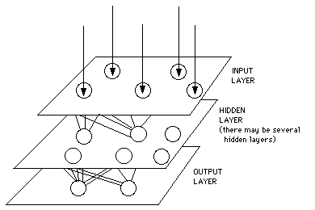
Symbolic vs. Subsymbolic AI
Subsymbolic AI: Model intelligence at a level similar to the neuron. Let such things as knowledge and planning emerge.
Symbolic AI: Model such things as knowledge and planning in data structures that make sense to the programmers that build them.
(blueberry (isa fruit)
(shape round)
(color purple)
(size .4 inch))
Notes:
Neural net picture from http://hem.hj.se/~de96klda/NeuralNetworks.htm#2.1.2%20The%20Artificial%20Neuron

Slide 35
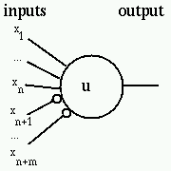
The Origins of Subsymbolic AI
1943 McCulloch and Pitts A Logical Calculus of the Ideas Immanent in Nervous Activity
“Because of the “all-or-none” character of nervous activity, neural events and the relations among them can be treated by means of propositional logic”
Notes:
http://diwww.epfl.ch/mantra/tutorial/english/mcpits/html/

Slide 36
Interest in Subsymbolic AI
40 50 60 70 80 90 00 10

Slide 37
Low-level (Sensory and Motor) Processing and the Resurgence of Subsymbolic Systems
Computer vision
Motor control
Subsymbolic systems perform cognitive tasks
  Detect credit card fraud
The backpropagation algorithm eliminated a formal weakness of earlier systems
Neural networks learn.

Slide 38
The Origins of Symbolic AI
Games
Theorem proving
Notes:
Note: They’re formal. Don’t need a lot of messy knowledge.

Slide 39
Games
Chess
Checkers:
      1952-1962 Art Samuel built the first checkers program
      Chinook became the world checkers champion in 1994
Othello:
      Logistello beat the world champion in 1997
Notes:
Pictures from M. Muller, Computer Go, AIJ v.134, 1-2.

Slide 40
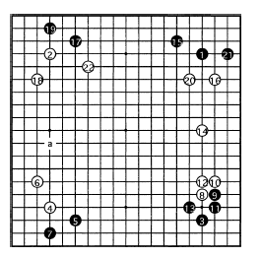
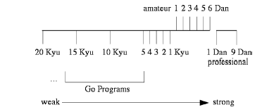
Games
Chess
Checkers: Chinook became the world checkers champion in
        1994
Othello: Logistello beat the world champion in 1997
Go:
Role Playing Games: now we need knowledge
Notes:
Pictures from M. Muller, Computer Go, AIJ v.134, 1-2.

Slide 41
Mathematics
1956 Logic Theorist (the first running AI program?)
1961 SAINT solved calculus problems at the college
freshman level
1967 Macsyma
Gradually theorem proving has become well enough understood that it is usually no longer considered AI
1996 J Moore and others verified the correctness of the
AMD5k86 Floating-Point Division algorithm

Slide 42
The Silver Bullet?
Is there an “intelligence algorithm”?
1957 GPS (General Problem Solver)
Start Goal

Slide 43
But What About Knowledge?
Why do we need it?
Find me stuff about dogs who save people’s lives.
Around midnight, two beagles spotted a fire in the house next door. Their barking alerted their owners, who called 911.
How can we represent it and use it?
How can we acquire it?
Notes:
Two beagles spot fire. Their barking alerts neighbors who call the police.

Slide 44
Representing Knowledge - Logic
McCarthy’s paper, “Programs with Common Sense”
at(I, car) ⇒ can (go(home, airport, driving))
at(I, desk) ⇒ can(go(desk, car, walking))
1965 Resolution theorem proving invented

Slide 45
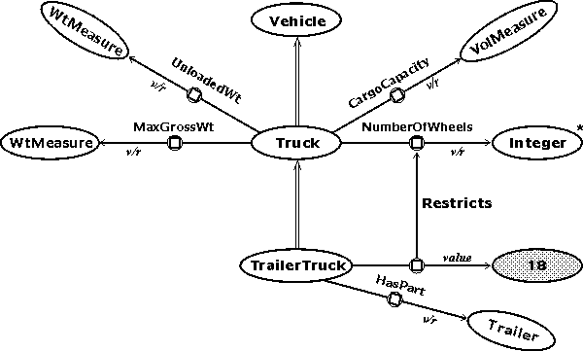
Representing Knowledge- Semantic Nets
1961
Notes:
http://www.jfsowa.com/pubs/semnet.htm

Slide 46
Representing Knowledge – Capturing Experience
Representing Experience with Scripts, Frames, and Cases
1977 Scripts
Joe went to a restaurant. Joe ordered a hamburger. When the hamburger came, it was burnt to a crisp. Joe stormed out without paying.
The restaurant script:
Did Joe eat anything?

Slide 47
Representing Knowledge - Rules
Expert knowledge in many domains can be captured in rules.
From XCON (1982):
If: the most current active context is distributing
massbus devices, and
there is a single-port disk drive that has not been
assigned to a massbus, and
there are no unassigned dual-port disk drives, and
the number of devices that each massbus should support is known, and
there is a massbus that has been assigned at least one disk drive that
should support additional disk drives, and
the type of cable needed to connect the disk drive to the previous
device on the massbus is known
Then: assign the disk drive to the massbus.

Slide 48
Representing Knowledge – Probabilistically
1975 Mycin attaches probability-like numbers to rules
If: (1) the stain of the ogranism is gram-positive, and
(2) the morphology of the organism is coccus, and
(3) the growth conformation of the organism is clumps
Then: there is suggestive evidence (0.7) that the identity of the organism is stphylococcus.
1970s Probabilistic models of speech recognition
1980s Statistical Machine Translation systems
1990s large scale neural nets

Slide 49
The Rise of Expert Systems
  1967 Dendral – a rule-based system that infered molecular structure from mass spectral and NMR data
  1975 Mycin – a rule-based system to recommend antibiotic therapy
  1975 Meta-Dendral learned new rules of mass spectrometry, the first discoveries by a computer to appear in a refereed scientific journal
  1979 EMycin – the first expert system shell
  1980’s The Age of Expert Systems

Slide 50
Expert Systems – The Heyday
1979 Inference
1980 IntelliCorp
1981 Teknowledge
1983 Carnegie Group
1980 XCON (R1) – first real commercial expert system at DEC, configures VAX systems
1981 Japanese Fifth Generation project launched as the
Expert Systems age blossoms in the US.
1984 Gold Hill Common Lisp
1986 neural net start up companies appear
1988 AI revenues peak at $1 billion. AI Winter begins.
Selling expert system shells

Slide 51
Expert Systems – Today: Medicine
One example domain, medicine, has expert systems whose tasks include:
  arrhythmia recognition from electrocardiograms
  coronary heart disease risk group detection
  monitoring the prescription of restricted use antibiotics
  early melanoma diagnosis
  gene expression data analysis of human lymphoma
  breast cancer diagnosis

Slide 52
Expert Systems – Today: Build Your Own
eXpertise2Go: http://www.expertise2go.com/
AcquiredIntelligence: http://www.aiinc.ca/demos/
(whales, graduate school)

Slide 53
Taking the SAT Exam
QUESTION: Sodium azide is used in air bags to rapidly produce gas to inflate the bag. The products of the decomposition reaction are:(a) Na and water.(b) Ammonia and sodium metal.(c) N2 and O2(d) Sodium and nitrogen gas.(e) Sodium oxide and nitrogen gas.
(d) Sodium and nitrogen gas.

Slide 54
SYSTEM-GENERATED ANSWER:
# What are the products of the given decomposition reaction?
By definition, oxidation-reduction reactions occur when electrons are transferred from the atom that is oxidized to the atom that is reduced. We need to look for changes in the oxidation states of the elements in the reaction.
  In the reactants, the oxidation state(s) of the element Na is/are (1). In the product, the oxidation state(s) is/are (0).
  Therefore, the reaction causes a change in oxidation state.
  Therefore, this is an oxidation reduction reaction.
By definition, a Binary Ionic-Compound Decomposition Reaction occurs when a binary ionic compound is heated.
Therefore, this reaction is a Binary-Ionic Compound Decomposition reaction.
In general, a Binary Ionic-Compound Decomposition Reaction converts a binary ionic-compound into basic elements.
In this reaction, NaN3 reacts to produce Na and N2.
# The products of the decomposition reaction are:
(d) Sodium and nitrogen gas.
The work of Bruce Porter et al here at UT

Slide 55
What About Things that People Do Easily?
Common sense
Moving Around
Language

Slide 56
What About Things that People Do Easily?
Common sense
  CYC
  UT (http://www.cs.utexas.edu/users/mfkb/RKF/tree/ )
  WordNet (http://www.cogsci.princeton.edu/~wn/)
Moving around
Language

Slide 57
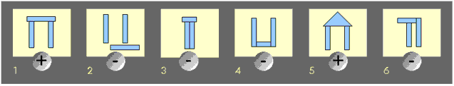
Hand-Coded Knowledge vs. Machine Learning
How much work would it be to enter knowledge by hand?
Do we even know what to enter?
1952-62 Samuel’s checkers player learned its evaluation
function
Winston’s system learned structural descriptions
from examples and near misses
1984 Probably Approximately Correct learning offers a
theoretical foundation
mid 80’s The rise of neural networks
Notes:
http://www.rci.rutgers.edu/~cfs/472_html/Learn/Winston.html

Slide 58
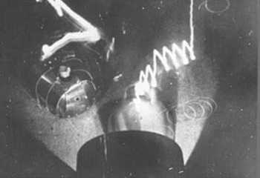
Robotics - Tortoise
1950 W. Grey Walter’s light seeking tortoises. In this picture, there are two, each with a light source and a light sensor. Thus they appear to “dance” around each other.
Notes:
http://www.epub.org.br/cm/n09/historia/documentos_i.htm

Slide 59
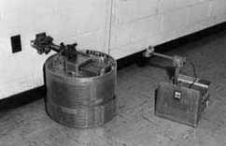
Robotics – Hopkins Beast
1964 Two versions of the Hopkins beast, which used sonar to guide it in the halls. Its goal was to find power outlets.
Notes:
http://www.frc.ri.cmu.edu/~hpm/book97/index.html

Slide 60
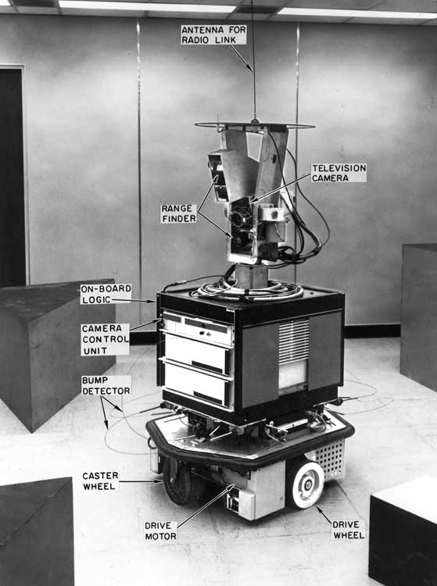
Robotics - Shakey
1970 Shakey (SRI) was driven by a remote-controlled computer, which formulated plans for moving and acting. It took about half an hour to move Shakey one meter.
Notes:
http://www.frc.ri.cmu.edu/~hpm/book98/fig.ch2/p027.html

Slide 61
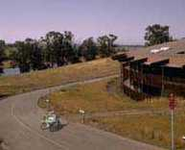
Robotics – Stanford Cart
1971-9 Stanford cart. Remote controlled by person or computer.
1971 follow the white line
1975 drive in a straight line by tracking skyline
1979 get through obstacle courses. Cross 30 meters in five hours, getting lost one time out of four
Notes:
http://www.frc.ri.cmu.edu/~hpm/book97/ch2/index.html

Slide 62
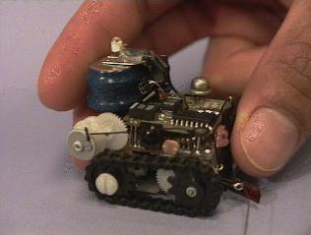
Planning vs. Reacting
In the early days: substantial focus on planning (e.g., GPS)
1979 – in “Fast, Cheap and Out of Control”, Rodney Brooks argued for a very different approach. (No, I’m not talking about the 1997 movie.)
The Ant, has 17 sensors. They are designed to work in colonies.
http://www.ai.mit.edu/people/brooks/papers/fast-cheap.pdf
http://www.ai.mit.edu/projects/ants/
Notes:
http://www.ai.mit.edu/people/brooks/papers/fast-cheap.pdf

Slide 63
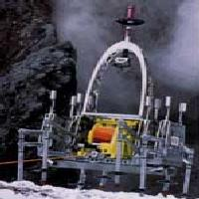
Robotics - Dante
1994 Dante II (CMU) explored the Mt. Spurr (Aleutian Range, Alaska) volcano. High-temperature, fumarole gas samples are prized by volcanic science, yet their sampling poses significant challenge. In 1993, eight volcanologists were killed in two separate events while sampling and monitoring volcanoes.
Using its tether cable anchored at the crater rim, Dante II is able to descend down sheer crater walls in a rappelling-like manner to gather and analyze high temperature gasses from the crater floor.
Notes:
http://www.ri.cmu.edu/projects/project_163.html

Slide 64
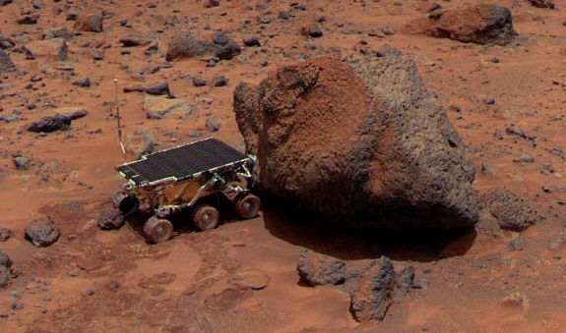
Robotics - Sojourner
Oct. 30, 1999 Sojourner on Mars. Powered by a 1.9 square foot solar array, Sojourner can negotiate obstacles tilted at a 45 degree angle. It travels at less than half an inch per second.
http://antwrp.gsfc.nasa.gov/apod/ap991030.html

Slide 65
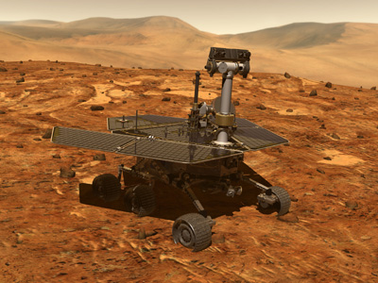
Robotics – Mars Rover
Tutorial on Rover: http://marsrovers.jpl.nasa.gov/gallery/video/animation.html
Notes:
http://marsrovers.jpl.nasa.gov/gallery/artwork/rover2browse.html

Slide 66
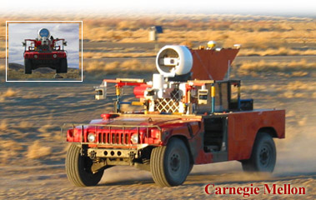
Sandstorm
March 13, 2004 - A DARPA Grand Challenge: an unmanned offroad race, 142 miles from Barstow to Las Vegas.
Notes:
Sandstorm is a modified Humvee. It cost $3M. The prize for the grand challenge is $1M. Sandstorm made it 9 miles. 15 teams entered. Sandstorm got the farthest of all: At mile 7.4, on switchbacks in a mountainous section, vehicle went off course, got caught on a berm and rubber on the front wheels caught fire, which was quickly extinguished. Vehicle was command-disabled.

Slide 67
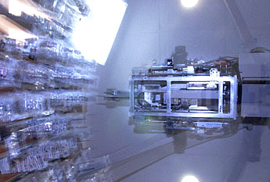
Moving Around and Picking Things Up
Phil, the drug robot, introduced in 2003
Notes:
Doctors will write the equivalent of 10 prescriptions for every person in the country, and as the population ages and drugs are more aggressively marketed, the numbers are growing.
A shortage of pharmacists needed to keep up with the demand hit its peak two years ago, but it still exists in some areas. There are about 5,000 open pharmacy positions nationwide.
And because of the paperwork and overwork associated with the enormous volume of prescriptions, mistakes still are being made. Most estimates put the number of mistakes at about 4 percent.
Still, that represents more than 100-million mistakes a year - sometimes with tragic consequences.

Slide 68
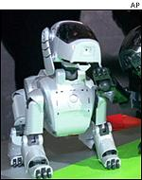
Robotics - Aibo
1999 Sony’s Aibo pet dog
Notes:
http://news.bbc.co.uk/1/hi/in_depth/sci_tech/2001/artificial_intelligence/1531432.stm

Slide 69
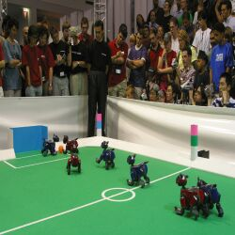
What Can You Do with an Aibo?
1997 – First official Rob-Cup soccer match
Picture from 2003 competition

Slide 70
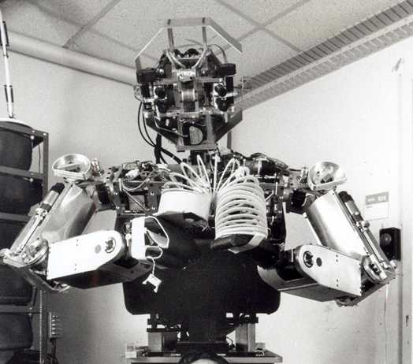
Robotics - Cog
1998 – now Cog
Humanoid intelligence requires humanoid interactions with the world.
http://www.eecs.mit.edu/100th/images/Brooks-Cog-Kismet.html

Slide 71
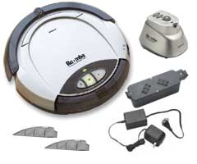
At the Other End of the Spectrum - Roomba
2001 A robot vacuum cleaner

Slide 72
Natural Language Processing
1964 STUDENT solves algebra word problems
The distance from New York to Los Angeles is 3000 miles. If the average speed of a jet plane is 600 miles per hour, find the time it takes to travel from New York to Los Angeles by jet.
1965 ELIZA models a Rogerian therapist
young woman: Men are all alike.
eliza: In what way?
young woman: They're always bugging us about something specific or other.
eliza: Can you think of a specific example?
young woman: Well, my boyfriend made me come here.
eliza: Your boyfriend made you come here?
Notes:
Is means equals. NPs are numbers.

Slide 73
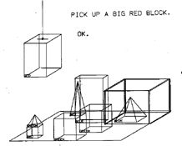
NLP, continued
1966 Alpac report kills work on MT
1971 SHRDLU

Slide 74
NLP, continued
1973 Schank – a richer limited domain: children’s stories
    Suzie was invited to Mary’s birthday party. She knew she wanted a new doll so she got it for her.
1977 Schank – scripts add a knowledge layer – restaurant
stories
1970’s and 80’s sophisticated grammars and parsers
But suppose we want generality? One approach is “shallow” systems that punt the complexities of meaning.

Slide 75
NLP Today
Grammar and spelling checkers
  Spelling: http://www.spellcheck.net/
Chatbots
  See the list at: http://www.aaai.org/AITopics/html/natlang.html#chat/
Speech systems
  Synthesis: The IBM system:
    http://www.research.ibm.com/tts/coredemo.html
Notes:
What do you want to do with your life?

Slide 76
Machine Translation: An Early NL Application
1949 Warren Weaver’s memo suggesting MT
1966 Alpac report kills government funding
Early 70s SYSTRAN develops direct Russian/English system
Early 80s knowledge based MT systems
Late 80s statistical MT systems

Slide 77
MT Today
Austin Police are trying to find the person responsible for robbing a bank in Downtown Austin.
El policía de Austin está intentando encontrar a la persona responsable de robar un banco en Austin céntrica.
The police of Austin is trying to find the responsible person to rob a bank in centric Austin.
Notes:
Why build machines to play games? That’s what we want to do. But what about knowledge-intensive yet boring tasks?
BabelFish

Slide 78
MT Today
A Florida teen charged with hiring an undercover policeman to shoot and kill his mother instructed the purported hitman not to damage the family television during the attack, police said on Thursday.
Un adolescente de la Florida cargado con emplear a un policía de la cubierta interior para tirar y para matar a su madre mandó a hitman pretendida para no dañar la televisión de la familia durante el ataque, limpia dicho el jueves.
An adolescent of Florida loaded with using a police of the inner cover to throw and to kill his mother commanded to hitman tried not to damage the television of the family during the attack, clean said Thursday.
Notes:
Using BabelFish babelfish.altavista.com
Going both ways is particularly difficult since the first pass may create some nonstandard prose, which may make sense to people but be really hard to translate.

Slide 79
MT Today
I have a dream, that my four little children will one day live in a nation where they will not be judged by the color of their skin but by the content of their character. I have a dream today – Martin Luther King
I am a sleepy, that my four small children a day of alive in a nation in where they will not be judged by the color of its skin but by the content of its character. I am a sleepy today. (Spanish)
http://www.shtick.org/Translation/translation47.htm

Slide 80
Why Is It So Hard?
Sue caught the bass with her new rod.
Notes:
What does bass mean?
What role is the with phrase playing?
To what does it attach? (see next slide)

Slide 81
Why Is It So Hard?
Sue caught (the bass) (with her new rod).
Notes:
With is the instrument and attaches to caught

Slide 82
Why Is It So Hard?
Sue caught the bass with the dark stripes.
Notes:
With is an attribute and attaches see next slide to bass

Slide 83
Why Is It So Hard?
Sue caught (the bass with the dark stripes).
Notes:
With is an attribute and attaches to bass

Slide 84
Why Is It So Hard?
Sue played the bass with her new bow.
Notes:
Now the meaning of bass changes.

Slide 85
Why Is It So Hard?
Sue played the bass with her new bow.
Sue played the bass with her new beau.
Notes:
But, if we’re speaking, how do we differentiate these two?

Slide 86
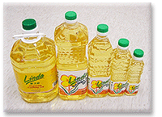
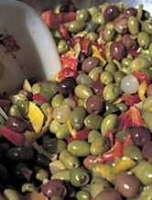
Why Is It So Hard?
Olive oil
Notes:
Assuming we don’t mean Olive Oil

Slide 87

Why Is It So Hard?
Olive oil
Notes:
Assuming we don’t mean Olive Oil

Slide 88
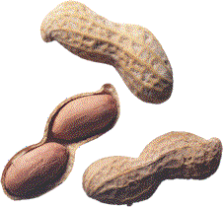
Why Is It So Hard?
Peanut oil

Slide 89
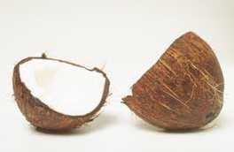
Why Is It So Hard?
Coconut oil

Slide 90
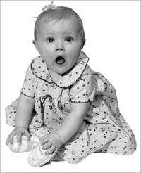
Why Is It So Hard?
Baby oil

Slide 91
Why Is It So Hard?
Cooking oil
Notes:
Jacket used for riding

Slide 92
MT Today
Is MT an “AI complete” problem?
  John saw a bicycle in the store window. He wanted it.
  John saw a bicycle in the store window. He pressed his nose up against it.
  John saw the Statue of Liberty flying over New York.
  John saw a plane flying over New York.
Notes:
Please go buy some baby oil.

Slide 93
Text Retrieval and Extraction
Try Ask Jeeves: http://www.askjeeves.com
To do better requires:
  Linguistic knowledge
  World knowledge
Newsblaster: http://www1.cs.columbia.edu/nlp/newsblaster/
Notes:
What’s the weather like in Austin?
Who invented the computer?
Will computers ever be smarter than people?

Slide 94
Programming Languages
1958 Lisp – a functional programming language with a
simple syntax.
(successor SitA ActionP)
1972 PROLOG - a logic programming language whose
primary control structure is depth-first search
ancestor(A,B) :- parent(A,B)
ancestor(A,B) :- parent(A,P), ancestor(P,B)
1988 CLOS (Common Lisp Object Standard) published.
Draws on ideas from Smalltalk and semantic nets

Slide 95
Cognitive Modeling
Symbolic Modeling
1957 GPS
1983 SOAR
Neuron-Level Modeling
McCulloch Pitts neurons: all or none response
More sophisticated neurons and connections
More powerful learning algorithm

Slide 96
Making Money – Software
Expert systems to solve problems in particular domains
Expert system shells to make it cheaper to build new systems in new domains
Language applications
  Text retrieval
  Machine Translation
  Text to speech and speech recognition
Data mining

Slide 97
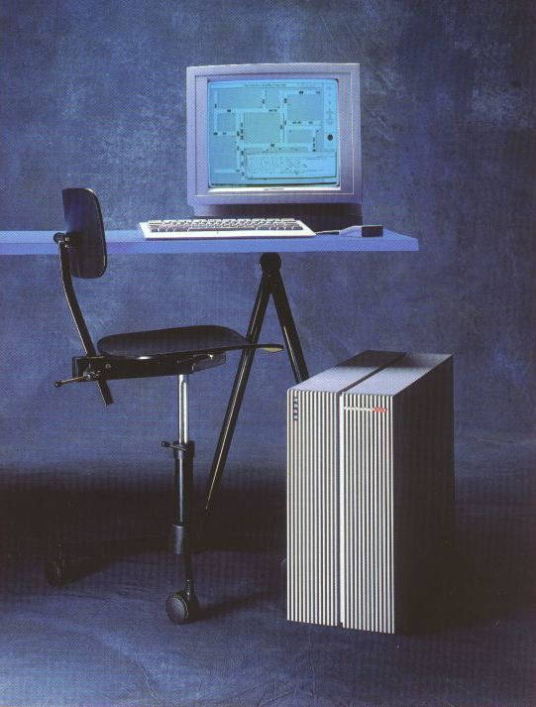
Making Money - Hardware
1980 Symbolics founded
1986 Thinking Machines introduces the Connection Machine
1993 Symbolics declared bankruptcy
Symbolics 3620 System c 1986: Up to 4 Mwords (16 Mbytes) optional physical memory, one 190 Mbyte fixed disk, integral Ethernet interface, five backplane expansion slots, options include an additional 190 Mbyte disk or 1/4'' tape drive, floating point accelerator, memory, RS232C ports and printers.

Slide 98
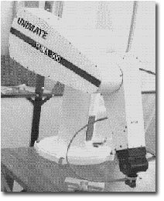
Making Money - Robots
1962 Unimation, first industrial robot company, founded. Sold a die casting robot to GM.
1990 iRobot founded, a spinoff of MIT
2000 The UN estimated that there are 742,500 industrial robots in use worldwide. More than half of these were being used in Japan.
2001 iRobot markets Roomba for $200.
Notes:
http://www.robotics.utexas.edu/rrg/learn_more/history/#firstrobot
http://news.bbc.co.uk/1/hi/in_depth/sci_tech/2001/artificial_intelligence/1531432.stm (UN estimate)

Slide 99
The Differences Between Us and Them
Emotions
Understanding
Consciousness

Slide 100


Emotions
The robot Kismet shows emotions
sad surprise
http://www.ai.mit.edu/projects/humanoid-robotics-group/kismet/

Slide 101




Understanding
Searle’s Chinese Room
Notes:
A Commemorative Certificate for ascending the great wall in China. (input)
I have ascended the great wall (output)

Slide 102
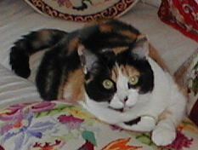





Consciousness
Me You

Slide 103


Today: The Difference Between Us and Them
Notes:
http://www.captcha.net/

Slide 104


Today: Computer as Artist
Two paintings done by Harold Cohen’s Aaron program:

Slide 105
Why AI?
"AI can have two purposes. One is to use the power of computers to augment human thinking, just as we use motors to augment human or horse power. Robotics and expert systems are major branches of that. The other is to use a computer's artificial intelligence to understand how humans think. In a humanoid way. If you test your programs not merely by what they can accomplish, but how they accomplish it, they you're really doing cognitive science; you're using AI to understand the human mind."
- Herb Simon

