Slide 1
Constraint Satisfaction Problems
Chapter 5
Section 1 – 3
‹#›

Slide 2
Outline
Constraint Satisfaction Problems (CSP)
Backtracking search for CSPs
Local search for CSPs
‹#›

Slide 3
Constraint satisfaction problems (CSPs)
Standard search problem:
state is a "black box“ – any data structure that supports successor function, heuristic function, and goal test
CSP:
state is defined by variables X_{i} with values from domain D_{i}
goal test is a set of constraints specifying allowable combinations of values for subsets of variables
Simple example of a formal representation language
Allows useful general-purpose algorithms with more power than standard search algorithms
‹#›

Slide 4
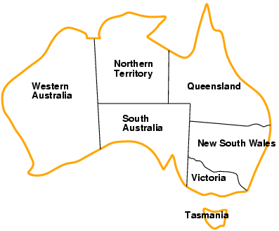
Example: Map-Coloring
Variables WA, NT, Q, NSW, V, SA, T
Domains D_{i} = {red,green,blue}
Constraints: adjacent regions must have different colors
e.g., WA ≠ NT, or (WA,NT) in {(red,green),(red,blue),(green,red), (green,blue),(blue,red),(blue,green)}
‹#›

Slide 5
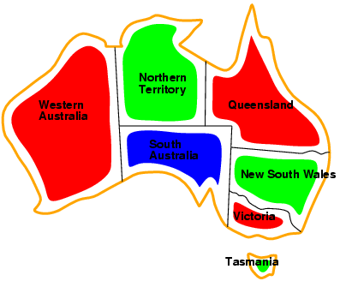
Example: Map-Coloring
Solutions are complete and consistent assignments, e.g., WA = red, NT = green,Q = red,NSW = green,V = red,SA = blue,T = green
‹#›

Slide 6
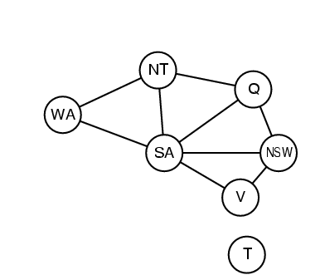
Constraint graph
Binary CSP: each constraint relates two variables
Constraint graph: nodes are variables, arcs are constraints
‹#›

Slide 7
Varieties of CSPs
Discrete variables
finite domains:
n variables, domain size d 🡪 O(d^{n}) complete assignments
e.g., Boolean CSPs, incl.~Boolean satisfiability (NP-complete)
infinite domains:
integers, strings, etc.
e.g., job scheduling, variables are start/end days for each job
need a constraint language, e.g., StartJob₁ + 5 ≤ StartJob₃
Continuous variables
e.g., start/end times for Hubble Space Telescope observations
linear constraints solvable in polynomial time by linear programming
‹#›

Slide 8
Varieties of constraints
Unary constraints involve a single variable,
e.g., SA ≠ green
Binary constraints involve pairs of variables,
e.g., SA ≠ WA
Higher-order constraints involve 3 or more variables,
e.g., cryptarithmetic column constraints
‹#›

Slide 9
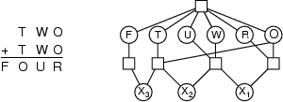
Example: Cryptarithmetic
Variables: F T U W R O X₁ X₂ X₃
Domains: {0,1,2,3,4,5,6,7,8,9}
Constraints: Alldiff (F,T,U,W,R,O)
O + O = R + 10 · X₁
X₁ + W + W = U + 10 · X₂
X₂ + T + T = O + 10 · X₃
X₃ = F, T ≠ 0, F ≠ 0
‹#›

Slide 10
Real-world CSPs
Assignment problems
e.g., who teaches what class
Timetabling problems
e.g., which class is offered when and where?
Transportation scheduling
Factory scheduling
Notice that many real-world problems involve real-valued variables
‹#›

Slide 11
Standard search formulation (incremental)
Let's start with the straightforward approach, then fix it
States are defined by the values assigned so far
Initial state: the empty assignment { }
Successor function: assign a value to an unassigned variable that does not conflict with current assignment
🡪 fail if no legal assignments
Goal test: the current assignment is complete
This is the same for all CSPs
Every solution appears at depth n with n variables 🡪 use depth-first search
Path is irrelevant, so can also use complete-state formulation
b = (n - l )d at depth l, hence n! · d^{n} leaves
‹#›

Slide 12
Backtracking search
Variable assignments are commutative}, i.e.,
[ WA = red then NT = green ] same as [ NT = green then WA = red ]
Only need to consider assignments to a single variable at each node
🡪 b = d and there are $d^n$ leaves
Depth-first search for CSPs with single-variable assignments is called backtracking search
Backtracking search is the basic uninformed algorithm for CSPs
Can solve n-queens for n ≈ 25
‹#›

Slide 13
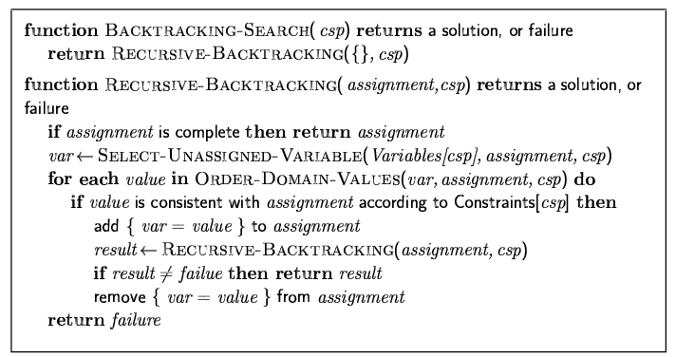
Backtracking search
‹#›

Slide 14

Backtracking example
‹#›

Slide 15
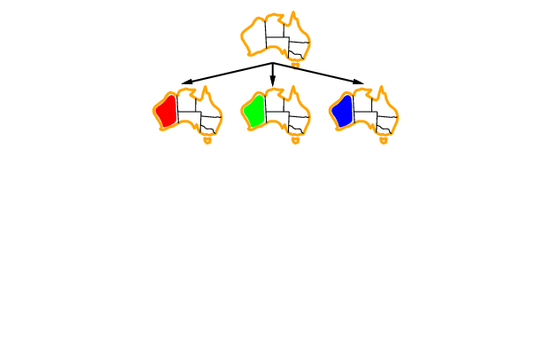
Backtracking example
‹#›

Slide 16
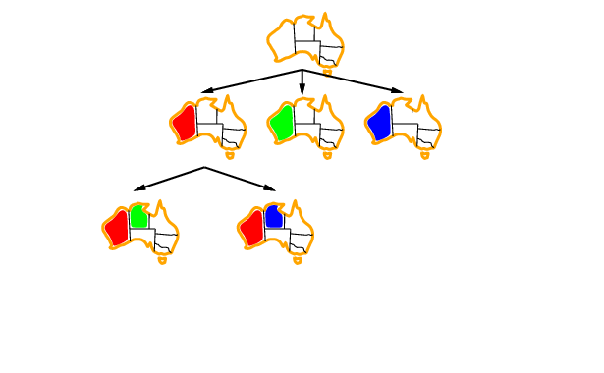
Backtracking example
‹#›

Slide 17
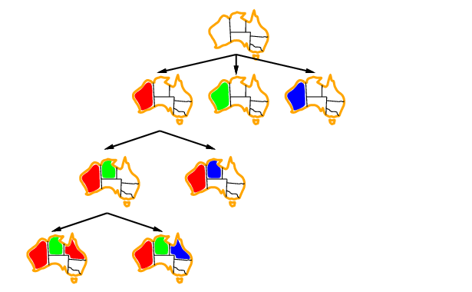
Backtracking example
‹#›

Slide 18
Improving backtracking efficiency
General-purpose methods can give huge gains in speed:
Which variable should be assigned next?
In what order should its values be tried?
Can we detect inevitable failure early?
‹#›

Slide 19

Most constrained variable
Most constrained variable:
choose the variable with the fewest legal values
a.k.a. minimum remaining values (MRV) heuristic
‹#›

Slide 20

Most constraining variable
Tie-breaker among most constrained variables
Most constraining variable:
choose the variable with the most constraints on remaining variables
‹#›

Slide 21
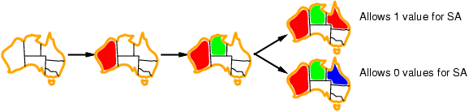
Least constraining value
Given a variable, choose the least constraining value:
the one that rules out the fewest values in the remaining variables
Combining these heuristics makes 1000 queens feasible
‹#›

Slide 22
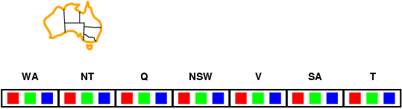
Forward checking
Idea:
Keep track of remaining legal values for unassigned variables
Terminate search when any variable has no legal values
‹#›

Slide 23
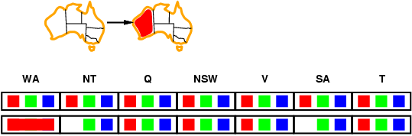
Forward checking
Idea:
Keep track of remaining legal values for unassigned variables
Terminate search when any variable has no legal values
‹#›

Slide 24
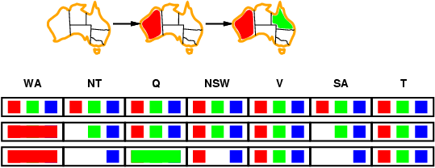
Forward checking
Idea:
Keep track of remaining legal values for unassigned variables
Terminate search when any variable has no legal values
‹#›

Slide 25
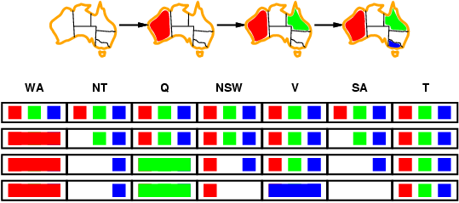
Forward checking
Idea:
Keep track of remaining legal values for unassigned variables
Terminate search when any variable has no legal values
‹#›

Slide 26
Constraint propagation
Forward checking propagates information from assigned to unassigned variables, but doesn't provide early detection for all failures:
NT and SA cannot both be blue!
Constraint propagation repeatedly enforces constraints locally
‹#›

Slide 27
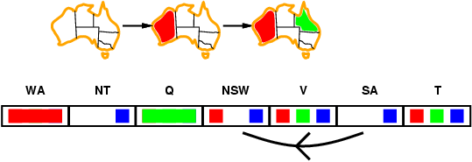
Arc consistency
Simplest form of propagation makes each arc consistent
X 🡪Y is consistent iff
for every value x of X there is some allowed y
‹#›

Slide 28
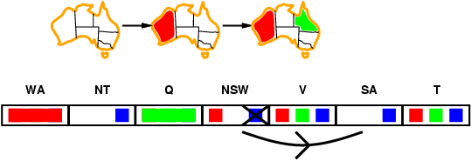
Arc consistency
Simplest form of propagation makes each arc consistent
X 🡪Y is consistent iff
for every value x of X there is some allowed y
‹#›

Slide 29
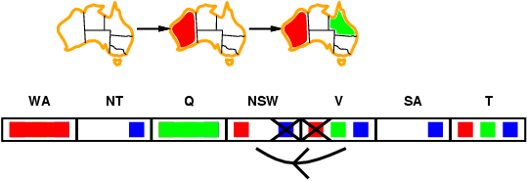
Arc consistency
Simplest form of propagation makes each arc consistent
X 🡪Y is consistent iff
for every value x of X there is some allowed y
If X loses a value, neighbors of X need to be rechecked
‹#›

Slide 30
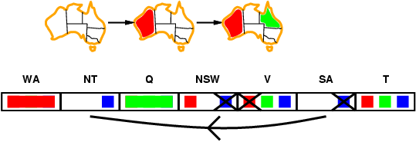
Arc consistency
Simplest form of propagation makes each arc consistent
X 🡪Y is consistent iff
for every value x of X there is some allowed y
If X loses a value, neighbors of X need to be rechecked
Arc consistency detects failure earlier than forward checking
Can be run as a preprocessor or after each assignment
‹#›

Slide 31
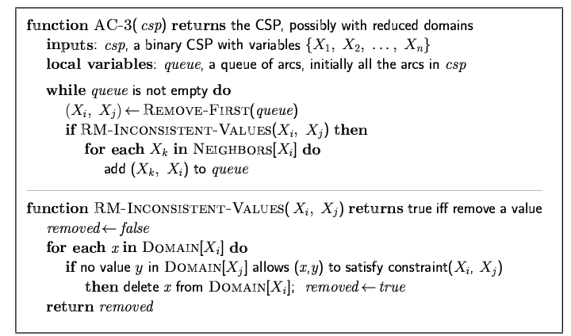
Arc consistency algorithm AC-3
Time complexity: O(n²d³)
‹#›

Slide 32
Local search for CSPs
Hill-climbing, simulated annealing typically work with "complete" states, i.e., all variables assigned
To apply to CSPs:
allow states with unsatisfied constraints
operators reassign variable values
Variable selection: randomly select any conflicted variable
Value selection by min-conflicts heuristic:
choose value that violates the fewest constraints
i.e., hill-climb with h(n) = total number of violated constraints
‹#›

Slide 33
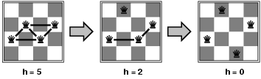
Example: 4-Queens
States: 4 queens in 4 columns (4⁴ = 256 states) Actions: move queen in column Goal test: no attacks Evaluation: h(n) = number of attacks
Given random initial state, can solve n-queens in almost constant time for arbitrary n with high probability (e.g., n = 10,000,000)
‹#›

Slide 34
Summary
CSPs are a special kind of problem:
states defined by values of a fixed set of variables
goal test defined by constraints on variable values
Backtracking = depth-first search with one variable assigned per node
Variable ordering and value selection heuristics help significantly
Forward checking prevents assignments that guarantee later failure
Constraint propagation (e.g., arc consistency) does additional work to constrain values and detect inconsistencies
Iterative min-conflicts is usually effective in practice
‹#›

