Slide 1
Chapter 5: Adversarial Search & Game Playing
Notes:
‹#›

Slide 2
Typical assumptions
Two agents whose actions alternate
Utility values for each agent are the opposite of the other
creates the adversarial situation
Fully observable environments
In game theory terms:
“Deterministic, turn-taking, zero-sum games of perfect information”
Can generalize to stochastic games, multiple players, non zero-sum, etc
Notes:
‹#›

Slide 3
Search versus Games
Search – no adversary
Solution is (heuristic) method for finding goal
Heuristics and CSP techniques can find optimal solution
Evaluation function: estimate of cost from start to goal through given node
Examples: path planning, scheduling activities
Games – adversary
Solution is strategy (strategy specifies move for every possible opponent reply).
Time limits force an approximate solution
Evaluation function: evaluate “goodness” of game position
Examples: chess, checkers, Othello, backgammon
Notes:
‹#›

Slide 4
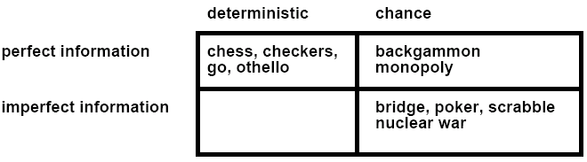
Types of Games
Notes:
‹#›

Slide 5
Game Setup
Two players: MAX and MIN
MAX moves first and they take turns until the game is over
Winner gets award, loser gets penalty.
Games as search:
Initial state: e.g. board configuration of chess
Successor function: list of (move, state) pairs specifying legal moves.
Terminal test: Is the game finished?
Utility function: Gives numerical value of terminal states. E.g. win (+1), lose (-1) and draw (0) in tic-tac-toe or chess
MAX uses search tree to determine next move.
Notes:
‹#›

Slide 6
Size of search trees
b = branching factor
d = number of moves by both players
Search tree is O(b^{d})
Chess
b ~ 35
d ~100
- search tree is ~ 10 ¹⁵⁴ (!!)
- completely impractical to search this
Game-playing emphasizes being able to make optimal decisions in a finite amount of time
Somewhat realistic as a model of a real-world agent
Even if games themselves are artificial
Notes:
‹#›

Slide 7
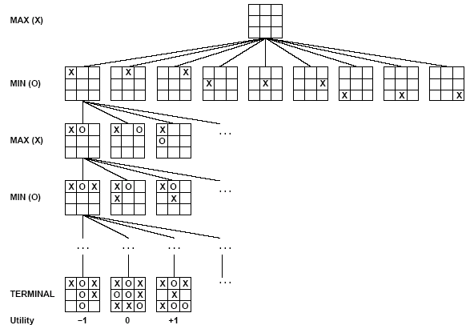
Partial Game Tree for Tic-Tac-Toe
Notes:
‹#›

Slide 8
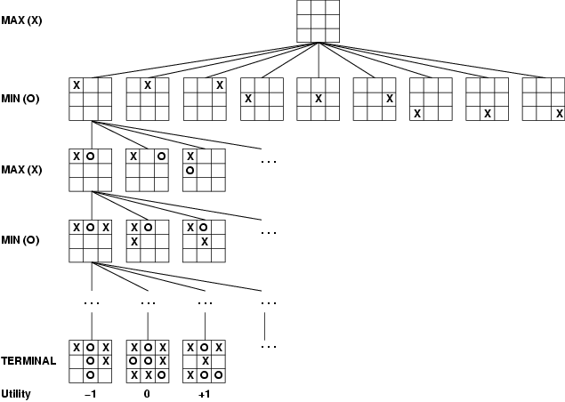
Game tree (2-player, deterministic, turns)
How do we search this tree to find the optimal move?
Notes:
‹#›

Slide 9
Minimax strategy
Find the optimal strategy for MAX assuming an infallible MIN opponent
Need to compute this all the down the tree
Assumption: Both players play optimally!
Given a game tree, the optimal strategy can be determined by using the minimax value of each node:
MINIMAX-VALUE(n)=
UTILITY(n) If n is a terminal
max_{s ∈ successors(n)} MINIMAX-VALUE(s) If n is a max node
min_{s ∈ successors(n)} MINIMAX-VALUE(s) If n is a min node
Notes:
‹#›

Slide 10
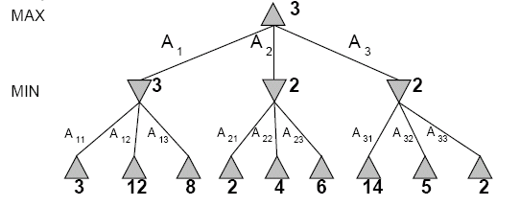
Two-Ply Game Tree
Notes:
‹#›

Slide 11
Two-Ply Game Tree
Notes:
‹#›

Slide 12
Two-Ply Game Tree
Notes:
‹#›

Slide 13
Two-Ply Game Tree
Minimax maximizes the utility for the worst-case outcome for max
The minimax decision
Notes:
‹#›

Slide 14
What if MIN does not play optimally?
Definition of optimal play for MAX assumes MIN plays optimally:
maximizes worst-case outcome for MAX
But if MIN does not play optimally, MAX will do even better
Can prove this (Problem 6.2)
Notes:
‹#›

Slide 15
Minimax Algorithm
Complete depth-first exploration of the game tree
Assumptions:
Max depth = d, b legal moves at each point
E.g., Chess: d ~ 100, b ~35
Criterion | Minimax
Time | O(b^{m})
Space | O(bm)
☹
☺
Notes:
‹#›

Slide 16
Pseudocode for Minimax Algorithm
function MINIMAX-DECISION(state) returns an action
inputs: state, current state in game
v←MAX-VALUE(state)
return the action in SUCCESSORS(state) with value v
function MAX-VALUE(state) returns a utility value
if TERMINAL-TEST(state) then return UTILITY(state)
v ← ∞
for a,s in SUCCESSORS(state) do
v ← MAX(v,MIN-VALUE(s))
return v
function MIN-VALUE(state) returns a utility value
if TERMINAL-TEST(state) then return UTILITY(state)
v ← ∞
for a,s in SUCCESSORS(state) do
v ← MIN(v,MAX-VALUE(s))
return v
Notes:
‹#›

Slide 17
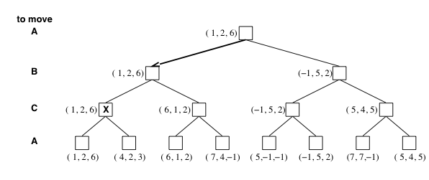
Multiplayer games
Games allow more than two players
Single minimax values become vectors
Notes:
‹#›

Slide 18
Aspects of multiplayer games
Previous slide (standard minimax analysis) assumes that each player operates to maximize only their own utility
In practice, players make alliances
E.g, C strong, A and B both weak
May be best for A and B to attack C rather than each other
If game is not zero-sum (i.e., utility(A) = - utility(B) then alliances can be useful even with 2 players
e.g., both cooperate to maximum the sum of the utilities
Notes:
‹#›

Slide 19
Practical problem with minimax search
Number of game states is exponential in the number of moves.
Solution: Do not examine every node
=> pruning
Remove branches that do not influence final decision
Revisit example …
Notes:
‹#›

Slide 20
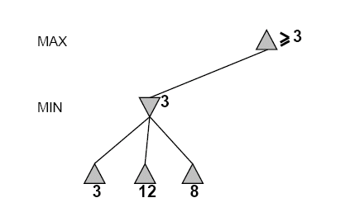
Alpha-Beta Example
Do DF-search until first leaf
Range of possible values
[-∞,+∞]
[-∞, +∞]
Notes:
‹#›

Slide 21
Alpha-Beta Example (continued)
[-∞,+∞]
[-∞,3]
Notes:
‹#›

Slide 22
Alpha-Beta Example (continued)
[-∞,+∞]
[-∞,3]
Notes:
‹#›

Slide 23
Alpha-Beta Example (continued)
[3,+∞]
[3,3]
Notes:
‹#›

Slide 24
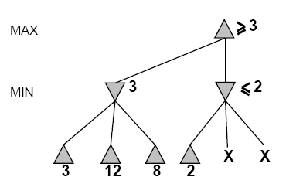
Alpha-Beta Example (continued)
[3,+∞]
This node is worse
for MAX
[3,3]
[-∞,2]
Notes:
‹#›

Slide 25
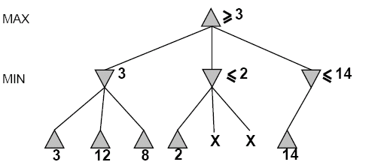
Alpha-Beta Example (continued)
[3,14]
,
[3,3]
[-∞,2]
[-∞,14]
Notes:
‹#›

Slide 26
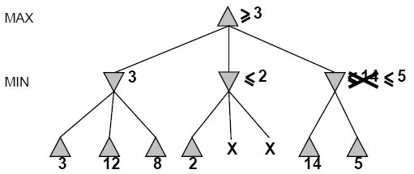

Alpha-Beta Example (continued)
[3,5]
,
[3,3]
[−∞,2]
[-∞,5]
Notes:
‹#›

Slide 27
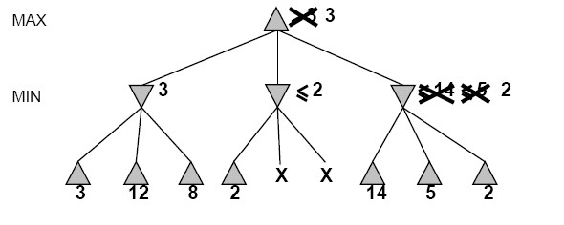
Alpha-Beta Example (continued)
[3,3]
[3,3]
[−∞,2]
[2,2]
Notes:
‹#›

Slide 28
Alpha-Beta Example (continued)
[3,3]
[3,3]
[-∞,2]
[2,2]
Notes:
‹#›

Slide 29
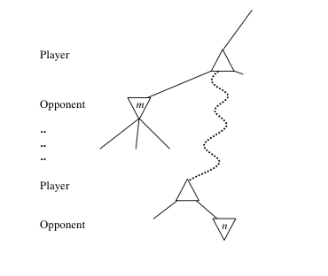
General alpha-beta pruning
Consider a node n somewhere in the tree
If player has a better choice at
Parent node of n
Or any choice point further up
n will never be reached in actual play.
Hence when enough is known about n, it can be pruned.
Notes:
‹#›

Slide 30
Alpha-beta Algorithm
Depth first search – only considers nodes along a single path at any time
α = highest-value choice we have found at any choice point along the path for MAX
β = lowest-value choice we have found at any choice point along the path for MIN
update values of α and β during search and prunes remaining branches as soon as the value is known to be worse than the current α or β value for MAX or MIN
Notes:
‹#›

Slide 31
The Algorithm
Visit the nodes in a depth-first manner
Maintain bounds on nodes.
A bound may change if one of its children obtains a unique value.
A bound becomes a unique value when all its children have been checked or pruned.
When a bound changes into a tighter bound or a unique value, it may become inconsistent with its parent.
When an inconsistency occurs, prune the sub-tree by cutting the edge between the inconsistent bounds/values.
🡪 This is like propagating changes bottom-up in the tree.
Notes:
‹#›

Slide 32
Pseudocode for Alpha-Beta Algorithm
function ALPHA-BETA-SEARCH(state) returns an action
inputs: state, current state in game
v←MAX-VALUE(state, - ∞ , +∞)
return the action in SUCCESSORS(state) with value v
Notes:
‹#›

Slide 33
Pseudocode for Alpha-Beta Algorithm
function ALPHA-BETA-SEARCH(state) returns an action
inputs: state, current state in game
v←MAX-VALUE(state, - ∞ , +∞)
return the action in SUCCESSORS(state) with value v
function MAX-VALUE(state,α , β) returns a utility value
if TERMINAL-TEST(state) then return UTILITY(state)
v ← - ∞
for a,s in SUCCESSORS(state) do
v ← MAX(v,MIN-VALUE(s, α , β))
if v ≥ β then return v
α ← MAX(α ,v)
return v
Notes:
‹#›

Slide 34
Effectiveness of Alpha-Beta Search
Worst-Case
branches are ordered so that no pruning takes place. In this case alpha-beta gives no improvement over exhaustive search
Best-Case
each player’s best move is the left-most alternative (i.e., evaluated first)
in practice, performance is closer to best rather than worst-case
In practice often get O(b^{(d/2)}) rather than O(b^{d})
this is the same as having a branching factor of sqrt(b),
since (sqrt(b))^{d} = b^{(d/2)}
i.e., we have effectively gone from b to square root of b
e.g., in chess go from b ~ 35 to b ~ 6
this permits much deeper search in the same amount of time
Notes:
‹#›

Slide 35
Final Comments about Alpha-Beta Pruning
Pruning does not affect final results
Entire subtrees can be pruned.
Good move ordering improves effectiveness of pruning
Repeated states are again possible.
Store them in memory = transposition table
Notes:
‹#›

Slide 36
Example
-which nodes can be pruned?
5
6
3
4
1
2
7
8
Notes:
‹#›

Slide 37
Practical Implementation
How do we make these ideas practical in real game trees?
Standard approach:
cutoff test: (where do we stop descending the tree)
depth limit
better: iterative deepening
cutoff only when no big changes are expected to occur next (quiescence search).
evaluation function
When the search is cut off, we evaluate the current state
by estimating its utility. This estimate if captured by the
evaluation function.
Notes:
‹#›

Slide 38
Static (Heuristic) Evaluation Functions
An Evaluation Function:
estimates how good the current board configuration is for a player.
Typically, one figures how good it is for the player, and how good it is for the opponent, and subtracts the opponents score from the players
Othello: Number of white pieces - Number of black pieces
Chess: Value of all white pieces - Value of all black pieces
Typical values from -infinity (loss) to +infinity (win) or [-1, +1].
If the board evaluation is X for a player, it’s -X for the opponent
Example:
Evaluating chess boards,
Checkers
Tic-tac-toe
Notes:
‹#›

Slide 39
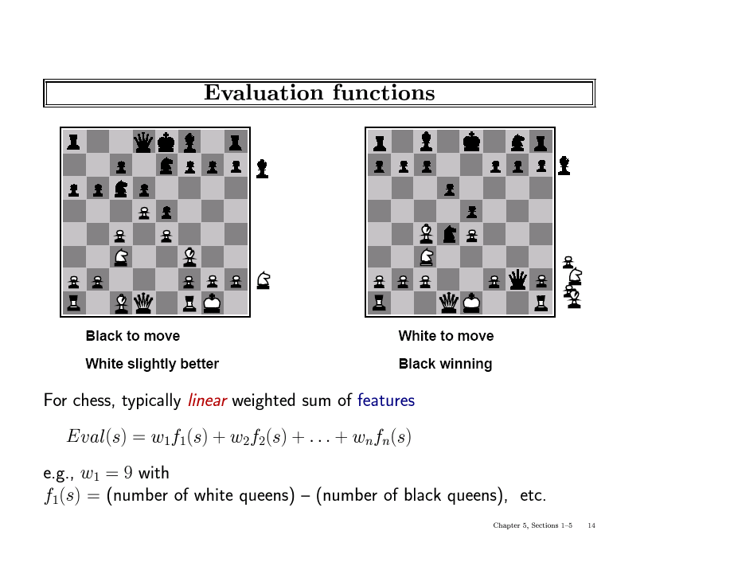
Notes:
‹#›

Slide 40
Iterative (Progressive) Deepening
In real games, there is usually a time limit T on making a move
How do we take this into account?
using alpha-beta we cannot use “partial” results with any confidence unless the full breadth of the tree has been searched
So, we could be conservative and set a conservative depth-limit which guarantees that we will find a move in time < T
disadvantage is that we may finish early, could do more search
In practice, iterative deepening search (IDS) is used
IDS runs depth-first search with an increasing depth-limit
when the clock runs out we use the solution found at the previous depth limit
Notes:
‹#›

Slide 41
Heuristics and Game Tree Search
The Horizon Effect
sometimes there’s a major “effect” (such as a piece being captured) which is just “below” the depth to which the tree has been expanded
the computer cannot see that this major event could happen
it has a “limited horizon”
there are heuristics to try to follow certain branches more deeply to detect to such important events
this helps to avoid catastrophic losses due to “short-sightedness”
Heuristics for Tree Exploration
it may be better to explore some branches more deeply in the allotted time
various heuristics exist to identify “promising” branches
Notes:
‹#›

Slide 42
The State of Play
Checkers:
Chinook ended 40-year-reign of human world champion Marion Tinsley in 1994.
Chess:
Deep Blue defeated human world champion Garry Kasparov in a six-game match in 1997.
Othello:
human champions refuse to compete against computers: they are too good.
Go:
human champions refuse to compete against computers: they are too bad
b > 300 (!)
See (e.g.) http://www.cs.ualberta.ca/~games/ for more information
Notes:
‹#›

Slide 43
Deep Blue
1957: Herbert Simon
“within 10 years a computer will beat the world chess champion”
1997: Deep Blue beats Kasparov
Parallel machine with 30 processors for “software” and 480 VLSI processors for “hardware search”
Searched 126 million nodes per second on average
Generated up to 30 billion positions per move
Reached depth 14 routinely
Uses iterative-deepening alpha-beta search with transpositioning
Can explore beyond depth-limit for interesting moves
Notes:
‹#›

Slide 44
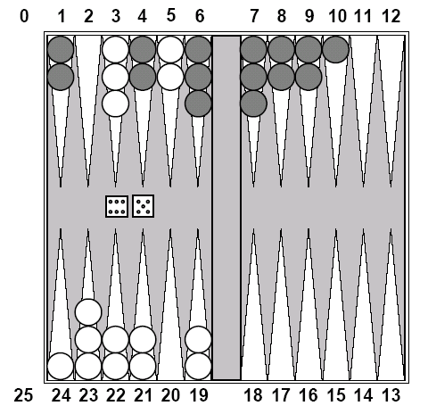
Chance Games.
Backgammon
your element of
chance
Notes:
‹#›

Slide 45
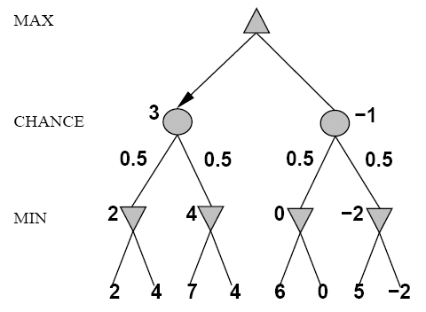
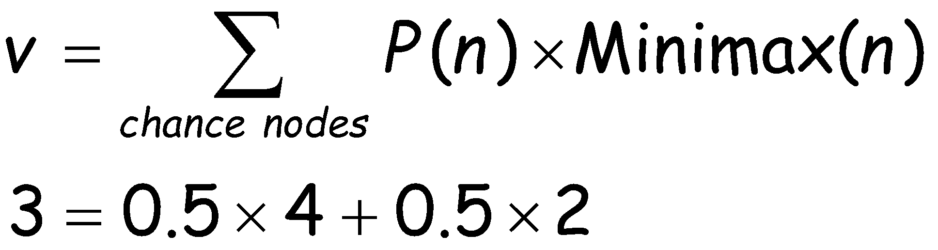
Expected Minimax
Interleave chance nodes
with min/max nodes
Again, the tree is constructed
bottom-up
Notes:
‹#›

Slide 46
Summary
Game playing can be effectively modeled as a search problem
Game trees represent alternate computer/opponent moves
Evaluation functions estimate the quality of a given board configuration for the Max player.
Minimax is a procedure which chooses moves by assuming that the opponent will always choose the move which is best for them
Alpha-Beta is a procedure which can prune large parts of the search tree and allow search to go deeper
For many well-known games, computer algorithms based on heuristic search match or outperform human world experts.
Notes:
‹#›

