Slide 1
Chapter 14 (AIAMA)
Probabilistic Reasoning
Sukarna Barua
Assistant Professor, CSE, BUET

Slide 2
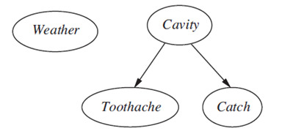
Bayesian Network
A Bayesian network (BN) is a probabilistic graphical model.
Also known in Bayesian Belief Networks.
Represented using a directed acyclic graph (DAG).
Nodes: Represent random variables.
Edges: Represent conditional relationship (cause and effect) between the random variables.
Cavity causes toothache.
Cavity causes catch.
Weather is independent of toothache and cavity.

Slide 3

Bayesian Network
Components of a Bayesian Network:
Nodes: Represent random variables.
Edges: Represent conditional relationship between the random variables.
Edge $A→B$: A is a parent of B. B is dependent on A.
Two nodes are conditionally independent given their parent.

Slide 4
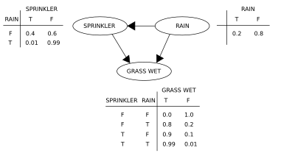
Bayesian Network: CPT
CPT: In a Bayesian network, each node is also annotated with quantitative probability information (conditional probability distribution).
When node has parents: CPT specifies the conditional probability distribution given parent.
Where node has no parents: CPT specifies the marginal probability distribution.

Slide 5
Bayesian Network: Application
Inference: Determine the probability of unobserved variables based on observed evidences.
Causal inference: What is the probability of grass being wet given it is raining?
Diagnostic inference: What is the probability of rain given grass is wet?

Slide 6
Bayesian Network: Example
You have a new burglar alarm installed at home. It is fairly reliable at detecting a burglary, but also responds on occasion to minor earthquakes.
You also have two neighbors, John and Mary, who have promised to call you at work when they hear the alarm. John nearly always calls when he hears the alarm, but sometimes confuses the telephone ringing with the alarm and calls then, too.
Mary, on the other hand, likes rather loud music and often misses the alarm altogether. Given the evidence of who has or has not called, we would like to estimate the probability of a burglary.

Slide 7
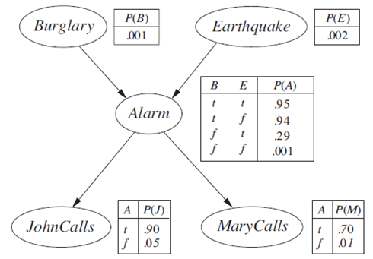
Bayesian Network: Example
Bayesian network for burglary alarm example:

Slide 8
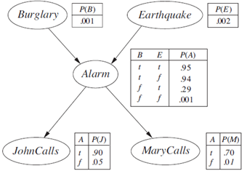
Bayesian Network: Some Observations
Burglay and Earthquake directly affect the probability of Alarm going off
John and Marry calls depending only on the Alarm (They know nothing about Burglary or Earthquake)

Slide 9
Bayesian Network: Example
CPT of a Bayesian Network:
Each row specifies the probability of all values (of the node) given a combination of values of the parent nodes
Each row must sum to 1.
For binary valued nodes, only one (1) probability value is specified for each row. [since the other can be derived]

Slide 10
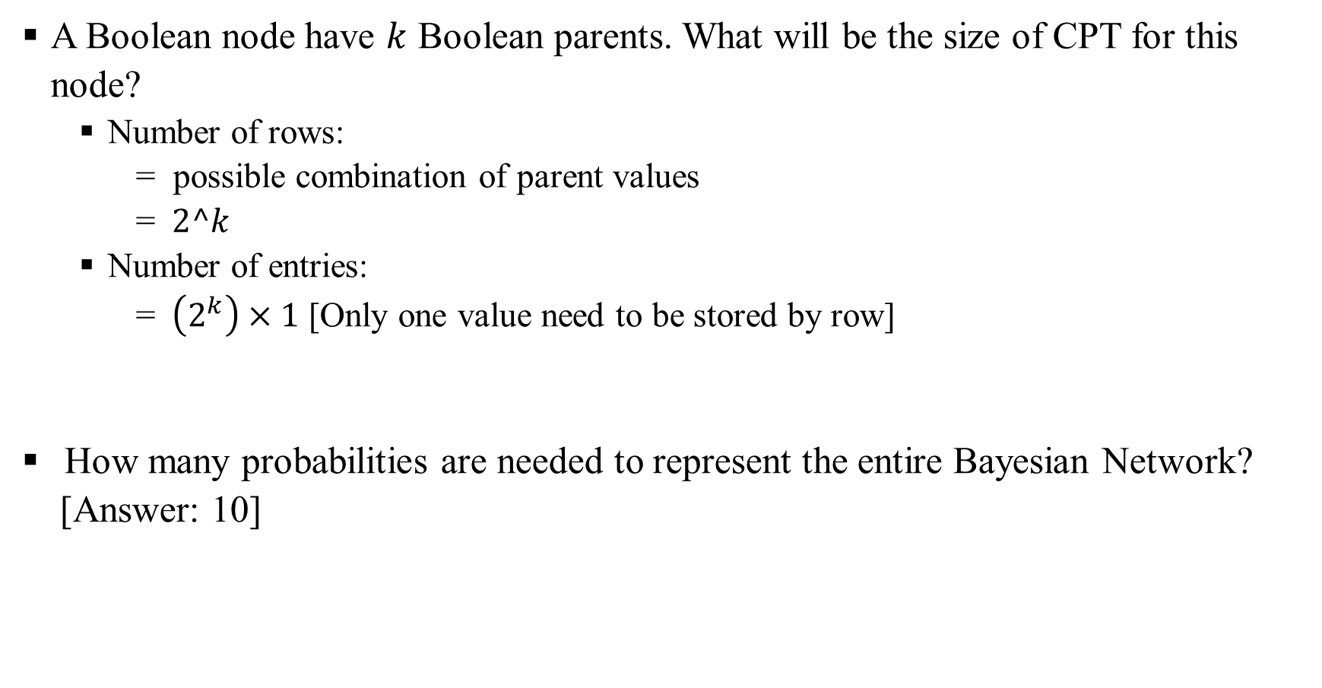
Bayesian Network: Size of CPTs
A Boolean node have $k$ Boolean parents. What will be the size of CPT for this node?
Number of rows:
= possible combination of parent values
= $2^k$
Number of entries:
= $\left(2^{k}\right)×1$ [Only one value need to be stored by row]
How many probabilities are needed to represent the entire Bayesian Network?
[Answer: 10]

Slide 11
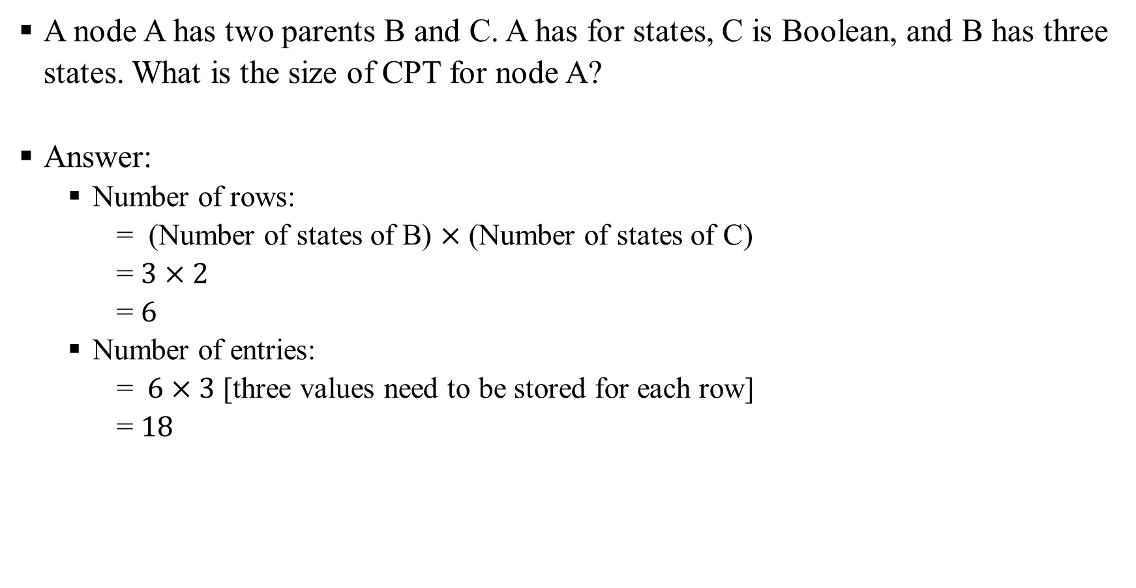
Bayesian Network: Size of CPTs
A node A has two parents B and C. A has for states, C is Boolean, and B has three states. What is the size of CPT for node A?
Answer:
Number of rows:
= (Number of states of B) $×$ (Number of states of C)
= $3×2$
= $6$
Number of entries:
= $6×3$ [three values need to be stored for each row]
= $18$

Slide 12
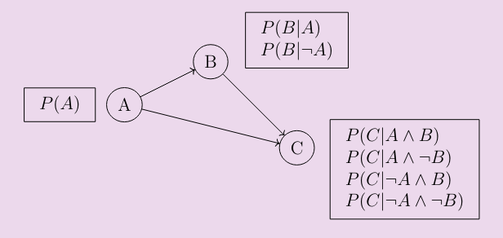

Bayesian Network: Size of CPTs
How many probabilities are needed to represent the Bayesian Network? Assume all are Boolean variables.
Answer: $1+2+5=7$
How many will be needed if $B$ and $C$ are conditionally independent given A?
Answer: $1+2+2=5.$

Slide 13
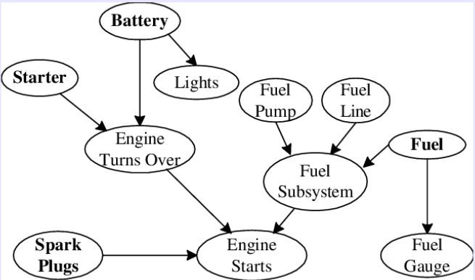
Bayesian Network: More Example
A Bayesian Network for car diagnostic system:
we may have problems in a particular part of the car, and that may be caused by many different reasons.
The battery might cause the lights to have different problems or it may cause the engine to have problems, and that in turn may affect whether or not the engine can start.

Slide 14
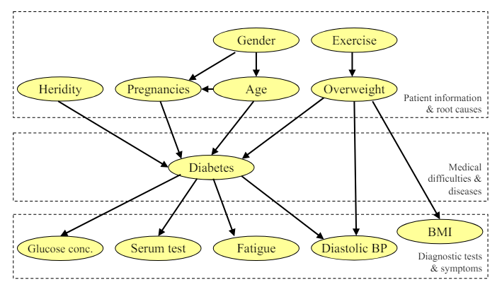
Bayesian Network: More Example
A Bayesian Network for diabetes diagnosis.
Symptoms and tests
Patient information: the patient’s age, weight, medical history, genetics, and so on.

Slide 15
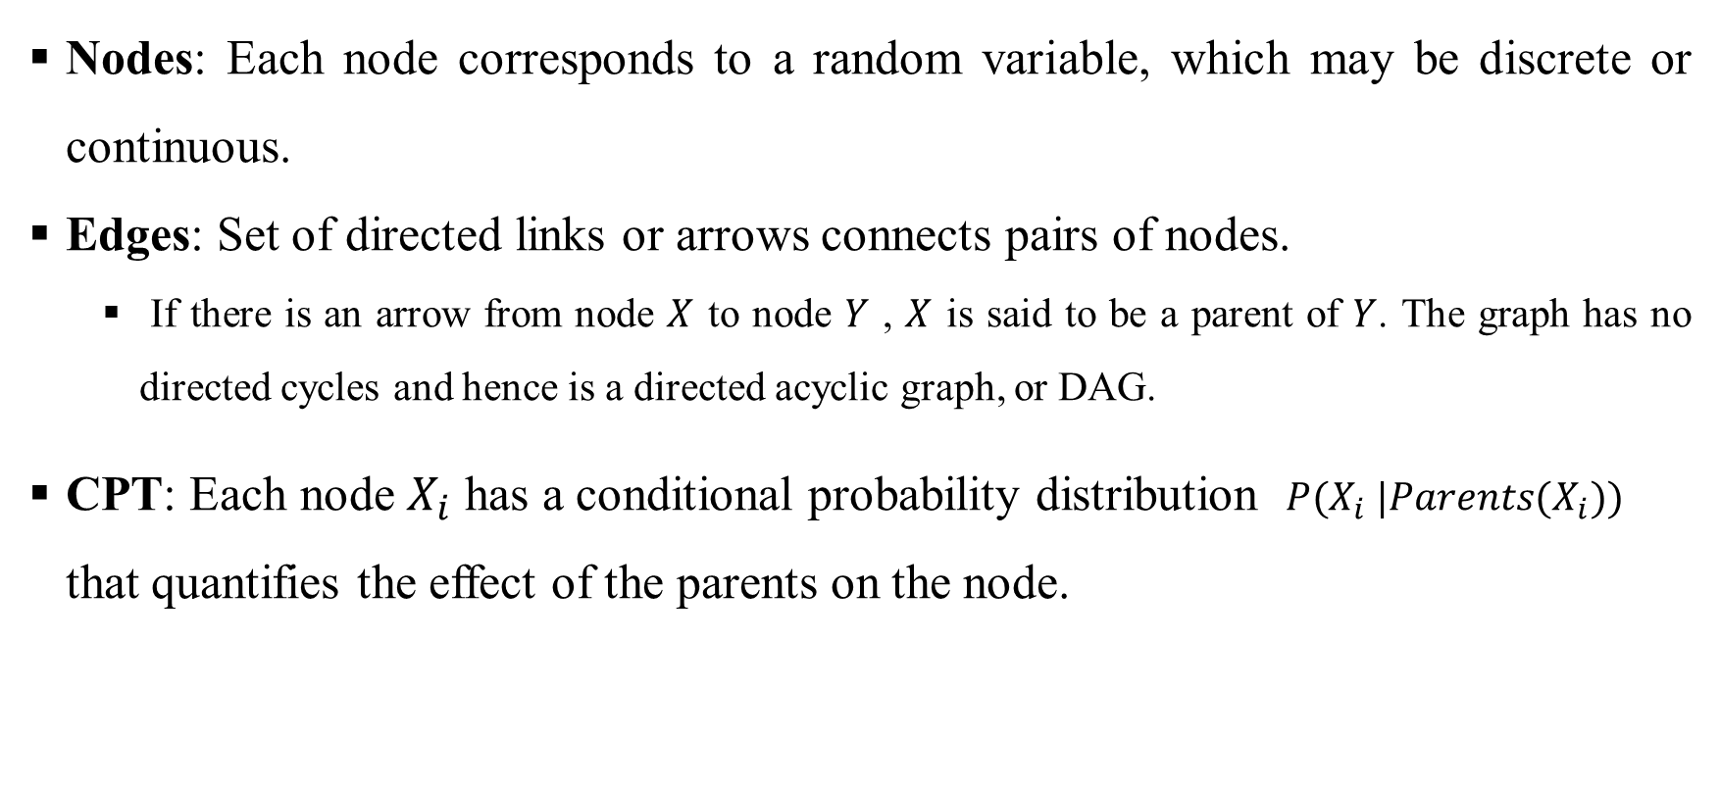
Bayesian Network: Full Specification
Nodes: Each node corresponds to a random variable, which may be discrete or continuous.
Edges: Set of directed links or arrows connects pairs of nodes.
If there is an arrow from node $X$ to node $Y$ , $X$ is said to be a parent of $Y$. The graph has no directed cycles and hence is a directed acyclic graph, or DAG.
CPT: Each node $X_{i}$ has a conditional probability distribution $P(X_{i} |Parents(X_{i}))$ that quantifies the effect of the parents on the node.

Slide 16
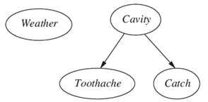
Bayesian Network: Conditional Independence
Implicitly defines conditional independence of random variables
Weather is Independent of other variables.
Toothache and Catch are conditionally independent given Cavity.

Slide 17
Bayesian Network: Conditional Independence
Implicitly defines conditional independence of random variables
JohnCalls is Independent of MarryCalls given Alarm.
MarryCalls is independent of EarthQuake given Alarm.
Is Burglary independent of Earthquake? [Yes, Why?].

Slide 18

Bayesian Network: Conditional Independence
Implicitly defines conditional independence of random variables.
- Are Burglary and Watson independent? [No]
- Are Burglary and Watson independent given Alarm? [Yes]

Slide 19
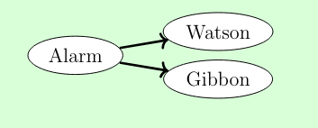
Bayesian Network: Conditional Independence
Implicitly defines conditional independence of random variables!
Are Watson and Gibbon independent? [No]
[ If Watson is calling, it is more likely that Alarm is off, which means that Gibbon is more likely to call ]

Slide 20
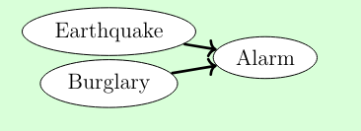
Bayesian Network: Conditional Independence
Implicitly defines conditional independence of random variables!
Are Earthquake and Burglary independent? [Yes]
Are Earthquake and Burglary independent given Alarm? [No]
[ If Earthquake is happening, then it is less likely that the Alarm is caused by Burglary. ]

Slide 21
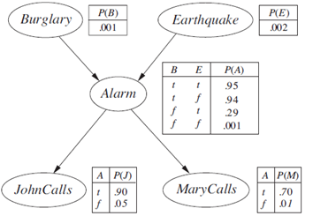
Bayesian Network: Full Joint Distribution
Bayesian network + conditional probability distribution for each variable, given its parents specify full joint distribution for all the variables.

Slide 22
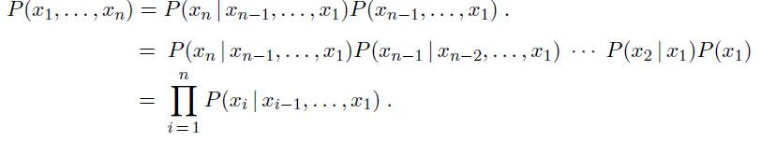

Bayesian Network: Full Joint Distribution
Given a Bayesian Network with variables/nodes $x_{1},x_{2},…,x_{n}$
Find the joint probability $P\left(x_{1},x_{2},…,x_{n}\right)$
We can show that:

Slide 23
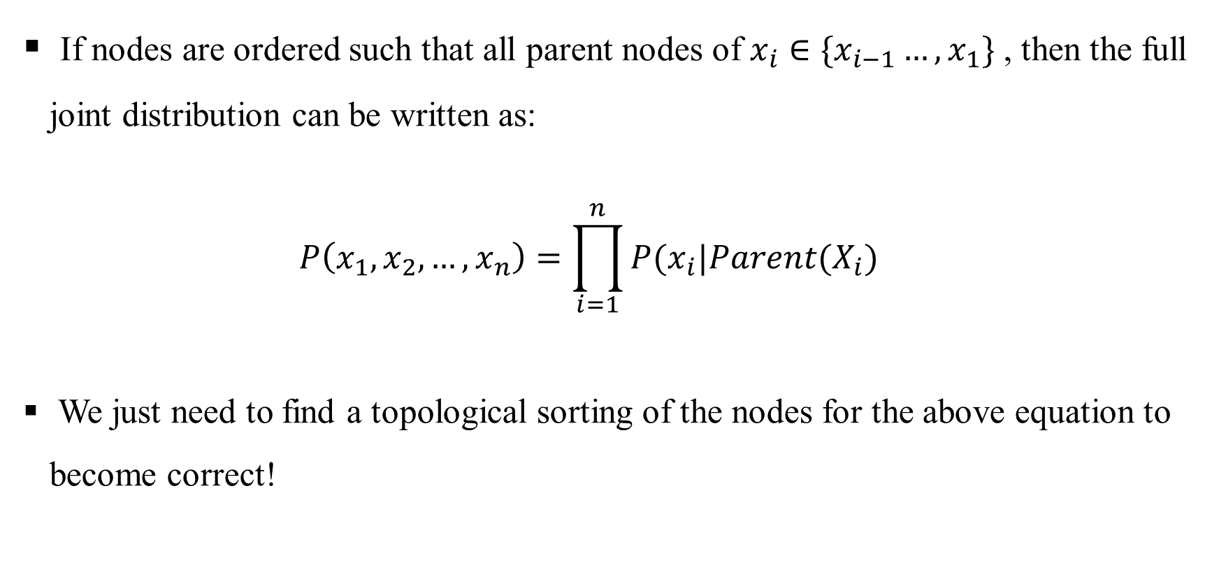
Bayesian Network: Full Joint Distribution
If nodes are ordered such that all parent nodes of $x_{i}∈\{x_{i−1}…,x_{1}\}$ , then the full joint distribution can be written as:
$$P\left(x_{1},x_{2},…,x_{n}\right)=\prod_{i=1}^{n}{P(x_{i}|Parent(X_{i})}$$
We just need to find a topological sorting of the nodes for the above equation to become correct!

Slide 24
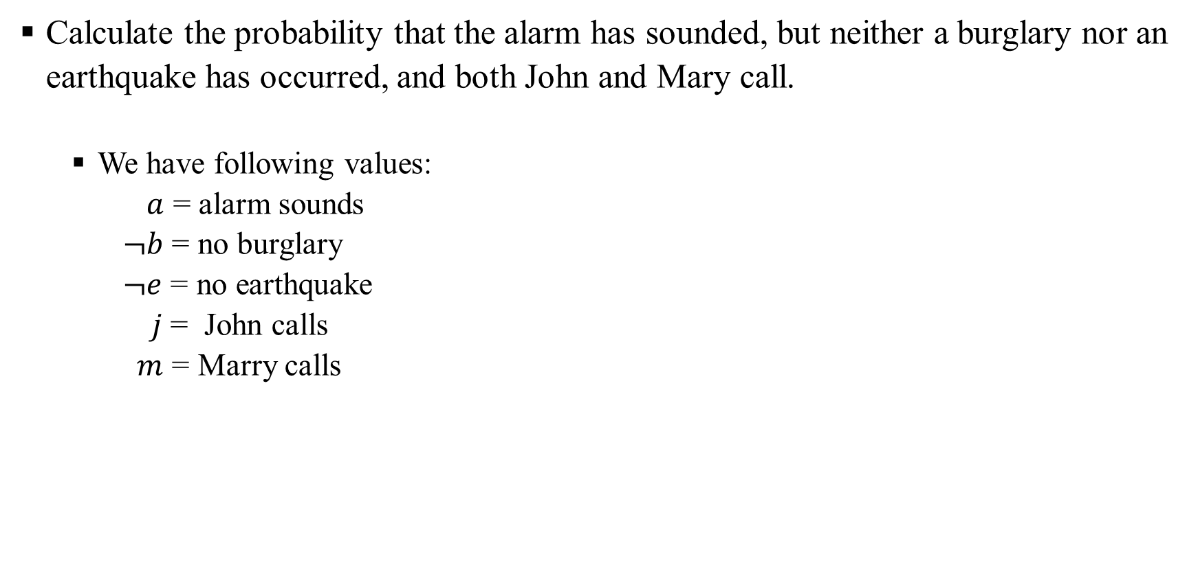
Bayesian Network: Compute Full Joint Distribution
Calculate the probability that the alarm has sounded, but neither a burglary nor an earthquake has occurred, and both John and Mary call.
We have following values:
$a$ = alarm sounds
$¬b$ = no burglary
$¬e$ = no earthquake
$j$ = John calls
$m$ = Marry calls

Slide 25

Bayesian Network: Compute Full Joint Distribution
Calculate the probability that the alarm has sounded, but neither a burglary nor an earthquake has occurred, and both John and Mary call.
We need to calculate $P\left(a,¬b, ¬e,j,m\right).$
We can compute the full joint distribution using CPTs.

Slide 26
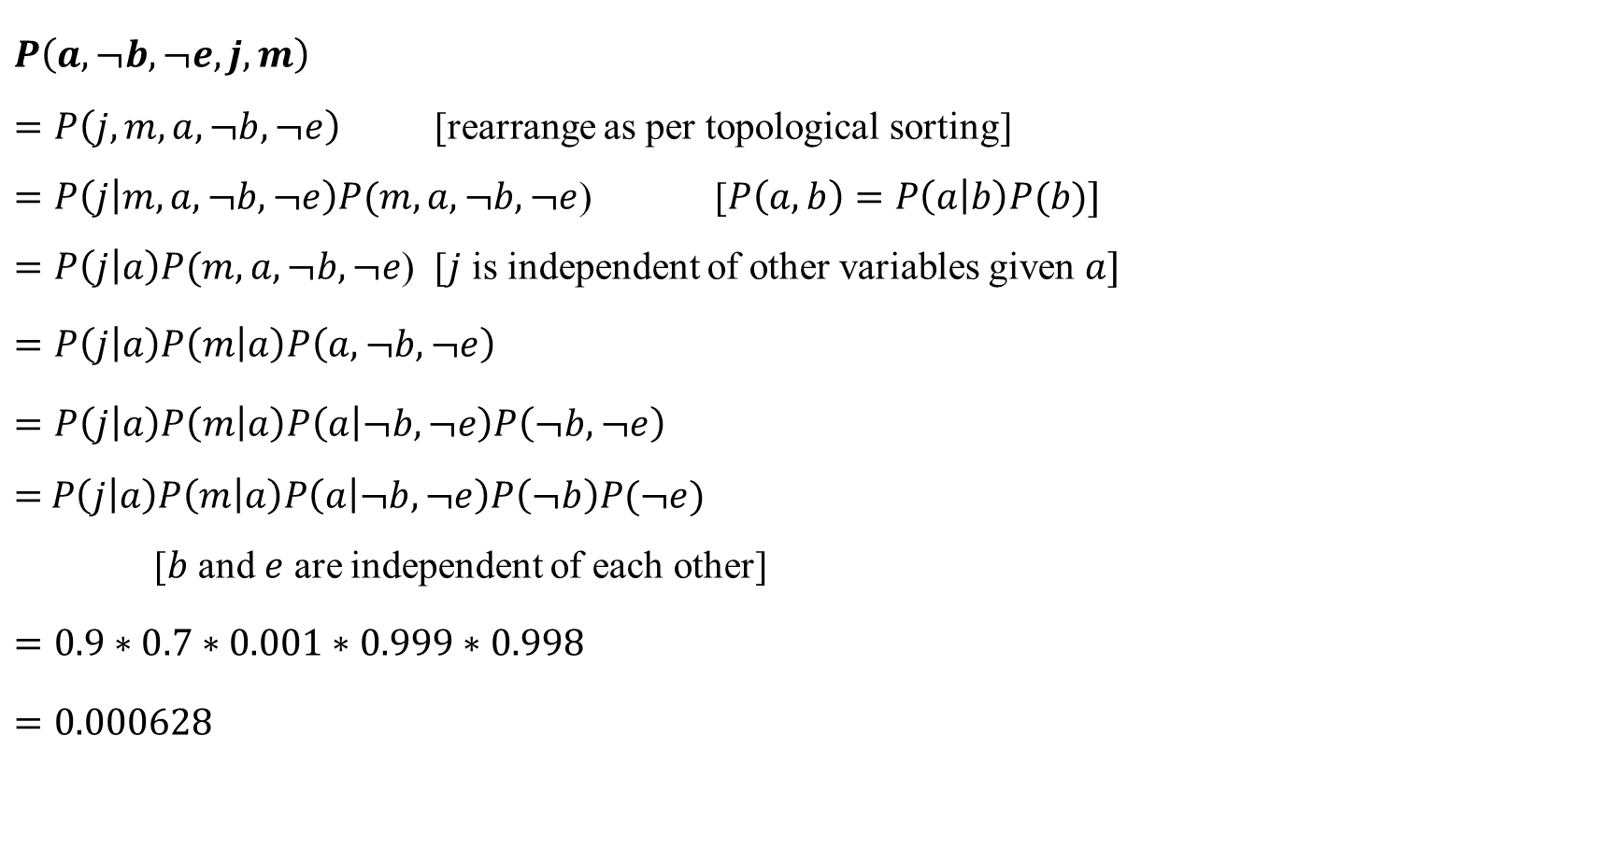
Bayesian Network: Compute Full Joint Distribution
$$P\left(a,¬b,¬e,j,m\right)$$
$=P\left(j,m,a,¬b,¬e\right)$ [rearrange as per topological sorting]
$=P\left(j | m,a,¬b,¬e\right)P(m,a,¬b,¬e$) [$P\left(a,b\right)=P\left(a | b\right)P(b)]$
$=P\left(j | a\right)P(m,a,¬b,¬e$) [$j$ is independent of other variables given $a]$
$$=P\left(j | a\right)P\left(m | a\right)P\left(a,¬b,¬e\right)$$
$$=P\left(j | a\right)P\left(m | a\right)P\left(a | ¬b,¬e\right)P\left(¬b,¬e\right)$$
$=$ $P\left(j | a\right)P\left(m | a\right)P\left(a | ¬b,¬e\right)P\left(¬b\right)P(¬e)$
[$b$ and $e$ are independent of each other]
$$=0.9∗0.7∗0.001∗0.999∗0.998$$
$$=0.000628$$

