Slide 1
Chapter 14 (AIAMA)
Probabilistic Reasoning
Sukarna Barua
Associate Professor, CSE, BUET

Slide 2
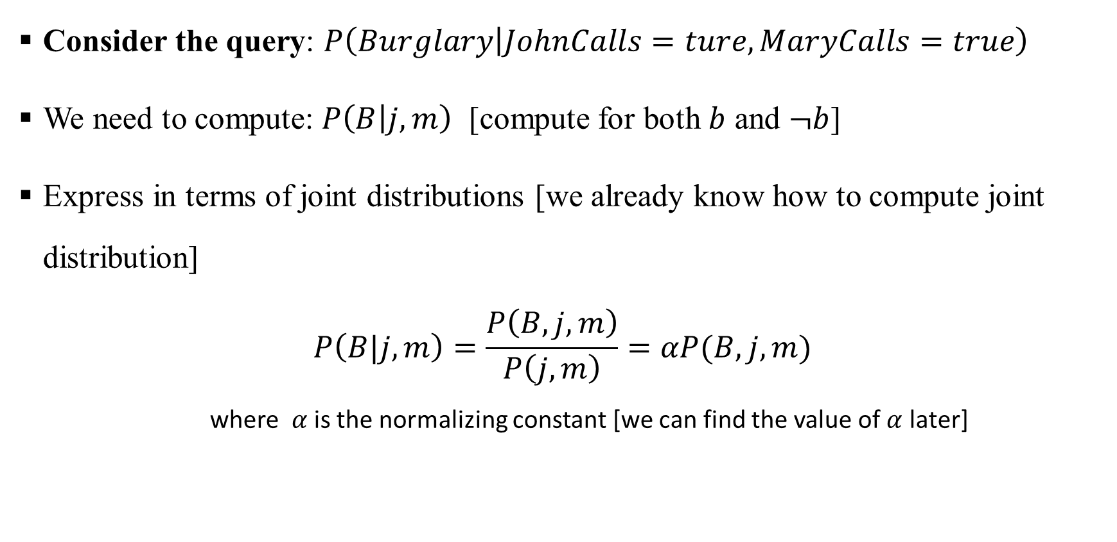
Bayesian Network: Exact Inference

Slide 3
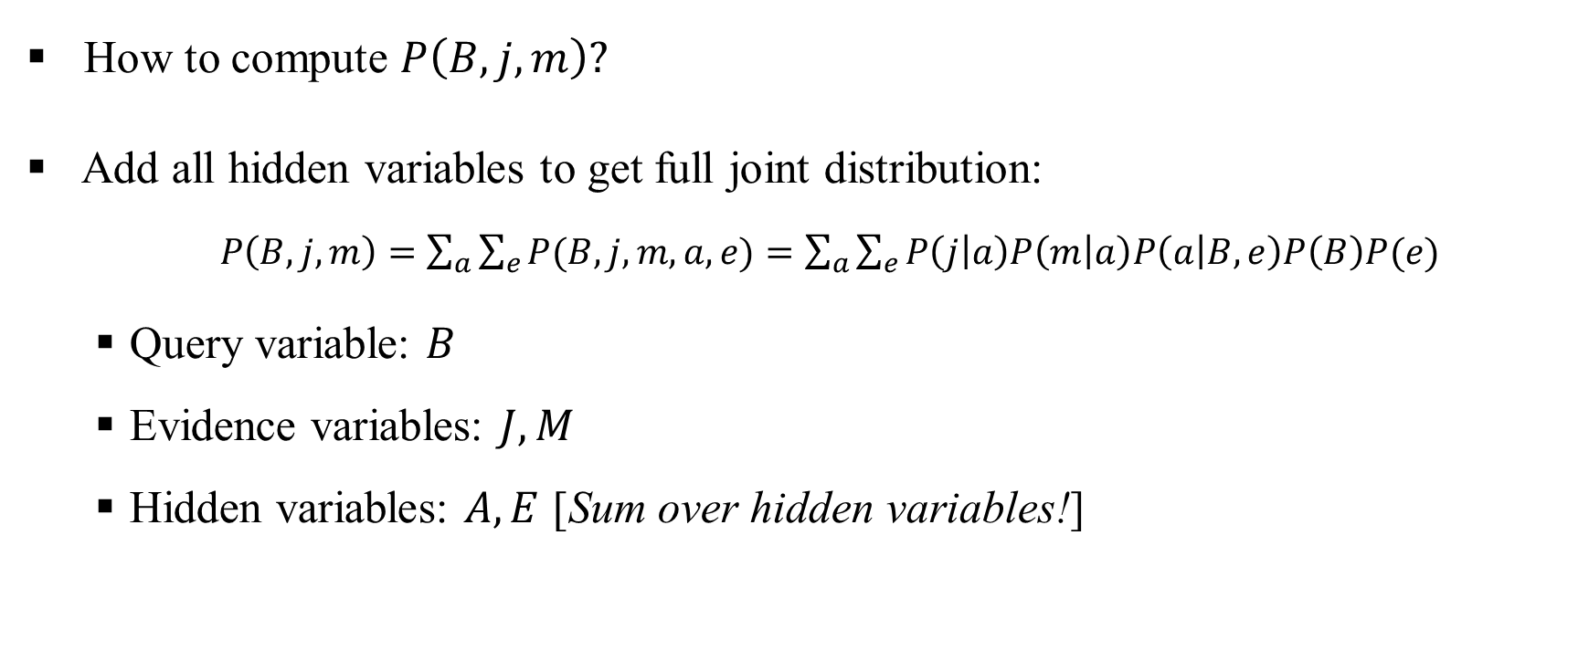
Bayesian Network: Exact Inference

Slide 4
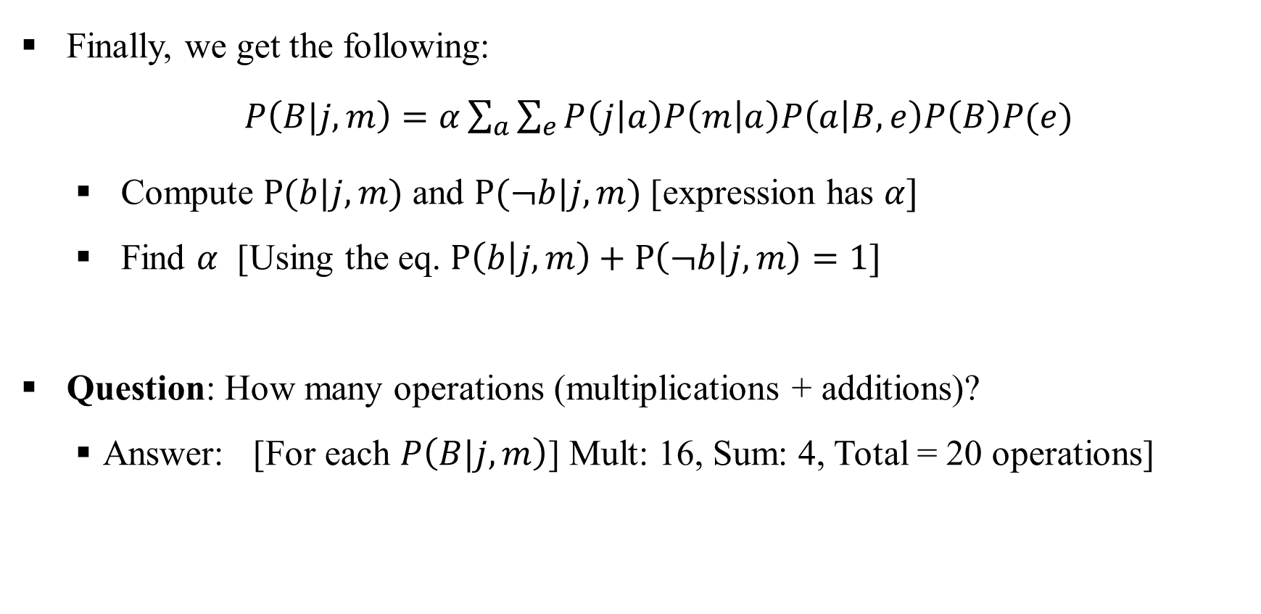
Bayesian Network: Exact Inference

Slide 5
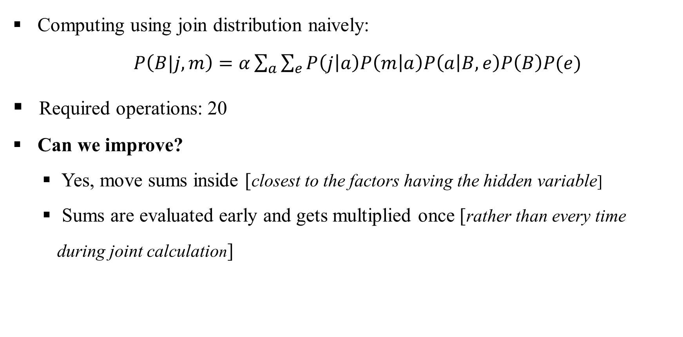
Bayesian Network: Exact Inference

Slide 6
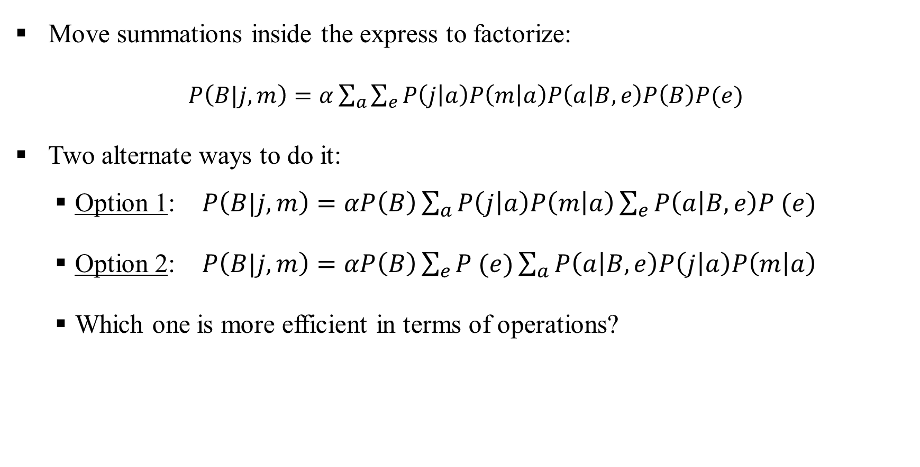
Bayesian Network: Exact Inference

Slide 7
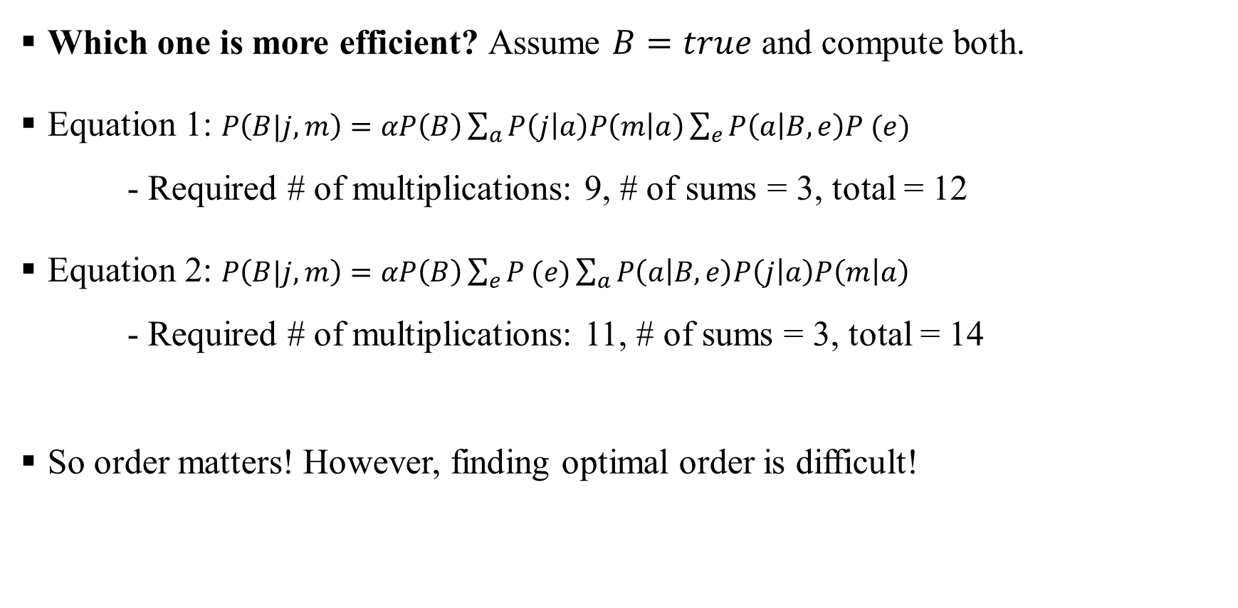
Bayesian Network: Exact Inference

Slide 8
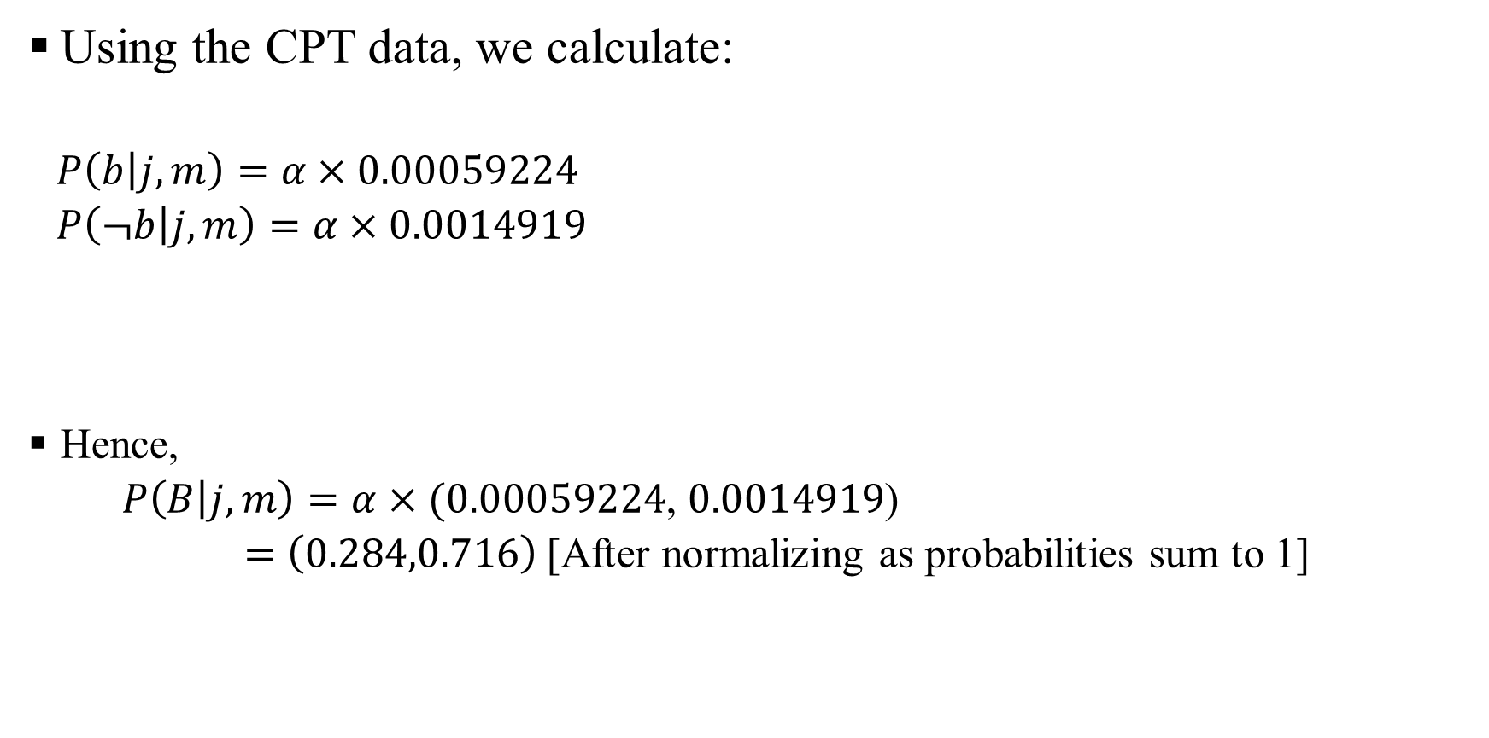
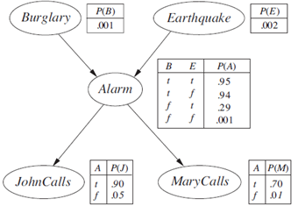
Bayesian Network: Exact Inference

Slide 9
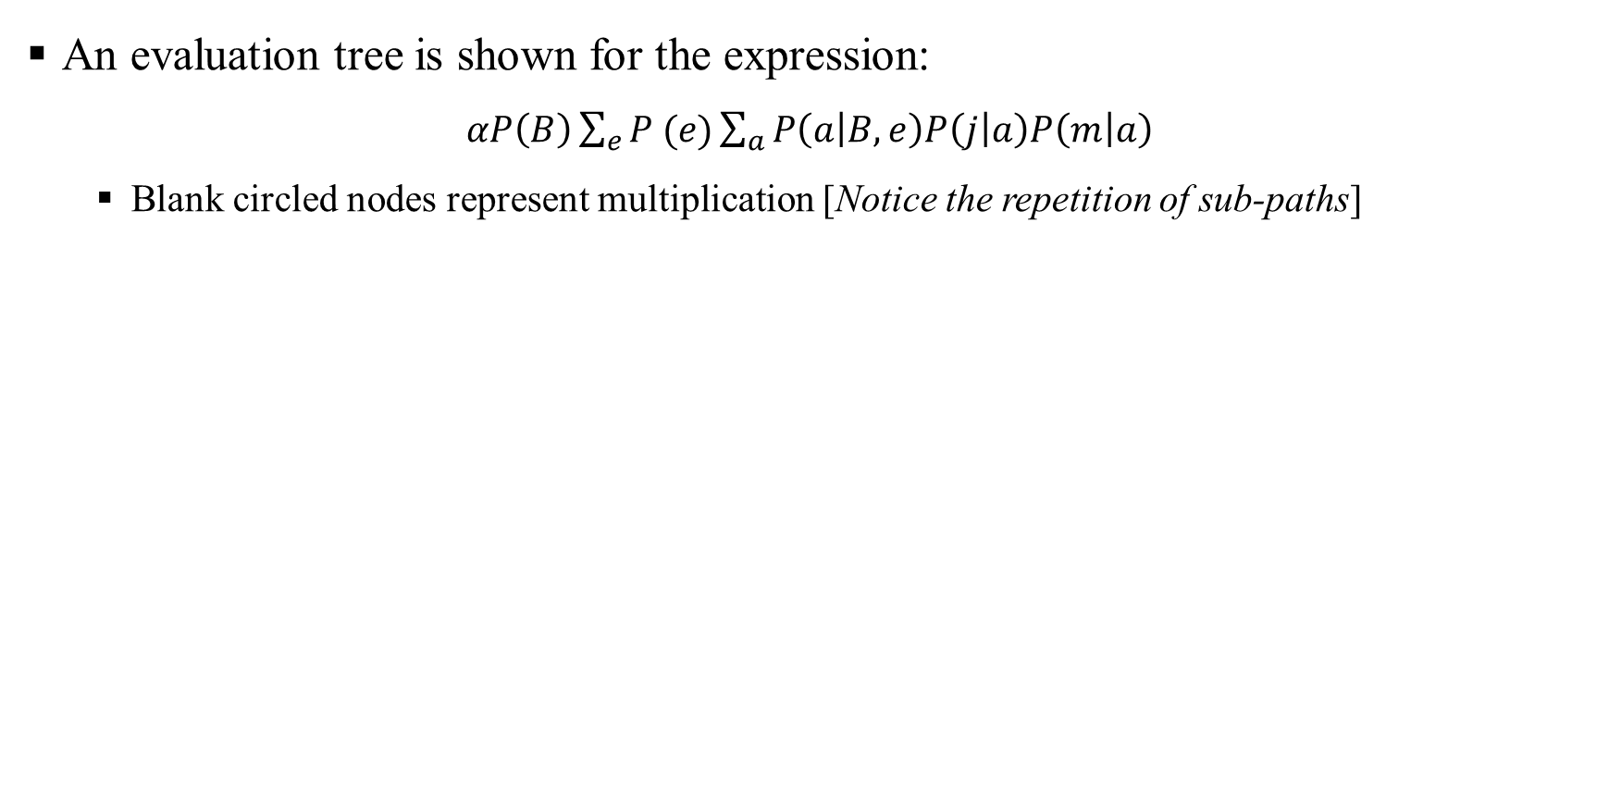
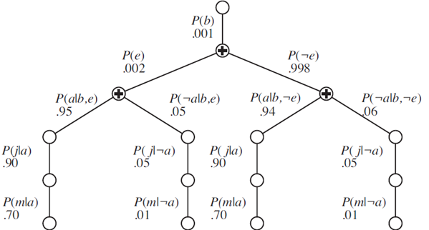
Bayesian Network: Exact Inference

Slide 10
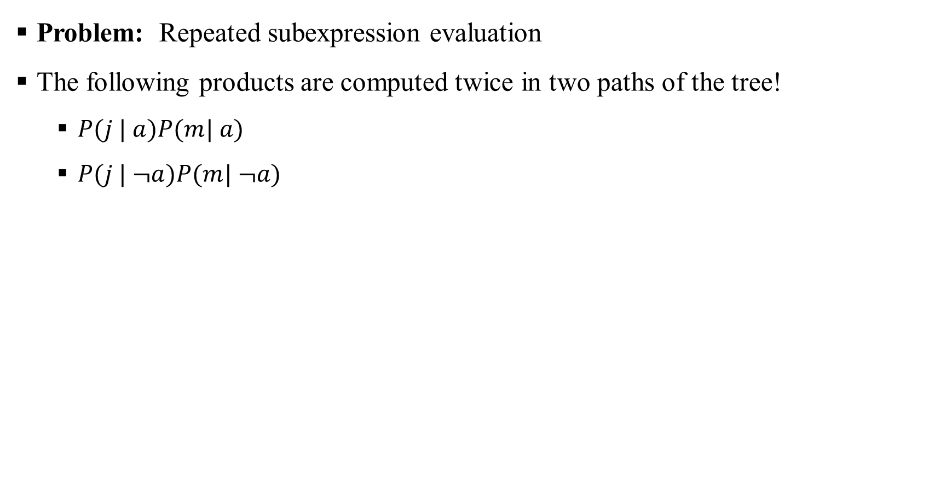
Bayesian Network: Exact Inference

Slide 11
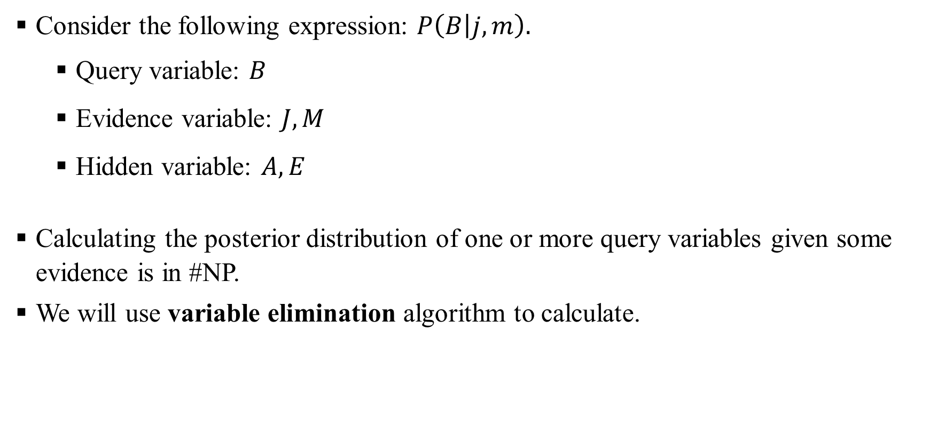
Bayesian Network: Variable Elimination Algorithm

Slide 12
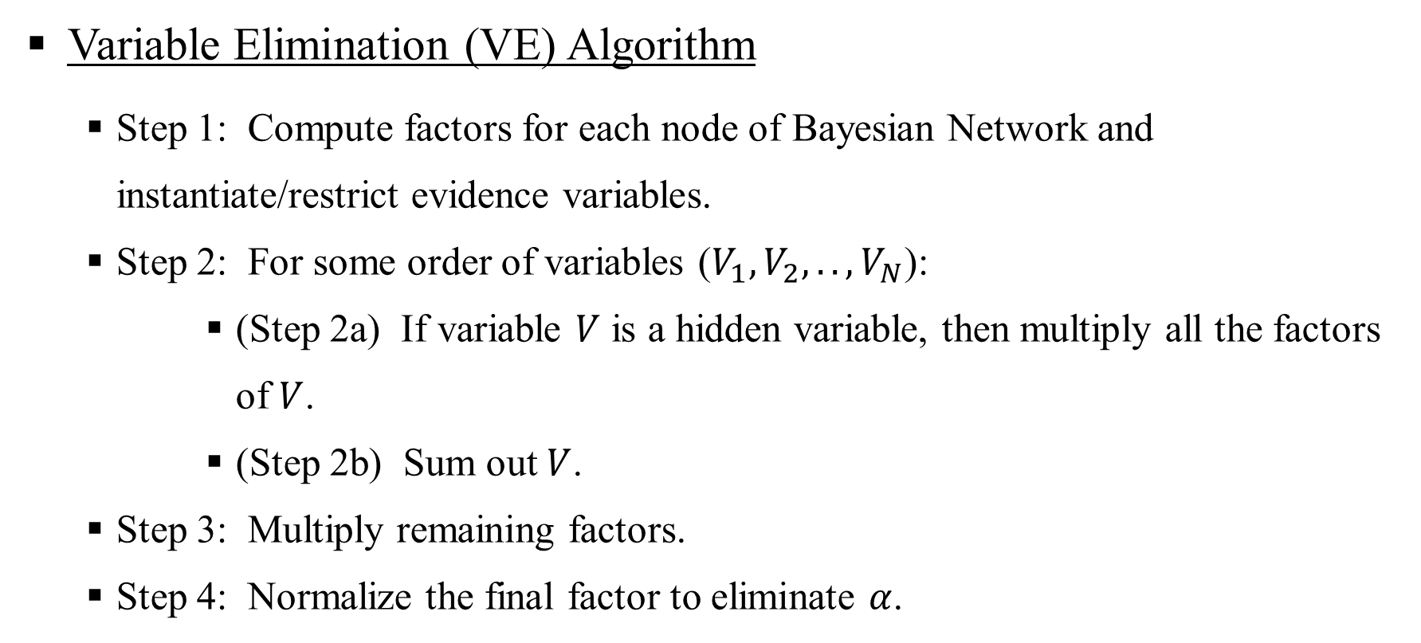
Bayesian Network: Variable Elimination Algorithm

Slide 13
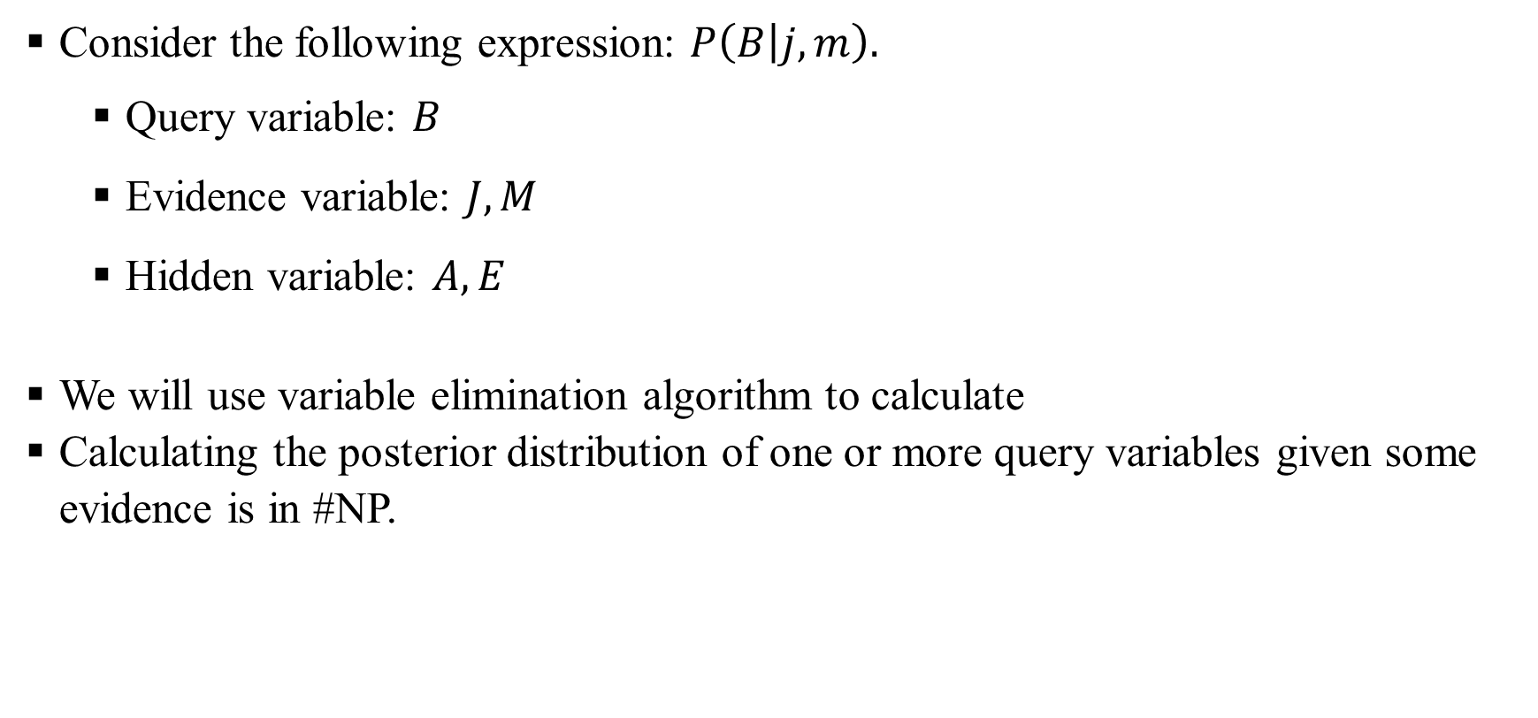
Bayesian Network: Variable Elimination Algorithm

Slide 14
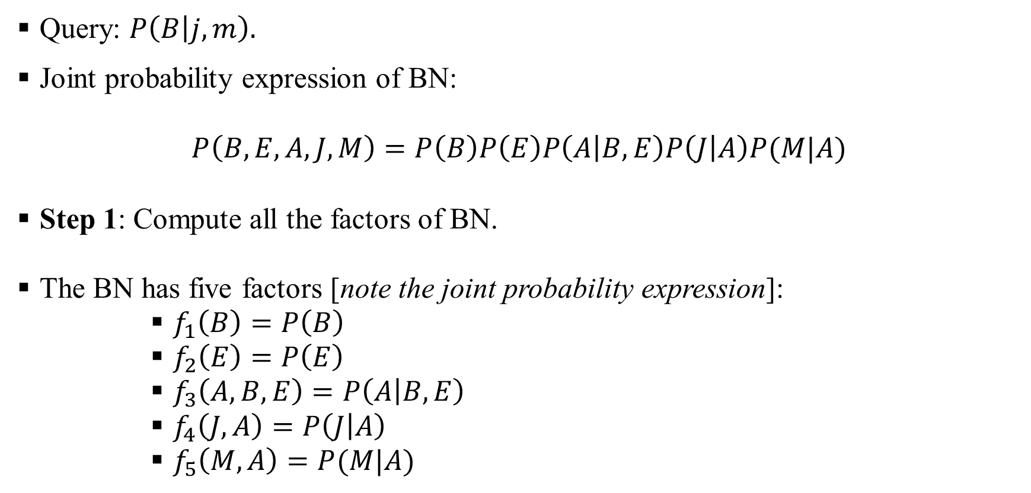
Bayesian Network: Variable Elimination Algorithm

Slide 15
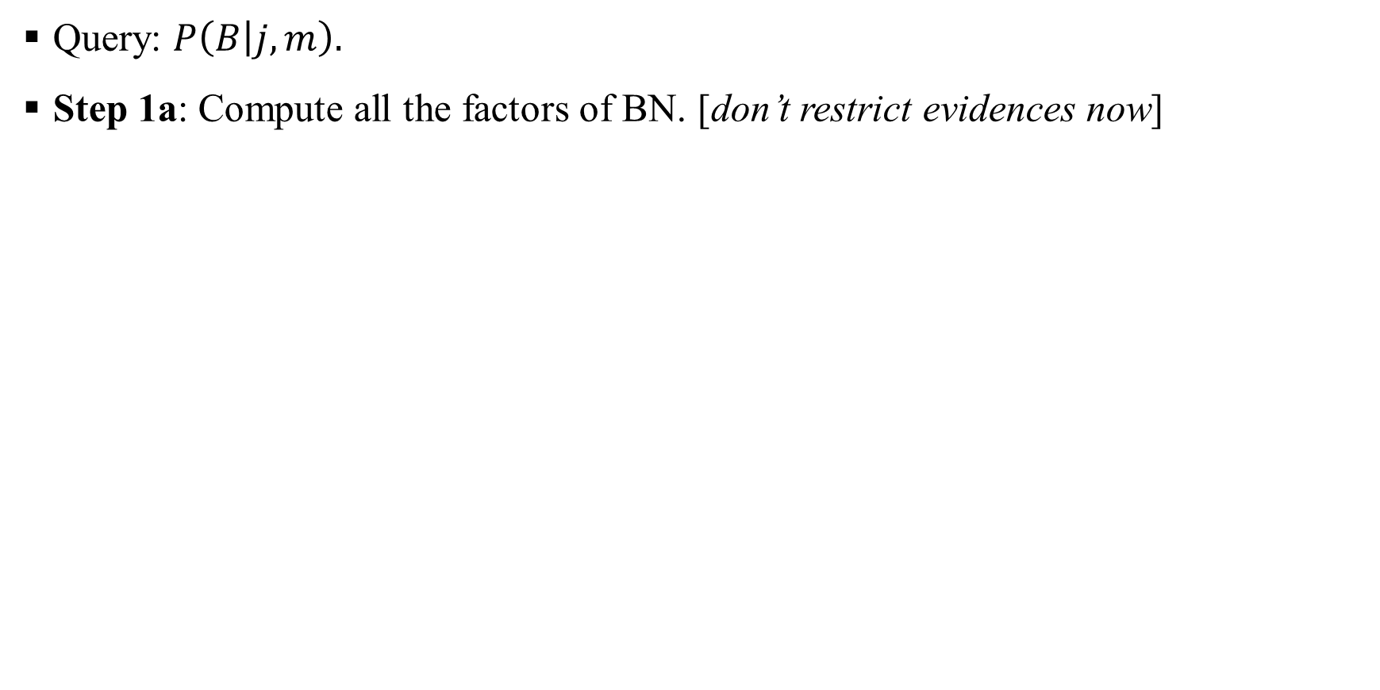
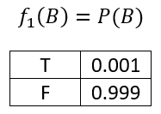
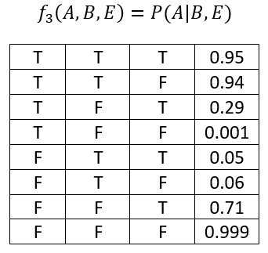
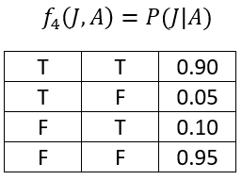
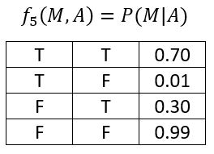
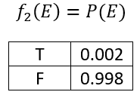
Variable Elimination Algorithm: Compute Factors

Slide 16
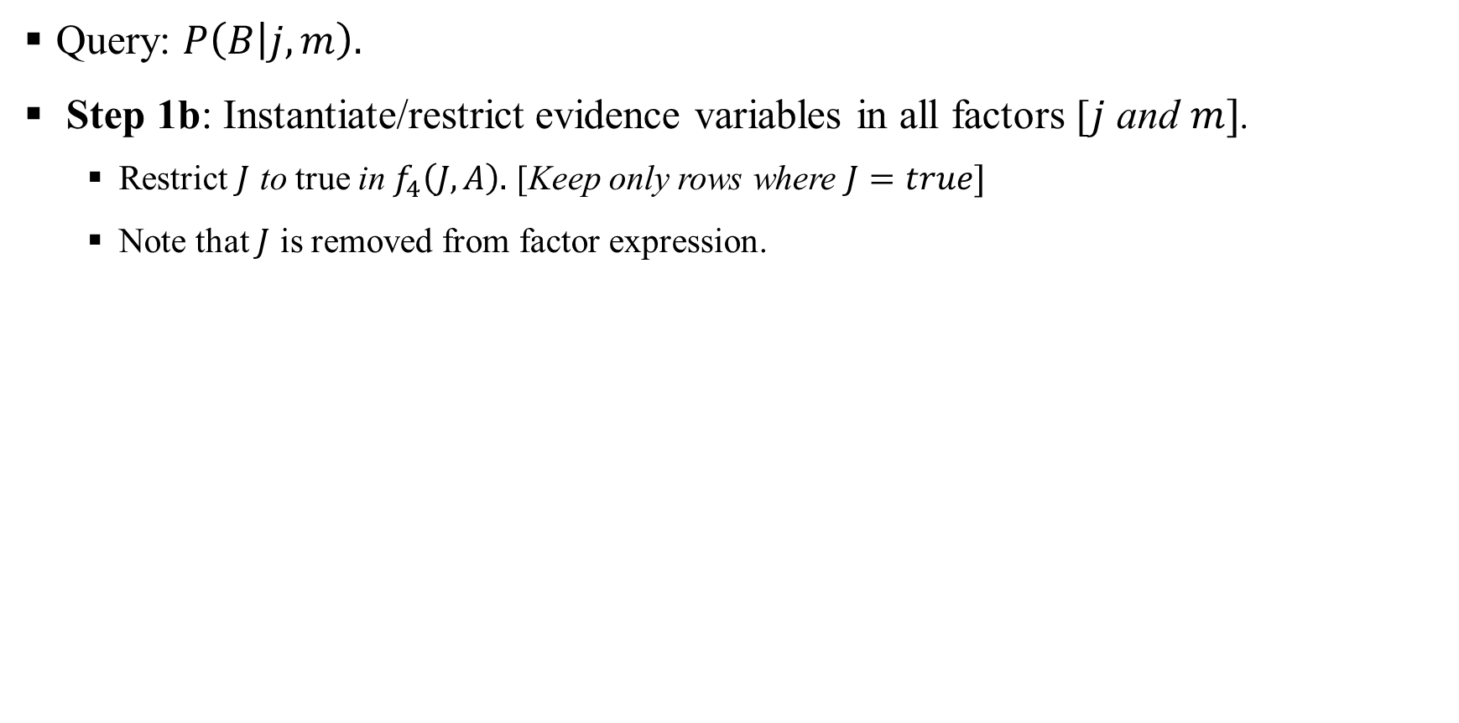
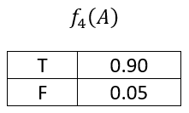

Variable Elimination Algorithm: Restrict Factors

Slide 17
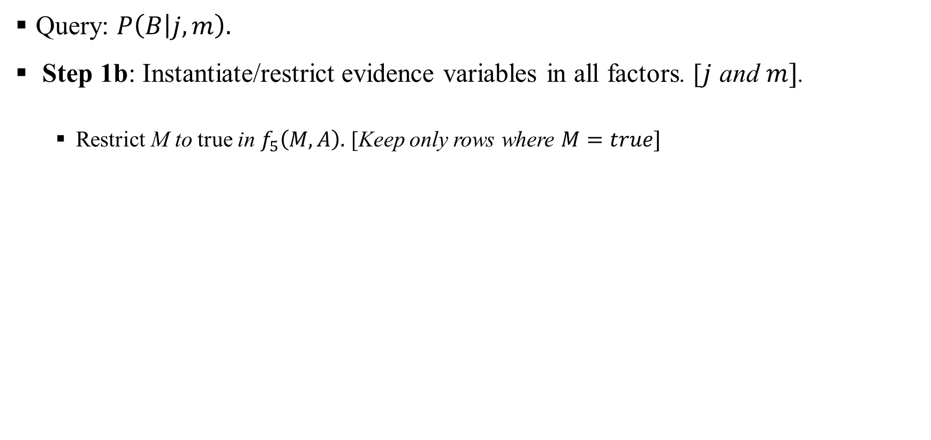
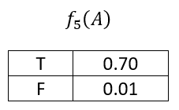
Variable Elimination Algorithm: Restrict Factors

Slide 18
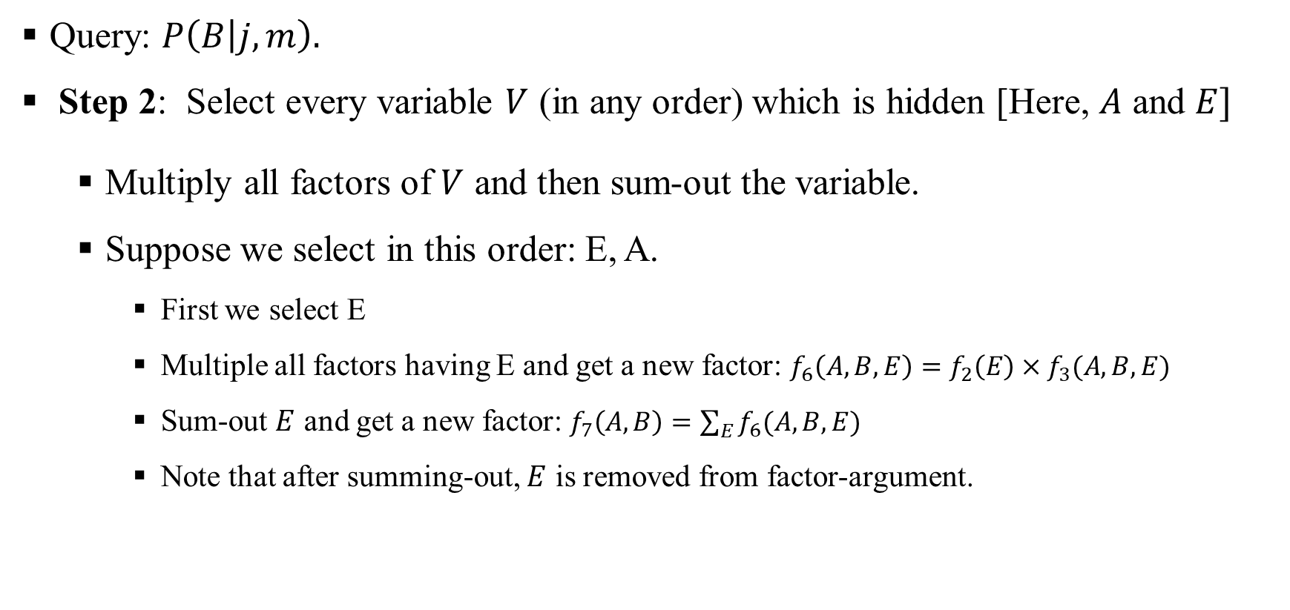
Variable Elimination Algorithm: Multiply Factors

Slide 19
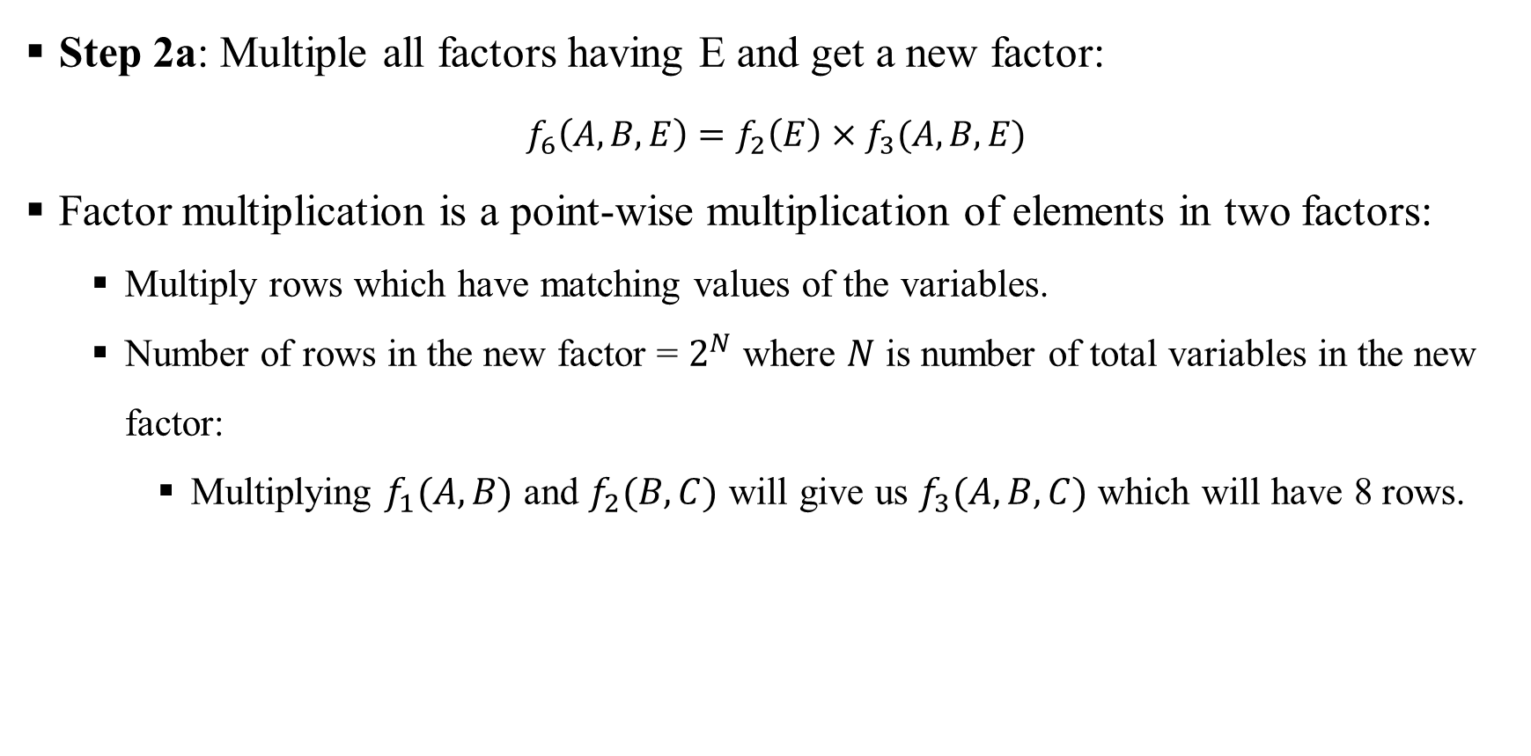
Bayesian Network: Multiply Factors

Slide 20
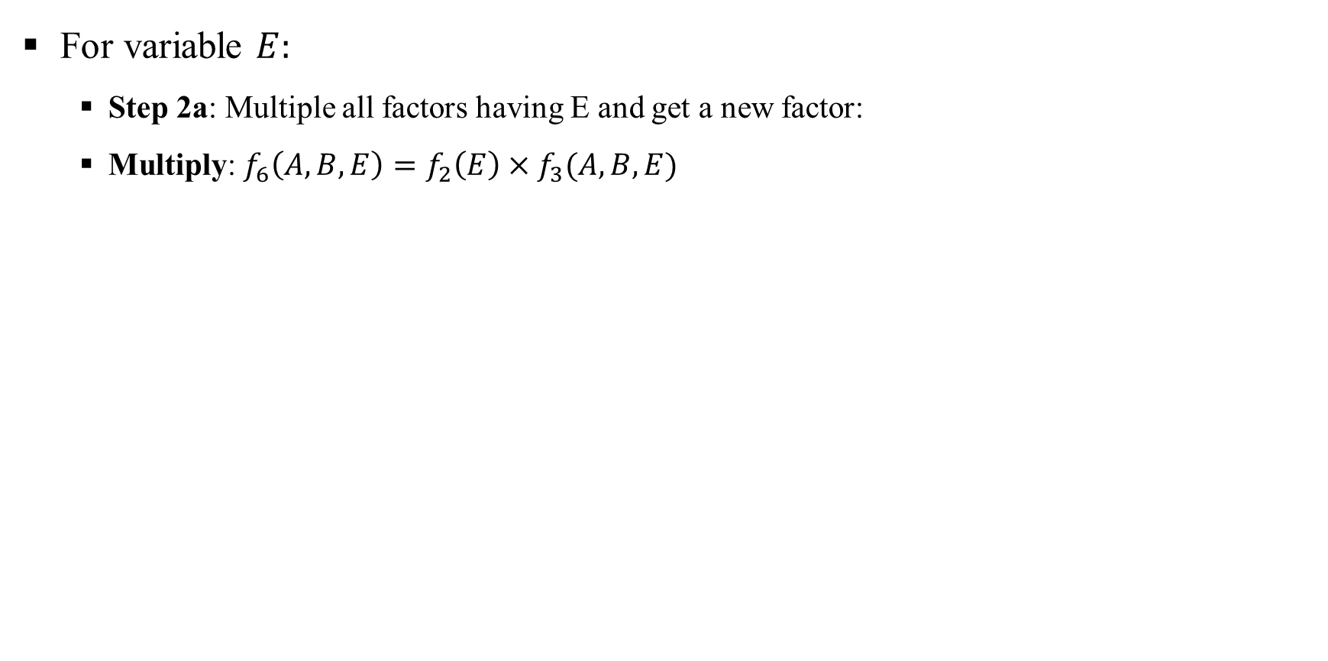
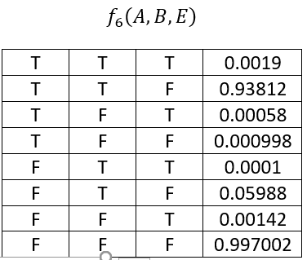

Bayesian Network: Multiply Factors

Slide 21
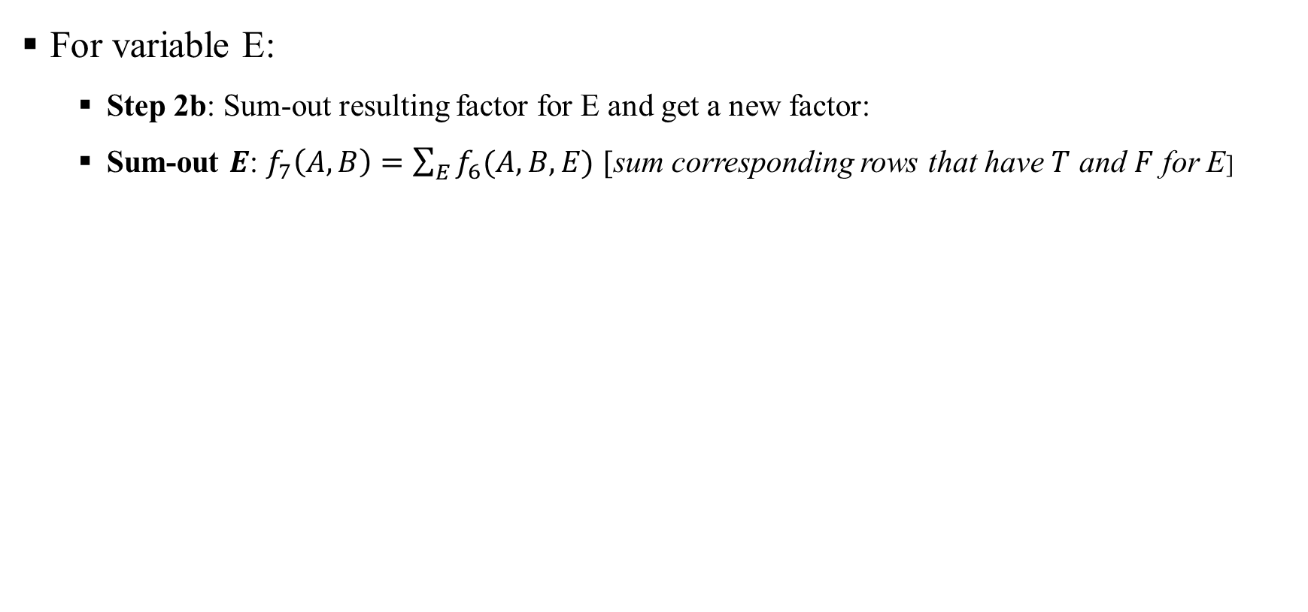
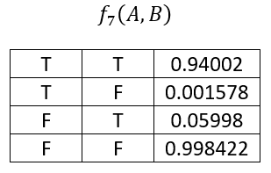
Bayesian Network: Multiply Factors

Slide 22
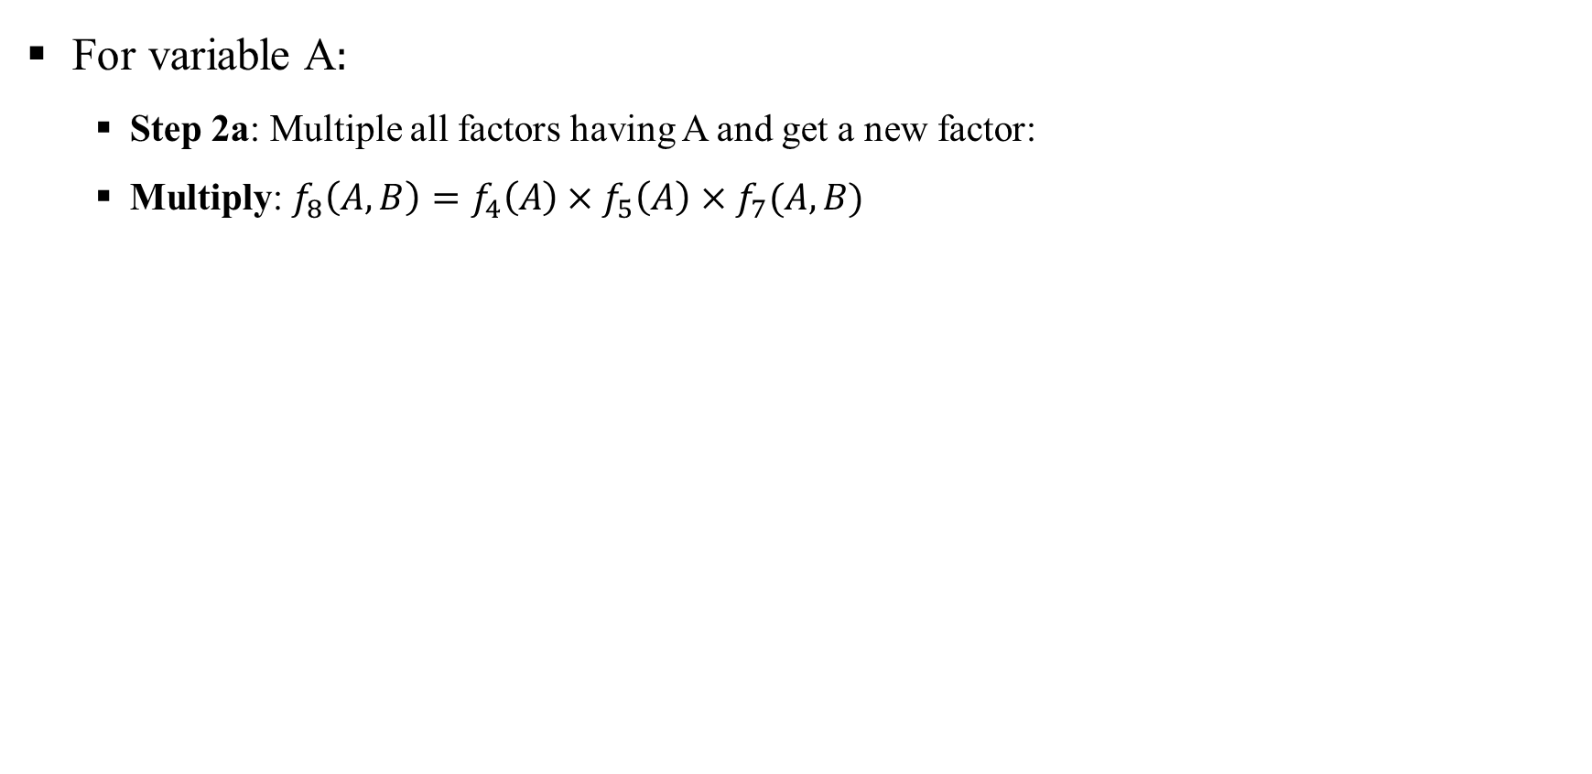
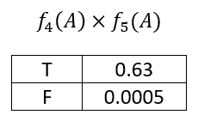
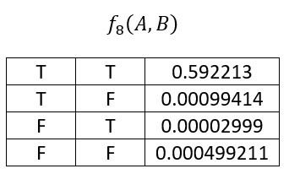
Bayesian Network: Multiply Factors

Slide 23
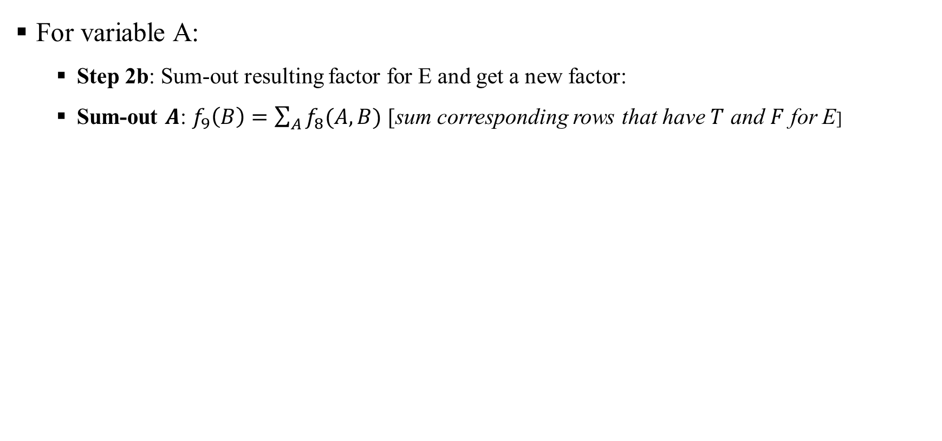
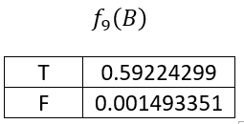
Bayesian Network: Multiply Factors

Slide 24
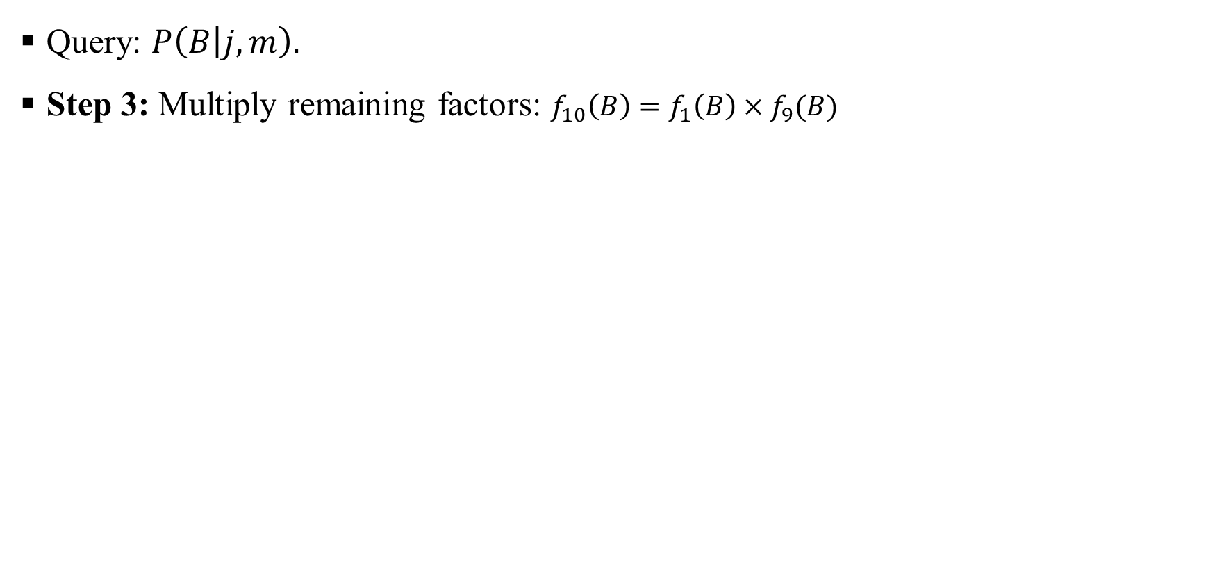
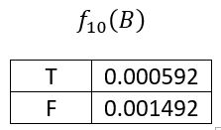
Bayesian Network: Multiply Remaining Factors

Slide 25
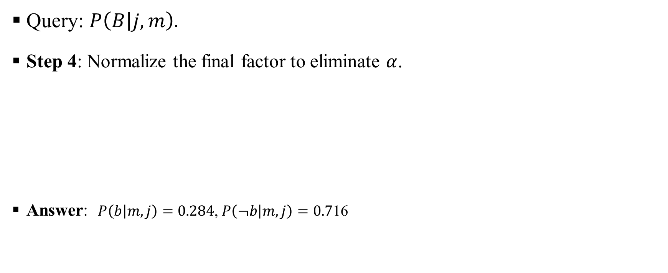
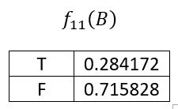
Bayesian Network: Normalize Result

Slide 26
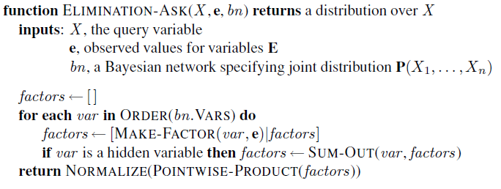
Bayesian Network: Variable Elimination Algorithm
Algorithm pseudocode [RN book]
Note: Step 1 (initialization) is missing in the pseudocode [it is implied in the MAKE-FACTOR function which is not a good approach!]

Slide 27
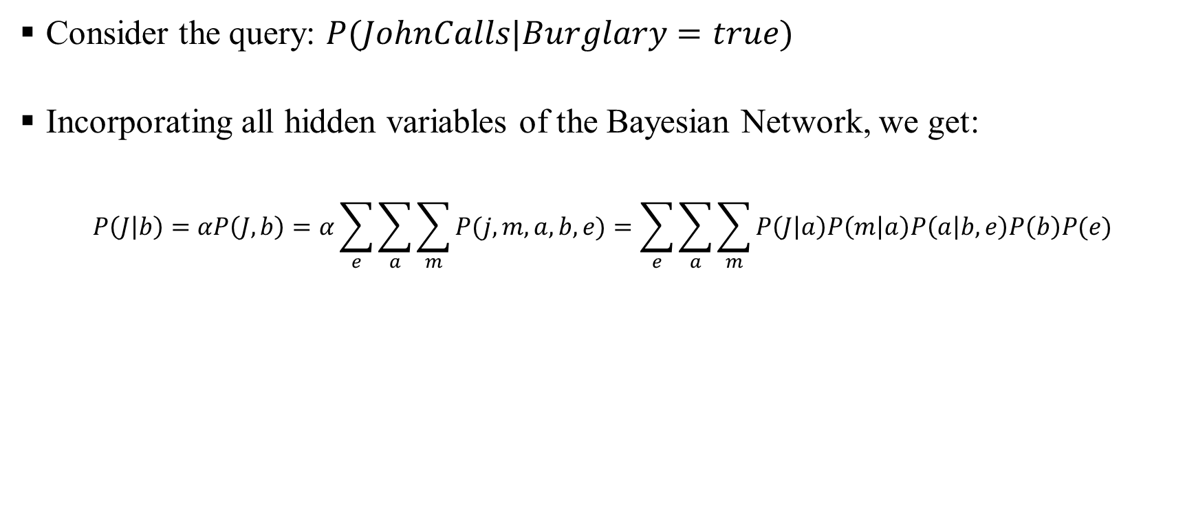
Bayesian Network: Irrelevant Variable

Slide 28
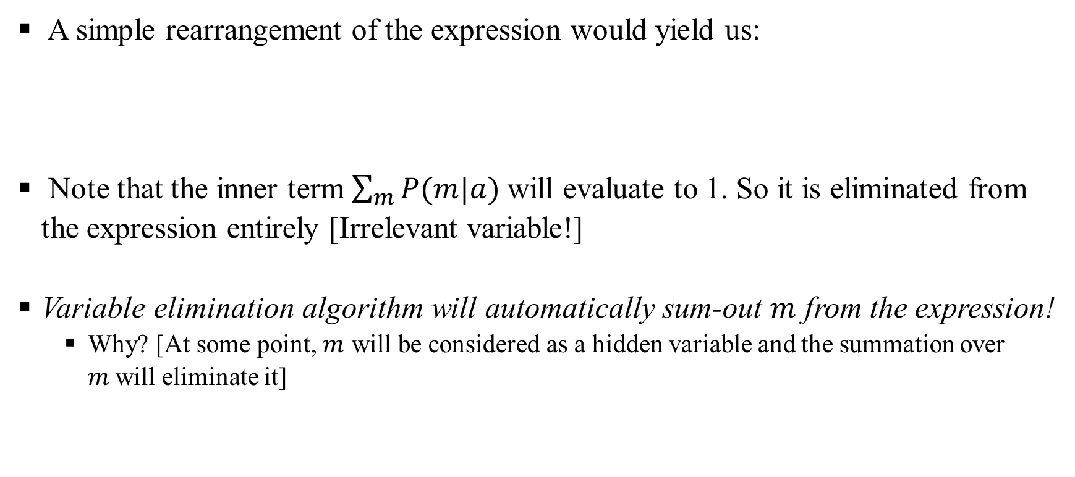
Bayesian Network: Irrelevant Variable

Slide 29
Bayesian Network: Irrelevant Variable
In general, we can remove any leaf node that is not a query variable or an evidence variable.
After removal of initial leaves, there may be some more leaf nodes, and these too may be irrelevant and removed [continue this process].
Every variable that is not an ancestor of a query variable or evidence variable is irrelevant to the query.
Finding the optimal ordering of hidden variables for VE is NP-Hard!

