Slide 1
Chapter 15 (AIAMA)
Probabilistic Reasoning Over Time
Sukarna Barua
Associate Professor, CSE, BUET

Slide 2
Temporal Probabilistic Models
Static world (as we considered in Bayesian network):
Random variables have a fixed number of states/values.
Values of Random variables doesn’t change over time
Dynamic world (time is an important factor):
Random variables have a fixed number of states/values.
Values of Random variables change over time.

Slide 3
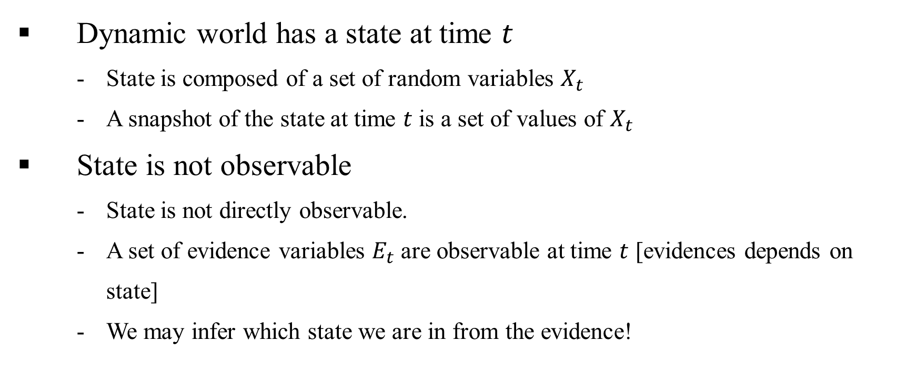
Temporal Probabilistic Models

Slide 4
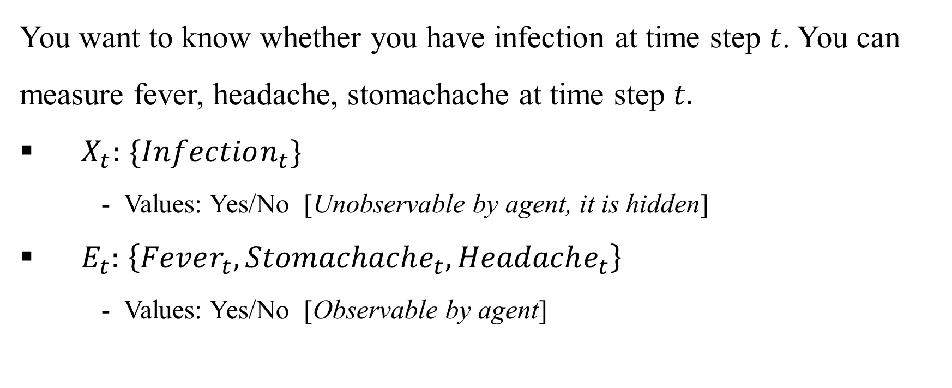
Temporal Probabilistic Models: Example

Slide 5
Temporal Probabilistic Models
In a temporal probabilistic model, agent have:
Environment: Partially observable
Belief state: What is the current state as agent maintains/believes?
Transition model: How the environment might evolve in the next time step
Sensor model: How the observable events happen at world state?
Decision: How the agent take action?
Evidence 🡪 Belief state 🡪 Decision

Slide 6
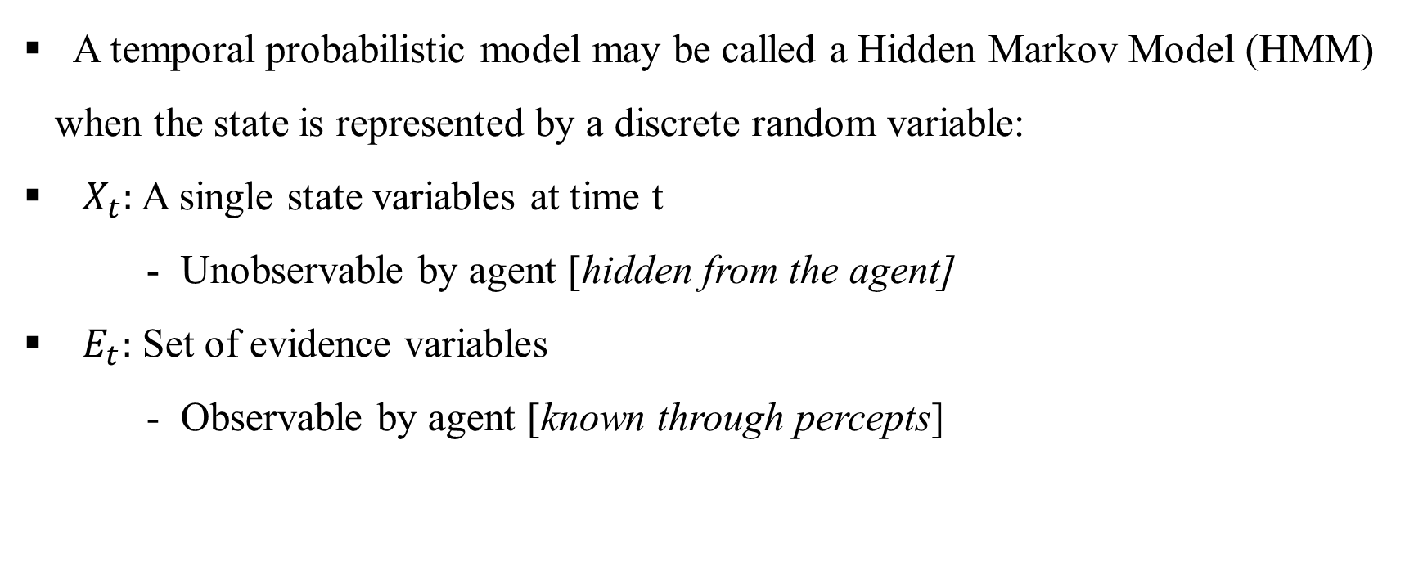
Hidden Markov Models

Slide 7
Hidden Markov Models
What happens if world state has multiple random variables?
- Multiple random variables may be mapped to a single random variable
Example: <Burglary, Earthquake> makes up agent state both are Boolean.
Construct a single variable <BE> with four values {0,1,2,3} where
0 means Burglary=T and Earthquake = T
1 means Burglary=T and Earthquake = F
2 means Burglary=F and Earthquake = T
3 means Burglary=F and Earthquake = F

Slide 8
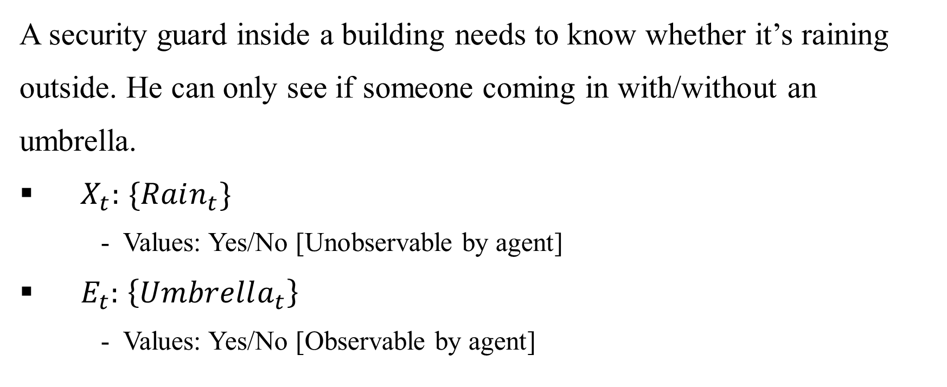
Hidden Markov Models: Example

Slide 9
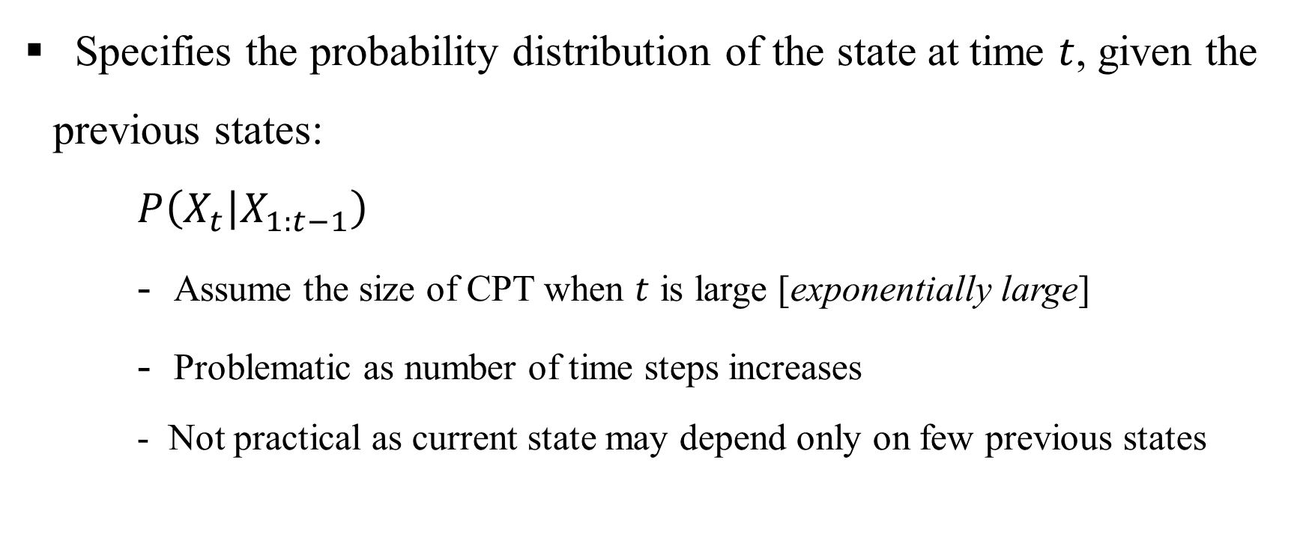
Transition Model

Slide 10
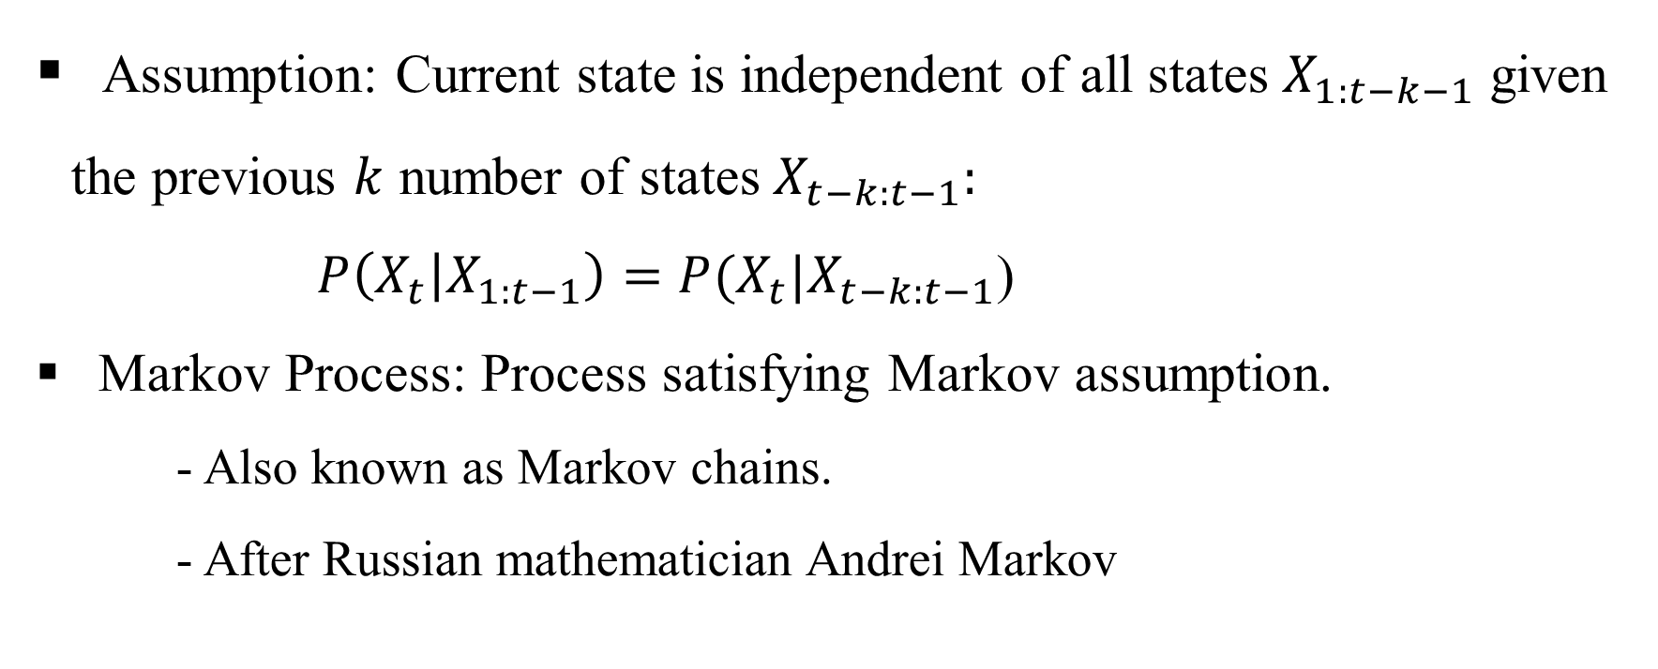
Markov Assumption for Transition Model

Slide 11
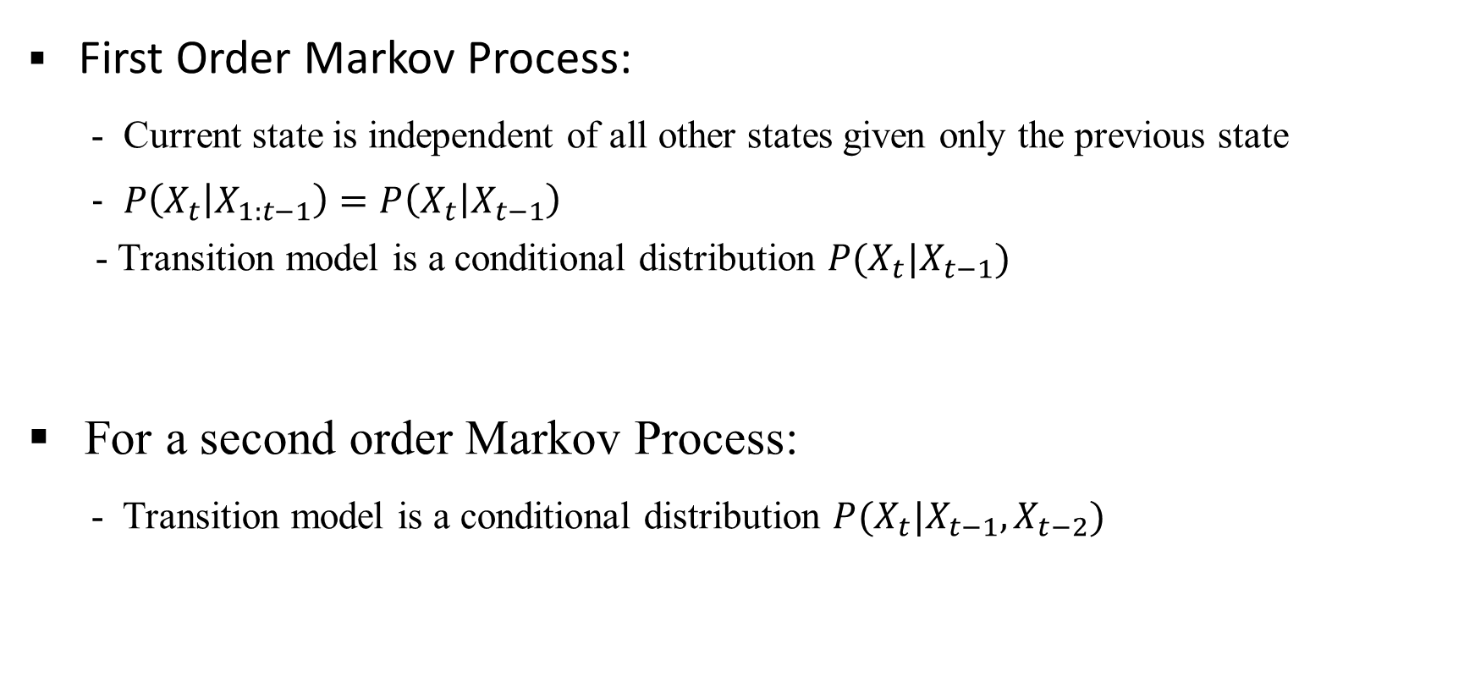
Order of Markov Process

Slide 12
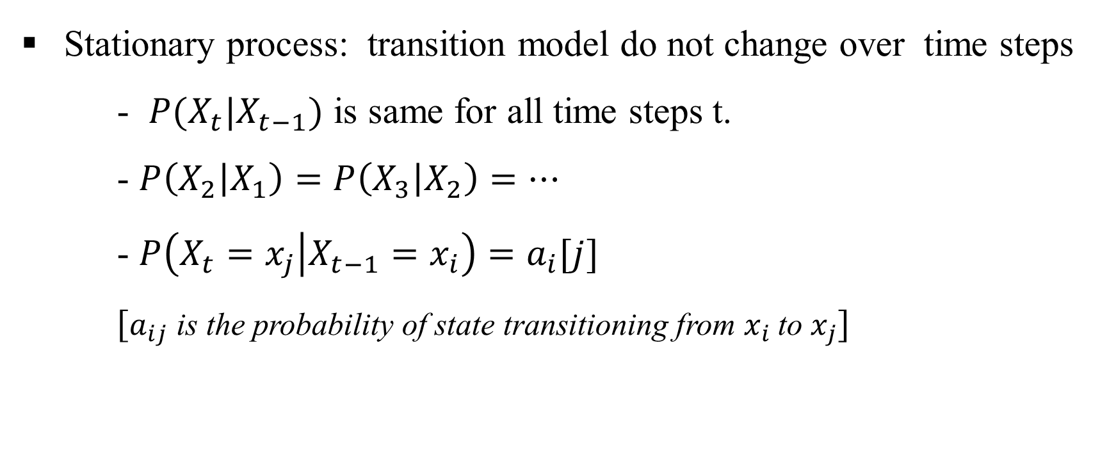
First Order Markov Process

Slide 13
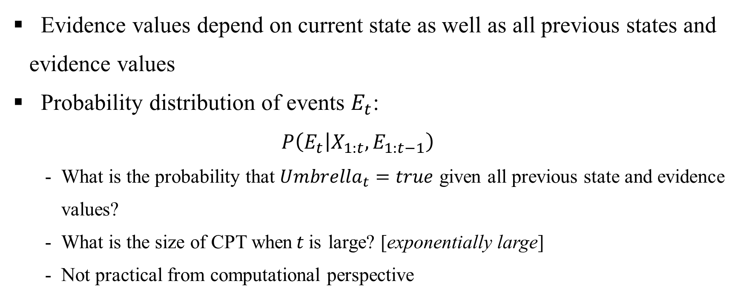
Sensor/Emission Model

Slide 14
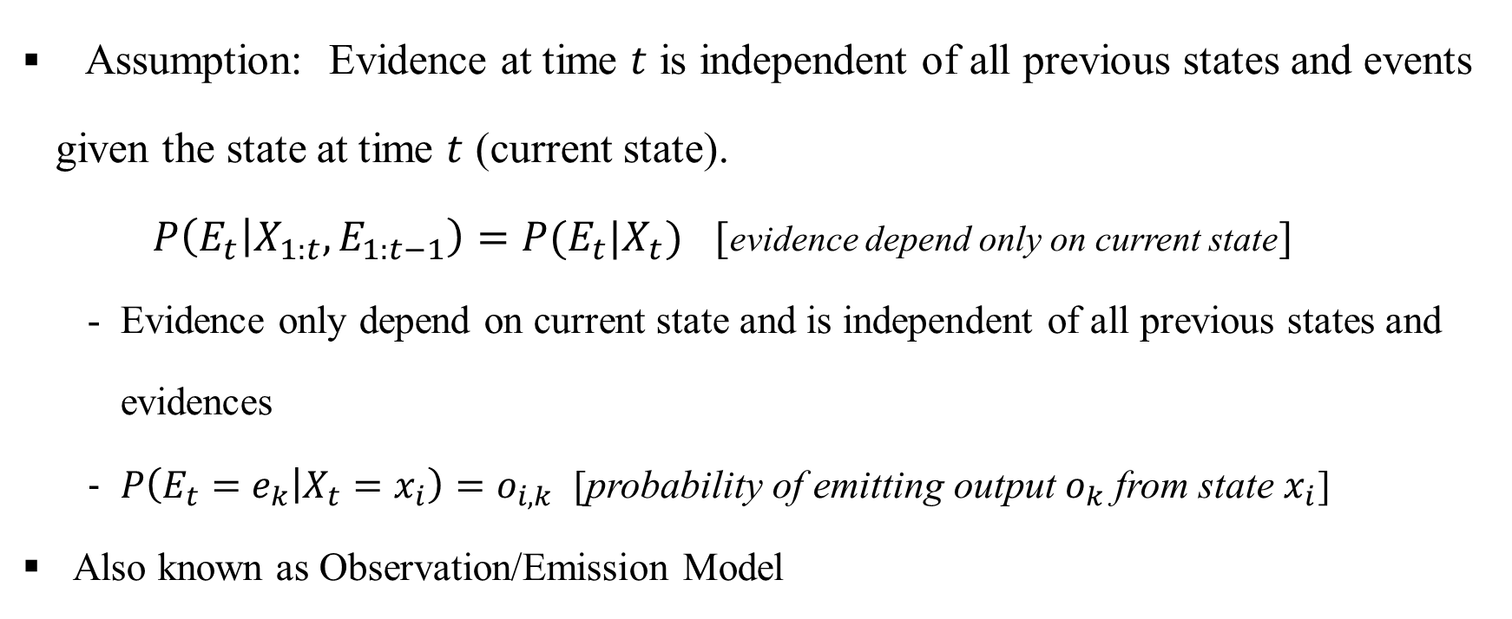
Markov Assumption for Sensor Model

Slide 15
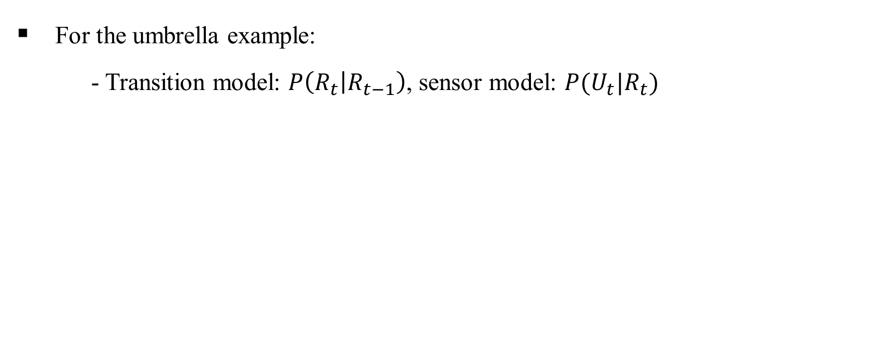
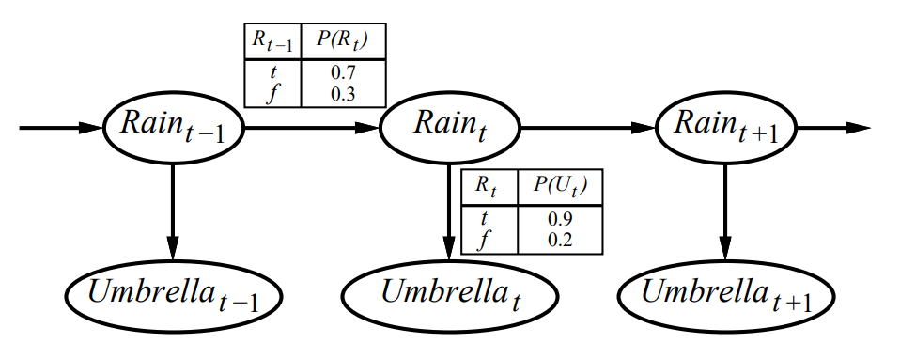
Example Markov Process

Slide 16
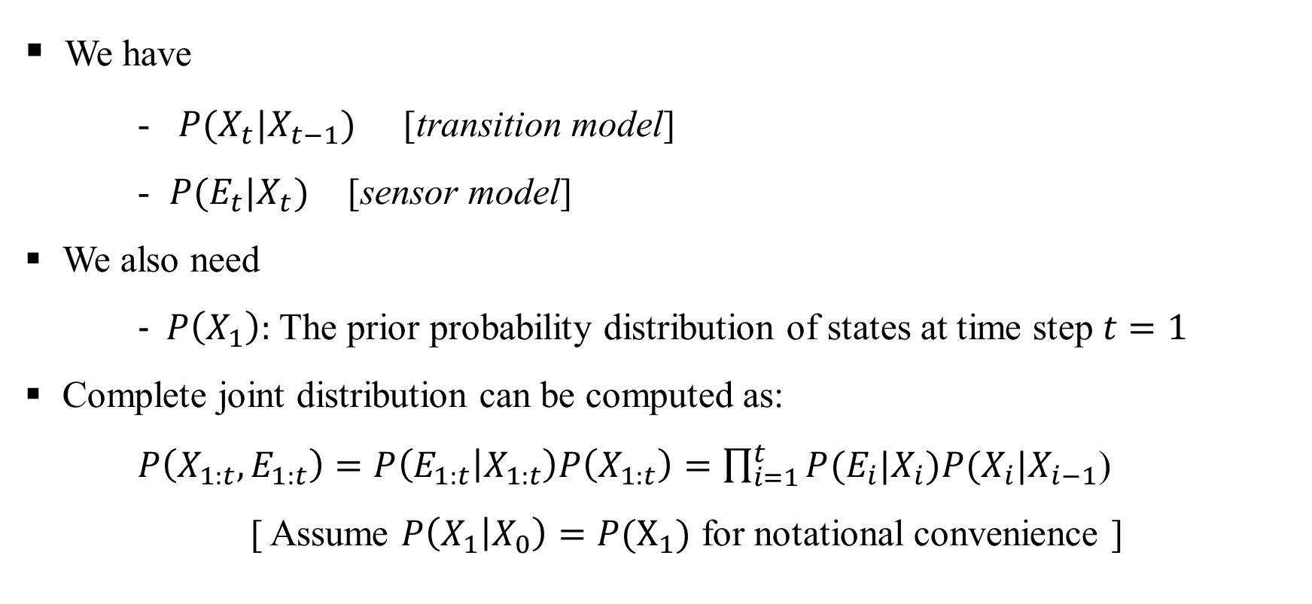
Complete/Full Joint Distribution

Slide 17
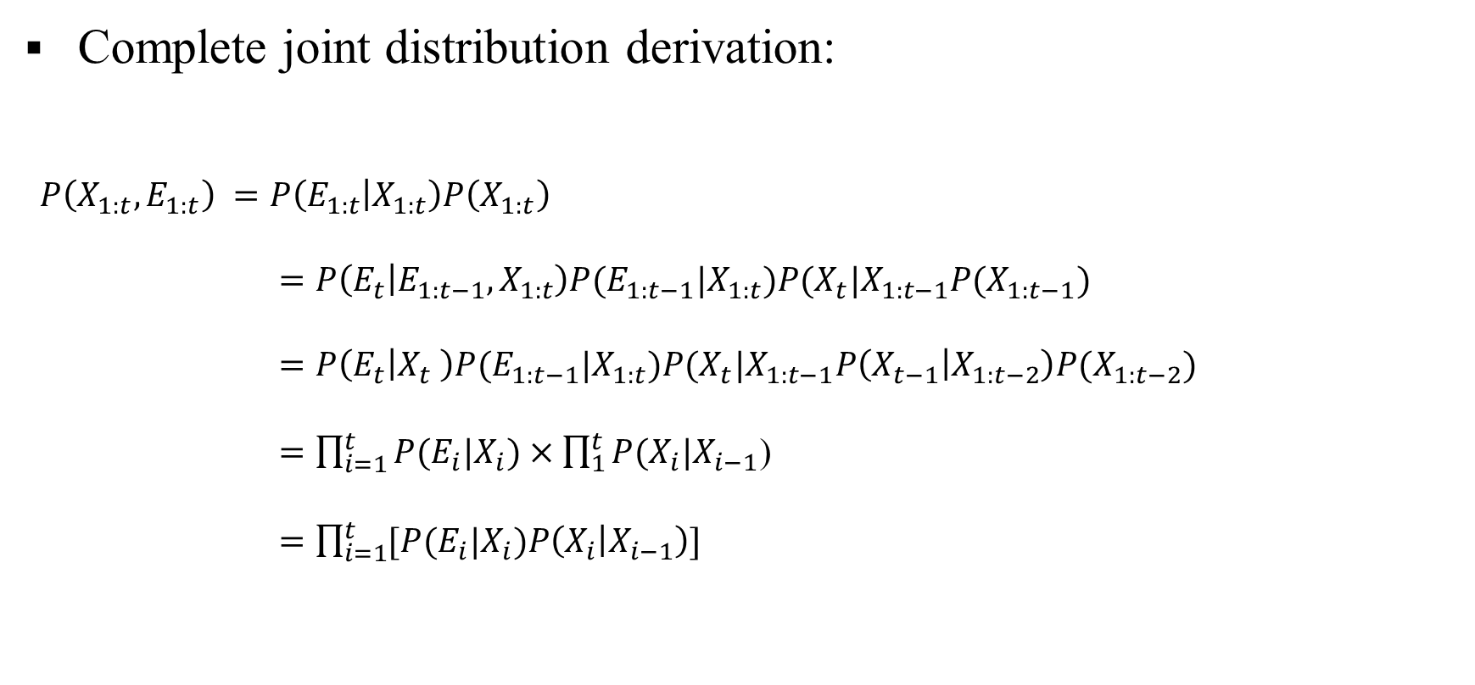
Complete/Full Joint Distribution

Slide 18
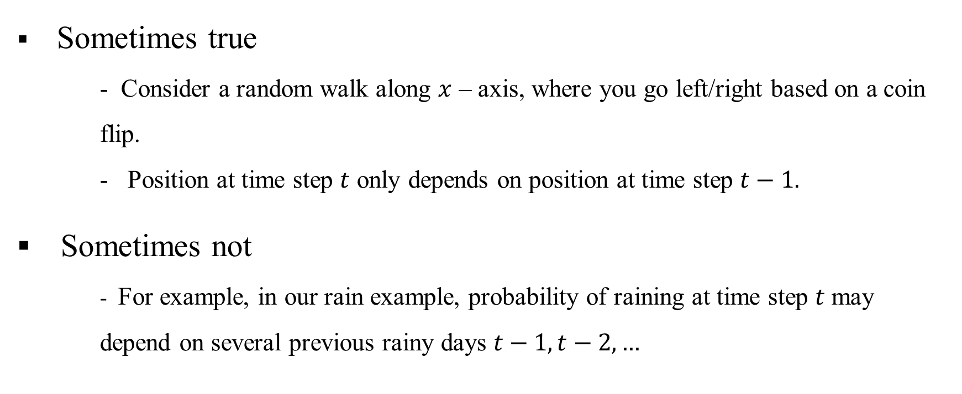
Is First Order Markov Process Accurate?

Slide 19
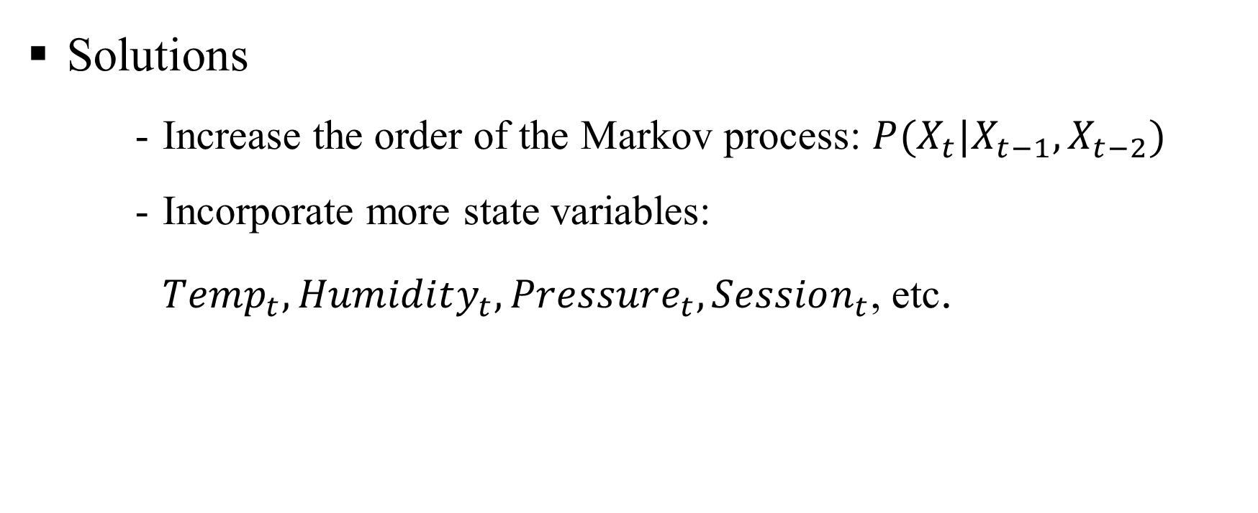
Improve First Order Markov Process?

Slide 20
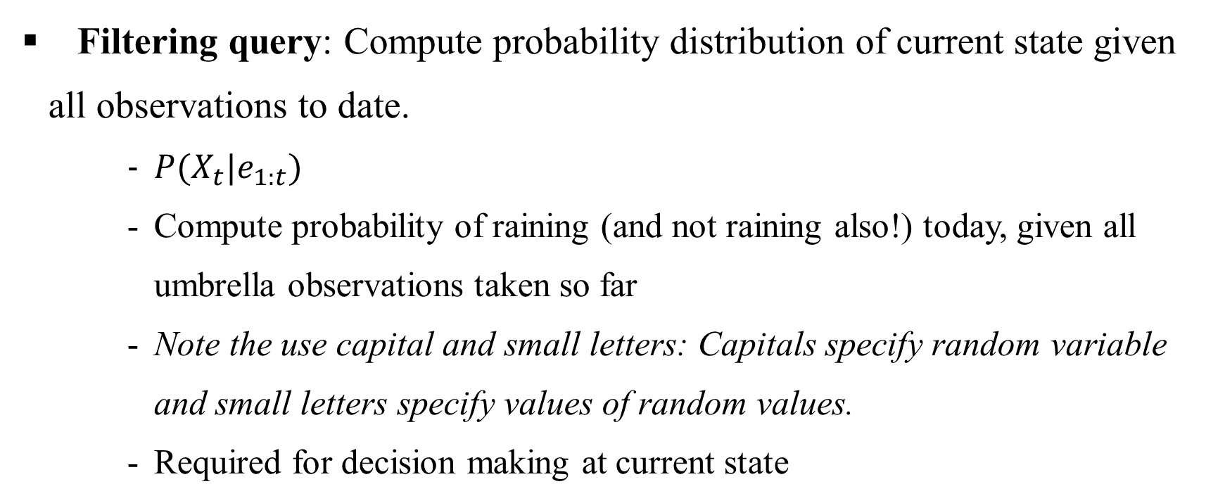
Inference in First Order Markov Process

Slide 21
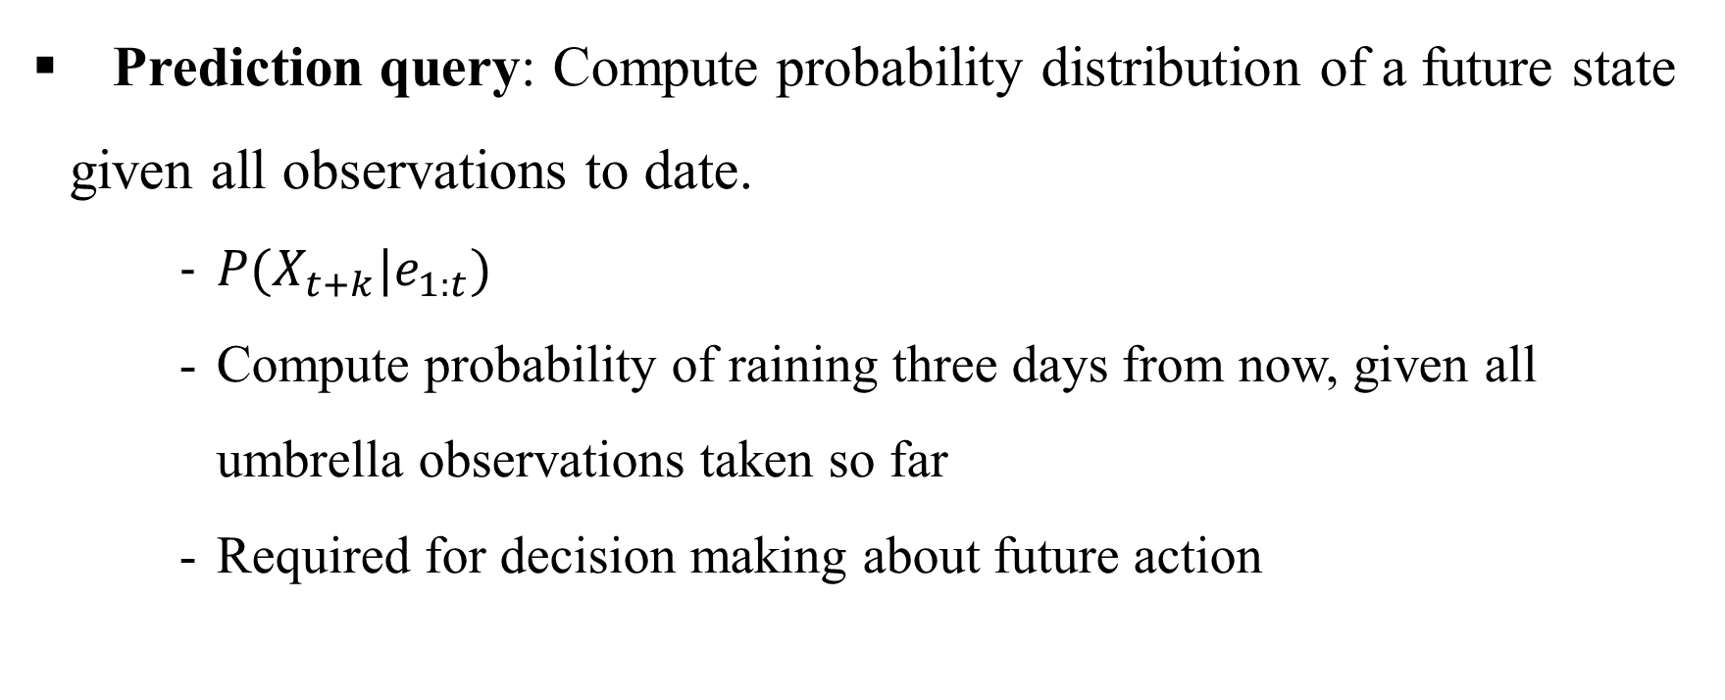
Inference in First Order Markov Process

Slide 22
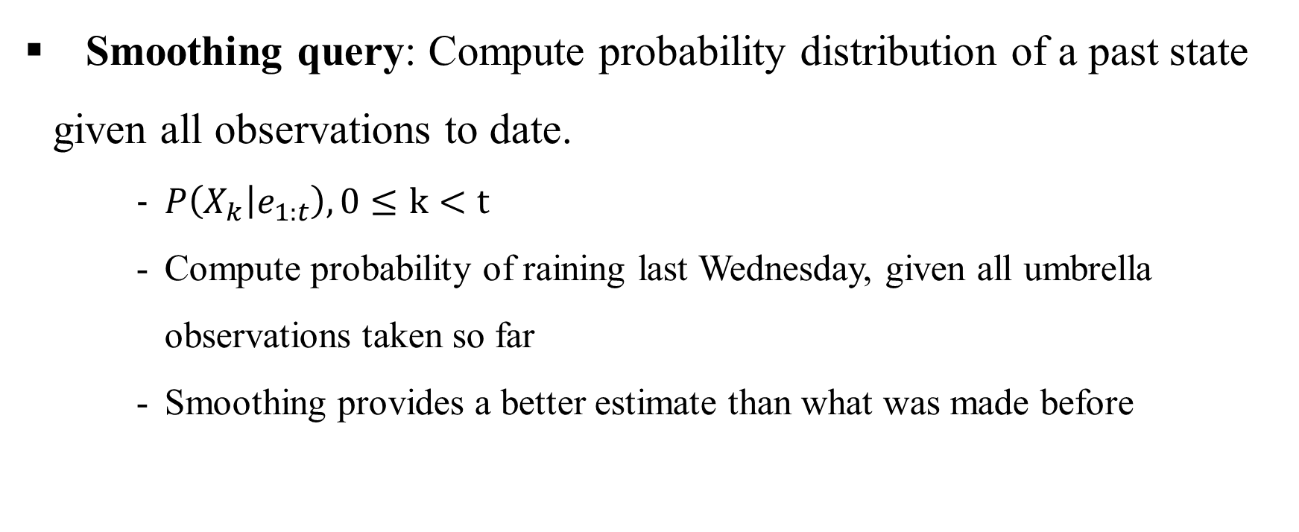
Inference in First Order Markov Process

Slide 23
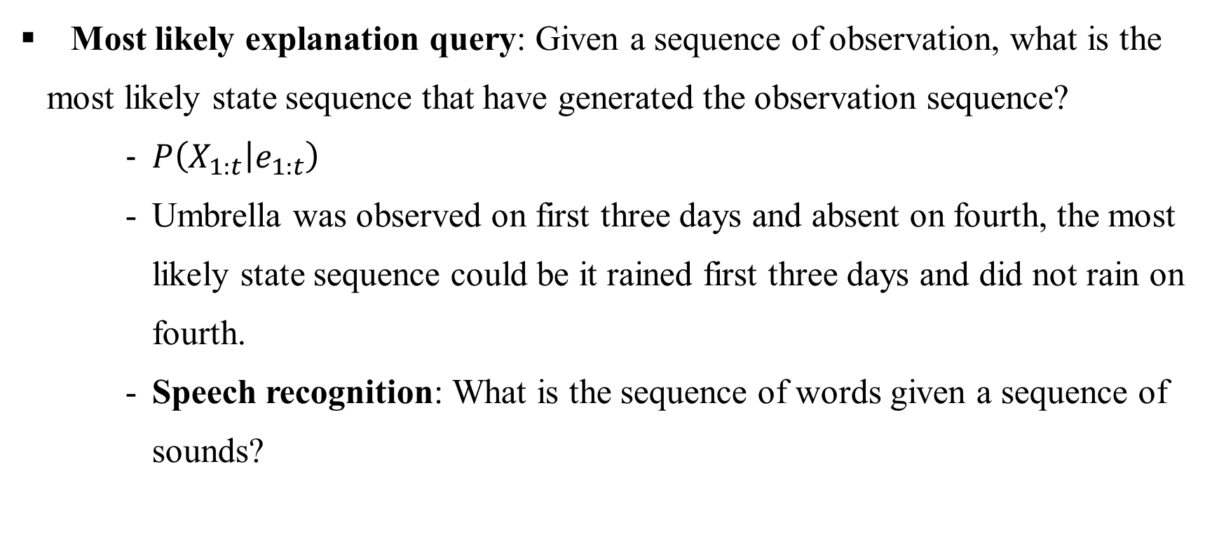
Inference in First Order Markov Process

Slide 24
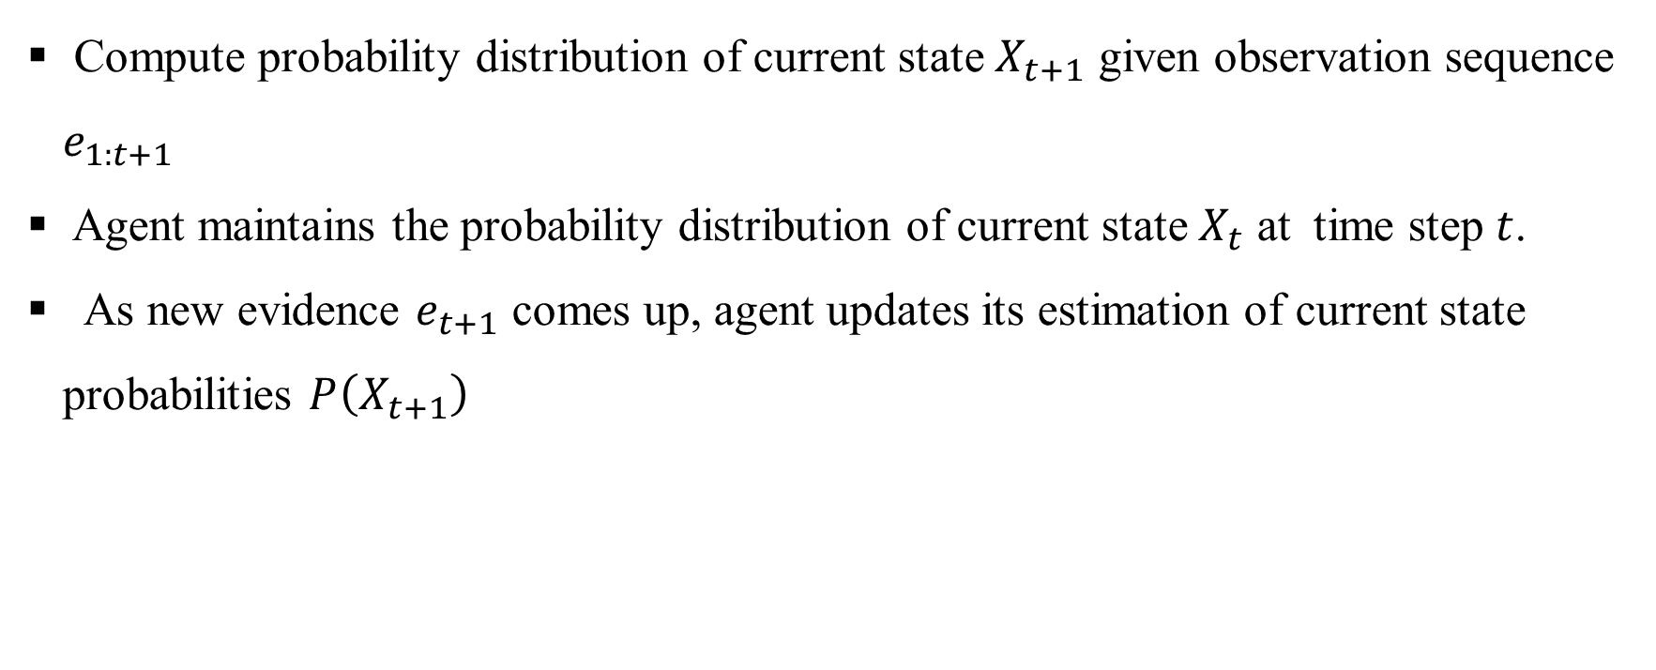
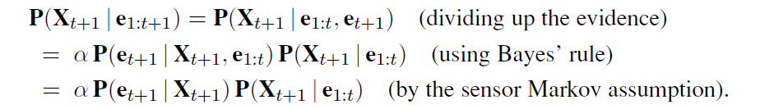
Filtering

Slide 25
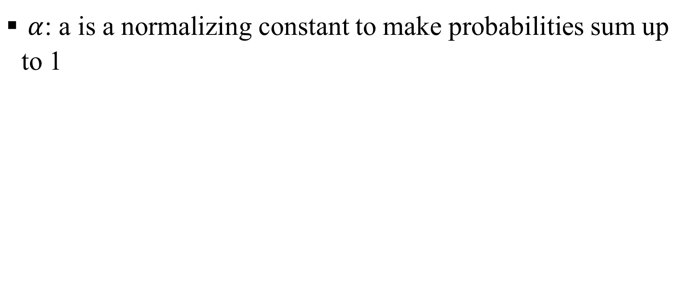
Filtering

Slide 26
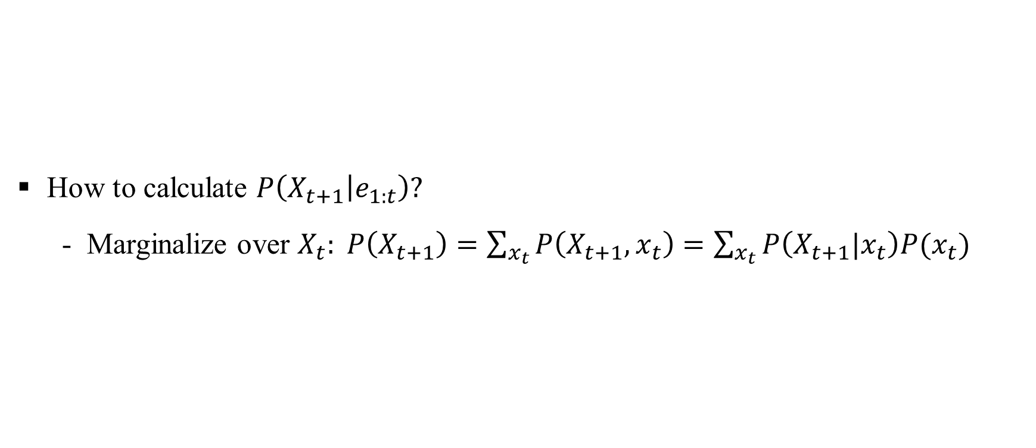
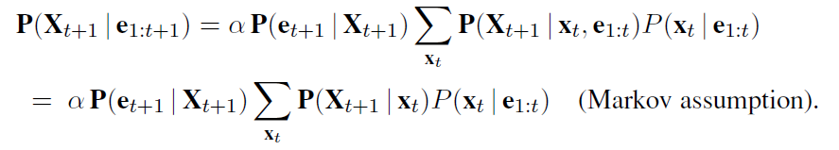
Filtering

Slide 27
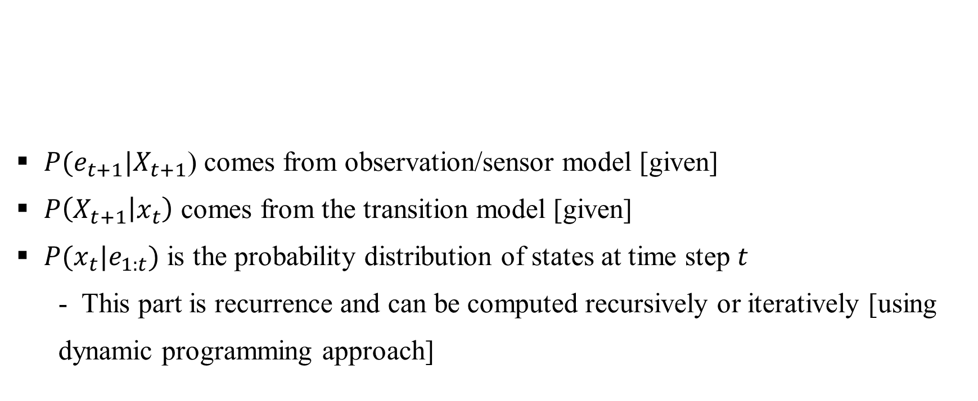
Filtering

Slide 28
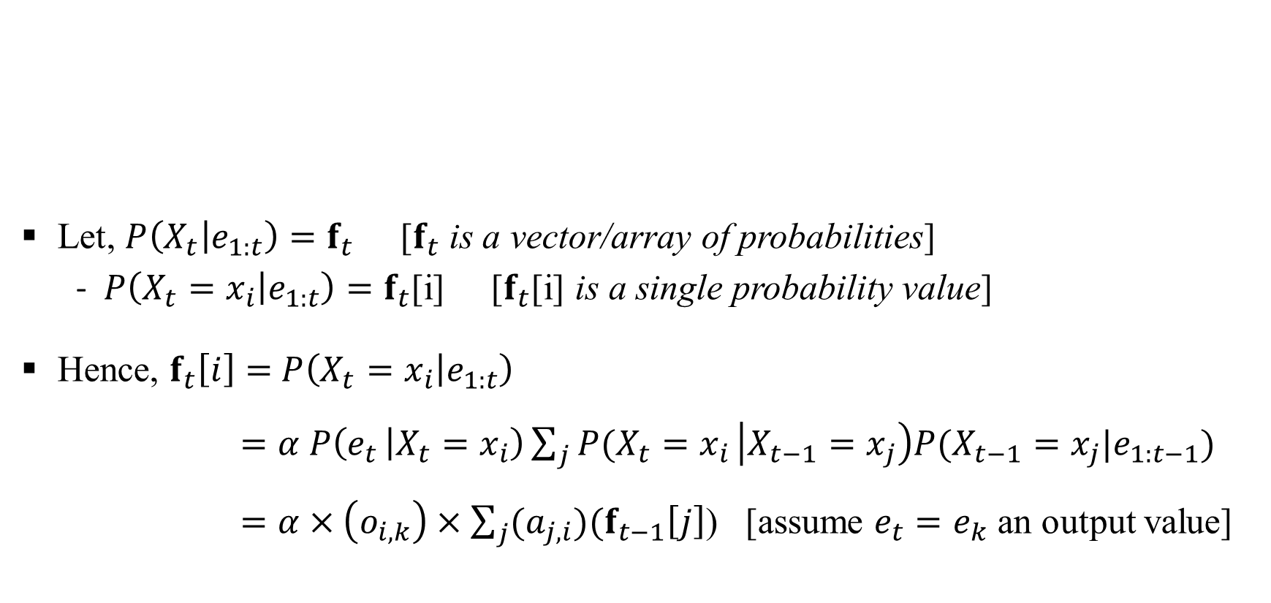
Filtering

Slide 29
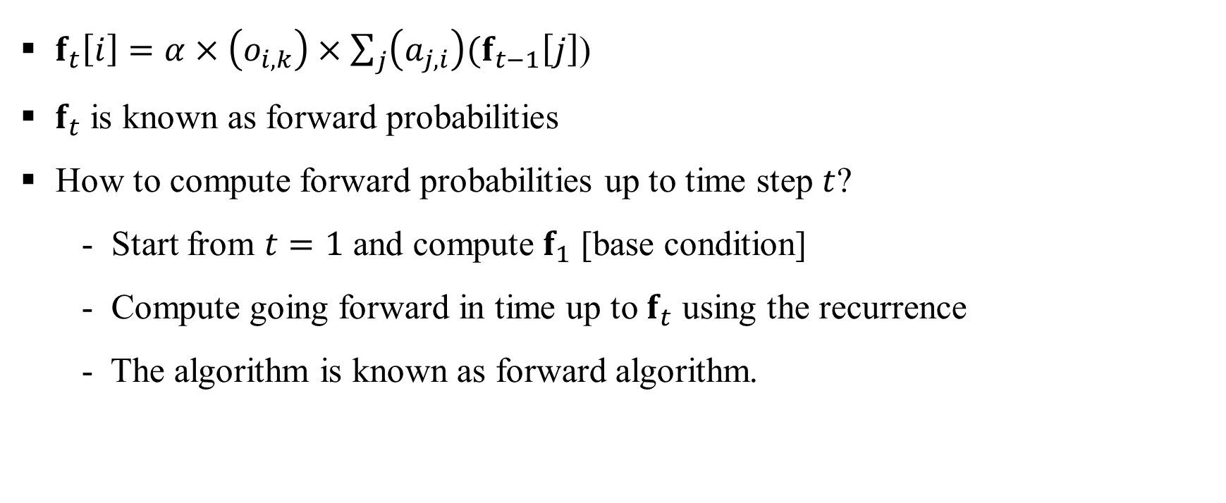
Filtering: Forward Algorithm

Slide 30
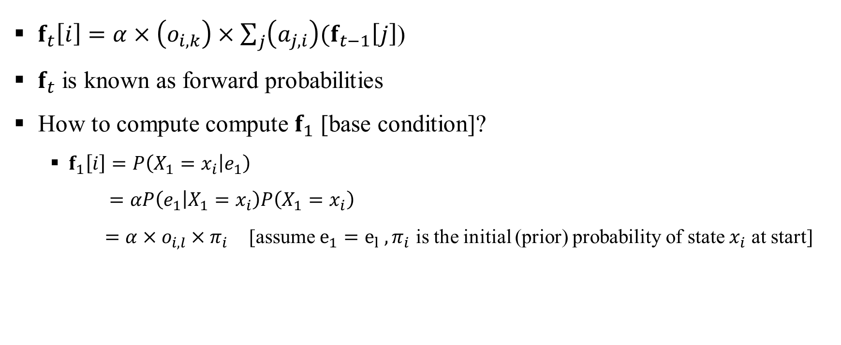
Filtering: Forward Algorithm

Slide 31
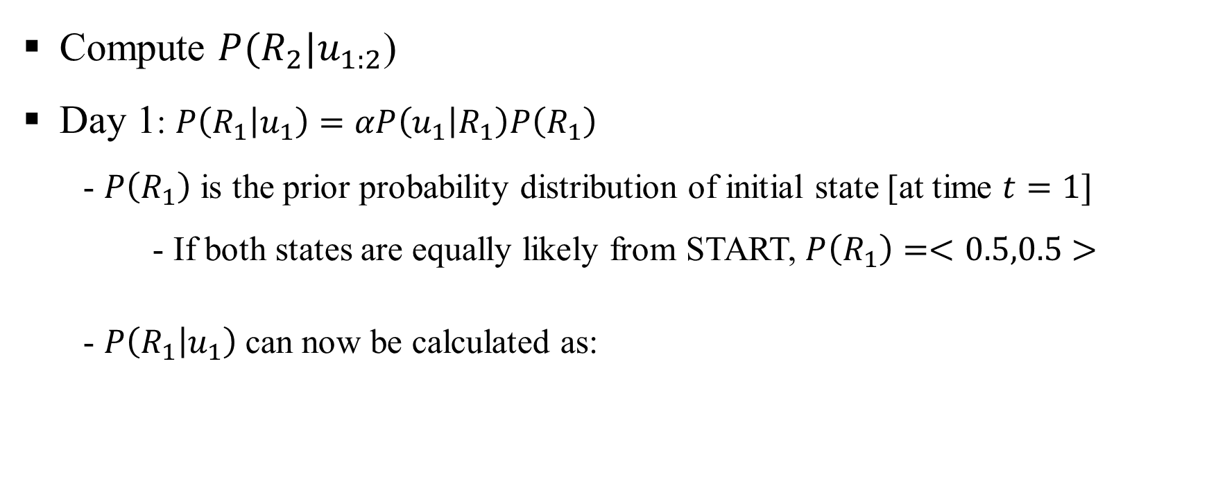

Filtering: Example

Slide 32
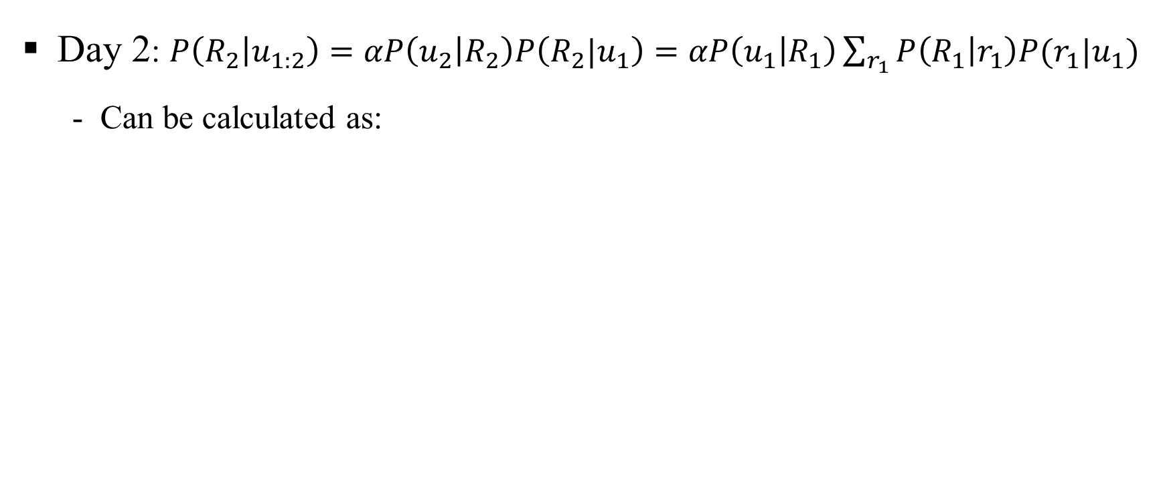
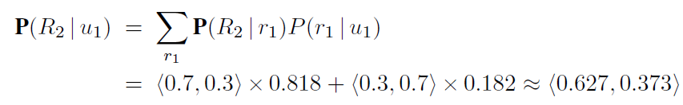

Filtering: Example

Slide 33
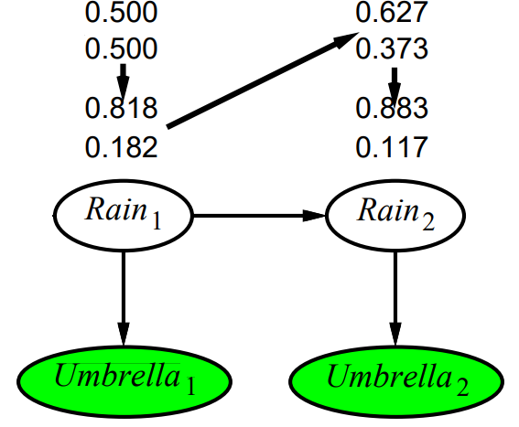
Filtering: Example
Probability of rain increases at day 2 from day 1 [why?]

Slide 34
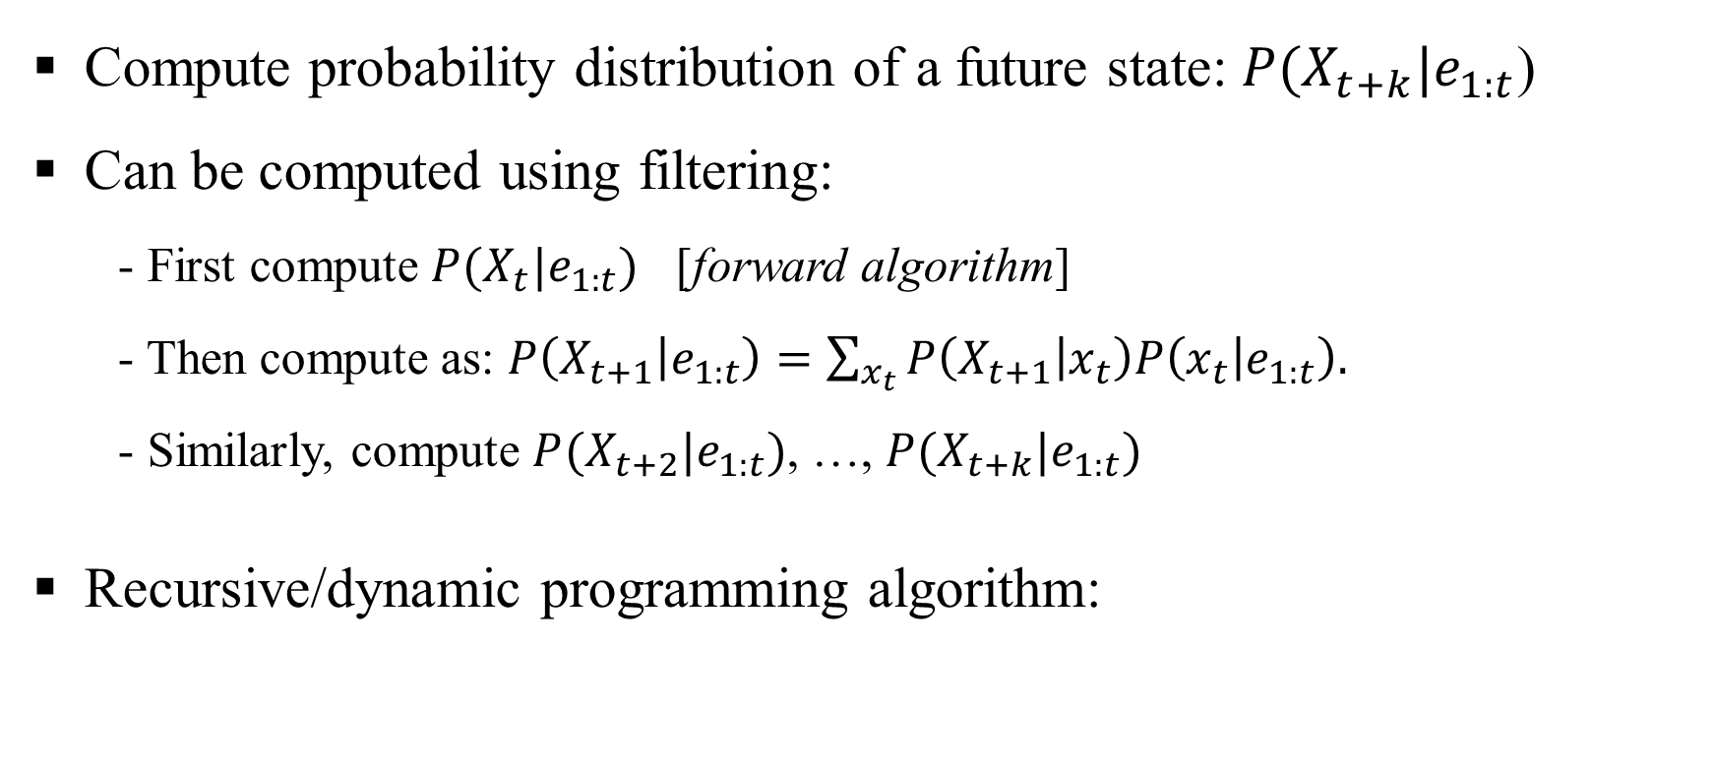

Prediction

Slide 35
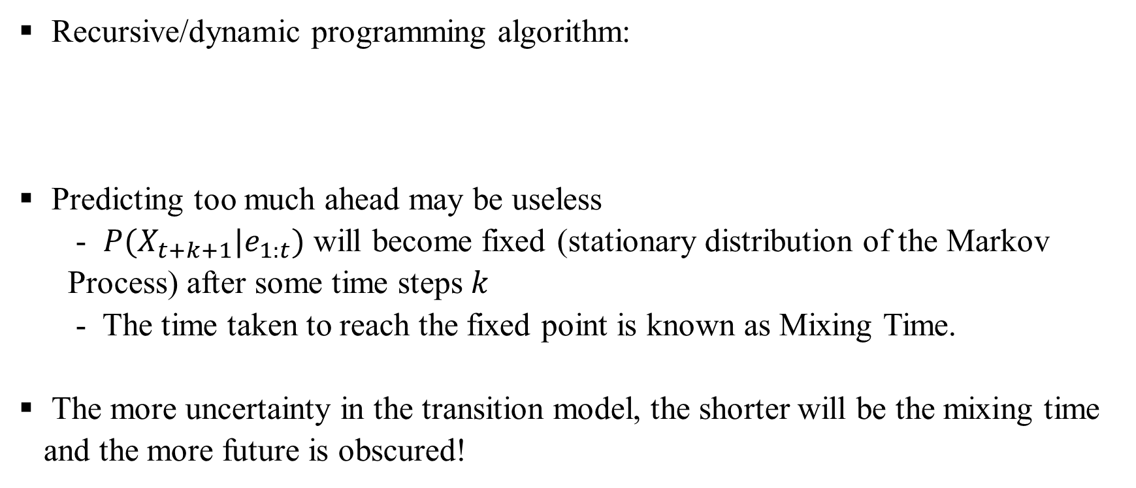
Prediction: Don’t Go Too Much Ahead

Slide 36
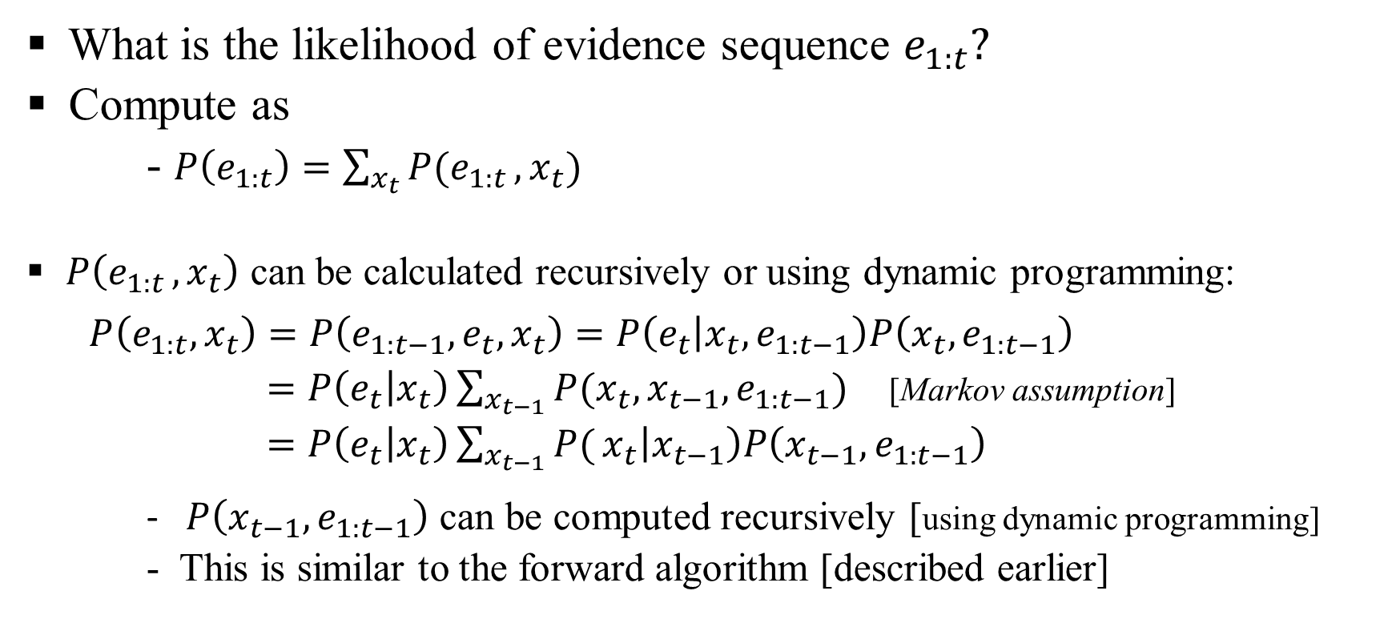
Likelihood of Evidence Sequence

