Slide 1
Chapter 15 (AIAMA)
Probabilistic Reasoning Over Time-02
Sukarna Barua
Associate Professor, CSE, BUET

Slide 2
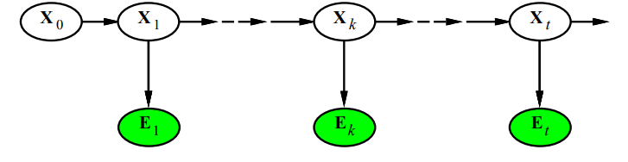

Smoothing
Compute the probability distribution over past states.
Compute $P(X_{k}|e_{1:t})$ where $0≤k<t$

Slide 3
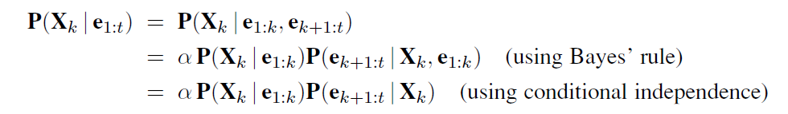
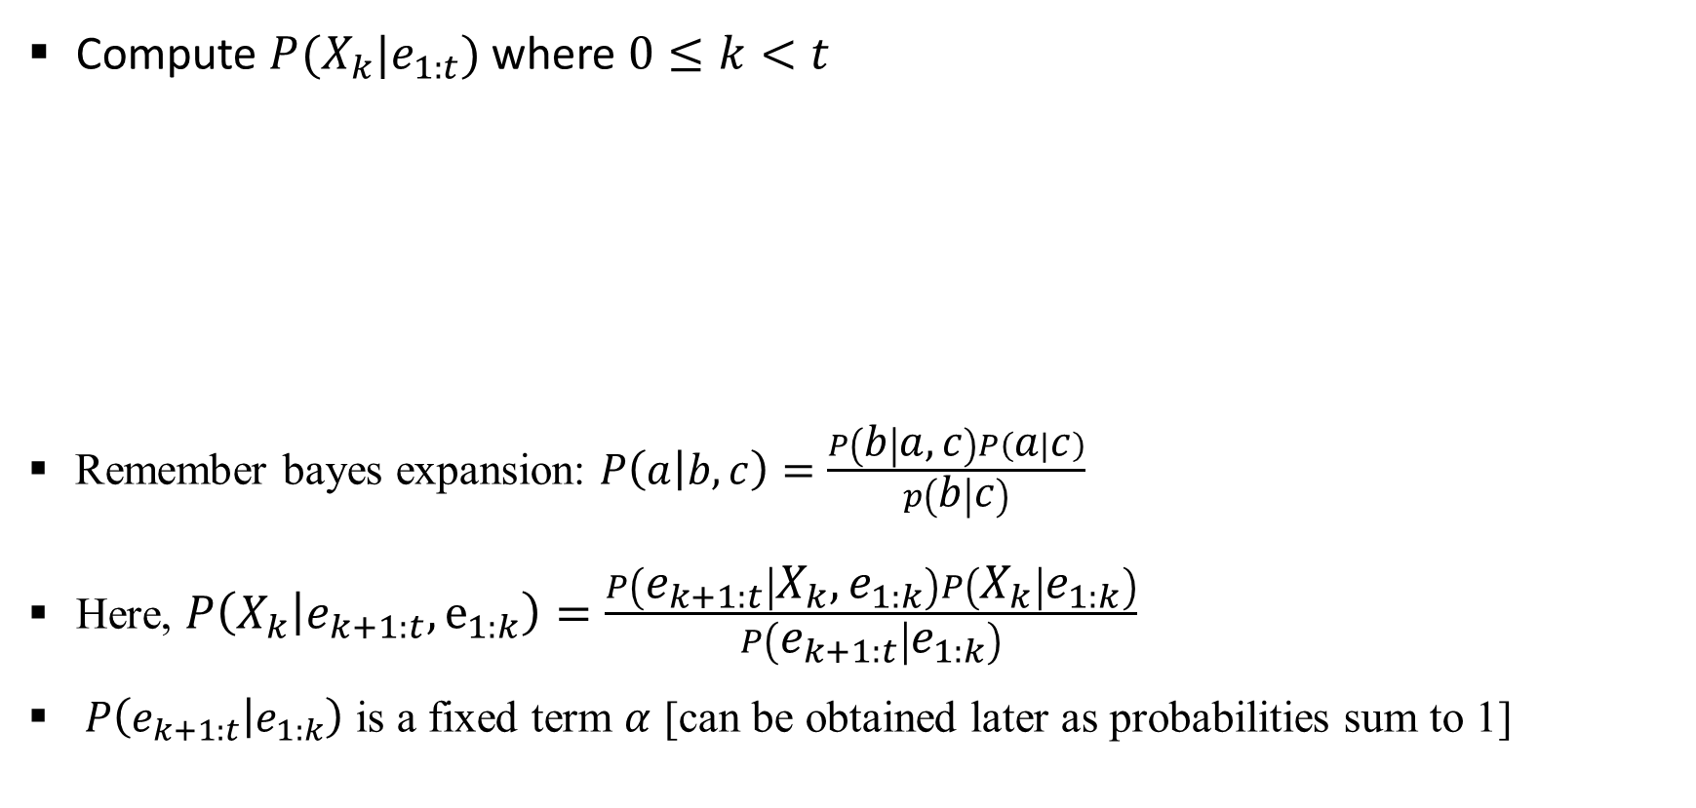
Smoothing
Compute $P(X_{k}|e_{1:t})$ where $0≤k<t$
Remember bayes expansion: $P\left(a | b,c\right)=\frac{P\left(b | a,c\right)P\left(a | c\right)}{p\left(b | c\right)}$
Here, $P\left(X_{k} | e_{k+1:t},e_{1:k}\right)=\frac{P\left(e_{k+1:t} | X_{k},e_{1:k}\right)P\left(X_{k} | e_{1:k}\right)}{P\left(e_{k+1:t} | e_{1:k}\right)}$
$P\left(e_{k+1:t} | e_{1:k}\right)$ is a fixed term $α$ [can be obtained later as probabilities sum to 1]

Slide 4

Smoothing
Compute $P(X_{k}|e_{1:t})$ where $0≤k<t$
Hence, $P\left(X_{k}=x_{i} | e_{1:t}\right)=αf_{k}[i]×P(e_{k+1:t }|X_{k}=x_{i})$
Where $f_{k}$ denotes forward probabilities [filtering problem]
Note that $f_{k}$ is a vector [ $f_{k}[i]=P\left(X_{k}=x_{i} | e_{1:k}\right)$ ]

Slide 5
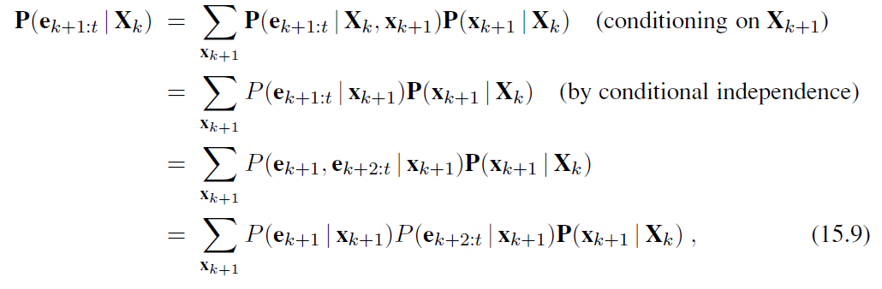

Smoothing
Now, how to compute $P\left(e_{k+1:t} | X_{k}\right)?$
$P\left(e_{k+1} | x_{k+1}\right)$ and $P\left(x_{k+1} | x_{k}\right)$ comes from the models [transition and sensor]
$P\left(e_{k+2:t} | x_{k+1}\right)$ can be obtained recursively or iteratively [using dynamic programming]

Slide 6
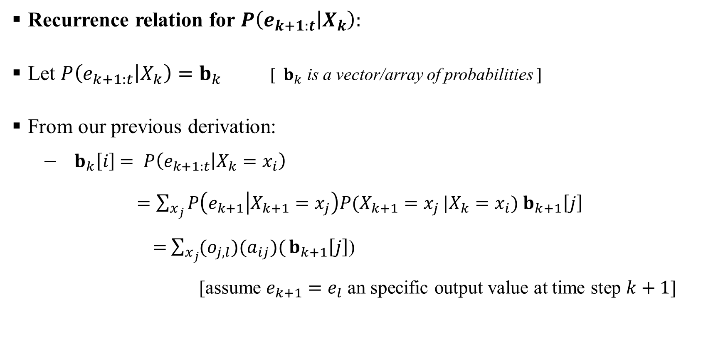
Smoothing
Recurrence relation for $P\left(e_{k+1:t} | X_{k}\right):$
Let $P\left(e_{k+1:t} | X_{k}\right)=b_{k}$ [${ b}_{k}$ is a vector/array of probabilities ]
From our previous derivation:
$− b_{k}\left[i\right]$ $= P\left(e_{k+1:t} | X_{k}=x_{i}\right)$
$=\sum_{x_{j}}{P\left(e_{k+1} | X_{k+1}=x_{j}\right)P(X_{k+1}=x_{j}}|X_{k}=x_{i})$ $b_{k+1}\left[j\right]$
$=$ $\sum_{x_{j}}{(o_{j,l})(a_{ij})(}b_{k+1}\left[j\right]$)
[assume $e_{k+1}=e_{l}$ an specific output value at time step $k+1$]

Slide 7
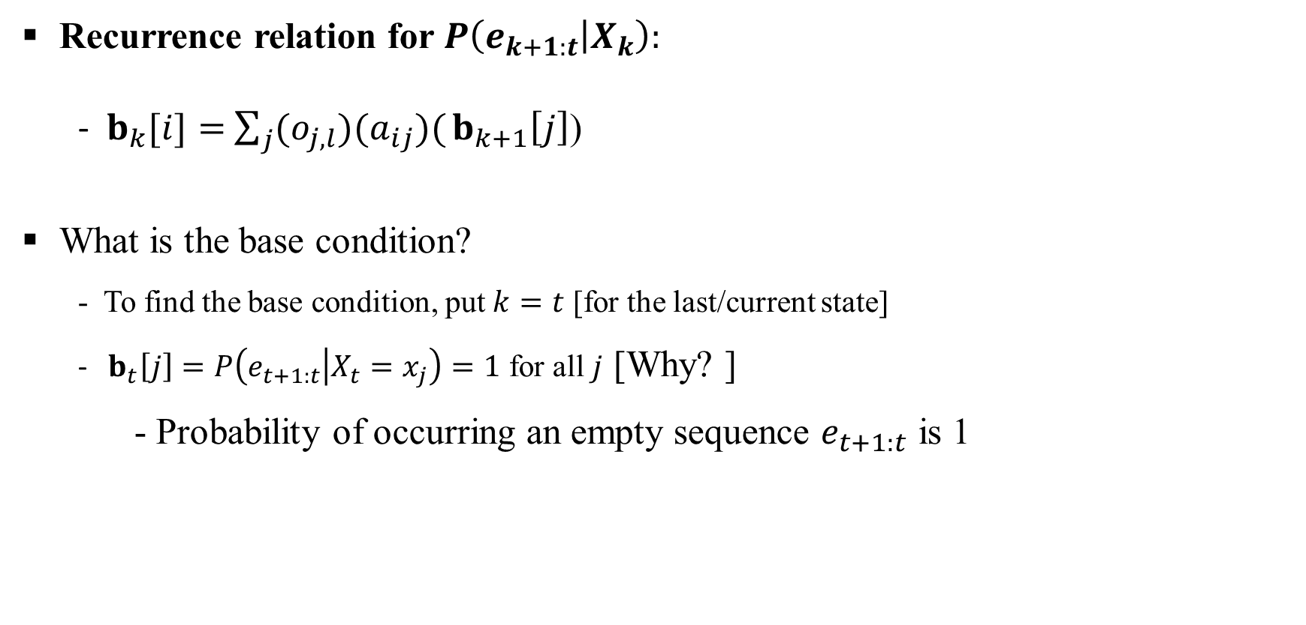
Smoothing
Recurrence relation for $P\left(e_{k+1:t} | X_{k}\right):$
- $b_{k}[i]=$ $\sum_{j}{(o_{j,l})(a_{ij})(}b_{k+1}\left[j\right]$)
What is the base condition?
- To find the base condition, put $k=t$ [for the last/current state]
- $b_{t}\left[j\right]=P\left(e_{t+1:t} | X_{t}=x_{j}\right)=1$ for all $j$ [Why? ]
- Probability of occurring an empty sequence $e_{t+1:t}$ is 1

Slide 8
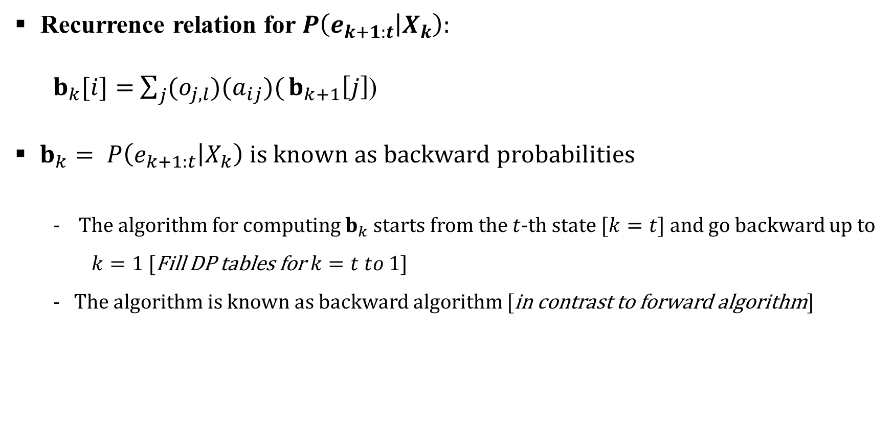
Smoothing
Recurrence relation for $P\left(e_{k+1:t} | X_{k}\right):$
$b_{k}[i]=$ $\sum_{j}{(o_{j,l})(a_{ij})(}b_{k+1}\left[j\right]$)
$b_{k}= P\left(e_{k+1:t} | X_{k}\right)$ is known as backward probabilities
- The algorithm for computing $b_{k}$ starts from the $t$-th state [$k=t]$and go backward up to $k=1$ [Fill DP tables for $k=t to 1]$
- The algorithm is known as backward algorithm [in contrast to forward algorithm]

Slide 9

Smoothing
Finally$smoothed probability P\left(X_{k}=x_{i} | e_{1:t}\right):$
$P\left(X_{k}=x_{i} | e_{1:t}\right)=α{×f}_{k}[i]×$ $b_{k}[i]$
In vector form:
$P\left(X_{k} | e_{1:t}\right)=α×f_{k}×$ $b_{k}$ [point-wise multiplication]
Again $α$ is normalizing constant.

Slide 10

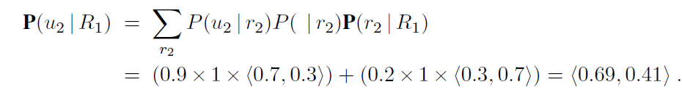
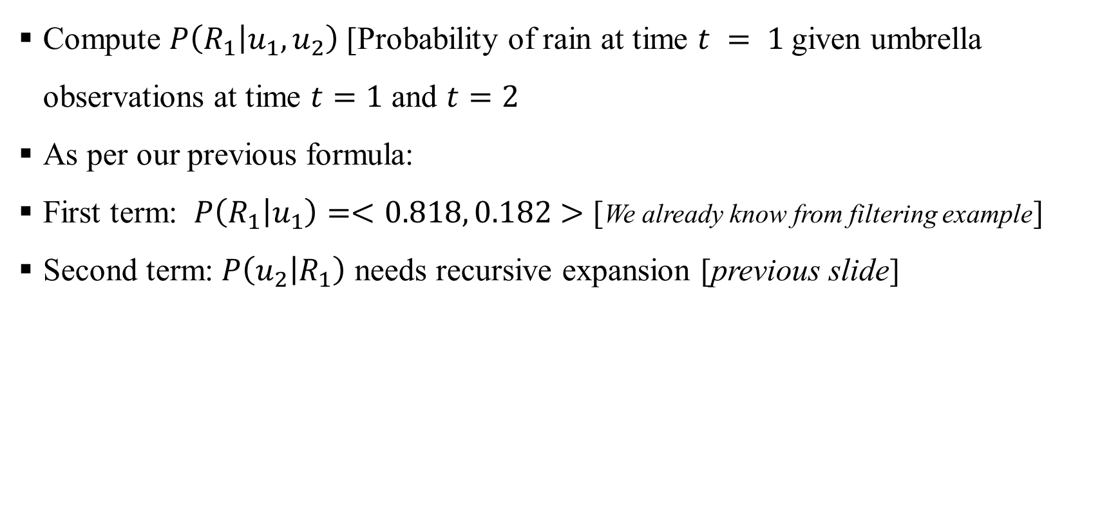
Smoothing: Example
Compute $P\left(R_{1} | u_{1},u_{2}\right)$ [Probability of rain at time $t = 1$given umbrella observations at time $t=1$ and $t=2$
As per our previous formula:
First term: $P\left(R_{1} | u_{1}\right)=<0.818, 0.182>$ [We already know from filtering example]
Second term: $P\left(u_{2} | R_{1}\right)$ needs recursive expansion [previous slide]

Slide 11

Smoothing: Example
Second term $P\left(u_{2} | R_{1}\right)$ needs recursive expansion [previous slides]
Finally, compute:

Slide 12
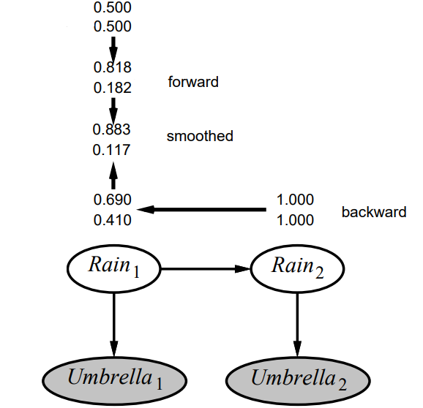


Smoothing: Example
Smoothed estimate:
Filtered estimate:

Slide 13
Smoothing: Example
Smoothed estimate:
Filtered estimate:
Observation: Smoothed estimate for rain on day 1 is higher than the filtered estimate (0.818) [Why?]
This is because the umbrella on day 2 makes it more likely to have rained on day 2 which in turn, because rain tends to persist, that makes it more likely to have rained on day 1.

Slide 14
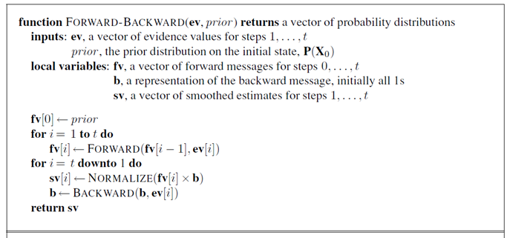
Smoothing: Algorithm Pseudocode
Forward and backward algorithm can be combined to compute posterior probabilities in linear time

Slide 15
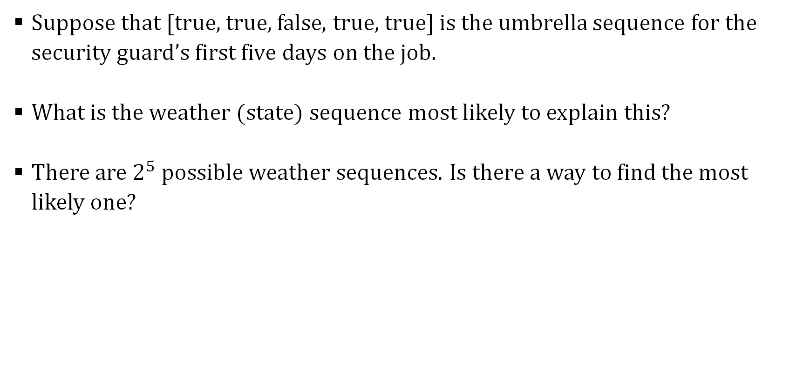
Most Likely Explanation
Suppose that [true, true, false, true, true] is the umbrella sequence for the security guard’s first five days on the job.
What is the weather (state) sequence most likely to explain this?
There are $2^{5}$ possible weather sequences. Is there a way to find the most likely one?

Slide 16
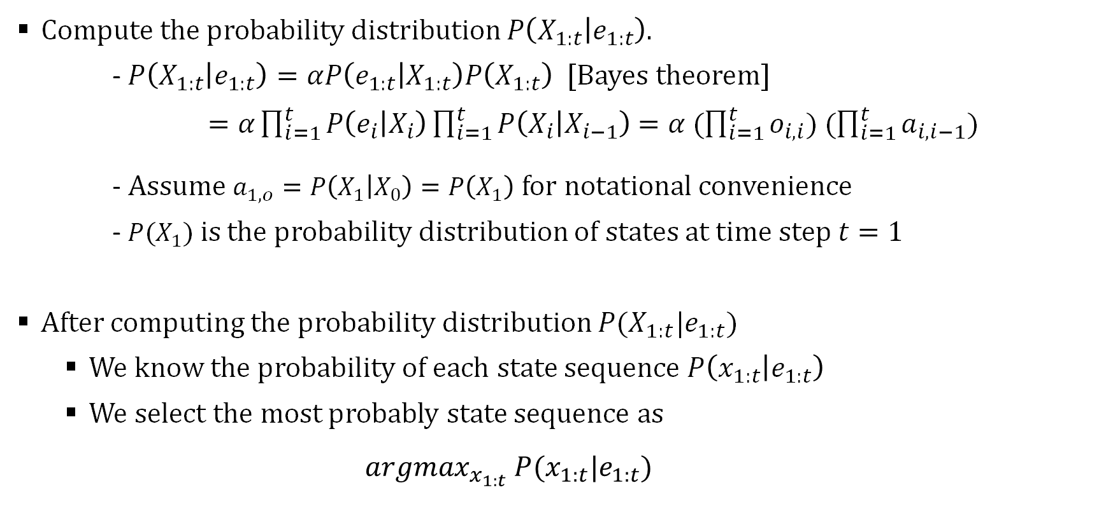
Most Likely Explanation: Naïve Approach
Compute the probability distribution $P\left(X_{1:t} | e_{1:t}\right)$.
- $P\left(X_{1:t} | e_{1:t}\right)=αP\left(e_{1:t} | X_{1:t}\right)P\left(X_{1:t}\right)$ [Bayes theorem]
$=α\prod_{i=1}^{t}{P\left(e_{i} | X_{i}\right)\prod_{i=1}^{t}{P\left(X_{i} | X_{i−1}\right)}}$ $=α (\prod_{i=1}^{t}{o_{i,i}) (\prod_{i=1}^{t}{a_{i,i−1}}})$
- Assume $a_{1,o}=P\left(X_{1} | X_{0}\right)=P\left(X_{1}\right)$ for notational convenience
- $P(X_{1}$) is the probability distribution of states at time step $t=1$
After computing the probability distribution $P(X_{1:t}|e_{1:t}$)
We know the probability of each state sequence $P\left(x_{1:t} | e_{1:t}\right)$
We select the most probably state sequence as
$$argmax_{x_{1:t}} P(x_{1:t}|e_{1:t})$$

Slide 17
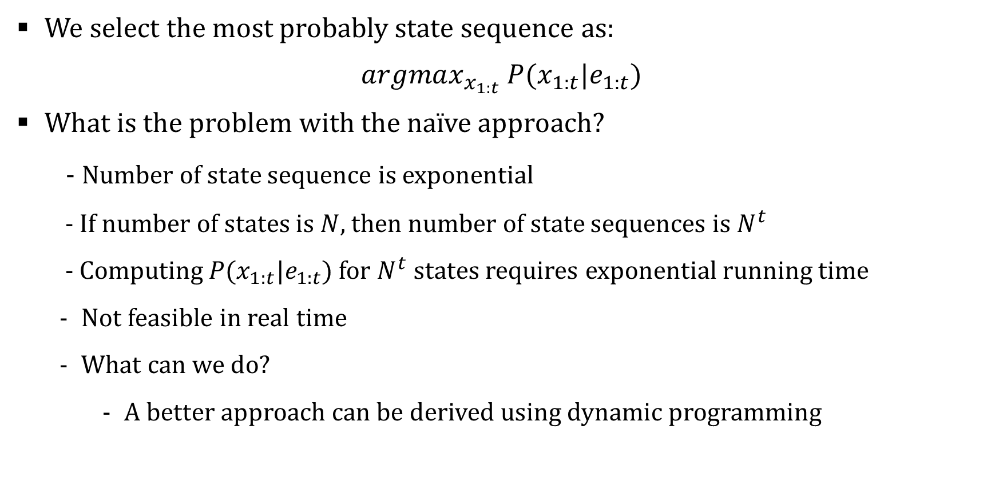
Most Likely Explanation: Naïve Approach
We select the most probably state sequence as:
$$argmax_{x_{1:t}} P(x_{1:t}|e_{1:t})$$
What is the problem with the naïve approach?
- Number of state sequence is exponential
- If number of states is $N$, then number of state sequences is $N^{t}$
- Computing $P(x_{1:t}|e_{1:t}$) for $N^{t}$ states requires exponential running time
Not feasible in real time
What can we do?
A better approach can be derived using dynamic programming

Slide 18
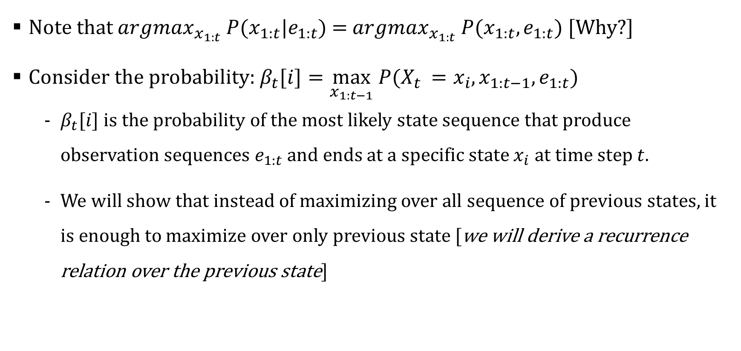
Most Likely Explanation
Note that $argmax_{x_{1:t}} P(x_{1:t}|e_{1:t}$) = $argmax_{x_{1:t}} P(x_{1:t},e_{1:t}$) [Why?]
Consider the probability: $β_{t}[i]=\max_{x_{1:t−1}} P(X_{t }=x_{i},x_{1:t−1},e_{1:t})$
$β_{t}[i]$ is the probability of the most likely state sequence that produce observation sequences $e_{1:t}$and ends at a specific state $x_{i}$ at time step $t.$
We will show that instead of maximizing over all sequence of previous states, it is enough to maximize over only previous state [we will derive a recurrence relation over the previous state]

Slide 19
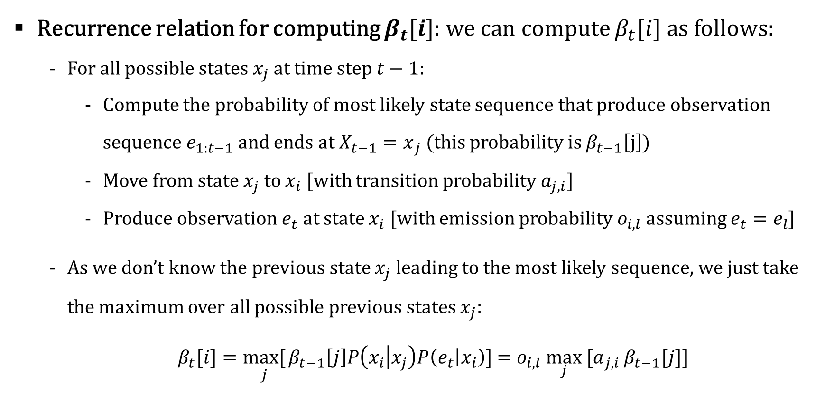
Most Likely Explanation
Recurrence relation for computing $β_{t}[i]$: we can compute $β_{t}[i]$ as follows:
For all possible states $x_{j}$at time step $t−1:$
Compute the probability of most likely state sequence that produce observation sequence $e_{1:t−1}$and ends at ${X_{t−1}=x}_{j}$ (this probability is $β_{t−1}\left[j\right])$
Move from state $x_{j}$to $x_{i}$ [with transition probability $a_{j,i}$]
Produce observation $e_{t}$ at state $x_{i}$ [with emission probability $o_{i,l}$ assuming $e_{t}=e_{l}$]
As we don’t know the previous state $x_{j}$ leading to the most likely sequence, we just take the maximum over all possible previous states $x_{j}$:
$β_{t}[i]=\underset{j}{max[}{β_{t−1}\left[j\right]P\left(x_{i} | x_{j}\right)P\left(e_{t} | x_{i}\right)]}$ = $o_{i,l}\max_{j}{[a}_{j,i}{β_{t−1}[j]]}$

Slide 20
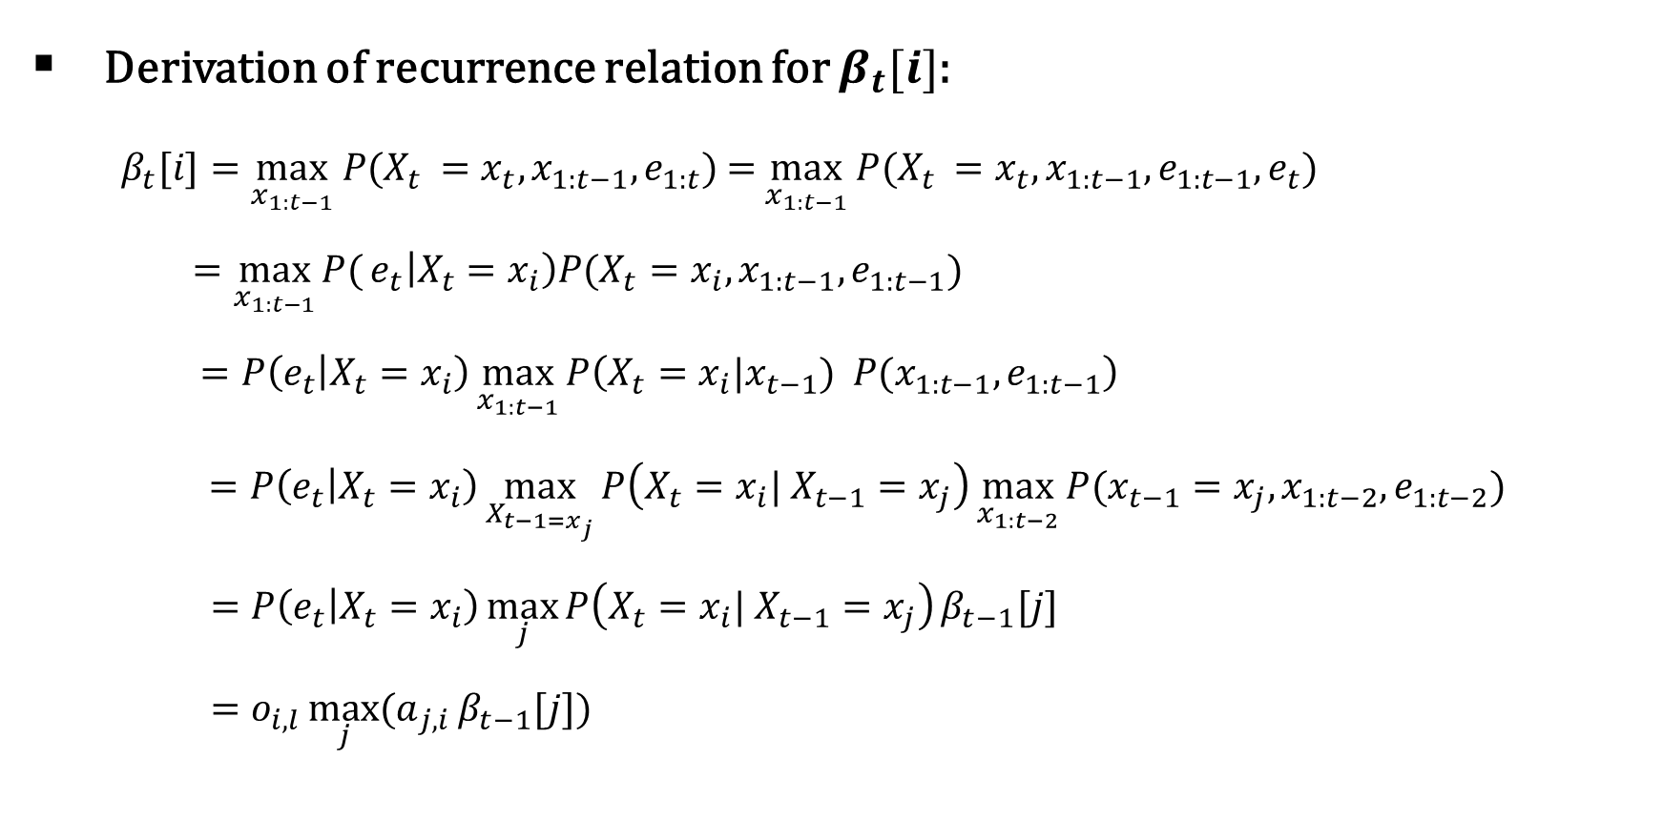
Most Likely Explanation
Derivation of recurrence relation for $β_{t}[i]$:
$β_{t}[i]=\max_{x_{1:t−1}} P(X_{t }=x_{t},x_{1:t−1},e_{1:t})$ = $\max_{x_{1:t−1}} P(X_{t }=x_{t},x_{1:t−1},e_{1:t−1},e_{t})$
$=\max_{x_{1:t−1}}{P(}e_{t}\left|X_{t}=x_{i}\right)P(X_{t}=x_{i}, x_{1:t−1},e_{1:t−1})$
$$=P\left(e_{t} | X_{t}=x_{i}\right)\max_{x_{1:t−1}}{P\left(X_{t}=x_{i}|{x_{t−1}) P(x}_{1:t−1},e_{1:t−1}\right)}$$
$$=P\left(e_{t} | X_{t}=x_{i}\right)\max_{X_{t−1=x_{j}}}{P\left(X_{t}=x_{i}| X_{t−1}=x_{j}\right)}\max_{x_{1:t−2}}{P(x_{t−1}=x_{j},x_{1:t−2},e_{1:t−2}) }$$
$=P\left(e_{t} | X_{t}=x_{i}\right)\max_{j}{P\left(X_{t}=x_{i}| X_{t−1}=x_{j}\right)}β_{t−1}[j]$
$=o_{i,l}\max_{j}{{(a}_{j,i}}β_{t−1}[j]$)

Slide 21
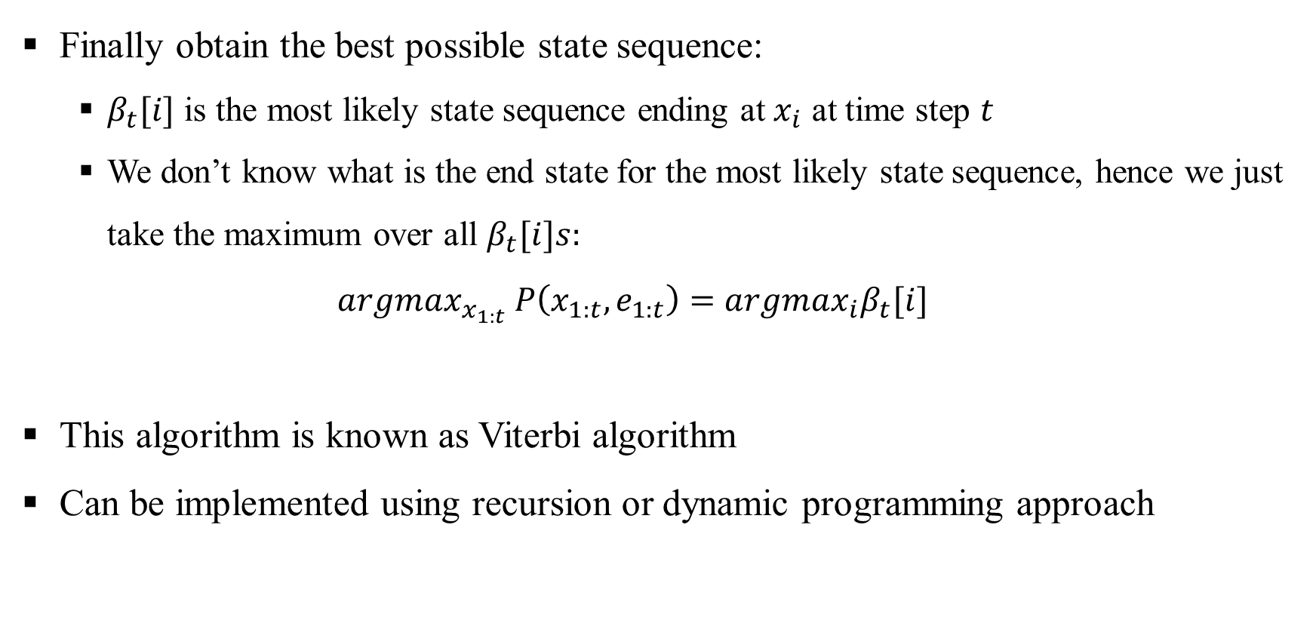
Most Likely Explanation
Finally obtain the best possible state sequence:
$β_{t}[i]$ is the most likely state sequence ending at $x_{i}$ at time step $t$
We don’t know what is the end state for the most likely state sequence, hence we just take the maximum over all $β_{t}[i]s:$
$$argmax_{x_{1:t}} P\left(x_{1:t},e_{1:t}\right)=argmax_{i}β_{t}[i]$$
This algorithm is known as Viterbi algorithm
Can be implemented using recursion or dynamic programming approach

