Slide 1
Chapter 17 (AIAMA)
Making Complex Decisions
Sukarna Barua
Associate Professor, CSE, BUET

Slide 2
Sequential Decision Problems
In a sequential decision problem:
Utility do not depend on a single decision/action.
- Example: You have two choices in a game: First choice gives you 10k with probability ½ and 0k otherwise. Second choice gives you 30k with probability ¼ and 5k otherwise. Which action should a rational agent choose? It is simple to choose this single action!
Utility depends on a sequence of agent’s decisions/actions.
- What an agent should do at any time depends on what it will do in the future.
- What an agent does in the future depends on what it did before.

Slide 3
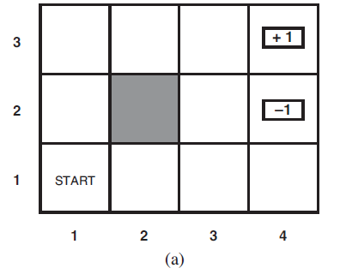
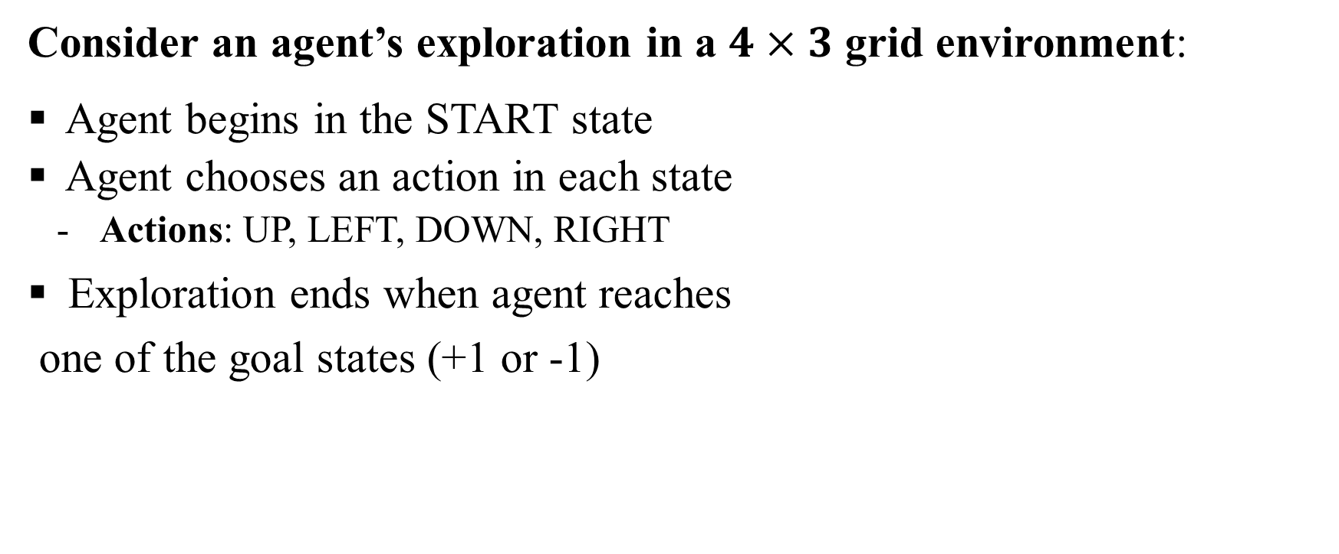
Sequential Decision Problems
Consider an agent’s exploration in a $4×3$ grid environment:
Agent begins in the START state
Agent chooses an action in each state
Actions: UP, LEFT, DOWN, RIGHT
Exploration ends when agent reaches
one of the goal states (+1 or -1)

Slide 4
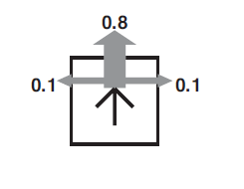
Sequential Decision Problems
Actions of agent:
Agent chooses an action in each state
Actions: UP, LEFT, DOWN, RIGHT
Action effect is not deterministic rather stochastic
Each action takes agent in the right direction with
probability 0.8
With 0.1 probability, agent can move to the right
angles of the intended direction
- If agent hits a wall, it bumps and stays in the same location

Slide 5
Sequential Decision Problems
Actions of agent: Example
Agent chooses action UP in (1,1)
With 0.8 prob, agent moves to (1,2)
With 0.1 prob, agent moves to (2,1)
With 0.1 probability, moves to left, bumps to wall
and stays at (1,1)

Slide 6
Sequential Decision Problems
What if action effect was deterministic?
The problem turns into a simple search problem:
Find the sequence of moves leading to goal.
DFS/BFS can easily find this.
In sequential decision problem:
Action effect is not deterministic.
Simple search do not work [Why? We need action for
for every state instead of a shortest path to goal]

Slide 7
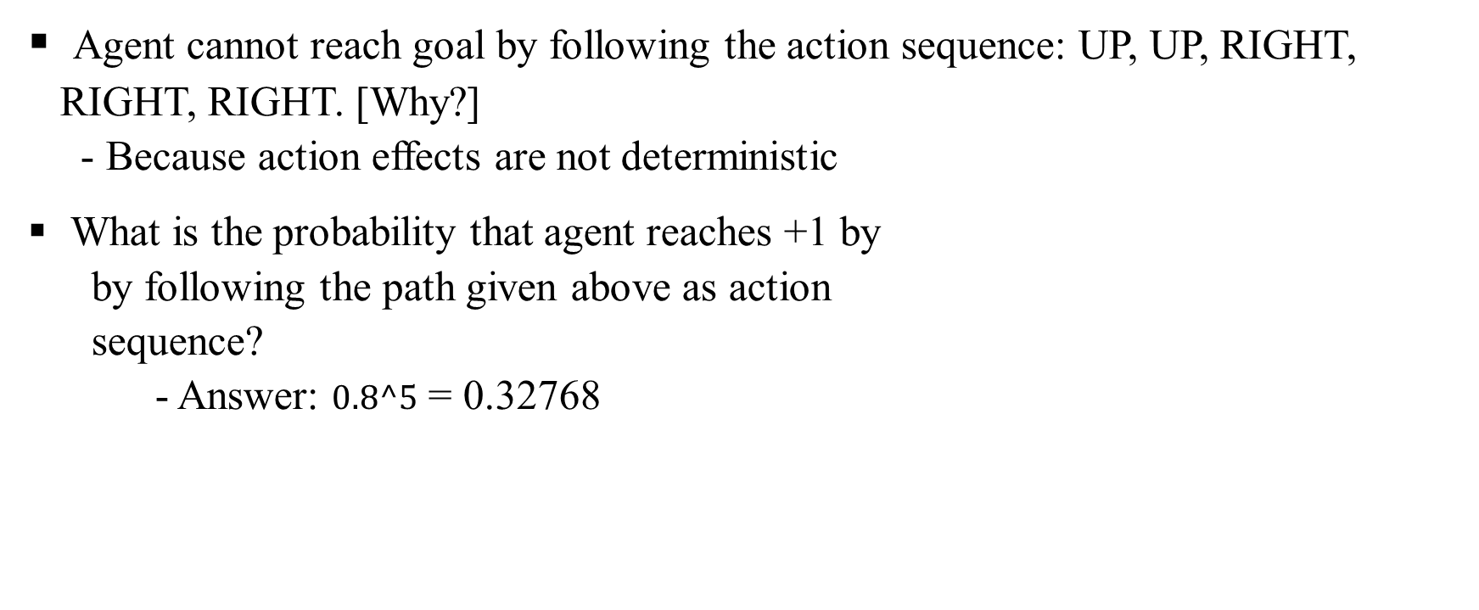
Sequential Decision Problems
Agent cannot reach goal by following the action sequence: UP, UP, RIGHT, RIGHT, RIGHT. [Why?]
- Because action effects are not deterministic
What is the probability that agent reaches +1 by
by following the path given above as action
sequence?
- Answer: $0.8^5$ = 0.32768

Slide 8
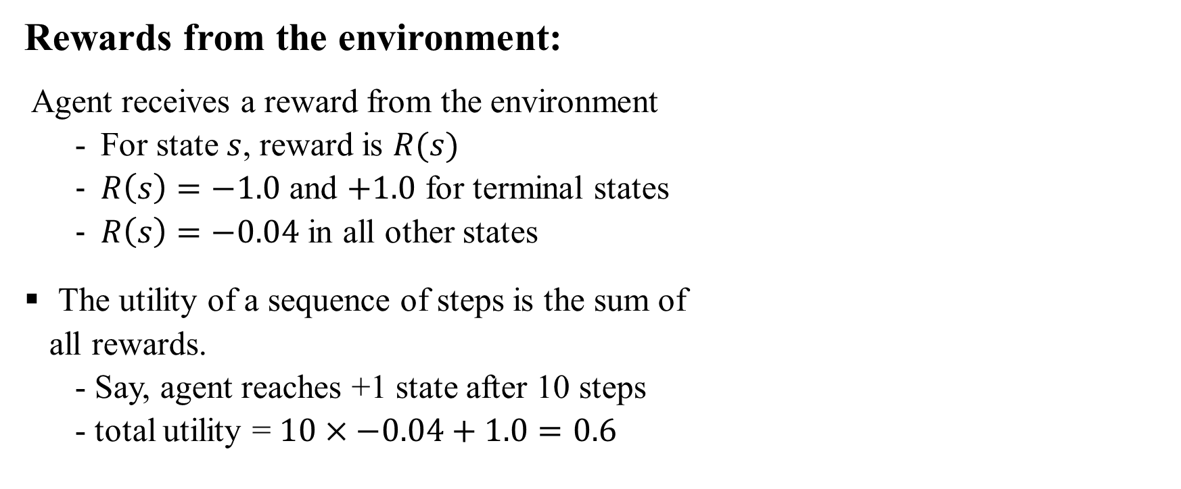
Sequential Decision Problems
Rewards from the environment:
Agent receives a reward from the environment
For state $s$, reward is $R(s)$
$R\left(s\right)=−1.0$ and $+1.0$ for terminal states
$R\left(s\right)=−0.04$ in all other states
The utility of a sequence of steps is the sum of
all rewards.
- Say, agent reaches +1 state after 10 steps
- total utility = $10×−0.04+1.0=0.6$

Slide 9
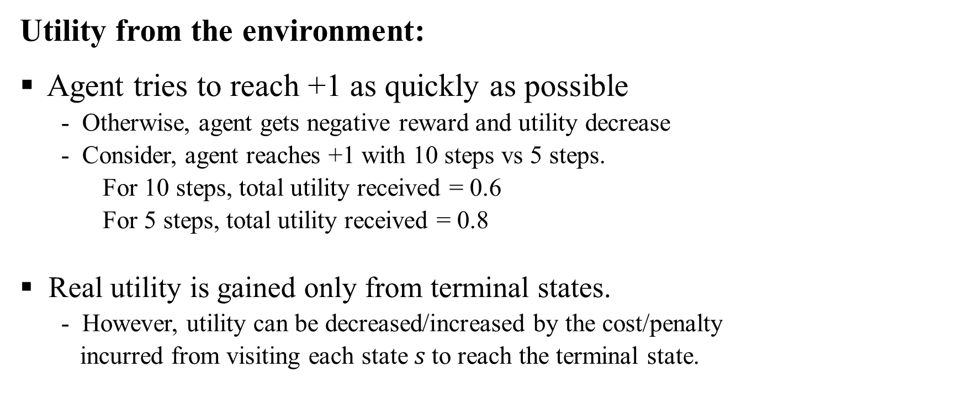
Sequential Decision Problems
Utility from the environment:
Agent tries to reach +1 as quickly as possible
Otherwise, agent gets negative reward and utility decrease
Consider, agent reaches +1 with 10 steps vs 5 steps.
For 10 steps, total utility received = 0.6
For 5 steps, total utility received = 0.8
Real utility is gained only from terminal states.
However, utility can be decreased/increased by the cost/penalty
incurred from visiting each state $s$to reach the terminal state.

Slide 10
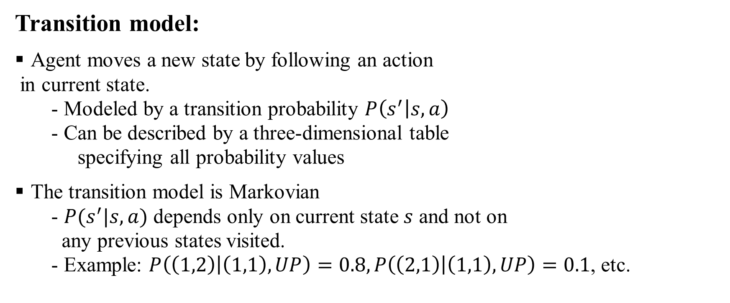
Sequential Decision Problems
Transition model:
Agent moves a new state by following an action
in current state.
- Modeled by a transition probability $P\left(s^{′} | s,a\right)$
- Can be described by a three-dimensional table
specifying all probability values
The transition model is Markovian
- $P(s^{′}|s,a)$ depends only on current state $s$ and not on
any previous states visited.
- Example: $P\left(\left(1,2\right) | \left(1,1\right),UP\right)=0.8,P\left(\left(2,1\right) | \left(1,1\right),UP\right)=0.1$, etc.

Slide 11
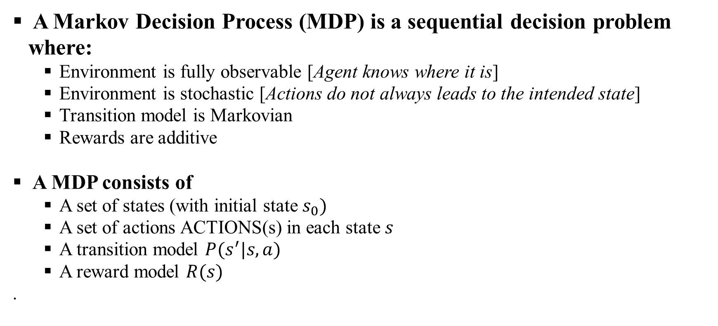
Markov Decision Process
A Markov Decision Process (MDP) is a sequential decision problem where:
Environment is fully observable [Agent knows where it is]
Environment is stochastic [Actions do not always leads to the intended state]
Transition model is Markovian
Rewards are additive
A MDP consists of
A set of states (with initial state $s_{0})$
A set of actions ACTIONS(s) in each state $s$
A transition model $P(s^{′}|s,a)$
A reward model $R(s)$
.

Slide 12
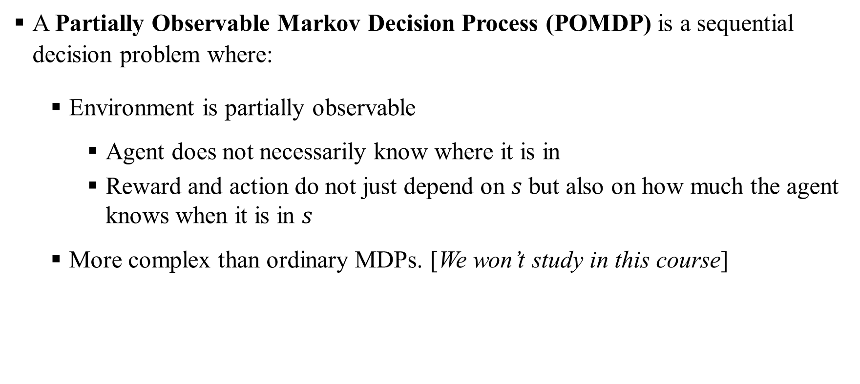
Markov Decision Process
A Partially Observable Markov Decision Process (POMDP) is a sequential decision problem where:
Environment is partially observable
Agent does not necessarily know where it is in
Reward and action do not just depend on $s$ but also on how much the agent knows when it is in $s$
More complex than ordinary MDPs. [We won’t study in this course]

Slide 13
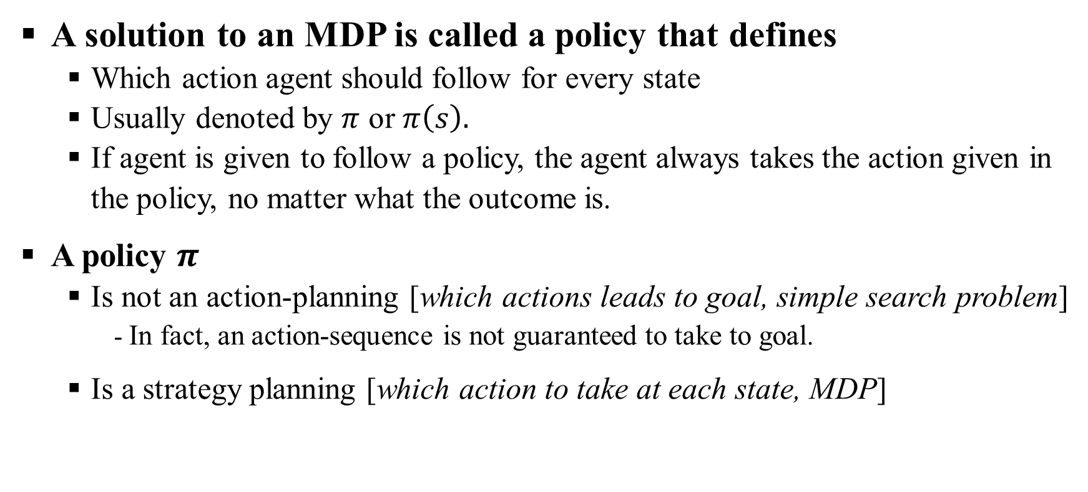
Markov Decision Process: Solution
A solution to an MDP is called a policy that defines
Which action agent should follow for every state
Usually denoted by $π$ or $π\left(s\right).$
If agent is given to follow a policy, the agent always takes the action given in the policy, no matter what the outcome is.
A policy $π$
Is not an action-planning [which actions leads to goal, simple search problem]
- In fact, an action-sequence is not guaranteed to take to goal.
Is a strategy planning [which action to take at each state, MDP]

Slide 14
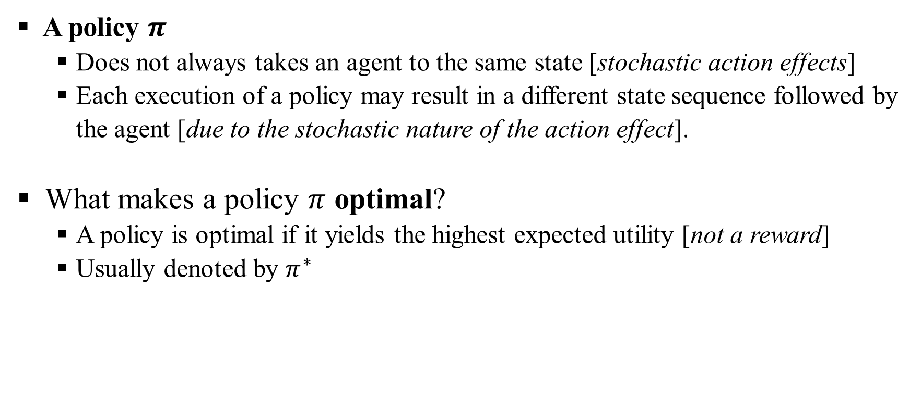
Markov Decision Process: Optimal Policy
A policy $π$
Does not always takes an agent to the same state [stochastic action effects]
Each execution of a policy may result in a different state sequence followed by the agent [due to the stochastic nature of the action effect].
What makes a policy $π$ optimal?
A policy is optimal if it yields the highest expected utility [not a reward]
Usually denoted by $π^{∗}$

Slide 15
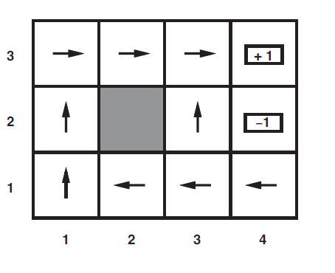

Markov Decision Process: Optimal Policy
Example: An optimal policy for the grid world problem with $R\left(s\right)=−0.04$ for nonterminal states.

Slide 16
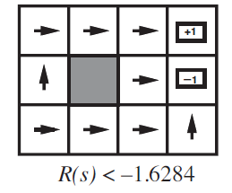
Markov Decision Process: Optimal Policy
What happens to optimal policy when R(s) ≤ −1.6284?
Life is so painful that the agent heads straight for the nearest exit, even if the exit is worth –1.
Note the action at (3,2) [Agent chooses -1 to quickly exit]

Slide 17
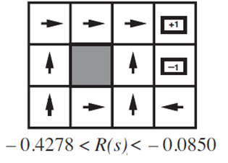

Markov Decision Process: Optimal Policy
What happens to optimal policy when $−0.4278< R\left(s\right)< −0.0850$?
Life is not so painful but unpleasant; the agent takes the shortest route to +1, and is willing to risk falling to -1 by accident
Note the action at (3,1) [Agent chooses UP to quickly exit]

Slide 18
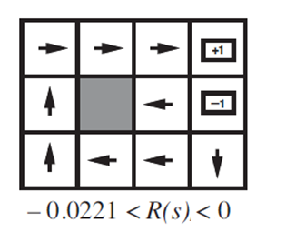

Markov Decision Process: Optimal Policy
What happens to optimal policy when$−0.0221 < R(s) < 0?$
The optimal policy takes no risks at all. In (4,1) and (3,2), the agent heads directly away from the –1 state so that it cannot fall in by accident, even though this means banging its head against the wall quite a few times.

Slide 19
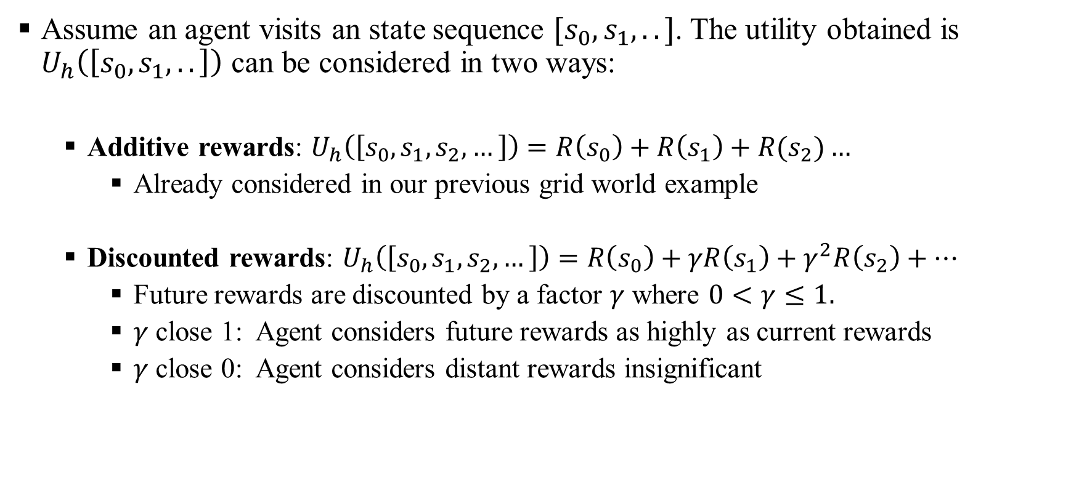
Markov Decision Process: Reward Types
Assume an agent visits an state sequence $[s_{0},s_{1},..]$. The utility obtained is $U_{h}\left(\left[s_{0},s_{1},..\right]\right)$ can be considered in two ways:
Additive rewards: $U_{h}\left(\left[s_{0},s_{1},s_{2},…\right]\right)=R\left(s_{0}\right)+R\left(s_{1}\right)+R(s_{2})…$
Already considered in our previous grid world example
Discounted rewards: $U_{h}\left(\left[s_{0},s_{1},s_{2},…\right]\right)=R\left(s_{0}\right)+γR\left(s_{1}\right)+γ^{2}R\left(s_{2}\right)+…$
Future rewards are discounted by a factor $γ$ where $0<γ≤1.$
$γ$ close 1: Agent considers future rewards as highly as current rewards
$γ$ close 0: Agent considers distant rewards insignificant

Slide 20
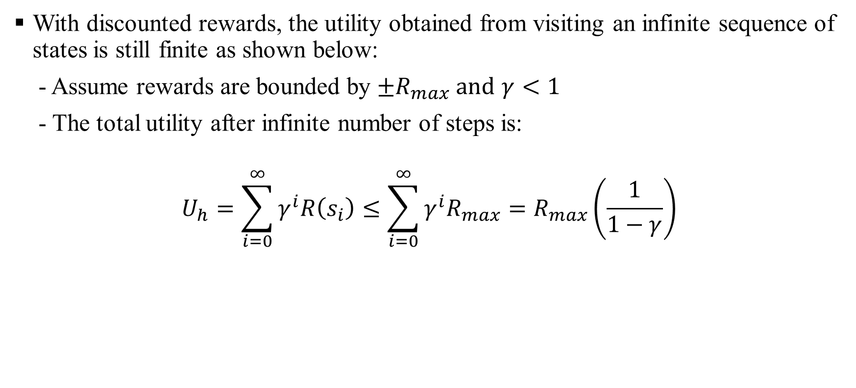
Markov Decision Process: Expected Utility is Bounded
With discounted rewards, the utility obtained from visiting an infinite sequence of states is still finite as shown below:
- Assume rewards are bounded by $±R_{max} and$ $γ<1$
- The total utility after infinite number of steps is:
$$U_{h}=\sum_{i=0}^{∞}{γ^{i}R\left(s_{i}\right)≤\sum_{i=0}^{∞}{γ^{i}R_{max}=R_{max}}}\left(\frac{1}{1−γ}\right)$$

Slide 21
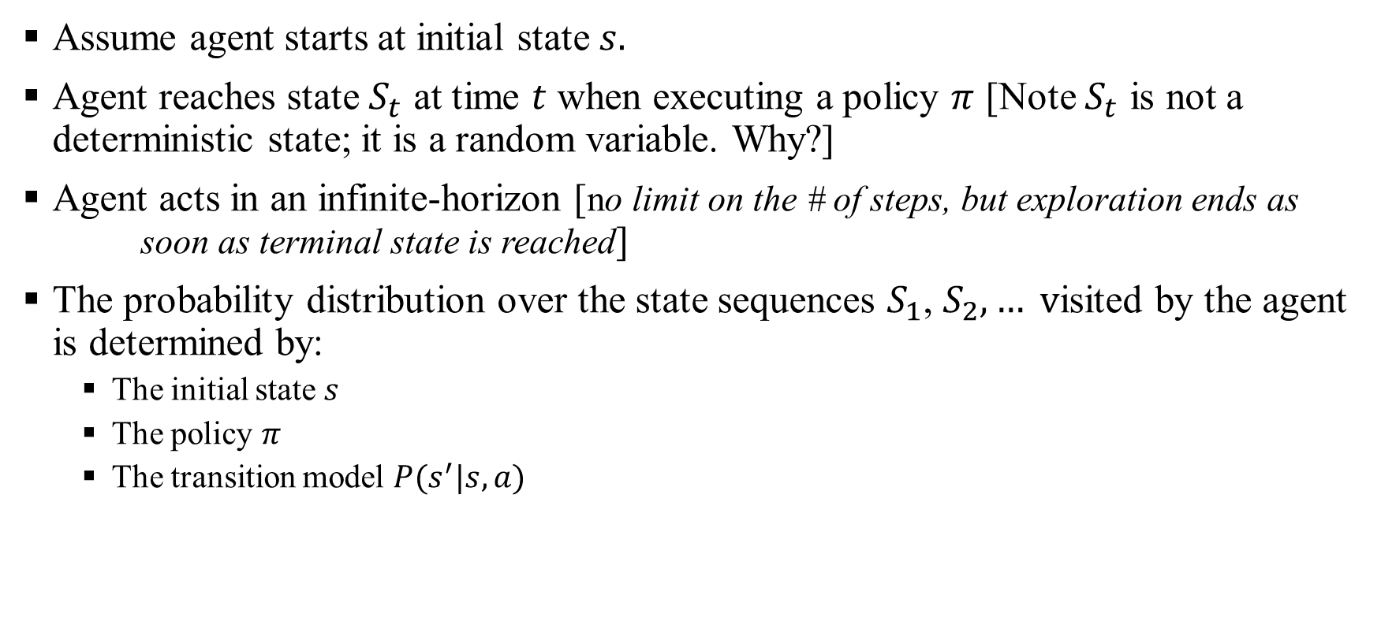
Markov Decision Process: Expected Utility of a Policy
Assume agent starts at initial state $s.$
Agent reaches state $S_{t}$ at time $t$ when executing a policy $π$ [Note $S_{t}$ is not a deterministic state; it is a random variable. Why?]
Agent acts in an infinite-horizon [no limit on the # of steps, but exploration ends as soon as terminal state is reached]
The probability distribution over the state sequences $S_{1}$, $S_{2},… v$isited by the agent is determined by:
The initial state $s$
The policy $π$
The transition model $P(s^{′}|s,a)$

Slide 22
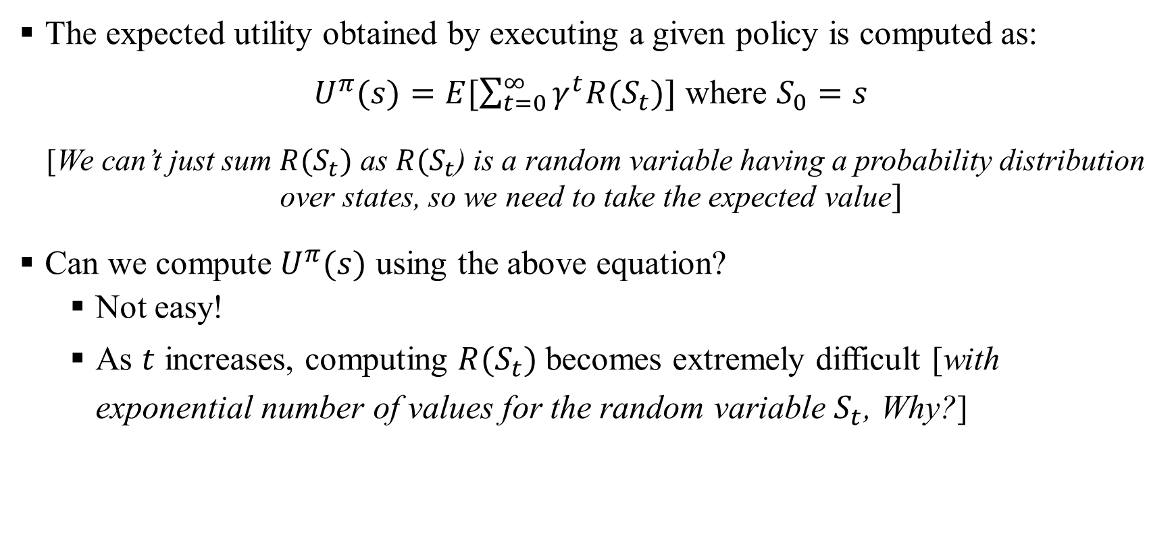
Markov Decision Process: Expected Utility for a Policy
The expected utility obtained by executing a given policy is computed as:
$U^{π}(s)=E[\sum_{t=0}^{∞}{γ^{t}R(S_{t})]}$ where $S_{0}=s$
[We can’t just sum $R(S_{t})$ as $R(S_{t}$) is a random variable having a probability distribution over states, so we need to take the expected value]
Can we compute $U^{π}(s)$ using the above equation?
Not easy!
As $t$ increases, computing $R(S_{t})$ becomes extremely difficult [with exponential number of values for the random variable $S_{t}$, Why?]

Slide 23
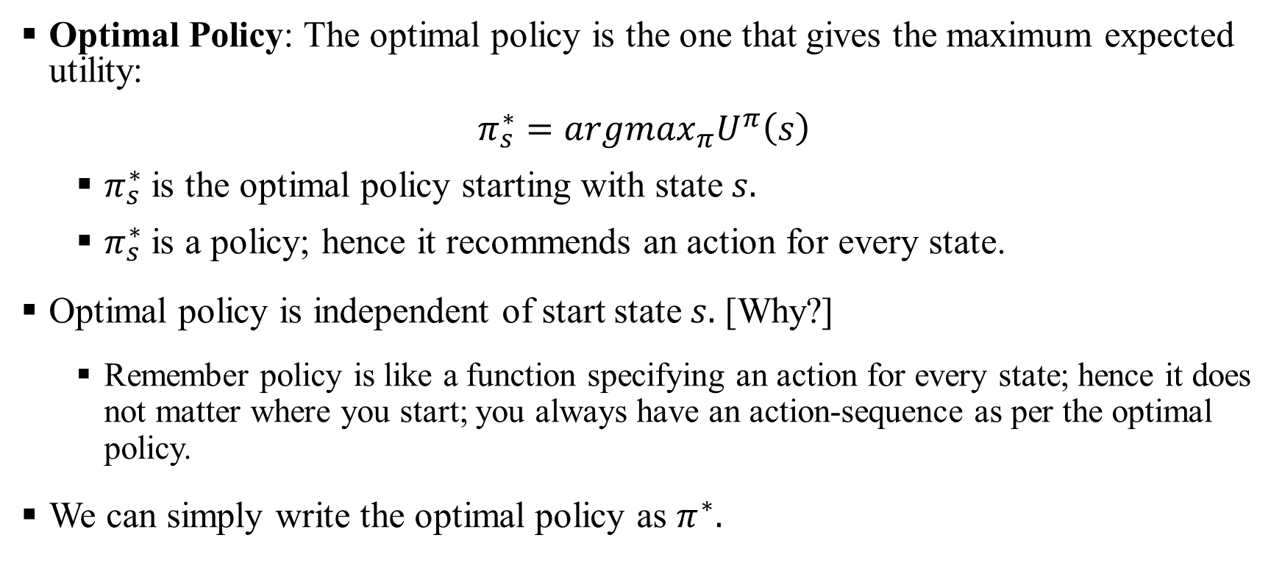
Markov Decision Process: Optimal Policy
Optimal Policy: The optimal policy is the one that gives the maximum expected utility:
$$π_{s}^{∗}=argmax_{π}U^{π}\left(s\right)$$
$π_{s}^{∗}$ is the optimal policy starting with state $s.$
$π_{s}^{∗}$ is a policy; hence it recommends an action for every state.
Optimal policy is independent of start state $s.$ [Why?]
Remember policy is like a function specifying an action for every state; hence it does not matter where you start; you always have an action-sequence as per the optimal policy.
We can simply write the optimal policy as $π^{∗}.$

Slide 24
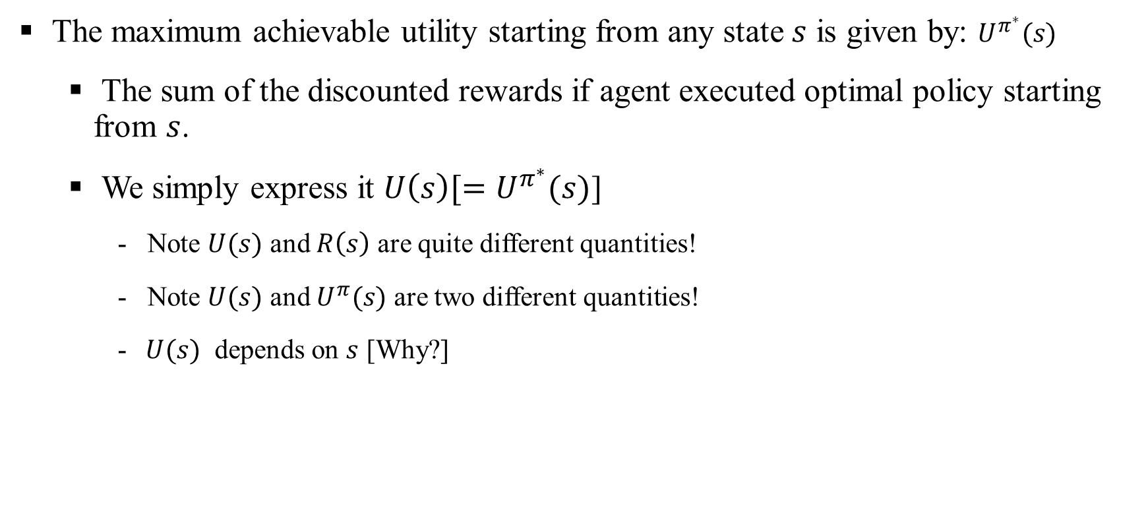
Markov Decision Process: Utility Function
The maximum achievable utility starting from any state $s$ is given by: $U^{π^{∗}}(s)$
The sum of the discounted rewards if agent executed optimal policy starting from $s$.
We simply express it $U\left(s\right)[=U^{π^{∗}}(s)$]
- Note $U(s)$ and $R\left(s\right)$ are quite different quantities!
- Note $U(s)$ and $U^{π}(s)$ are two different quantities!
- $U(s)$ depends on $s$ [Why?]

Slide 25
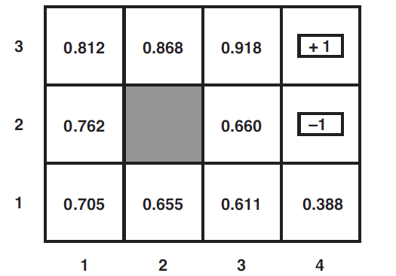

Markov Decision Process: Utility Function
Following figure shows the maximum utility $U(s)$ for different states in the grid world problem for $γ=1$ and $R\left(s\right)=−0.04$
Note that states closer to +1 have higher utilities compared to states far from it.
Why? [Because starts far away needs more steps to reach +1, thus additive rewards $(−0.04$per state) reduces the utility]

Slide 26
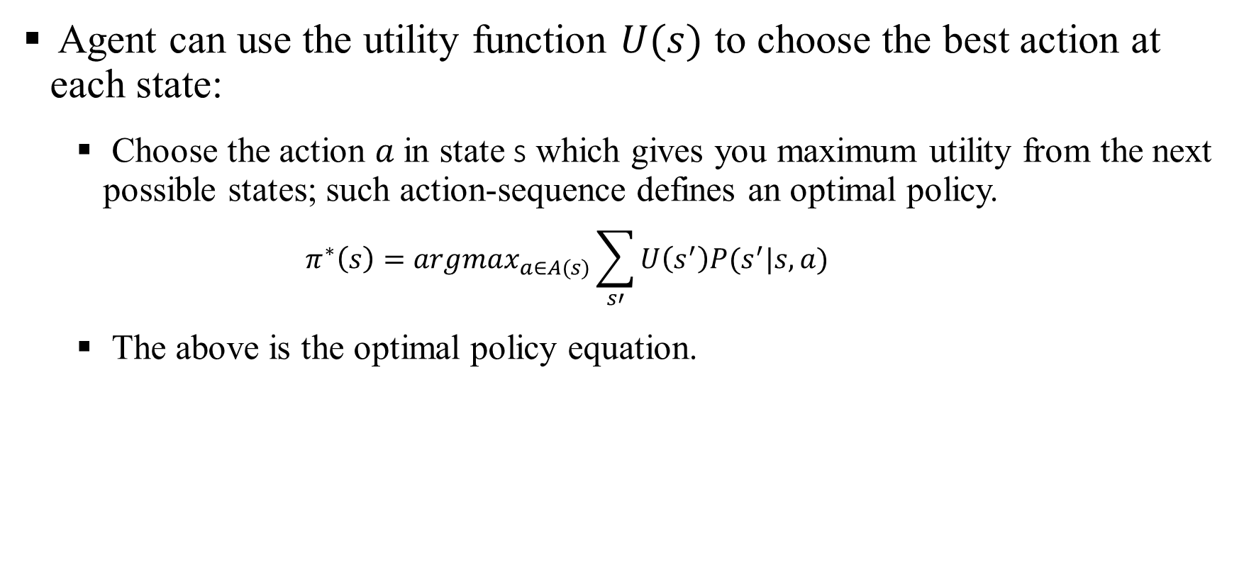
Markov Decision Process: Optimal Action
Agent can use the utility function $U(s)$ to choose the best action at each state:
Choose the action $a$in state s which gives you maximum utility from the next possible states; such action-sequence defines an optimal policy.
$$π^{∗}\left(s\right)=argmax_{a∈A(s)}\sum_{s′}{U\left(s^{′}\right)P(s^{′}|s,a) }$$
The above is the optimal policy equation.

Slide 27
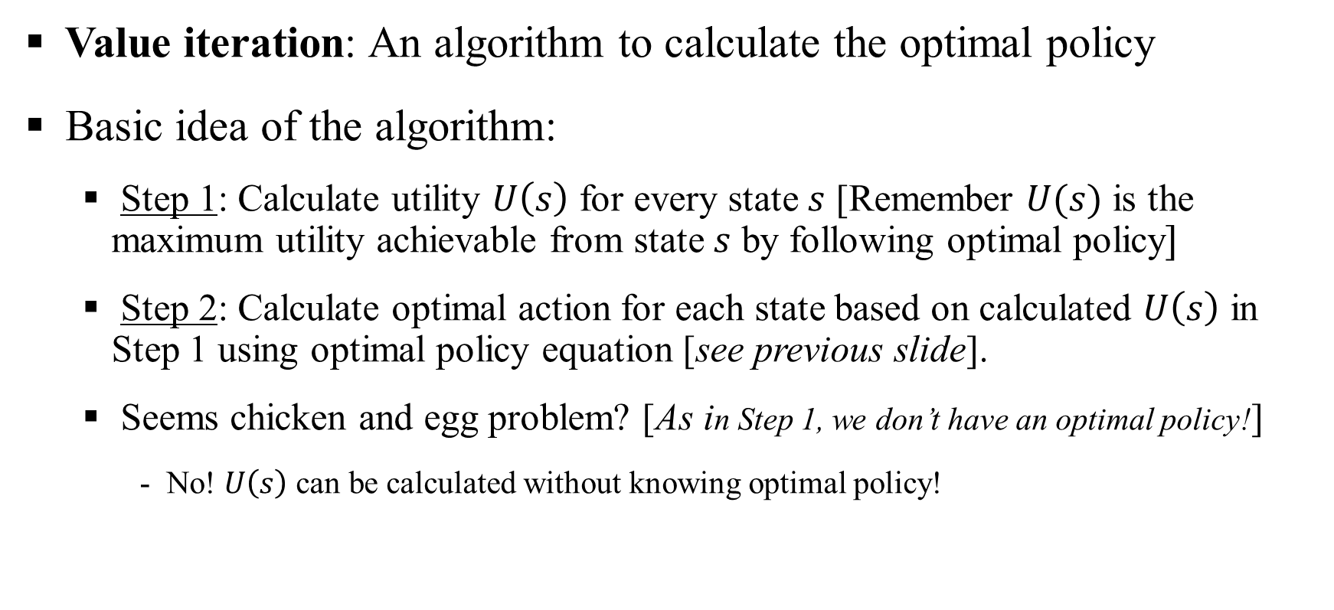
Markov Decision Process: Value Iteration
Value iteration: An algorithm to calculate the optimal policy
Basic idea of the algorithm:
Step 1: Calculate utility $U\left(s\right)$ for every state $s$ [Remember $U(s)$ is the maximum utility achievable from state $s$ by following optimal policy$]$
Step 2: Calculate optimal action for each state based on calculated $U\left(s\right)$ in Step 1 using optimal policy equation [see previous slide].
Seems chicken and egg problem? [As in Step 1, we don’t have an optimal policy!]
- No! $U\left(s\right)$ can be calculated without knowing optimal policy!

Slide 28
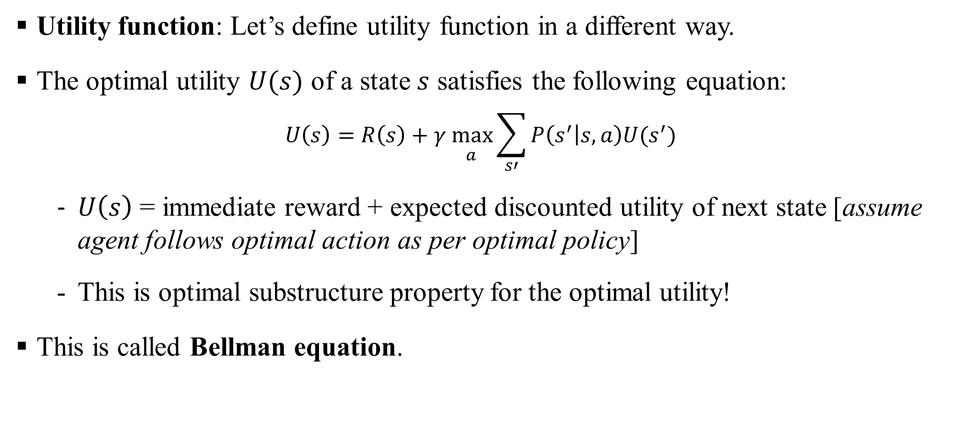
Markov Decision Process: Bellman Equation
Utility function: Let’s define utility function in a different way.
The optimal utility $U(s)$ of a state $s$ satisfies the following equation:
$$U\left(s\right)=R\left(s\right)+\underset{ a}{γ max}{\sum_{s′}{P\left(s^{′} | s,a\right)U(s^{′})}}$$
$U\left(s\right)$ = immediate reward + expected discounted utility of next state [assume agent follows optimal action as per optimal policy]
This is optimal substructure property for the optimal utility!
This is called Bellman equation.

Slide 29
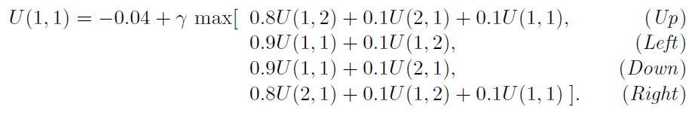
Markov Decision Process: Bellman Equation Example
Let’s verify Bellman Equation for grid world problem.
Bellman equation for state (1,1) is:
Plugging in numbers from the figure:
We can show UP is the best action
Choose any other action (i.e., RIGHT) and verify Bellman equation won’t be satisfied.

Slide 30
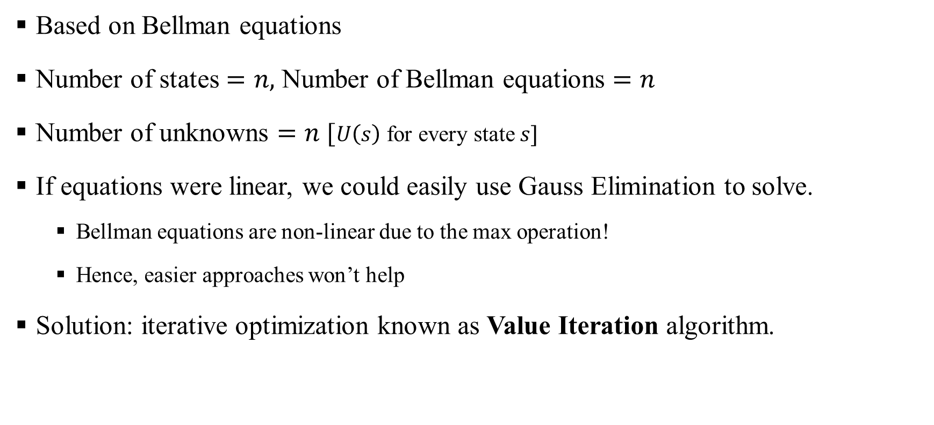
Markov Decision Process: Value Iteration Algorithm
Based on Bellman equations
Number of states $=n,$ Number of Bellman equations $=n$
Number of unknowns $=n$ [$U\left(s\right)$ for every state $s]$
If equations were linear, we could easily use Gauss Elimination to solve.
Bellman equations are non-linear due to the max operation!
Hence, easier approaches won’t help
Solution: iterative optimization known as Value Iteration algorithm.

Slide 31
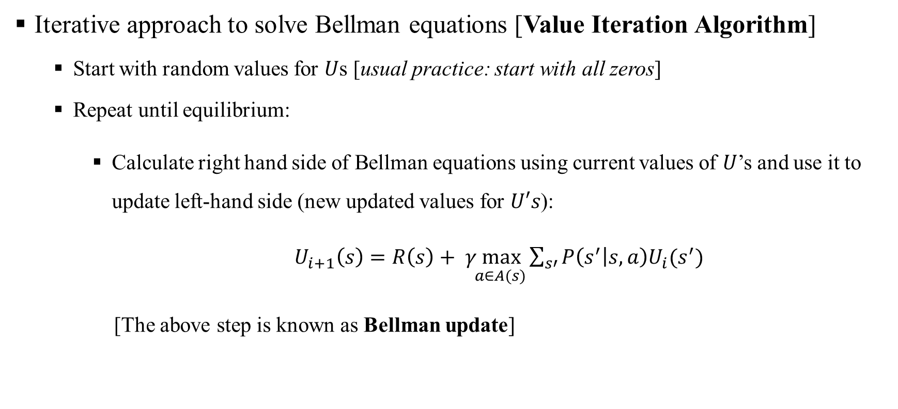
Markov Decision Process: Value Iteration Algorithm
Iterative approach to solve Bellman equations [Value Iteration Algorithm]
Start with random values for $U$s [usual practice: start with all zeros]
Repeat until equilibrium:
Calculate right hand side of Bellman equations using current values of $U$’s and use it to update left-hand side (new updated values for $U′s$):
$U_{i+1}\left(s\right)=R\left(s\right)+\underset{ a∈A(s)}{γ max}{\sum_{s′}{P\left(s^{′} | s,a\right)U_{i}(s^{′})}}$
[The above step is known as Bellman update]

Slide 32
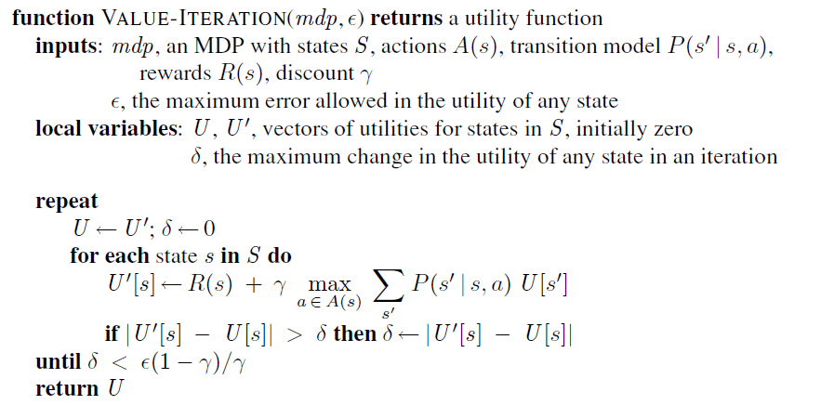
Markov Decision Process: Value Iteration Algorithm
Pseudocode of value iteration algorithm:

Slide 33
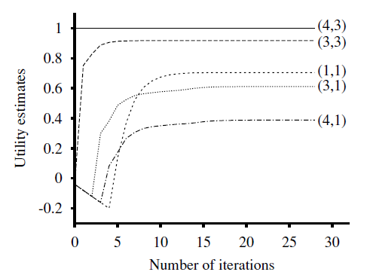
Markov Decision Process: Value Iteration Example
Value iteration applied to grid world problem with initial utilities as 0s.
Note the number of iterations required for convergence of utilities for different states.

Slide 34
Markov Decision Process: Value Iteration Algorithm
Does the value iteration converge to a solution?
If apply Bellman update infinitely often, the equilibrium is guaranteed.
Final utility values must be the solutions to Bellman equations.
The solution is also unique.
Proof of convergence: We won’t study in this course.
Once utilities are obtained, we can also find the optimal policy! [best action from each state satisfying Bellman equation]

Slide 35
Markov Decision Process: Policy Iteration Algorithm
Is it possible to get an optimal policy even when the utility function estimate is inaccurate?
Answer: Yes. If one action is clearly better than all others, then the exact magnitude of the utilities on the states involved need not be precise.
An alterative approach can be designed using the above idea. This is known as Policy Iteration.

Slide 36
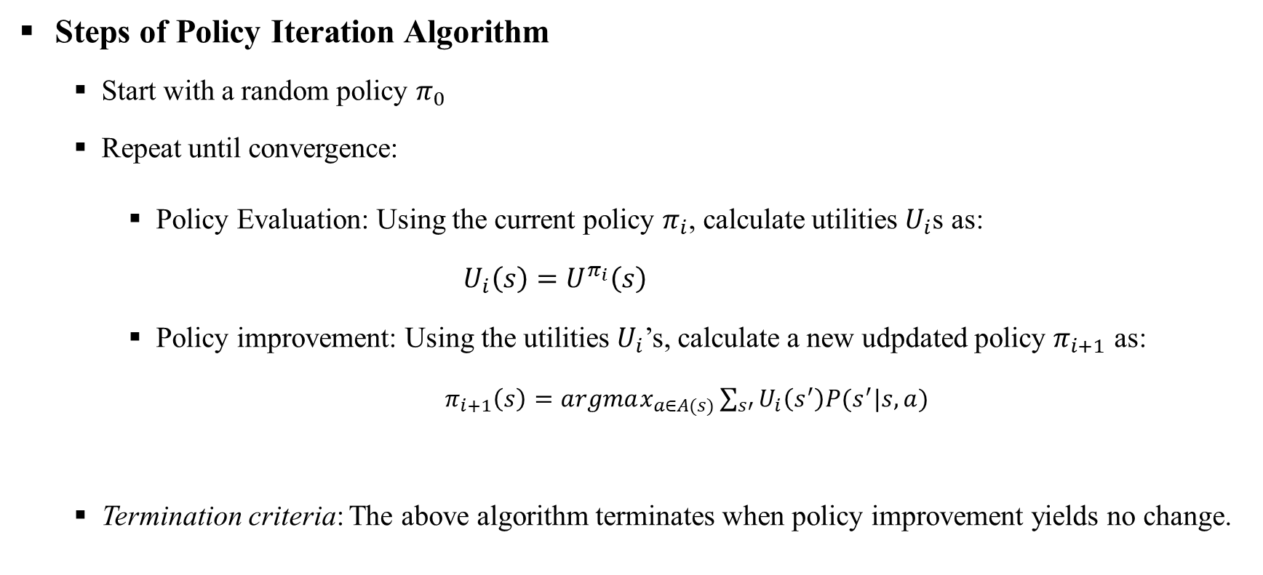
Markov Decision Process: Policy Iteration Algorithm
Steps of Policy Iteration Algorithm
Start with a random policy $π_{0}$
Repeat until convergence:
Policy Evaluation: Using the current policy $π_{i}$, calculate utilities $U_{i}$s as:
$U_{i}\left(s\right)=U^{π_{i}}\left(s\right)$
Policy improvement: Using the utilities $U_{i}$’s, calculate a new udpdated policy $π_{i+1}$ as:
$π_{i+1}\left(s\right)=argmax_{a∈A(s)}\sum_{s′}{U_{i}\left(s^{′}\right)P(s^{′}|s,a) }$
Termination criteria: The above algorithm terminates when policy improvement yields no change.

Slide 37
Markov Decision Process: Policy Iteration Algorithm
How to evaluate the two steps?
Policy improvement: Pretty straightforward.
Policy evaluation: Not easy thought! [we discussed it previously]
Solution? Use an approach similar to the value iteration algorithm.
One important difference: Bellman equations for unities will be linear now! [why?]

Slide 38
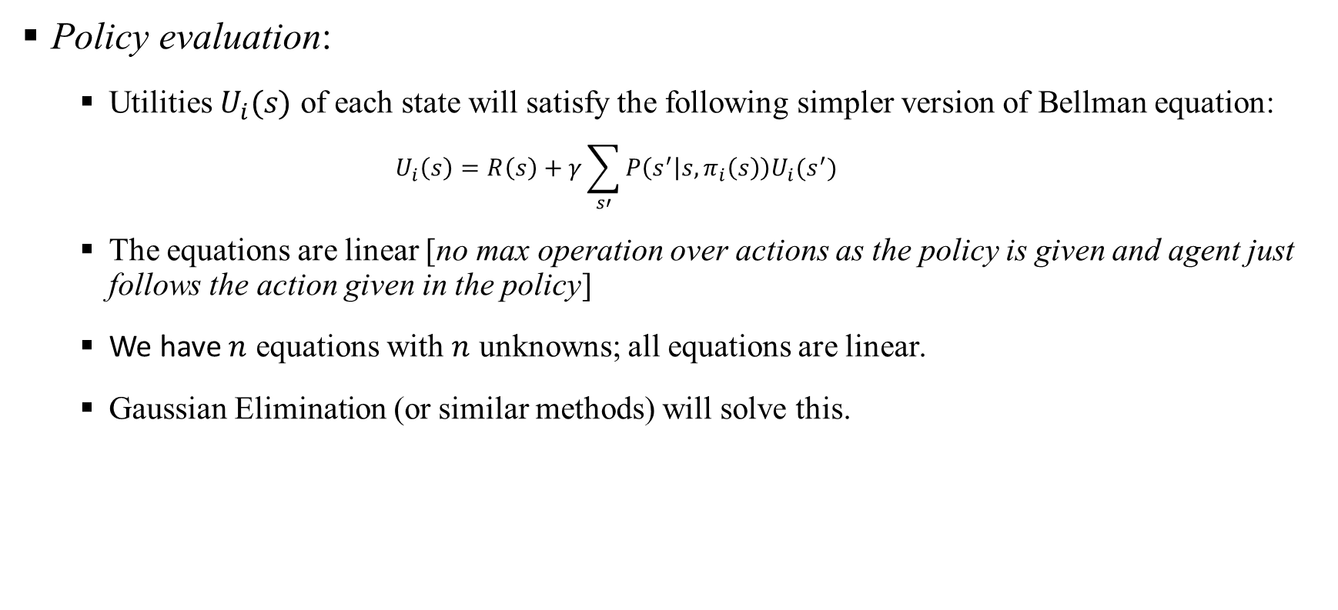
Markov Decision Process: Policy Iteration Algorithm
Policy evaluation:
Utilities $U_{i}(s)$ of each state will satisfy the following simpler version of Bellman equation:
$$U_{i}\left(s\right)=R\left(s\right)+γ\sum_{s′}{P\left(s^{′} | s,π_{i}\left(s\right)\right)U_{i}(s^{′})}$$
The equations are linear [no max operation over actions as the policy is given and agent just follows the action given in the policy]
We have $n$ equations with $n$ unknowns; all equations are linear.
Gaussian Elimination (or similar methods) will solve this.

Slide 39

Markov Decision Process: Policy Iteration Algorithm
Policy evaluation:
Small state space: Gaussian elimination with $O(n^{3})$ run-time.
For large space: Use modified policy iteration to find $U$’s
- Same as policy iteration algorithm
- Use small number of iterations as exact solution is not needed

Slide 40
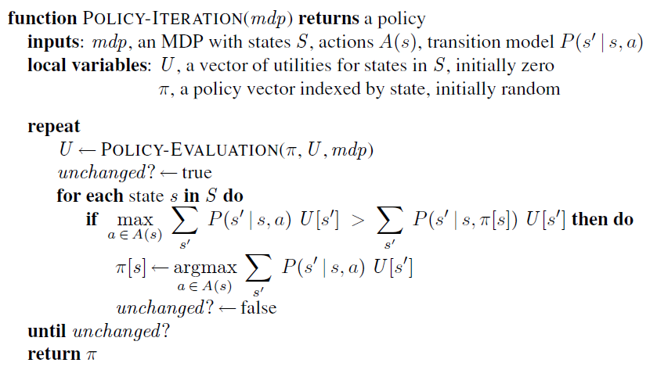
Markov Decision Process: Policy Iteration Algorithm
Pseudocode:

