Slide 1
Chapter 18 (AIAMA)
Learning From Examples

Slide 2
Chapter 18 (AIAMA)
Learning From Examples
Sukarna Barua
Associate Professor, CSE, BUET

Slide 3
Learning Agent
An agent is learning if it improves its performance on future tasks after making observations about the world.
Learning can be online or offline
Online: You learn as you observe each data; learn continuously over time.
Offline: You are given with a set of pre-observed data and you learn from the data; learn once.

Slide 4
Learning Agent
Input data:
Traffic info of several days in a month
Data may have labels:
- Rows are marked with “Good” and “Bad” traffic days
Learning algorithm:
Allow agent learns from the input data to predict new days as “Good” or “Bad”.

Slide 5
Learning types
Unsupervised: Learn patterns in the input
Example: “Good traffic days” and “bad traffic days” learned by a taxi driver without any label to a data
Also known as clustering
Data do not have labels (Good/Bad).

Slide 6
Learning types
Supervised:
Learn from input-output pairs.
Data have labels (i.e., class information)
Can predict “Good” or “Bad” from traffic info of a day

Slide 7
Learning types
Reinforcement:
Learn from reinforcements, rewards and punishments
Example: lack of a tip at the end of a journey an indication that taxi driver did something wrong

Slide 8
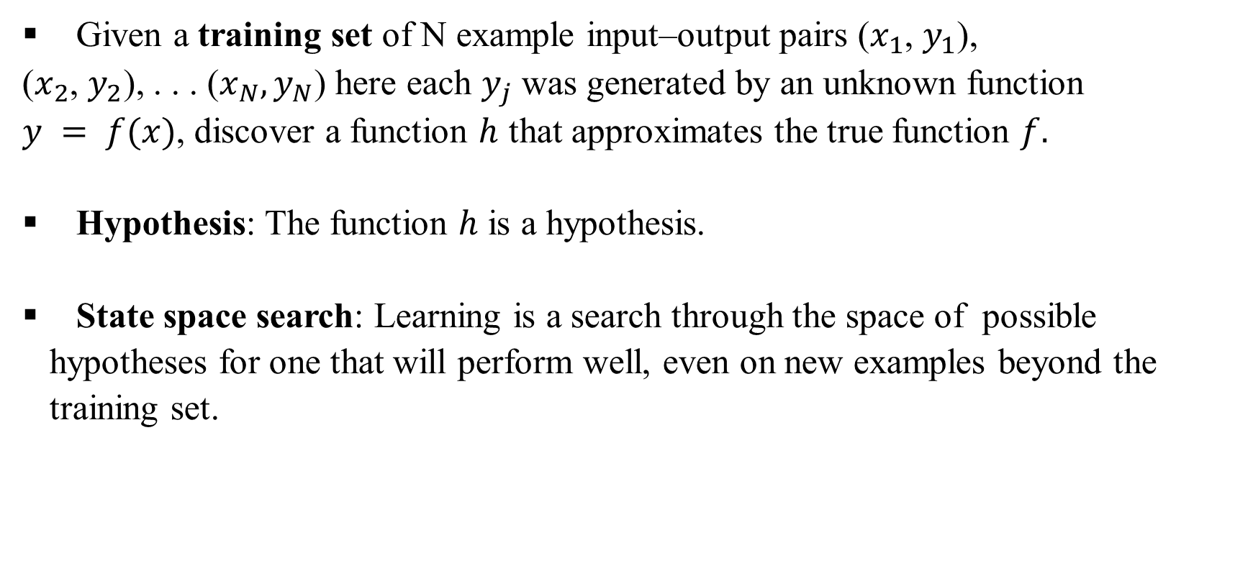
Supervised Learning
Given a training set of N example input–output pairs ($x_{1}$, $y_{1}$),
($x_{2}$, $y_{2}$), . . . ($x_{N}, y_{N}$) here each $y_{j}$ was generated by an unknown function
$y = f(x)$, discover a function $h$ that approximates the true function $f.$
Hypothesis: The function $h$ is a hypothesis.
State space search: Learning is a search through the space of possible hypotheses for one that will perform well, even on new examples beyond the training set.

Slide 9
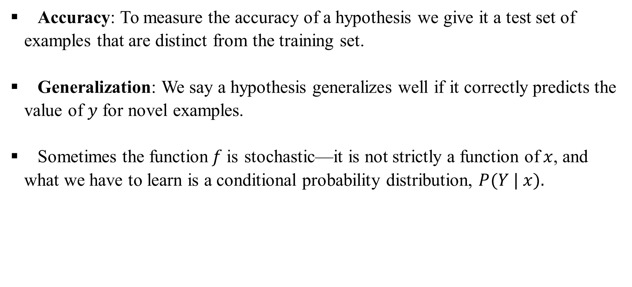
Supervised Learning
Accuracy: To measure the accuracy of a hypothesis we give it a test set of examples that are distinct from the training set.
Generalization: We say a hypothesis generalizes well if it correctly predicts the value of $y$ for novel examples.
Sometimes the function$f$is stochastic—it is not strictly a function of$x$, and what we have to learn is a conditional probability distribution, $P(Y | x).$

Slide 10
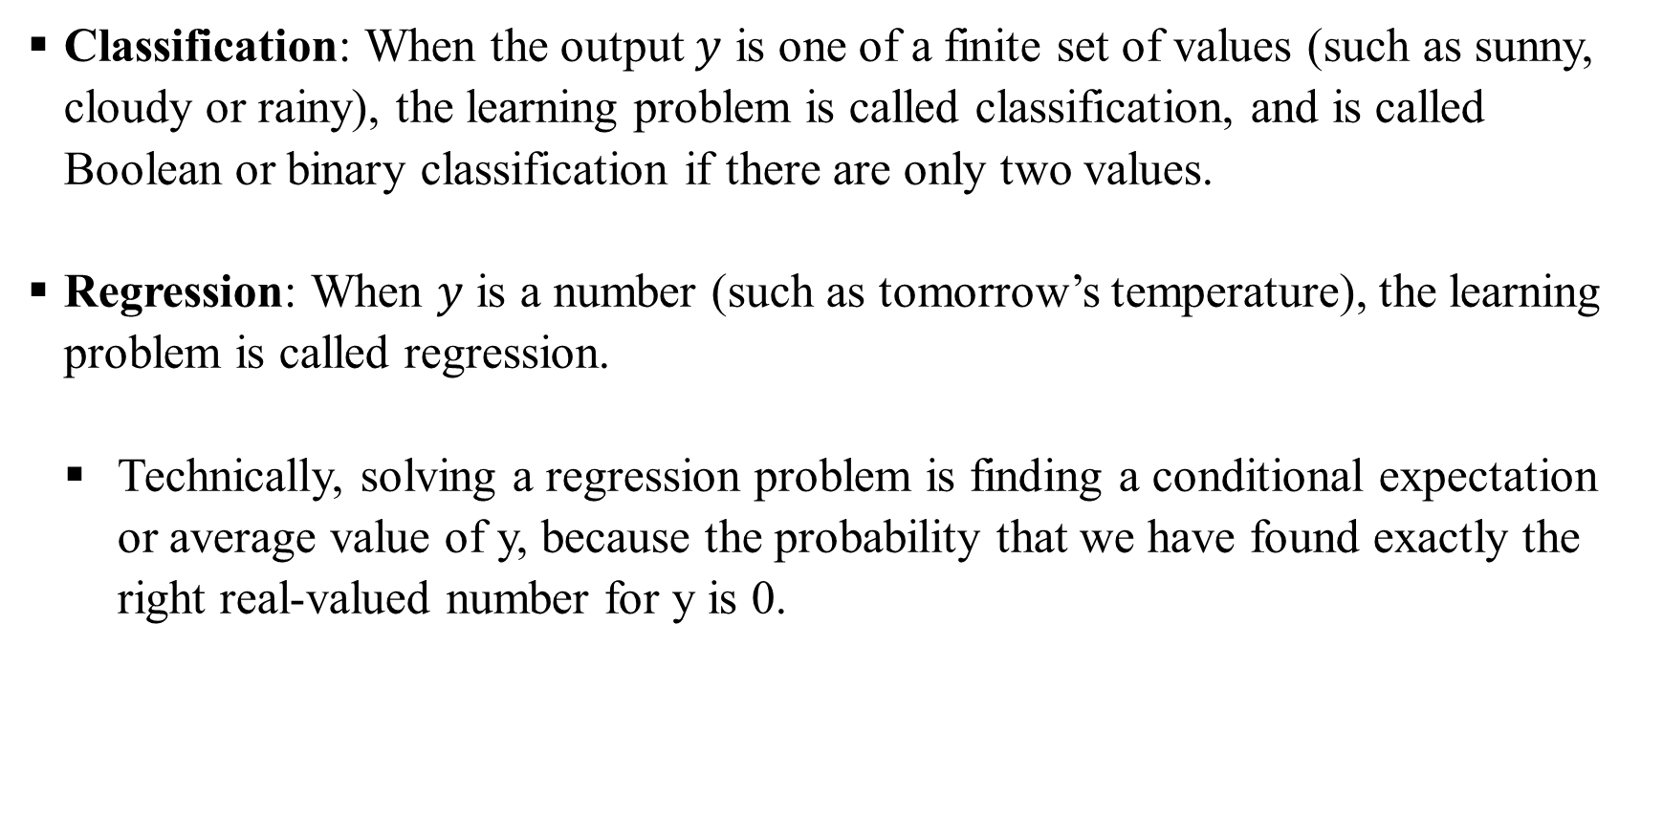
Supervised Learning
Classification: When the output $y$ is one of a finite set of values (such as sunny, cloudy or rainy), the learning problem is called classification, and is called Boolean or binary classification if there are only two values.
Regression: When $y$ is a number (such as tomorrow’s temperature), the learning problem is called regression.
Technically, solving a regression problem is finding a conditional expectation or average value of y, because the probability that we have found exactly the right real-valued number for y is 0.

Slide 11
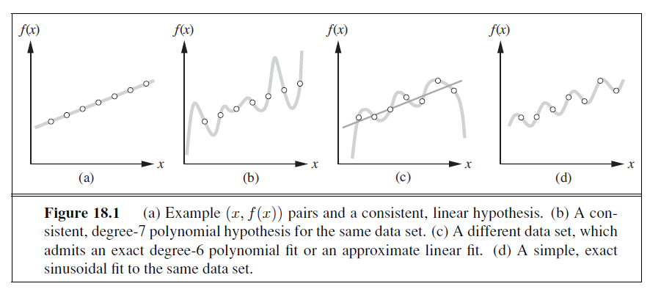
Supervised Learning
What is the best hypothesis to choose from the hypotheses space? All are consistent (agrees with all data points)
(a) Linear
(b) 6-deg polynomial

Slide 12
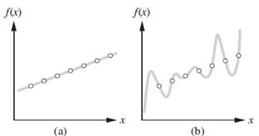
Supervised Learning
Occam’s razor: Select the simplest hypothesis consistent with the data.
After 14th-century English philosopher William of Ockham
Defining simplicity is not easy, but it seems clear that a degree-1 polynomial is simpler than a degree-7 polynomial, and thus (a) should be preferred to (b).
Simplicity is evidence for truth – Swinburne 1997

Slide 13
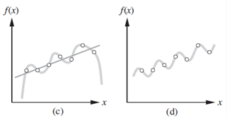
Supervised Learning
Consistency vs Generalization
Figure (c) shows a second data set.
There is no consistent straight line for this data set;
A degree-6 polynomial is an exact fit: may not find
any pattern in the data and we do not expect it to
generalize well.
A straight line that is not consistent with any of the data points, but might generalize fairly well for unseen values of x.
In general, there is a tradeoff between complex hypotheses that fit the training data well and simpler hypotheses that may generalize better.

Slide 14
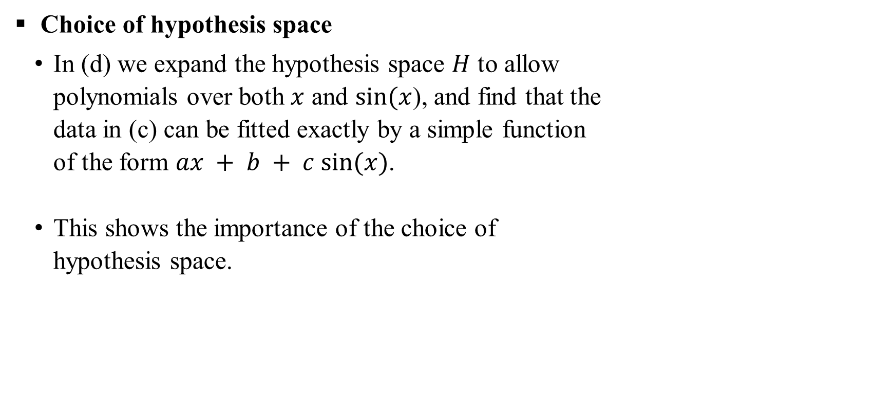
Supervised Learning
Choice of hypothesis space
In (d) we expand the hypothesis space $H$ to allow
polynomials over both $x$ and $sin⁡(x$), and find that the
data in (c) can be fitted exactly by a simple function
of the form $ax + b + c sin⁡(x)$.
This shows the importance of the choice of
hypothesis space.

Slide 15
Supervised Learning
Realizable: We say that a learning problem is realizable if the hypothesis space contains the true function.
Unfortunately, we cannot always tell whether a given learning problem is realizable, because the true function is not known.

Slide 16
Supervised Learning
Example of Realizability:
Linearly Separable Data: If you are training a linear classifier (e.g., logistic regression or a perceptron) on a dataset that is perfectly linearly separable, then the problem is realizable because there exists a linear function that can classify the data with zero error.
Non-Linear Data: If the data is not linearly separable, but you are restricted to using linear classifiers, the problem is non-realizable because no linear function can perfectly classify the data.

Slide 17
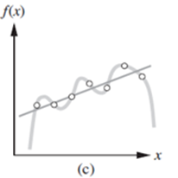
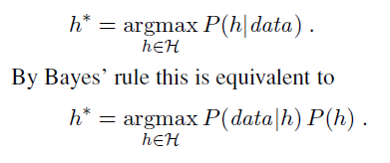
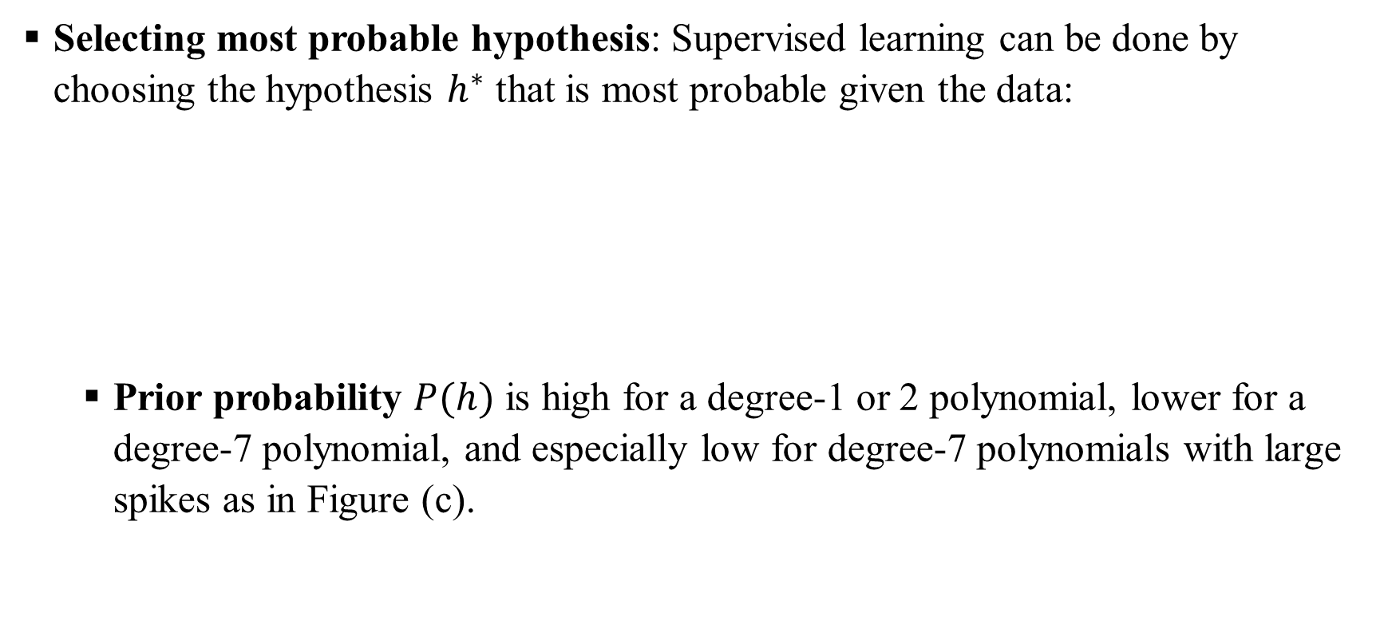
Supervised Learning
Selecting most probable hypothesis: Supervised learning can be done by choosing the hypothesis $h^{∗}$ that is most probable given the data:
Prior probability $P(h)$ is high for a degree-1 or 2 polynomial, lower for a degree-7 polynomial, and especially low for degree-7 polynomials with large spikes as in Figure (c).

Slide 18
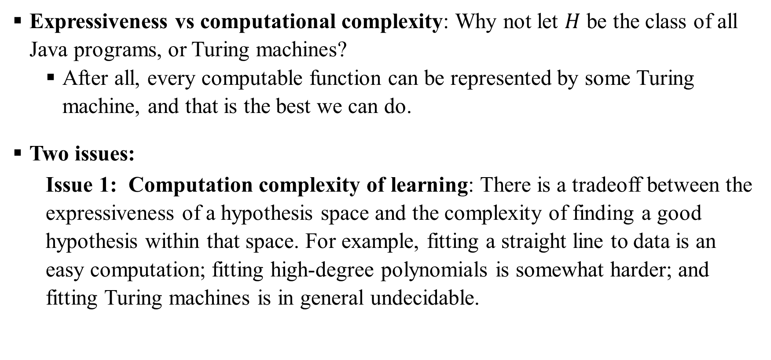
Supervised Learning
Expressiveness vs computational complexity: Why not let $H$ be the class of all Java programs, or Turing machines?
After all, every computable function can be represented by some Turing machine, and that is the best we can do.
Two issues:
Issue 1: Computation complexity of learning: There is a tradeoff between the expressiveness of a hypothesis space and the complexity of finding a good hypothesis within that space. For example, fitting a straight line to data is an easy computation; fitting high-degree polynomials is somewhat harder; and fitting Turing machines is in general undecidable.

Slide 19
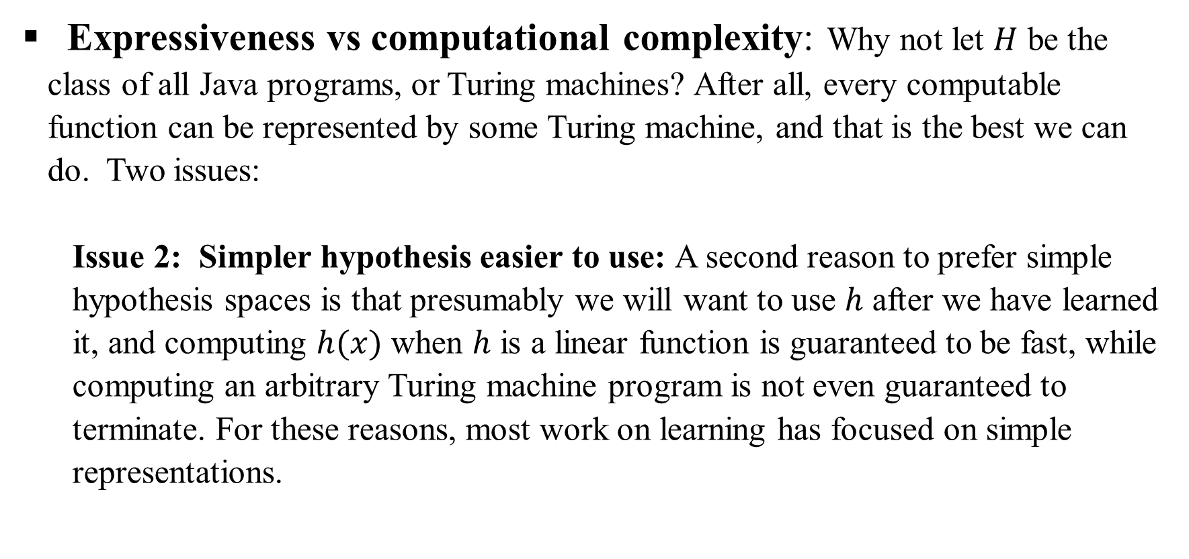
Supervised Learning
Expressiveness vs computational complexity: Why not let $H$ be the class of all Java programs, or Turing machines? After all, every computable function can be represented by some Turing machine, and that is the best we can do. Two issues:
Issue 2: Simpler hypothesis easier to use: A second reason to prefer simple hypothesis spaces is that presumably we will want to use $h$ after we have learned it, and computing $h(x)$ when $h$ is a linear function is guaranteed to be fast, while computing an arbitrary Turing machine program is not even guaranteed to terminate. For these reasons, most work on learning has focused on simple representations.

