Slide 1
Chapter 18 (AIAMA)
Learning From Examples-02
Sukarna Barua
Associate Professor, CSE, BUET

Slide 2
Decision Tree
A decision tree:
Represents a function that takes as input a vector of attribute values
Returns a “decision”—a single output value.
The input and output values can be discrete or continuous.
For now we will concentrate on problems where
Inputs have discrete values
Output has exactly two possible values; this is Boolean classification, where each example input will be classified as true (a positive example) or false (a negative example).

Slide 3
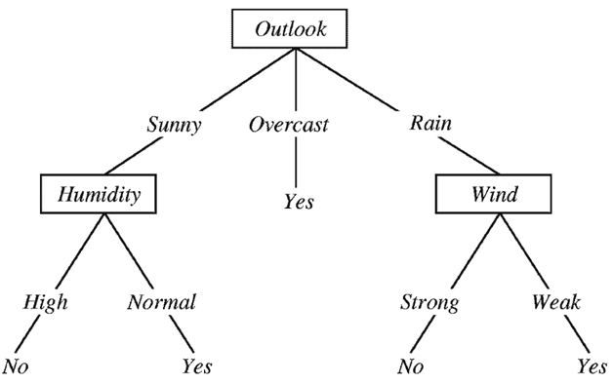
Decision Tree
A decision tree for rain forecasting.
Input: {Outlook=Sunny, Humidity=Normal, Wind=Strong}
Output: Yes [Rainy]

Slide 4
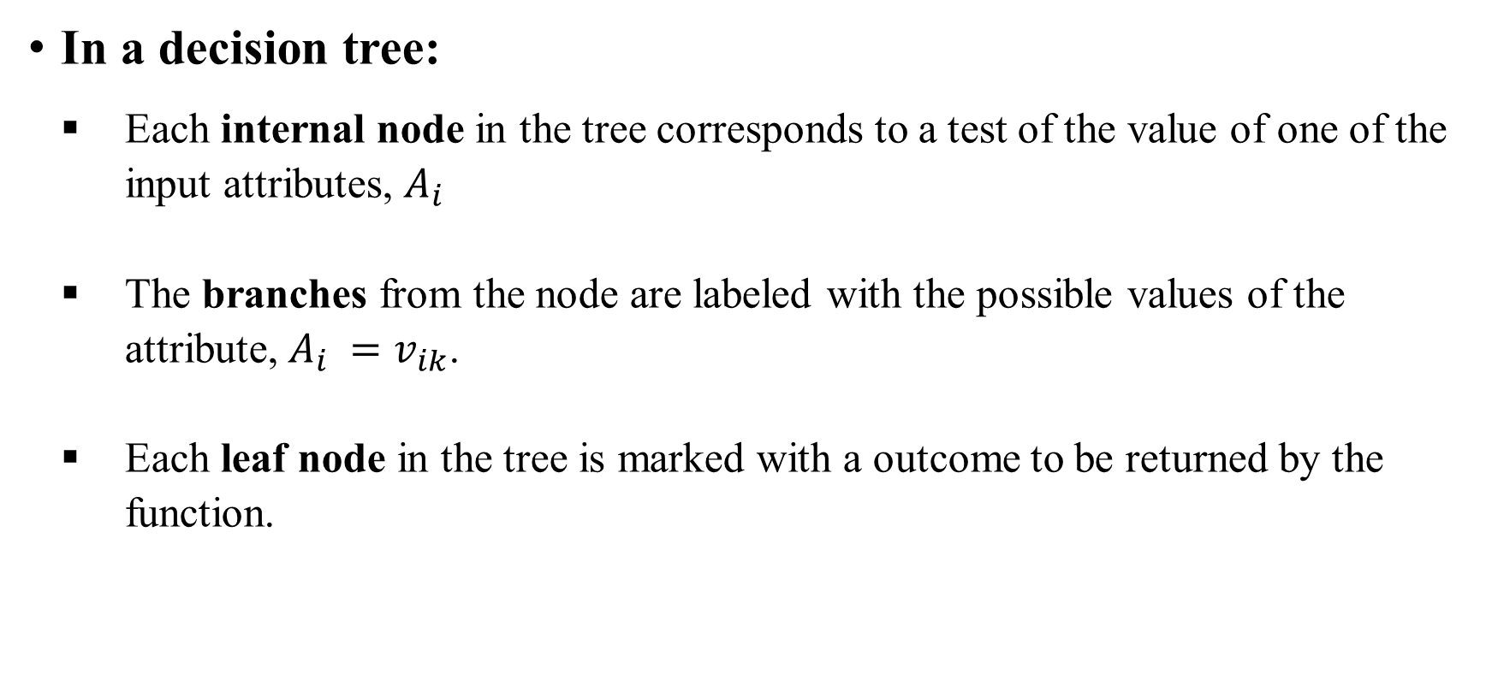
Decision Tree

Slide 5
Decision Tree: Example
Problem: Build a decision tree to decide whether to wait at a restaurant.
Learning Goal:
WillWait - to decide whether to wait for a table at a restaurant.
Goal is binary valued (i.e., binary classification task)
Values: {Yes, No}

Slide 6
Decision Tree: Example
Input Attributes
1. Alternate: whether there is a suitable alternative restaurant nearby.
2. Bar : whether the restaurant has a comfortable bar area to wait in.
3. Fri/Sat: true on Fridays and Saturdays, false otherwise.
4. Hungry: whether we are hungry.
5. Patrons: how many people are in the restaurant (values are None, Some, and Full ).
Price: the restaurant’s price range ($, $$, $$$).

Slide 7
Decision Tree: Example
Input Attributes
7. Raining: whether it is raining outside.
8. Reservation: whether we made a reservation.
9. Type: the kind of restaurant (French, Italian, Thai, or burger).
10. WaitEstimate: the wait estimated by the host (0–10 minutes, 10–30, 30–60, or >60).
Note that every variable has a small set of possible values; the value of WaitEstimate, for example, is not an integer, rather it is one of the four discrete values 0–10, 10–30, 30–60, or >60.

Slide 8
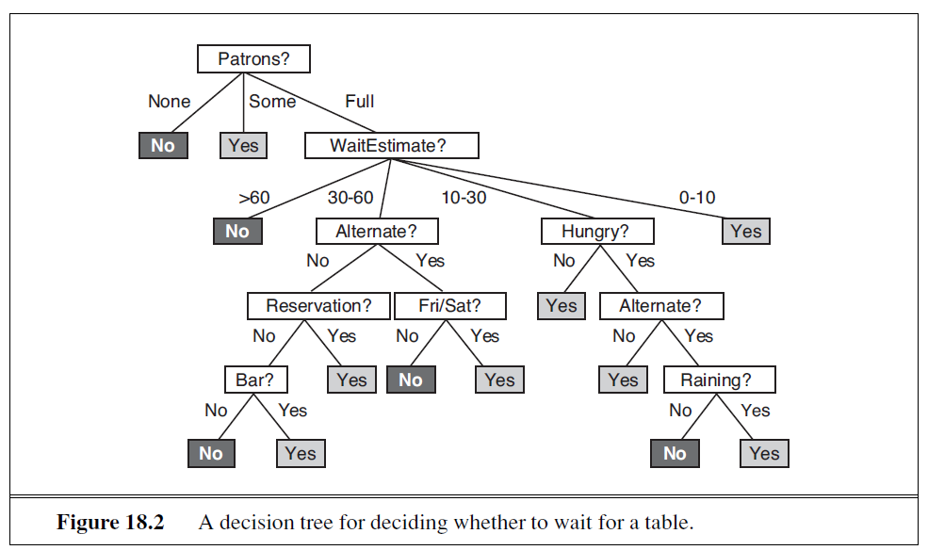
Decision Tree: Example
An example decision tree for the restaurant problem

Slide 9
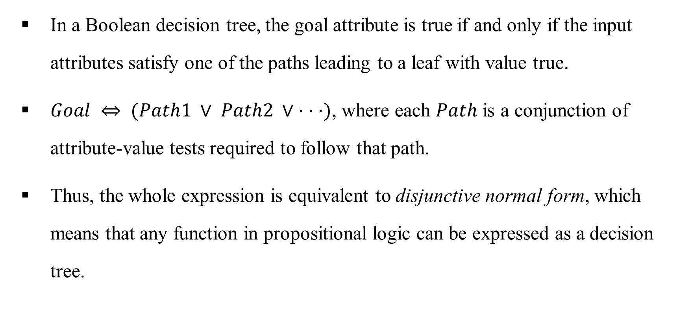
Expressiveness of Decision Trees

Slide 10
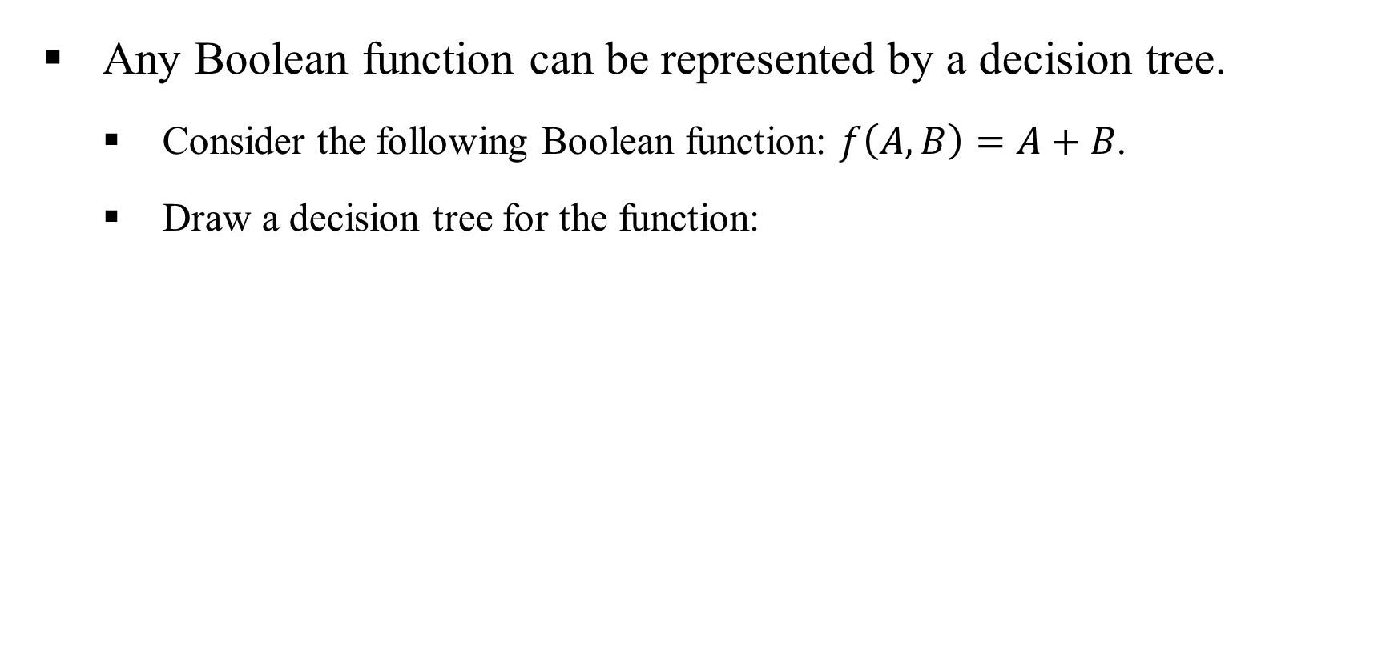
Expressiveness of Decision Trees

Slide 11
Expressiveness of Decision Trees
For a wide variety of problems, the decision tree format yields a nice, concise result.
But some functions cannot be represented concisely:
For example, the majority function, which returns true if and only if more than half of the inputs are true, requires an exponentially large decision tree.
Decision trees are good for some kinds of functions and bad for others.

Slide 12
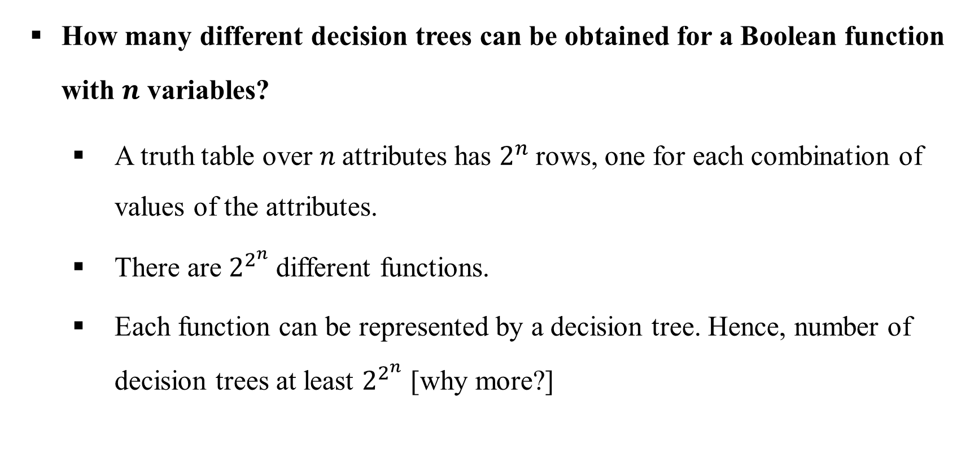
Expressiveness of Decision Trees

Slide 13
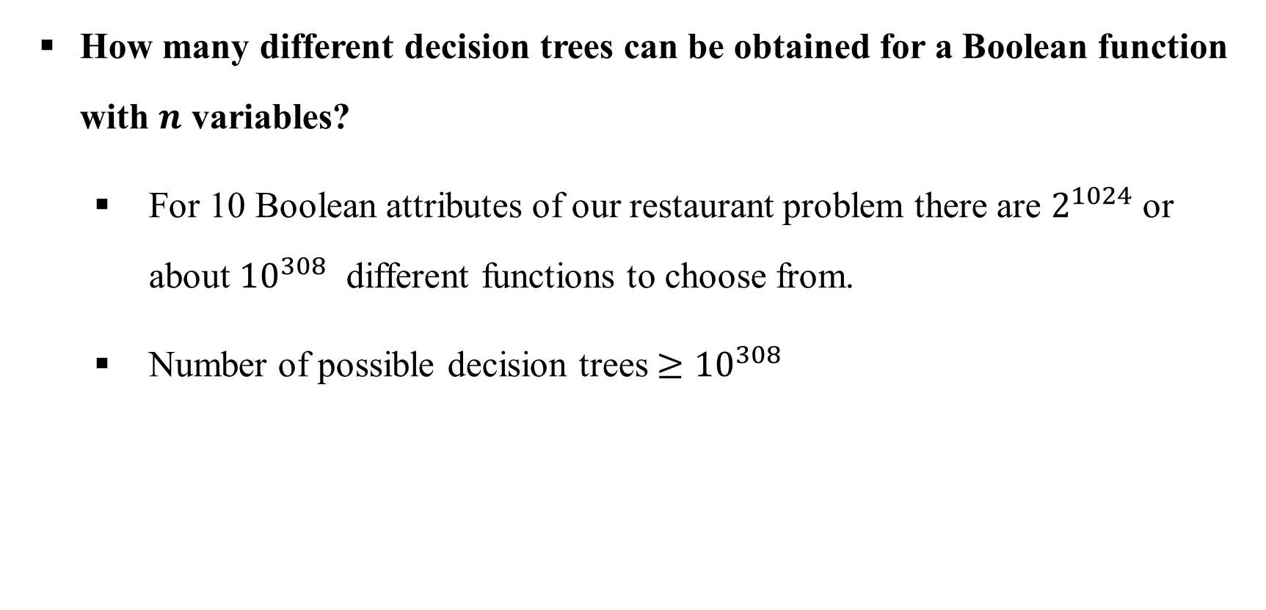
Expressiveness of Decision Trees

Slide 14
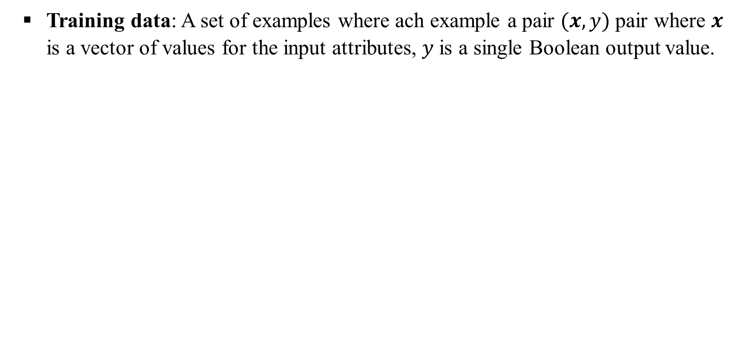
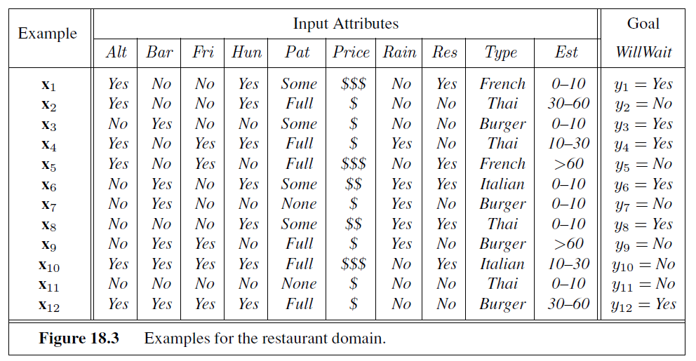
Inducing Decision Trees

Slide 15
Inducing Decision Trees
Build a decision tree that is -
Consistent with the examples [Not always expected though, generalization may suffer]
Is as small as possible. [Occam's razor]

Slide 16
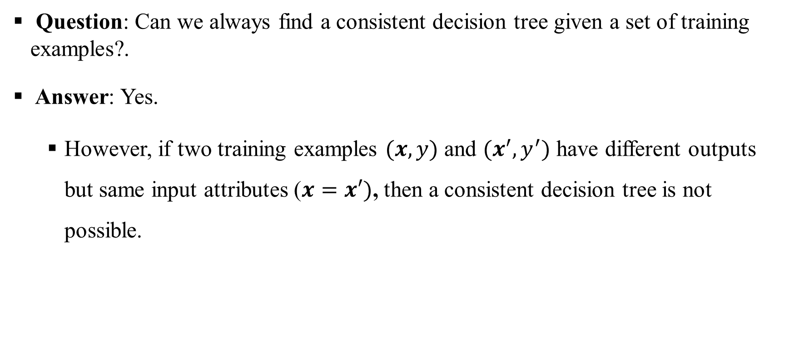
Inducing Decision Trees

Slide 17
Inducing Decision Trees
Unfortunately, it is an intractable problem to find the smallest consistent tree; there is no way to efficiently search through hypotheses space.
An NP-hard problem!
What can we do if cannot find the smallest decision tree?
Solution: Use heuristics to find a closest one.
With some simple heuristics, we can find a good approximate solution: a small (but not the smallest) consistent tree.
This is a greedy approach. [Remember what is greedy]

Slide 18
Decision Tree Learning
Greedy approach to build a decision tree:
Start with empty decision tree.
Select an attribute to test at the next level [node]:
Always select the most important attribute to test first. [greedy strategy]
The test creates new branches and divides the problem into smaller subproblems.
Recurse on each child (created for each branch)

Slide 19
Decision Tree Learning
Greedy strategy: Always select the most important attribute to test first.
Most important attribute implies the one that makes the most difference to the classification of an example. [Get leaves as early as possible]
Get correct classification with a small number of test
All paths in the tree will be short
Tree as a whole will be shallow.
Above greedy strategy is a local optimal choice, may not necessarily leads to the globally smallest tree!

Slide 20
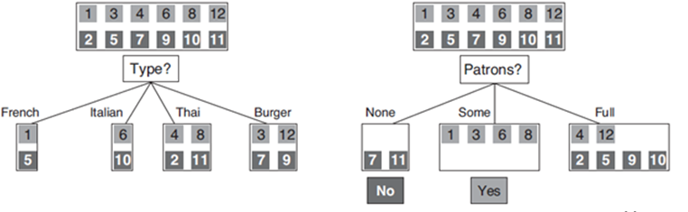
Decision Tree Learning
Which attribute to test at root? Type vs Patron?
Type: all subsets (i.e., branches) needs further exploration.
Patron: two branches become leaves, only one needs further exploration.

Slide 21
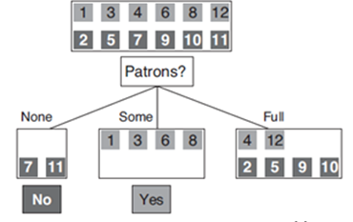
Decision Tree Learning Algorithm
Decision tree construction:
Step 1: Test an attribute at each node.
Step 2: Partition the examples according to values and
create child nodes with relevant examples.
Step 3: Now consider child node for further tests of attributes except the one which have already been tested in the hierarchy (recursive operation)
.

Slide 22
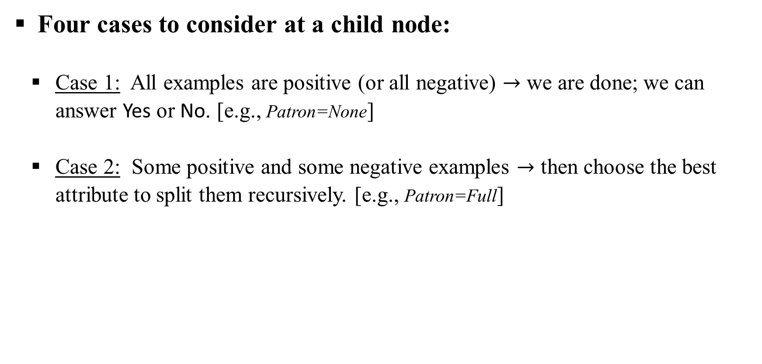
Decision Tree Learning Algorithm

Slide 23
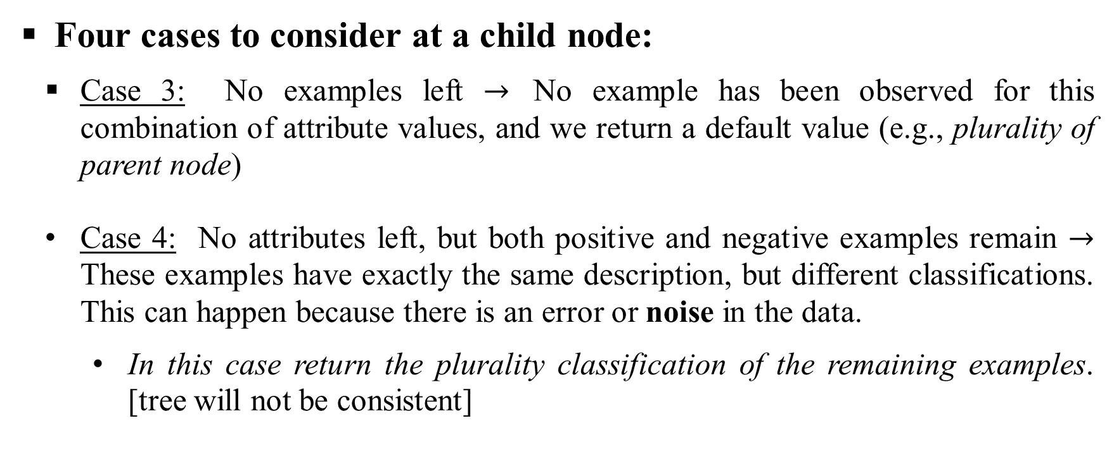
Decision Tree Learning Algorithm

Slide 24
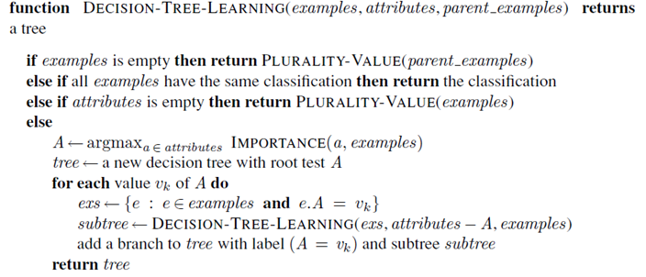
Decision Tree Learning Algorithm
Algorithm pseudocode
Function PLURAITY-VALUE selects the most common class/output among the examples

Slide 25
Choosing the Most Important Attribute
Which attribute is the most important now?
Perfect attribute: One that splits into subsets where each subset contain either all positive or all negative examples. [all branches become leaf nodes]
Useless attribute: One that splits into subsets where each subset contain fairly equal mix of positive and negative examples. [all branches need recursive exploration]

Slide 26
Choosing the Most Important Attribute
Perfect vs. useless? How to measure?
A formal measure of perfect vs useless: Entropy
The fundamental quantity in information theory (Shannon and Weaver, 1949).
Entropy is a measure of the uncertainty of a random variable.
Acquisition of information corresponds to a reduction in entropy.
A random variable with only one value—a coin that always comes up heads—has no uncertainty and thus its entropy is defined as zero; thus, we gain no information by observing its value.

Slide 27
Choosing the Most Important Attribute
Entropy: Average number of bits per symbol to encode information.
The roll of a fair four-sided die has 2 bits of entropy, because it takes two bits to describe one of four equally probable choices.
An unfair coin that comes up heads 99% of the time.
This coin has less uncertainty than the fair coin—if we guess heads we’ll be wrong only 1% of the time—it’s entropy measure should be close to zero, but positive.

Slide 28
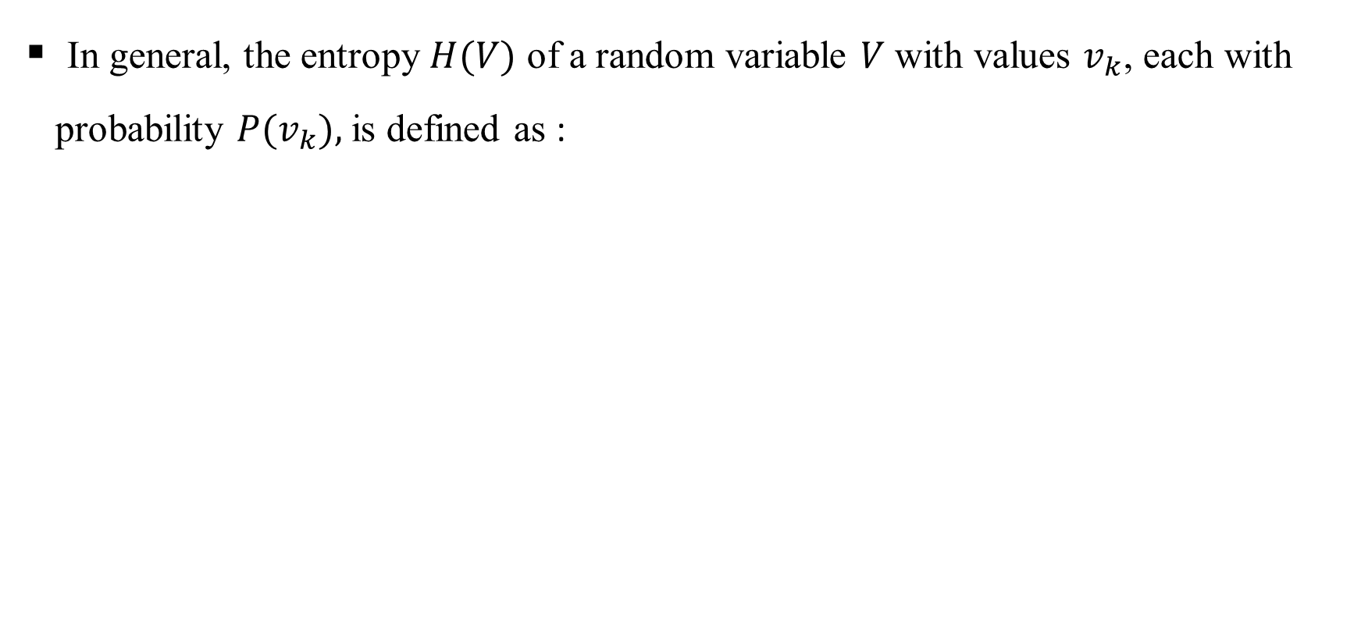
Entropy Measure

Slide 29
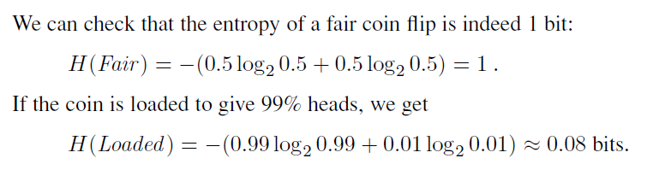
Entropy Measure
Verify that entropies measures are correct.

Slide 30
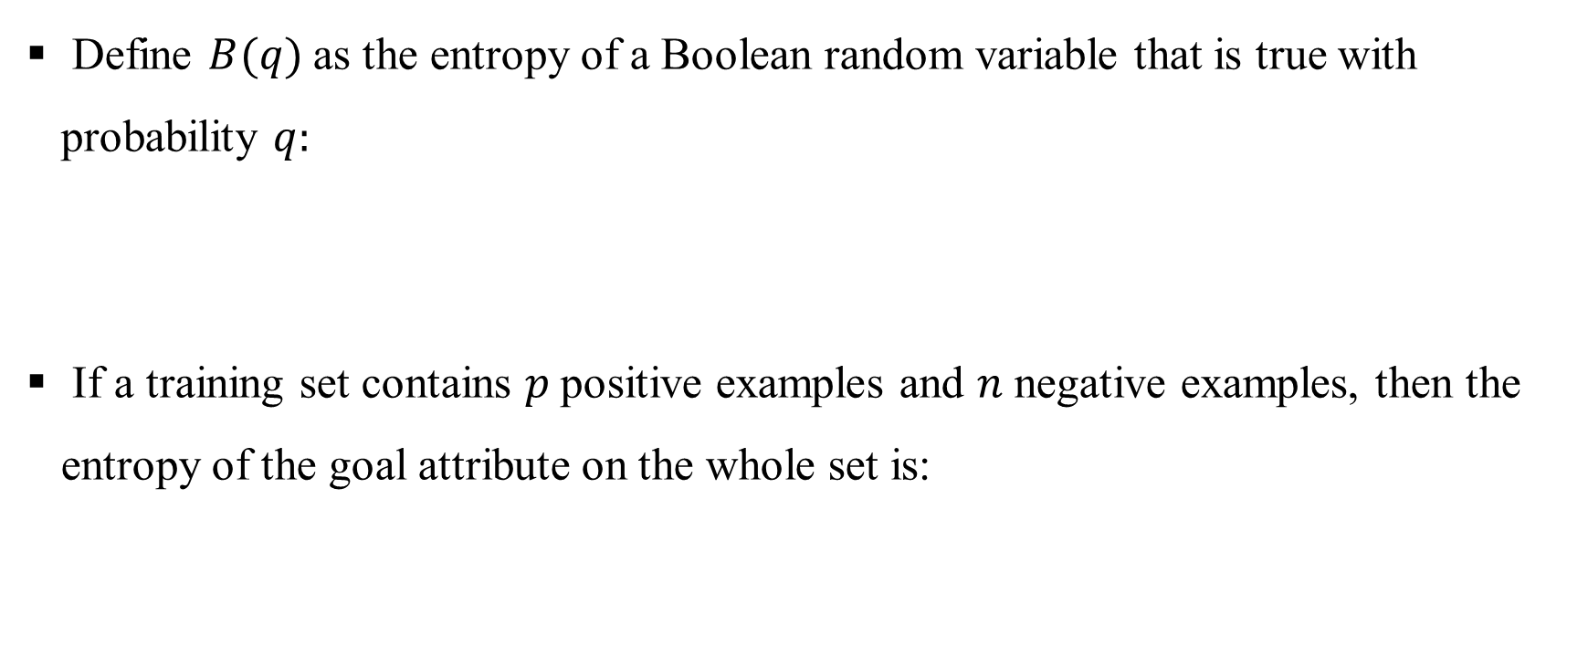

Entropy Measure

Slide 31
Entropy Measure in Decision Tree
Decision tree contest: Entropy represents an impurity measure of the set.
A set with 5 positive and 5 negative examples: Most impure, entropy should be highest.
A set with 10 positive and 0 negative examples: Purest, entropy should be the lowest.

Slide 32
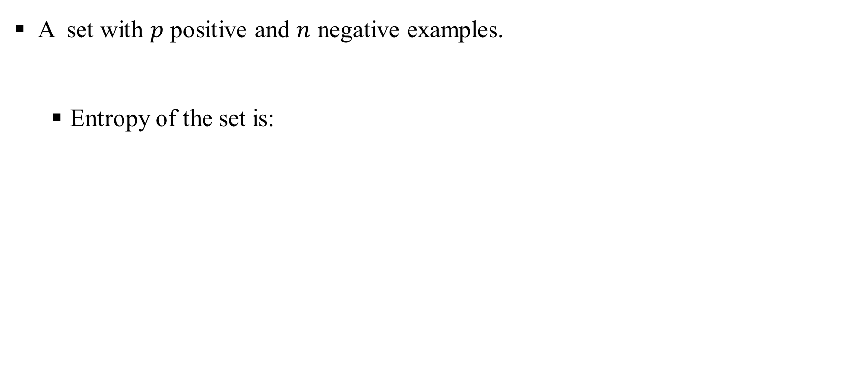

Entropy Before Split

Slide 33
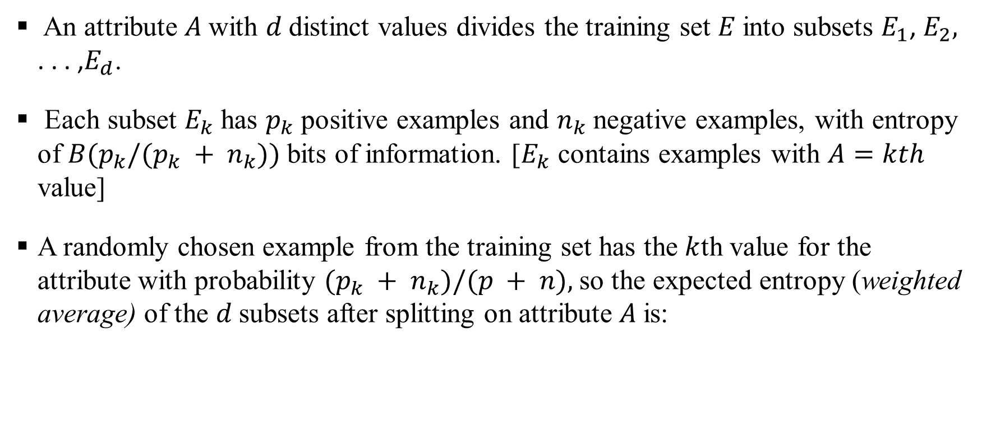

Entropy After Splitting

Slide 34
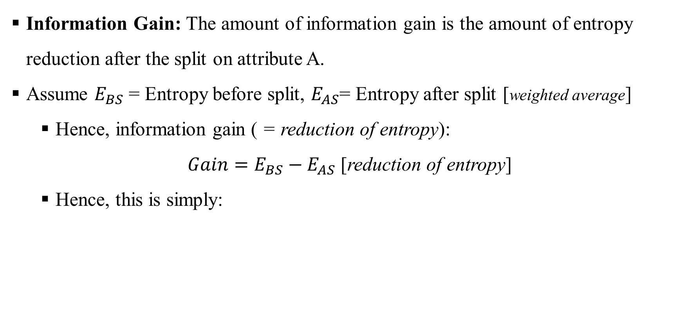

Information Gain

Slide 35

Information Gain
Information Gain:
Compute the information gain for the attributes Patron and Type:
Patron is a better attribute than Gain! Hence, choose Patron over Type.
Choose the attribute which gives the highest information gain!

Slide 36
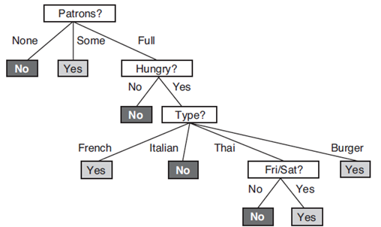
Final Decision Tree
Final decision tree constructed from given examples.
Question: What is the information gain for Type attribute at level 3?

Slide 37
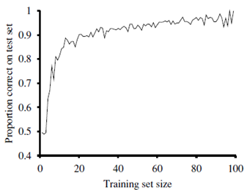
Decision Tree Learning Curve
Experiment with 100 examples: Construct decision trees
Split into train and test (e.g., 1 and 99, 2 and 98, etc.)
Random split 20 times and report average accuracy on test set
Note: As the training size grows, accuracy increases.

Slide 38
Overfitting
Overfitting: Too much importance on every training example
Complex tree
Suffers generalization: very low training error, but very high test error.
Misses important concepts
A consistent decision tree over training data may result in a complex tree
Noisy data may also induce complexity in the tree

Slide 39
Overfitting Solution
Pre-prune: Prune the tree before it gets large
Early stopping: limit depth during tree construction
Post-pruning: Prune the tree after construction
Remove irrelevant nodes
Replace internal nodes with most common class [Only replace if test error do not increase]

Slide 40
Decision Tree Issues
Missing values: Some examples have missing value in some attributes
Solution: Replace missing value with mean of the attribute over the entire dataset
Continuous-valued attribute: For example, height is continuous-valued.
Convert to categorical attribute:
Height > 40cm: Tall and Height <40cm: Short

