Slide 1
Network
Introduction to
Computer Networks
Slide Source: Cisco Networking

Slide 2


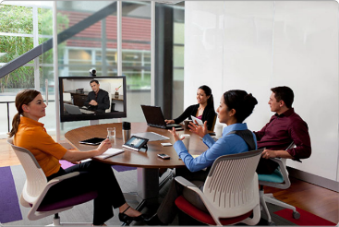
Networking Today
Network has no boundary and supports the way we:
Learn
Communicate
Work
Play

Slide 3
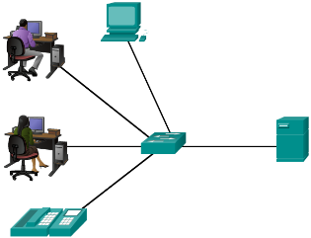
LANs and WANs
Local Area Networks
Spans across small geographical area
Interconnects end devices
Administrated by a single organization
Provide high speed bandwidth to internal devices
WAN Area Networks
Interconnects LAN
Administrated by multiple service providers
Provide slower speed links between LANS
Can you name more network types?

Slide 4






Network Components

Slide 5
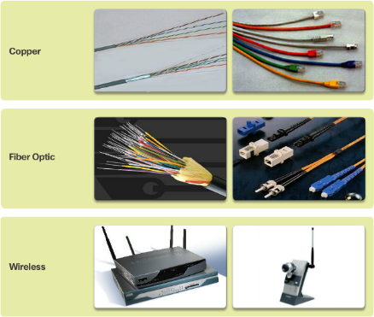
Network Components
End Devices
Either the source or destination of a message
Intermediary Network Devices
Connect multiple individual networks to form an internetwork
Connect the individual end devices to the network
Network Media
Provide the pathway for data transmission
Interconnect devices

Slide 6
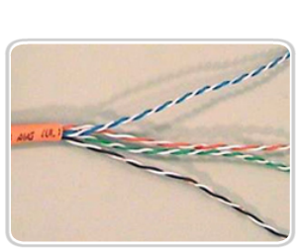
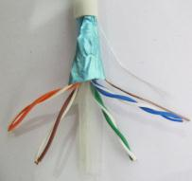

Copper Media
Unshielded Twisted Pair (UTP) Cable
Shielded Twisted Pair (STP) Cable
Coaxial Cable

Slide 7
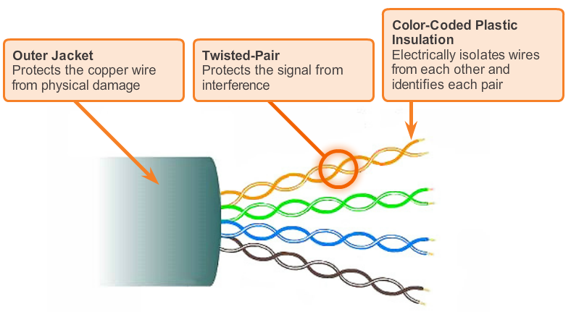
UTP Cable

Slide 8
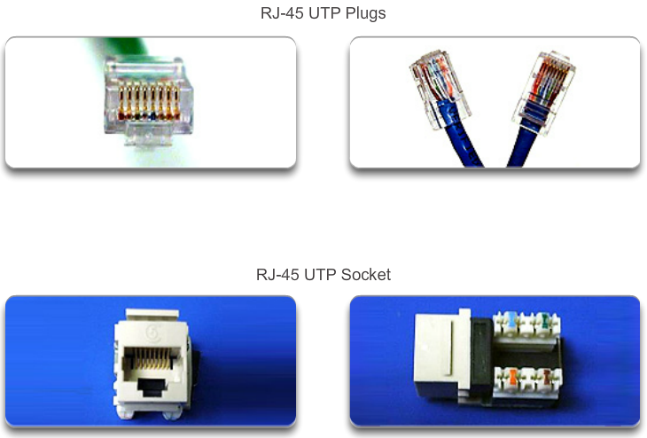
UTP Connectors

Slide 9
Creation of Internet, Development of TCP/IP
The first packet switching network and predecessor to today’s Internet was the Advanced Research Projects Agency Network (ARPANET), which came to life in 1969 by connecting mainframe computers at four locations.
ARPANET was funded by the U.S. Department of Defense for use by universities and research laboratories. Bolt, Beranek and Newman (BBN) was the contractor that did much of the initial development of the ARPANET, including creating the first router known as an Interface Message Processor (IMP).
In 1973, Robert Kahn and Vinton Cerf began work on TCP to develop the next generation of the ARPANET. TCP was designed to replace ARPANET’s current Network Control Program (NCP).
In 1978, TCP was divided into two protocols: TCP and IP. Later, other protocols were added to the TCP/IP suite of protocols including Telnet, FTP, DNS, and many others.

Slide 10
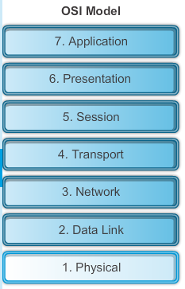
The OSI Reference Model

Slide 11
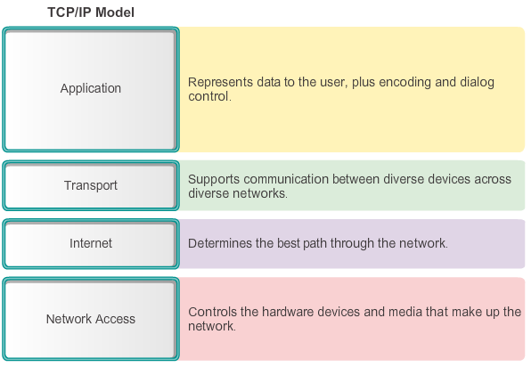
The TCP/IP Reference Model
Notes:
3.2.4.3 The TCP/IP Protocol Model

Slide 12
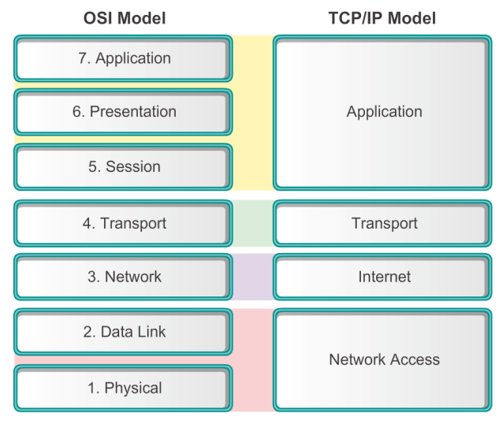
Comparing the OSI and TCP/IP Models

Slide 13
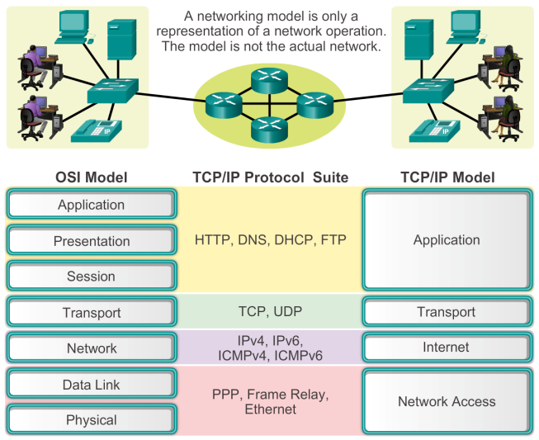
Benefits of Using a Layered Model

Slide 14
Establishing the Rules
An identified sender and receiver
Common language and grammar
Speed and timing of delivery
Confirmation or acknowledgment requirements

Slide 15
Network Protocols
How the message is formatted or structured
The process by which networking devices share information about pathways with other networks
How and when error and system messages are passed between devices
The setup and termination of data transfer sessions

Slide 16
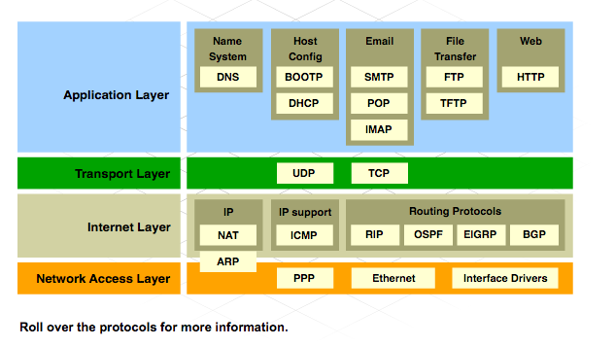
TCP/IP Protocol Suite and Communication

Slide 17
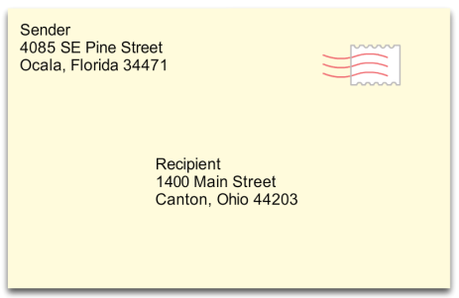
Message Formatting and Encapsulation
Example: Personal letter contains the following elements:
Identifier of the recipient’s location
Identifier of the sender’s location
Salutation or greeting
Recipient identifier
The message content
Source identifier
End of message indicator

Slide 18
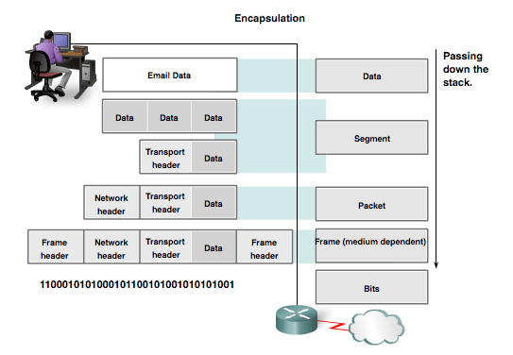
Protocol Data Units (PDUs)
Data
Segment
Packet
Frame
Bits

Slide 19
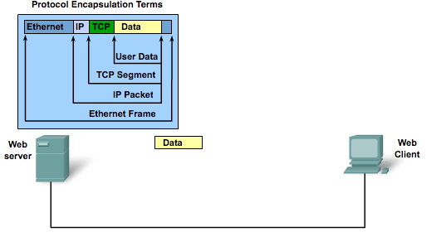
Protocol Encapsulation

Slide 20
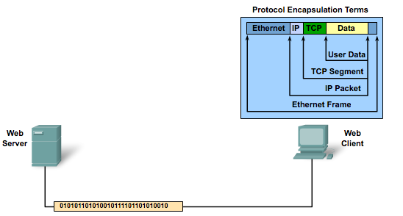
Protocol De-encapsulation

Slide 21


MAC and IP Addresses
R1
192.168.1.1
11-11-11-11-11-11
ARP
Request
S1
PC1
192.168.1.110
AA-AA-AA-AA-AA-AA
R1
PC2
192.168.1.111
BB-BB-BB-BB-BB-BB
FTP Server
192.168.1.9
CC-CC-CC-CC-CC-CC

Slide 22
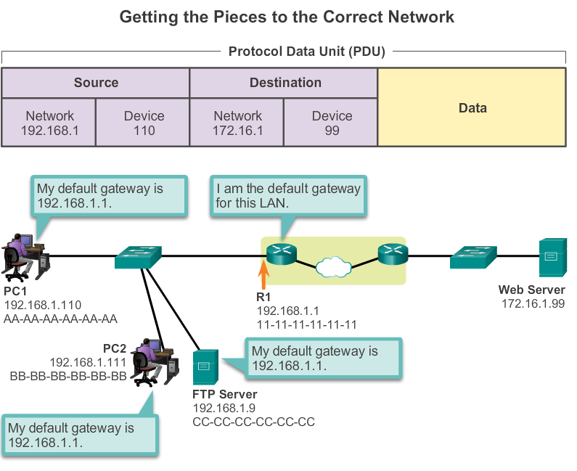
Default Gateway

Slide 23
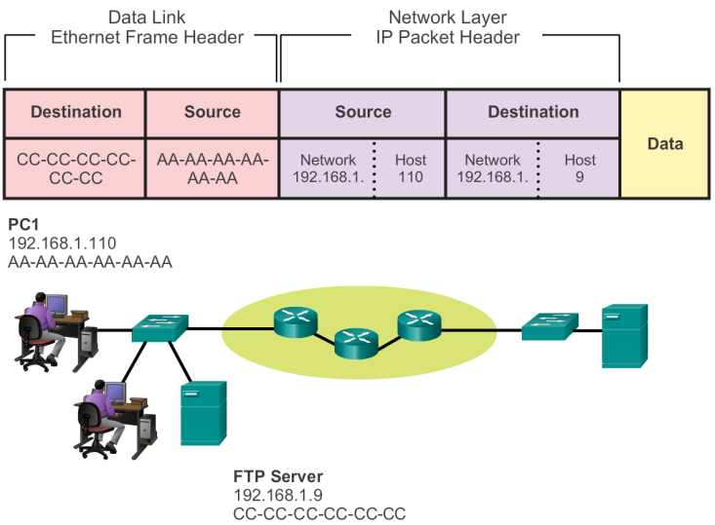

Communicating with Device / Same Network

Slide 24
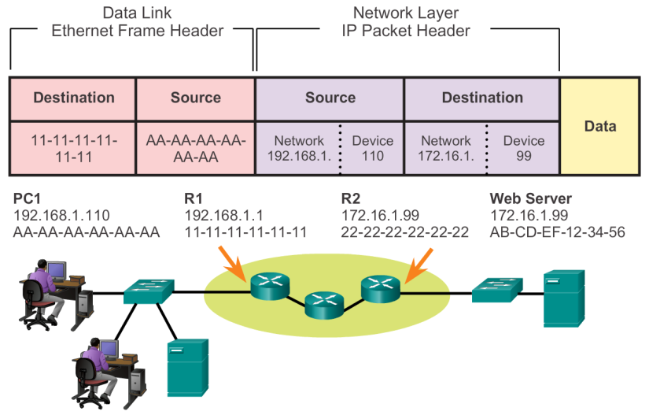
Communicating Device / Remote Network

Slide 25
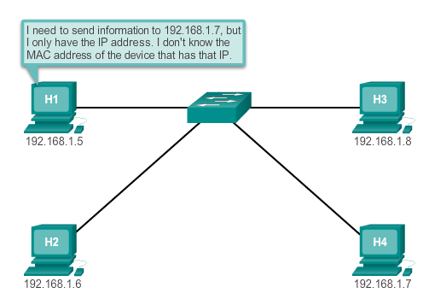
Address Resolution Protocol (ARP)

Slide 26
ARP Operation
ARP Table
Maps data link layer address to destination IPv4 address.
As a node receives frames from the media, it records the source IP and MAC address as a mapping in the ARP table.
ARP Request
Layer 2 broadcast to all devices on the Ethernet LAN.
The node that matches the IP address in the broadcast will reply.
If no device responds to the ARP request, the packet is dropped because a frame cannot be created.

Slide 27
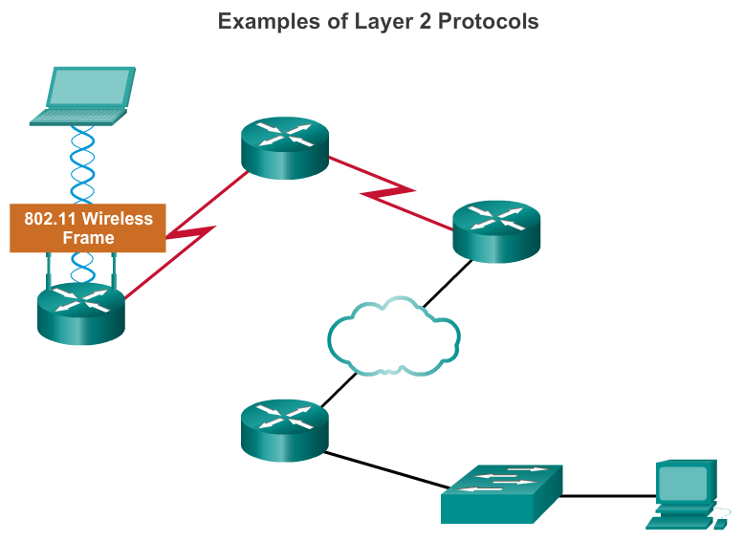
LAN and WAN Frames
Notes:
4.4.4.5 LAN and WAN Frames

Slide 28
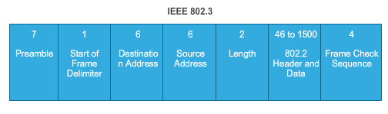
Ethernet Frame format
Preamble and Start Frame Delimiter Fields –
Used for synchronization between the sending and receiving devices.
Length/Type Field –
Defines the exact length of the frame's data field; describes which protocol is implemented.
Data and Pad Fields –
Contains the encapsulated data from a higher layer, an IPv4 packet.

Slide 29
The Network Layer
The network layer, or OSI Layer 3, provides services to allow end devices to exchange data across the network. To accomplish this end-to-end transport, the network layer uses four basic processes:
Addressing end devices
Encapsulation
Routing
De-encapsulating
Notes:
6.1.1.1 The Network Layer

Slide 30
Network Layer Protocols
IP version 4 (IPv4)
IP version 6 (IPv6)
Notes:
6.1.1.2 Network Layer Protocols

Slide 31
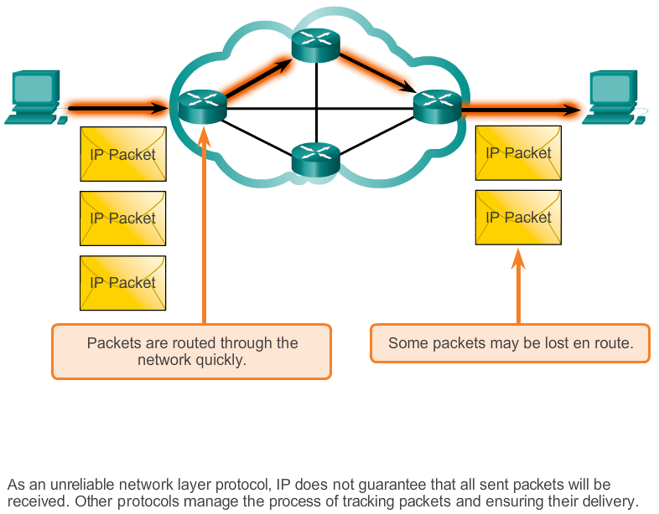
Best Effort Delivery

Slide 32
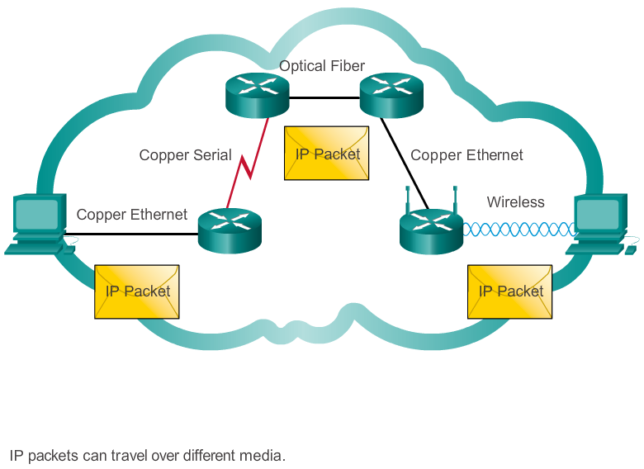
IP – Media Independent

Slide 33
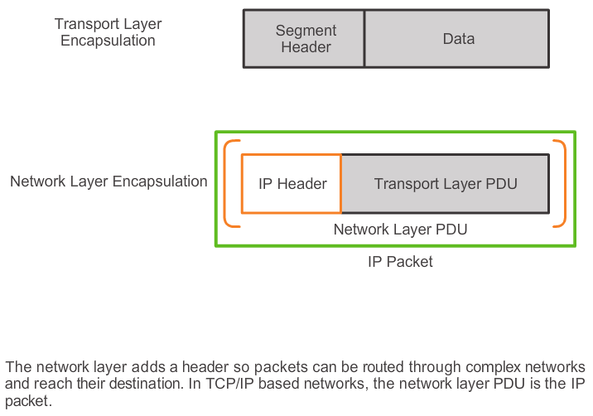
Encapsulating IP

Slide 34
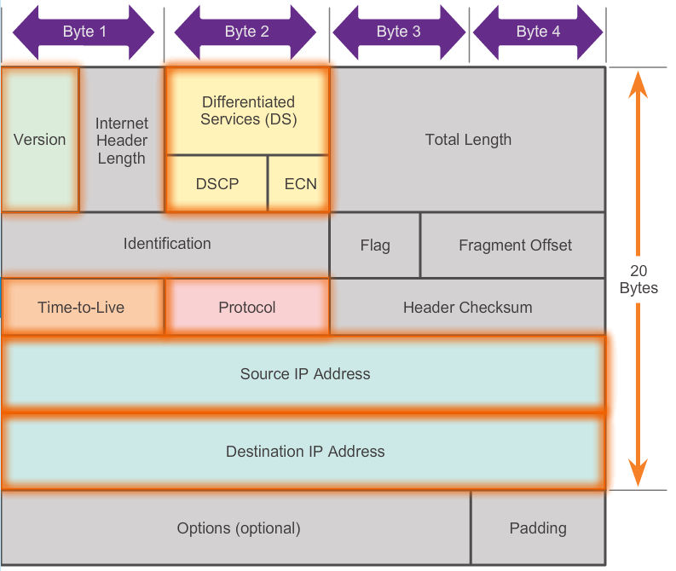
IPv4 Packet Header

Slide 35
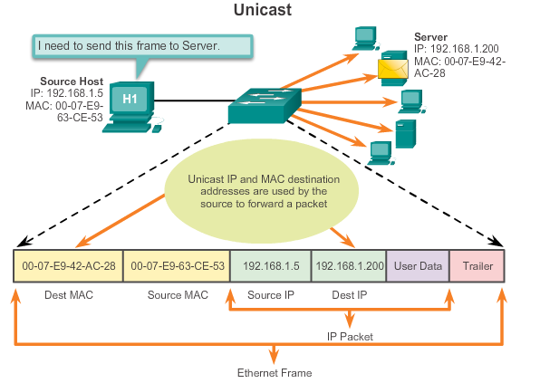
Unicast Address

Slide 36
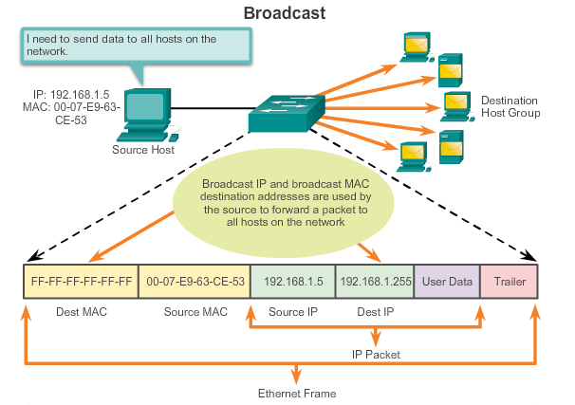
Broadcast Address

Slide 37
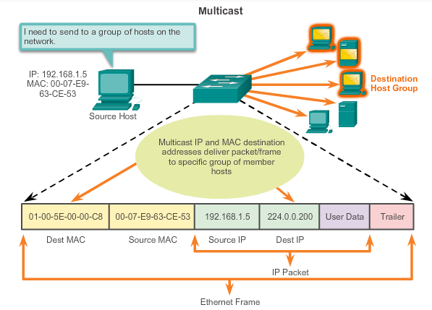
Multicast Address
Multicast MAC address is a special value that begins with 01-00-5E in hexadecimal
Range of IPV4 multicast addresses is 224.0.0.0 to 239.255.255.255

Slide 38
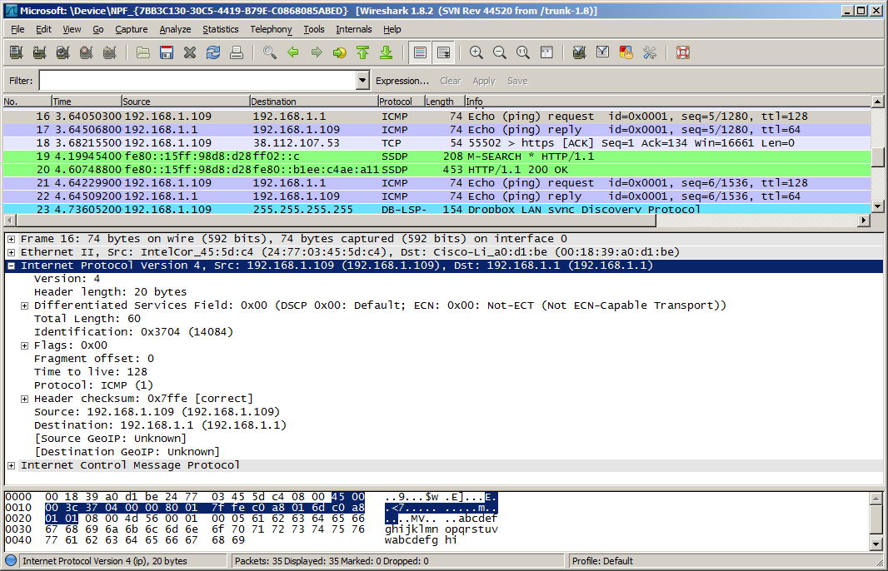
Sample IPv4 Headers in Wireshark

Slide 39

Limitations of IPv4
IP Address depletion
Internet routing table expansion
Lack of end-to-end connectivity
Notes:
6.1.4.1 Limitations of IPv4

Slide 40
IPv6
Increased address space
Improved packet handling
Eliminates the need for NAT
Integrated security
4 billion IPv4 addresses 4,000,000,000
340 undecillion IPv6 addresses 340,000,000,000,000,000,000,000,000,000,000,000,000

Slide 41
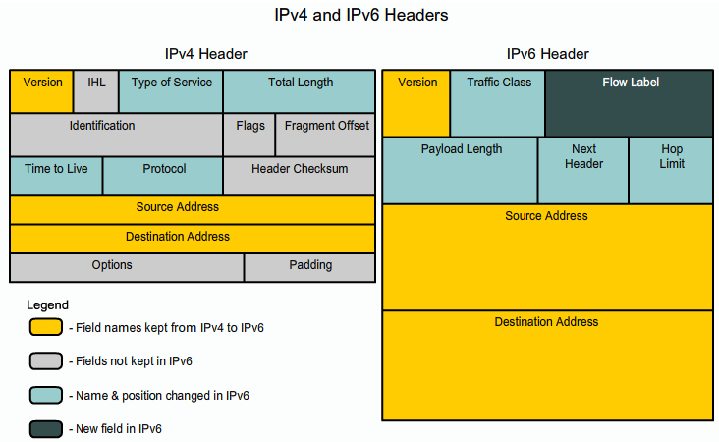
IPv4 and IPv6 Headers

Slide 42
IPv6 Packet Header
Byte 1
Byte 2
Byte 3
Byte 4
Version | Traffic Class |  | Flow Label
Payload Length |  |  |  | Next Header | Hop Limit
Source IP Address
Destination IP Address

