Slide 1
Introduction
Chapter 1

Slide 2
Uses of Computer Networks
Business Applications
Home Applications
Mobile Users
Social Issues
‹#›

Slide 3
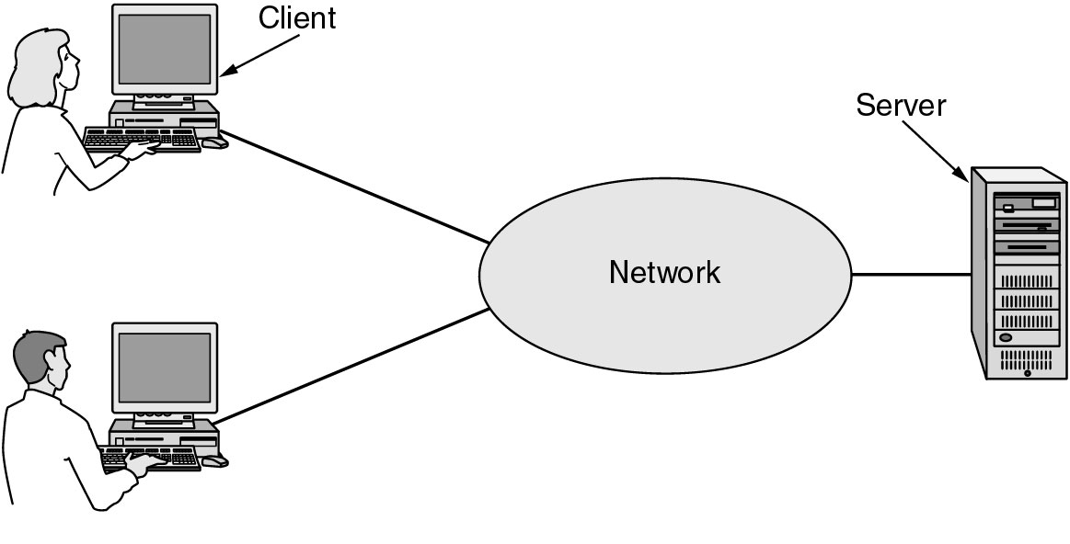
Business Applications of Networks
A network with two clients and one server.
‹#›

Slide 4
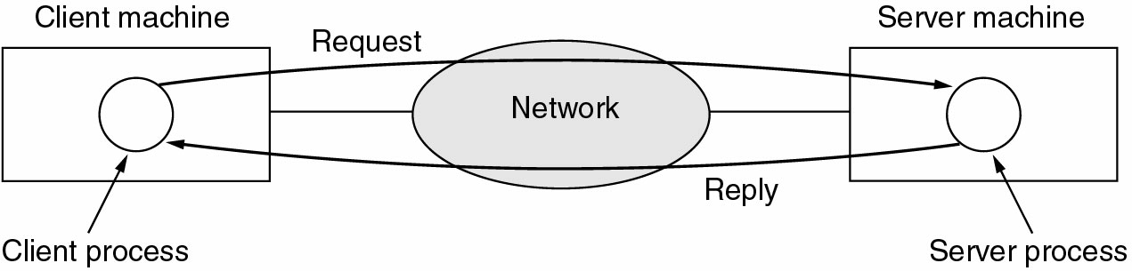
Business Applications of Networks (2)
The client-server model involves requests and replies.
‹#›

Slide 5
Home Network Applications
Access to remote information
Person-to-person communication
Interactive entertainment
Electronic commerce
‹#›

Slide 6
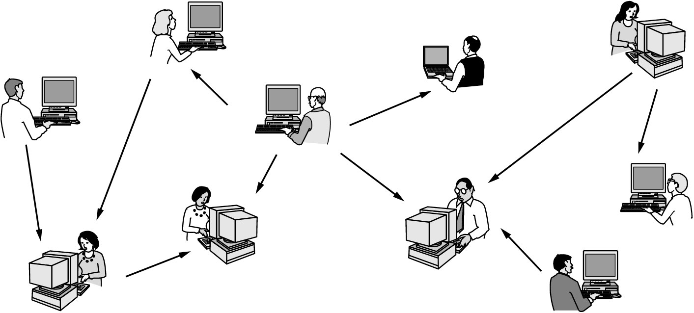
Home Network Applications (2)
In peer-to-peer system there are no fixed clients and servers.
‹#›

Slide 7
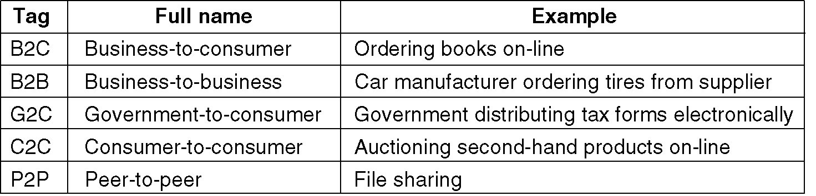
Home Network Applications (3)
Some forms of e-commerce.
‹#›

Slide 8
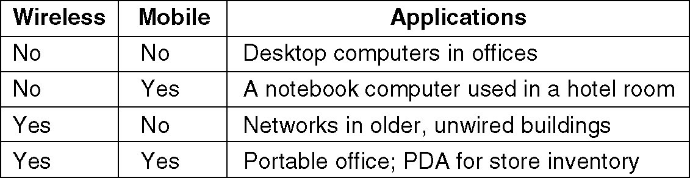
Mobile Network Users
Combinations of wireless networks and mobile computing.
‹#›

Slide 9
Network Hardware
Local Area Networks
Metropolitan Area Networks
Wide Area Networks
Wireless Networks
Home Networks
Internetworks
‹#›

Slide 10
Broadcast Networks
Types of transmission technology
Broadcast links
Point-to-point links
‹#›

Slide 11
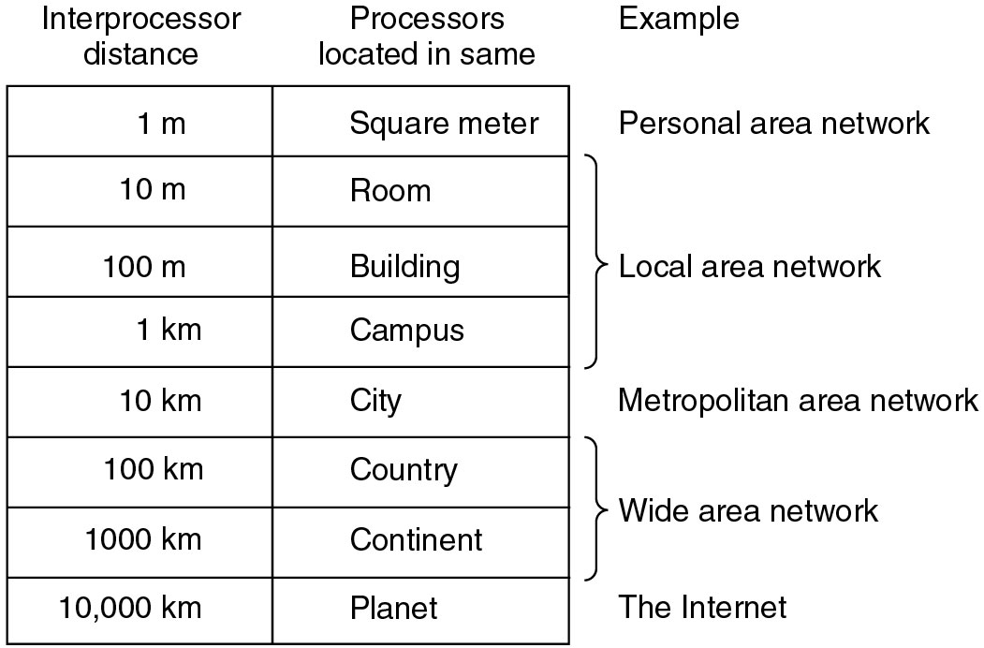
Broadcast Networks (2)
Classification of interconnected processors by scale.
‹#›

Slide 12
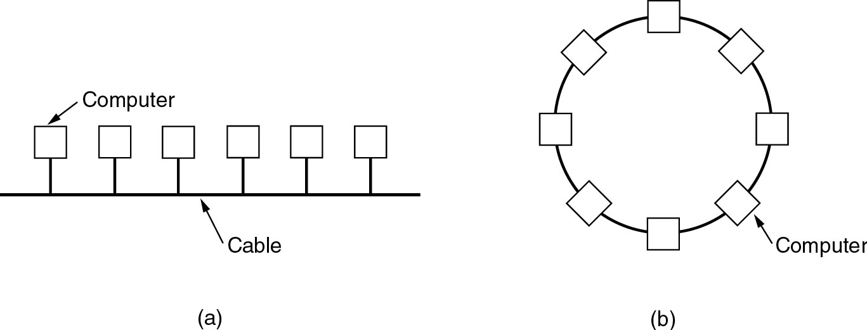
Local Area Networks
Two broadcast networks
(a) Bus
(b) Ring
‹#›

Slide 13
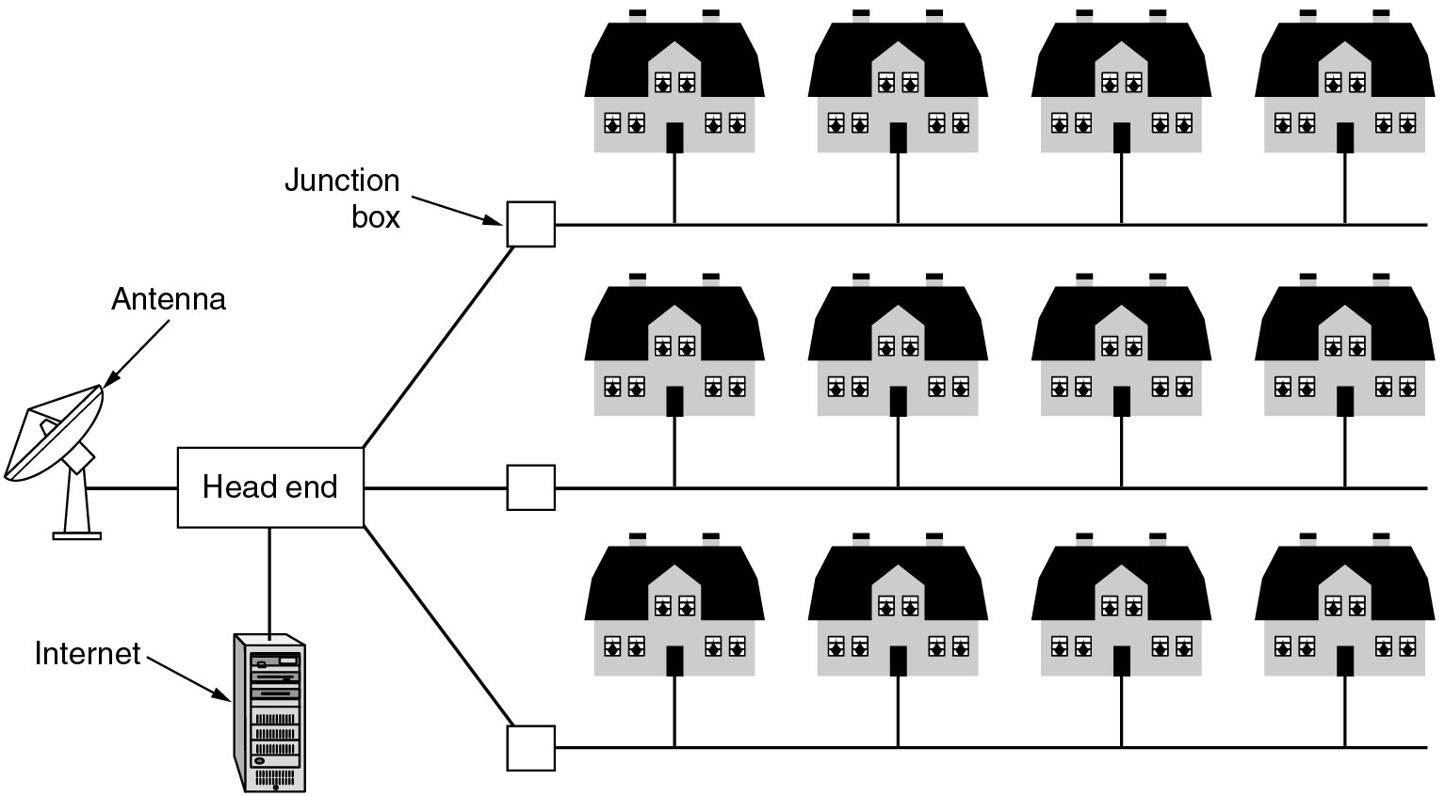
Metropolitan Area Networks
A metropolitan area network based on cable TV.
‹#›

Slide 14
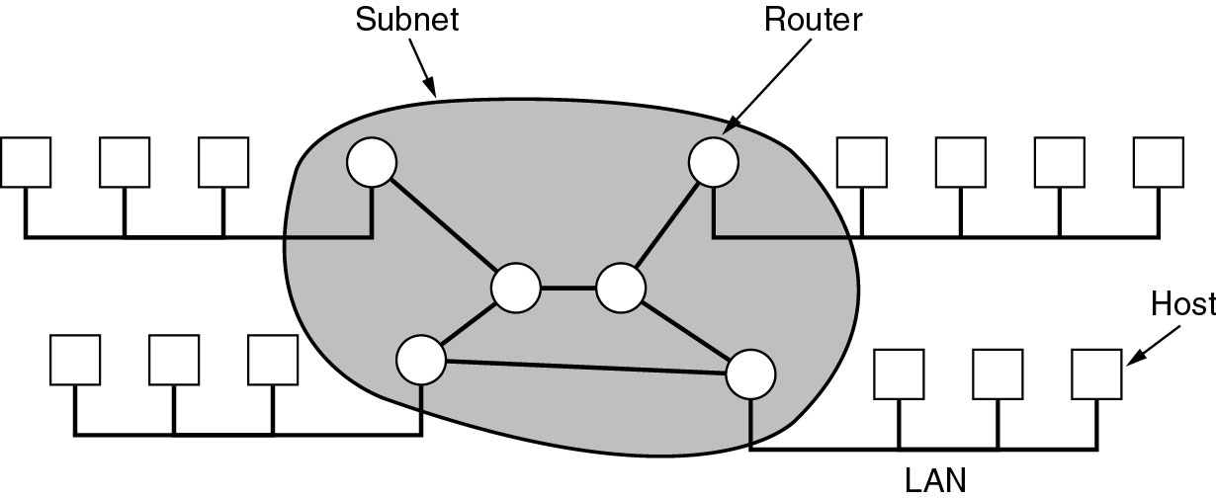
Wide Area Networks
Relation between hosts on LANs and the subnet.
‹#›

Slide 15
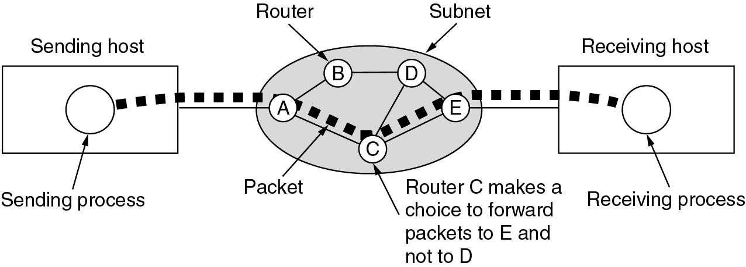
Wide Area Networks (2)
A stream of packets from sender to receiver.
‹#›

Slide 16
Wireless Networks
Categories of wireless networks:
System interconnection
Wireless LANs
Wireless WANs
‹#›

Slide 17
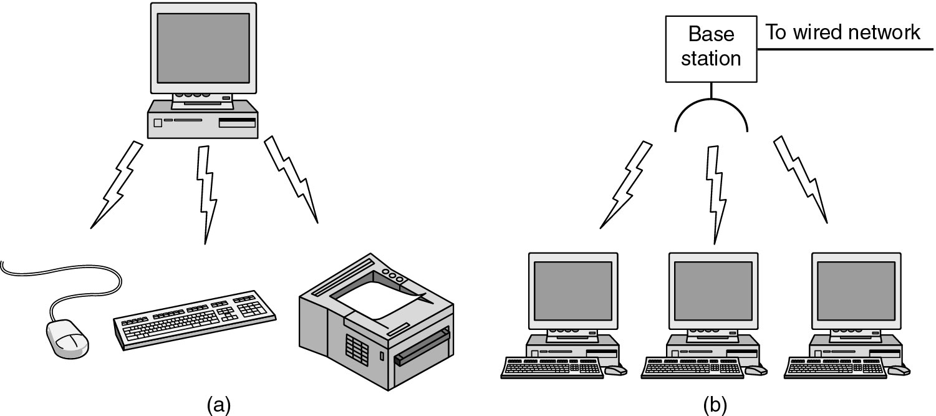
Wireless Networks (2)
(a) Bluetooth configuration
(b) Wireless LAN
‹#›

Slide 18
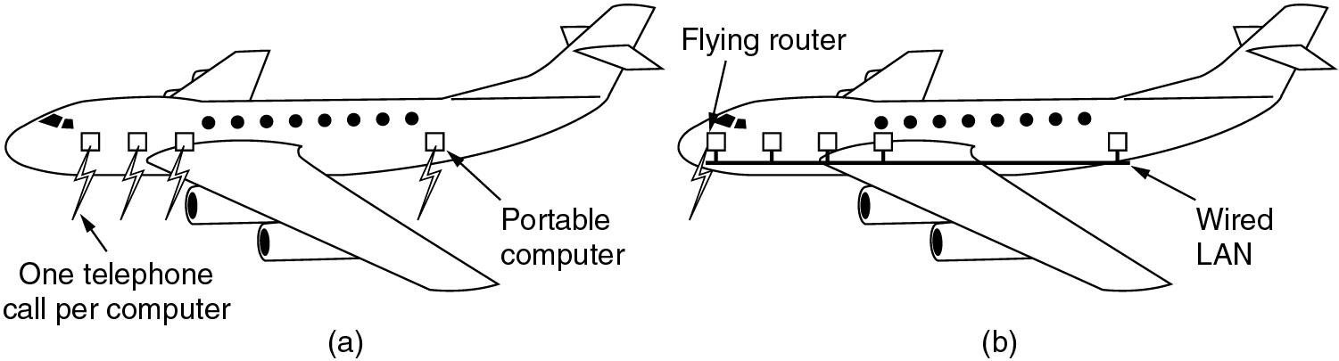
Wireless Networks (3)
(a) Individual mobile computers
(b) A flying LAN
‹#›

Slide 19
Home Network Categories
Computers (desktop PC, PDA, shared peripherals)
Entertainment (TV, DVD, VCR, camera, stereo, MP3)
Telecomm (telephone, cell phone, intercom, fax)
Appliances (microwave, fridge, clock, furnace, airco)
Telemetry (utility meter, burglar alarm, babycam)
‹#›

Slide 20
Network Software
Protocol Hierarchies
Design Issues for the Layers
Connection-Oriented and Connectionless Services
Service Primitives
The Relationship of Services to Protocols
‹#›

Slide 21
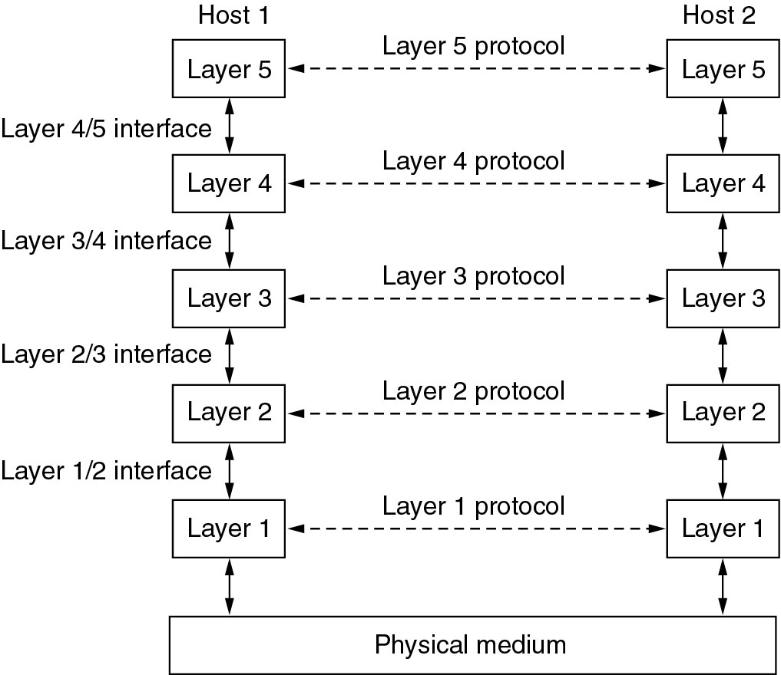
Network Software Protocol Hierarchies
Layers, protocols, and interfaces.
‹#›

Slide 22
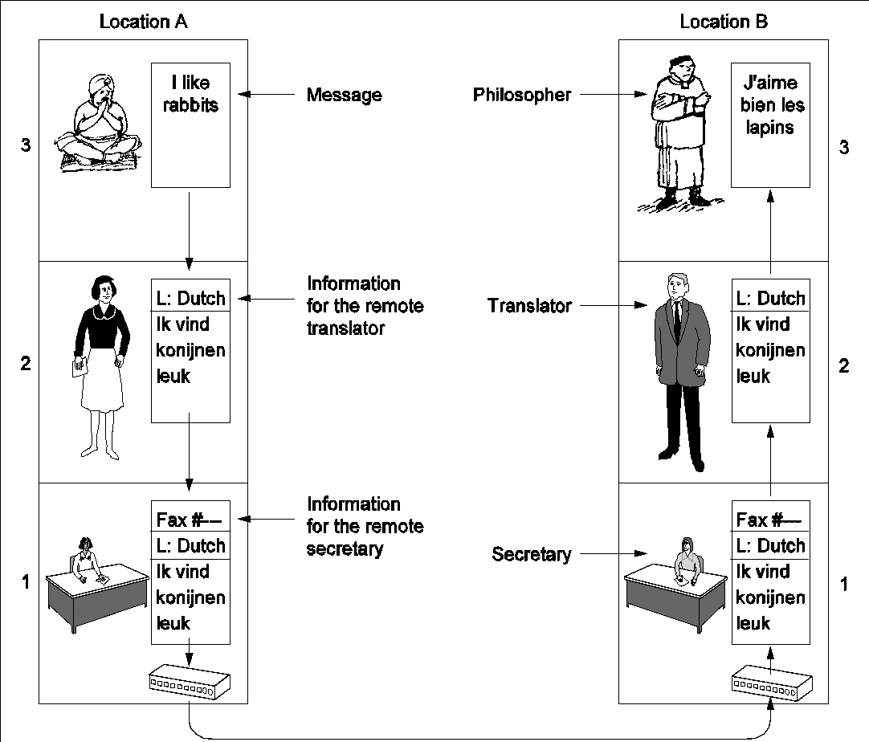
Protocol Hierarchies (2)
The philosopher-translator-secretary architecture.
‹#›

Slide 23
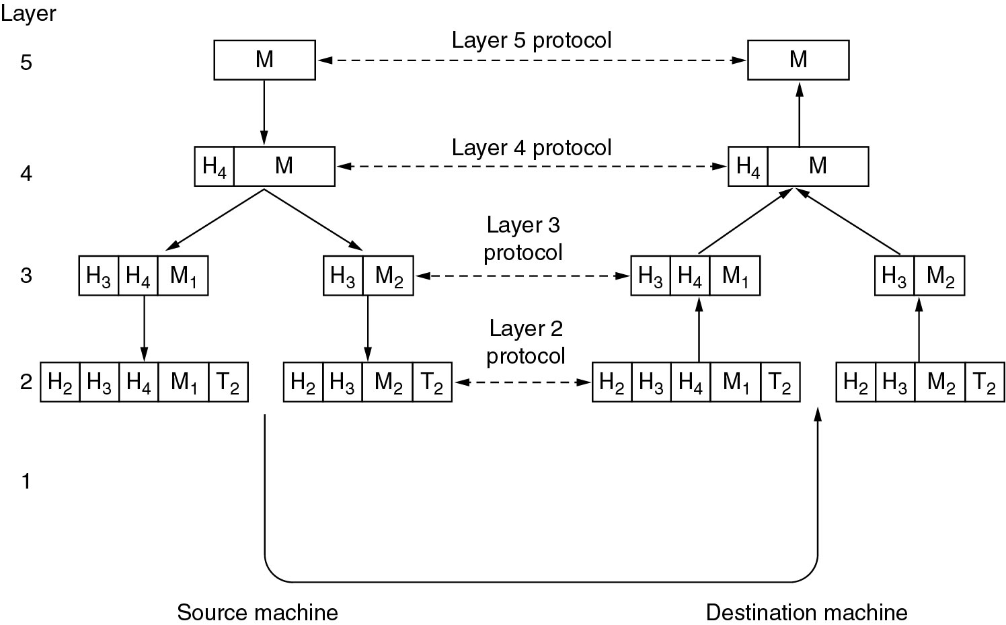
Protocol Hierarchies (3)
Example information flow supporting virtual communication in layer 5.
‹#›

Slide 24
Design Issues for the Layers
Addressing
Error Control
Flow Control
Multiplexing
Routing
‹#›

Slide 25
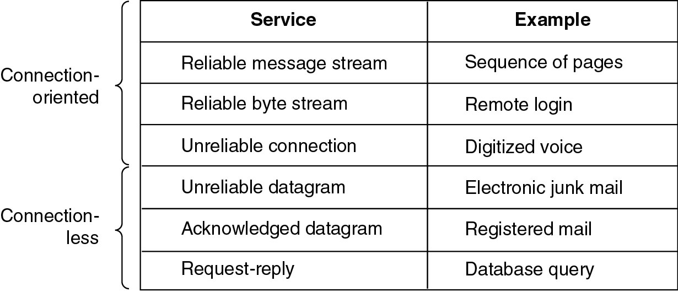
Connection-Oriented and Connectionless Services
Six different types of service.
‹#›

Slide 26
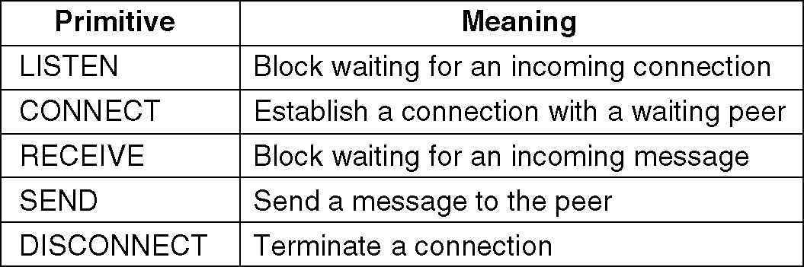
Service Primitives
Five service primitives for implementing a simple connection-oriented service.
‹#›

Slide 27
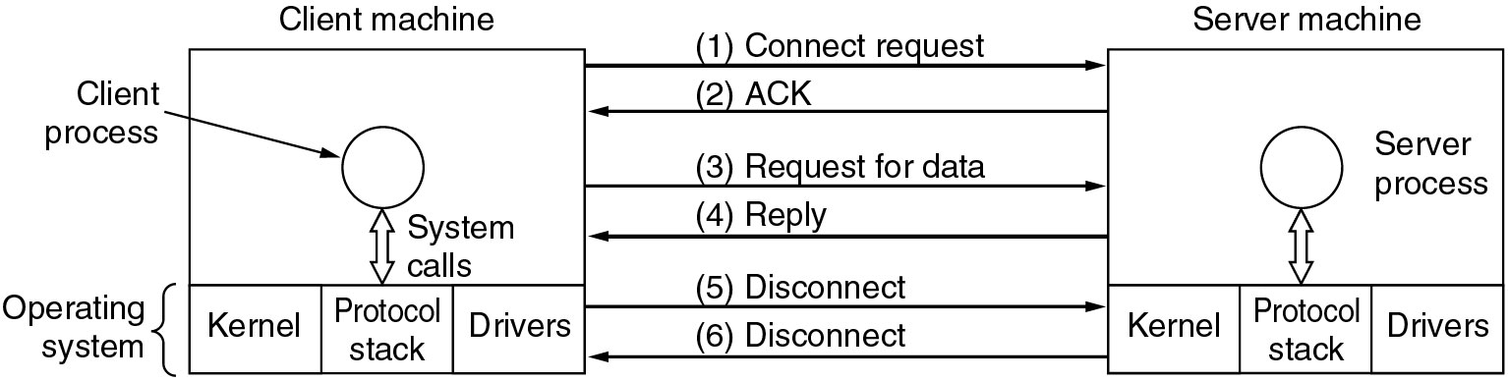
Service Primitives (2)
Packets sent in a simple client-server interaction on a connection-oriented network.
‹#›

Slide 28
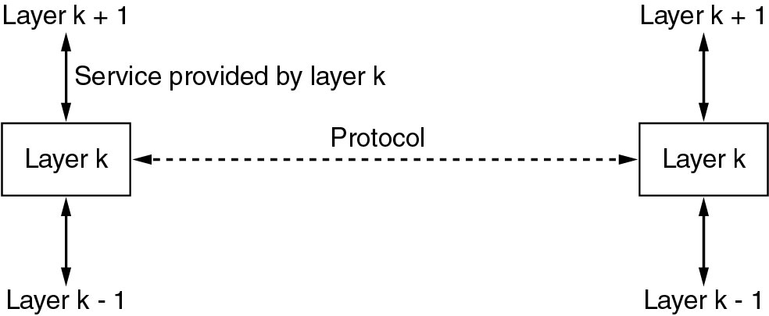
Services to Protocols Relationship
The relationship between a service and a protocol.
‹#›

Slide 29
Reference Models
The OSI Reference Model
The TCP/IP Reference Model
A Comparison of OSI and TCP/IP
A Critique of the OSI Model and Protocols
A Critique of the TCP/IP Reference Model
‹#›

Slide 30
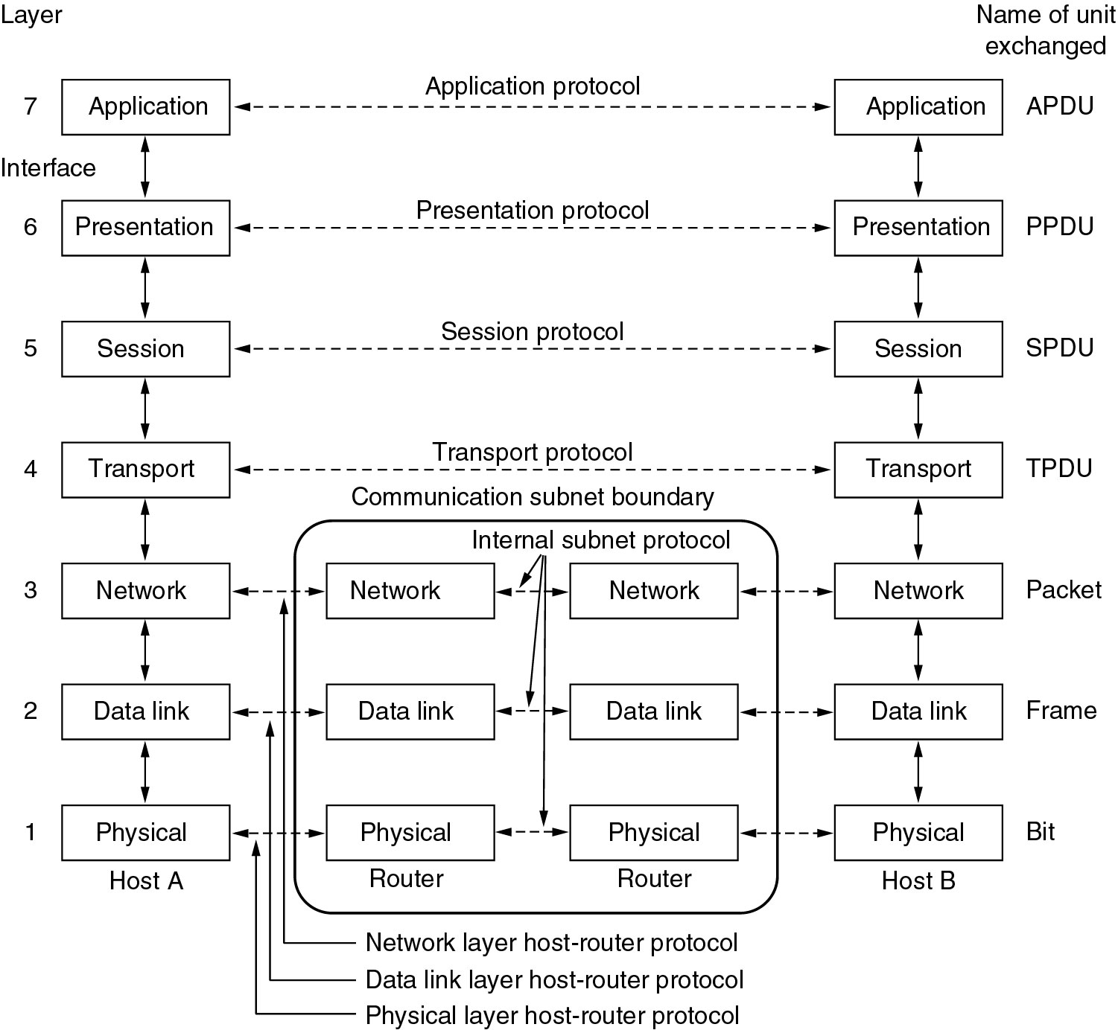
Reference Models
The OSI reference model.
‹#›

Slide 31
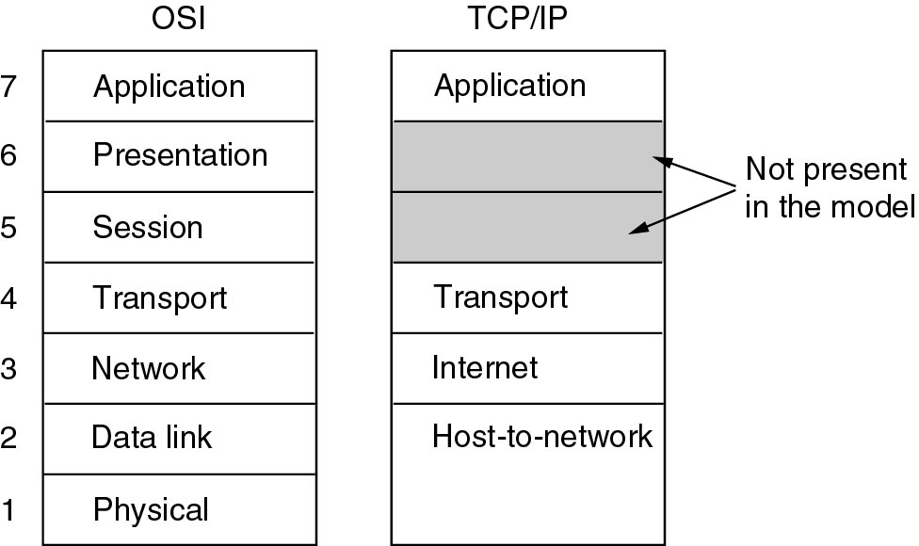
Reference Models (2)
The TCP/IP reference model.
‹#›

Slide 32
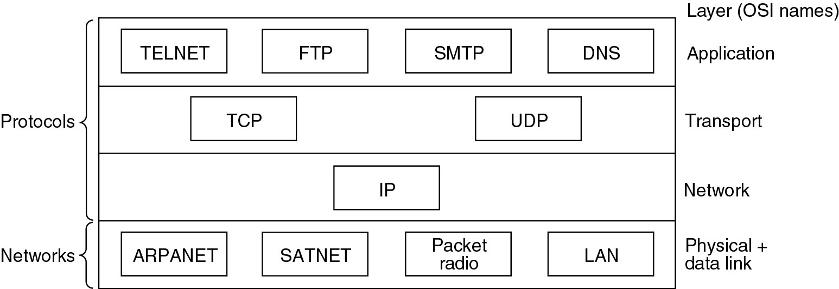
Reference Models (3)
Protocols and networks in the TCP/IP model initially.
‹#›

Slide 33
Comparing OSI and TCP/IP Models
Concepts central to the OSI model
Services
Interfaces
Protocols
‹#›

Slide 34
A Critique of the OSI Model and Protocols
Why OSI did not take over the world
Bad timing
Bad technology
Bad implementations
Bad politics
‹#›

Slide 35
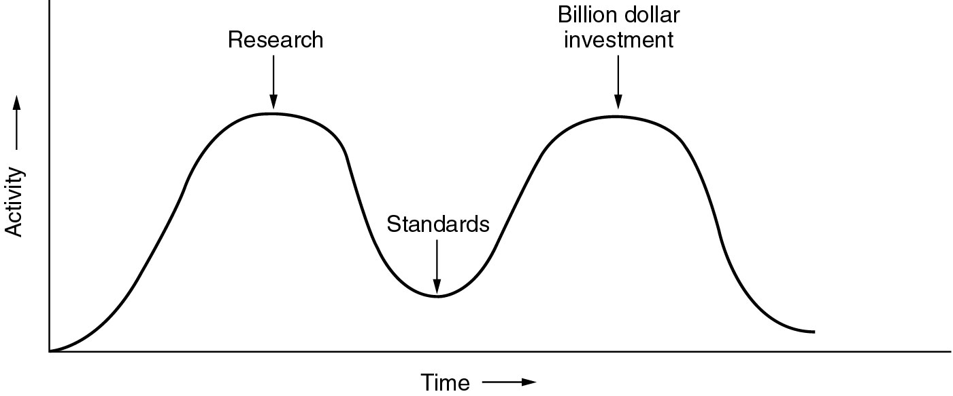
Bad Timing
The apocalypse of the two elephants.
‹#›

Slide 36
A Critique of the TCP/IP Reference Model
Problems:
Service, interface, and protocol not distinguished
Not a general model
Host-to-network “layer” not really a layer
No mention of physical and data link layers
Minor protocols deeply entrenched, hard to replace
‹#›

Slide 37
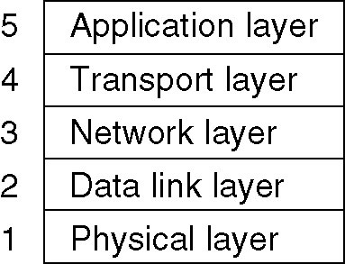
Hybrid Model
The hybrid reference model to be used in this book.
‹#›

Slide 38
Example Networks
The Internet
Connection-Oriented Networks: X.25, Frame Relay, and ATM
Ethernet
Wireless LANs: 802.11
‹#›

Slide 39
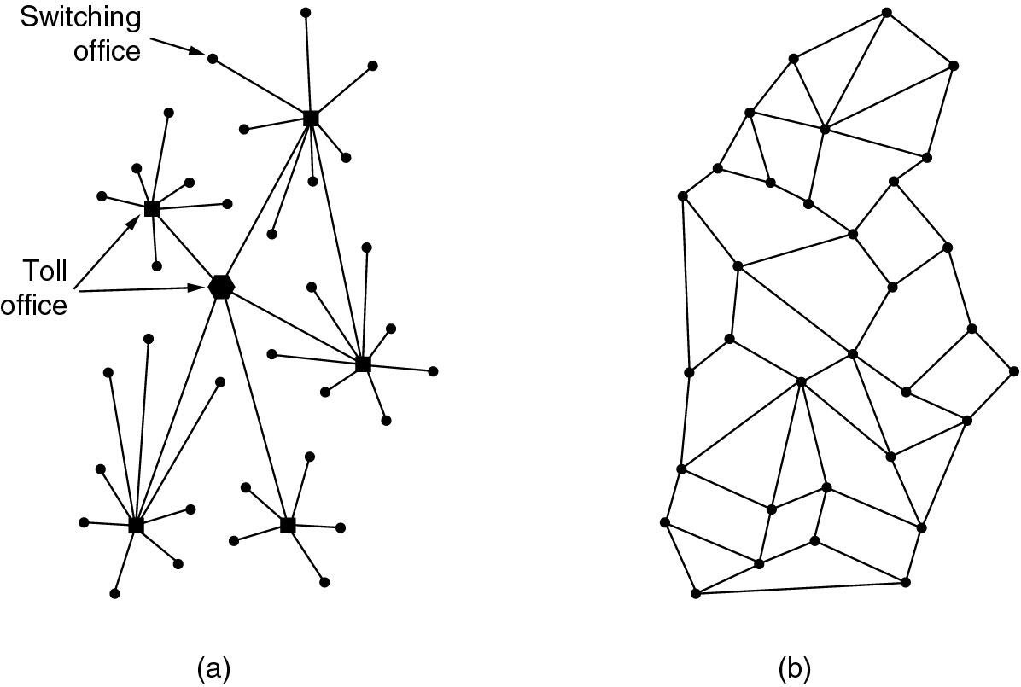
The ARPANET
(a) Structure of the telephone system.
(b) Baran’s proposed distributed switching system.
‹#›

Slide 40
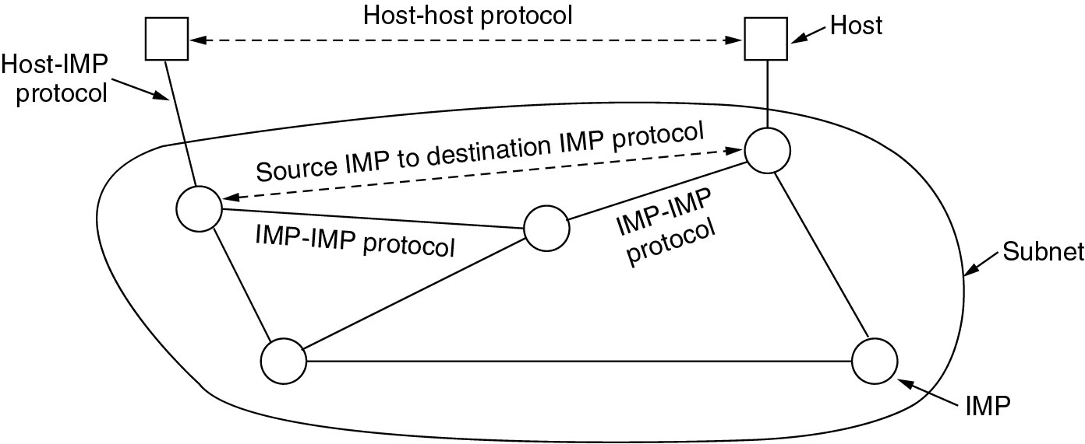
The ARPANET (2)
The original ARPANET design.
‹#›

Slide 41
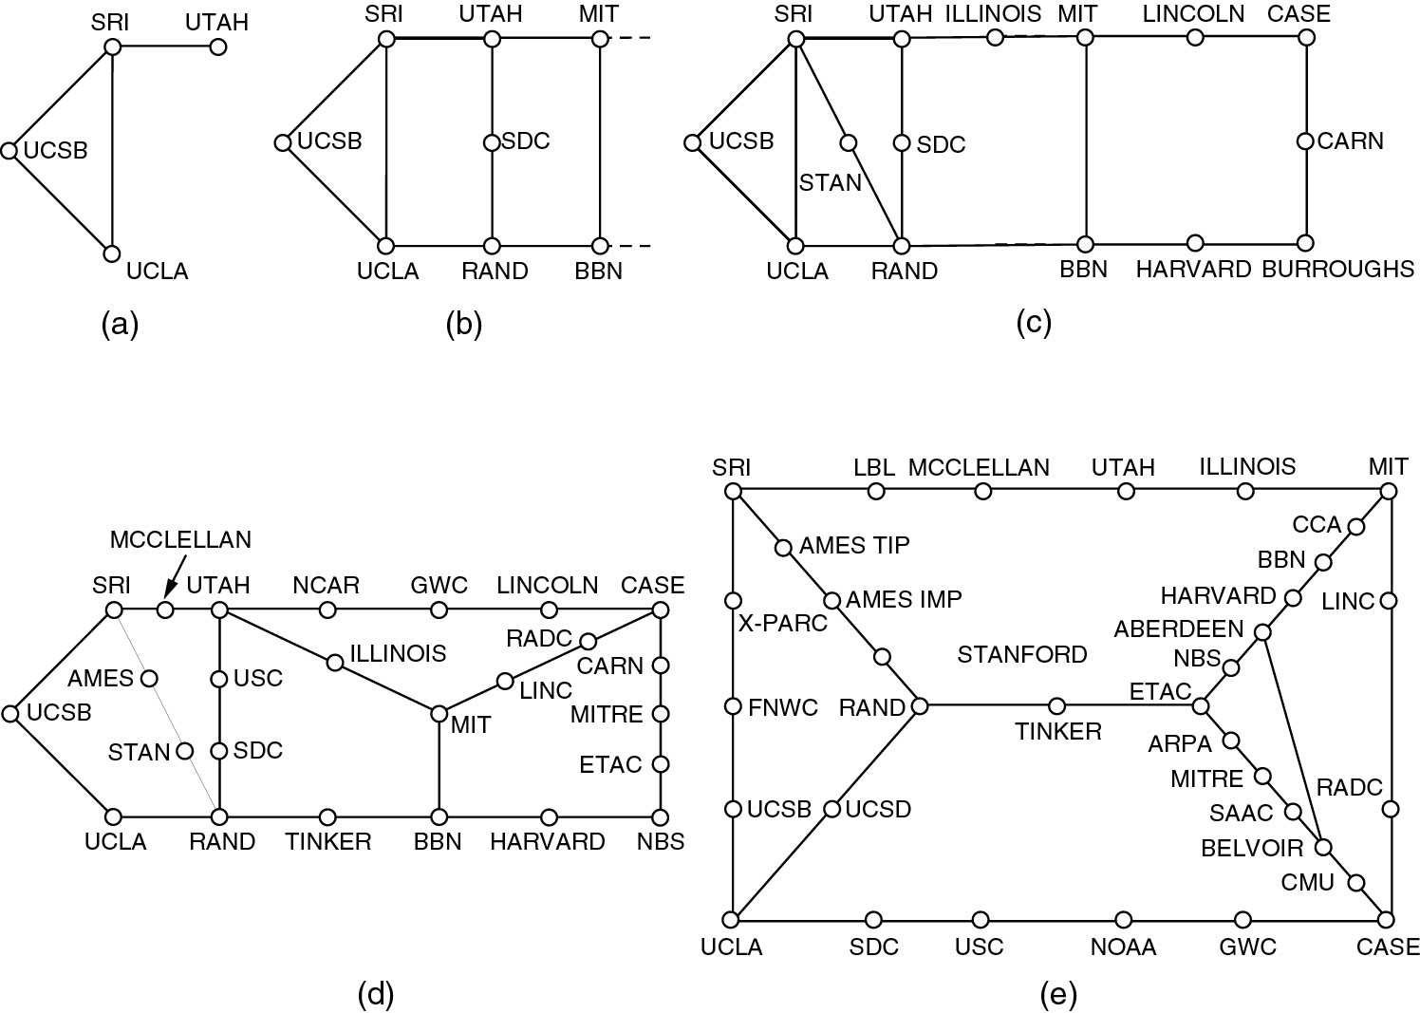
The ARPANET (3)
Growth of the ARPANET (a) December 1969. (b) July 1970.
(c) March 1971. (d) April 1972. (e) September 1972.
‹#›

Slide 42
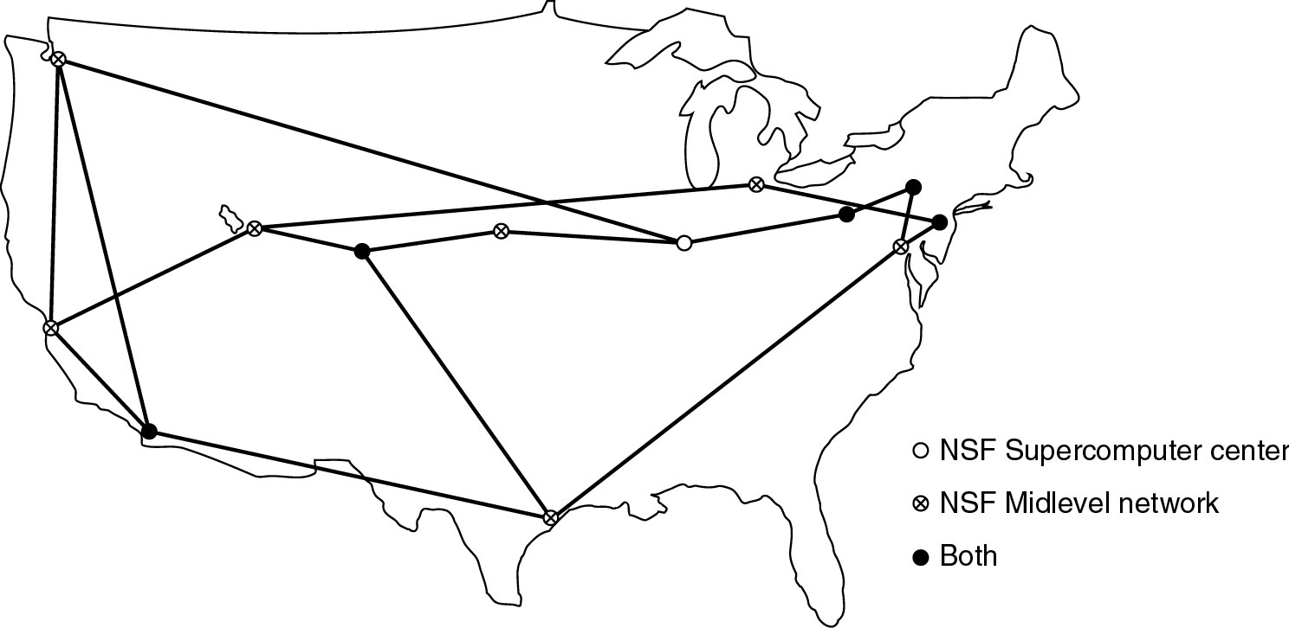
NSFNET
The NSFNET backbone in 1988.
‹#›

Slide 43
Internet Usage
Traditional applications (1970 – 1990)
E-mail
News
Remote login
File transfer
‹#›

Slide 44
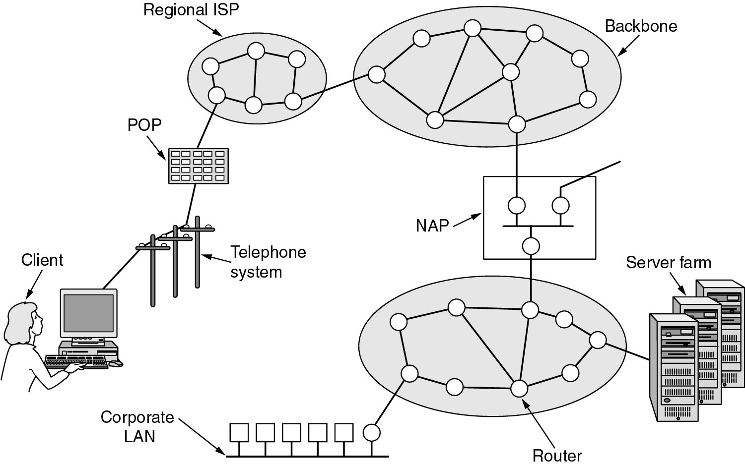
Architecture of the Internet
Overview of the Internet.
‹#›

Slide 45
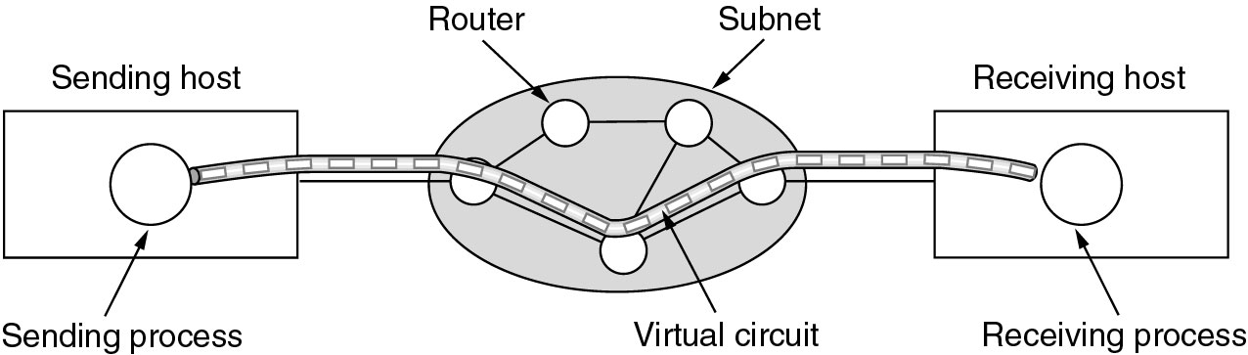
ATM Virtual Circuits
A virtual circuit.
‹#›

Slide 46
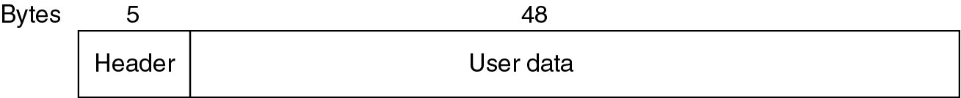
ATM Virtual Circuits (2)
An ATM cell.
‹#›

Slide 47
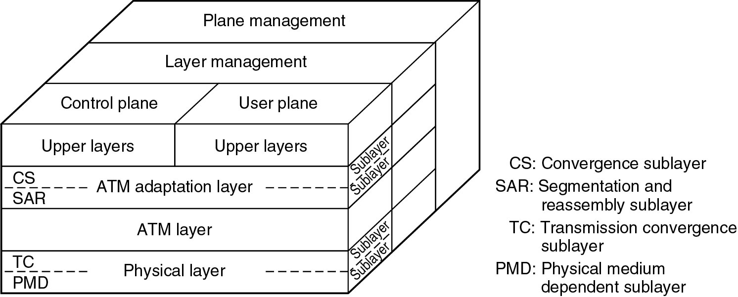
The ATM Reference Model
The ATM reference model.
‹#›

Slide 48
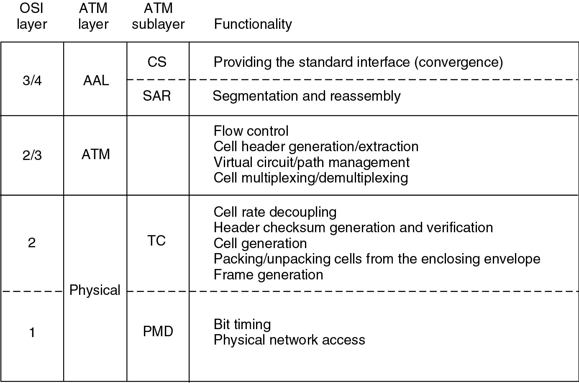
The ATM Reference Model (2)
The ATM layers and sublayers and their functions.
‹#›

Slide 49
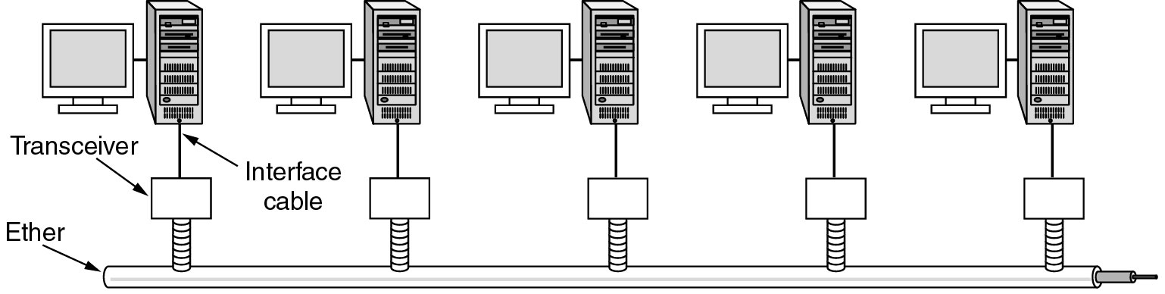
Ethernet
Architecture of the original Ethernet.
‹#›

Slide 50
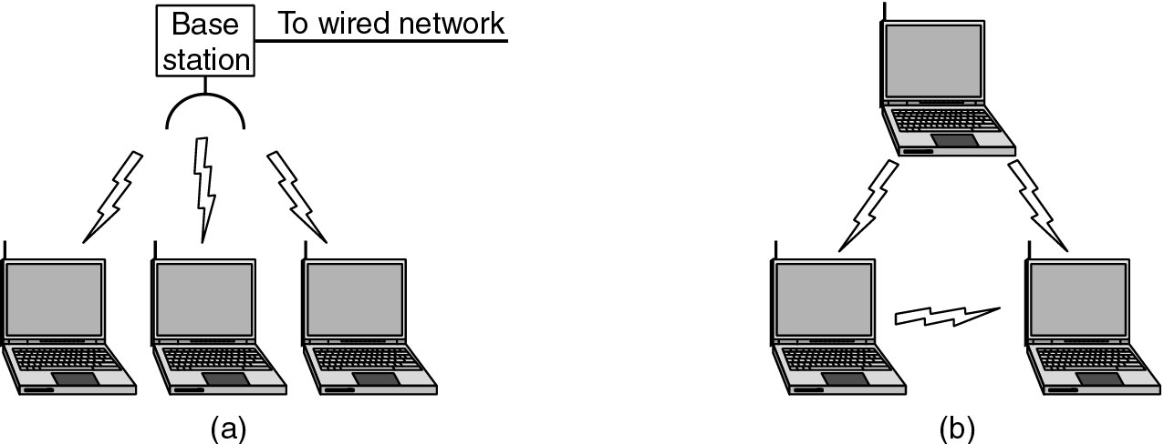
Wireless LANs
(a) Wireless networking with a base station.
(b) Ad hoc networking.
‹#›

Slide 51
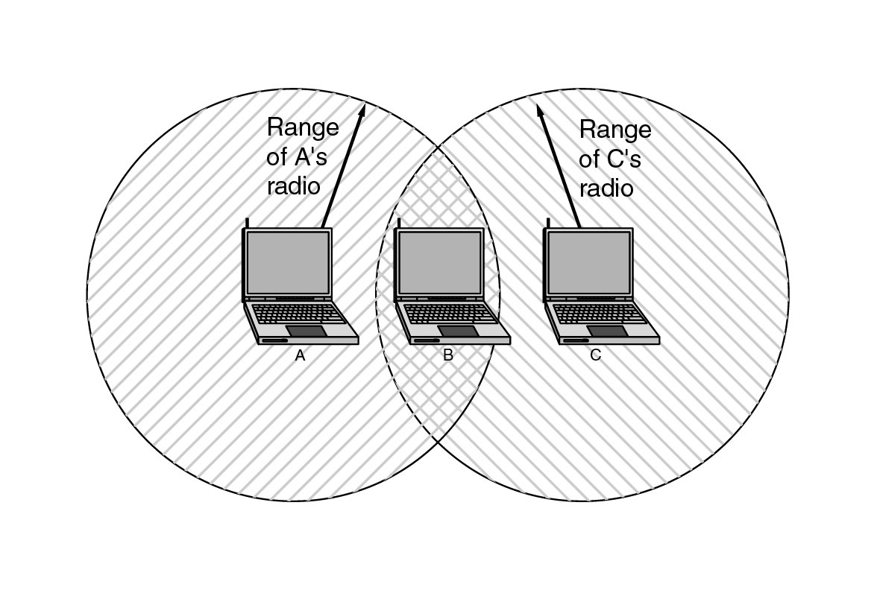
Wireless LANs (2)
The range of a single radio may not cover the entire system.
‹#›

Slide 52
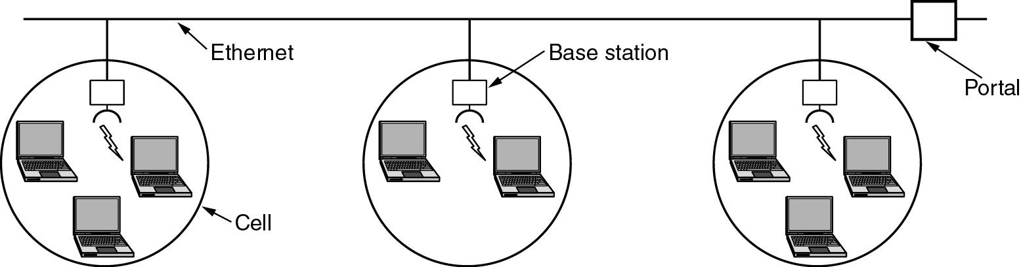
Wireless LANs (3)
A multicell 802.11 network.
‹#›

Slide 53
Network Standardization
Who’s Who in the Telecommunications World
Who’s Who in the International Standards World
Who’s Who in the Internet Standards World
‹#›

Slide 54
ITU
Main sectors
Radiocommunications
Telecommunications Standardization
Development
Classes of Members
National governments
Sector members
Associate members
Regulatory agencies
‹#›

Slide 55
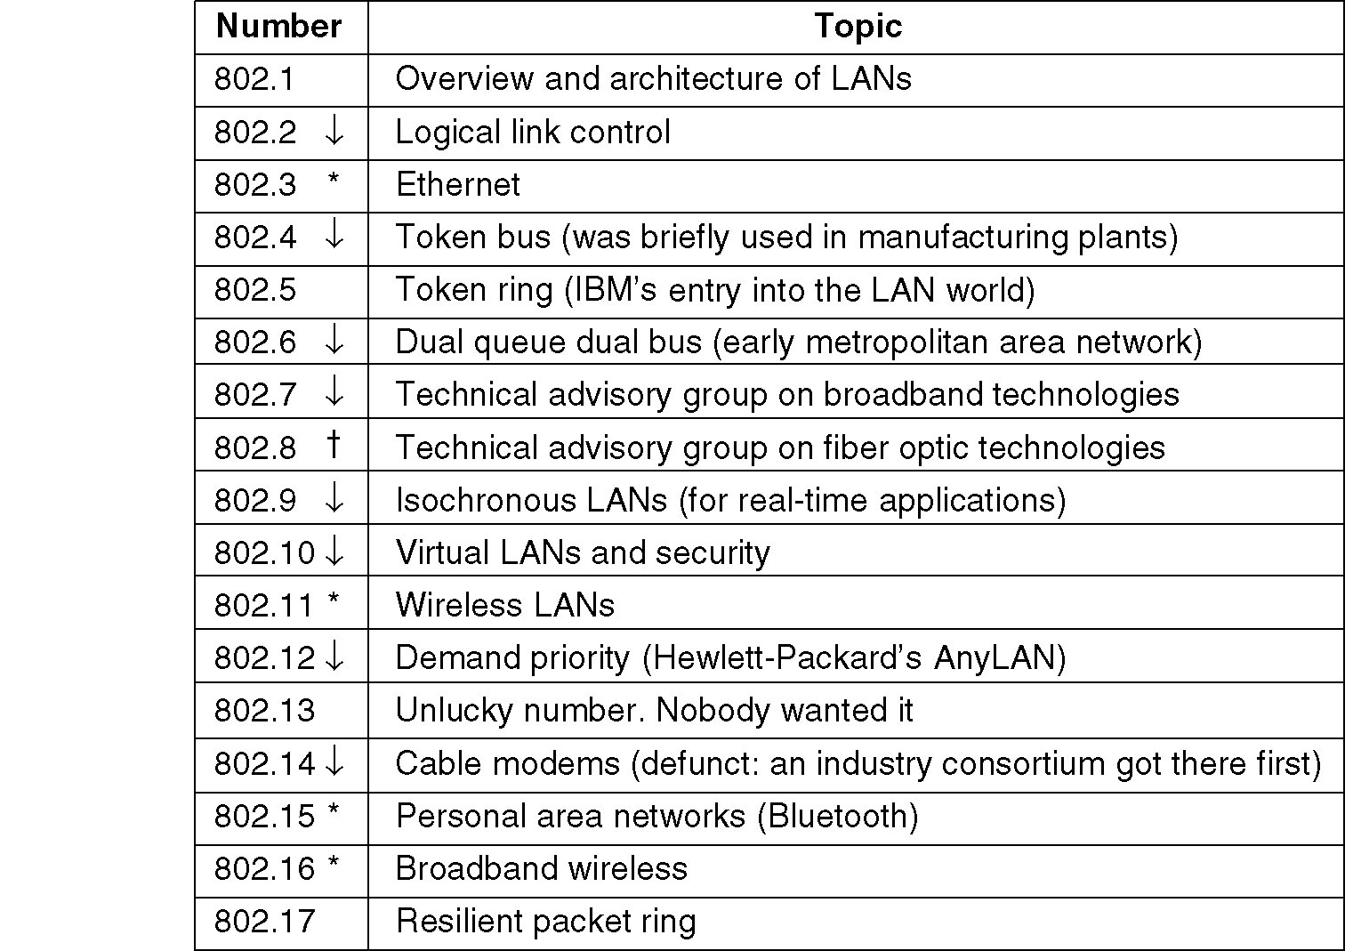
IEEE 802 Standards
The 802 working groups. The important ones are marked with *. The ones marked with 🡫 are hibernating. The one marked with † gave up.
‹#›

Slide 56
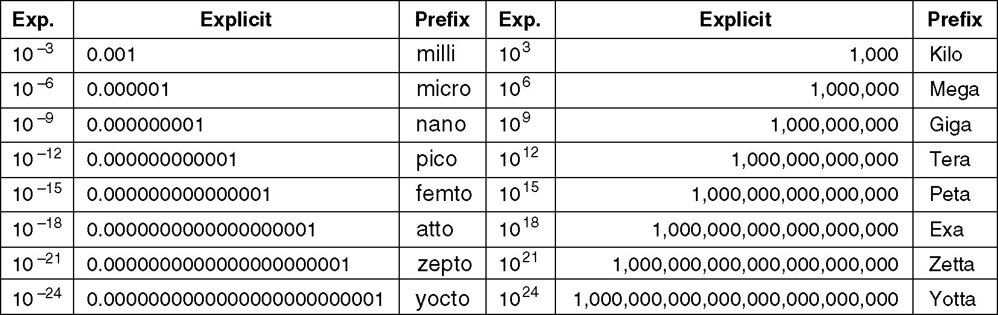
Metric Units
The principal metric prefixes.
‹#›
Notes:
‹#›

