Slide 1
Usability
The effectiveness with which users can accomplish tasks in a (software) system, as measured by
Learnability: is it easy to learn?
Efficiency: once learned, is it fast to use?
Safety: are errors few and recoverable?

Slide 2

Relative importance of usability dimensions
Depends on the user
Novices need learnability.
Experts need efficiency.
But no user is uniformly a novice or an expert.
Depends on the task
Missile launchers need safety.
Video streaming needs efficiency.

Slide 3

Usability matters: the cost of getting it wrong
50% of all “malfunctioning” electronic devices returned to stores are in full working order, but users can't figure out how to operate them.
[Elke den Ouden, 2006]
Three Mile Island: nuclear reactor meltdown caused by an ambiguous user interface

Slide 4
A good user interface is hard to design …
You are not the user
Most software engineering is about communicating with other programmers.
UI is about communicating with users.
Users are always right …
Consistent problems are the system’s fault.
Except when they aren’t
Users don’t always know what they want.
UI accounts for 50% of
• design, implementation, and maintenance time
• lines of code

Slide 5
Achieving usability: best practices
User testing and field studies
Evaluations and reviews by UI experts
Prototyping
Cheap, throw-away implementations
Low-fidelity: paper prototypes
Medium-fidelity: code prototypes
Key to success: good UI focuses on the user, not the developer or the system.

Slide 6
What is prototyping? Why do it?
Prototyping: creating a scaled-down or incomplete version of a system to demonstrate or test its aspects.
Benefits of prototyping:
aids UI design
help discover requirements
help discover test cases and provide a basis for testing
allows interaction with user to ensure satisfaction
team-building

Slide 7
Some prototyping methods
Code prototyping
implement a "quick" / incomplete version of a UI
Prototyping with UI builders (e.g., Visual Studio)
draw a GUI by dragging/dropping UI controls on screen
Paper prototyping
a paper version of a UI

Slide 8
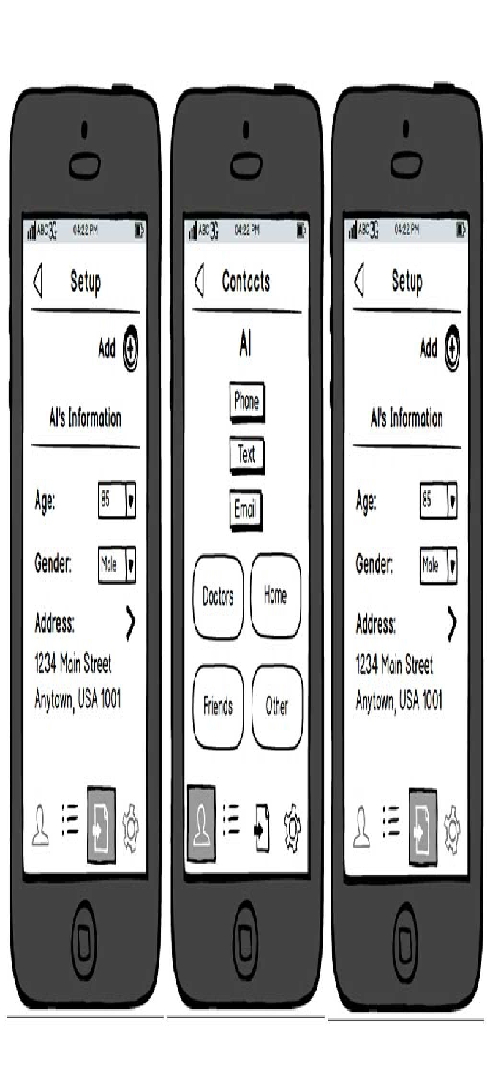
Why paper prototyping?
Much faster to create and change than code
More visual bandwidth (can see more at once)
More conducive to working in teams
Can be done by non-technical people
Feels less permanent or final

Slide 9
When to do prototyping?
During or after requirements but before design
helps uncover requirements and upcoming design issues
shows us what is in the UI, but also shows us details of how the user can achieve goals in the UI

Slide 10
UI Design Considerations

Slide 11


Schneiderman's 8 Golden Rules

Slide 12
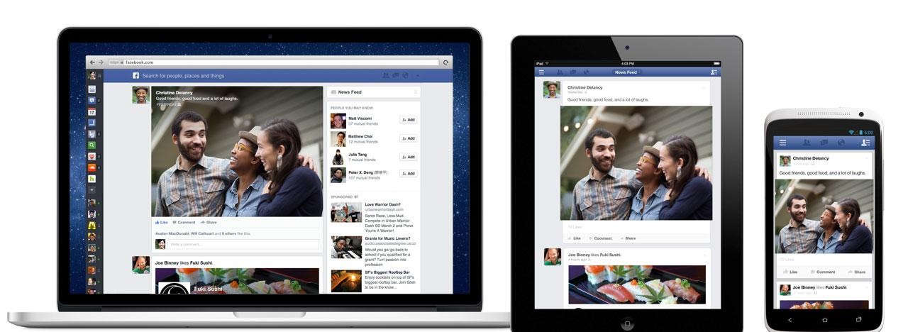
Rule 1: Strive for consistency.
Consistent sequences of actions should be required in similar situations; identical terminology should be used in prompts, menus, and help screens; and consistent commands should be employed throughout.

Slide 13
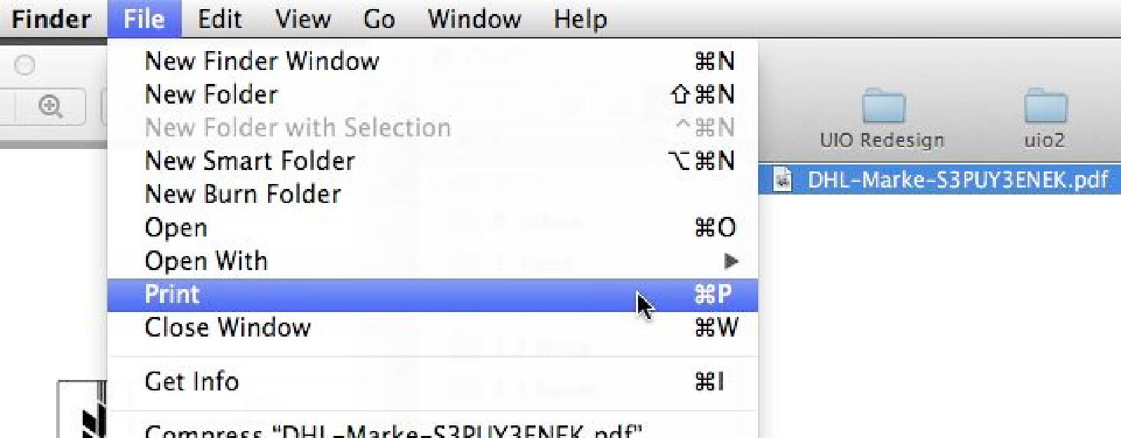
Rule2: Enable frequent users to use shortcuts
As the frequency of use increases, so do the user's desires to reduce the number of interactions and to increase the pace of interaction. Abbreviations, function keys, hidden commands, and macro facilities are very helpful to an expert user.

Slide 14
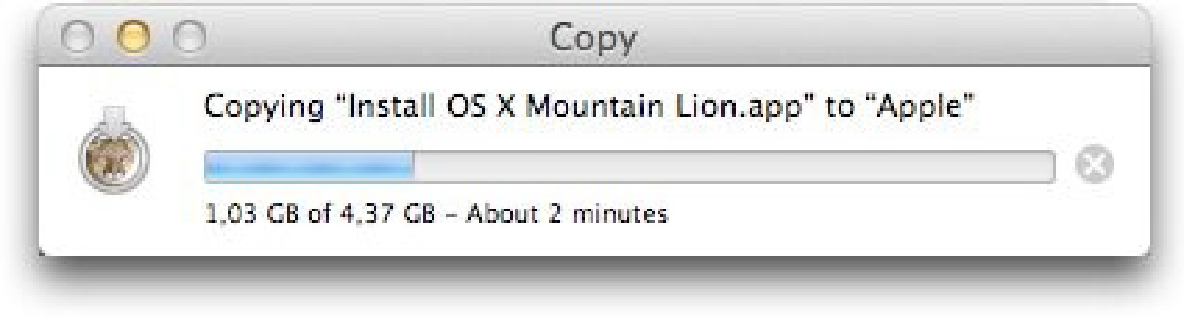
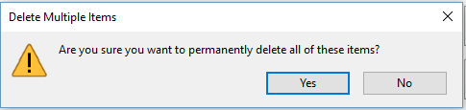
Rule 3: Offer informative feedback
For every operator action, there should be some system feedback. For frequent and minor actions, the response can be modest, while for infrequent and major actions, the response should be more substantial.

Slide 15
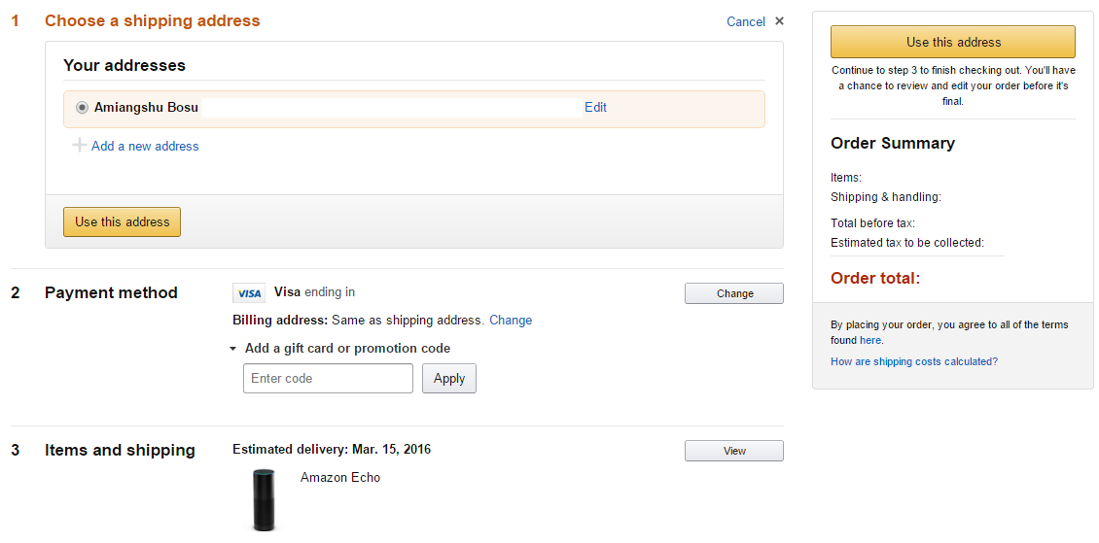
Rule 4: Design dialog to yield closure
Sequences of actions should be organized into groups with a beginning, middle, and end. The informative feedback at the completion of a group of actions gives the operators the satisfaction of accomplishment, a sense of relief, the signal to drop contingency plans and options from their minds, and an indication that the way is clear to prepare for the next group of actions.

Slide 16
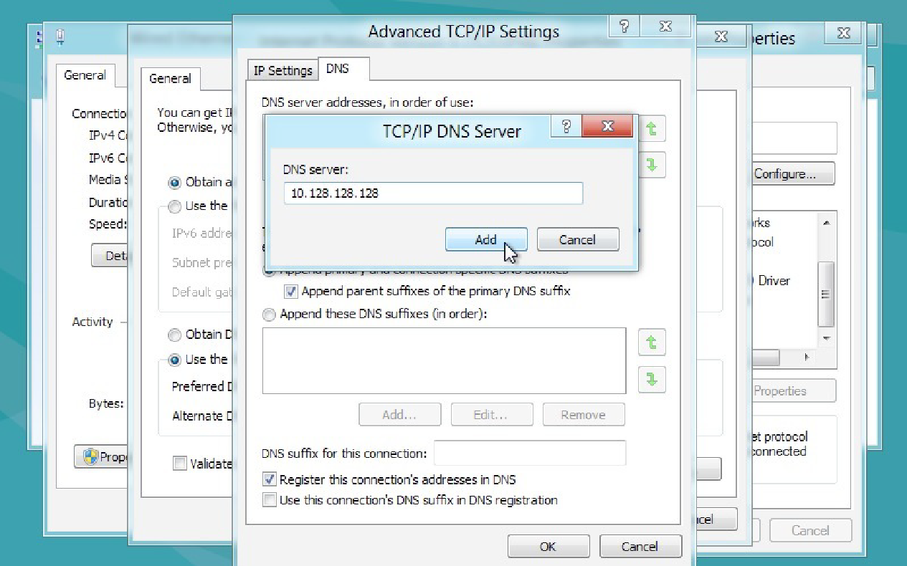
Rule 4: Design dialog to yield closure

Slide 17
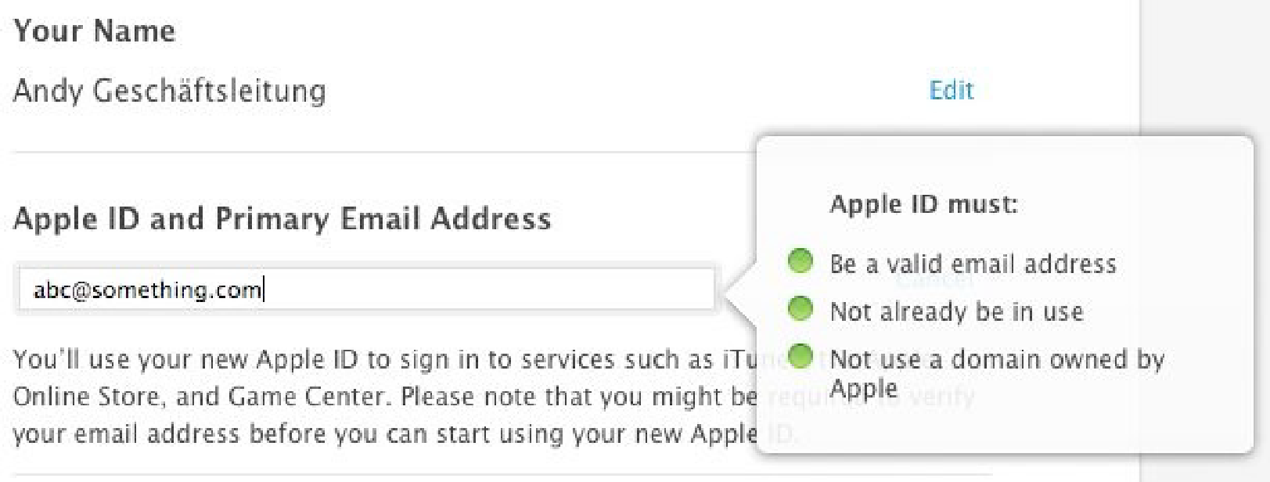
Rule 5: Offer simple error handling
As much as possible, design the system so the user cannot make a serious error. If an error is made, the system should be able to detect the error and offer simple, comprehensible mechanisms for handling the error.

Slide 18
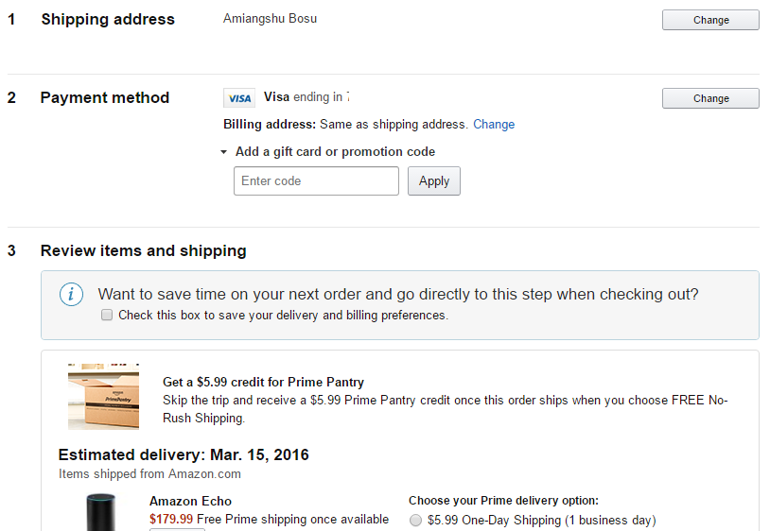
Rule 6: Permit easy reversal of actions
This feature relieves anxiety, since the user knows that errors can be undone; it thus encourages exploration of unfamiliar options. The units of reversibility may be a single action, a data entry, or a complete group of actions.

Slide 19
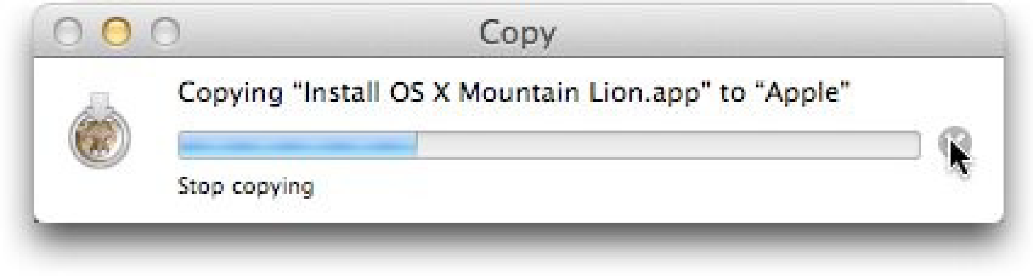
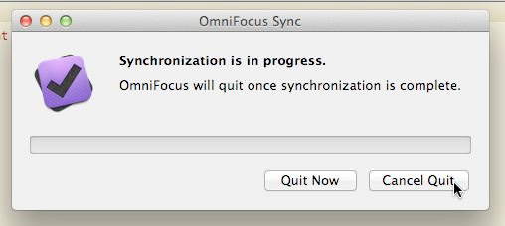
Rule 7: Let the user be in control.
Experienced operators strongly desire the sense that they are in charge of the system and that the system responds to their actions. Design the system to make users the initiators of actions rather than the responders.

Slide 20
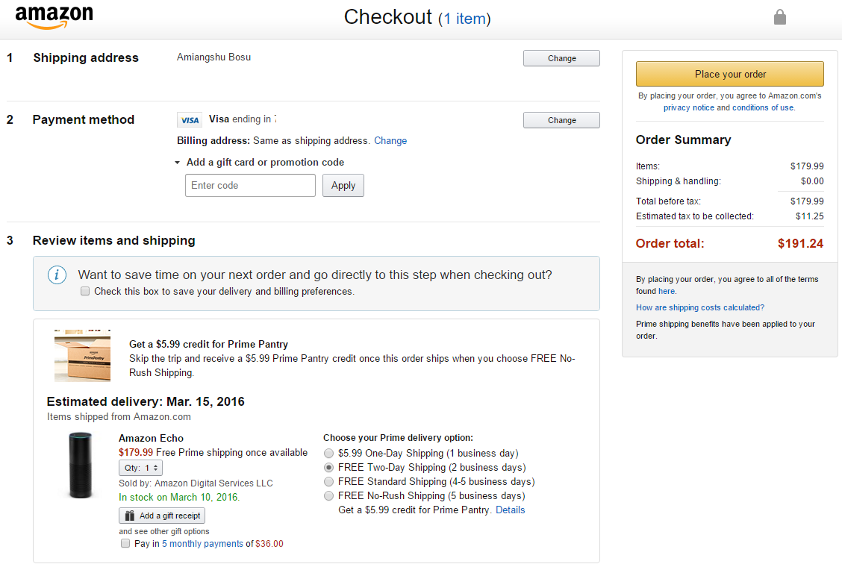
Rule 8: Reduce short-term memory load on the user.
The limitation of human information processing in short-term memory requires that displays be kept simple, multiple page displays be consolidated, window-motion frequency be reduced, and sufficient training time be allotted for codes, mnemonics, and sequences of actions.

Slide 21
UI Design components

Slide 22
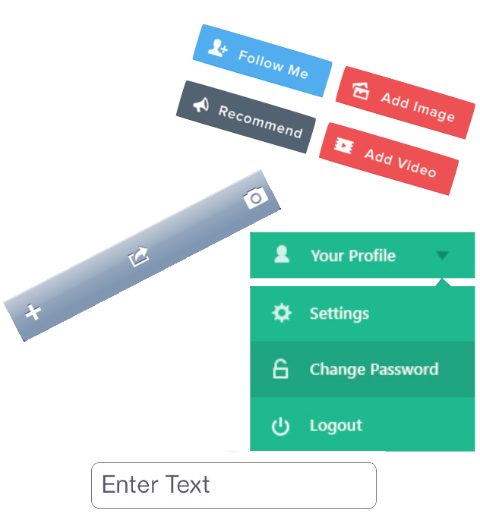
When to use?
a button?
a check box?
a radio button?
a text field?
a list?
a combo box?
a menu?
a dialog box?

Slide 23
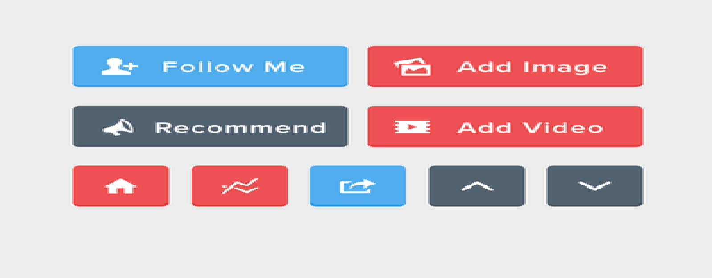

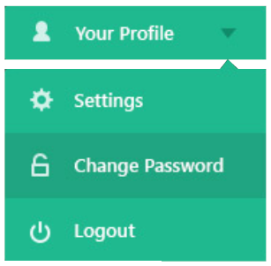
UI design: buttons, toolbars, menus
Use buttons for single independent actions that are relevant to the current screen.
Use button text with verb phrases such as "Save“ or "Cancel", not generic: "OK", "Yes", "No"
Use Mnemonics or Accelerators (Ctrl-S)
Use toolbars for common actions.
Use menus for infrequent actions that may be applicable to many or all screens.
Users hate menus! Try not to rely too much on menus. Provide another way to access the same functionality (toolbar, hotkey, etc.)

Slide 24
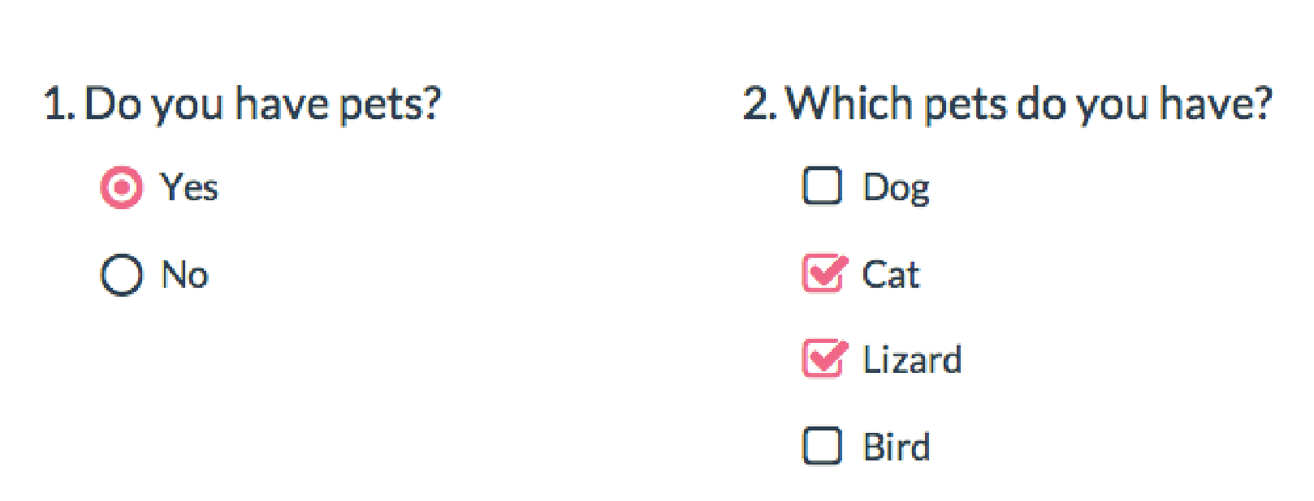
UI design: check boxes and radio buttons
Use check boxes for independent on/off switches.
Use radio buttons for related choices, when only one choice can be activated at a time.

Slide 25

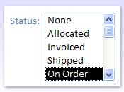
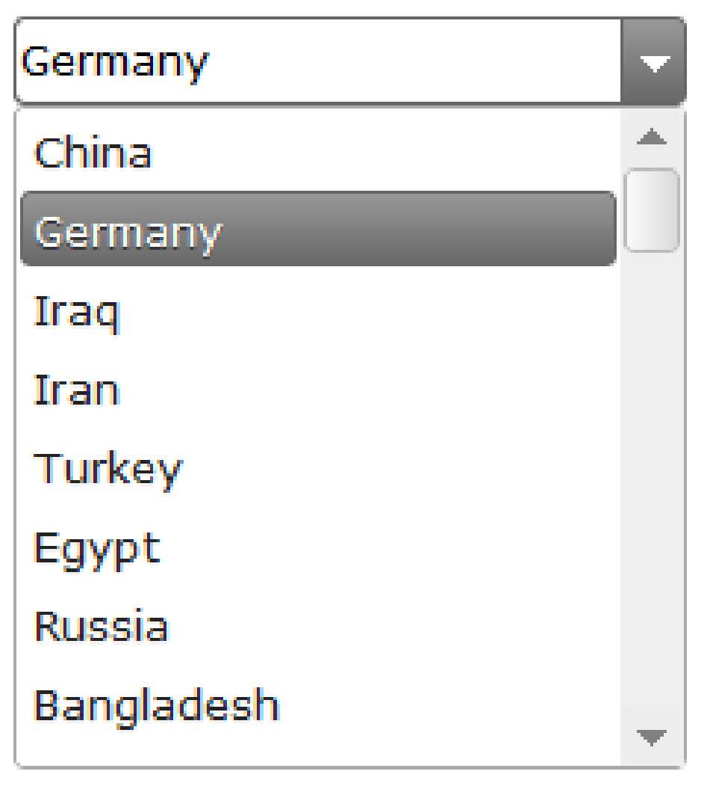
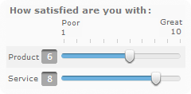
UI design: text fields, lists, combo boxes, sliders
Use text fields (usually with a label) when the user may type in anything they want.
Use lists when there are many fixed choices (too many for radio buttons); all choices visible on screen at once.
Use combo boxes when there are many fixed choices; don't take up screen real estate by showing them all at once.
Use a slider or spinner for a numeric value.

Slide 26
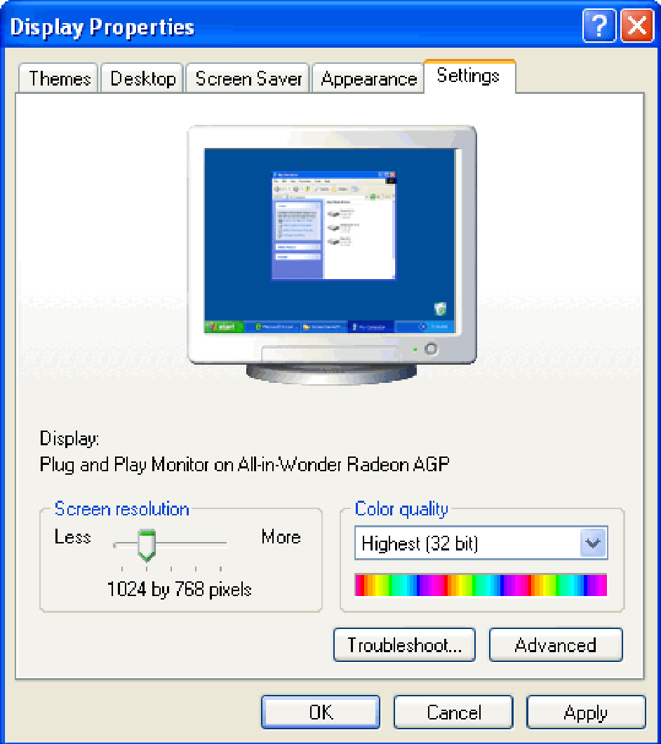
UI design: dialogs and panes
Use a tabbed pane when there are many screens that the user may want to switch between at any moment
Use dialog boxes or option panes to present temporary screens or options
“modal” dialog box prevents any other action

