Slide 1
Register: typical course of events
Actor Action (Student) | Actor Action (Adviser) | System Response
1. Open registration Interface |  | 2. Ask for Student Id, Password
3. Provide Id, Password |  | 4. Show List of unfinished courses
5. Select a course |  | 6. Get Pre-requisite list for that course
 |  | 7. Check results of those courses
 |  | 8. If not passed, then give message to student and deselect the course Otherwise, do nothing
9. Finalize selection |  | 10. Check total credit hour
 |  | 11. If ok, then proceed to next step otherwise, give a message requesting the student to revise his selection
 |  | 12. Notify Adviser
 | 13. Ask for details | 14. Show details
 | 15. Authorize | 16. Update state
 |  | 17. update registration information for selected courses and show confirmation message, Print course card

Slide 2
Register: Sequence Diagram 1
:MainMenuUI
A Student
:Register
[selectedItem=register]
Register()
itemSelected()
:Student
:RegisterUI
Student()
RegisterUI()
showLogin()
login(id,pw)
verifyLogin(id,pw)
getStudentInfo(id)
[pwAccepted=false]
showLogin()

Slide 3
Register: Sequence Diagram 2
:RegisterUI
:Register
:Courses
A Student
[pwAccepted=true]
Course()
:RegInfos
*getCourseList()
RegInfo()
*getRegInfo(id)
prepareUnfinishedCourseList()
showCourseList(*Courses)
selectCourse(Cid)
selectCourse(Cid)
checkPreRequisite()
loop
showError(type)
[PRcompleted=true]/addToList(RegInfo)
showConfirmation(type)

Slide 4
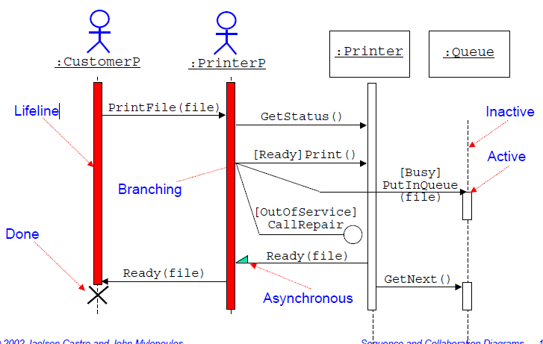

Slide 5
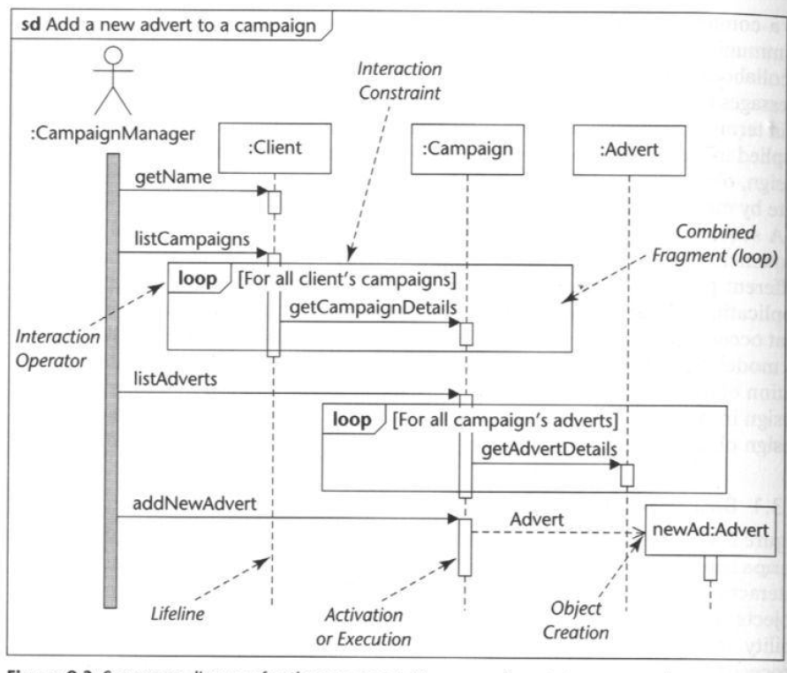

Slide 6
Collaboration Diagrams
Hold the same information as sequence diagrams
Show links between objects that participate in the collaboration
No time dimension, sequence is captured with sequence numbers
Sequence numbers are written in a nested style (for example, 3.1 and 3.1.1) to indicate the nesting of control within the interaction that is being modelled
‹#›
Notes:
‹#›

Slide 7
Message Labels
Type | Example
Simple message. | 4: addNewItem()
Nested call with return value. The return value is placed in the variable name. | 3.1.2: name:= getName()
Conditional message. This message is only sent if the condition [balance > 0] is true. | [balance > 0] 5: debit(amount)
Synchronization with other threads. Message 4: playVideo() is invoked only once the two concurrent messages 3.1a and 3.1b are completed. | 3.1a, 3. 1b / 4:playVideo()
‹#›

Slide 8
Navigating Links
checkCampaignBudget()
2: getOverheads()
:Client
:Campaign
1: *getCost ()
The direction in which a
link can be navigated
:Advert
‹#›

Slide 9
Register: Collaboration Diagram
2. showLogin()
7. showCourseList()
11. showPRError()
14b. showTCError()
18. showConfirmation()
3. login()
8. selectCourse()
12. finalize()
16. authorize()
15. authorize()
Student
RegisterUI
AuthorizeRegistrationUI
Adviser
4. verifyLogin()
9. verifyPreReq()
13. finalize()
14a. showRegInfo()
Register
5. getCourseInfo()
10. getResult()
Course
6. getRegInfo()
17. updateRegInfo()
1. getStudentInfo()
Result
Registration
Info
Student
18. updateRegInfo()

Slide 10
Model Consistency
The allocation of operations to objects must be consistent with the class diagram and the message signature must match that of the operation
Every sending object must have the object reference for the destination object
Either an association exists between the classes or another object passes the reference to the sender
Message pathways should be carefully analysed
‹#›
Notes:
‹#›

