Slide 1
Agile Development
‹#›

Slide 2
What is “Agility”?
Effective (rapid and adaptive) response to change
Effective communication among all stakeholders
Drawing the customer onto the team
Organizing a team so that it is in control of the work performed
Yielding …
Rapid, incremental delivery of software
‹#›

Slide 3
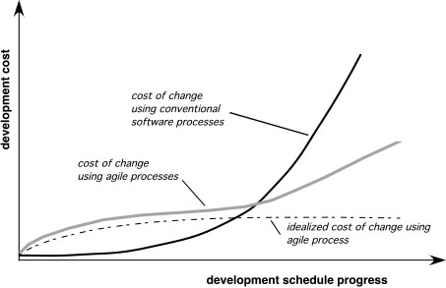
Agility and the Cost of Change
‹#›

Slide 4
An Agile Process
Is driven by customer descriptions of what is required (scenarios)
Develops software iteratively with a heavy emphasis on construction activities
Delivers multiple ‘software increments’
Adapts as changes occur
‹#›

Slide 5
Agility Principles
1. Satisfy the customer
2. Welcome changes
3. Deliver working software frequently
4. Gather motivated individuals
5. Work together
6. Conversation.
7. Measure progress using working software.
8. Promote a constant pace of development.
9. Continuous attention to technical excellence and good design.
10. Simplicity
11. Self–organizing teams.
12. Reflect on how to become more effective
‹#›

Slide 6
Human Factors
the process molds to the needs of the people and team
key traits of the people on an agile
Competence.
Common focus.
Collaboration.
Decision-making ability.
Fuzzy problem-solving ability.
Mutual trust and respect.
Self-organization.
‹#›

Slide 7
Extreme Programming (XP)
The most widely used agile process, originally proposed by Kent Beck
takes well-known, proven practices in software development to their extremes.
Pair Programming, Testing (TDD), Simple Design and Refactoring, Team Collaboration, Continuous Integration and Feedback
designed to improve software quality and responsiveness to changing customer requirements
emphasizes frequent releases in short development cycles
‹#›

Slide 8
XP Values
Communication
between software engineers and other stakeholders
Simplicity
design only for immediate needs rather than consider future needs
Feedback
From the customers and team members.
Courage
To design only for today rather than working in advance to save time
Respect
For clients, team members and the software itself
‹#›

Slide 9
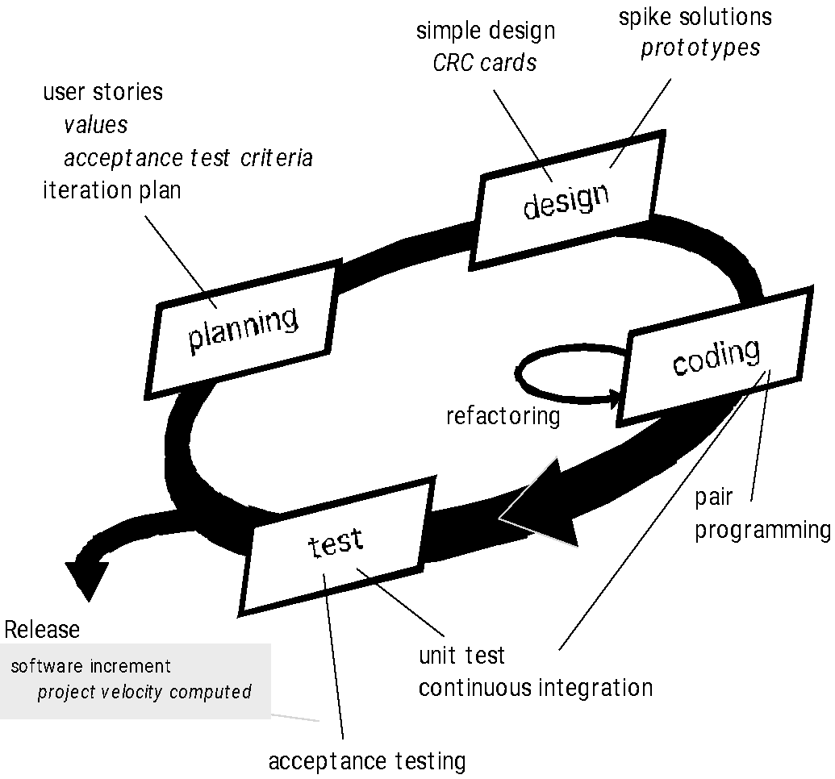
XP Process
‹#›

Slide 10
XP Process
XP Planning
Begins with listening client “requirements” and the creation of “user stories”
Agile team assesses each story and assigns a cost
If any story is estimated to require more than three development weeks, it is split
Stories are grouped to for a deliverable increment
A commitment is made on delivery date
After the first increment, “project velocity” is used to help define subsequent delivery dates for other increments
Project Velocity: Number of implemented user stories in the first release
‹#›

Slide 11
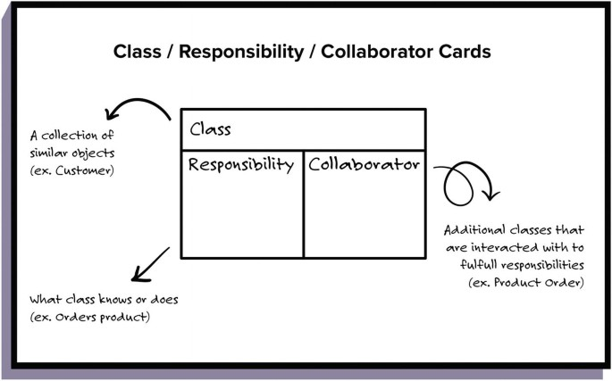
Extreme Programming (XP)
XP Design
Follows the KIS principle (Keep It Simple)
Encourage the use of CRC (class-responsibility-collaborator) cards
For difficult design problems, suggests the creation and evaluation of “spike solutions”—a design prototype to minimize risk
Encourages “refactoring”—an iterative refinement of the internal program design
‹#›

Slide 12
Extreme Programming (XP)
XP Coding
Recommends the construction of unit tests before coding commences
better able to focus on what must be implemented
Instant feedback from passing/failing the unit tests
Encourages “pair programming”
two people work together
one might think about the coding details, the other about coding standards
XP Testing
All unit tests are executed daily
“Acceptance tests” are defined by the customer and eexcuted to assess customer visible functionality
‹#›

Slide 13
Extreme Programming (XP)
Advantages
XP encourages simple code which allows modification at any given time.
This process model promotes testing codes from day one, resulting in more agile software development.
XP maintains an energizing and uplifting environment for developers within a project team.
‹#›

Slide 14
Extreme Programming (XP)
Disadvantages
The extreme focus on coding can lead to neglecting design, resulting in degradation of software product quality.
Lack of documentation and monitoring may lead to repetition of similar error in the future.
‹#›

Slide 15
Scrum
One of the widely used process models in software industry.
Originally proposed by Schwaber and Beedle
Prioritizes simplicity in a project
Develops product in an iterative manner with frequent delivery
‹#›

Slide 16
Scrum Process Patterns
Backlog: a prioritized list of project requirements or features that provide business value for the customer.
Sprint: Each iteration of project development phases. Usually lasts from 2 weeks to 1 month
Scrum Meeting: Short meetings (typically 15 minutes) held daily to discuss Progress, Challenge, Plan.
Demo: partially implemented software increment delivered to the customer for feedback
‹#›

Slide 17
Scrum
Work occurs in “sprints” and is derived from a “backlog” of existing requirements
Meetings are very short and sometimes conducted without chairs
“demos” are delivered to the customer with the time-box allocated
Project manager is called “Scrum Master” who ensures the team works efficiently
Subtasks in a project are called “Tickets”. Team members pull tickets when available.
Testing and documentation are on-going as the product is constructed
‹#›

Slide 18
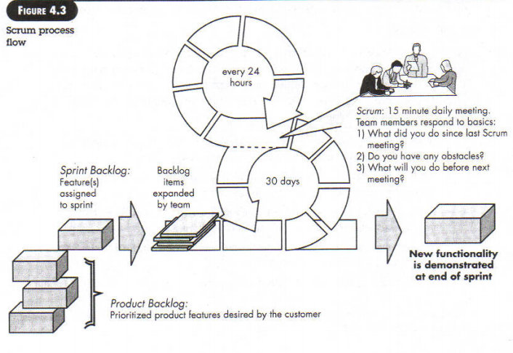
Scrum
‹#›

Slide 19
Scrum
Advantages
Scrum encourages less authority and hierarchy in a project team, thus, giving developers more freedom to express themselves and work.
This process model focuses on adaptability to tackle rapid changes in client requirements.
In scrum, the products usually take less time to become deliverable.
In scrum, different aspects of current sprint is reviewed in retrospective phase, thus, ensuring less mistakes in next sprint.
‹#›

Slide 20
Scrum
Disadvantages
Scrum usually works well with small team.
‹#›

Slide 21
Kanban
Kanban is yet another agile development method
In Japanese, the word Kanban means signboard which is visible to everyone around it.
Kanban puts heavy focus on the visualization of different aspects of a project so that everyone involved in a project is kept up-to-date all the time.
‹#›
Notes:
‹#›

Slide 22


Kanban
To-Do
In Progress
Done!
Introduction
Details
‹#›
Goods & Bads

Slide 23
Kanban
In kanban, just like scrum, different tasks in a project are further divided into modular subtasks.
Each of such subtasks is, then, assigned to a Kanban card which contains details on that particular subtask as well as associated user story (aka client requirement).
A Kanban board is maintained to keep track of kanban cards.
‹#›

Slide 24
Kanban
Like scrum, kanban follows pull system, that is, whenever a participant is available, he/she attempts to pull a kanban card from left to right by working on the subtask assigned.
Similar to scrum, there is an Agile coach in a project team in kanban and the team conducts Daily stand-up meeting and retrospectives during a project.
‹#›

Slide 25
Kanban
Advantages
Kanban encourages leadership from every participant in a project, thus, creating a free environment in which everyone can express his/her opinion about project and take decisions rapidly in the process.
This process model can adapt to different natures of a project team.
Developers can adjust workload per kanban card by analyzing the kanban board to maintain a decent lead time in workﬂow.
‹#›

Slide 26
Disadvantages
In kanban, there is no particular timeframe which may result in delay of the project.
Kanban
‹#›

Slide 27
Key Differences
Aspect | XP | Scrum | Kanban
Focus | Focuses on engineering practices and delivering high-quality code through continuous feedback. | Focuses on project management and the structured development of products through time-boxed iterations (sprints). | Focuses on visualizing workflow, optimizing flow, and reducing work in progress (WIP).
Team Size | Typically works good for small team | Typically works good for small team | Works for teams of any size.
Work Flexibility | The customer can request changes regularly, and the team adjusts based on frequent feedback. | Changes during a sprint are discouraged. Changes are considered in the next sprint. | Highly flexible; changes can be made anytime, as tasks are pulled into the flow when capacity allows.
‹#›

Slide 28
Reference
Chapter 3
Software Engineering -- A Practitioner's Approach, 7th edition
Pressman
‹#›

