Slide 1
Version Control Systems

Slide 2
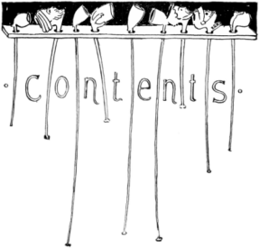
Table of Contents
Version Control Systems: Intro
Versioning Models
Lock-Modify-Unlock
Copy-Modify-Merge
Distributed Version Control
Tags and Branching
Subversion, Git – Demo
Project Hosting Sites

Slide 3
Version Control
A software engineering discipline
Consists of techniques, practices and tools for working on shared source code and files
Mechanisms for management, control and tracking the changes
Defines the process of change management
Keeps track of what is happening in the project over the time
Solves conflicts in the changes
Helps in evaluation

Slide 4

Software Development Lifecycle
Release
The Final
Product
Analysis
Testing
Text
Scripts
and Data
Requirements
Version Control
Build
Scripts,
Final
Product
Models
Build
Design
Source Code
Implementation

Slide 5

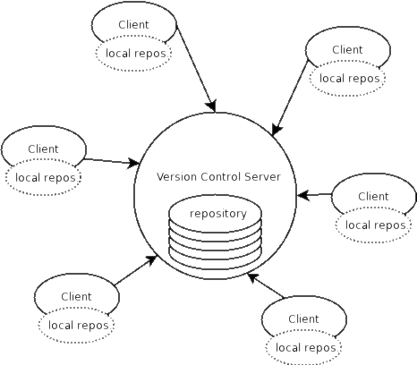


Version Control
Managing Different Versions of the Same File / Document

Slide 6
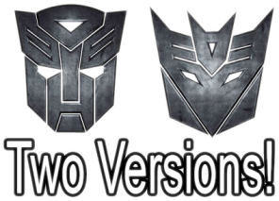
Version Control Systems (VCS)
Functionality
File versions control
Merge and differences search
Branching
File locking
Console and GUI clients

Slide 7
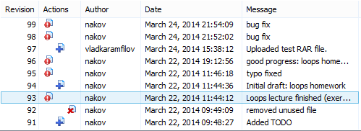
Version Control (Revision Control)
Constantly used in software engineering
During the software development
While working with documents
Changes are identified with an increment of the version number
for example 1.0, 2.0, 2.17
Version numbers are historically linked with the person who created them
Full change logs are kept

Slide 8
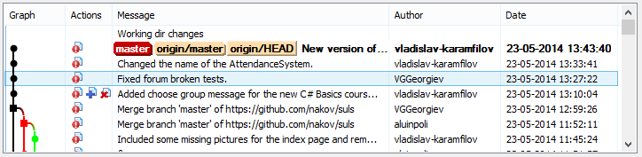
Change Log
Systems for version control keep a complete change log (history)
The date and hour of every change
The user who made the change
The files changed + old and new version
Old versions can be retrieved, examined and compared
It is possible to return to an old version (revert)

Slide 9
Vocabulary
Repository (source control repository)
A server that stores the files (documents)
Keeps a change log
Revision, Version
Individual version (state) of a document that is a result of multiple changes
Clone, Checkout
clone: Creates a local copy of a remote repository, including all branches and history.
checkout: Switches between branches or restores the working directory to a specific state.
It is possible to lock the files

Slide 10
Vocabulary (2)
Change
A modification to a local file (document) that is under version control
Commit, Check-In
Stores the changes
commit records changes to your local repository, while a check-in submits changes directly to a central repository
Automatically creates a new version
Conflicts may occur!

Slide 11
Vocabulary (3)
Conflict
The simultaneous change to a certain file by multiple users
Fetch / Pull
Used to update the local repo with the latest changes in central repo.
Fetch retrieves changes from the remote repository without applying them, while pull retrieves and immediately applies those changes to the current branch.
Revert / Undo Changes
Cancels the local changes
Restores their state from the repository

Slide 12
Vocabulary (4)
Merge
Combines the changes to a file changed locally and simultaneously in the repository
Tag
a marker used to reference a specific commit in the repository's history
Branch / Branching
Division of the repositories in a number of separate workflows

Slide 13

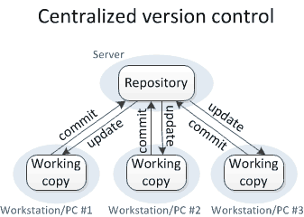
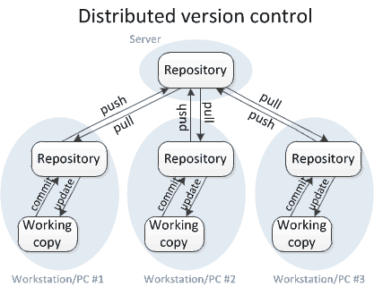

Versioning Models
Lock-Modify-Unlock, Copy-Modify-Merge, Distributed Version Control

Slide 14
Centralized Version Control
Key Characteristics
A single central repository exists.
Developers must be connected to the server to
work.
Changes are committed directly to the central repository.
Source: http://homes.cs.washington.edu/~mernst/advice/version-control.html

Slide 15
Centralized Version Control
Pros
Simple to Set Up
Single Source of Truth
Access Control
Straightforward Collaboration
Cons
Single Point of Failure
Limited Offline Work
Potential Data Loss
Source: http://homes.cs.washington.edu/~mernst/advice/version-control.html

Slide 16
Distributed Version Control
Key Characteristics
Multiple copies of the repository exist
Developers can work offline and sync changes
later.
Source: http://homes.cs.washington.edu/~mernst/advice/version-control.html

Slide 17
Distributed Version Control
Pros
Offline Work
Resilience
Fast Operations
Flexible Collaboration
Cons
Learning Curve
Storage Overhead
Initial Clone Time
Source: http://homes.cs.washington.edu/~mernst/advice/version-control.html

Slide 18

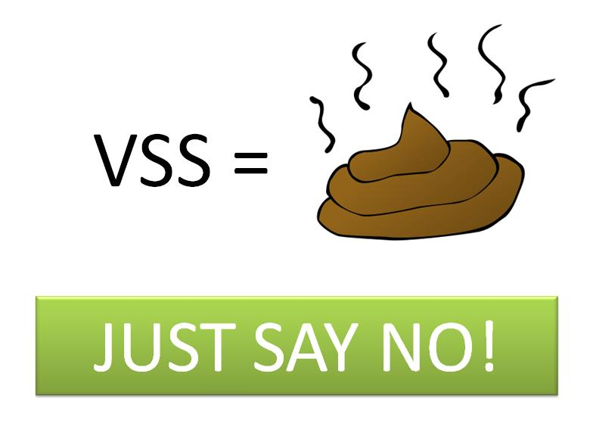
Versioning Models
Lock-Modify-Unlock
Only one user works on a given file at a time
No conflicts occur
Users wait each other for the locked files 🡪 works for small development teams only
Pessimistic concurrency control
Examples:
Visual SourceSafe (VSS) – old fashioned
SVN, Git, TFS (with exclusive locking)
Lock-modify-unlock is rarely used

Slide 19



Versioning Models (2)
Copy-Modify-Merge
Users make parallel changes to their own working copies
Conflicts are possible when multiple user edit the same file
Conflicting changes are merged and the final version emerges (automatic and manual merge)
Optimistic concurrency control
Examples:
SVN, Git, TFS

Slide 20


Versioning Models (3)
Distributed Version Control
Users work in their own repository
Using the Lock-Modify-Unlock model
Local changes are locally committed
No concurrency, no local conflicts
From time to time, the local repository is pushed to the central repository
Conflicts are possible and merges often occur
Example of distributed version control systems:
Git, Mercurial

Slide 21


Problems with Locking
Administrative problems:
Someone locks a given file and forgets about it
Time is lost while waiting for someone to release a file 🡪 works in small teams only
Unneeded locking of the whole file
Different changes are not necessary in conflict
Example of non-conflicting changes:
Bob works at the begging of the file
Alice works at the end of the file

Slide 22

Merging Problems
When a file is concurrently modified, changes should be merged
Merging is hard!
It is not always automatic process
Coordination and responsibility between the developers is required
Commit changes as early as finished
Do not commit code that does not compile or blocks the work of the others
Leave meaningful comments at each commit

Slide 23
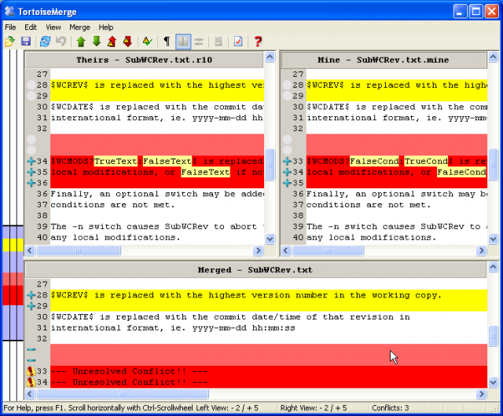
File Comparison / Merge Tools
During manual merge use file comparison
There are visual comparison / merge tools:
TortoiseMerge
WinDiff
AraxisMerge
WinMerge
BeyondCompare
CompareIt
…

Slide 24
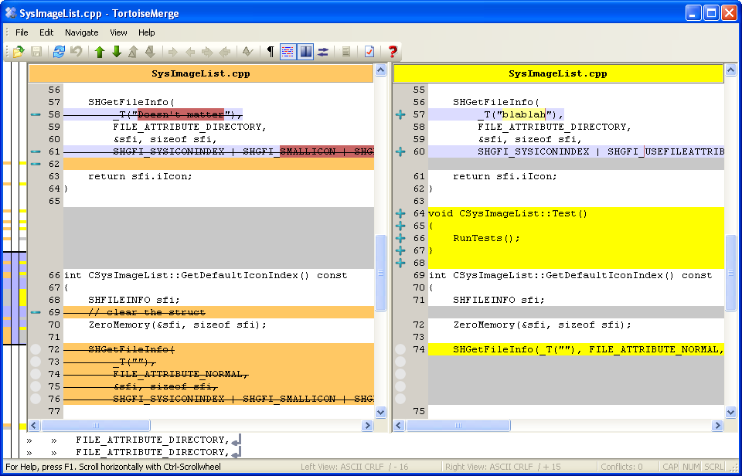
File Comparison – Example

Slide 25



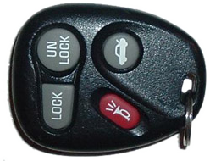
The "Lock-Modify-Unlock" Model

Slide 26




The Lock-Modify-Unlock Model (1)
Bob and Alice check-out file A.
The check-out is done without locking. They just get a local copy.
Repository
A
Check-out
Check-out
A
A
Alice
Bob

Slide 27
The Lock-Modify-Unlock Model (2)
Repository
Bob locks file A and begins modifying it.
A
Lock
A
Аndy
(Local Edit)
Alice
Bob

Slide 28

The Lock-Modify-Unlock Model (3)
Alice tries to lock the file too, but she can’t.
Alice waits for Bob to finish and unlock the file.
Repository
A
Wait
A
Bob
Alice
Bob

Slide 29
The Lock-Modify-Unlock Model (4)
Repository
Bob commits his changes and unlocks the file.
Bob
Commit
A
Bob
Alice
Bob

Slide 30
The Lock-Modify-Unlock Model (5)
Now Alice can take the modified file and lock it.
Alice edits her local copy of the file.
Repository
Bob
Lock
Bob
Bob
(Local Edit)
Alice
Bob

Slide 31
The Lock-Modify-Unlock Model (6)
Alice finishes, commits her changes and unlocks the file.
Repository
Bob
Alice
Commit
Bob
Alice
Bob
Alice
Bob

Slide 32
The Lock-Modify-Unlock Model (7)
Bob updates the changes from the repository.
Repository
Bob
Alice
Update
Bob
Alice
Bob
Alice
Alice
Bob

Slide 33
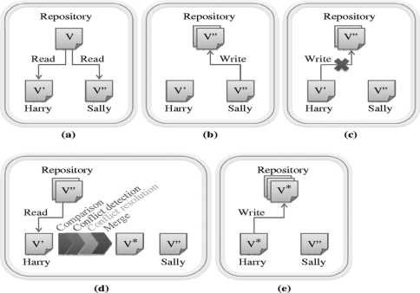
The "Copy-Modify-Merge" Model

Slide 34

The Copy-Modify-Merge Model (1)
Bob and Alice check-out a file A.
The check-out is done without locking.
Repository
A
Check-out
Check-out
A
A
Alice
Bob

Slide 35

The Copy-Modify-Merge Model (2)
Both of them edit the local copies of the file (in the same time).
Repository
A
Alice
Bob
(Local Edit)
(Local Edit)
Alice
Bob

Slide 36
The Copy-Modify-Merge Model (3)
Alice commits her changes to the repository.
Repository
Alice
Commit
Alice
Bob
Alice
Bob

Slide 37
The Copy-Modify-Merge Model (4)
Bob tries to commit his changes.
A conflict occurs.
Repository
Alice
Commit
Alice
Alice
Bob
Bob
(Local Conflict)
Alice
Bob

Slide 38
The Copy-Modify-Merge Model (5)
Bob updates his changes with the ones from the repository.
The changes merge into his local copy.
A merge conflict can occur.
Repository
Alice
Update
(with merge)
Alice
Bob
&
Alice
(Local Merge)
Alice
Bob

Slide 39
The Copy-Modify-Merge Model (6)
Bob commits the merged changes to the repository.
A common version with the changes of Bob and Alice is inserted.
Repository
Bob
&
Alice
Commit
Alice
Bob
&
Alice
Alice
Bob

Slide 40
The Copy-Modify-Merge Model (7)
Alice updates the changes from the repository.
She gets the common version with both changes from Bob and Alice.
Repository
Bob
&
Alice
Update
Bob
&
Alice
Bob
&
Alice
Alice
Bob

Slide 41

Distributed Version Control

Slide 42

Distributed Version Control (1)
Bob and Alice clone the remote repository locally.
They both have the same files in their local repositories.
Remote Repository (Server)
A
Clone
Clone
A
A
Local Repository
(Bob)
Local Repository
(Alice)
Bob
Alice

Slide 43
Distributed Version Control (2)
Remote Repository (Server)
Bob and Alice work locally on a certain file A.
A
(Local Edit)
(Local Edit)
Bob
A
A
Alice
Local Repository
(Bob)
Local Repository
(Alice)
Bob
Alice

Slide 44
Distributed Version Control (3)
Bob and Alice commit locally the modified file A into their local repositories.
Remote Repository (Server)
A
Commit (locally)
Commit (locally)
Bob
Bob
Alice
Alice
Local Repository
(Bob)
Local Repository
(Alice)
Bob
Alice

Slide 45
Distributed Version Control (4)
Bob pushes the file A to the remote repository.
Still no conflicts occur.
Remote Repository (Server)
Bob
Push
Bob
Bob
Alice
Alice
Local Repository
(Bob)
Local Repository
(Alice)
Bob
Alice

Slide 46
Distributed Version Control (5)
Alice tries to push her changes.
A versioning conflict occurs.
Remote Repository (Server)
Bob
Push (conflict)
Bob
Bob
Alice
Alice
Local Repository
(Bob)
Local Repository
(Alice)
Bob
Alice

Slide 47
Distributed Version Control (6)
Alice merges the her local files with the files from the remote repository.
Conflicts are locally resolved.
Remote Repository (Server)
Bob
Pull (Fetch + Merge)
Bob
Bob
Alice
+Bob
Alice
+Bob
Local Repository
(Bob)
Local Repository
(Alice)
Bob
Alice

Slide 48
Distributed Version Control (7)
Remote Repository (Server)
Alice commits her merged changes.
No version conflict.
Alice
+Bob
Bob
Push (no conflict)
Bob
Bob
Alice
+Bob
Alice
+Bob
Local Repository
(Bob)
Local Repository
(Alice)
Bob
Alice

Slide 49
Distributed Version Control (8)
Bob pulls (updates) the changed files from the remote repository.
Remote Repository (Server)
Alice
+Bob
Bob
Pull
Alice
+Bob
Alice
+Bob
Alice
+Bob
Alice
+Bob
Local Repository
(Bob)
Local Repository
(Alice)
Bob
Alice

Slide 50


Tags and Branches

Slide 51



Tags
Allows us to give a name to a group of files in a certain version
File A
1.1
1.2
1.3
1.4
Tag "Beta 2"
File B
1.1
1.2
File C
1.1
1.2
1.3

Slide 52
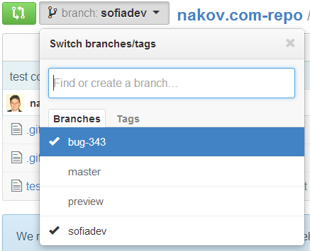
Branching
Branching allows splitting the development line into separate branches
Different developers work in different branches
Branching is suitable for:
Development of new feature
Features are invisible in the main development line
Until merged with it

Slide 53
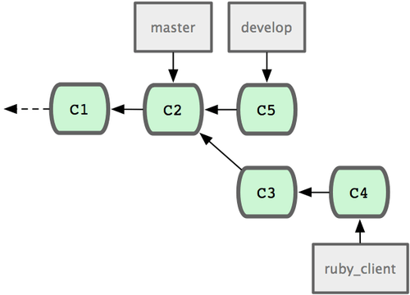
Merging Branches
Some companies work in separate branches
For each new feature / fix / task
Once a feature / fix / task is completed
It is tested locally and committed in its branch
Finally it is merged into the main development line
Merging is done locally
Conflicts are resolved locally
If the merge is tested and works well, it is integrated back in the main development line

Slide 54
Branching – Example
Branch 1.2.1.2 ->
1.2.1.2.1
1.2.1.2.2
Branch 1.2.1. ->
1.2.1.1
1.2.1.2
1.1
1.2
1.3
1.4
Main trunk
(remote master)
File A
Branch 1.2.2. ->
1.2.2.1
1.2.2.1
1.2.2.3

Slide 55
Merging Branches – Example
Branch 1.2.2.2.2 ->
1.2.2.2.2.1
1.2.2.2.2.2
Branch 1.2.2. ->
1.2.2.1
1.2.2.2
Main trunk
(remote master)
1.1
1.2
1.3
1.4
1.5
File A
Branch 1.2.4. ->
1.2.4.1
1.2.4.2
1.2.4.3

Slide 56
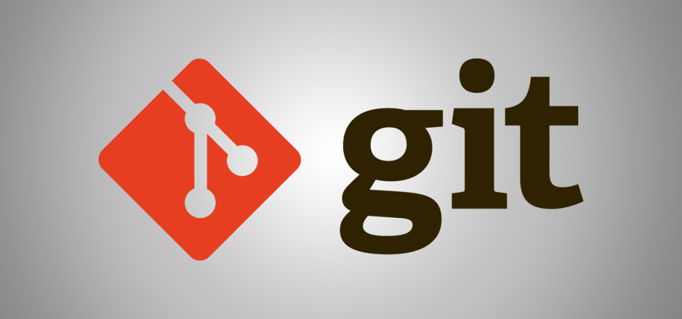
Working with Git

Slide 57
What is Git?
Git
Distributed source-control system
Work with local and remote repositories
Git bash – command line interface for Git
Free, open-source
Has Windows version (msysGit)
http://msysgit.github.io

Slide 58
Installing Git
msysGit Installation on Windows
Download Git for Windows from: http://msysgit.github.io
“Next, Next, Next” does the trick
Options to select (they should be selected by default)
“Use Git Bash only”
“Checkout Windows-style, commit Unix-style endings”
Git installation on Linux:
sudo apt-get install git

Slide 59
Basic Git Commands
Starting a New Project
When you're creating a new project and want to start tracking it with Git.
Converting an Existing Project to a Git Repository
git init
mkdir my-project
cd my-project
git init
cd existing-project
git init

Slide 60
Basic Git Commands
Cloning an existing Git repository
Copies a remote repository to the local machine
Checkout
Switches to the specified branch
git clone [remote url]
git checkout <branch-name>

Slide 61
Basic Git Commands
Preparing (adding / selecting) files for a commit
git add [filename] ("git add ." adds everything)

Slide 62
Basic Git Commands
Committing to the local repository
records changes to your local repository.
Check-in
Pushes your local changes to a central repository.
git commit –m "[your message here]"
git push [remote name] [local name]

Slide 63
Basic Git Commands
Fetch and merge the latest changes from the remote repository
git pull [remote] [branch]

Slide 64
Basic Git Commands
Revert (Undo a Commit)
Creates a new commit that undoes the changes introduced by a specific commit.
git revert [commit-hash]

Slide 65
Basic Git Commands (2)
Check the status of your local repository (see the local changes)
Output
For a clean repo (no changes)
git status
On branch main
nothing to commit, working tree clean

Slide 66

TortoiseGit
Using the Windows GUI Git Client – Live Demo

Slide 67

Project Hosting and Team Collaboration Sites
GitHub, SourceForge, Google Code, CodePlex, Project Locker

Slide 68
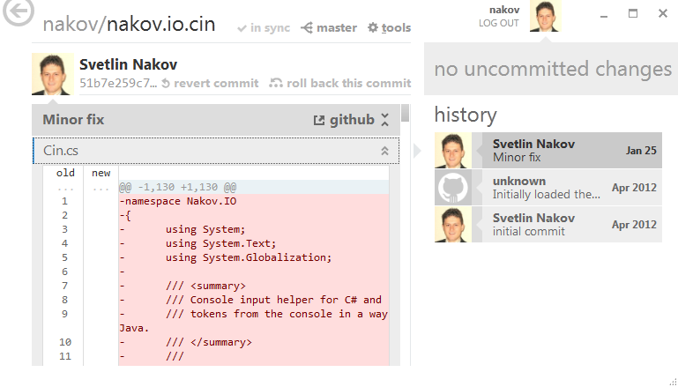
Project Hosting Sites
GitHub – https://github.com
The #1 project hosting site in the world
Free for open-source projects
Paid plans for private projects
GitHub provides own Windows client
GitHub for Windows
http://windows.github.com
Dramatically simplifies Git
For beginners only

Slide 69
Project Hosting Sites
Google Code – http://code.google.com/projecthosting/
Source control (SVN), file release, wiki, tracker
Very simple, basic functions only, not feature-rich
Free, all projects are public and open source
1-minute signup, without heavy approval process
SourceForge – http://www.sourceforge.net
Source control (SVN, Git, …), web hosting, tracker, wiki, blog, mailing lists, file release, statistics, etc.
Free, all projects are public and open source

Slide 70
Project Hosting Sites (2)
CodePlex – http://www.codeplex.com
Microsoft's open source projects site
Team Foundation Server (TFS) infrastructure
Source control (TFS), issue tracker, downloads, discussions, wiki, etc.
Free, all projects are public and open source
Project Locker – http://www.projectlocker.com
Source control (SVN), TRAC, CI system, wiki, etc.
Private projects (not open source)
Free and paid editions

Slide 71
Project Hosting Sites (3)
Assembla – http://www.assembla.com
Source control (SVN, Git), issue tracker, wiki, chats, files, messages, time tracking, etc.
Private / public projects, free and paid editions
Bitbucket – http://bitbucket.org
Source control (Mercurial), issue tracker, wiki, management tools
Private projects, free and paid editions
Others: Unfuddle, XP-Dev, Beanstalk

Slide 72
Acknowledgement
Software University Foundation
"Knowledge Sharing and Team Working" course by Telerik Academy under CC-BY-NC-SA license

Slide 73
Thank You

