Slide 1

Google Cloud

Slide 2



Google Cloud Organization – Resource Hierarchy
Organization
Folder
Folder
Project
Project
Cloud Virtual Network
Folder
Compute Engine
Cloud SQL

Slide 3
Instance
Instance: An instance is a virtual machine (VM) hosted on Google's infrastructure. An instance can be created using the google cloud console or the gcloud command prompt.
Instance Creation
Public Image
Custom Image
Snapshots
Existing Disks
Provided and maintained by Google,
open source communities, and third-party vendors.
Available only to your Cloud project
Custom Images can be created from boot disks and other Images
Creating Instance from snapshots earlier taken for the machines
Creating Instance from disks

Slide 4
Machine Lifecycle
State | Remarks
PROVISIONING | Resources are allocated for the VM. The VM is not running yet
STAGING | Resources are acquired, and the VM is preparing for first boot.
RUNNING | The VM is booting up or running
STOPPING | The VM is being stopped. A stop was requested, or a failure occurred. This is a temporary status after which the VM enters the TERMINATED status.
REPAIRING | The VM is being repaired. Repairing occurs when the VM encounters an internal error or the underlying machine is unavailable due to maintenance. During this time, the VM is unusable. If repair succeeds, the VM returns to one of the above states.
TERMINATED | The VM is stopped or the VM encountered a failure. You can restart or delete the VM.
SUSPENDING | The VM is in the process of being suspended
SUSPENDED | The VM is in a suspended state.VM can be resumed or it can be deleted

Slide 5
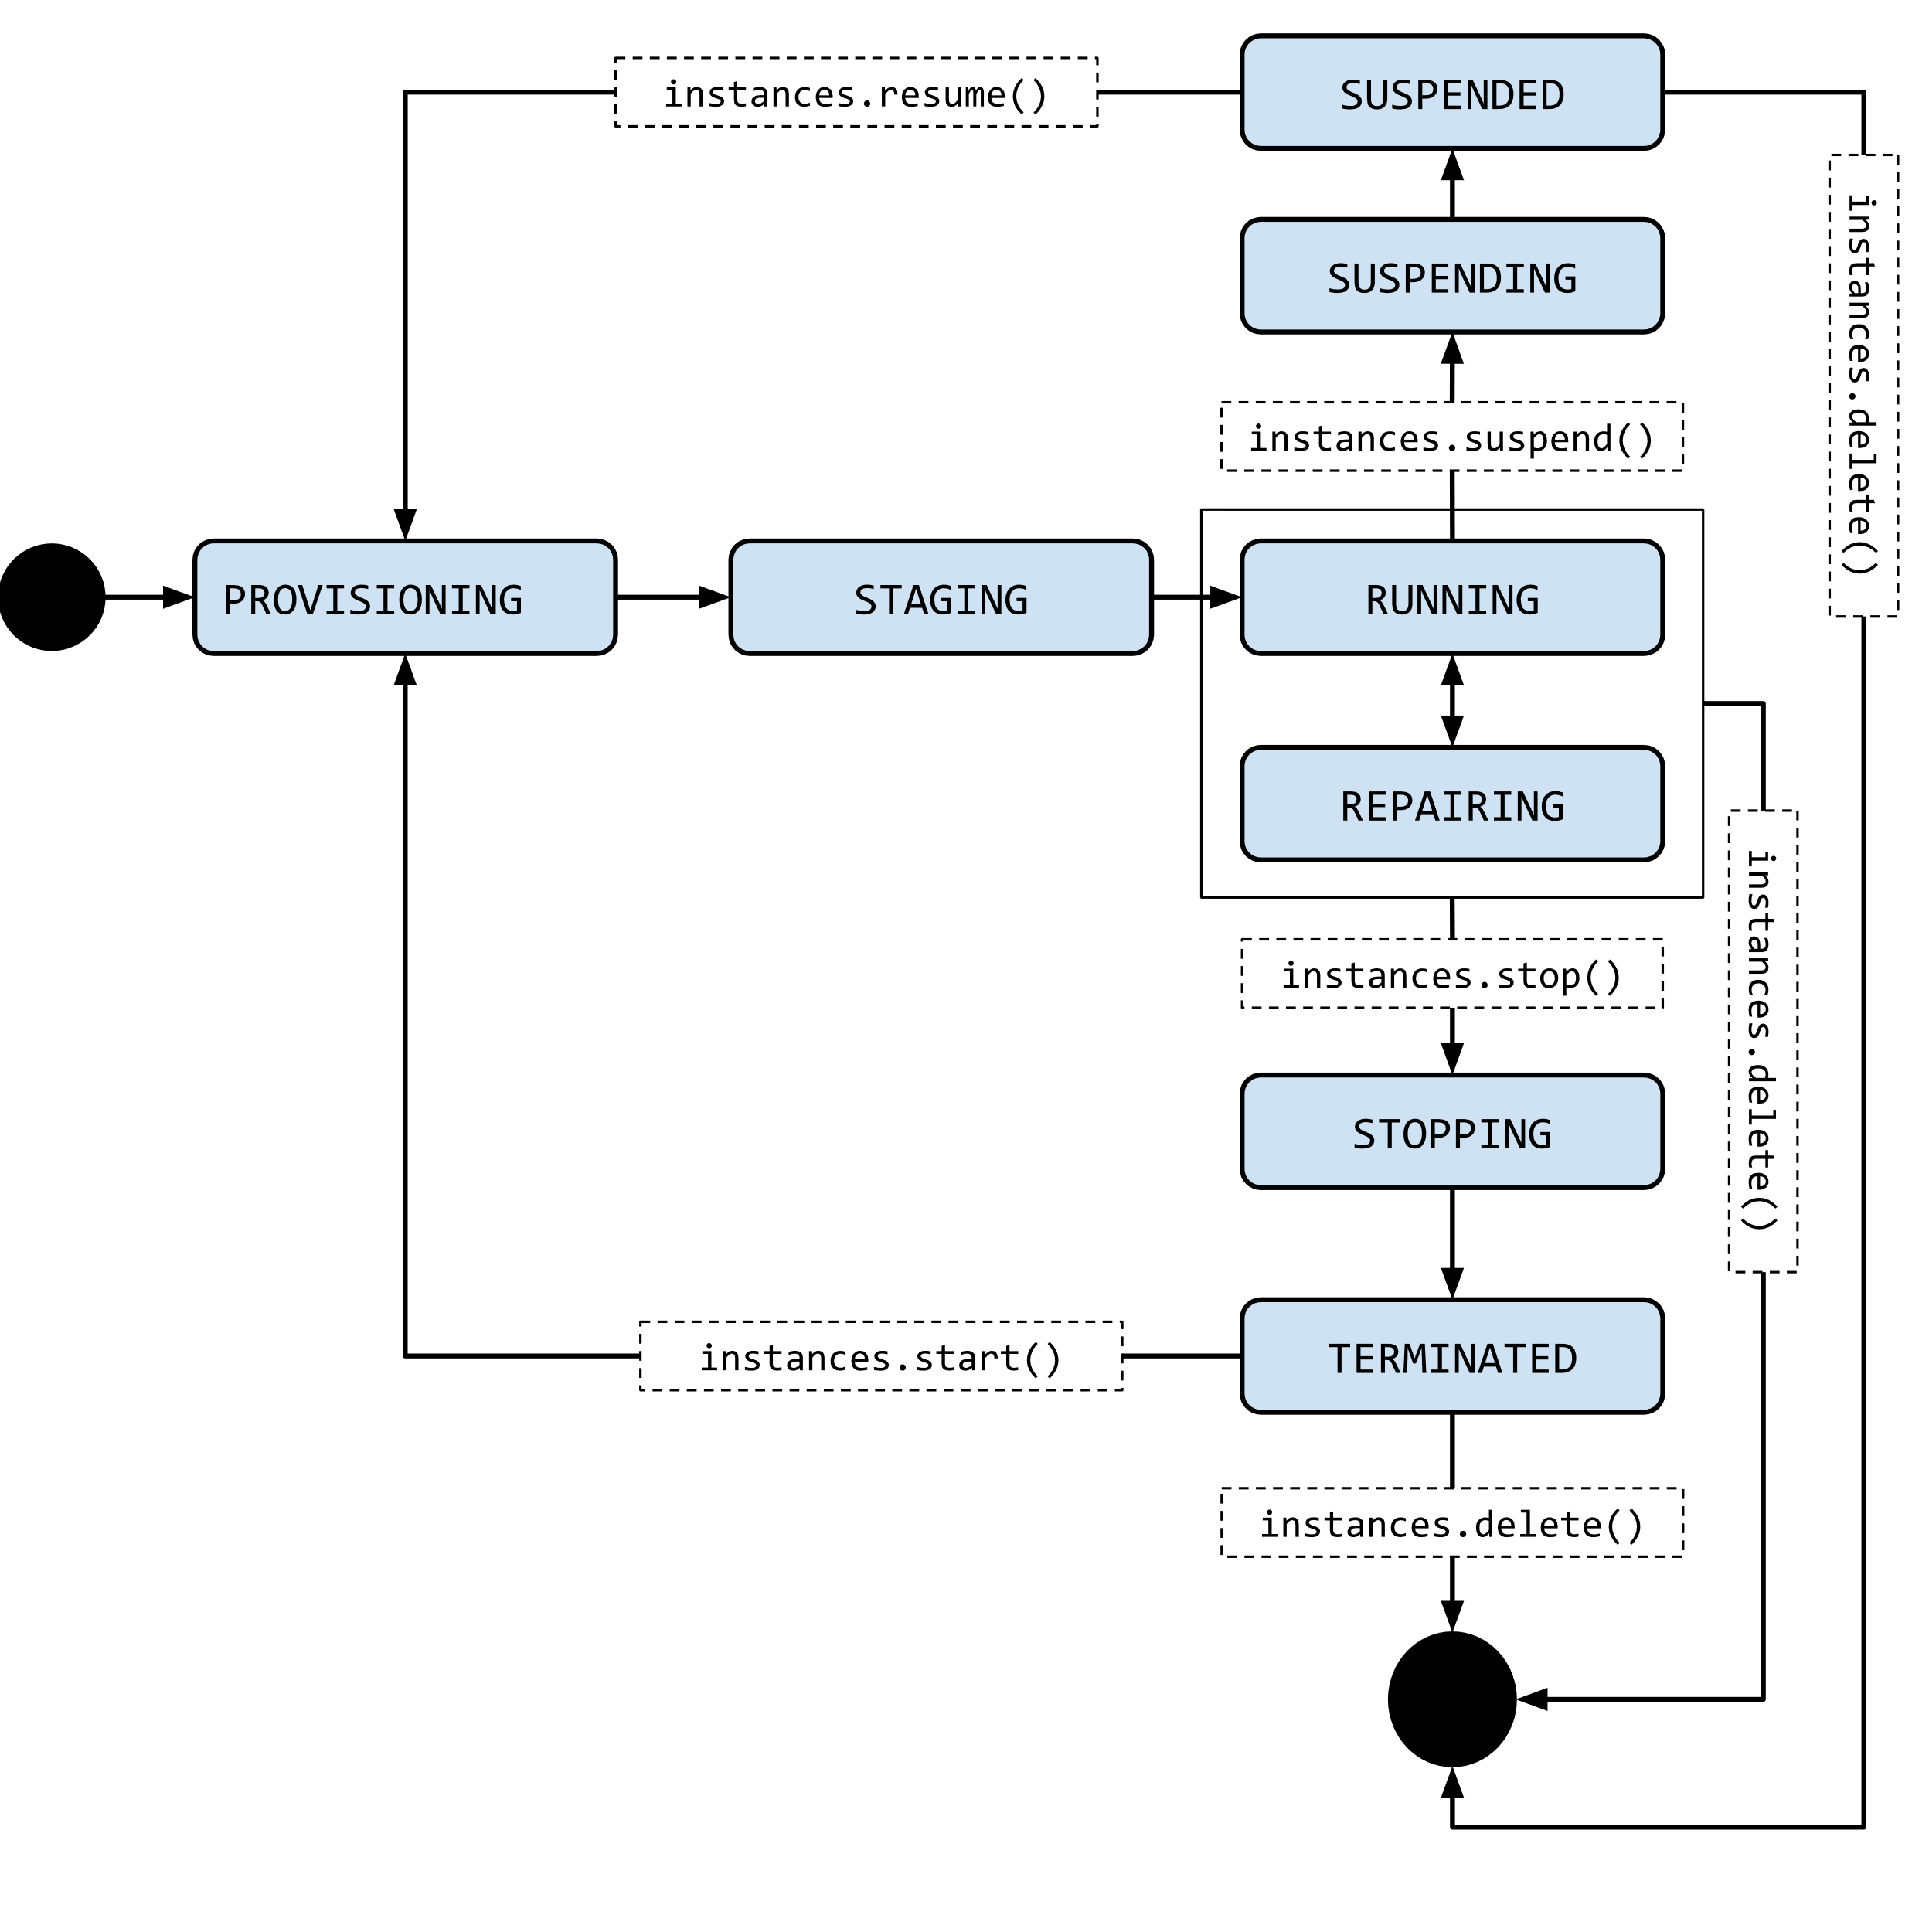
Life Cycle Diagram

