Slide 1
Introduction
India's agricultural sector faces several challenges, including water scarcity, erratic rainfall, and inefficient irrigation practices.
Smart irrigation systems, which use advanced technologies such as sensors, automation, and real-time data, offer a promising solution to address these issues.
However, the adoption of these systems is still limited in India, largely due to financial and infrastructural barriers. Regions like Maharashtra, Gujarat, and Rajasthan have seen some adoption of these systems, but their usage remains relatively low.
Only around 10-15% of farmers in India use smart irrigation systems

Slide 2
ISSUE TO BE ADDRESSED
It requires the farmer to directly monitor the supply, which includes switching on/off the motor and opening/closing the valves.
With irrigation activities getting only a few hours of power supply a day, most of which happens overnight, it is difficult to manage it during odd hours.
Farmers facing expenditure on source of water i.e. pumping set/electric pump, diesel electricity and manpower up to 50,000 rupees for one crop for one season.

Slide 3
Factors affecting Farmers’ income
Farm laborers constitute more than half of the total workforce engaged in Indian agriculture. Also, farmers’ expenses towards labor charges account for more than 50 per cent of the total variable cost of production for most crops.
Reduction in supply of laborers along with the support by a number of government schemes, including the Mahatma Gandhi National Rural Employment Guarantee Act (MGNREGA) has led to an escalation in farm wages which is adversely impacting the profitability of the farmer.
We aim to eliminate the labour costs of irrigation by automation

Slide 4
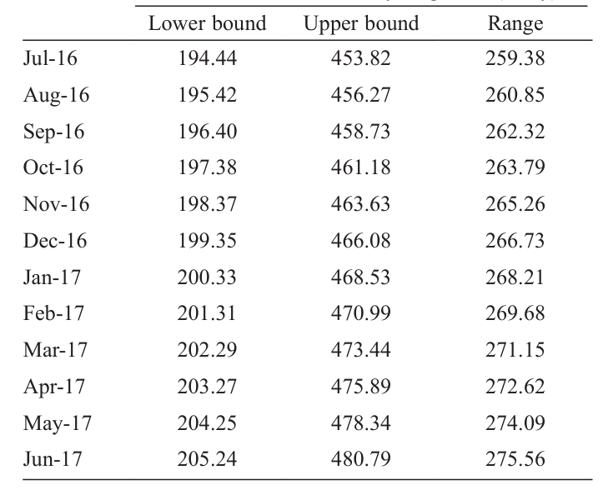
As a matter of fact, the average daily wage rate of a male worker has risen from Rs.78 per day in 2007-08 to Rs.232.2 per day in 2013-14; whereas for a female worker it rose from Rs.57.9 per day to Rs.182.5 per day during the same period.
Rural wages have been growing by 17% annually on average since 2006-07 outstripping urban wages.

Slide 5
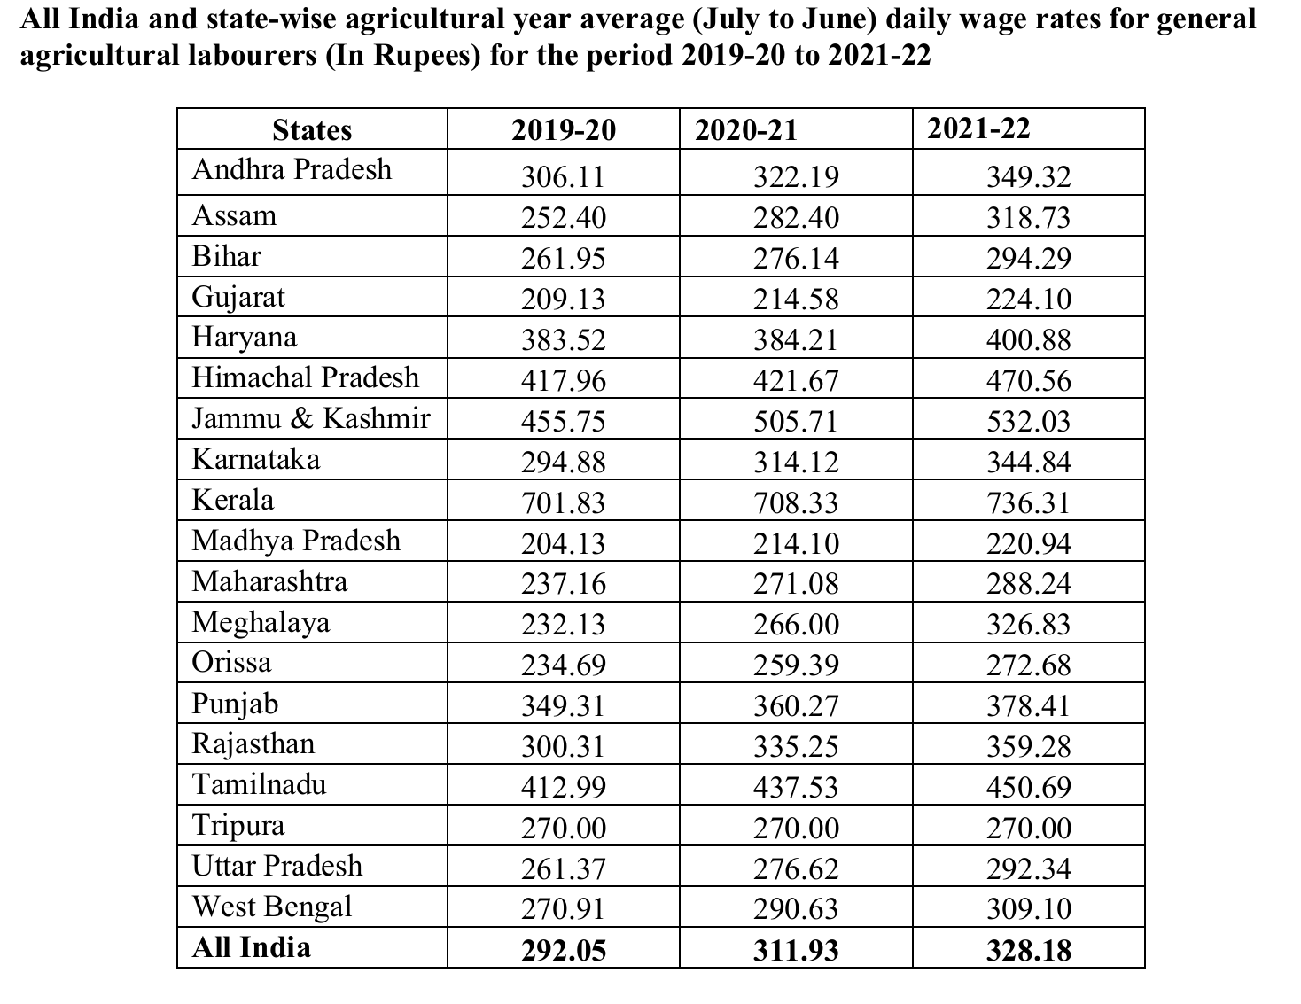
The data highlights the increasing wage rates for general agricultural laborers across states in India from 2019-20 to 2021-22, with an All-India average rise from ₹292.05 to ₹328.18. States like Kerala, Himachal Pradesh, and Jammu & Kashmir show particularly high daily wages, indicating a significant cost burden for farmers, especially smallholders.

Slide 6
Our project addresses this challenge by reducing dependency on manual labor through automation and smart resource management. By optimizing irrigation and soil monitoring processes using IoT-based solutions, farmers can minimize labor costs, improve efficiency, and maximize yields. This not only helps mitigate rising wage expenses but also ensures sustainable and cost-effective agricultural practices

Slide 7
REFERENCES
Mr. Rajpal (July, 2020) - “An Analysis about Wages for Agricultural Labourers in India ”
S.K. Srivastava (December 2020) – “Changing Agricultural Labour Market and Its Effects on Farm Economy in India”
SHWETA BHATT – “An Empirical Analysis of the Adoption of HI-Tech Farming Techniques Among the Farmers of the Eastern Uttar Pradesh Belt”
B S Yashavanth ( June 2018 ) Disparity in wages of agricultural labourers in India
RAJYA SABHA STARRED QUESTION 261. (MARCH 2023) – Income of agricultural labourers

