Slide 1

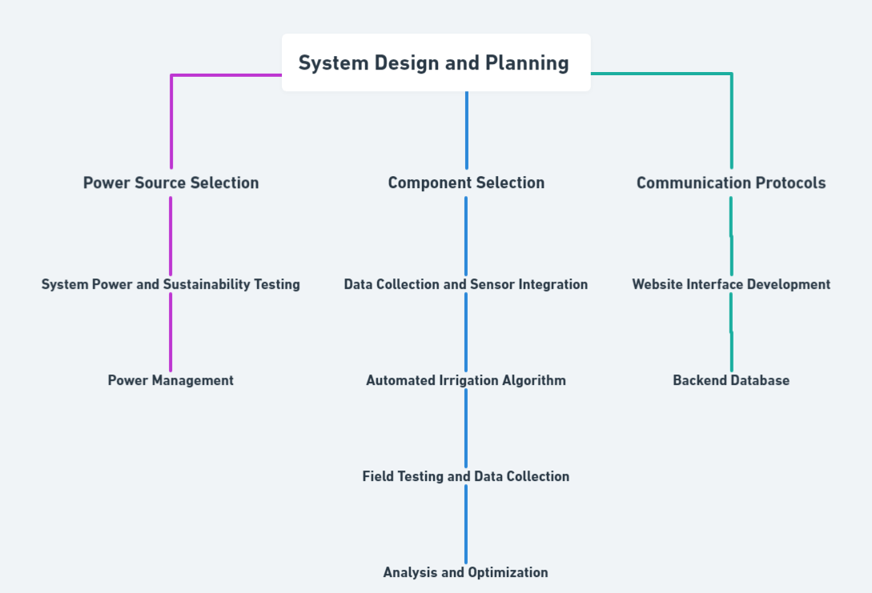

RV College of Engineering, Bengaluru – 560059.
Go, change the world
Title: Scalable Agri Assistance System
Pramath J | Samaraditya P H | Tejas N Naik | Aditya Mallanagouda Yargal
RVCE24BCS017 | RVCE24BCS054 | RVCE24BME055| RVCE24BAS060
Theme: Envirnoment
Introduction
Tools used
Our project focuses on developing a Scalable Agri-Assistance system that uses sensors and real-time (by leveraging sensors) data to optimize irrigation and minimize water wastage.
Inefficient irrigation wastes 40% of water and pesticide overuse contaminates 30% of groundwater. This project offers a cost-effective solution to optimize water use and prevent soil degradation, crucial for sustainable farming.
Over-irrigation and excessive pesticide use not only waste these valuable resources but also degrade soil health, leading to lower yields and higher long-term costs.
Hardware
18650 Battery (3.7v) [power source]
HW736 [solar charger for Li-Ion batteries]
Esp32 [microcontroller]
AMS1117 (3.3v) [Voltage regulator]
Capacitive moisture sensor ( with 662k voltage regulator and TLC555C OR TLC555I chip )
XL6009 [Buck booster upto 30v]
Veroboard [Soldering Board]
Soldering Iron
Soldering flux [to remove oxidation layer]
2000-count digital multimeter [voltmeter, ammeter]
12. Solid core wires [forming connections on veroboard]
13. 6V polycrystalline solar panel [charging power source for battery]
14. Bread board,Motor driver (replicating 240v relay in existing system), Water pump and Plastic pipe-*for demonstration only*
Software
Arduino IDE
ESP32 Windows Driver [ CP210x ]
ESP32 Extension [ Espressif ]
VSC
Canva [for diagram]
SolidWorks2020 [3d encasing design]
UltiMaker Cura [3D printing]
KiCAD [circuit design]
Problem Definition
In India, the overuse of water for irrigation is a persistent issue, primarily due to the lack of technological involvement in farming.
Most farmers rely on “intuition” rather than real-time data, leading to excessive irrigation even when crops may not require it.
This not only depletes precious water resources but also contributes to waterlogging, reduced soil fertility, and inefficient energy usage for water pumps.
In a country like India where water is a scarce and precious resource, inefficient irrigation methods have a major long term effect in the ground water levels.
Results and Discussions
The System was subjected to sustainability testing for
Battery life
Power draw under max power draw condition
and was proven to sustain itself even under low sunlight and upto 1.5 days without any sunlight
Based on test results, the pump was ON for about half the time as the conventional system, implying the potential to save about half as much as water used traditionally.
This value may vary more or less based on the soil wetness status on a daily basis.
For example : The field used for testing consists of 70 coconut trees in a 2 Acre land, where each tree requires about 100L of water per day.
This usage can be reduced to 50-60L by using an automated system leading to savings of around 30L(reduced number due to hot summer days) per tree per day.
So per year, upto (30x70x365) = 766,000 Litres of water can be saved
Objectives
To Save water by using only the required amount of water for irrigation
Develop a smart irrigation system that utilizes affordable components and solar power, optimizing water usage while minimizing costs for scalable agricultural applications.
Implement an irrigation system that optimizes water usage based on soil moisture levels, reducing waste and conserving resources.
Create a user-friendly web interface that allows users to monitor soil moisture levels and control irrigation remotely via the ESP32.
Methodology
Conclusions
The project focused on addressing the issue of excessive water usage in Indian agriculture, primarily caused by the lack of accessible, technology-based solutions.
The main objective was to develop an affordable, solar-powered agricultural assistance system capable of monitoring soil moisture levels, improving irrigation efficiency, and providing farmers with practical insights.
The system combined a soil moisture sensor, ESP32 modules, and a solar-powered energy management system. Using the ESP-NOW protocol, it enabled communication between sensor nodes and the main module, allowing real-time soil moisture monitoring and remote control of irrigation motors through a mobile device.
Testing results confirmed the potential for significant water savings through the system. By irrigating only when the soil moisture levels dropped below the optimal threshold, unnecessary water usage was avoided, demonstrating the viability of technology-driven farming practices.
Timeline
Week (1 to 2) - Phase 1: Planning and Design
Finalize project concept and objectives
Week (3 to 4) - Phase 1: Prototype Development
Integrate sensors and microcontrollers for basic functionality
Week (5 to 6) - Phase 2: Prototype Testing and Demonstration
Test real-time data transmission and control of irrigation via relay
Week (7 to 8) - Phase 2: Scalability and Portability Testing
Finalize testing of the prototype for connectivity between modules and scalability
Week (9 to 10) - Phase 3: Field Testing and Refinements
Implement solar panels to make the modules self-sustaining
Week (11 to 12) - Phase 3: Final Testing and Adjustments
Week (13+) - Website Development and Testing and Integration
References
(03-March-2020) “Decrease in Agricultural Holdings” - pib.gov.in
Dr. Vibha Dhawan (2017) “Water and Agriculture in India”- oav.de/fileadmin/user_upload/5_Publikationen/5_Studien/170118_Study_Water_Agriculture_India.pdf
Rajini Jain & Prabhat Kishore (March-2020) “Irrigation in India: Status, Challenges and options”- researchgate.net/publication/340234257_Irrigation_in_India_Status_challenges_and_options
Rita Pandey (August-2014) “Groundwater Irrigation in Punjab” https://www.nipfp.org.in/media/medialibrary/2014/09/WP_2014_140.pdf#:~:text=The%20water%20tables%20in%20Punjab%20have%20been,year%20of%20excessive%20extraction)%20(World%20Bank%202010).&text=Punjab%20had%20the%20largest%20area%20experiencing%20such%20decline%20(Sekhri%2C%202012a).
C.V. Dharma Rao (2018) “Water use efficiency” nwm.gov.in/sites/default/files/1.%20National-water-mission-%20%20%20water-use-efficiency.pdf
QR Code of the Demonstration Video

