Slide 1
Electric and Hybrid Vehicles Technology
Dr. Sachin Argade

Slide 2
Agenda
Syllabus
Class tests
Class Quizzes
Class Project
Mid Semester exam
End Semester exam

Slide 3
EEM3202T: Electric and Hybrid Vehicle Technology
Teaching Scheme: TH: 03 Hours/Week | Credit TH: 03
Examination Scheme:
In Sem. Evaluation : 20 Marks
Mid Sem. Exam : 30 Marks
End Sem. Exam : 50 Marks
Total : 100 Marks

Slide 4
Course Outcomes
At the end of the semester student should be able to
CEEM3202T_1: Infer basic architecture of EVs and HEVs, their subsystems
CEEM3202T_2: Interpret performance and selection of energy storage systems in EVs
CEEM3202T_3: Analyze battery management system
CEEM3202T_4: Interpret Power Electronics and Motor Controller subsystem in EVs

Slide 5
Before MSE – 2 proctored class Tests (50 Marks each), (4 Marks)
1st Test after finished 1.5 Units (Unit 1 full and Unit 2 half) Approx.=12 Jan
2nd Test after finishing next 1.5 Units (Remaining Unit 2 and Unit 3 Complete) Approx.= 11 Feb
After MSE – 2 proctored class Tests (50 Marks each), (4 Marks)
3rd Test after finished 1.5 Units (Unit 4 full and Unit 5 Half)
4th Test after finishing next 1.5 Units (Remaining Unit 5 and Unit 6 Complete)
Class Project/ Case Study: Individual: Presentations and report (typed) will carry marks. (8Marks).
It will be declared on 29th December 2025
Continuous in class quizzes, they will be surprise quizzes. (2 Marks)
Total for ISE = 20 Marks

Slide 6
Make a 100 Pages note book for tests and quizzes. You should have it with you for each and every class. Quizzes can happen any time.
MSE- first 3 Units – 30 Marks
ESE- All 6 Units – 50 Marks

Slide 7
Types of Vehicles
Conventional gasoline vehicle (gasoline fuel and ICE),
Hybrid vehicle (gasoline fuel, electrical drive, and large rechargeable battery),
Electric vehicle (high-capacity electrical battery and electrical drive/generator),
Hydrogen fuel cell vehicle (high-pressure hydrogen fuel tank, fuel cell, electrical drive),
Hydrogen internal combustion vehicle (high-pressure hydrogen fuel tank and ICE),
Ammonia-fueled vehicle (liquid ammonia fuel tank, ammonia thermo-catalytic decomposition and separation unit to generate pure hydrogen, hydrogen-fueled ICE).

Slide 8
Why Electric?
The Origin Story: Early Electric Vehicles (1830s–1910).
The Great Pause: The Rise of the Internal Combustion Engine (ICE).
The Modern Rebirth: From Hybrid to High-Performance EVs.
The Imperative: Environmental & Climate Impact.
The Benefit: Social, Health, and Economic Importance.

Slide 9
EV History, Part I: Faster Than the Ford
1830s: Early prototypes by pioneers like Anderson and Parker.
1900: Peak Popularity—Nearly 1/3 of vehicles in the U.S. were electric.
Key Advantages: Quiet, odourless, and easy to operate (no manual cranking).
Target Market: Highly popular with women and urban drivers.

Slide 10
EV History, Part II: The End of the First Era
1908: Henry Ford's Model T introduces mass-production, making gasoline cars affordable.
1912: The invention of the Electric Starter eliminates the dangerous hand-crank for ICE cars.
Infrastructure: Cheap, abundant oil and better roads favored long-distance ICE travel.
Outcome: EVs were relegated to niche uses by the 1930s.

Slide 11
The Modern Revival: The Road to High-Performance
1970s: Oil crises spur renewed interest in alternatives (briefly).
1997: Toyota Prius popularizes the Hybrid Electric Vehicle (HEV) concept.
1990s: Government mandates (e.g., California ZEV) prompt corporate development (GM EV1).
2008: Tesla utilizes Lithium-ion batteries to deliver high performance and long range, launching the modern EV era.

Slide 12
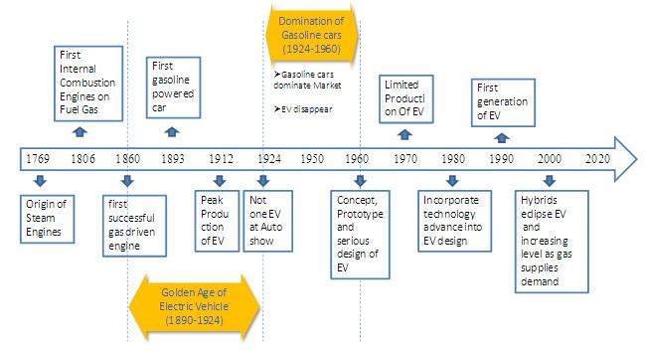

Slide 13
Overview of Electric Vehicles
Nitrogen Oxides
Carbon Monoxide
Unburned Hydrocarbons
Other Pollutants
Global Warming

Slide 14
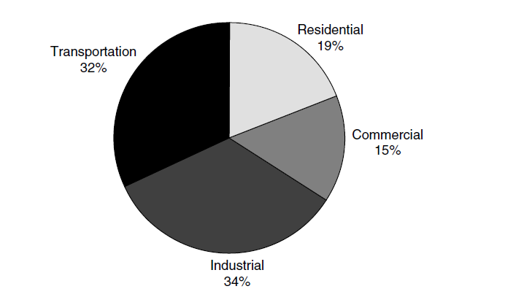

Slide 15
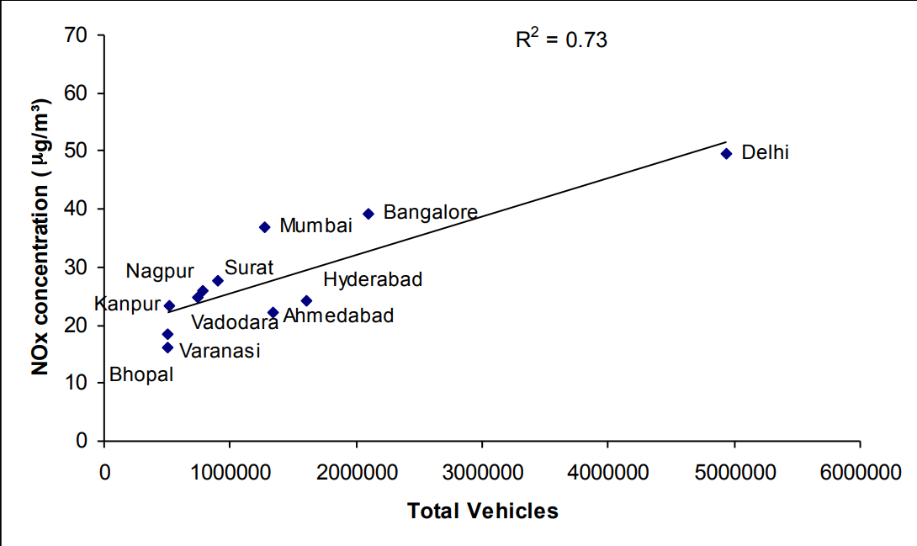

Slide 16
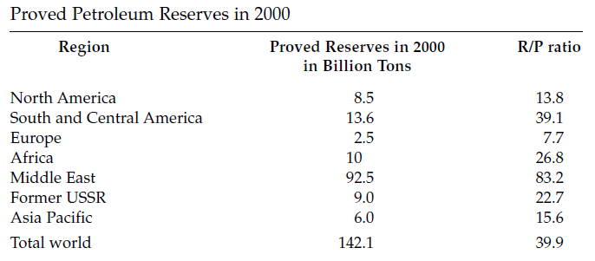
Petroleum resources

Slide 17
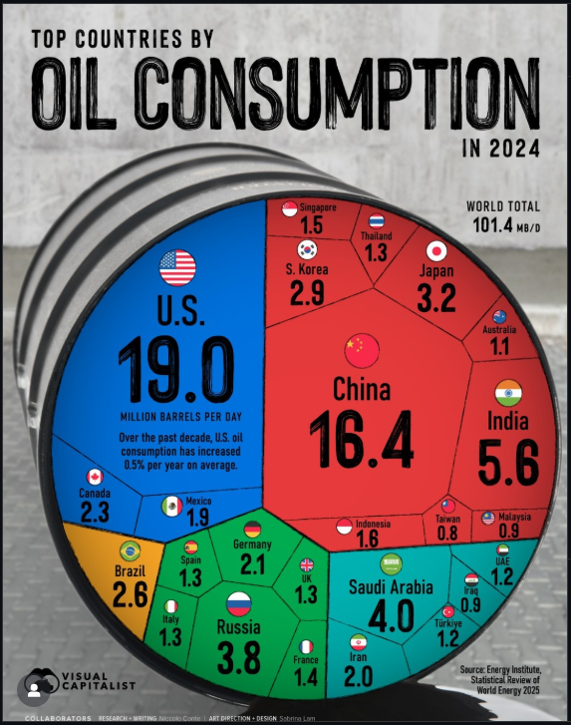

Slide 18
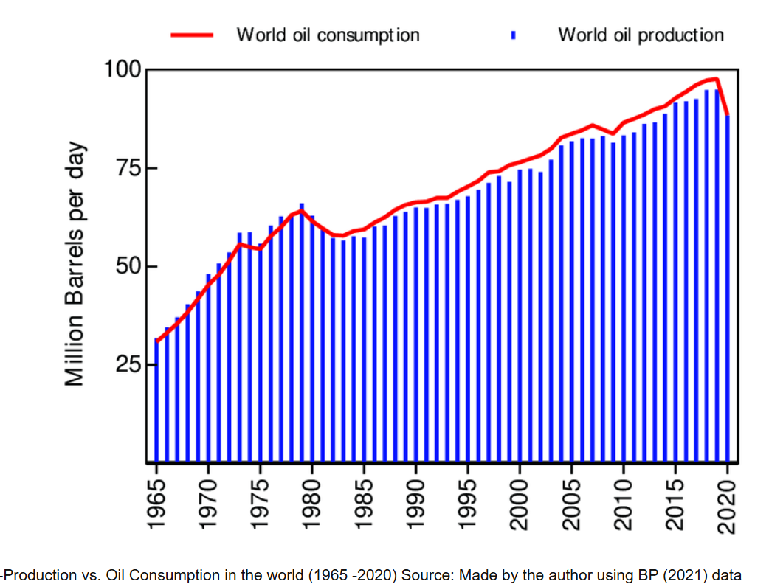

Slide 19
Societal Benefits: Quieter, Healthier Communities
Public Health: Reduced air pollution leads to fewer respiratory illnesses and early deaths in cities.
Noise Reduction: Significantly quieter motors reduce noise pollution, improving urban tranquility.
Energy Security: Reduces reliance on volatile global oil markets, stabilizing national energy supply.
V2G Potential: Vehicle-to-Grid technology allows EVs to support the grid during peak demand.

Slide 20
Economic Impact: Lower Costs, New Opportunities
Fuel Cost Savings: Electricity is significantly cheaper per mile than gasoline in most regions.
Lower Maintenance: Fewer moving parts means reduced service needs (no oil changes, fewer brake pad replacements).
Job Creation: Growth in battery manufacturing, charging infrastructure installation, and software development.
Global Competitiveness: Positioning nations as leaders in future transportation technology.

Slide 21
The Environmental Imperative: Cleaning the Air
Zero Tailpipe Emissions: Immediately removes harmful pollutants (NOₓ, PM) from dense urban areas.
Lower Lifetime Emissions: Even with manufacturing and grid energy, EVs generally result in lower lifetime CO₂ than ICEs.
Grid Decarbonization: EV benefits grow substantially as power generation shifts to renewables (Solar, Wind).
Energy Efficiency: Electric motors convert approx. 77\% of energy to motion, vs. 12–30% for ICEs.

Slide 22
environmental impact analysis
All stages of the life cycle were considered, starting from
The extraction of natural resources to produce materials and
Ending with conversion of the energy stored onboard the vehicle into mechanical energy for vehicle displacement and
Other purposes (heating, cooling, lighting, etc.).
In addition, vehicle production stages and end-of-life disposal are considered
As it contributes to environmental impact

Slide 23
Economical Analysis
Vehicle price,
Fuel cost, and
Driving range.
Maintenance costs
Cost of Battery replacement in Evs and HEVs

Slide 24
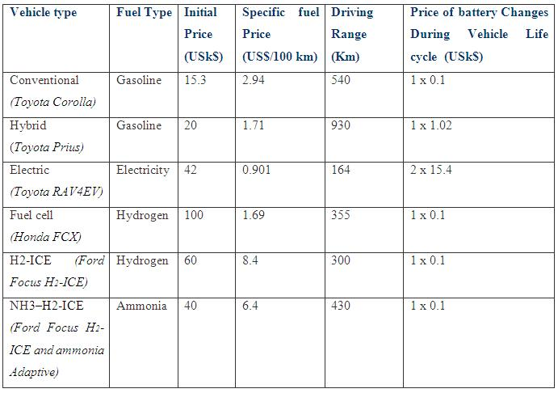

Slide 25
Environmental Analysis
Air pollution (AP)
The main GHGs were CO₂ , CH₄ , N₂O, and SF₆ (sulfur hexafluoride), which have GHG impact weighting coefficients relative to CO₂ of 1, 21, 310, and 24,900, respectively.
Greenhouse gas (GHG) emissions
For AP, the airborne pollutants CO, NO_{X} , SO_{X} , and VOCs are assigned the following weighting coefficients: 0.017, 1, 1.3, and 0.64, respectively.

Slide 26
The vehicle production stage contributes to the total life cycle environmental impact through the pollution associated with
The extraction and processing of material resources,
Manufacturing and
The vehicle disposal stage.
Additional sources of GHG and AP emissions were associated with the fuel production and utilization stages

Slide 27
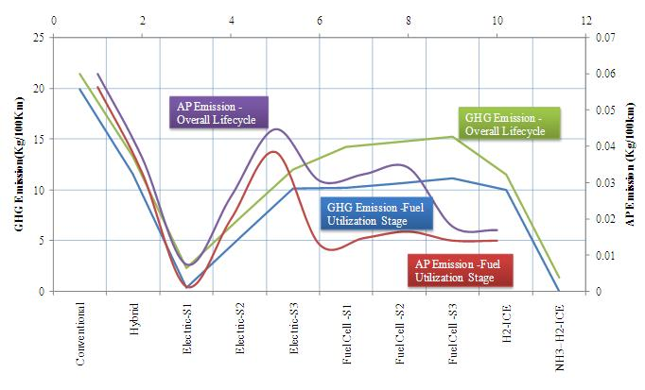

Slide 28
electricity production
Regarding electricity production for the electric cars
when electricity is produced from renewable energy sources and nuclear energy;
when 50% of the electricity is produced from renewable energy sources and 50% from natural gas at an efficiency of 40%;
when electricity is produced from natural gas at an efficiency of 40%.

Slide 29
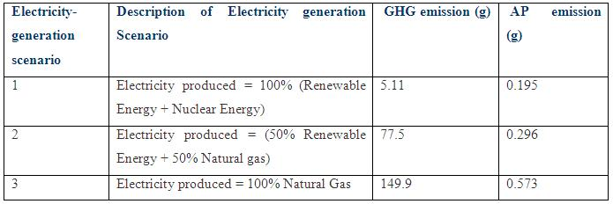
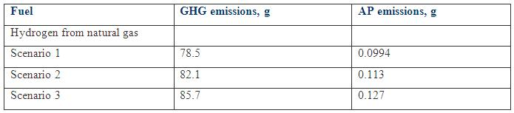

Slide 30
Results of technical–economical–environmental Analysis:
This analysis showed that the hybrid and electric cars have advantages over the others
If electricity is generated from renewable energy sources, the electric car is advantageous to the hybrid vehicle
If the electricity is generated from fossil fuels, the electric car remains competitive only if the electricity is generated onboard.
If the electricity is generated with an efficiency of 50–60% by a gas turbine engine connected to a high-capacity battery and electric motor, the electric car is superior in many respects.
For electricity-generation scenarios 2 and 3, using ammonia as a means to store hydrogen onboard a vehicle is the best option among those analyzed

Slide 31
Key Hurdles to Mass Adoption
Charging Infrastructure: Expanding accessible public fast-charging networks across all routes.
Battery Technology: Reducing costs, improving density, and accelerating charging speeds (e.g., solid-state).
Raw Materials: Ensuring ethical sourcing and implementing robust battery recycling programs.
Initial Cost: Making EVs affordable for the mass market without heavy subsidies.

Slide 32


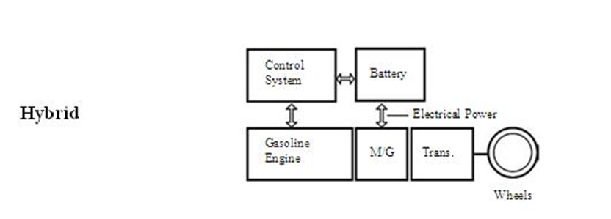

Slide 33
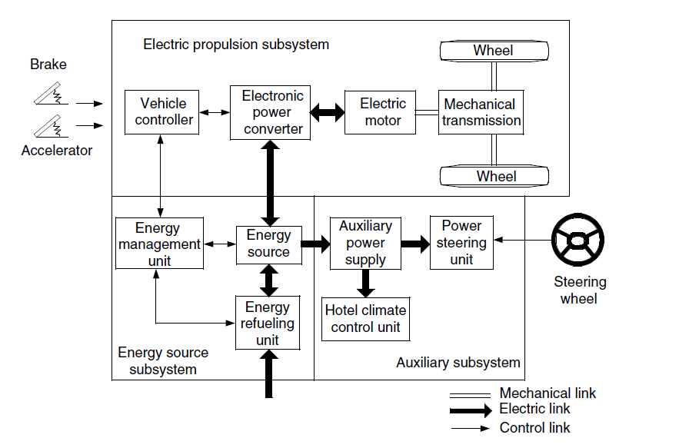

Slide 34

Vehicle Acceleration (According to newtons second law)
is the total tractive effort of the vehicle
Mv is the total mass of the vehicle, and δ is the mass factor,
Is the total resistance,

Slide 35
Total Tractive Force
Rolling Resistance Force(F_{rr})
Aerodynamic drag force(F_{aero})
Hill climbing Force(F_{hc})
Acceleration Force(F_{xi})
Linear Acceleration Force
Angular acceleration force

Slide 36
Total Power Required
Total Power P = F_{te} . V
F_{te} (Total Tractive Power) = F_{rr} + F_{ad} + F_{hc} + F_{la} + F_{wa}
F_{rr} - Rolling Resistance Force
F_{ad} – Aerodynamic Drag Force
F_{hc} - Hill Climbing Force
F_{la} - Linear Acceleration Force
F_{wa} - Angular Acceleration Force
Rolling Resistance Force
µ_{rr} - Rolling Resistance Constant
m - Mass of the Vehicle
g - Gravitational acceleration constant
F_{rr} = µ_{rr} m.g

Slide 37
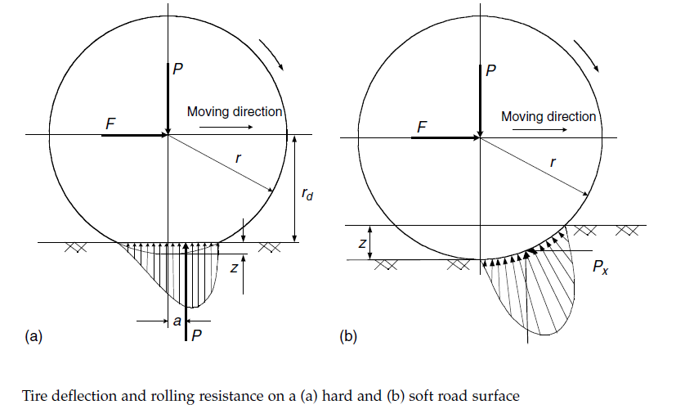

Slide 38
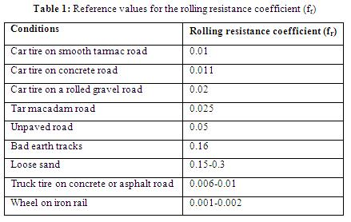

Slide 39
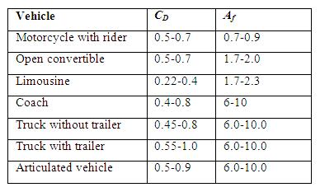
Aerodynamic Drag Force
F_{ad} = ½ρC_{d}Av² Newtons
ρ – Air Density kg/m³
A – Frontal Area m²
C_{d} – Drag Coefficient
v - Velocity of the Vehicle m/s
Reference values for drag coefficient (C_{D}) and the frontal area (A_{f} in m²) for some vehicle types

Slide 40
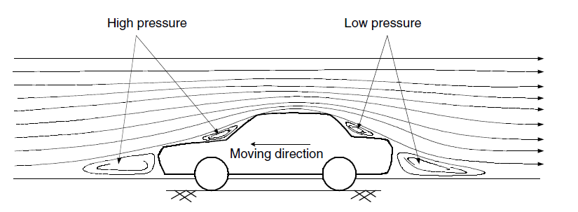

Slide 41
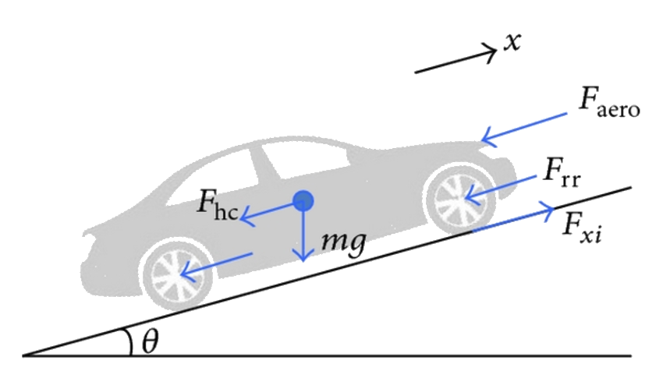
Hill Climbing Force
F_{hc} = m.g.Sin θ
Linear Acceleration Force
(F_{la}) = m.a
Θ varies from 0 – 10 degree hill
Rise / Run
F_{hc} = m.g.Sin θ
Length
Rise
θ
Run

Slide 42
Angular Acceleration
I= Moment of Inertia
G= Gear ratio
a = Acceleration
r = radius of tire
= Efficiency of Gear

Slide 43
Parameters | Notations | Value | Units
Weight | m | 1,000.00 | Kg
Width | W | 1.00 | m
Height | H | 1.50 | m
Rolling Resistance | µ_{rr} | 0.02
Air Density | ƥ | 1.25 | kg/m2
Drag Coefficient | Cd | 0.30
gravitational Force | g | 9.80
Speed in km |  | 40.00 | kpmh
Frontal Area | A | 1.50 | m2
Velocity | v | 11.11 | m/sec

Slide 44
Total Power = Total Tractive Force x Velocity
Velocity = kmpm -> m/s
= 40 * 1000/3600
Tractive Force =
Rolling Resistance Force + Aerodynamic drag force
Total Power P = F_{te} . v
F_{te} (Total Tractive Power) = F_{rr} + F_{ad}
Tractive Force | F_{te} | 230.72 | Nm
Total Power for 40Km | P | 2,563.58 | Watts

Slide 45
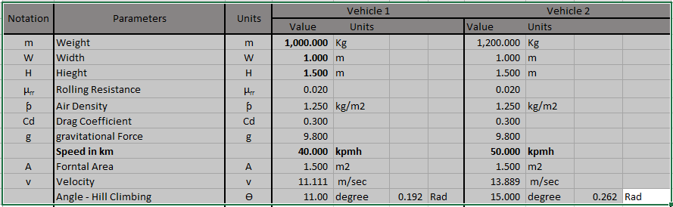

Slide 46
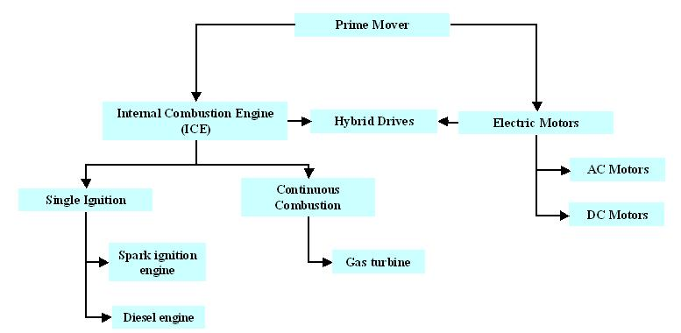

Slide 47
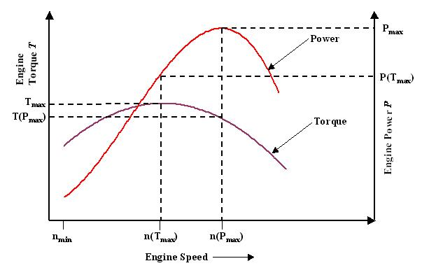

Slide 48
Motor Operating Region
POwer
Constant Torque Region
P = T. ω
Torque
Constant Power Region
ω_{c}
(Base Speed or critical speed)
Speed

Slide 49
The Maximum torque of an electric vehicle is a simple function of angular speed.
Mostly low speeds, the maximum torque is a constant
Until the motor speed reaches a critical value after which the torque falls.

Slide 50
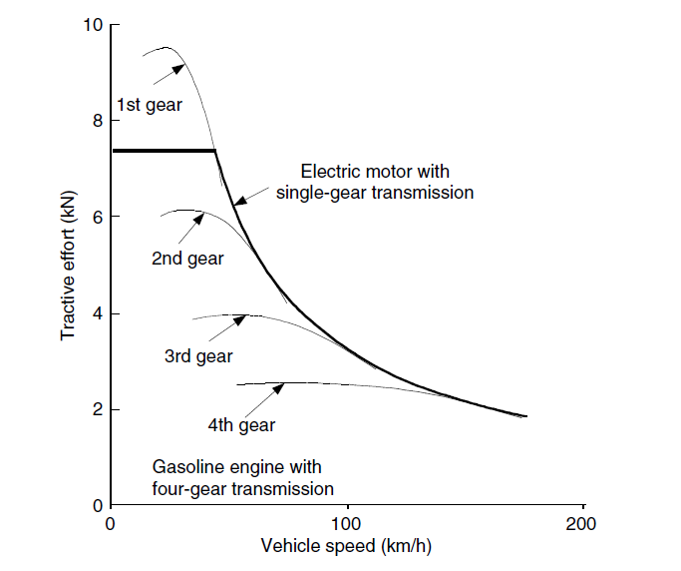

Slide 51
Observation
Huge Variation in Motive power
Vehicle is fully loaded to unloaded condition
Vehicle in hill climbing condition
Vehicle Speed
While Calculating Vehicle Power, all the extreme conditions to be taken in to consideration
Eg: Typical Extreme Conditions
Over load : 20% of Full load
Gradience : 20%

Slide 52
Acceleration of Force
The Vehicle will not be at constant speed.
Dynamic equation for Acceleration force (dv/dt)
m.dv/dt = F_{t} - (F_{rr} + F_{ad} + F_{hc} )
The Tractive Force greater than all resistance forces results into acceleration, similarly deceleration

Slide 53
How fast can vehicle reach the top speed?
Limiting Factors I
Weight of vehicle
Motor power of vehicle
Limiting Factors II
The Drive wheels will spin on the ground if, tractive effort>adhesive capability between tire and ground
Significant Slipping on the ground for wet, icy, snow covered or soft soil
Irrespective of the maximum torque power train can apply on wheel

Slide 54
How fast can vehicle reach the top speed?
Slip S (Tire) = (1 – V/rω) * 100% for running
Slip S (Tire) = (1 – rω/V) * 100% For Breaking
V – Translatory Speed of Tire center,
w – Angular speed of tire,
r – Rolling radius of the tire

Slide 55
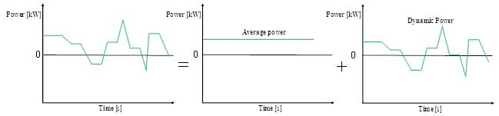

Slide 56



F_{hc} = m.g.Sin θ
Total Power P = F_{te} . v
F_{te} Total Tractive Power = F_{rr} + F_{ad} + F_{hc} + F_{la} + F_{wa}
F_{rr} = µ_{rr} m.g
F_{ad} = ½ρC_{d}Av² Newtons
(F_{la}) = m.a

Slide 57
Conclusion: Driving the Future
EVs are a proven technology with deep historical roots.
The shift is crucial for climate mitigation and local air quality.
The transition offers tangible social and economic benefits (health, cost savings).
Continued innovation in batteries and infrastructure will define the next decade of mobility.

