Slide 1
Power Diodes & Power Electronics Switches
Dr. Sachin Argade

Slide 2
What is a Power Diode?
Think of it as an electrical "one-way valve" for electricity
Allows current to flow in only one direction, like water in a pipe
Used in mobile chargers, laptop adapters, and EV charging systems
Power diodes handle high voltage and current (unlike small signal diodes)

Slide 3
Why "Power" Diode?
Regular diode: Works with small signals (milliamps)
Power diode: Handles large amounts of power (hundreds of amps)
Example: Your phone charger uses small diodes
Example: EV battery charger uses power diodes

Slide 4
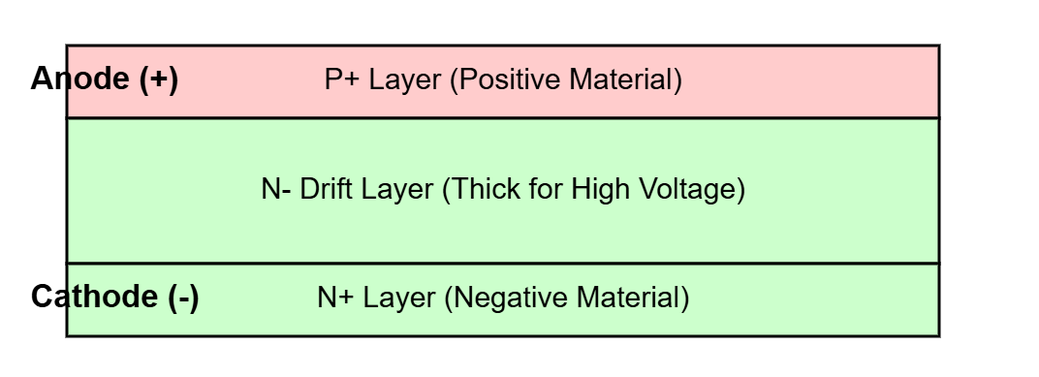
Power Diode Structure
The thick middle layer helps block high voltage

Slide 5
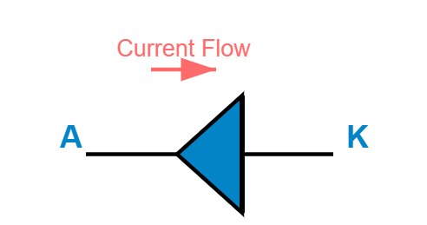
Power Diode Symbol
Current flows from Anode to Cathode (like arrow direction)

Slide 6
How Does a Diode Work?
Forward direction: When anode is positive, diode conducts (like open valve)
Reverse direction: When cathode is positive, diode blocks (like closed valve)
Small voltage drop when conducting: About 0.7V for silicon diodes
This one-way property is called "rectification"

Slide 7
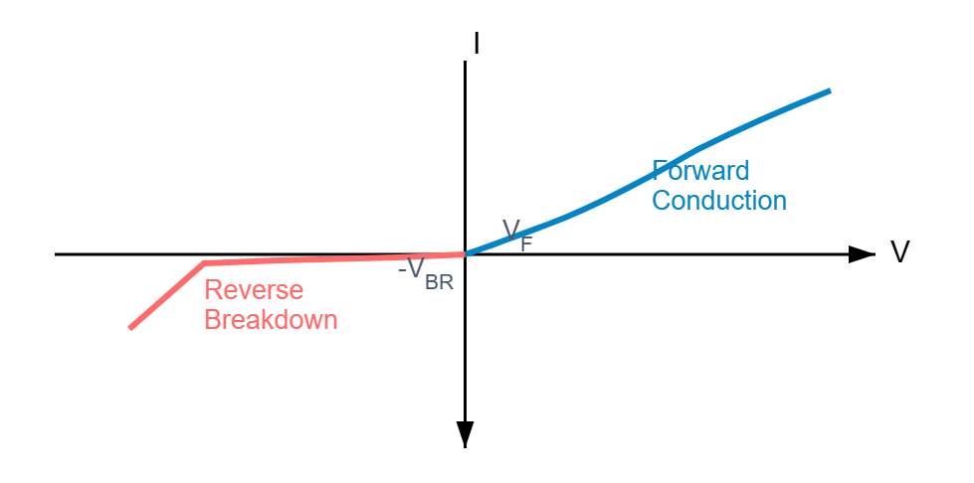
Diode Behavior Graph
Forward: Diode ON after 0.7V | Reverse: Diode OFF (blocks)

Slide 8
Forward Conduction Explained
When anode voltage is higher than cathode: Diode turns ON
Small voltage drop occurs: Typically 0.7V for silicon, 0.3V for Schottky
This voltage drop causes some heat generation
Example: In a 12V system, diode drops it to 11.3V

Slide 9
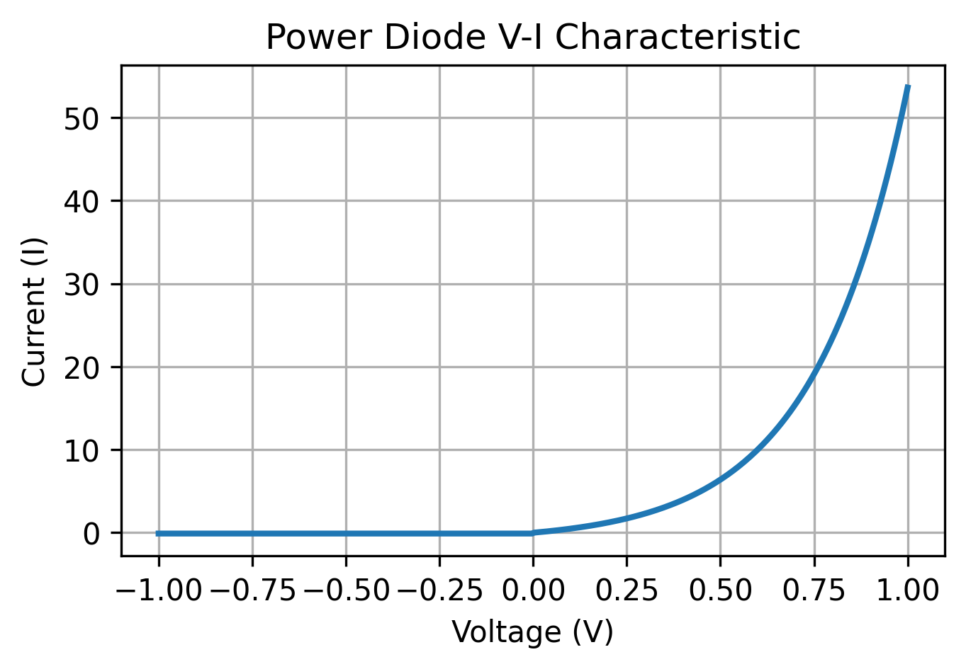
Power Diode V‑I Characteristic
Forward region shows rapid current increase after threshold voltage.
Reverse region shows very small leakage current.
Breakdown occurs when reverse voltage exceeds device rating.
This curve helps estimate conduction losses.

Slide 10
Reverse Blocking
When cathode voltage is higher than anode: Diode turns OFF
Very small leakage current flows (microamps)
Can block voltage up to its rating (e.g., 600V, 1200V)
Beyond this voltage: Diode breaks down (gets damaged)

Slide 11
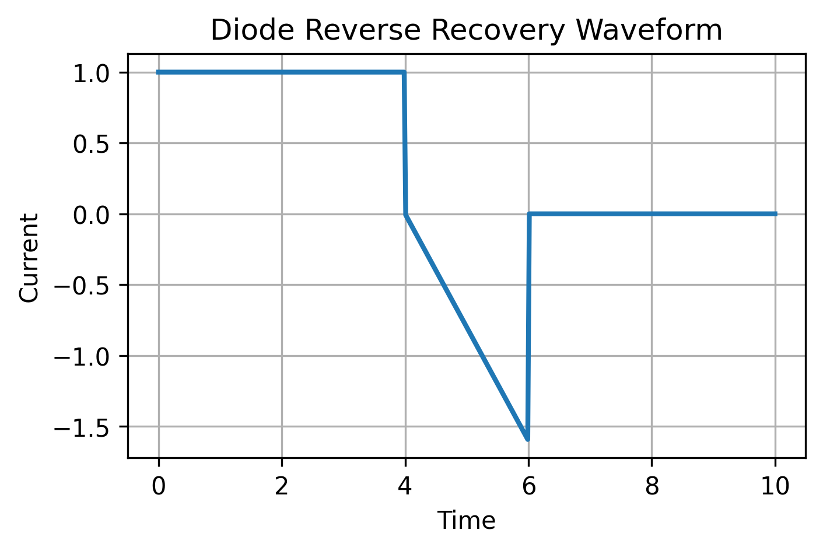
Reverse Recovery
When a diode switches OFF stored charge must be removed.
This produces reverse current called reverse recovery current.
Recovery time influences switching losses.
Fast recovery diodes are used in high frequency converters.

Slide 12
Types of Power Diodes
Standard Diodes: Used in AC to DC converters (slow switching)
Fast Recovery Diodes: Used in high-speed circuits (quick switching)
Schottky Diodes: Very low voltage drop, used in low-voltage systems
SiC Diodes: Advanced material, used in EVs for better efficiency

Slide 13
Where Do We Use Diodes?
Mobile phone chargers: Converting AC wall power to DC
Laptop adapters: Rectifying AC to charge battery
Solar panels: Preventing reverse current at night
LED lights: Controlling current direction

Slide 14
Diodes in Electric Vehicles (Part 1)
Battery charger: Converting AC from wall to DC for battery
Freewheeling diodes: Protecting motor controller circuits
Reverse polarity protection: Preventing wrong battery connections
DC-DC converter: Stepping down voltage for 12V accessories

Slide 15
Diodes in Electric Vehicles (Part 2)
Regenerative braking: Diodes handle reverse current from motor
Battery management system: Preventing cell discharge in wrong direction
Isolation sensing: Detecting ground faults for safety
These applications improve safety and efficiency

Slide 16
Power Electronics Switches
Controllable switches that turn ON and OFF like electronic valves
Unlike diodes, we can control these switches

Slide 17
What is a Power Switch?
Electronic component that can be turned ON or OFF by a control signal
Acts like a light switch but works electronically at high speed
Can switch thousands of times per second
Main types: MOSFET, IGBT, Thyristor, GTO

Slide 18
Main Types of Power Switches
MOSFET: Fast switching, used in laptops and small EVs
IGBT: High power, used in large EV motors and trains
Thyristor (SCR): Very high power, used in industrial applications
GTO: Improved thyristor with better control

Slide 19
MOSFET- Metal-Oxide-Semiconductor Field-Effect Transistor
Stands for: Metal-Oxide-Semiconductor Field-Effect Transistor
Think of it as a voltage-controlled tap for electricity
Has three terminals: Gate (control), Drain (input), Source (output)
Apply voltage to Gate to turn ON, remove voltage to turn OFF

Slide 20
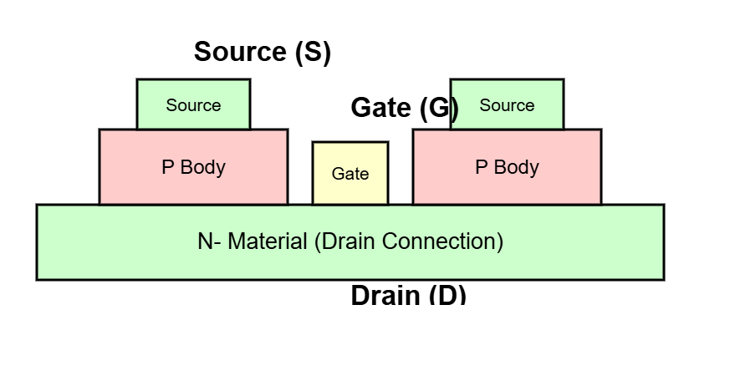
MOSFET Structure Simplified

Slide 21
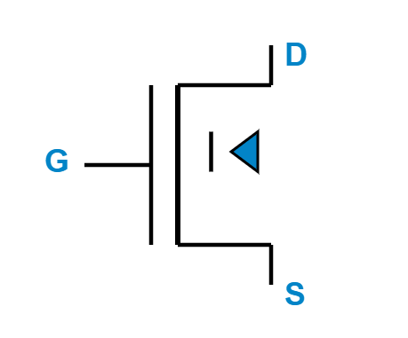
How Does MOSFET Work?
Apply positive voltage to Gate (e.g., 10-15V): MOSFET turns ON
Current flows from Drain to Source (like tap is open)
Remove Gate voltage (0V): MOSFET turns OFF
No current flows from Drain to Source (like tap is closed)
It requires almost zero steady‑state gate current.
Commonly used in EV DC‑DC converters.
Control voltage at Gate turns the switch ON/OFF

Slide 22
MOSFET Key Features
Very fast switching: Can turn ON/OFF in nanoseconds
Low control power: Gate needs very little current to operate
Commonly used in: DC-DC converters, laptop chargers, small EV converters
Good for low to medium voltage applications (up to 600V)

Slide 23
MOSFET Applications
Laptop power supplies: Regulating voltage for battery charging
LED drivers: Controlling brightness of LED lights
Motor speed controllers: Adjusting fan or pump speeds
DC-DC converters in EVs: Stepping down high voltage to 12V

Slide 24
IGBT - Insulated Gate Bipolar Transistor
Stands for: Insulated Gate Bipolar Transistor
Combination of MOSFET (easy control) and BJT (high power)
Has three terminals: Gate (control), Collector (input), Emitter (output)
Used when we need high power handling with simple control

Slide 25
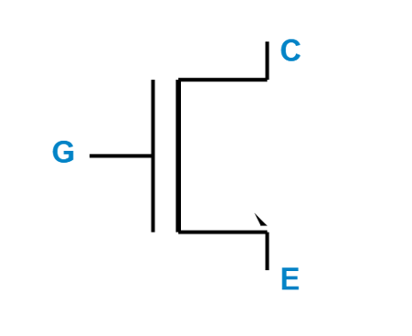
How Does IGBT Work?
Apply positive voltage to Gate (10-15V): IGBT turns ON
Current flows from Collector to Emitter
Remove Gate voltage: IGBT turns OFF (with small delay)
Combines easy control of MOSFET with power handling of BJT
Similar to MOSFET but with arrow showing bipolar nature

Slide 26
IGBT Key Features
Can handle very high power (hundreds of kilowatts)
Lower voltage drop when ON compared to MOSFET (less heat)
Moderate switching speed (slower than MOSFET but still fast)
Commonly used in: Large EV motors, industrial drives, trains

Slide 27
MOSFET vs IGBT - Quick Comparison
MOSFET
IGBT
Very fast switching
Low to medium power
Used in: Laptop chargers
Good for high frequency
Moderate speed
High power handling
Used in: EV motors
Good for high voltage

Slide 28
IGBT Applications
Electric vehicle traction inverters: Driving the main motor
Industrial motor drives: Controlling large pumps and compressors
Railway traction: Electric trains and metro systems
Welding machines: High current switching for arc welding

Slide 29
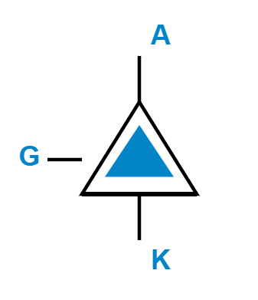
Thyristor (SCR) - Silicon Controlled Rectifier
Acts like a controllable diode that latches ON
Has three terminals: Anode, Cathode, Gate (trigger)
Once turned ON, it stays ON until current is stopped

Slide 30
Thyristor Structure
Step 1: Anode must be positive with respect to cathode
Step 2: Apply small positive pulse to Gate to trigger
Step 3: Thyristor latches ON and stays ON
Step 4: To turn OFF, reduce anode current to zero

Slide 31
Thyristor Key Features
Can handle extremely high power (megawatts)
Once triggered, Gate loses control (latching behavior)
Used in AC circuits where current naturally goes to zero
Very low voltage drop when conducting (efficient)

Slide 32
Thyristor Applications
AC motor speed controllers: Industrial fans and pumps
Light dimmers: Controlling brightness of AC lights
Battery chargers: High-power charging systems
HVDC transmission: High-voltage DC power lines

Slide 33
GTO - Gate Turn-Off Thyristor
Improved version of thyristor with better control
Can be turned ON by positive gate signal
Can be turned OFF by negative gate signal (unlike SCR)
Used where we need full control over high power

Slide 34
Silicon Carbide (SiC) Devices
Made from Silicon Carbide instead of regular Silicon
Can work at much higher temperatures (200°C vs 150°C)
Handle higher voltage with smaller size
Faster switching with lower losses

Slide 35
SiC Advantages for Electric Vehicles
Better efficiency: Less energy wasted as heat
Smaller cooling systems: Reduces vehicle weight
Faster charging: Can handle higher charging currents
Longer range: More efficient power conversion

Slide 36
Power Electronics in Electric Vehicles
Understanding where these components work in your EV

Slide 37
Main Power Systems in EV
Traction Inverter: Converts battery DC to motor AC
Onboard Charger: Converts grid AC to battery DC
DC-DC Converter: Steps down voltage for accessories
Battery Management System: Monitors and protects battery

Slide 38
Traction Inverter - Heart of EV
Function: Converts DC battery power to AC for motor
Uses: 6 IGBT or SiC MOSFET switches in 3-phase bridge
Controls: Motor speed by changing AC frequency
Regenerative braking: Motor generates power, inverter sends it back to battery

Slide 39
Why EV Needs Inverter
Battery stores DC (Direct Current)
Motor needs AC (Alternating Current) to rotate efficiently
Inverter changes DC to AC using fast switching
By changing AC frequency, we control motor speed

Slide 40
Onboard Charger (OBC)
Function: Converts AC from wall socket to DC for battery
Uses: Power diodes or MOSFETs for rectification
Controls: Charging current and voltage automatically
Protection: Stops charging when battery is full

Slide 41
DC-DC Converter
Function: Steps down high voltage (400V) to low voltage (12V)
Uses: MOSFETs for fast switching and diodes for freewheeling
Powers: Lights, wipers, radio, dashboard, air conditioning
Replaces: Traditional 12V battery in conventional cars

Slide 42
Battery Management System (BMS)
Uses diodes: To prevent reverse current between cells
Uses MOSFETs: For cell balancing (equalizing charge)
Protection circuits: Disconnect battery in case of fault
Monitors: Voltage, current, and temperature of each cell

Slide 43
Summary
Power diodes: One-way valves for electricity
MOSFETs: Fast switches for low to medium power
IGBTs: Powerful switches for high power applications
SiC devices: Future of efficient power electronics

Slide 44
Key Takeaways
All EVs use multiple power electronics components
Choosing right component depends on voltage, current, and speed
Power electronics make EVs efficient and controllable
Future EVs will use more SiC devices for better performance

Slide 45
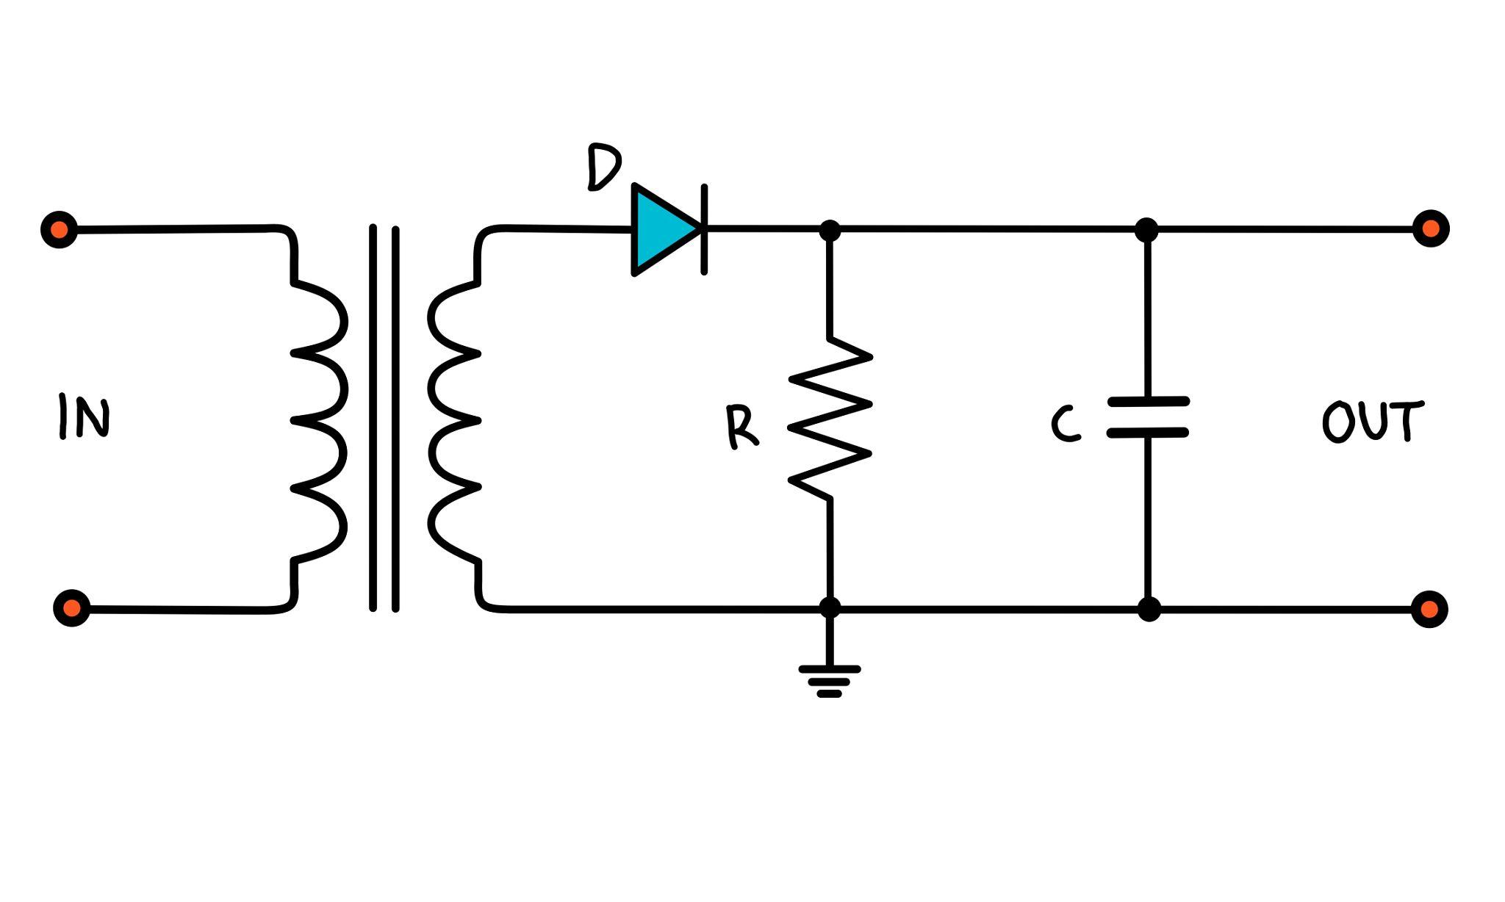
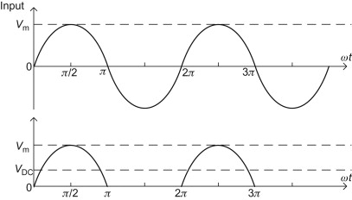
Half Wave rectifier

Slide 46
Working Principle
Positive Half Cycle
When AC input becomes positive, the diode becomes forward biased.
Current flows through the diode and load resistor.
Output voltage appears across the load.
Negative Half Cycle
When AC input becomes negative, the diode becomes reverse biased.
The diode blocks current.
Output voltage becomes zero.

Slide 47
Thus only one half of the AC waveform appears at the output.
Output Waveform
Output is pulsating DC.
Only positive half cycles appear.

Slide 48
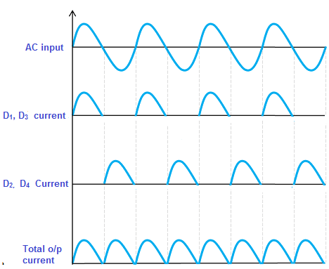
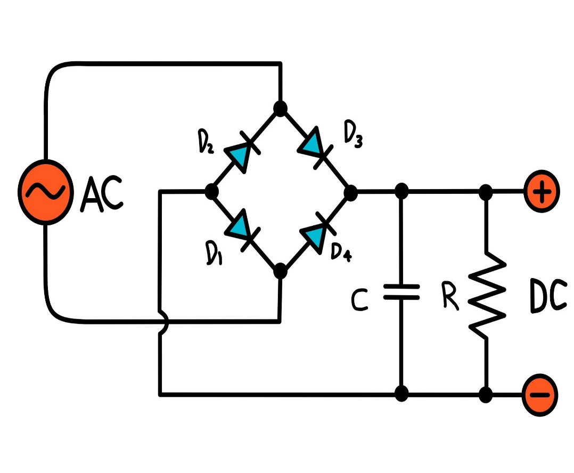
Full Wave Rectifier
A full-wave bridge rectifier converts both positive and negative halves of AC into DC using four diodes arranged in a bridge configuration.

Slide 49
Working Principle:
Positive Half Cycle
Diodes D1 and D3 conduct.
Diodes D2 and D4 are reverse biased.
Current flows through the load in one direction.
Negative Half Cycle
Diodes D2 and D4 conduct.
Diodes D1 and D3 are reverse biased.
Current again flows through the load in the same direction.
Thus both halves of the AC waveform are converted to DC.

Slide 50
Output Waveform
Both positive and negative cycles become positive at output.
Output is pulsating DC with higher frequency ripple.
Applications:
Power supplies
Battery chargers
DC motor drives
Electronic equipment power circuits

Slide 51
Basic Concept of DC–AC Conversion
Process
Battery (DC) → Inverter (DC to AC conversion) → AC Motor → Mechanical power → Wheels
The inverter converts the constant DC voltage of the battery into variable-frequency and variable-voltage AC required by the motor.

Slide 52
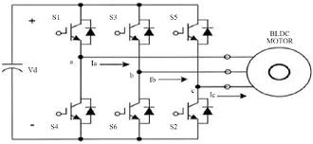
Most EVs use a three-phase voltage source inverter (VSI).
Structure
6 power switches (IGBTs or MOSFETs)
Arranged in three legs
Each leg produces one phase (A, B, C)
Switch pairs
Phase A → S1, S4
Phase B → S3, S6
Phase C → S5, S2
EV Inverter Main Components
Battery Pack
DC Link Capacitor
Power Inverter (IGBT/MOSFET based)
Motor Controller
AC Traction Motor

Slide 53
Working Principle
Step 1: DC Supply
The battery provides high voltage DC (200–800 V depending on EV design).
Step 2: High-Speed Switching
Power semiconductor switches operate at 5 kHz – 20 kHz.
Step 3: PWM Control
Using Pulse Width Modulation (PWM), the inverter synthesizes a sinusoidal AC waveform.
Step 4: Three-Phase Output
The inverter generates:
Phase A voltage
Phase B voltage
Phase C voltage
These are 120° phase shifted AC signals that drive the motor.

Slide 54
Mathematical Representation
The three-phase voltages generated are:
V_{a}=V_{m}sin(ωt)
V_{b}​=V_{m​}sin(ωt−120∘)
V_{c}​=V_{m}​sin(ωt−240∘)
Where
V_{m}= peak phase voltage
ω = angular frequency
t = time
By controlling frequency, the EV controls motor speed.

Slide 55
Power Devices Used in EV Inverters
Device | Used In
MOSFET | Low power EVs, e-bikes
IGBT | Most electric cars
SiC MOSFET | High efficiency EVs (Tesla, Hyundai, Porsche)
EV inverter also performs:
Motor torque control
Regenerative braking
Current limiting
Motor protection
Efficiency optimization
During regenerative braking, the inverter works in reverse:
Motor AC → Inverter → DC → Battery charging.

Slide 56
AC to DC
In an EV, AC to DC transformation happens mainly in the on‑board charger (OBC) during AC charging, where grid AC is converted into controlled DC to charge the high‑voltage battery.
EV batteries store energy as DC, typically a few hundred volts (for example 200–900 V depending on vehicle and SOC).
When you plug into an AC charger (home or public “AC station”), AC from the grid goes through the OBC inside the car, which converts it to DC and sends it to the pack via the BMS.
With DC fast charging, the AC→DC conversion is done in the off‑board charger; the station outputs DC directly, bypassing the vehicle’s OBC.

Slide 57
AC input + EMI(Electromagnetic Interference) / protection
Grid AC (often 200–400 V single‑ or three‑phase) passes through contactors, fuses, and EMI filters to meet grid EMC (electromagnetic compatibility) and safety requirements.
AC→DC rectifier + PFC stage
A full‑wave rectifier plus an active power‑factor‑correction (PFC) stage converts AC to a regulated high‑voltage DC “PFC bus”.
PFC shapes input current to be almost sinusoidal and in phase with the voltage, giving high power factor and low harmonics.

Slide 58
Isolated DC‑DC converter (DC bus → battery DC)
From the PFC DC bus (often several hundred volts), an isolated DC‑DC stage converts and isolates to the exact battery voltage required at that moment.
This stage runs in CC/CV modes under BMS supervision to control charging current and voltage safely.
Battery connection and BMS
The DC output passes through contactors and measurement circuits to the battery; BMS monitors cell voltages, temperature, and current and commands the OBC to adjust or stop charging.

Slide 59
Operating modes and power levels
Normal AC charging (“Level 1/2”) uses the OBC, with typical power from about 1–2 kW up to around 11–22 kW depending on vehicle and grid phases.
In this mode, the AC→DC converter in the car determines the maximum AC charging rate; higher‑power OBCs allow faster AC charging but add cost and thermal complexity.

Slide 60
Why this AC→DC chain is special in EVs
Must meet strict grid standards for power factor and harmonics (hence sophisticated PFC, not just a diode bridge and bulk capacitor).
Must be highly efficient (around mid‑90% range) and compact, often sharing hardware and cooling with other power‑electronics like DC‑DC and inverter.
Must coordinate tightly with the BMS for safe charging (cell balancing, temperature limits, SOC estimation, etc.).

Slide 61
BMS and OBC control interaction
The BMS is “master”; OBC is a “slave power module” that follows BMS requests.
Handshake with Electric Vehicle Supply Equipment (EVSE)
Vehicle charge controller communicates with the AC EVSE (pilot signal, control pilot, proximity, or digital comms depending on standard).
Max available current from grid/EVSE is determined (e.g. 32 A).
BMS decides charge limits
Based on cell voltages, pack voltage, temperatures, SOC, and SOH, BMS computes allowable charge current I_{chg,max} and target voltage V_{target}
It considers safety limits (cell over‑voltage, pack over‑current, temperature windows).

Slide 62
BMS sends setpoints to OBC
Over CAN or other in‑vehicle network, BMS sends allowed current, target voltage, and possibly ramp rates or mode (CC/CV).
OBC confirms its own limits (thermal, grid current limit, hardware max) and returns a feasible set point if needed.
OBC inner control loops
PFC stage: inner current loop tracks a sinusoidal reference; outer DC‑bus loop regulates V_{dc}
DC‑DC stage: inner current loop controls battery current, outer loop controls battery voltage during CV phase.

Slide 63
Charging profile (CC/CV)
Constant‑current phase: OBC regulates I_{bat}=I_{ref} commanded by BMS; BMS monitors cell voltages and temp.
Once any cell approaches its upper limit, BMS switches to constant‑voltage behaviour: it commands a V_{target} and progressively reduces current.
Fault and safety handling
If BMS detects over‑temperature, over‑voltage, communication loss, isolation fault, etc., it sends reduced current or stop command; OBC must ramp down gracefully and open contactors if required.

Slide 64
AC charging vs DC fast charging path
Aspect | AC charging (OBC) inside EV | DC fast charging (off‑board)
Where AC→DC happens | Inside vehicle OBC power stages. | In the charging station power converter
Vehicle hardware | Uses rectifier+PFC + isolated DC‑DC, 3–22 kW. | Only HV contactors, DC/DC fuse, BMS; no high‑power AC→DC in car
Control master | BMS commands OBC set points | BMS communicates limits; station’s converter executes
Power levels | Typically 1–22 kW | Commonly 50–350+ kW
Grid quality | Vehicle OBC must meet PF/THD standards. | Station enforces PF/THD; vehicle sees DC only

Slide 65
In both cases, BMS always decides how much current and voltage are acceptable,
but in AC charging the OBC implements the power conversion,
while in DC fast charging the external charger does that and the vehicle mostly manages contactors and monitoring.

