Slide 1
SUMMER INTERNSHIP
Prameela
AP20110010120

Slide 2
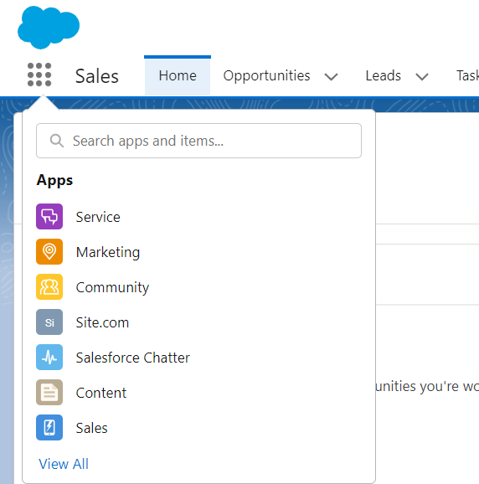
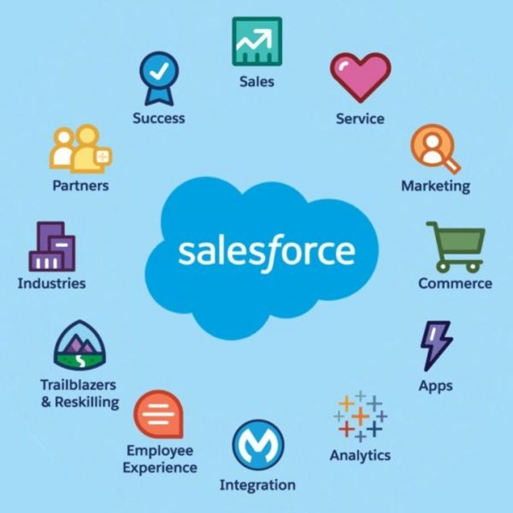
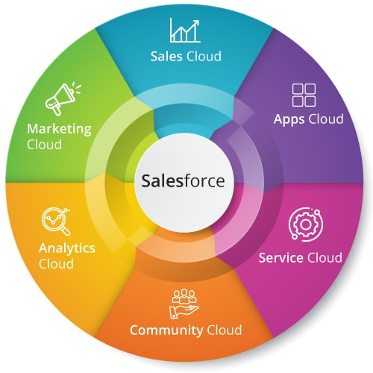
INTRODUCTION
Salesforce-supported virtual internship - Launched by Smartbridge through the smartinternz platform.
Role: Salesforce developer.

Slide 3
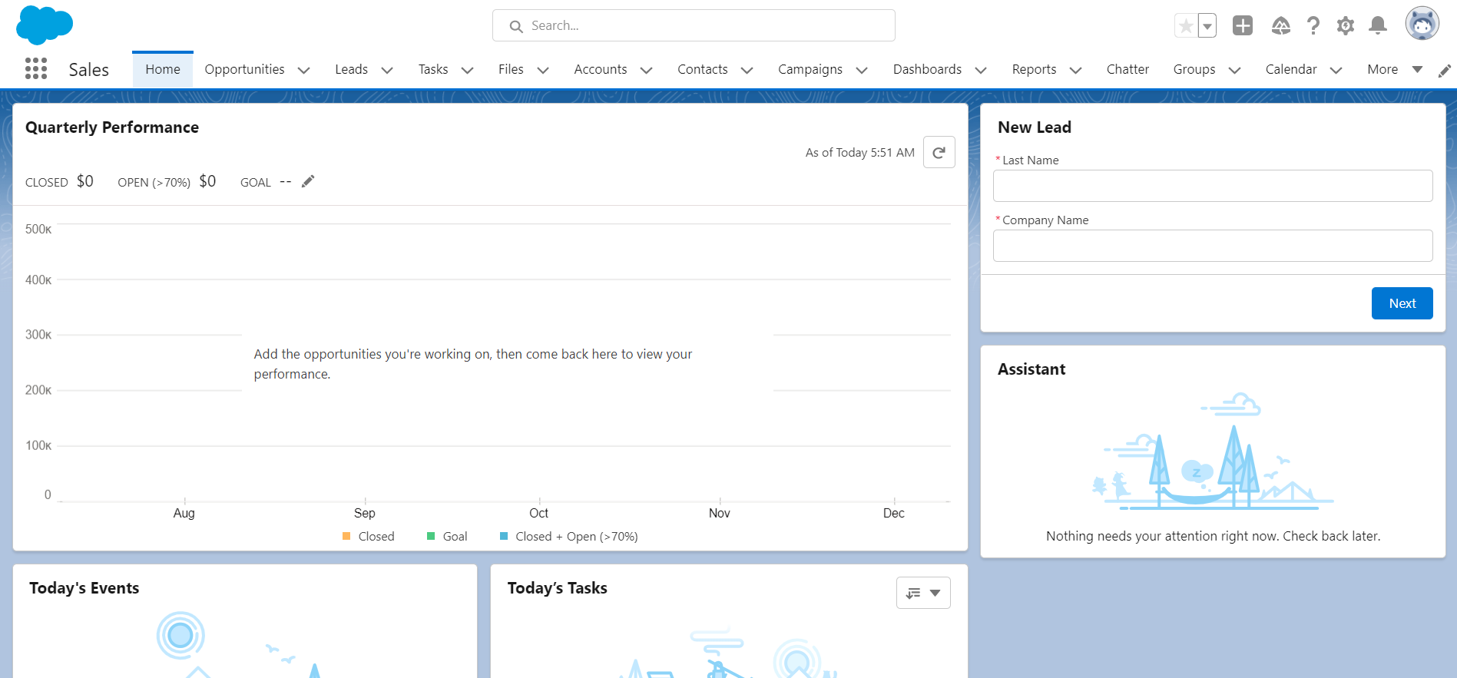
Salesforce is a customer success platform, designed to help businesses sell, service, market, analyze, and connect with their customers.

Slide 4
Overview of the Project
Self-Learning
Apex Specialist Super badge
Process Automation Specialist Super Badge

Slide 5
DETAILS of the internship PROJECT
Self-Learning:
Relationships: Link objects to make connections between them.
Process Automation: Tools that simplify tasks. Automation tools provided by salesforce: Workflow, Process Builder, Flow builder, Approvals.
Security: Deals with sharing settings of data and visibility between users across the organization.
Apex: Apex is an object-oriented programming language that allows developers to execute flow and transaction control statements on the Lightning platform server. It ensures deliver of high quality apps.
Integration: Creating a connection between a specific Salesforce instance and another database or instance or system.

Slide 6
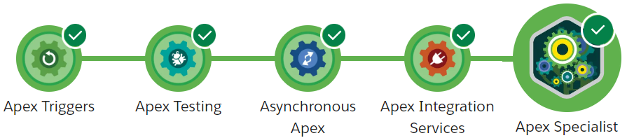
Apex Specialist
Recreation vehicle rental company
Service requests for broken or malfunctioning equipment and routine maintenance requests for vehicles
Integrate Salesforce with the company’s back-office system
Synchronization – to ensure the company’s headquarters (HQ) knows how much equipment is available when making a maintenance request, and alerts them when they need to order more equipment.

Slide 7
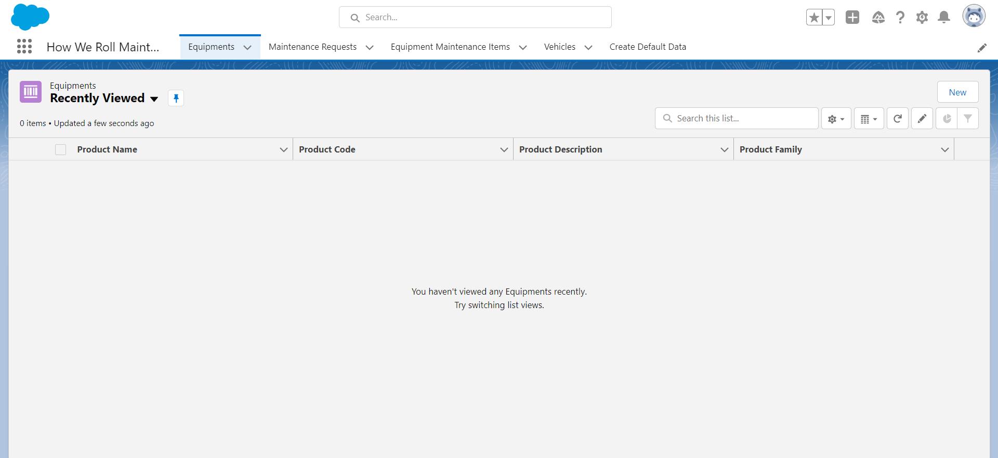

Slide 8
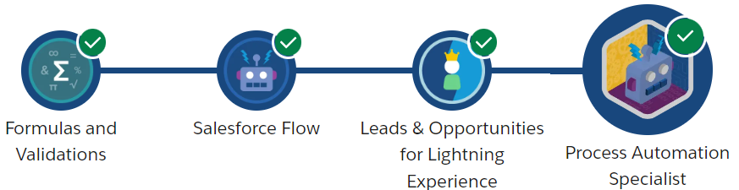
Process Automation Specialist:
Representatives request deal approvals by emailing a manager. Managers evaluate leads one by one before assigning them to the right team. The list of inefficient, error-prone business processes goes on and on. Meanwhile, the company is missing out on opportunities because the sales team spends too much time keeping records and not enough time closing deals. So, the company needs to get automated.

Slide 9
RB Robotics uses the following standard objects to store all deal-related data.
Account - Businesses that purchase from RB Robotics (Customer - Direct and Customer - Channel) and businesses that might purchase in the future (Prospect)
Contact - Prospective and existing customers of RB Robotics
Opportunity - Potential sale of Rainbowbots or RB Robotics assembly systems
Custom Objects:
Robot Setup—Information about RB Robotics robot setup. Each robot setup record has a Master-Detail relationship to an opportunity.
Fields
Name
Date
Notes
Day of the Week

Slide 10
Thank You

