Slide 1

Dynamic Routing protocols

Slide 3

Types of Igp
Distance Vector Routing
Link state Routing

Slide 4
Tech Requirements
Network
Satellite
Link

Slide 5

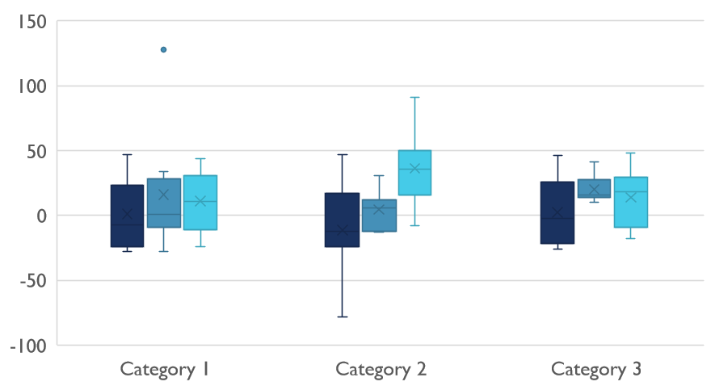
Competitive Landscape

Slide 6

Thank You
someone@example.com

