Slide 1
SUBJECT ALLOCATION OF FACULTY MEMBERS
Group - 6:
AP20110010074 – Kavyasri
AP20110010081 – Hima Sri
AP20110010112 – Sai Manoj
AP20110010120 – Prameela
AP20110010122 – Rakesh
Under the guidance of Dr. Tapas Kumar Mishra

Slide 2
Contents:
Problem statement
Objective
Constraint Satisfaction Problem
Constraints
Project model
Input and output models
Conclusion

Slide 3
PROBLEM
STATEMENT:
In any educational institute, the timetable committee has to assign subjects to faculty before starting the new academic year . In this process the subject allocation committee has to take many points into consideration such as interests of faculty in a subject, capability of the faculty to take newly introduced challenging subject, availability of faculty, and some other points. The subject allocation committee has to do tiresome, complex manual work which takes a lot of time to analyse before assigning any subject to any faculty.
objective :
Allocating faculty with a set of subjects to different sections based on their preferences/interests, availability etc. by using constraint satisfaction problem.

Slide 4
Constraint satisfaction problem
Constraint satisfaction is a technique where a problem is solved when its value satisfies certain constraints or rules of the problem.
Here in CSP we represent each problem with a set of components namely V, D, and C. where,
V: It is a set of variables.
D: It is a set of domains.
C: It is a set of constraints.
The constraint value is a pair of (scope, rel). Where scope is a tuple of variables which participate in constraint and rel is relation which includes a list of values which the variables can take to satisfy the constraints.

Slide 5
Components in csp
variables
In our project variables are set of faculties and set of sections
constraints
Faculty should not go for two subjects for the same section.
Total number of sections a faculty can go for teaching must be less than three.
Subject allocation should be done based on the preferences. i.e., first preference subject should be allocated first.
Each section should have atmost five to six subjects.

Slide 6
Project model
Database required
Faculty database : consists of faculty and their preferences
Section database : consists of sem, section and their subjects
From sections
Choose subject from sections database one by one
From faculty
Find the faculty having that subject as a first preference.
allocation
If we find the faculty, we allocate them. Otherwise we search for faculties having that subject as a second preference.

Slide 7
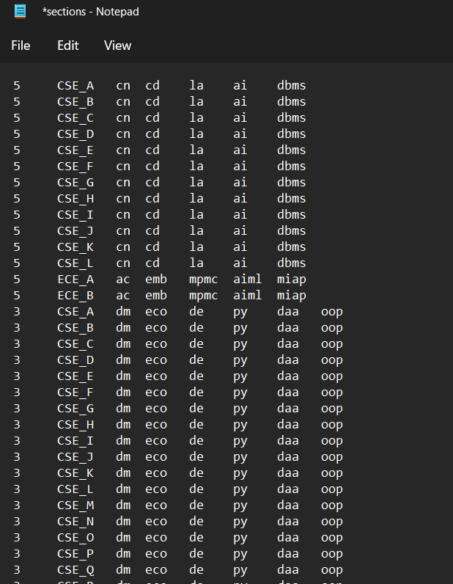
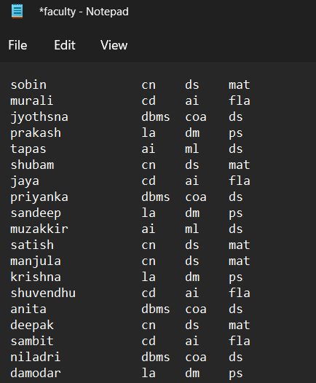
Input databases

Slide 8
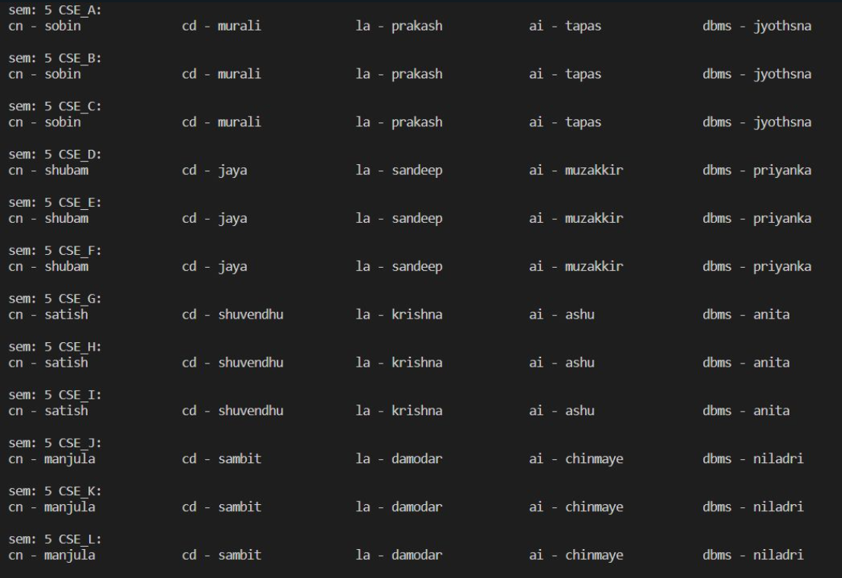
output

Slide 9
conclusion
Now a days many institutes are doing physical or manual work for allocating subjects to faculty which takes long time to assign and a heavy load to the person who is doing it. There may be chances of making errors frequently. So, here we came up with the method mentioned above to overcome the problems faced during allocating the subjects to faculty which makes it easier to the institutes to make the work faster and reducing the chances of errors.

Slide 10
Thank you

