Slide 1

CYBER KILL CHAIN
Presented By,
Prameela K
CSA- JUNE 2024
ICT Academy of Kerala
An Analysis of cybersecurity Attack Phases

Slide 2
What is Cyber Kill chain?
The Cyber kill chain is a security framework that helps organizations identify and stop cyber attacks by breaking them down into stages.
The Cyber kill chain was developed by Lockheed Martin in 2011 and is based on the military concept of a kill chain. It is often used in penetration testing, which is a simulated attack on a computer system to evaluate its security.
The Cyber kill chain helps organizations prepare for cyberattacks and protect their data. However, this model also has flaws and new methods are constantly being discovered.

Slide 3
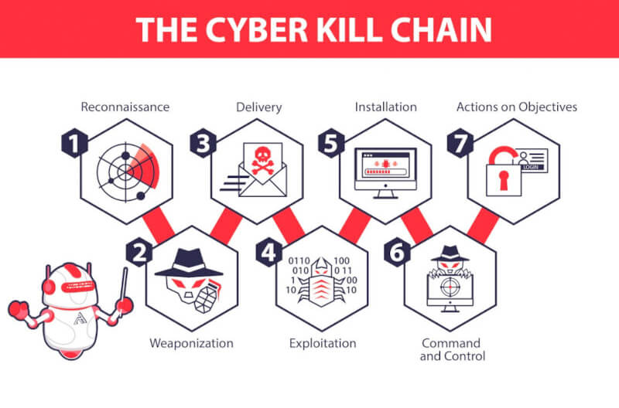

Slide 4
1. Reconnaissance
This is the initial stage where the attacker gathers as much information as possible about the target. The goal is to identify potential vulnerabilities that can be exploited. Attackers may research publicly available information, scan network ports, or use social engineering techniques to gather insights.
Eg: An attacker might visit a company’s website to gather details about its employees, infrastructure, or technologies in use. They could also scan for open ports to see if any services are vulnerable.

Slide 5
2. Weaponization
During Weaponization, the attacker creates a malicious payload by combining malware (like a virus, worm, or Trojan) with an exploit that will take advantage of a specific vulnerability in the target’s system. The weaponized payload is prepared but not yet delivered to the target.
Eg: An attacker may create a malicious PDF file that exploits a known vulnerability in a PDF reader, or develop a piece of malware that will open a backdoor into the target’s system.

Slide 6
3. Delivery
In this stage, the attacker delivers the weaponized payload to the target. Delivery methods can include phishing emails, malicious websites, infected USB drives, or other forms of malware propagation.
Eg: A spear- phishing email is sent to target employee with a malicious attachment or link. Once the target opens the file or clicks the link, the payload is delivered to the target system.

Slide 7
4. Exploitation
This stage occurs when the attacker’s weaponized payload is activated. The malware or exploit code executes on the target system by taking advantage of vulnerabilities, often leading to the installation of malicious software.
Eg: After the victim opens the infected email attachment, the attacker’s exploit is executed, leading to unauthorized code execution on the target machine. This could result in privilege escalation or disabling security features.

Slide 8
5. Installation
In this installation phase, the attacker installs malware on the compromised system to establish a persistent backdoor or foothold. This allows the attacker to maintain access even if the system is rebooted or other security measures are taken.
The attacker may install a Remote Access Trojan (RAT), which allows them to remotely control the system, or a rootkit that conceals the presence of malware.

Slide 9
6. Command And Control (C2)
Once the malware is installed, the attacker sets up a communication channel between the compromised system and an external server controlled by the attacker. This is necessary for the attacker to issue commands and remotely control the target system.
The installed malware connects to the attacker’s server, sending periodic updates and allowing the attacker to send further instructions or commands, such as retrieving data or spreading malware to other systems.

Slide 10
7. Action On Objectives
This is the final stage where the attacker achieves their goal, whether it’s data theft, system damage, or further spread of the attack within the network. The objectives could include data exfiltration, encryption of data (ransomware), or even destruction of critical system.
The attacker could exfiltrate sensitive company data, steal customer information, install ransomware to demand a payment, or destroy important data to sabotage operations.

Slide 11
Conclusion
The Cyber Kill Chain helps break down Cyberattacks into actionable stages, enabling organizations to detect, disrupt, and prevent threats more effectively. By understanding each phase, security teams can strengthen defenses, reduce risks, and stay ahead of attackers. It’s a vital tool for building stronger, proactive cybersecurity strategies in today’s ever evolving threat landscape.

