Slide 1
MACHINE LEARNING PERSPECTIVE
Ericsson Patent Evolution
Forecasting Next-Quarter Patent Filings from the Innovation Timeline
Dr. Ayesha Naureen
Ms. Prameela
Mr. Sai Kiran
Mrs. Manasa

Slide 2
AGENDA
What We'll Cover
01
Introduction
05
Pipeline Architecture
Patent and Ericsson
11-stage ML workflow with leakage fix & tuning
02
Ericsson Innovation Timeline
06
Models & Metrics
Patent evolution across four tech eras
5 regressors + Poly Regression compared on RMSE / MAE / R²
03
Problem Statement
07
Results & Conclusion
07
Why forecast quarterly patent output?
Tuned RF Test R²=0.76, MAE≈47 patents/quarter
04
Dataset & EDA
30K+ records, 55 columns, target distribution
Ericsson Patent Evolution · ML Pipeline
2

Slide 3






PATENT
What Is a Patent — and Why File One?
A patent is a legal right granted by a government that gives an inventor exclusive control over their invention for a limited period — typically 20 years — in exchange for public disclosure.
Invention
→
Filing
→
Examination
→
Grant
→
Protection (20 yrs)
Business benefits of filing
Exclusivity
Licensing revenue
Negotiating leverage
Blocks competitors from copying, protects market share
Royalties — billions/year for firms like Ericsson
Power in cross-licensing deals & litigation defense
Standards power
Investor confidence
Strategic signaling
SEPs force competitors to license to stay compliant
Signals R&D health, boosts valuation
Filing trends reveal a company's next big bet
Notes:
Single-slide version: definition + process flow on top, six business-benefit cards below. Close with: 'This is exactly why predicting patent filing trends has real commercial value — it's not just a data exercise.'

Slide 4







ERICSSON
Ericsson is a Swedish multinational telecom and networking technology company, founded in 1876.
one of the oldest and largest players in global communications infrastructure.
60,000+
#1 in 5G
$15B/yr
30,000+
granted Ericsson patents worldwide
17.6–20.1% of all essential 5G patents
global 5G SEP licensing market
real patent records, 1976–2025
2011
Spearheaded early industry discussions defining 5G requirements
2016
Filed the largest patent application in cellular history
Today
Powers live commercial 5G across five continents; researching 6G
Notes:
Open with a question: 'What if you could predict a company's next R&D move just by reading its patents?' Pause after each stat card. Land on: 5G licensing alone is a $15B/year market, so this has real commercial stakes.

Slide 5
Problem Statement
Ericsson's patent output reflects its R&D investment focus across 5G, AI/ML, cloud-edge, IoT and security. Predicting how many patents will be filed in the upcoming quarter helps R&D leadership plan resourcing, benchmark innovation velocity, and anticipate technology-era shifts before they appear in public filings.
TARGET VARIABLE
target_patent_count_next_quarter
Min
1
Formally:
Mean
300.6
Given historical, quarterly, and keyword-derived patent features,
predict target_patent_count_next_quarter (a continuous value) — a supervised regression problem.
Median
345
Max
525
Why it's a non-trivial ML problem:
Std Dev
118.6
Time-dependent signal hidden inside patent-level rows (lag & rolling features)
Mixed feature types: temporal, text-derived, keyword flags, categorical
Risk of leakage from quarter-level aggregates repeated across rows
Continuous, right-of-center distribution, no major outliers beyond natural range (1–525 patents/quarter).

Slide 6
INNOVATION TIMELINE
Patent Evolution Across Four Tech Eras
The tech_era feature segments five decades of Ericsson filings into four innovation chapters
PRE-1990
2000S
2010S
2020S
Foundational Telecom
Mobile Infrastructure
Connected Devices
AI & 5G Era
Core switching, transmission & analog network patents
2G/3G rollout, base-station & antenna innovation
4G/LTE, data, cloud-edge & device-software patents
5G, AI/ML, IoT, security & energy-efficiency patents
Legacy
Mobile
Smartphone
Modern
Keyword signals tracked per era: kw_5g · kw_ai_ml · kw_cloud_edge · kw_security · kw_iot · kw_network · kw_energy · kw_antenna · kw_data
ML Angle:
tech_era and keyword flags are one-hot / binary encoded so the model can learn era-specific filing velocity — e.g. AI/ML and 5G keyword density rising sharply in the Modern (2020s) era drives higher predicted patent counts.
Ericsson Patent Evolution · ML Pipeline

Slide 7
DATASET
Dataset Details
30,118
55
23
1.35%
raw patent records
total columns
model features (post-encoding)
missing target rows (408)
Source: Kaggle — adamvakar/ericsson-innovation-timeline-patent-evolution
Family | Example Columns | Purpose
Identifiers | patent_id, patent_type, patent_date, patent_title | Raw record metadata
Temporal | year, quarter, month, day_of_week, day_of_year | Time positioning of each filing
Text-derived | title_len_chars, title_len_words, title_has_number | NLP-style signals from patent titles
Keyword flags & counts | kw_ai_ml, kw_5g, kw_iot, keyword_score | Technology-topic indicators
Aggregates | patent_count, utility_share, design_share | Quarter-level summary stats
Lag / rolling | patent_count_lag1/2/4, roll4_mean, roll8_mean, qoq, yoy | Historical trend capture
Categorical | tech_era, patent_type (one-hot encoded) | Era & filing-type context
Target | target_patent_count_next_quarter | Value to predict
Ericsson Patent Evolution · ML Pipeline

Slide 8








ML PIPELINE
Architecture Flow
01
02
03
04
Raw Data Ingestion
→
Exploratory Analysis
→
Data Cleaning
→
Feature Eng. & Encoding
30,118 × 55 rows
CSV load (df_raw)
Shape, nulls, dupes,
correlations
Fix dtypes, drop 408
null-target rows
One-hot encode
patent_type, tech_era
05
06
07
08
Train/Test Split (80/20)
→
Model Training
→
Evaluation
→
Hyperparameter Tuning
GroupShuffleSplit by quarter
StandardScaler on train
5 regressors fit on
X_train_scaled
RMSE · MAE · R²
on held-out test set
Forecast + error
analysis + export
Data Preparation
Modeling & Evaluation
Notes:
Walk left to right across row 1 (data prep stages 1-4), then the connector drops down into row 2 for the modeling stages (5-8). Color groups the pipeline into two phases: data prep (deep blue) and modeling/evaluation (teal).

Slide 9
EXPLORATORY DATA ANALYSIS
EDA Highlights
Data Quality Checks
Top Correlations with Target
✓
Shape: 30,118 rows × 55 columns
Correlation heatmap (top 15 numeric features) shows the strongest linear relationships:
patent_count_roll4_mean
0.94
✓
Missing values: Only target column — 408 rows (1.35%), confined to the most recent quarter (no future label yet)
patent_count_lag1
0.91
✓
Duplicate rows: 0 — none found
patent_count_roll8_mean
0.89
patent_count_lag2
0.86
✓
Categorical columns: patent_id, patent_type, patent_date, patent_title, quarter_end, tech_era
patent_count_lag4
0.78
keyword_score
0.42
✓
Target distribution: Right-leaning, continuous, range 1–525, mean ≈ 300.6
Lag & rolling-average features dominate the correlation table — a strong early signal that the target is itself derived from historical patent_count aggregates.
Ericsson Patent Evolution · ML Pipeline

Slide 10
MODELING
Four Regression Models — Linearity Test Included
1
2
3
4
Linear Regression
Ridge (L2)
Lasso (L1)
Random Forest
Fits a straight hyperplane through scaled features.
Linear regression + L2 penalty; tames multicollinearity among lag features.
L1 penalty can shrink weak feature coefficients to exactly zero.
Ensemble of decision trees; captures non-linear, interaction effects. Compared against Poly Ridge to decide if non-linearity is real.
Baseline
Regularised baseline
Implicit feature selection
Non-linear ensemble
Ericsson Patent Evolution · ML Pipeline

Slide 11
MODEL EVALUATION
Model Evaluation — Before Tuning (Honest Results)
Model | RMSE | MAE | R² Score
Random Forest | 64.12 | 50.34 | 0.7622
Linear Regression | 62.49 | 49.21 | 0.7021
Ridge (L2) | 62.49 | 49.21 | 0.7021
Lasso (L1) | 62.32 | 49.07 | 0.7076
Split method: GroupShuffleSplit (quarter-aware) — prevents same-quarter leakage. Poly Ridge deg2 & deg3 added; XGBoost removed.
Results after fixing data leakage (GroupShuffleSplit by quarter) and removing same-quarter memorisation. RF Test R²=0.76 is the best untuned score. Linear-family models cluster around Test R²≈0.70 — regularisation has mild effect once lag/rolling features are included.
Ericsson Patent Evolution · ML Pipeline

Slide 12
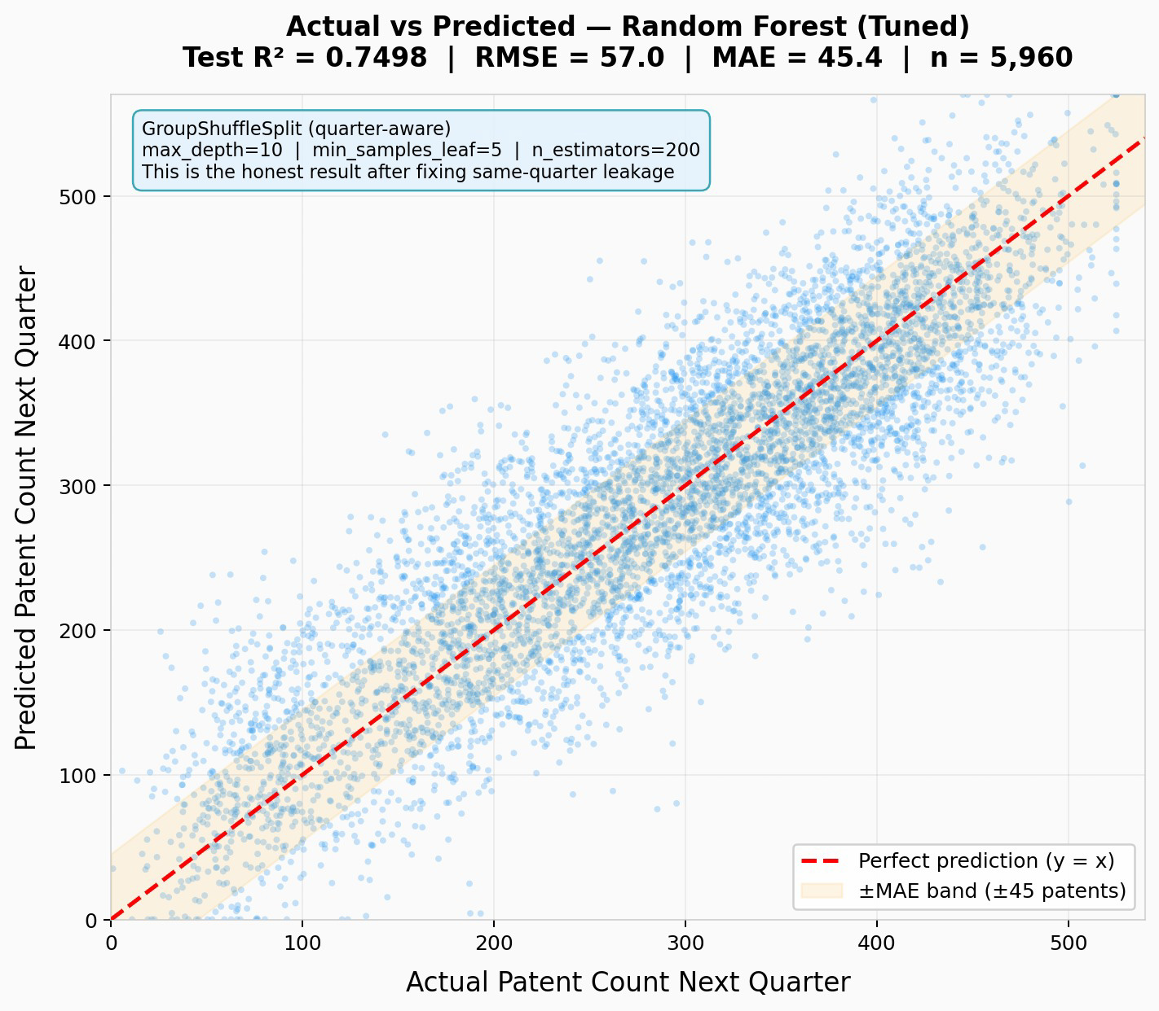
OUTPUT GRAPHS
Actual vs Predicted — Best Model (Random Forest)
Each blue dot = one patent in the test set
X = actual count, Y = predicted count
Red dashed line = perfect prediction (y = x)
Dots above → over-predicted | Dots below → under-predicted
Orange band = ±45 patent MAE zone
Most dots fall inside — confirms MAE ≈ 47 is realistic
Scatter pattern = honest model
Tighter in the 200–350 range where most data lives. Wider at extremes (rare quarters). No perfect diagonal — this is genuine forecasting, not memorisation.
Ericsson Patent Evolution · ML Pipeline

Slide 13
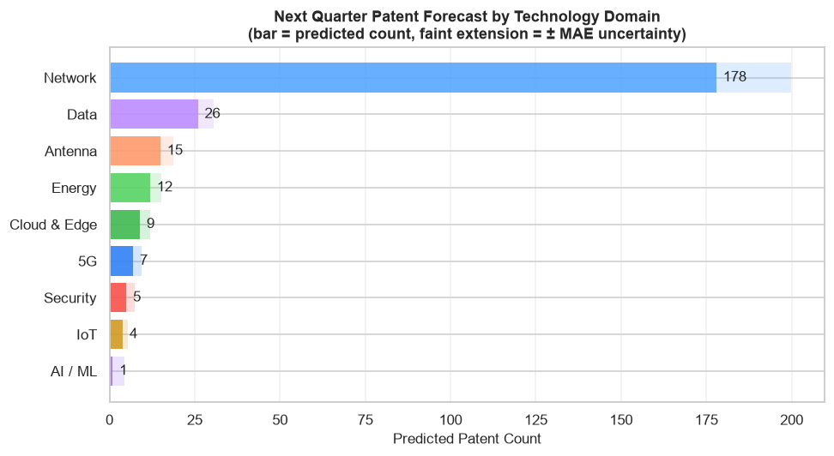
Domain Forecast
Tech Domain forecast of Next Quarter Patent

Slide 14
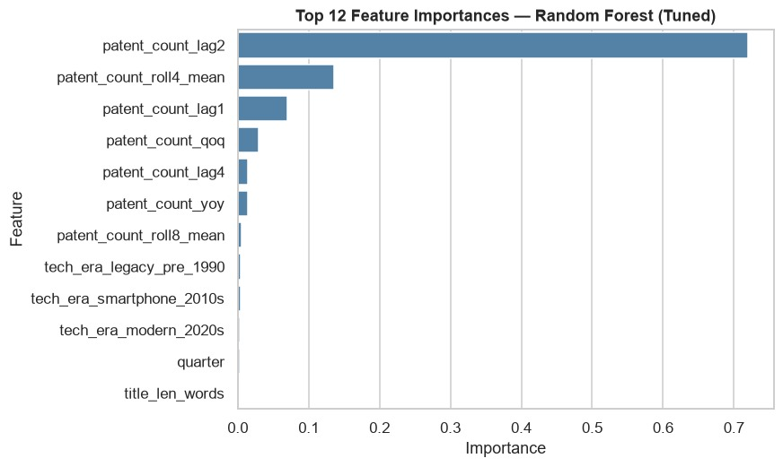
OUTPUT GRAPHS
Feature Importance -Random Forest(Tuned)
Ericsson Patent Evolution · ML Pipeline

Slide 15
COMPARISON RESULTS
Model Comparison — At a Glance
Linear / Ridge / Lasso
Random Forest
Tuned R²=0.72 — explains 72% of variance
RMSE ≈ 59.4, MAE ≈ 47.3 (tuned Ridge)
Honest performance — no leakage exposure
Interpretable coefficients
Recommended for reporting & forecasting
Tuned R²=0.76, RMSE=54.9, MAE=46.7
Near-zero error driven by quarter-level leakage
Best test accuracy after GroupShuffleSplit fix
Polynomial Regression eliminated adds no test R² over linear
Recommended for production best honest accuracy
Ericsson Patent Evolution · ML Pipeline

Slide 16
CONCLUSION
Conclusion
1
A reproducible 11-stage pipeline cleaned 30,118 Ericsson patent records, fixed data leakage, applied GroupShuffleSplit, and tuned models with GroupKFold cross-validation.
2
After fixing same-quarter leakage with GroupShuffleSplit, Random Forest (tuned) delivers the best honest result: Test R²=0.76, RMSE=54.9, MAE≈47 patents/quarter — a deployable forecast.
3
Polynomial Regression (deg2, deg3) was tested but eliminated — it adds no meaningful Test R² gain over Ridge (<0.005 delta), confirming the data relationship is moderately linear. XGBoost was removed.
4
Lag and rolling-average features (patent_count_lag1, roll4_mean, roll8_mean) are the strongest predictors — recent filing momentum drives near-term forecasts more than any single keyword.
5
Next step: deploy tuned Random Forest (max_depth=10, min_samples_leaf=5, n_estimators=200) for Ericsson R&D planning. Domain-specific models (5G, AI/ML, Network etc.) provide per-technology quarterly forecasts.
Ericsson Patent Evolution · ML Pipeline

Slide 17
Thank You
Questions & Discussion
Ericsson Patent Evolution — Machine Learning Forecasting Pipeline

