Slide 1

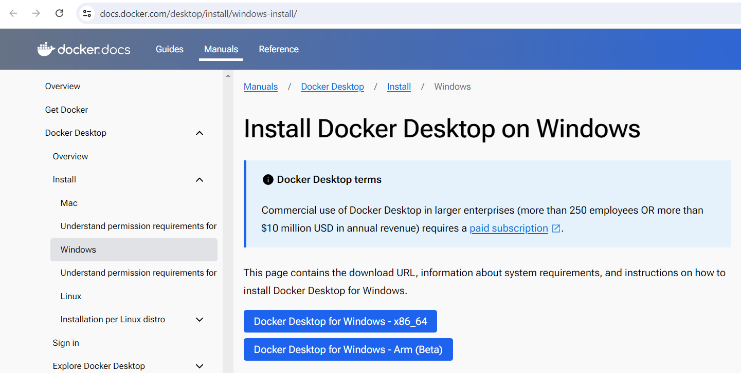
DOT NET CORE RABBIT MQ PRODUCER

Slide 2
