Slide 1

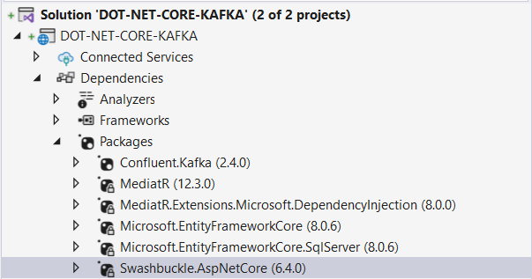
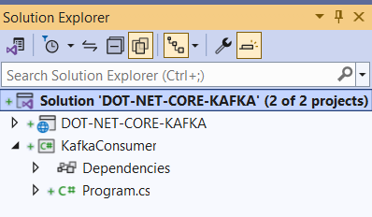
DOT NET CORE & KAFKA

Slide 2

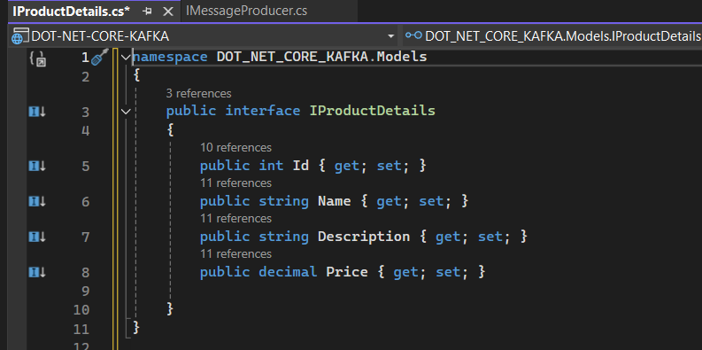
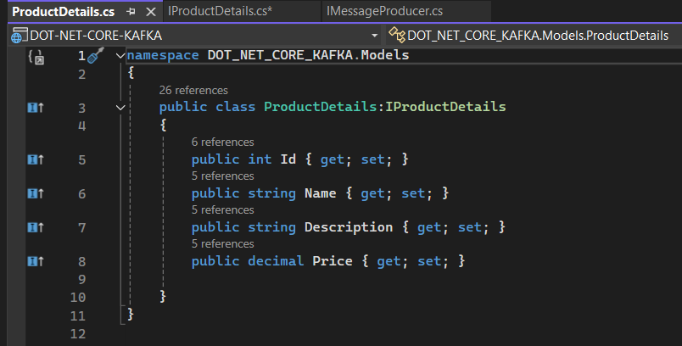
Models

Slide 3
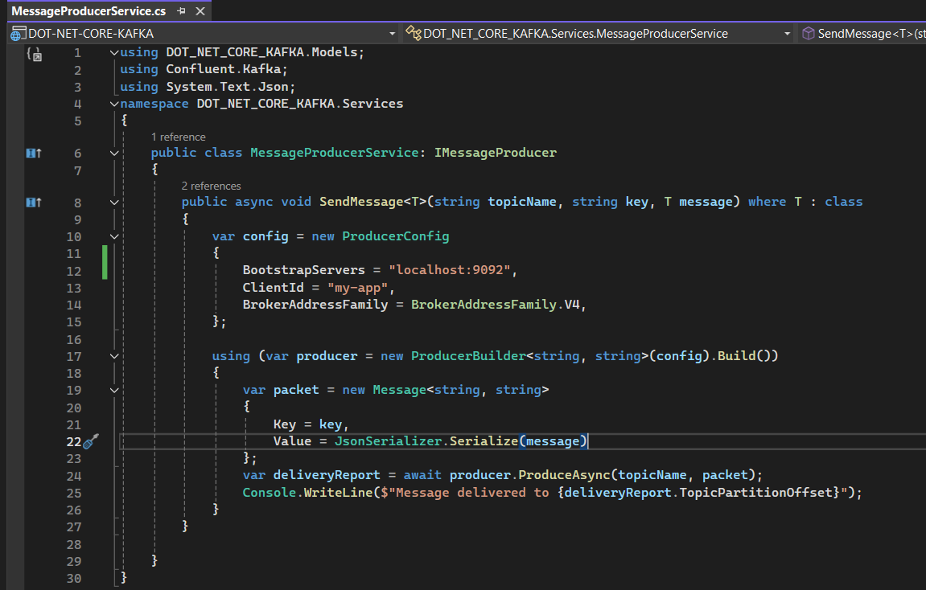
Producer Service - Send Message to a Kafka Topic

Slide 4
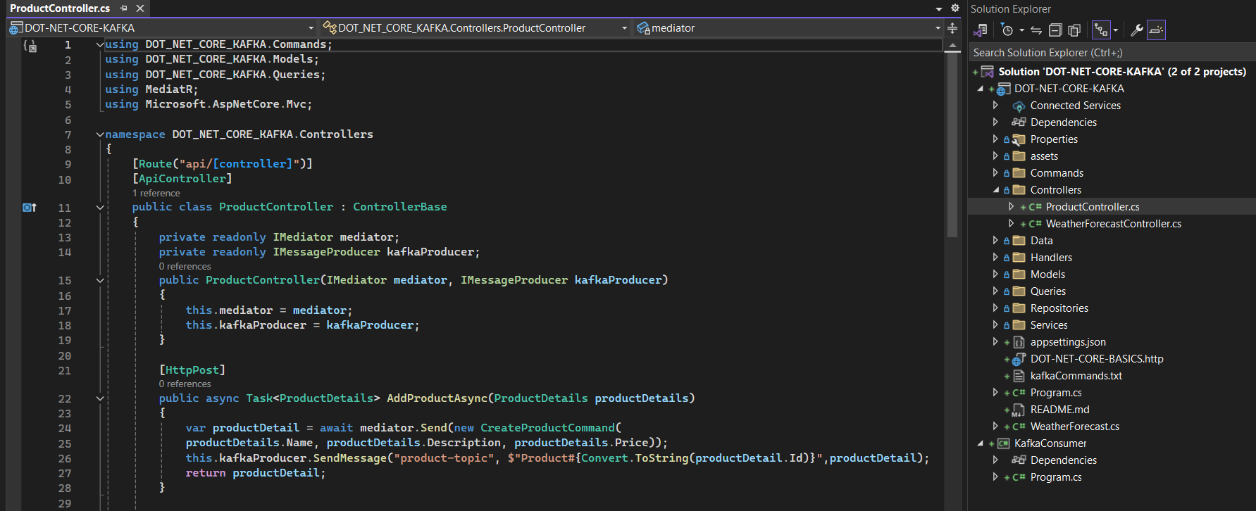
Product Controller – produce Kafka message when new product is added.

Slide 5
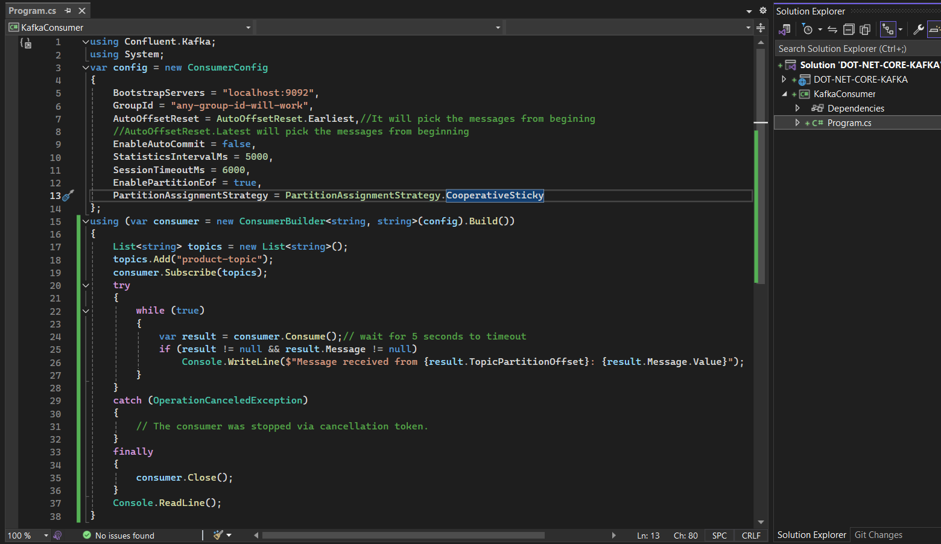
Consume Message from a Kafka Topic

Slide 6
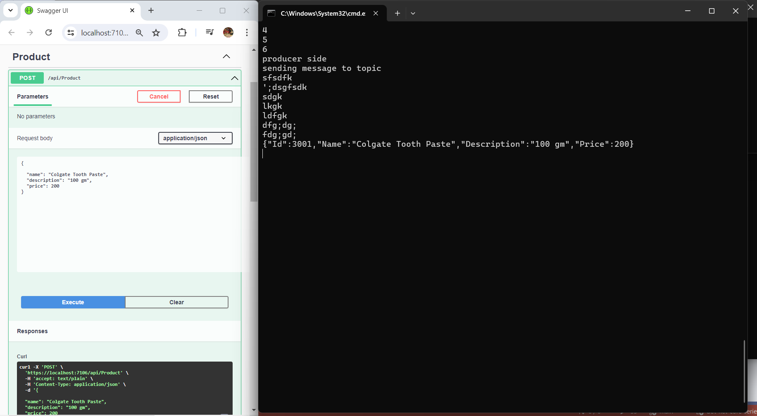
Dot Net Core and Apache Kafka

