Slide 1
Reference
https://www.youtube.com/watch?v=w84uFSwulBI
https://www.c-sharpcorner.com/article/rabbitmq-message-queue-using-net-core-6-web-api/

Slide 2
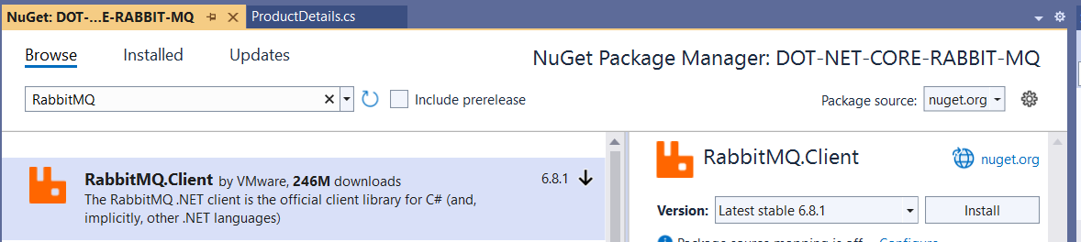
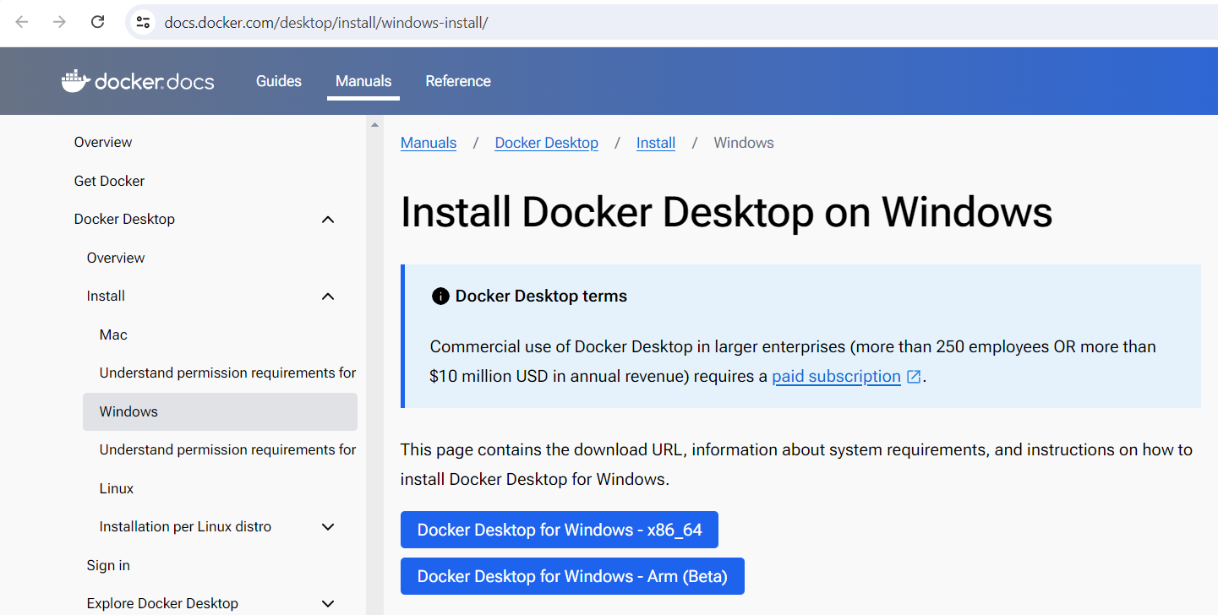
DOT NET CORE RABBIT MQ PRODUCER

Slide 3
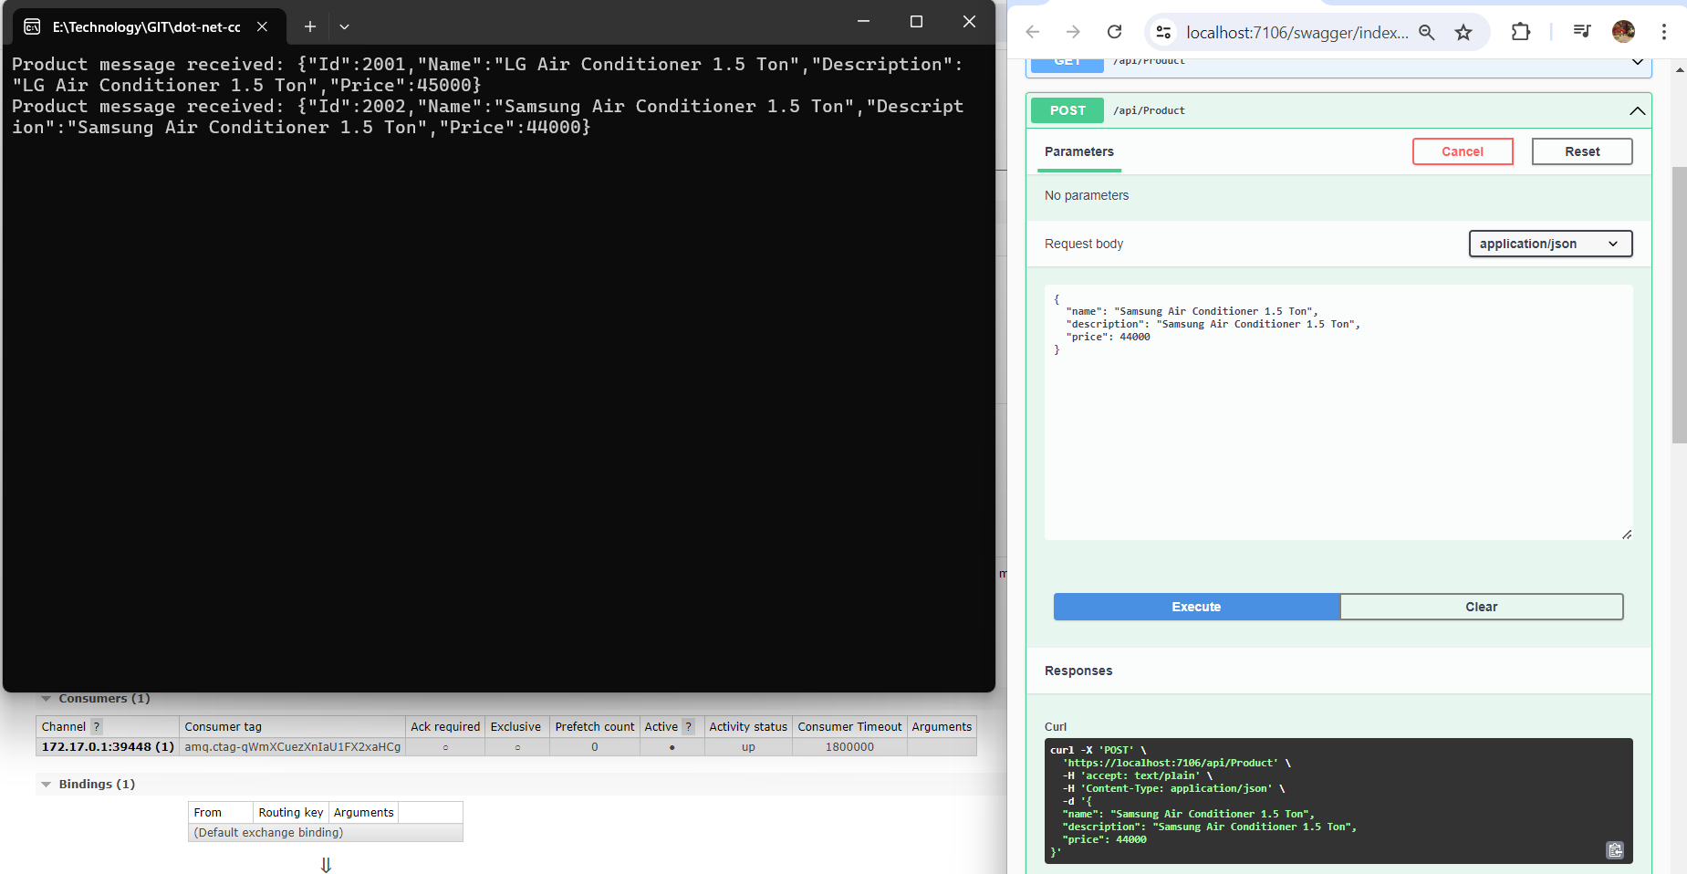

Slide 4
Customize this Template
Template editing instructions
and feedback

