Slide 1
Reference
https://www.youtube.com/watch?v=w84uFSwulBI

Slide 2
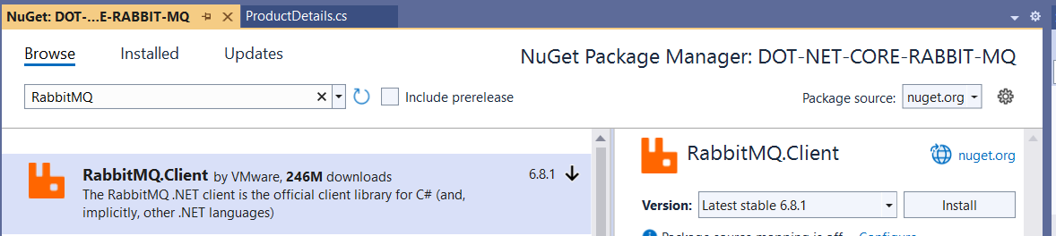
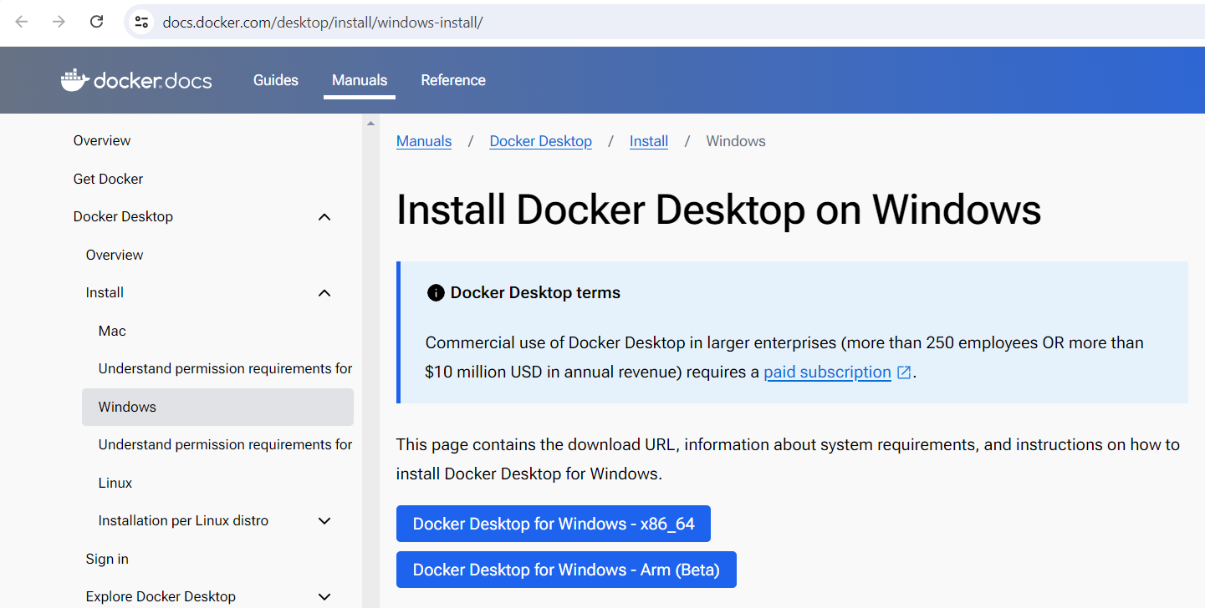

Slide 3
Customize this Template
Template editing instructions
and feedback

