Slide 1
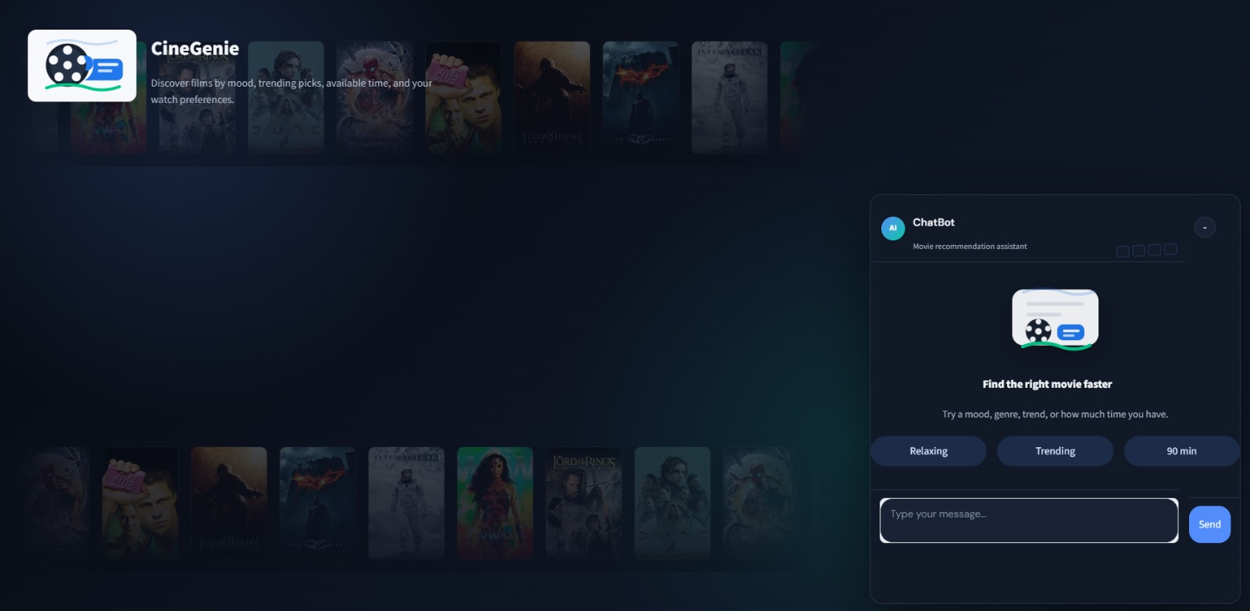







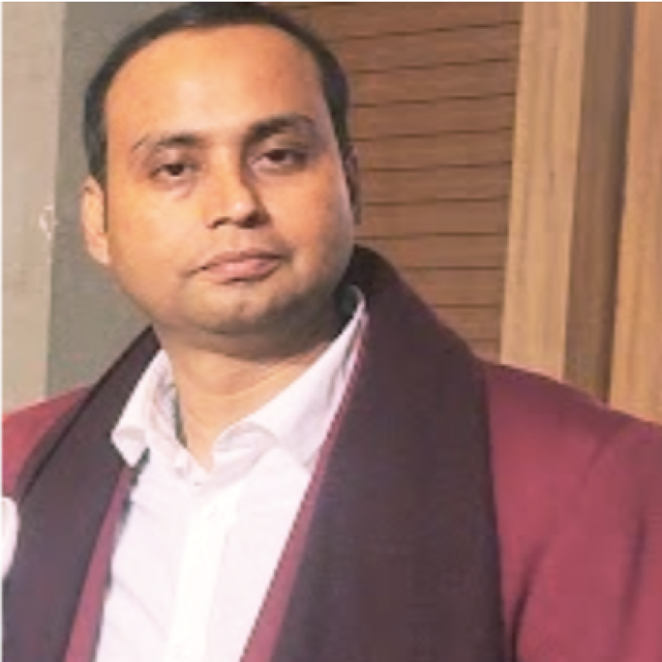



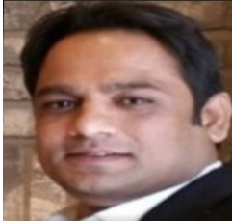

Project # 30
Domain-Oriented Chatbot for Movie Recommendations
CineGenie
Ask . Discover . Watch
Hybrid AI Architecture · Intent Classification · LLM Fallback · TMDB Integration
Contributors:
Source Code:
🎬 https://github.com/pramendraindian/movie-agent
Pramendra Prabhakar Singh
Monikongkona Hazarika
Shashank Srivastava
Arpit Dwivedi
⁠Sajith K N
Sujit Kumar sandilya.sujit@gmail.com
Shahnawaz
Subhasis Mishra
Neerja Nawal
Vijaysandeep Gabbur
Devesh Joshi
h
Bharat Bhushan Sharma
⁠Sunny Surve

Slide 2
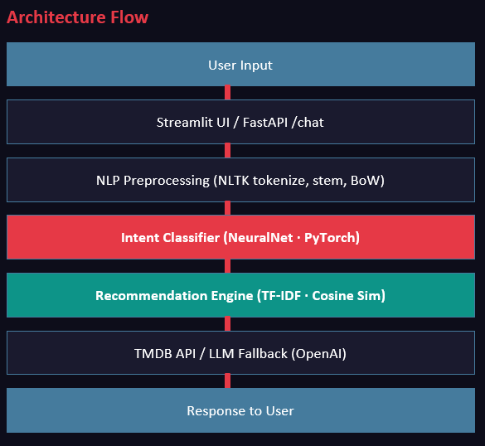



Problem Statement
Users struggle with decision fatigue when choosing from 500,000+ movies, as current tools lack intent understanding, genre/context awareness, and a unified interface for natural language and smart recommendations.
Solution Statement
A unified movie discovery platform that uses natural language with genre‑ and context‑aware dialogue to deliver smart, personalized recommendations and eliminate decision fatigue.
Dataset Description
Attribute | Detail
Source | Kaggle / TMDB API
Dataset | TMDB Movies 2023
Size | 930,000+ movies
Format | CSV + API calls
Features | Title, Genre, Rating, Popularity, Overview, Keywords
Preprocessing | Deduplicate, fill nulls, normalize numerics, filter invalid
For more details, click here ...

Slide 3
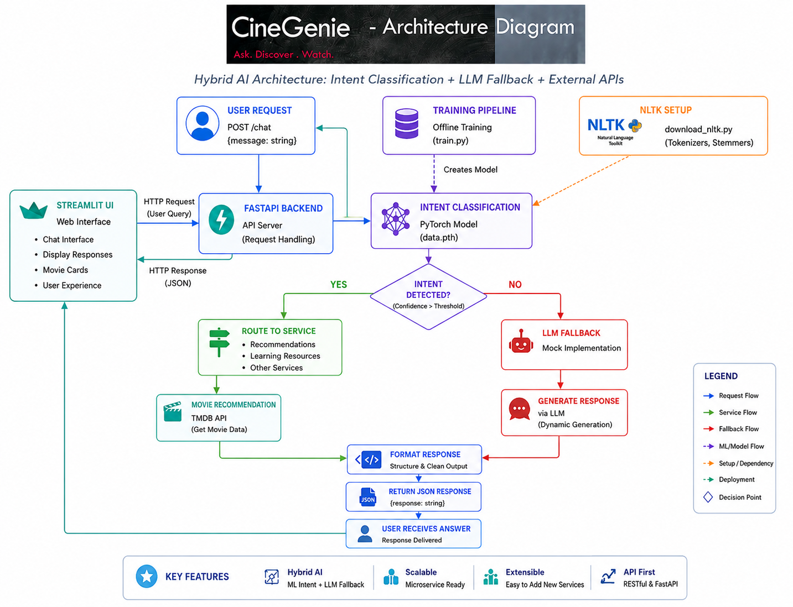
Methodology & System Architecture
Python
Backend
PyTorch
Intent Model
FastAPI
REST API
TMDB
Data Source
🎬 https://github.com/pramendraindian/movie-agent

Slide 4
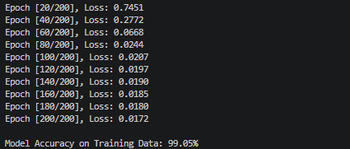
Experimental Details
Neural Network Architecture (Intent Classifier)
Layer | Type | Units / Config
Input | Linear (Dense) | vocab_size → hidden_size (8)
Hidden 1 | ReLU Activation | 8 neurons
Hidden 2 | Linear + ReLU | 8 → 8 neurons
Output | Linear (Softmax via CE) | 8 → num_tags
03
Live movie data instead of static CSV snapshots
Evaluation Metrics
Accuracy ~99%+
04
Session/persistent state for personalized context
Epochs 200
05
Loss – Decreasing over EPOCHs
Train a model to predict individual user ratings
06
API Latency <200ms

Slide 5
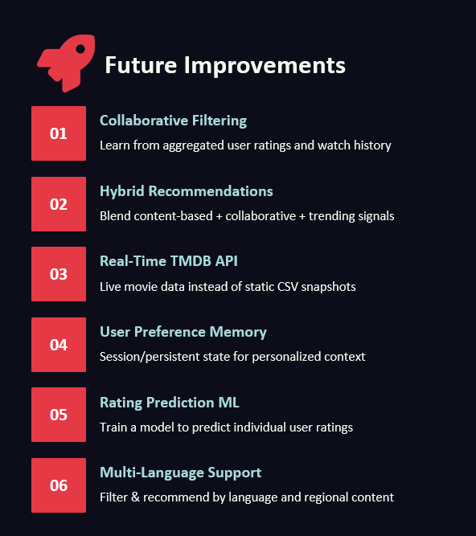
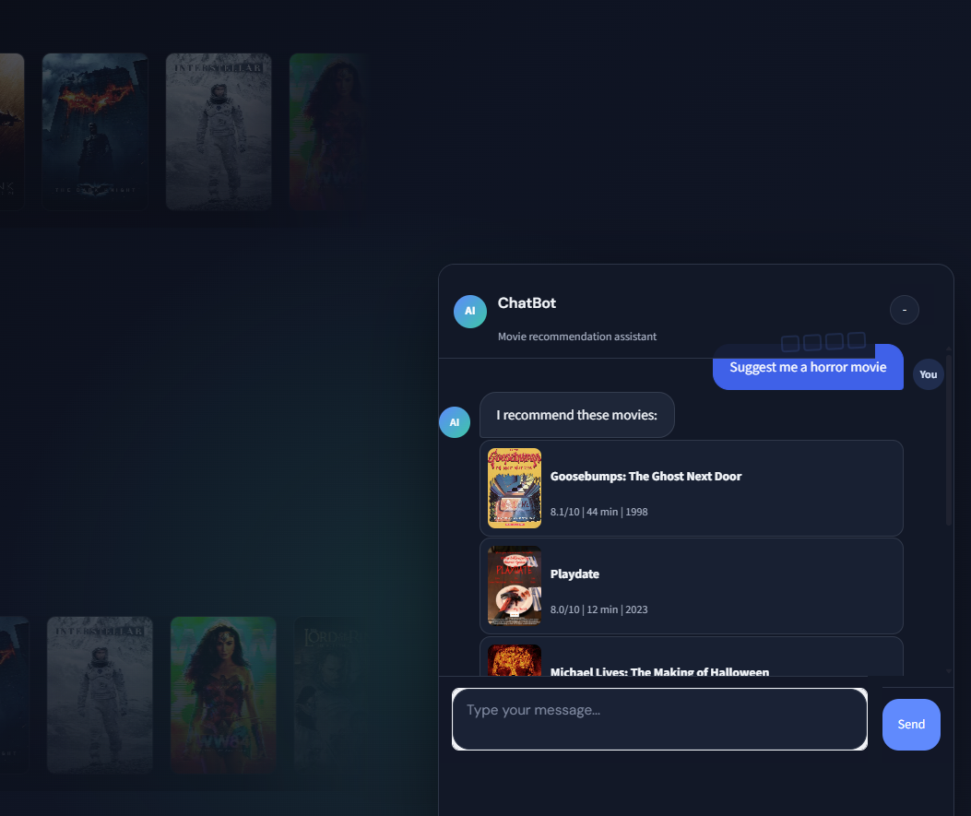
Results
01
Learn from aggregated user ratings and watch history
02
03
Live movie data instead of static CSV snapshots
Intent Accuracy ~95%+
04
Session/persistent state for personalized context
Loss (CE) ↓ over epochs
05
Rec Precision Genre-matched
Train a model to predict individual user ratings
06

