Slide 1
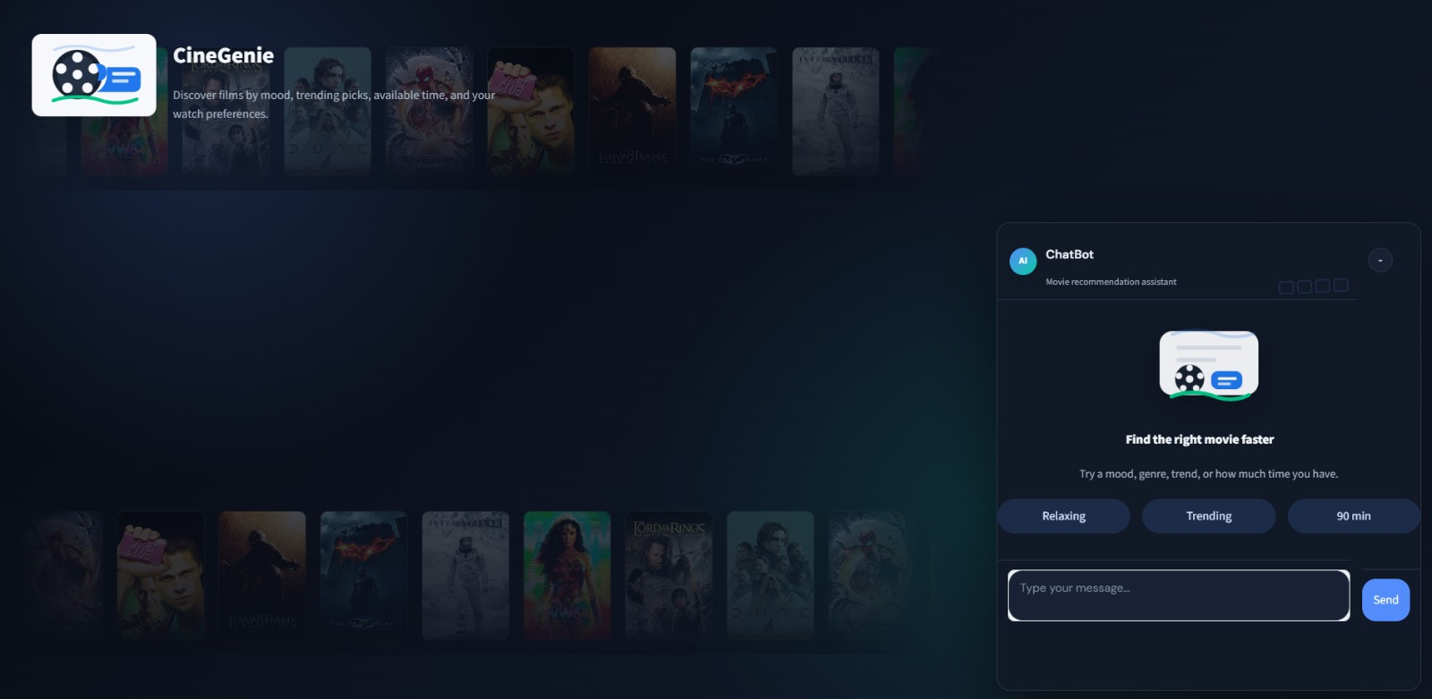
CineGenie
Ask . Discover . Watch
Hybrid AI Architecture · Intent Classification · LLM Fallback · TMDB Integration
🎬 github.com/pramendraindian/movie-agent

Slide 2


Problem Statement
Dataset Description
Attribute | Detail
Source | Kaggle / TMDB API
Dataset | TMDB Movies 2023
Size | 930,000+ movies
Format | CSV + API calls
Features | Title, Genre, Rating, Popularity, Overview, Keywords
Preprocessing | Deduplicate, fill nulls, normalize numerics, filter invalid
Users face decision fatigue choosing from 500,000+ movies
Generic search tools lack intent understanding
No unified interface combining natural language + smart recommendations
Existing bots lack genre-aware & context-aware dialogue
Dataset Split
Goal: Conversational bot that understands intent & delivers tailored movie picks

Slide 3




Methodology & System Architecture
Architecture Flow
Intent Classification (PyTorch NLP)
NeuralNet trained on patterns from intents.json. Bag-of-words + NLTK stemming. Adam optimizer, CrossEntropyLoss, 200 epochs.
User Input
Streamlit UI / FastAPI /chat
Content-Based Filtering
TF-IDF vectorization on genres, keywords, overview. Cosine similarity for finding similar movies.
NLP Preprocessing (NLTK tokenize, stem, BoW)
Genre & Trend Filtering
Intent Classifier (NeuralNet · PyTorch)
Rule-based sorting by rating & popularity. Supports 10+ genre intents including action, drama, sci-fi, horror.
Recommendation Engine (TF-IDF · Cosine Sim)
LLM Fallback (OpenAI)
TMDB API / LLM Fallback (OpenAI)
When intent confidence is low, query is escalated to OpenAI for general-purpose response.
Response to User

Slide 4
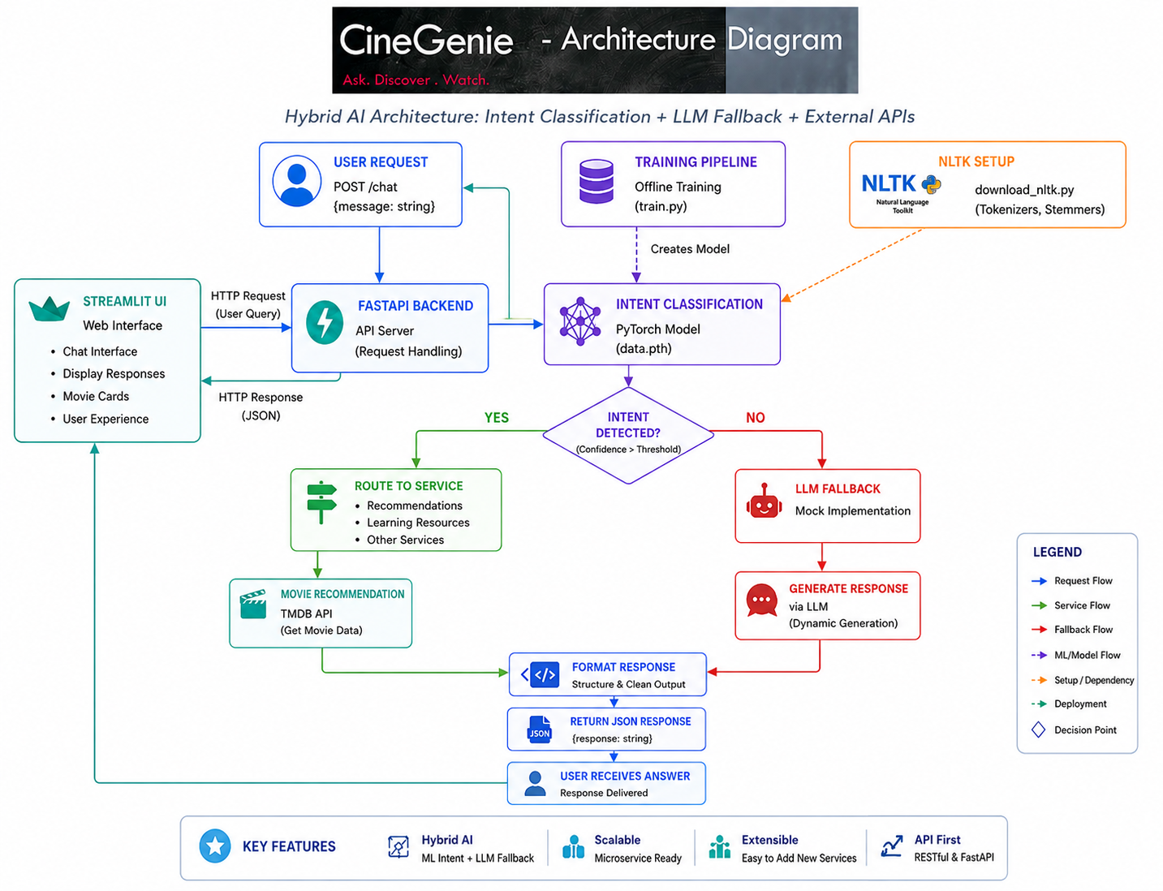
Methodology & System Architecture
Python
Backend
PyTorch
Intent Model
FastAPI
REST API
TMDB
Data Source

Slide 5
Experimental Details
Neural Network Architecture (Intent Classifier)
Evaluation Metrics
Layer | Type | Units / Config
Input | Linear (Dense) | vocab_size → hidden_size (8)
Hidden 1 | ReLU Activation | 8 neurons
Hidden 2 | Linear + ReLU | 8 → 8 neurons
Output | Linear (Softmax via CE) | 8 → num_tags
Intent Accuracy ~95%+
Loss (CE) ↓ over epochs
Rec Precision Genre-matched
API Latency <200ms
Hyperparameters & Training Config
Additional Techniques
Parameter | Value
Optimizer | Adam (lr = 0.001)
Loss Function | CrossEntropyLoss
Epochs | 200
Hidden Size | 8 neurons
TF-IDF Max Features | 5,000
Similarity Metric | Cosine Similarity
Singleton pattern (lazy data loading)
Similarity matrix caching (startup speed)
Min-vote threshold (quality filter)
NLTK stemming (vocabulary compression)
Docker-ready modular layout

Slide 6
Results & Discussion
~95%
930K+
200
<200ms
Intent Accuracy
Movies Indexed
Training Epochs
API Response
Training Loss (Simulated) — CrossEntropyLoss over 200 Epochs
Intent Recognition Accuracy by Category
✔ What Worked Well
PyTorch intent classifier converges well with stemmed BoW features. Singleton caching prevents reload overhead. Genre keyword matching covers 10+ intents. TF-IDF cosine similarity captures semantic movie likeness.
✘ Limitations
No collaborative filtering (no user history). Cold-start problem for new genres. LLM fallback depends on external API key availability.

Slide 7


Future Improvements
Conclusion
01
Collaborative Filtering
The Movie Recommendation Chatbot successfully demonstrates a practical Hybrid AI Architecture combining lightweight NLP intent classification with multiple recommendation strategies.
Learn from aggregated user ratings and watch history
02
Hybrid Recommendations
Blend content-based + collaborative + trending signals
Intent classifier achieves ~95%+ accuracy across 6+ categories
TF-IDF cosine similarity delivers relevant content-based picks
930,000+ TMDB movies available for recommendations
FastAPI backend is production-ready and Docker-friendly
Streamlit UI provides a clean conversational experience
LLM fallback (OpenAI) handles out-of-scope queries gracefully
03
Real-Time TMDB API
Live movie data instead of static CSV snapshots
04
User Preference Memory
Session/persistent state for personalized context
05
Rating Prediction ML
Train a model to predict individual user ratings
06
Multi-Language Support
🎬 github.com/pramendraindian/movie-agent
Filter & recommend by language and regional content

