Slide 1
TEAM 50

Slide 2
Problem Statement
Prediction of the popularity of the music tracks based on the features provided in the dataset some of which include acousticness, danceability, energy, explicit, instrumentainess, key, liveness, loudness, and more.

Slide 3
Understanding of the Problem Statement
The target variable is “popularity” which has 5 categories: ‘Very high’, ‘high’, ‘average’, ‘low’, ‘very low’. For each category, there is an initial bid price (for royalties to be paid) and expected revenue collections(in 10k $) which is provided as data. Based on the predictions, 10000(in 10k $) will be invested to place bids on the 4000 music tracks. The required model should generate the highest possible revenue.

Slide 4
Dataset
TRAINING DATA
80%
TEST DATA
20%

Slide 5
Basic Workflow
ACQUIRE
DATA
DATA
VISUALIZATION
FEATURE
ENGINEERING
MODEL
SELECTION
MODEL TRAINING

Slide 6
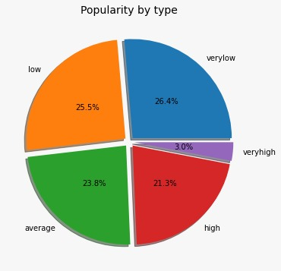
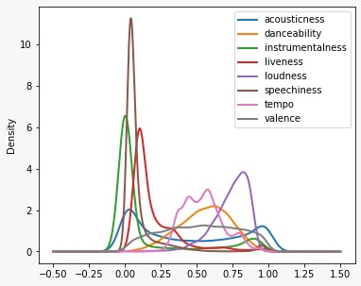
Visualisation
fig(b)
fig(a)
fig(b)
fig(a): The data is not uniformly distributed over the desired output values.As one can see ‘very high’ popularity data is not adequate.
fig(b): is the overlap of density plots of all the features.
We can see that instrumentalness,speechiness, and liveness are nearer to zero, and loudness,acousticness, and danceability are far away from zero.

Slide 7
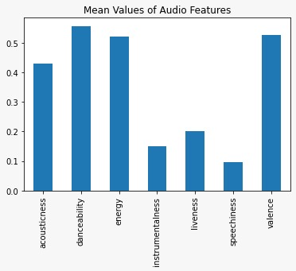
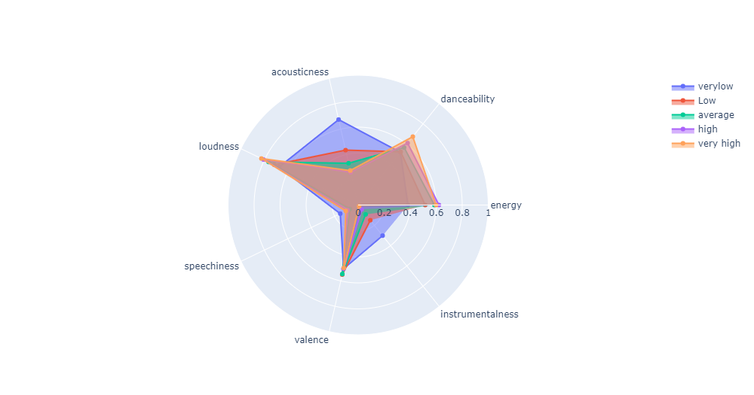
Exploring the Features
fig(d)
From the above figures,one can see the mean value of features over its range.
We can say that valence, acousticness, danceability, energy have high means which indicates their high importance in popularity prediction.

Slide 8
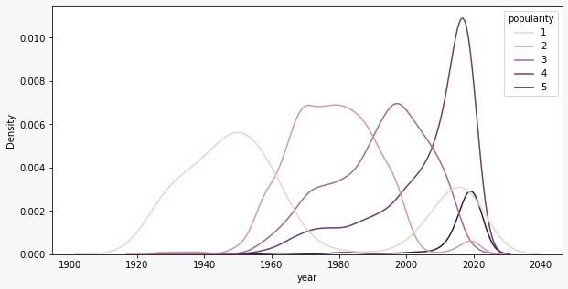
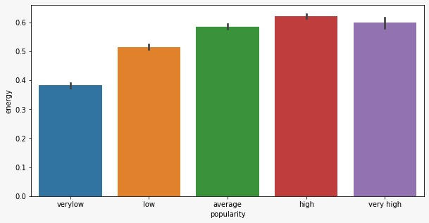
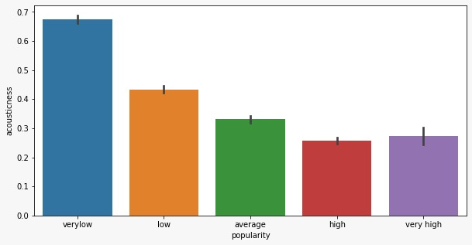
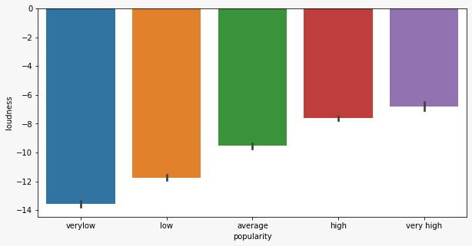
Various plots of different features against ‘Popularity’.

Slide 9
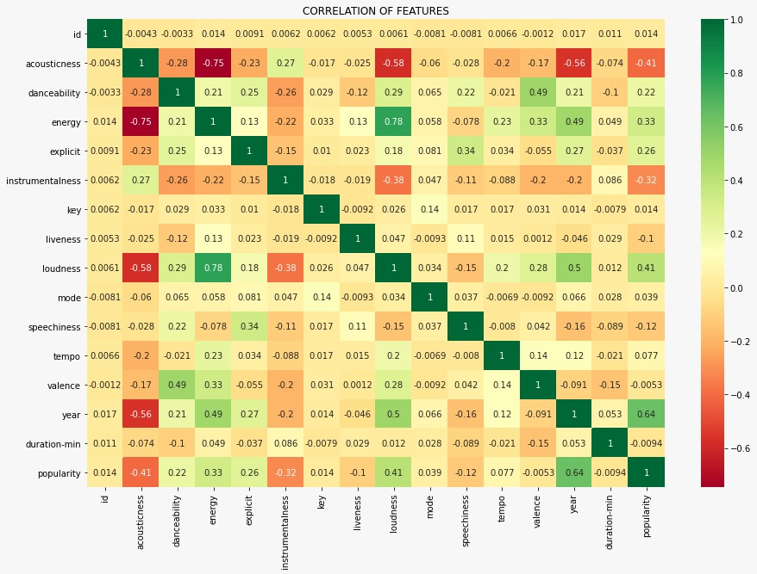
Correlation Matrix
We can use this correlation matrix to determine if there exists any correlation between popularity and song characteristics.
Negative correlation
Positive correlation

Slide 10
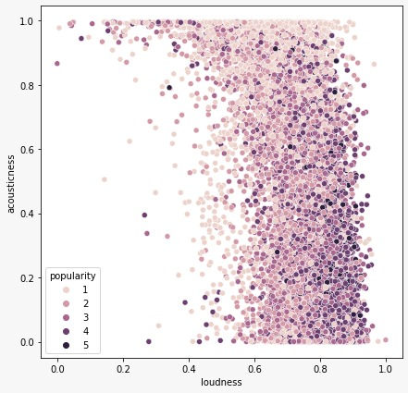
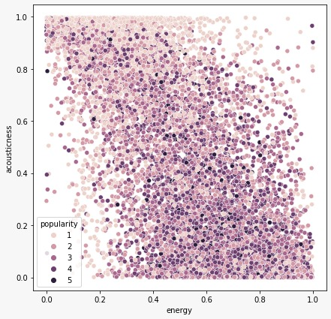
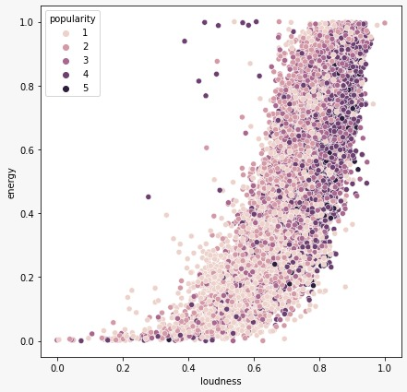
fig(1) Acousticness vs Energy
fig(3) Energy vs Loudness
fig(2) Acousticness vs Loudness

Slide 11
Features Retained
XGBoost
CATBoost
K Nearest Neighbours
Random Forest
Accousticness
Danceability
Energy
Instrumentalness
Duration-Min
Liveness
Explicit
Tempo
Valence
Year
Key
Mode
Accousticness
Danceability
Energy
Instrumentalness
Duration-Min
Liveness
Explicit
Tempo
Valence
Year
Key
Mode
Loudness
Accousticness
Danceability
Energy
Instrumentalness
Duration-Min
Liveness
Explicit
Tempo
Valence
Year
Key
Mode
Accousticness
Danceability
Energy
Instrumentalness
Duration-Min
Liveness
Explicit
Tempo
Valence
Year
Mode

Slide 12
CatBoost
Machine learning algorithm
Uses gradient boosting on decision tree.
Provides variety of training models.
The training model used : CatBoostClassifier
Compatible with scikit-learn tools.
Reduces need for extensive hyper-parameters tuning.
CatBoostClassifier
Include parameter : Learning rate, Regularization, Tree depth, etc.

Slide 13
Implementation
CatBoost Classifier was applied after replacing the string values of the features popularity, explicit and mode into integer then balancing the data set using SMOTE. SMOTE is used for oversampling imbalanced classification data set.
The parameters were set as :
Depth : 11
Learning_rate : 0.05
Iteration : 780
l2_leaf_reg : 2

Slide 14
CatBoost Classification Report
 | Precision | Recall | f1-Score
0 | 0.86 | 0.79 | 0.83
1 | 0.58 | 0.70 | 0.63
2 | 0.52 | 0.45 | 0.48
3 | 0.65 | 0.59 | 0.62
4 | 0.87 | 0.95 | 0.91
0 : Very Low Popularity
1 : Low Popularity
2 : Average Popularity
3 : High Popularity
4 : Very High Popularity
Accuracy : 70.08%

Slide 15
K-Nearest Neighbours
Machine learning algorithm
Based on supervised learning technique
Used for solving classification and regression problems
It assumes that similar things or data points exist in close proximity.

Slide 16
KNN Classification Report
 | Precision | Recall | f1-Score
0 | 0.85 | 0.68 | 0.76
1 | 0.59 | 0.68 | 0.63
2 | 0.50 | 0.48 | 0.49
3 | 0.47 | 0.26 | 0.33
4 | 0.16 | 0.78 | 0.26
0 : Very Low Popularity
1 : Low Popularity
2 : Average Popularity
3 : High Popularity
4 : Very High Popularity
ACCURACY : 55%

Slide 17
Quick calculation time
Simple algorithm
– to interpret
Advantages of KNN
Can be used for
classification and
regression
No need to tune too many parameters

Slide 18
XGboost
Machine learning algorithm
Extreme gradient boosting
Based on gradient boosting decision tree algorithms
It uses a gradient descent algorithm to minimize the loss when added adding new models
This supports both classification and regression modelling problems.

Slide 19
XGBoost
BOOSTING
REGULARIZATION
Stronger model from weaker models
Each model works on the previous residual error
Min_child_weight, Max_depth
Prevents overfitting

Slide 20
XGBoost Classification Report
 | Precision | Recall | f1-Score
0 | 0.83 | 0.82 | 0.82
1 | 0.58 | 0.70 | 0.63
2 | 0.49 | 0.48 | 0.48
3 | 0.62 | 0.53 | 0.57
4 | 0.52 | 0.34 | 0.41
0 : Very Low Popularity
1 : Low Popularity
2 : Average Popularity
3 : High Popularity
4 : Very High Popularity
ACCURACY : 63%

Slide 21
Random Forest
An ensemble classifier which uses many decision tree models.
Can be used for classification or Regression.
Accuracy and variable importance information is provided with the results.
Random Forest classifier consists of collection of tree- structured classifiers {h(x, өk), k = 1….} where өk are independent and identically distributed random trees and each tree casts a unit vote for the final classification of input x.
Uses gini index for determining the final class in each tree.
The final class of each tree is aggregated and voted by weighted values to construct the final classifier.

Slide 22
Random Forest Classification Report
 | Precision | Recall | f1-Score
0 | 0.82 | 0.80 | 0.81
1 | 0.56 | 0.69 | 0.62
2 | 0.51 | 0.47 | 0.49
3 | 0.69 | 0.57 | 0.62
4 | 0.87 | 0.92 | 0.90
0 : Very Low Popularity
1 : Low Popularity
2 : Average Popularity
3 : High Popularity
4 : Very High Popularity
ACCURACY : 69%

Slide 23
Advantages of Random Forest
Produces a highly accurate classifier and learning is fast.
Runs efficiently on large databases.
Can handle thousands of input variables without variable deletion.
Computes proximities between pairs of cases that can be used in clustering, locating outliers or gives interesting views of thee data.
Offers an experimental method for detecting variable interactions.

Slide 24
Comparison of Accuracy in various models used
Accuracy
MODEL
55%
KNN
63%
XGBoost
69%
Random Forest
70.08%
CatBoost

Slide 25
Why did CatBoost Classifier perform better?
Performance: CatBoost provides state of the art results and it is competitive with any leading machine learning algorithm on the performance front.
Robust: It reduces the need for extensive hyper-parameter tuning and lower the chances of overfitting also which leads to more generalized models. Although, CatBoost has multiple parameters to tune and it contains parameters like the number of trees, learning rate, regularization, tree depth, fold size, bagging temperature and others
Easy-to-use: You can use CatBoost from the command line, using an user-friendly API for both Python and R.
It can also return very good result with relatively less data, unlike DL models that need to learn from a massive amount of data.

Slide 26
THANK YOU

Slide 27
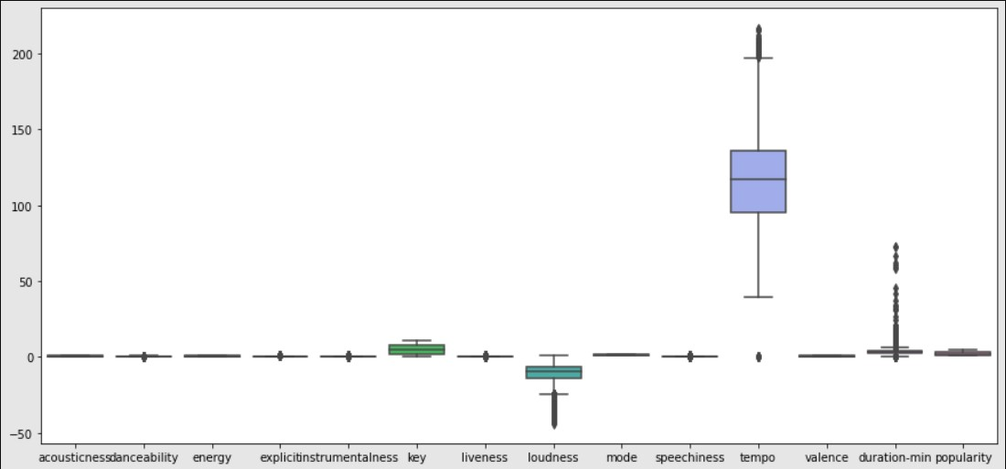
Appendix

Slide 28
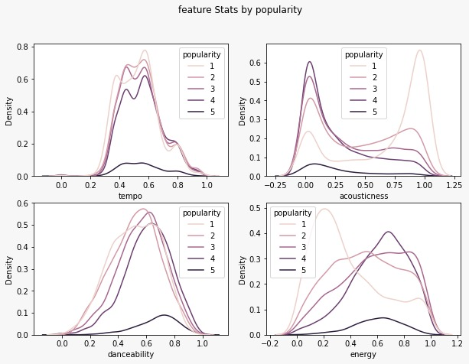
Appendix

Slide 29
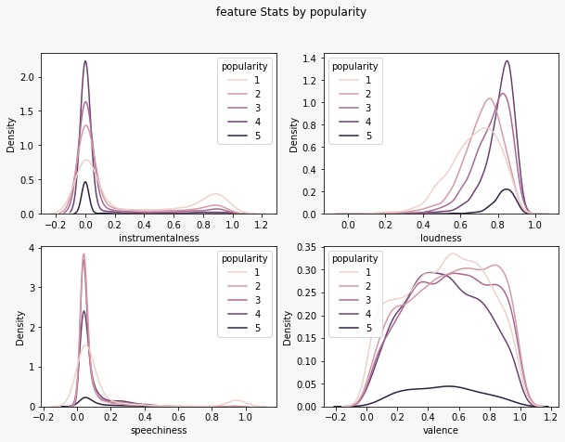
Appendix

Slide 30
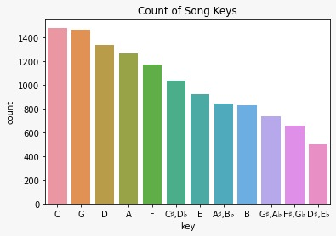
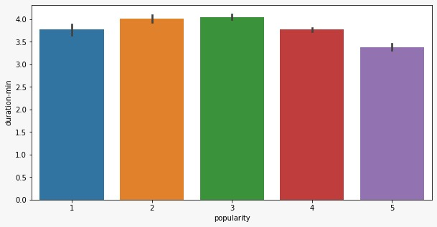
Appendix

Slide 31
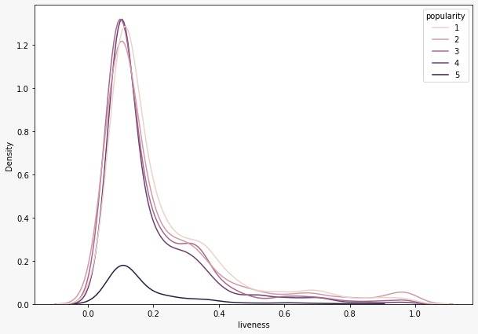
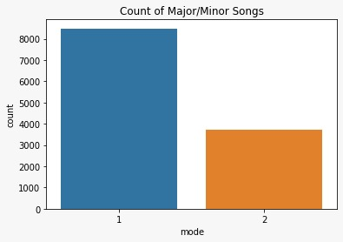
Appendix

Slide 32
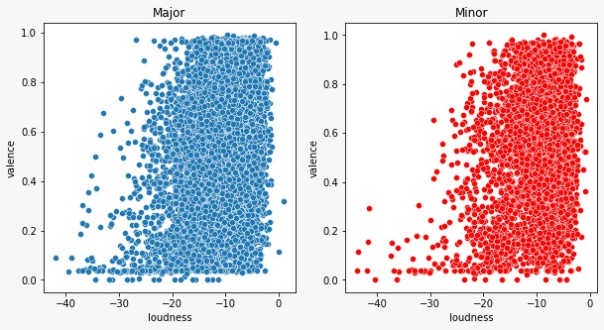
Appendix

Slide 33
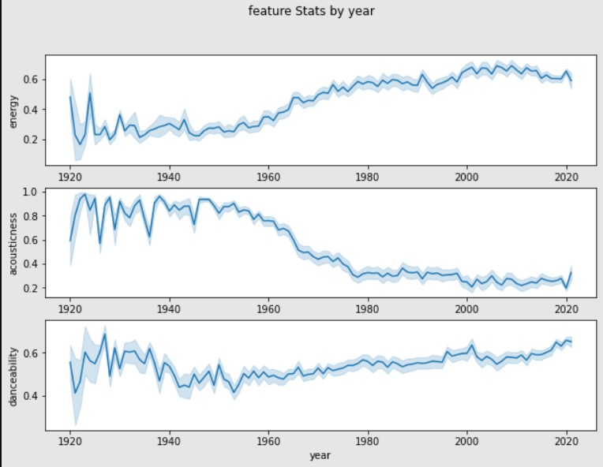
Appendix

Slide 34
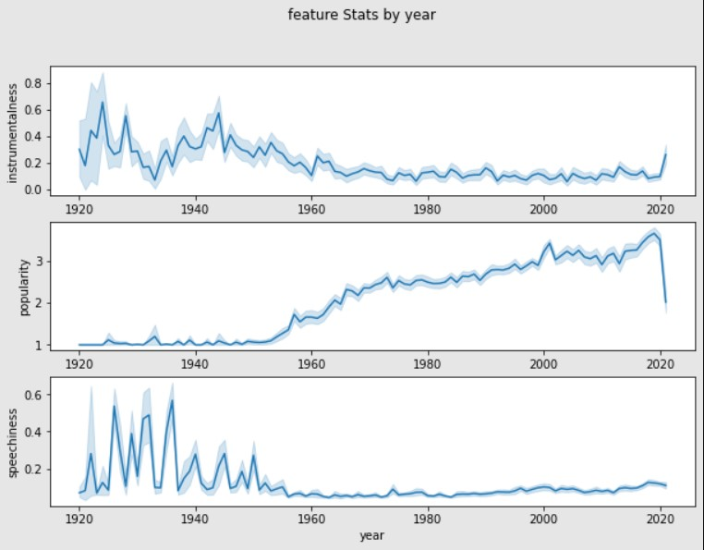
Appendix

Slide 35
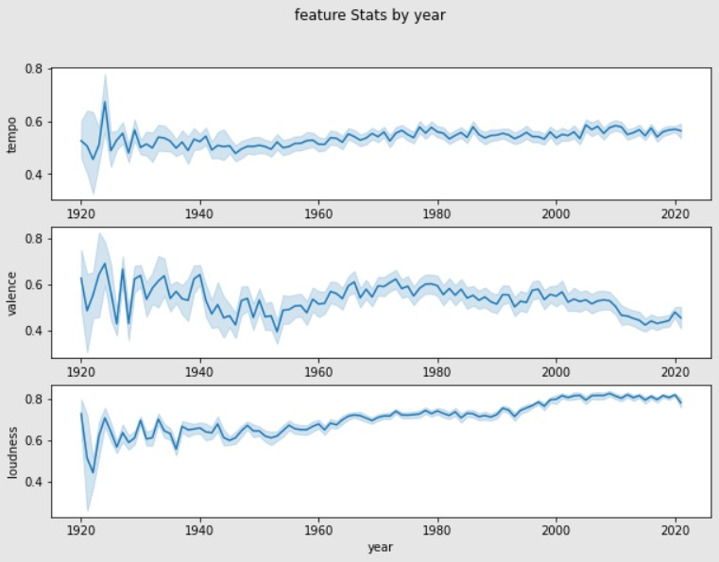
Appendix

